Slide 1

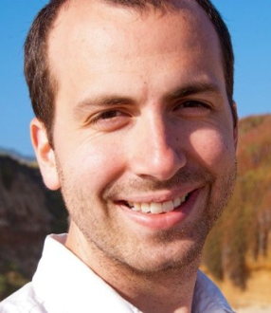
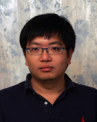



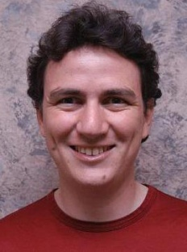
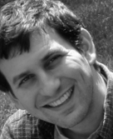

2
Distributed Graph-Parallel Computation on Natural Graphs
Joseph Gonzalez
The Team:
Yucheng
Low
Haijie
Gu
Aapo
Kyrola
Danny
Bickson
Carlos
Guestrin
Joe
Hellerstein
Alex
Smola

Slide 2
How will we design and implement parallel learning systems?
Big-Learning

Slide 3
Map-Reduce / Hadoop
The popular answer:
Build learning algorithms on-top of high-level parallel abstractions

Slide 4
Map-Reduce for Data-Parallel ML
Excellent for large data-parallel tasks!
Data-Parallel Graph-Parallel
Map Reduce
Feature
Extraction
Cross
Validation
Graphical Models
Gibbs Sampling
Belief Propagation
Variational Opt.
Semi-Supervised Learning
Label Propagation
CoEM
Computing Sufficient
Statistics
Collaborative
Filtering
Tensor Factorization
Graph Analysis
PageRank
Triangle Counting

Slide 5
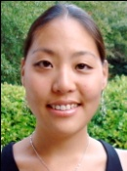


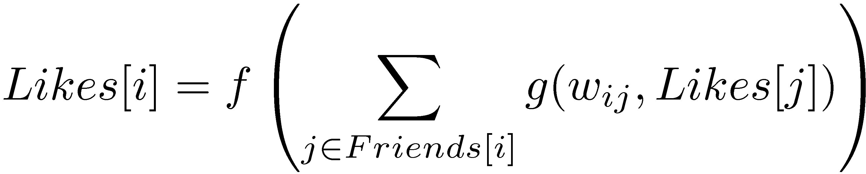

Label Propagation
Social Arithmetic:
Recurrence Algorithm:
iterate until convergence
Parallelism:
Compute all Likes[i] in parallel
Sue Ann
50% What I list on my profile
40% Sue Ann Likes
10% Carlos Like
80% Cameras
20% Biking
+
40%
I Like:
60% Cameras, 40% Biking
Profile
50%
50% Cameras
50% Biking
Me
Carlos
10%
30% Cameras
70% Biking
http://www.cs.cmu.edu/~zhuxj/pub/CMU-CALD-02-107.pdf

Slide 6



Properties of Graph-Parallel Algorithms
Dependency
Graph
Local Updates
Iterative
Computation
My Interests
Friends Interests
Parallelism: Run local updates simultaneously

Slide 7
Map-Reduce for Data-Parallel ML
Excellent for large data-parallel tasks!
Data-Parallel Graph-Parallel
Map Reduce
Map Reduce?
Graph-Parallel Abstraction
Feature
Extraction
Cross
Validation
Graphical Models
Gibbs Sampling
Belief Propagation
Variational Opt.
Semi-Supervised Learning
Label Propagation
CoEM
Computing Sufficient
Statistics
Collaborative
Filtering
Tensor Factorization
Data-Mining
PageRank
Triangle Counting

Slide 8
Graph-Parallel Abstractions
Vertex-Program associated with each vertex
Graph constrains the interaction along edges
Pregel: Programs interact through Messages
GraphLab: Programs can read each-others state

Slide 9
The Pregel Abstraction
Compute
Communicate
Pregel_LabelProp(i)
// Read incoming messages
msg_sum = sum (msg : in_messages)
// Compute the new interests
Likes[i] = f( msg_sum )
// Send messages to neighbors
for j in neighbors:
send message(g(w_{ij}, Likes[i])) to j
Barrier
Notes:
Put equation on slide

Slide 10
The GraphLab Abstraction
Vertex-Programs are executed asynchronously and directly read the neighboring vertex-program state.
GraphLab_LblProp(i, neighbors Likes)
// Compute sum over neighbors
sum = 0
for j in neighbors of i:
sum = g(w_{ij}, Likes[j])
// Update my interests
Likes[i] = f( sum )
// Activate Neighbors if needed
if Like[i] changes then
activate_neighbors();
Activated vertex-programs are executed eventually and can read the new state of their neighbors
Notes:
Put equation on the slide

Slide 11
Never Ending Learner Project (CoEM)
Better
Optimal
Hadoop | 95 Cores | 7.5 hrs
GraphLab | 16 Cores | 30 min
GraphLab CoEM
Distributed GraphLab | 32 EC2 machines | 80 secs
6x fewer CPUs!
15x Faster!
0.3% of Hadoop time
11

Slide 12
The Cost of the Wrong Abstraction
Log-Scale!

Slide 13

























Startups Using GraphLab
Companies experimenting (or downloading) with GraphLab
Academic projects exploring (or downloading) GraphLab
Notes:
Projects using GraphLab
GaBP:
USCS: Smoothing genomic sequences UCSB: Performance testing of linear solvers McGill: performance of linear solvers PMF:
Universities:
HKUST (Hong Kong University) - KDD CUP VU University Amsterdam: integrating TV into the web University of Lubliana: KDD CUP Heldia institute of technology: community detection in social networks University of Austin, Texas: KDD CUP University of the Aegean: KDD CUP University of Macedonia: KDD CUP University of South Florida: stock market predictions: https://sites.google.com/site/thesisonstockmining/home New Maxico State University (UMSC): KDD CUP Hasmukh Goswami College of Engineering, India: Sagar Soni - Collaborative filtering. Companies:
smarttypes.org: clustering social networks rummble.com: clustering social networks AT&T Labs: KDD CUP Facebook: recommendations Yahoo Research (Smola’s group) matrix factorization with side information for collaborative filtering.
Downloads also from: Google, MSR, IBM Research, Apple, NEC, Hitachi, Xerox, Nokia. Clustering:
http://www.nottingham.edu.my/index.aspx - building a recommender system using data from flickr UCLA - topic models like LDA and LSI NBP:
University of Waterloo Applications on top:
Cornell: community detection on networks Yahoo Research (Barcelona) : graph processing library MIT: create different kinds of parallel or distributed systems for the sampling algorithm running within probabilistic programming engines

Slide 14
Why do we need
2

Slide 15
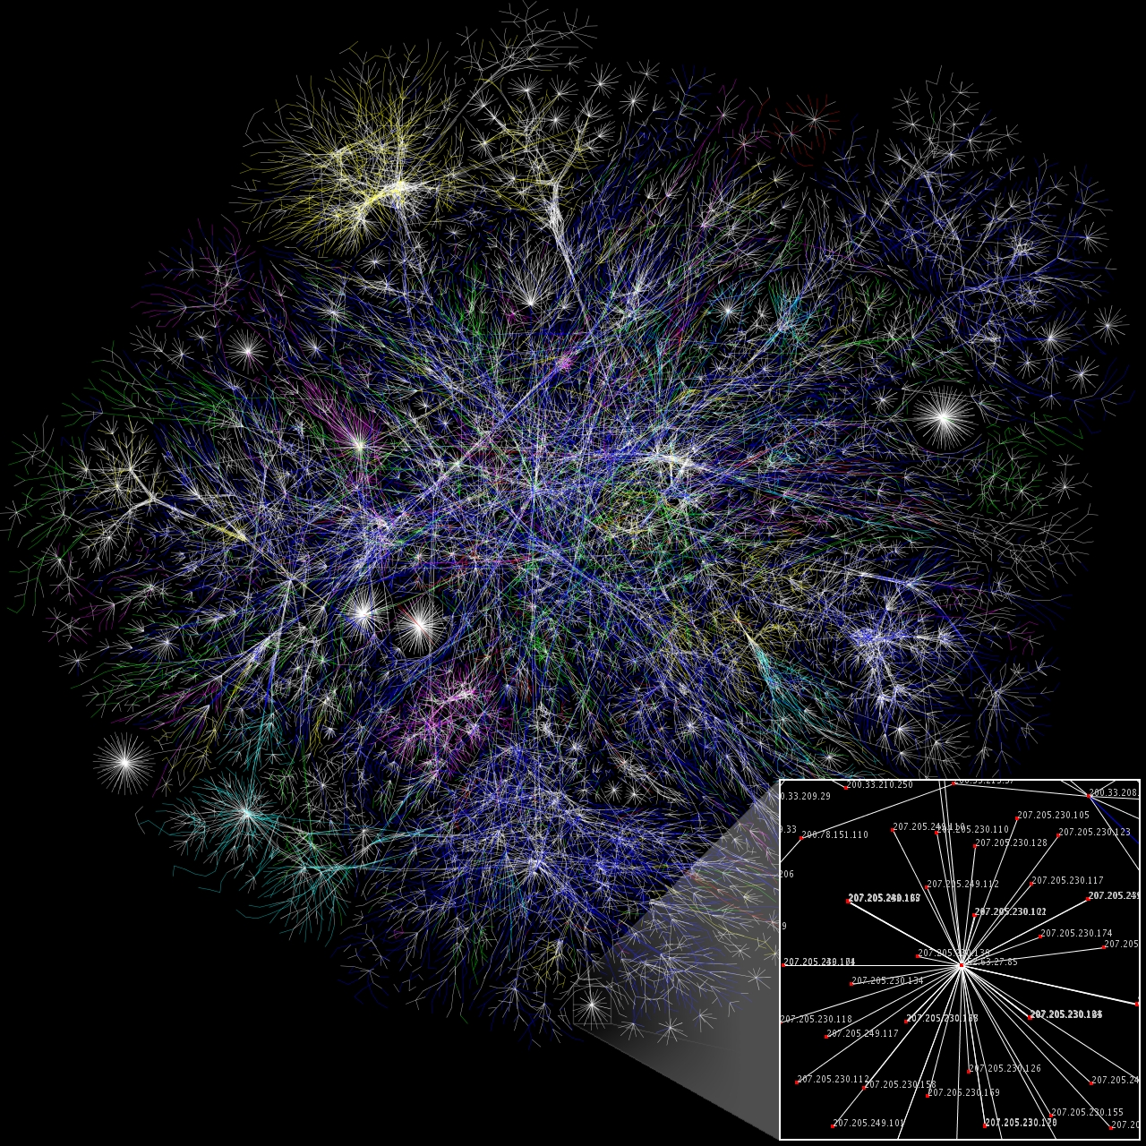
Natural Graphs
[Image from WikiCommons]

Slide 16
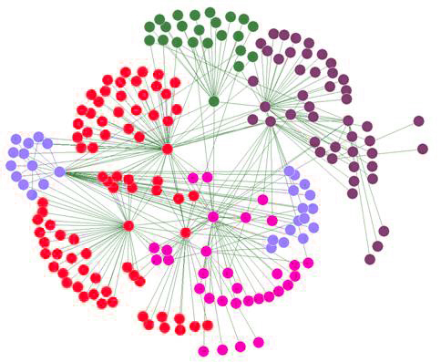
Assumptions of Graph-Parallel Abstractions
Ideal Structure
Natural Graph
Small neighborhoods
Low degree vertices
Vertices have similar degree
Easy to partition
Large Neighborhoods
High degree vertices
Power-Law degree distribution
Difficult to partition

Slide 17
Power-Law Structure
High-Degree
Vertices
Top 1% of vertices are adjacent to
50% of the edges!
-Slope = α ≈ 2

Slide 18
Challenges of High-Degree Vertices
Edge information too large for single machine
Touches a large
fraction of graph
(GraphLab)
Produces many
messages
(Pregel)
Sequential
Vertex-Programs
Asynchronous consistency requires heavy locking (GraphLab)
Synchronous consistency is prone to stragglers (Pregel)

Slide 19
Graph Partitioning
Graph parallel abstraction rely on partitioning:
Minimize communication
Balance computation and storage
Machine 1
Machine 2

Slide 20
Natural Graphs are Difficult to Partition
Natural graphs do not have low-cost balanced cuts [Leskovec et al. 08, Lang 04]
Popular graph-partitioning tools (Metis, Chaco,…) perform poorly [Abou-Rjeili et al. 06]
Extremely slow and require substantial memory

Slide 21
Random Partitioning
Both GraphLab and Pregel proposed Random (hashed) partitioning for Natural Graphs
Machine 1
Machine 2
10 Machines → 90% of edges cut
100 Machines → 99% of edges cut!

Slide 22
In Summary
GraphLab and Pregel are not well suited for natural graphs
Poor performance on high-degree vertices
Low Quality Partitioning

Slide 23
2
Distribute a single vertex-program
Move computation to data
Parallelize high-degree vertices
Vertex Partitioning
Simple online heuristic to effectively partition large power-law graphs

Slide 24
Decompose Vertex-Programs
Gather (Reduce)
Apply
Scatter
User Defined:
Apply the accumulated value to center vertex
Update adjacent edges and vertices.
Gather( ) → Σ
Y
Σ₁ + Σ₂ → Σ₃
User Defined:
User Defined:
Apply( , Σ) →
Y’
Scatter( ) →
Y
Y
Scope
Y
Y
Y’
Parallel
Sum
+ + … + →
Y
Y
Y

Slide 25
Writing a GraphLab2 Vertex-Program
LabelProp_GraphLab2(i)
Gather(Likes[i], w_{ij}, Likes[j]) :
return g(w_{ij}, Likes[j])
sum(a, b) : return a + b;
Apply(Likes[i], Σ) : Likes[i] = f(Σ)
Scatter(Likes[i], w_{ij}, Likes[j]) : if (change in Likes[i] > ε) then activate(j)
Notes:
How ever, in some cases, this can seem rather inefficient.

Slide 26
Distributed Execution of a Factorized Vertex-Program
Machine 1
Machine 2
Σ₁
Y
Σ ₂
Y
( + )( )→
Y
Y
Y
Y
O(1) data transmitted over network
Notes:
Make colors more consistent

Slide 27
Cached Aggregation
Repeated calls to gather wastes computation:
Solution: Cache previous gather and update incrementally
Wasted computation
Y
+ + … + + → Σ’
Y
Y
Y
Y
Δ
Cached Gather (Σ)
Old Value
New Value
+ +…+ + Δ → Σ’
Y
Y
Y
Y
Y

Slide 28
Writing a GraphLab2 Vertex-Program
Reduces Runtime of PageRank by 50%!
LabelProp_GraphLab2(i)
Gather(Likes[i], w_{ij}, Likes[j]) :
return g(w_{ij}, Likes[j])
sum(a, b) : return a + b;
Apply(Likes[i], Σ) : Likes[i] = f(Σ)
Scatter(Likes[i], w_{ij}, Likes[j]) : if (change in Likes[i] > ε) then activate(j)
Post Δ_{j} = g(w_{ij ,}Likes[i]^{new}) - g(w_{ij ,}Likes[i]^{old})
Notes:
How ever, in some cases, this can seem rather inefficient.

Slide 29
Execution Models
Synchronous and Asynchronous

Slide 30
Synchronous Execution
Similar to Pregel
For all active vertices
Gather
Apply
Scatter
Activated vertices are run on the next iteration
Fully deterministic
Potentially slower convergence for some machine learning algorithms

Slide 31
Asynchronous Execution
Similar to GraphLab
Active vertices are processed asynchronously as resources become available.
Non-deterministic
Optionally enable serial consistency

Slide 32
Preventing Overlapping Computation
Conflict
Edge
Conflict
Edge
New distributed mutual exclusion protocol

Slide 33
Multi-core Performance
Pregel (Simulated)
GraphLab
GraphLab2
Factorized + Caching
GraphLab2
Factorized
Multicore PageRank (25M Vertices, 355M Edges)

Slide 34
Vertex-Cuts for Partitioning
What about graph partitioning?
Percolation theory suggests that Power Law graphs can be split by removing only a small set of vertices. [Albert et al. 2000]

Slide 35
GraphLab2 Abstraction Permits New Approach to Partitioning
Rather than cut edges:
we cut vertices:
CPU 1
CPU 2
Theorem: For any edge-cut we can directly construct a vertex-cut which requires strictly less communication and storage.
Must synchronize
many edges
Y
Y
CPU 1
CPU 2
Y
Must synchronize a single vertex
Y

Slide 36
Constructing Vertex-Cuts
Goal: Parallel graph partitioning on ingress.
Propose three simple approaches:
Random Edge Placement
Edges are placed randomly by each machine
Greedy Edge Placement with Coordination
Edges are placed using a shared objective
Oblivious-Greedy Edge Placement
Edges are placed using a local objective

Slide 37
Random Vertex-Cuts
Assign edges randomly to machines and allow vertices to span machines.
Machine 1
Machine 2
Y
Y

Slide 38
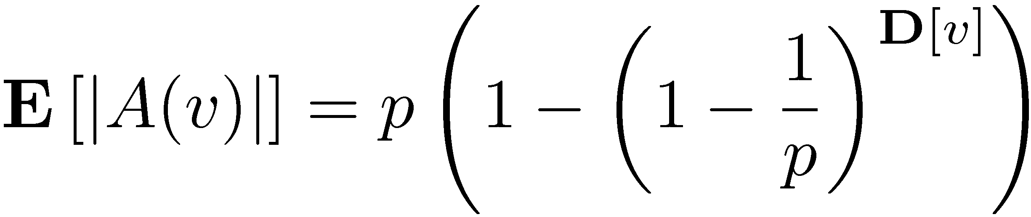
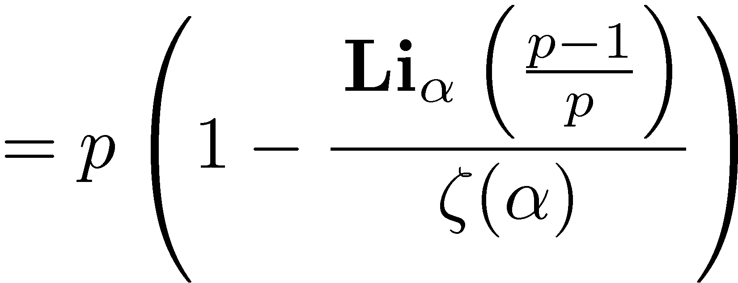
Random Vertex-Cuts
Assign edges randomly to machines and allow vertices to span machines.
Expected number of machines spanned by a vertex:
Degree of v
Spanned Machines
Number of Machines Spanned by v
Numerical
Functions

Slide 39
Random Vertex-Cuts
Assign edges randomly to machines and allow vertices to span machines.
Expected number of machines spanned by a vertex:
α = 1.65
α = 1.7
α = 1.8
α = 2

Slide 40
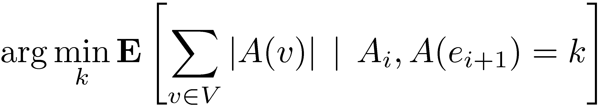
Greedy Vertex-Cuts by Derandomization
Place the next edge on the machine that minimizes the future expected cost:
Greedy
Edges are greedily placed using shared placement history
Oblivious
Edges are greedily placed using local placement history
Placement information for previous vertices
Notes:
Greedy algorithm is no worse than random placement in expectation

Slide 41
Greedy Placement
Shared objective
Machine1
Machine 2
Shared Objective (Communication)

Slide 42
Oblivious Placement
Local objectives:
CPU 1
CPU 2
Local Objective
Local Objective

Slide 43
Partitioning Performance
Twitter Graph: 41M vertices, 1.4B edges
Spanned Machines
Load-time (Seconds)
Oblivious/Greedy balance partition quality and partitioning time.

Slide 44
32-Way Partitioning Quality
 | Vertices | Edges
Twitter | 41M | 1.4B
UK | 133M | 5.5B
Amazon | 0.7M | 5.2M
LiveJournal | 5.4M | 79M
Hollywood | 2.2M | 229M
Spanned Machines
Oblivious
2x Improvement
+ 20% load-time
Greedy
3x Improvement
+ 100% load-time
Notes:
To understand how the partitioning can have an effect on runtime. We just first have an implementation of PowerGraph.

Slide 45
System Evaluation

Slide 46
Implementation
Implemented as C++ API
Asynchronous IO over TCP/IP
Fault-tolerance is achieved by check-pointing
Substantially simpler than original GraphLab
Synchronous engine < 600 lines of code
Evaluated on 64 EC2 HPC cc1.4xLarge

Slide 47
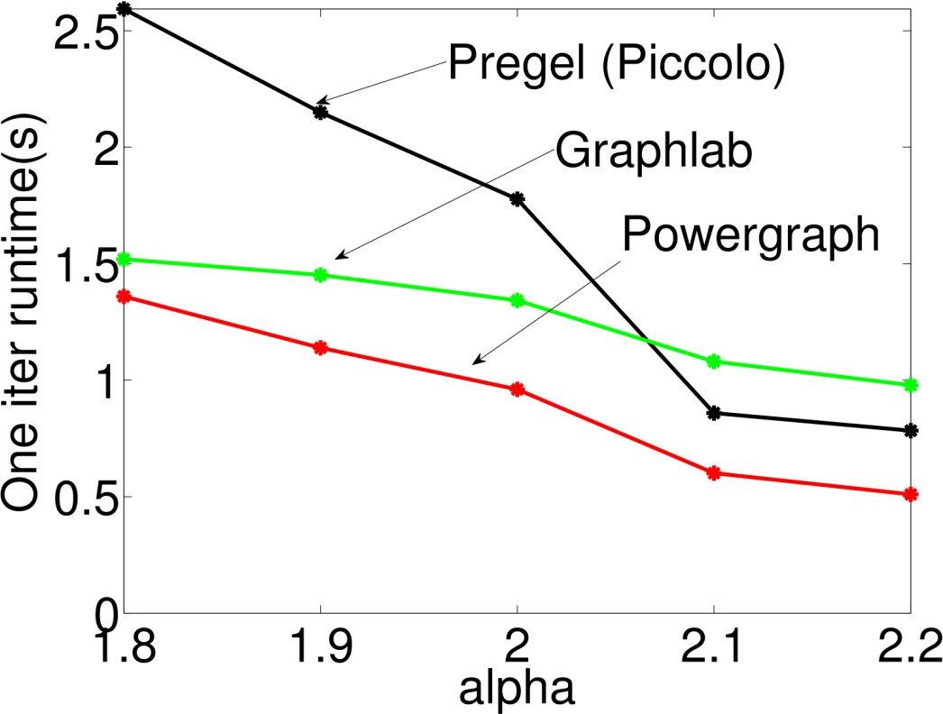
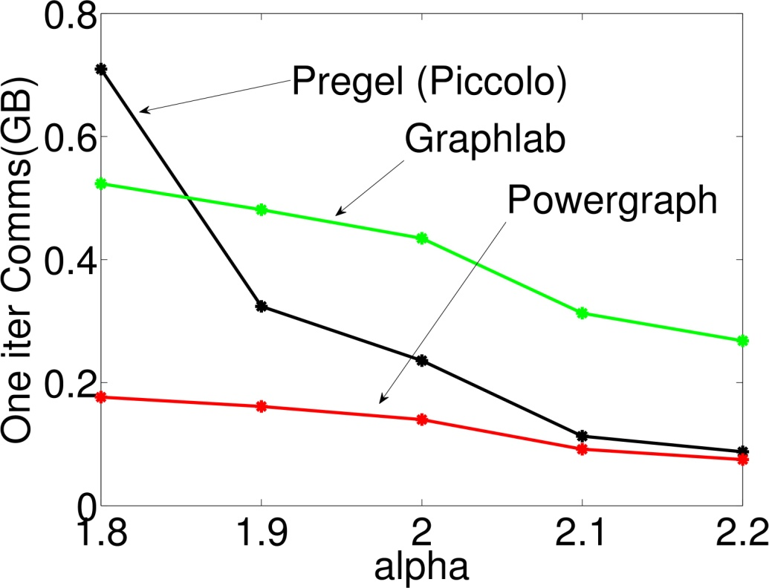
Comparison with GraphLab & Pregel
PageRank on Synthetic Power-Law Graphs
Random edge and vertex cuts
Runtime
Communication
GraphLab2
GraphLab2
Denser
Denser
Notes:
All use random cuts

Slide 48
Benefits of a good Partitioning
Better partitioning has a significant impact on performance.

Slide 49
Performance: PageRank
Twitter Graph: 41M vertices, 1.4B edges
Random
Random
Oblivious
Oblivious
Greedy
Greedy
Notes:
In comparison, Spark takes 97s per iteration on 100 cores.

Slide 50





Matrix Factorization
Matrix Factorization of Wikipedia Dataset
(11M vertices, 315M edges)
Docs
Wiki
Words
Consistency = Lower Throughput

Slide 51
Matrix Factorization
Consistency → Faster Convergence
Fully Asynchronous
Serially Consistent
Notes:
But on the most important metric of all. Faster convergence

Slide 52
PageRank on AltaVista Webgraph
1.4B vertices, 6.7B edges
Pegasus
800 cores
1320s
GraphLab2
512 cores
76s
Notes:
FALOUTSOS PERSONAL COMMUNICATION (PEGASUS)

Slide 53
Conclusion
Graph-Parallel abstractions are an emerging tool for large-scale machine learning
The Challenges of Natural Graphs
Power-Law degree distribution
Difficult to partition
GraphLab2:
Distributes single vertex programs
New vertex partitioning heuristic to rapidly place large power-law graphs
Experimentally outperforms existing graph-parallel abstractions

Slide 54
Official release in July.
2
http://graphlab.org
jegonzal@cs.cmu.edu

Slide 55
Pregel Message Combiners
User defined commutative associative (+) message operation:
Machine 1
Machine 2
+
Sum

Slide 56
Costly on High Fan-Out
Many identical messages are sent across the network to the same machine:
Machine 1
Machine 2

Slide 57
GraphLab Ghosts
Neighbors values are cached locally and maintained by system:
Machine 1
Machine 2
Ghost

Slide 58
Reduces Cost of High Fan-Out
Change to a high degree vertex is communicated with “single message”
Machine 1
Machine 2

Slide 59
Increases Cost of High Fan-In
Changes to neighbors are synchronized individually and collected sequentially:
Machine 1
Machine 2

Slide 60
Comparison with GraphLab & Pregel
PageRank on Synthetic Power-Law Graphs
Power-Law Fan-In
Power-Law Fan-Out
GraphLab2
GraphLab2
Denser
Denser
Notes:
All uses random cuts

Slide 61
Straggler Effect
PageRank on Synthetic Power-Law Graphs
Power-Law Fan-In
Power-Law Fan-Out
GraphLab
Pregel (Piccolo)
Pregel (Piccolo)
GraphLab2
GraphLab
GraphLab2
Denser
Denser
Notes:
All uses random cuts

Slide 62
Cached Gather for PageRank
Initial Accum
computation
time
Reduces runtime by ~ 50%.

Slide 63
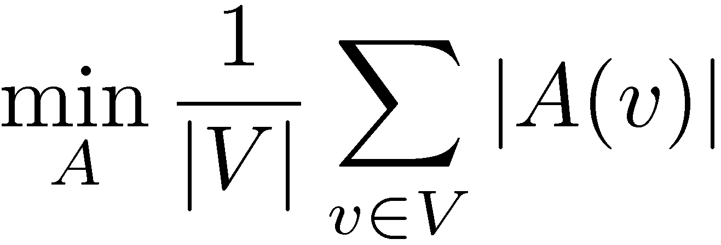
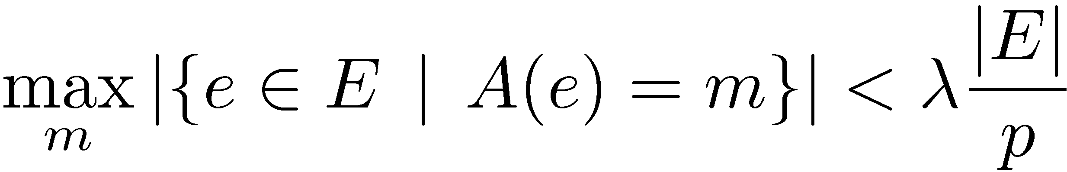
Vertex-Cuts
Machine 1
Edges are assigned to machines
Vertices span machines
Forms a Mirror Set
Cut Objective:
Minimize mirrors:
Balance Constraint:
No machine has too many edges
Machine 4
Mirror Set
Machine 2
Machine 3

Slide 64
Relation to Abelian Groups
We can define an incremental update when:
Gather(U, V) → T
T is an Abelian Group:
Commutative associative (+) and an inverse (-)
Define delta value as:
Δ_{v} = Gather(U^{new}, V) - Gather(U^{old}, V)

