Slide 1
Human-Computable Passwords
Jeremiah Blocki
Manuel Blum
Anupam Datta
Santosh Vempala

Slide 2
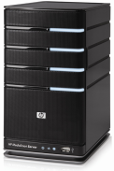







Password Management
p₁
p₂
p₃
p₄
p₅
Competing Goals:
Security
Usability

Slide 3


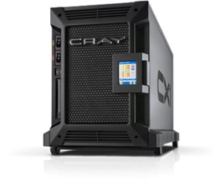

Password Security Game
p₁
p₂
p₃
p₄
p₅
BCRYPT(p₄)
p₅
PayPaul.com
q_{$1,000,000} guesses
+

Slide 4
Previous Work
Naturally Rehearsing Passwords
  Presentation on Thursday
  Password Management Scheme: Shared Cues

Slide 5
Security Results
Attacks | k= 1 | k= 1 t=1 | k=2
Reuse | No | No | No | No
Strong Random Independent | Yes | Yes | Yes | Yes
Shared Cues | Yes | Yes | Yes | No
Usable + Insecure
Unusable + Secure
Usable + Secure
Phishing Attack
Offline Attack
Notes:
One approach to password management is to simply reuse the same password everywhere. While this is the easiest approach it is highly insecure. If the adversary compromises the user’s password for one account (e.g., phishing/malware/plaintext password leaks) then every account is compromised.
An alternative approach is to select independent passwords for each account. This approach provides the strongest security guarantees (an adversary who compromises the password for one account has no advantage attacking another account). However, the usability demands are far to great. Many accounts are visited infrequently (e.g., IRS might be visited annually). The user would need to be constantly reminded to rehearse each of these passwords or else it is likely that he would forget them.
Our approach --- Shared Cues --- achieves strong security and usability guarantees. Our security guarantees are almost as strong as Strong Random Independent, and our usability guarantees are almost as good as Reuse.

Slide 6
Security Results
Attacks | k= 1 | k= 1 t=1 | k=2
Reuse | No | No | No | No
Strong Random Independent | Yes | Yes | Yes | Yes
Shared Cues | Yes | Yes | Yes | No
Usable + Insecure
Unusable + Secure
Usable + Secure
Phishing Attack
Offline Attack
Notes:
One approach to password management is to simply reuse the same password everywhere. While this is the easiest approach it is highly insecure. If the adversary compromises the user’s password for one account (e.g., phishing/malware/plaintext password leaks) then every account is compromised.
An alternative approach is to select independent passwords for each account. This approach provides the strongest security guarantees (an adversary who compromises the password for one account has no advantage attacking another account). However, the usability demands are far to great. Many accounts are visited infrequently (e.g., IRS might be visited annually). The user would need to be constantly reminded to rehearse each of these passwords or else it is likely that he would forget them.
Our approach --- Shared Cues --- achieves strong security and usability guarantees. Our security guarantees are almost as strong as Strong Random Independent, and our usability guarantees are almost as good as Reuse.

Slide 7
Previous Work
Naturally Rehearsing Passwords
  Presentation on Thursday
  Password Management Scheme: Shared Cues
Key Question: Can we get better security if we ask the user to perform simple computations to generate his passwords?

Slide 8
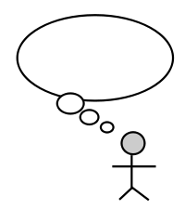



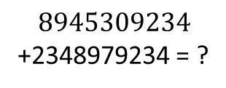
Human Computation
Restricted
  Simple operations (addition, lookup)
  Operations performed in memory (limited space)
$$8945309234$$
+2348979234 = ?
$$9+8=7 mod 10$$

Slide 9
Human Computation
Restricted
  Simple operations (addition, lookup)
  Operations performed in memory (limited space)
Improve Security?
  Simple Computations vs. Pure Recall

Slide 10
Candidate Scheme
Memorize a Random Mapping
  One time step!
Password Computed as a Response to Public Challenges
Required Operations
  Addition modulo 10
  Memory lookups

Slide 11
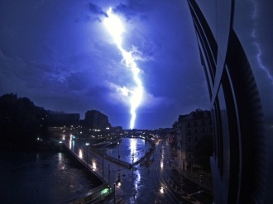
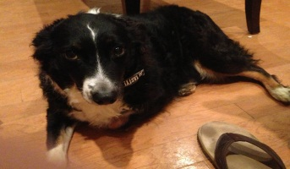
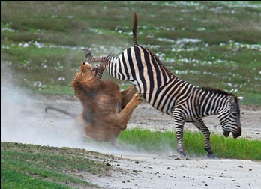
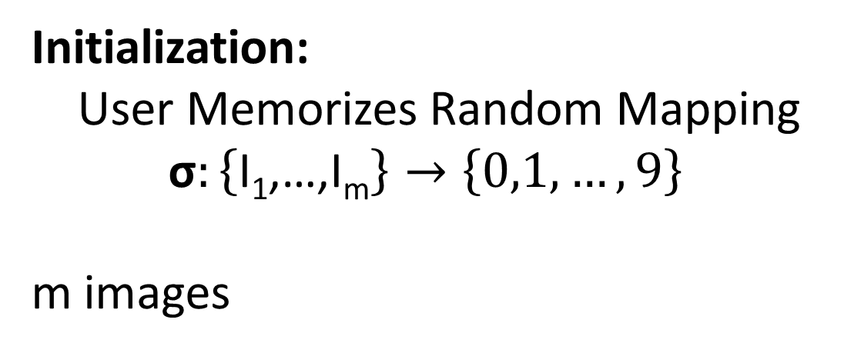
Random Mapping
Image I |  |  | …
σ(I) | 9 | 3 | … | 6
Initialization:
User Memorizes Random Mapping
$$\text{σ}:\left\{\text{I}\text{1}\text{,…,}\text{Im}\right\}→\left\{0,1,…,9\right\}$$
m images

Slide 12
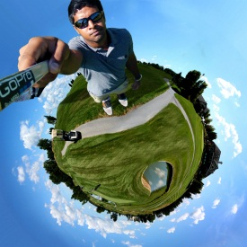
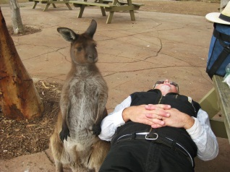
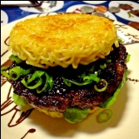

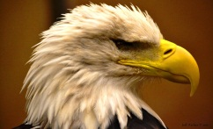
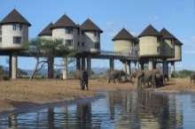


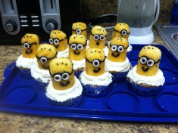
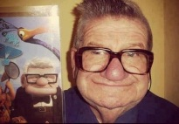
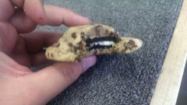
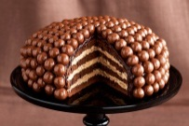

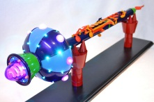
Single-Digit Challenge
0
1
2
3
4
5
6
7
8
9
Response:
σ + σ = 2 mod 10

Slide 13
Single-Digit Challenge
0
1
2
3
4
5
6
7
8
9
Response:
σ + σ = 2 mod 10

Slide 14
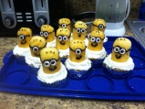
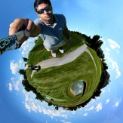
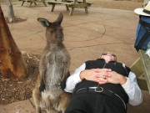
Single-Digit Challenge
0
1
2
3
4
5
6
7
8
9
Response:
σ + σ + σ
= 7 + 4 + 5 = 6 mod 10

Slide 15
Passwords
0
1
2
3
4
5
6
7
8
9
Username:
σ + σ + σ
= 7 + 4 + 5 = 6 mod 10
jblocki
Password:

Slide 16
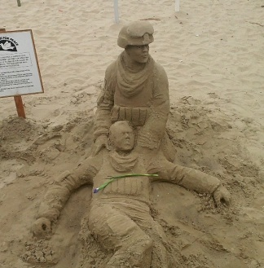
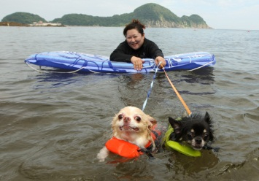
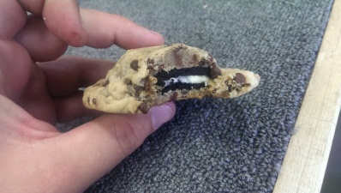
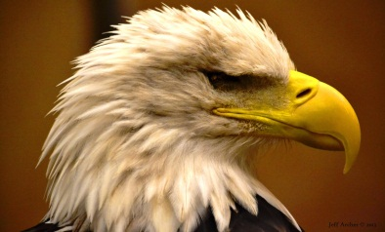
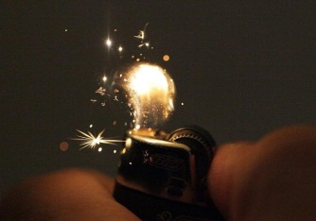
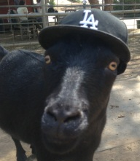
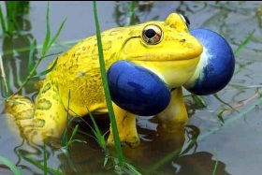






Passwords
0
1
2
3
4
5
6
7
8
9
Username:
jblocki
Password:
*

Slide 17

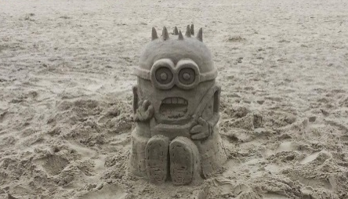

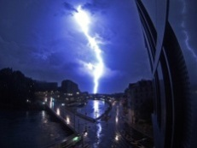


Passwords
0
1
2
3
4
5
6
7
8
9
Username:
jblocki
Password:
**

Slide 18
Usability
  Memorization is a one time cost
  Mapping f is rehearsed naturally
  Can Add new Images over Time
Time
  75 seconds for a 10 digit password
  7.5 seconds per digit (average)

Slide 19
Usability (Time)
It takes me
7.5 seconds per digit (average)
2.5 minutes for a 20-digit password
<30 seconds for a 4-digit password

Slide 20
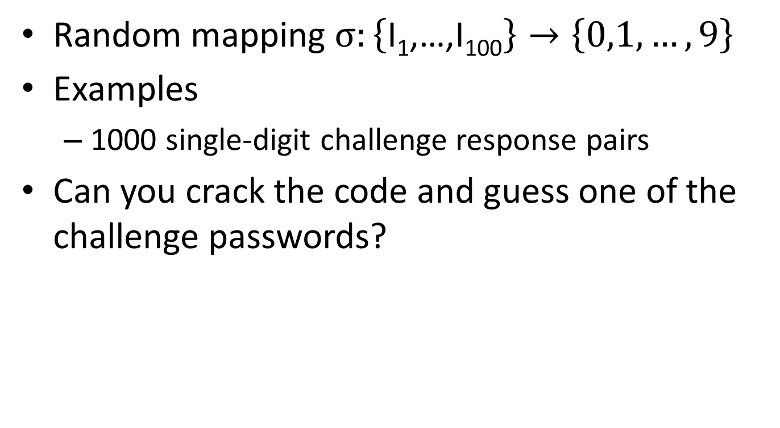
Open Challenge
Random mapping $σ:\left\{\text{I}\text{1}\text{,…,}\text{I}\text{100}\right\}→\left\{0,1,…,9\right\}$
Examples
  1000 single-digit challenge response pairs
Can you crack the code and guess one of the challenge passwords?
http://www.cs.cmu.edu/~jblocki/HumanComputablePasswordsChallenge/challenge.htm

Slide 21
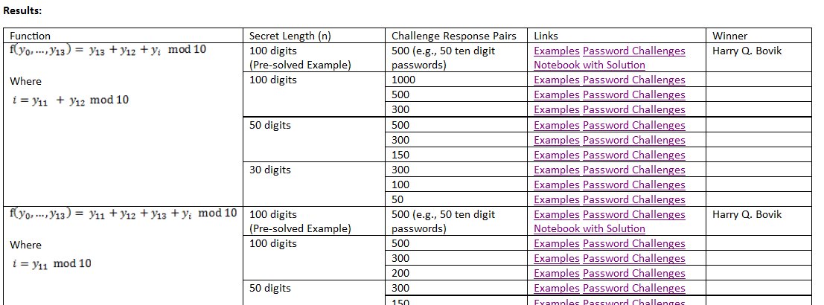
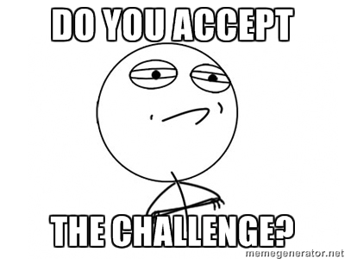
Open Challenge
http://www.cs.cmu.edu/~jblocki/HumanComputablePasswordsChallenge/challenge.htm

