Slide 1
Clinical Shadow Program

Slide 2
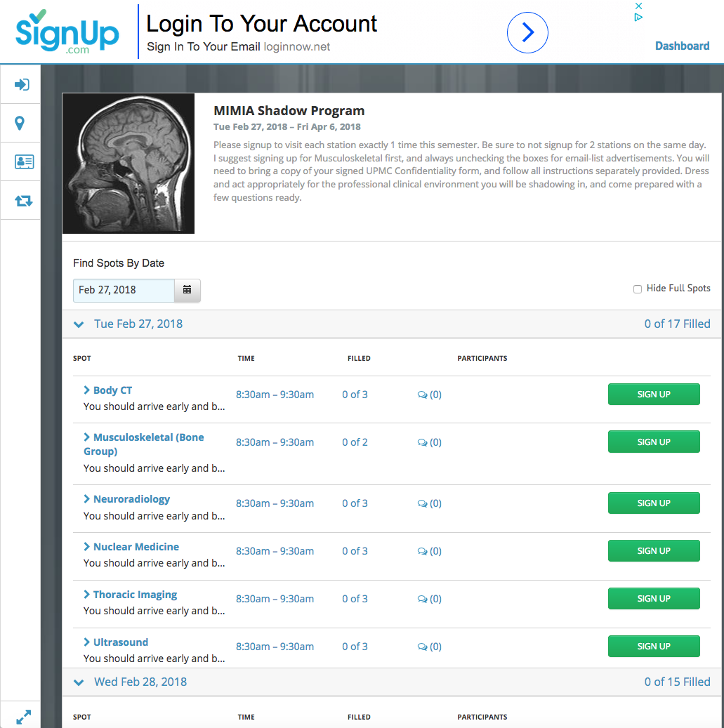
Pick at most one per day

Slide 3
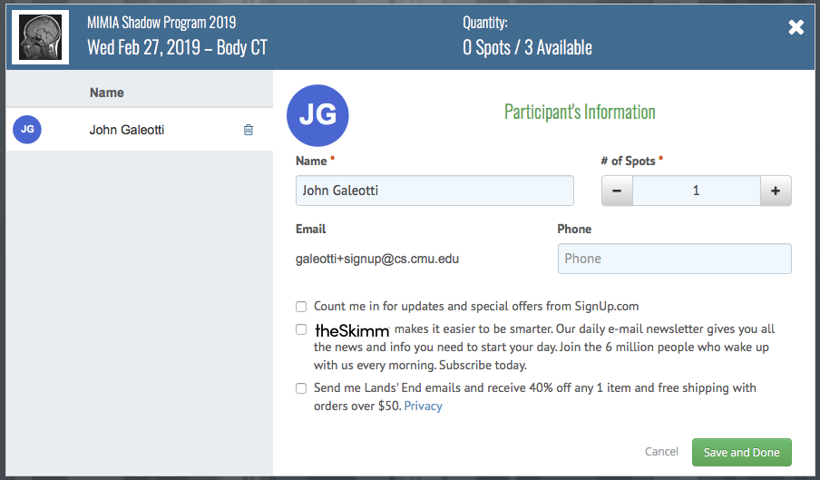
If you’re already signed in, clicking a “SIGN UP” button leads to this:
Keep at 1
I suggest unchecking these boxes
Don’t forget to Save

Slide 4
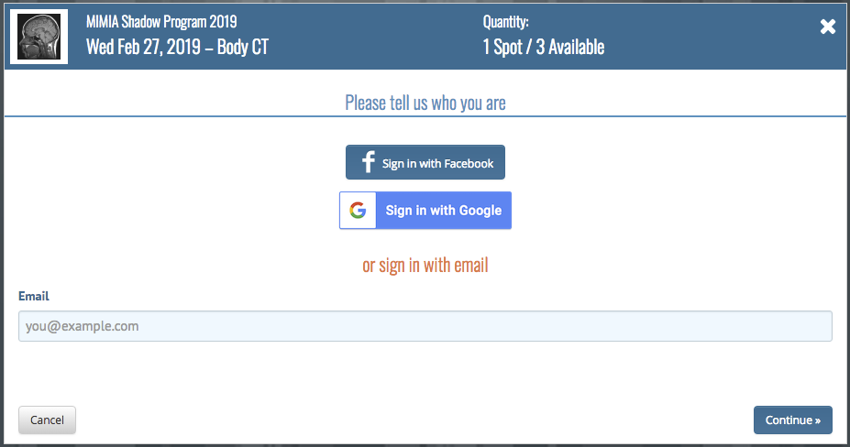
I suggest logging into Signup.com before the signup opens, or else you will be delayed with this instead:

Slide 5
Schedule: Signing Up
Signup once for each of the 6 stations.
You may only signup for 1 station per day.
You will sign up to shadow on exactly 6 different days
Up to 3 students can simultaneously visit each station on a given day.
Exception: Musculoskeletal can only accept 2 students per day and no students on Wednesday.
I suggest signing up for musculoskeletal first, since they have the fewest slots available
If the radiologists' schedules suddenly do not comply, then we may have to notify you (with 1 week notice, if possible) that you need to reschedule for a given station.
This doesn’t usually happen

Slide 6
Schedule: 8:30 AM
You must be present from 8:30 - 9:30 AM.
You should arrive early (8:00 am) and be prepared to wait.
The radiologists are doing us a big favor by allowing us to come watch them.
They have real patients, and chaotic schedules.
Some of them will probably have to keep you waiting, but you should never keep them waiting.
Some of them may have to leave on a moment's notice as well.
Usually, you will be able to remain in the reading room (under someone else's "supervision" until 9:30 though).
Hopefully the attending will start the readout with the residents sometime between 8:30 - 9:00am
If you miss the readout, just mention in your report that the readout never happened between 8:30 - 9:30.

Slide 7
Interacting with the clinicians: Be prepared in advance
Have a set of questions to ask — feel free to be creative
Sample questions are included at the bottom of the directions document—I suggest bringing it with you
Pay close attention if the clinicians debate a patient’s diagnosis or condition.
Come up with new questions based on what you are observing.

Slide 8
DON’T MESS UP
It is very important that you do not make the clinicians regret letting you come:
Dress and act appropriately for a professional clinical environment
Patients might think you are a doctor — don’t make the patient’s feel uncomfortable or distrust UPMC.
Make sure you have a signed UPMC confidentiality agreement with you.
If you are sick and contagious, you should not go
Keep the clinicians healthy
Please notify your instructor as soon as possible to reschedule without any penalty.

Slide 9
DON’T MESS UP (continued)
The first time you miss a station for which you are scheduled (without good reason), you may contact your instructor to reschedule for 50% credit for that station.
If you do not show up a second time, you will be removed from the Shadow Program, get a 0 for all subsequent stations, and your instructor will be very unhappy with you.

Slide 10
Follow-up assignment (once for each station)
After visiting each station, send an email to your TA and your instructor with the following information:
Your name
The date of your visit
Which station you visited
Your short report (≥ 100 words) about your visit:
What did you learn?
What role you see (either at present, or that you could see in the future) for computer analysis, visualization, or robotics/engineering in this branch of radiology?

