Slide 1
A Compositional and Interpretable Semantic Space
Alona Fyshe, Leila Wehbe, Partha Talukdar, Brian Murphy, and Tom Mitchell
Carnegie Mellon University
amfyshe@gmail.com

Slide 2
VSMs and Composition
lettuce
carrots
apple
pear
orange

Slide 3

How to Make a VSM
Many cols
Few cols
Corpus
Statistics
Count
Dim.
Reduction
VSM

Slide 4
VSMs and Composition
lettuce
carrots
apple
seedless orange
pear
orange

Slide 5
VSMs and Composition
adjective
noun
estimate
f( , )
=
Stats for seedless
Stats for orange
Observed stats for “seedless orange”
observed

Slide 6
Previous Work
What is “f”?
            (Mitchell & Lapata, 2010; Baroni and Zamparelli, 2010; Blacoe and Lapata, 2012; Socher et al., 2012; Dinu et al., 2013; Hermann & Blunsom, 2013)
Which VSMs are best for composition?
  (Turney, 2012, 2013; Fyshe et al., 2013; Baroni et al., 2014)

Slide 7
Our Contributions
Can we learn a VSM that
  is aware of composition function?
  is interpretable?
Is edible
F
F
Notes:
Because we’re interested in studying meaning, not just estimating it

Slide 8
How to make a VSM
Corpus
  16 billion words
  50 million documents
Count dependencies arcs in sentences
    MALT dependency parser
Point-wise Positive Mutual Information

Slide 9
Matrix Factorization in VSMs
Corpus Stats (c)
X
A
D
≈
Words
VSM
Notes:
Turn up and down L to capture more or less information in A

Slide 10
Interpretability
Latent Dims
A
Words

Slide 11
Interpretability
SVD (Fyshe 2013)
  well, long, if, year, watch
  plan, engine, e, rock, very
  get, no, features, music, via
Word2vec (pretrained on Google News)
  pleasantries, draft_picks, chairman_Harley_Hotchkiss, windstorm, Vermont_Yankee
  Programme_Producers_AMPTPP, ###/mt, Al_Mehwar, NCWS, Whereas
  Ubiquitous_Sensor_Networks, KTO, discussing, Hibernia_Terra_Nova, NASDAQ_ENWV

Slide 12
Non-Negative Sparse Embeddings
X
A
D
≈
(Murphy 2012)
Notes:
Solve by alternately minimizing A and D

Slide 13
Interpretability
SVD
  well, long, if, year, watch
  plan, engine, e, rock, very
  get, no, features, music, via
NNSE
  inhibitor, inhibitors, antagonists, receptors, inhibition
  bristol, thames, southampton, brighton, poole
  delhi, india, bombay, chennai, madras

Slide 14
A Composition-aware VSM

Slide 15
Modeling Composition
Rows of X are words
  Can also be phrases
Adjectives
X
A
Adjectives
Nouns
Nouns
Phrases
Phrases

Slide 16
Modeling Composition
Additional constraint for composition
Adjectives
w₁
A
Nouns
w₂
Phrases
p
p = [w₁ w₂]

Slide 17
Weighted Addition

Slide 18
Modeling Composition

Slide 19
Modeling Composition
Reformulate loss with square matrix B
B
A
α
β
-1
adj. col.
noun col.
phrase col

Slide 20
Modeling Composition

Slide 21
Optimization
Online Dictionary Learning Algorithm
  (Mairal 2010)
Solve for D with gradient descent
Solve for A with ADMM
  Alternating Direction Method of Multipliers

Slide 22
Testing Composition
SVD
w₁
W. add
W. NNSE
CNNSE
w₂
p
A
w₁
w₂
p
A
w₁
w₂
p

Slide 23
Phrase Estimation
Predict phrase vector
Sort test phrases by distance to estimate
r
Rank (r/N*100)
Reciprocal rank (1/r)
Percent Perfect (δ(r==1))
N

Slide 24
Phrase Estimation
  Chance 50
  ~ 0.05
  1%

Slide 25
Interpretable Dimensions

Slide 26
Interpretability

Slide 27
Testing Interpretability
SVD
w₁
SVD
NNSE
CNNSE
w₂
p
A
w₁
w₂
p
A
w₁
w₂
p

Slide 28
Interpretability
Select the word that does not belong:
  crunchy
  gooey
  fluffy
  crispy
  colt
  creamy

Slide 29
Interpretability

Slide 30
Phrase Representations
A
top scoring
words/phrases
phrase
top scoring
dimension

Slide 31
Phrase Representations
Choose list of words/phrases most associated with target phrase “digital computers”
  aesthetic, American music, architectural style
  cellphones, laptops, monitors
  both
  neither

Slide 32
Phrase Representation

Slide 33
Testing Phrase Similarity
108 adjective-noun phrase pairs
Human judgments of similarity [1…7]
E.g.
      Important part : significant role (very similar)
      Northern region : early age (not similar)
  (Mitchell & Lapata 2010)

Slide 34
Correlation of Distances
Model A
Behavioral Data
Model B

Slide 35
Testing Phrase Similarity

Slide 36
Interpretability

Slide 37
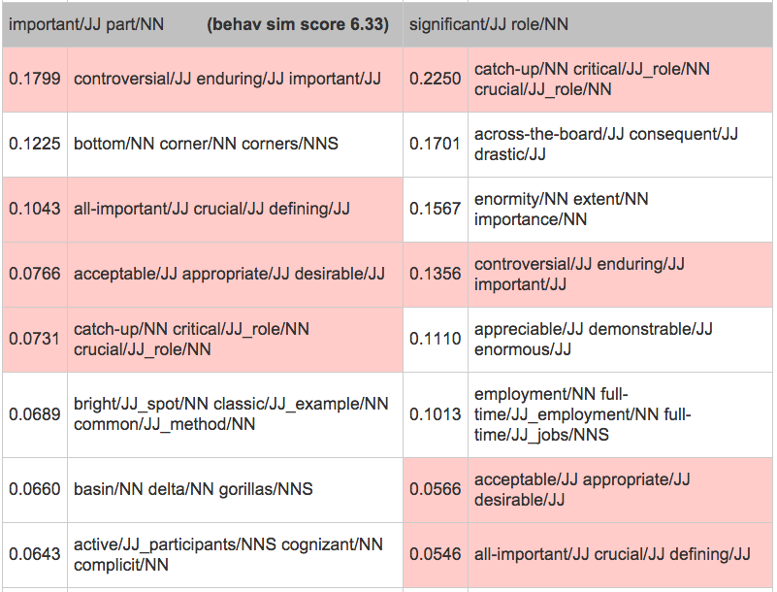
Better than Correlation: Interpretability
(behav sim score 6.33/7)
http://www.cs.cmu.edu/~afyshe/thesis/cnnse_mitchell_lapata_all.html

Slide 38
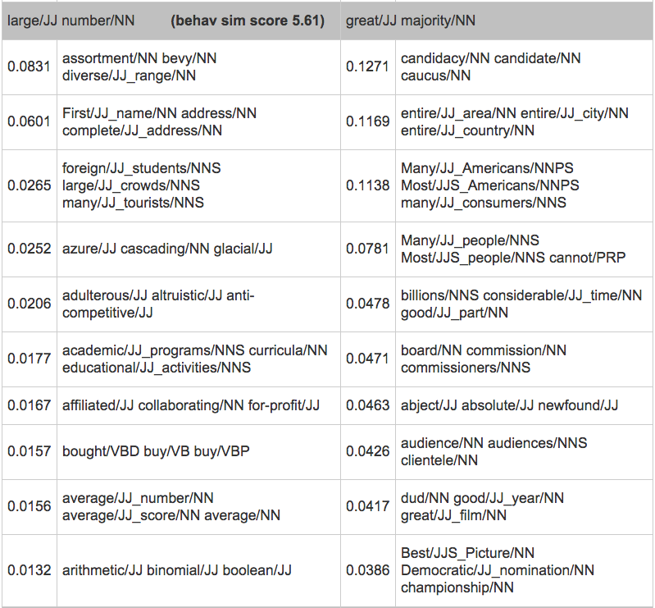
Better than Correlation: Interpretability
(behav sim score 5.61/7)
http://www.cs.cmu.edu/~afyshe/thesis/cnnse_mitchell_lapata_all.html

Slide 39
Summary
Composition awareness improves VSMs
  Closer to behavioral measure of phrase similarity
  Better phrase representations
Interpretable dimensions
  Helps to debug composition failures

Slide 40
Thanks!
www.cs.cmu.edu/~fmri/papers/naacl2015/
amfyshe@gmail.com

