Slide 1
Hackathons for
Scientific Software
How and When do they Work?
Erik H. Trainer, Chalalai Chaihirunkarn,
Arun Kalyanasundaram, James D. Herbsleb
Notes:
Hi, my name is Erik Trainer and I’ll be talking to you today about a relatively old phenomenon that’s recently gaining popularity in scientific communities. It’s known as the hackathon.

Slide 2
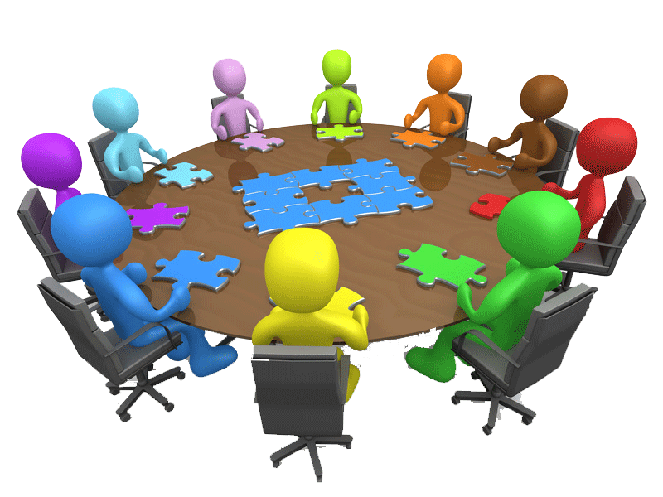
Software is Key for Science
Scientists write
their own
Possible
community resources
Useless without maintenance!
Notes:
The fact is that software is an integral part of modern scientific practice. Analysis, simulation, and visualization all rely on software.
<CLICK>Scientists write their own software, from small scripts that process experiment data to large end user “workbenches.”
<CLICK> Variations of this software have probably already been written by other scientists, and some proportion is an invisible resource that scientists may be willing to share.
<CLICK> Unless the software is updated to work with new versions of popular libraries and frameworks, and run on different operating systems – it’s useless!

Slide 3
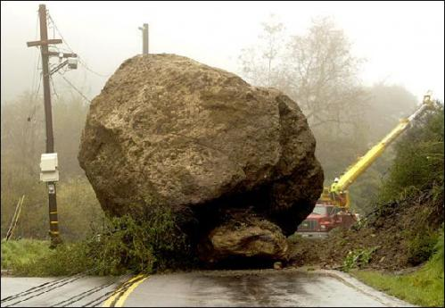
“Open-Source it!” is Not a Good Answer to Maintenance
“Open-Source it!”
Tools address short-term needs
[de la Flor et al., 2010]
Scientists don’t know
others’ needs
[Howison & Herbsleb, 2011; 2013]
Scientists’, community’s
time scales differ
Human infrastructure
is often weak
[Lee et al., 2006; Steinmacher et al., 2015]
Notes:
Open source is widely held up as a promising approach, but falls short. The worst case is uploading the source-code to a public web site and expecting a community to form around it
Why does an open-source approach fall short?
<CLICK> First of all, scientists who build tools are serving their own short-term needs [21].
Second, <CLICK> even if the tools could be of much more value to a community if built in a particular way the scientists building them often lack knowledge of these needs as well as the incentives to meet them
Third, <CLICK> unlike open-source software, much scientific software only remains active for the span of the research grants supporting them.
Fourth, <CLICK> scientists who would be willing to invest the time to adapt, extend, and maintain these tools may be deterred by the lack of human infrastructure [24] and unfamiliarity with the codebase.

Slide 4
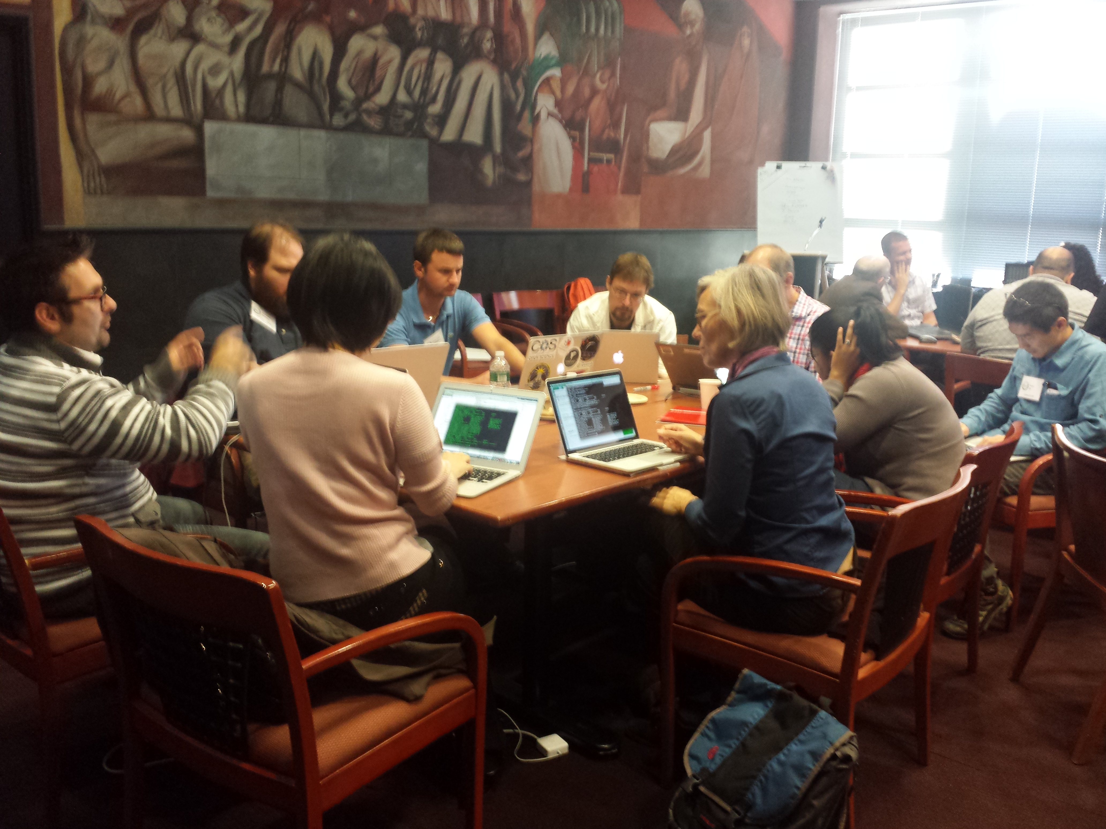
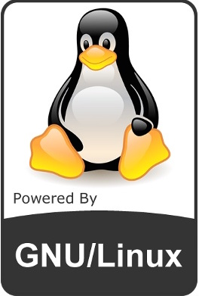

4
Advance technical work via collocation
Notes:
To overcome these barriers, scientists are experimenting with hackathons, short-term intense events where teams of computer programmers and others involved in software development collaborate intensively on software projects.
<CLICK> Tech companies are using them to grow their user base, create demand for their products, and encourage product innovation
<CLICK> Open source projects use them to work on specific development issues, and incorporate new developers.
<CLICK> Prior research suggests that hackathons may be effective ways to advance technical work via collocation

Slide 5
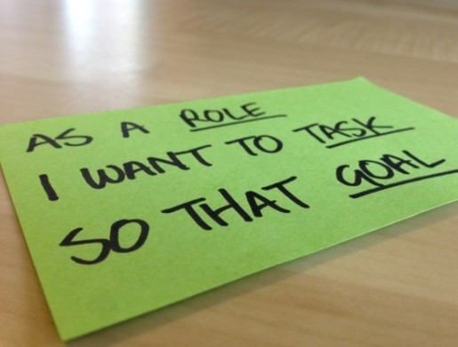
5
Create awareness of community needs via formal & informal communication channels
Notes:
Create awareness of community needs via formal/informal communication channels

Slide 6
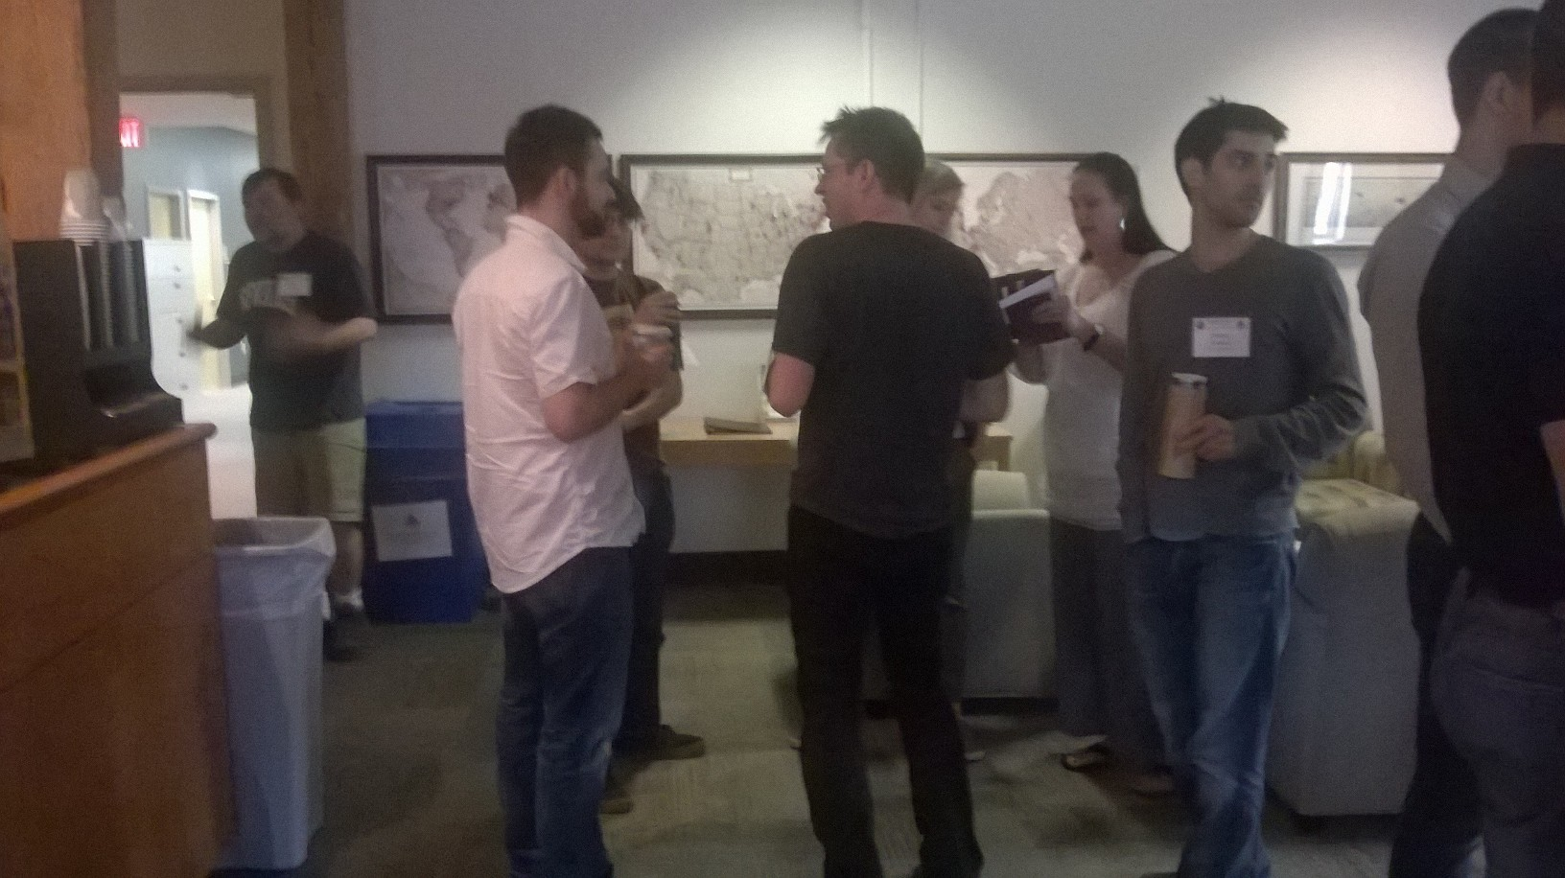
6
Build durable social ties via face-to-face
interaction
Notes:
And build durable social ties via face to face interactions

Slide 7
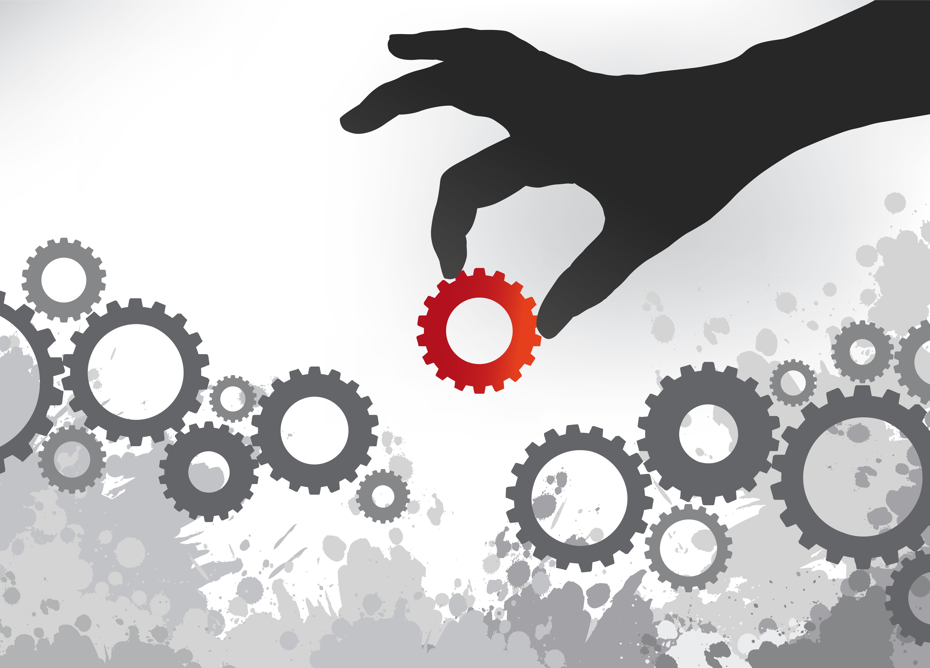
Research Questions:
1) What are the stages a hackathon goes through as it evolves?
2) How do variations in how stages are conducted affect outcomes?
Notes:
But does getting together in the same room for a few days really create an understanding of what the needs of the community are?
Does the software that is produced really address these needs? It it useful after the hackathon ends?
Is a hackathon just an excuse to get a bunch of people together in a room to socialize?
<CLICK>
To obtain a deeper understanding of the hackathon phenomenon, we asked the following questions:

Slide 8
Multiple-Case Study
Cases
Description
Data
OpenBio
(July 9-10, 2014)
BioHack
(November 10-14, 2014)
PolarVis
(November 3-4, 2014)
OSS bioinformatics project developers
2 days
7 interviews
17 hrs. observation
Documentation
OSS bioinformatics project developers
5 days
2 interviews
Documentation
Polar scientists, visualization developers
2 days
7 interviews
17 hrs. observation
Documentation
Notes:
To answer these questions we conducted a multiple case study. For our first case, we wanted a hackathon that we could attend and observe, and therefore obtain a complete picture of activity.
We selected OpenBio, a hackathon that aimed to give developers of open source bioinformatics tools focused time to spend on their projects
To see if the stages we identified generalized, we selected BioHack as a literal replication
We sought a theoretical replication next in PolarVis, a hackathon aimed to link polar scientists and visualization developers working on related problems. We wanted to see how the interdisciplinary nature of the event could facilitate or hinder achieving balance between developers’ interests and domain scientists’ needs (a key problem identified by SciTS literature).
We collected multiple sources of evidence and applied standard qualitative analysis techniques, continuing until theoretical saturation.

Slide 9

Findings
Notes:
So what did we find?

Slide 10
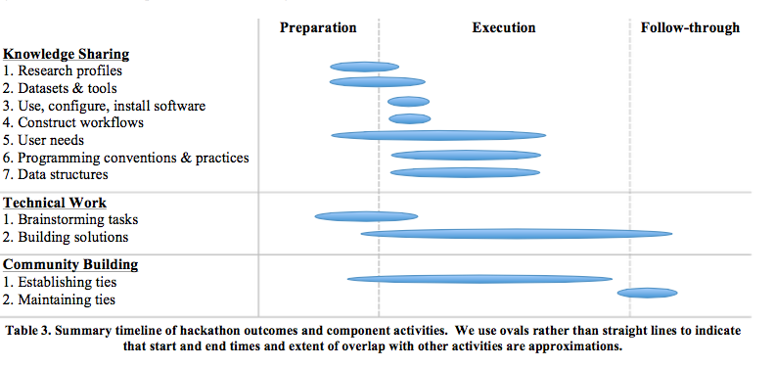
Idea Brainstorming
Learning about Tools, Datasets, and Research Profiles
Alignment: Preparing Tools and Datasets
Team Formation
Building Solutions
Knowledge Sharing
Building Social Ties
Reification of Ideas
Stimulation of User Engagement
Maintenance of
Social Ties
Notes:
We group activities under three primary stages: preparation (before the main event), execution (face to face event), and follow-through (afterward)
The top figure shows outcomes and component activities within the hackathon lifecycle. Surprisingly, some, such as learning about users’ needs actually begin to take shape before execution begins.
<CLICK>
Below, I’m showing the categories that emerged from our analysis. Because of the time limit I’ll talk about a few today that I think are important, especially when bringing multiple disciplines together.

Slide 11
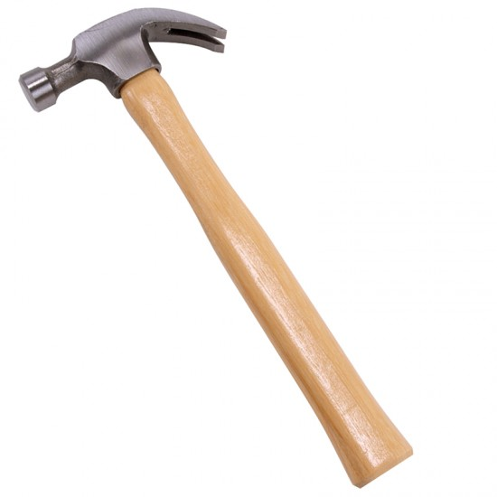

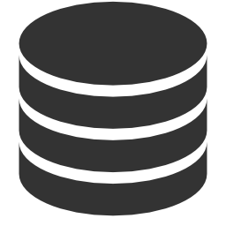


Preparation →
Idea Brainstorming
Computer Scientists
?
Different disciplines involved
Tools suggested
Positive comments
Experts brought
Characterizing disciplines
Unintentional exclusion
@
X
+1
Domain Scientists
Notes:
Idea brainstorming begins a few weeks before the hackathon. Participants use asynchronous communication technologies, such as a shared google document, or an issue tracker.
After a participant proposes an idea, <CLICK> others start to ask for clarifications and details about the information provided. For instance, what does each column represent in the dataset?
People from different disciplines are involved here, typically in <CLICK> suggesting useful technologies with which they have familiarity
--------------------------
As the idea becomes clearer, support builds. <CLICK> We see positive comments in support of an idea, but some critiquing goes on as well
People use social networking functionality such as the <CLICK> @ mention to direct attention to <CLICK> experts on the tools or ask about usage details
As this unfolds, <CLICK> participants begin to understand needs and skillsets and can characterize the community
<CLICK>However, domain scientists may not be familiar with the tools, preventing them from participation. <CLICK> This is is an important point about bringing multiple disciplines together; different disciplines have familiarity with different tools, and some will be unintentionally excluded
So brainstorming has some important by-products, but the result is just a collection of ideas, voiced support, and maybe some refinement—but there is generally no concrete task identified.

Slide 12

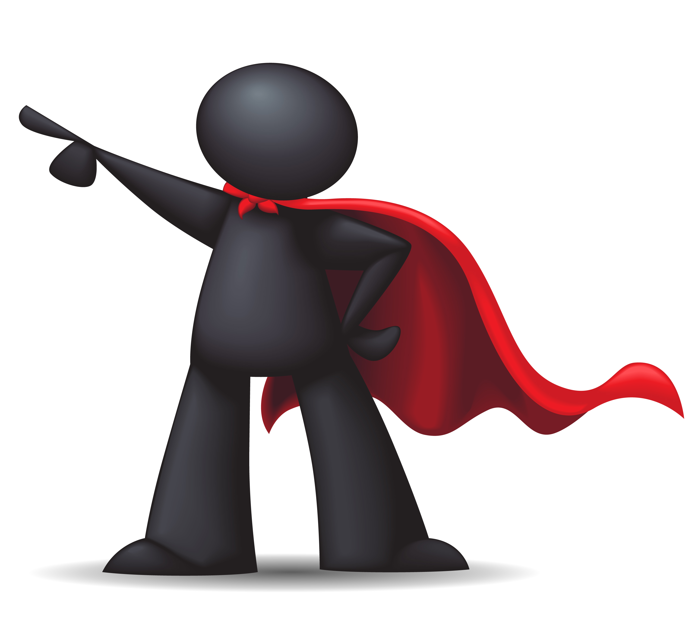

Execution →
Team Formation
Open
Shepherding
Selection by
Organizer
Selection by
Attraction
Notes:
Ideas identified in the preparation stage seed team formation; we found 3 strategies. In the open shepherding style of OpenBio, most participants came to the hackathon already associated with a project (and therefore a team) since the objective was to give these developers focused time on their projects. There were, however, “free agents,” attendees not
associated with these projects. During individual introductions, the event organizer suggested matches between free agents and existing teams and teams with each other.
In Selection by organizer style of PolarVis, organizers selected a few ideas with high interest to work on first. Other high interest ideas were reserved for later, according to the organizers, in order to balance between ideas that had lower interest. When teams were determined complete, new teams formed around remaining ideas.
In the selection by attraction style of BioHack, ideas that people got behind were de facto selected. Volunteers gave short talks about their ideas, and afterward everyone else was free to wander around the room, discussing pitches, offering suggestions, and deciding how to fit in. In contrast to the selection by organizer style, teams in the selection by attraction style stayed together for the duration of the hackathon.

Slide 13
Execution →
Building Solutions
?
Tradeoffs
  Awareness of
  user needs
  Technical progress
Polar
TASK
Vis
Homogenous
teams
Repeated
discussions
Notes:
<CLICK> Our analysis revealed tradeoffs between awareness of user needs and technical progress
We found that PolarVis teams generated many discussions of colllaboration plans, but few novel software prototypes
Why was this?
It seemed to have stemmed from not having clear team objectives, and was exacerbated by the team formation strategy chosen.
As I mentioned earlier, the result of brainstorming is a collection of ideas, relevant tools, and support, not concrete tasks. <CLICK> Because inputs needed from each discipline were not clear, polar scientists and data visualization developers were uncertain how they could concretely contribute. As a result, participants joined teams based primarily on their interests. This led to <CLICK> relatively homogenous teams, limiting the available expertise in each team.
In the selection by organizer style, when some teams dissolved mid-day continuing teams had to <CLICK> rehash previous discussions for newcomers (P9), leaving little time to take ideas from concept to realization.
Changing the teams around mid-day resulted in losing technical productivity, but seems to have helped raise awareness of user needs through the prolonged discussions.

Slide 14
Discussion
Mixing domain scientists &
computer scientists
Tradeoffs between technical progress, awareness of user needs
Ongoing work on follow-through
Implications for funding agencies
  Proposal maintenance plans
Notes:
So, <CLICK> Including domain scientists were included with computer scientists revealed <CLICK> tradeoffs between technical progress and awareness of user needs.
In other words, the optimal way to make technical progress is to decide what to implement up front, and then place developers in a room and have them code for 2 days – but then there’d be no way for developers to learn about what users of the tools need.
The optimal way to generate user needs is to put developers and end users in a room and have them talk for 2 days – but then there would be no way to make any technical progress.
Both types of outcomes can endure beyond the end of the hackathon, and <CLICK> our ongoing work is looking at this. The code might end up becoming integrated into the respective projects or the starting point of anew project. What’s less obvious is that the awareness of needs may change the way people develop software, to think about the needs of others when they do so; we know from previous work that this happens.
It is clear that <CLICK> funding agencies are interested in producing and sustaining software that advances scientific knowledge [35]. Hackathons may be an element of scientific software sustainability. <CLICK> For instance, hackathons could be included in software maintenance plans for proposal applications. Policy prescriptions could help funders design and evaluate these plans. More careful empirical study, especially of design considerations and lasting impact, will be needed in the meantime.
-----------------
In addition to minimal prerequisites, there may be other considerations that would lead to particular design choices in the CCE, for example: the need or desire to link communities working on related problems, or interacting software; the need to grow human infrastructure or bring in fresh members to replace those who have moved on; the need to get members up to speed on a new technology or a new kind of functionality; or the need to take advantage of emerging opportunities such as a new computing resource or data source.

Slide 15
Conclusions
Practices across hackathon stages address specialized needs of
scientific software
Differences in kinds of disciplines included, team formation strategies suggest tradeoffs among technical progress, awareness of user needs
Opportunities for policy
Notes:
<CLICK>
<CLICK>
<CLICK> Policy is more of an open question, funders are interested in sustainability of the software, wouldn’t it be great if we had some policy prescriptions based on our findings from hackathons that could help here?

Slide 16
Acknowledgements
Collaborators
Funding
  Chalalai Chaihirunkarn
  Arun Kalyanasundaram
  Jim Herbsleb
  Our participants
Google Open Source Programs Office
Alfred P. Sloan Foundation
National Science Foundation
  #1064209, #1111750, #0943168
Notes:
I’d like to quickly acknowledge my collaborators and funding sources…

Slide 17
Thank You ☺
Practices across hackathon stages address specialized needs of
scientific software
Differences in kinds of disciplines included, team formation strategies suggest tradeoffs among technical progress, awareness of user needs
Opportunities for policy
Contact: etrainer@cs.cmu.edu
Notes:
And say thank you for your attention!

Slide 20
EXTRAS

Slide 21
Improving Inclusiveness
Computer science more male (than domain scientists)
Women with same competency will rate themselves lower
Specify different roles needed
Don’t refer to people as hackers or coders
Reach out to labs (often with phone call) run by women and minorities
Notes:
In the United States, the proportion of women represented in undergraduate computer science education and the white-collar information technology workforce peaked in the mid-1980s, and has declined ever since. In 1984, 37.1% of Computer Science degrees were awarded to women; the percentage dropped to 29.9% in 1989-1990, and 26.7% in 1997-1998.^{[8]} Figures from the Computing Research Association Taulbee Survey indicate that fewer than 12% of Computer Science bachelor's degrees were awarded to women at U.S. PhD-granting institutions in 2010-11.^{[9]}

