Slide 1

An Efficient SMT Solver
Lecturer: Qinsi Wang
May 2, 2012

Slide 2
Z3
high-performance theorem prover being developed at Microsoft Research.
  mainly by Leonardo de Moura and Nikolaj Bjørner.
  Free (online interface, APIs, …) ☺
  but Not open source ☹

Slide 3
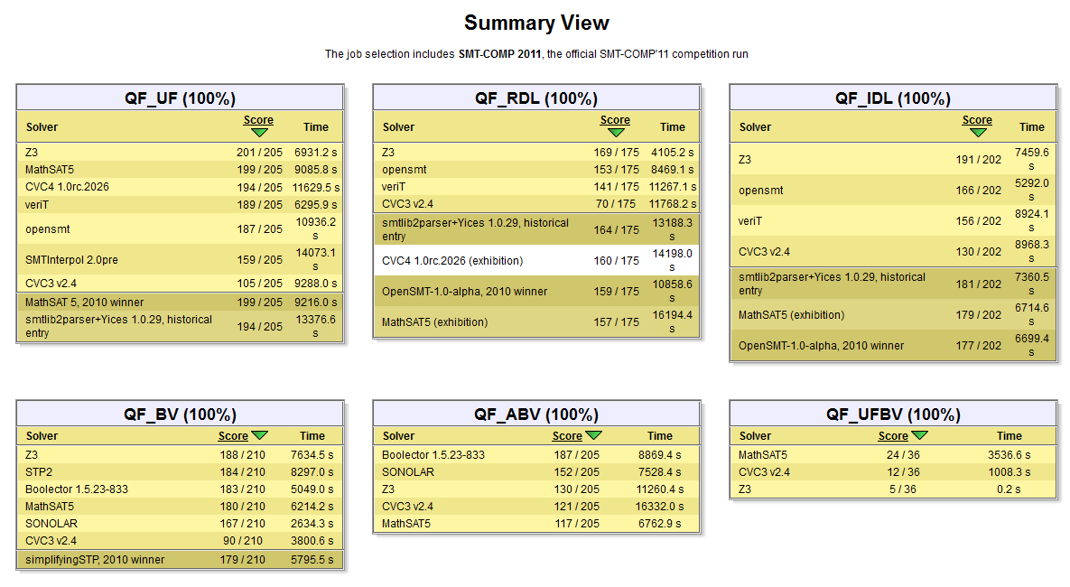
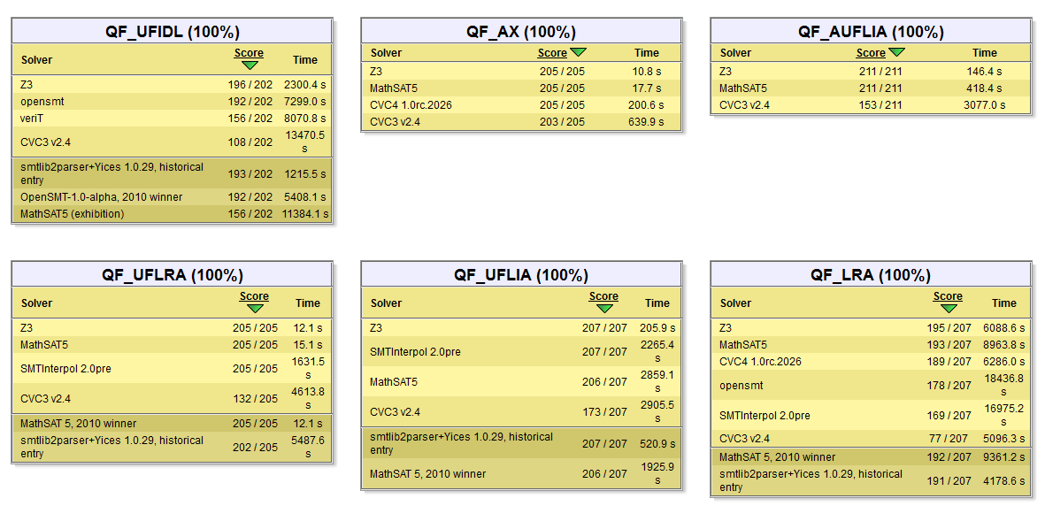
Why Z3?
Great performance
  SMT-Competition 2011 (http://www.smtcomp.org/2011/), first place in 18 out of 21 benchmarks
Notes:
As we all know, Z3 is not the only available SMT solver. There are other SMT solvers such as CVC, MathSAT, and so on. Then, why do we bother learning it?
Benchmarks are divided in “logics”:
QF_UF: unquantified formulas built over a signature of uninterpreted sort, function and predicate symbols.
QF_UFLIA: unquantified linear integer arithmetic with uninterpreted sort, function, and predicate symbols.
QF_AUFLIA: closed linear formulas over the theory of integer arrays with free sort, function and predicate symbols.
QF_IDL: Theories of difference logic over Q.
QF_RDL: Theories of difference logic over Z.
QF_BV: Theories of fixed-size bit vectors.

Slide 4
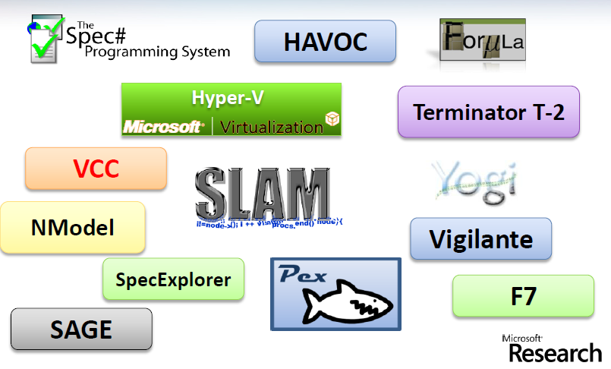
Why Z3?
Widely used

Slide 5
This Lecture
SAT and SMT
  Structure of Z3
  SAT solver
Theory solvers
Interface SAT solver with Theory solvers
Combine different theory solvers

Slide 6
Satisfiability Modulo Theories (SMT)
A decision problem for first-order logic formulas with respect to combinations of background theories.
  such as arithmetic, bit-vectors, arrays, and uninterpreted functions.
Is formula ϕ satisfiable modulo theory T ?
SMT solvers have specialized algorithms for T

Slide 7
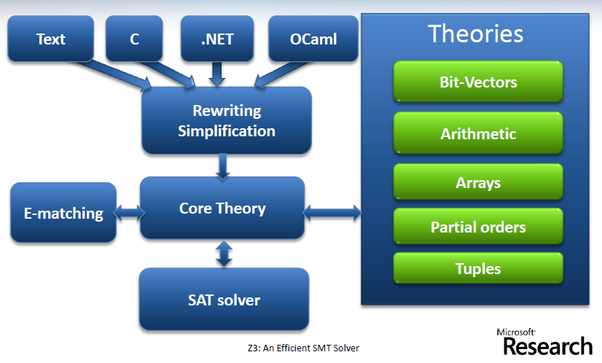
SMT solver = SAT solver + various Theory solvers
Z3: An Efficient SMT Solver, Leonardo de Moura and Nikolaj Bjørner, 2008.
Notes:
SMT generalizes boolean satisfiability (SAT) by adding equality reasoning, arithmetic, fixed-size bit-vectors, arrays, quantifiers, and other useful first-order theories.
The SAT solver enumerates possible truth assignments.
The theory solver is a decision procedure that checks whether the truth assignments are satisfiable in the theory (or combination of theories).
A schematic overview of Z3 is shown in the following figure.

Slide 8
SAT solver: A propositional core
Z3 integrates a modern DPLL-based SAT solver
SAT Solvers: check satisfiability of propositional formulas
Logical basics
Modern Boolean SAT solvers are based on the Davis-Putnam and Davis-Logemann-Loveland (DPLL) procedures
Notes:
I will skip the logical basics, such as the definitions of logics, language, interpretation, vaild, and format of CNF, partly because Will have covered most of them in last lecture.
Optional:
Most successful SAT solvers are based on an approach called “systematic search.” The search space is a tree with each vertex representing a Boolean variable and the out edges representing the two choices (true and false)for this variable. For a formula containing n Boolean variables, the tree has 2n leaves. Each path from the root to a leaf corresponds to a truth assignment. A model is a truth assignment that makes the formula true. We also say the model satisfies the formula, and the formula is satisfiable.

Slide 9
DPLL procedure _ CNF
Input formula is in Conjunctive Normal Form (CNF)
Rather than constructing a CNF formula equivalent to φ, it’s cheaper to construct a CNF formula φ′ that preserves satisfiability:
  φ is satisfiable iff φ′ is satisfiable
Notes:
In last lecture, Will has told us how to transform arbitrary propositional formula into equivalent CNF format.

Slide 10
DPLL procedure _ CNF
Efficient Conversion to CNF
  Key idea: replace a subformula ψ by a fresh variable p, then add clauses to express the constraint p <=> ψ
  Example: if replace (p1 ∧ p2) by a fresh p, what do we need to add?
  Concern?
    Compared to the traditional method (find equivalent one), will this method return a longer formula, which will increase the complexity of the problem for the SAT solver later?
Notes:
In last lecture, Will has told us how to transform arbitrary propositional formula into equivalent CNF format.
(￢p ∨ p1), (￢p ∨ p2), and (p ∨ ￢p1 ∨ ￢p2)
Kind of elongate the length of resulting formula?

Slide 11
The (original) DPLL Search Procedure
Exhaustive resolution is not practical (exponential amount of memory).
DPLL tries to build incrementally a model M for a CNF formula F using three main operations: decide, propagate, and backtrack
M is grown by:
  deducing the truth value of a literal from M and F, or
  guessing the truth value of an unassigned literal

Slide 12
The (original) DPLL Search Procedure
Deducing is based on the unit-propagation rule:
  If F contains a clause C ∨ l and
  all literals of C are false in M
  then l must be true.
If a wrong guess leads to an inconsistency, the procedure backtracks to the last guess and tries the opposite value.
Notes:
Improvements to DPLL in Modern SAT solvers

Slide 13
Improvements to DPLL in modern SAT solvers
Breakthrough: Conflict-driven clause learning and backjumping.
  When an inconsistency is detected, use resolution to construct a new (learned) clause
    The learned clause may avoid repeating the same conflict
  This clause is used to determine how far to backtrack
    Backtracking can happen further than the last guess
Notes:
Instead of discarding the conflict encountered,

Slide 14
Abstract DPLL in Z3
During search, a DPLL state is a pair: M || F
  M is a truth assignment
  F is a set of clauses
    problem clauses + learned clauses
Notes:
Instead of discarding the conflict encountered,

Slide 15
Abstract DPLL in Z3
The truth assignment is a list of literals:
  either decision literals(guesses) or
  implied literals (by unit propagation).
If literal l is implied by unit propagation from clause C ∨ l, then the clause is recorded as the explanation for lC∨l in M.
Notes:
Instead of discarding the conflict encountered,

Slide 16
Abstract DPLL in Z3
During conflict resolution, the state is written M || F || C
  M and F are as before, and
  C is a clause.
    C is false in the assignment M ( M |= ¬C)
    C is either a clause of F or is derived by resolution from clauses of F.
Notes:
Instead of discarding the conflict encountered,

Slide 17
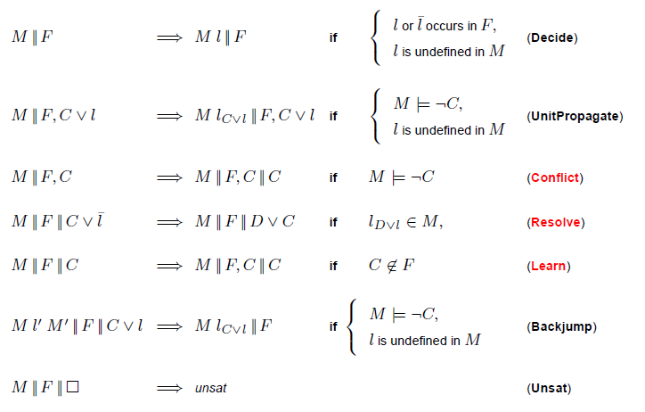
Abstract DPLL in Z3
Notes:
The rules in black are the ones used in original DPLL, and the red ones are ones introduced according to the improvement we discussed just now.
Explain the rules one by one…
For Backjump
there is some clause C \/ l’ s.t.:
F |=_{T} C \/ l’ and M |= ¬C
L’ is undefined in M
L’or ¬l’ occurs in a clause of F
This means that when we do back jump, we don’t need always to choose the last guess to return

Slide 18
Abstract DPLL in Z3: Strategies
Only apply Decide if UnitPropagate and Conflict cannot be applied.
Learn only one clause per conflict (the clause used in Backjump).
Use Backjump as soon as possible.
Use the rightmost (applicable) literal in M when applying Resolve.
Notes:
Abstract DPLL is very flexible. You can tell easily that, at some point, there are multiple rules can be applied.
Here gives some useful strategies.
You don’t wanna introduce more nondeterminisms in the future steps.

Slide 19

Abstract DPLL in Z3: Example 1
Given a, b, c, d, and e are Boolean variables, can we find a model M for F, where F is

Slide 20
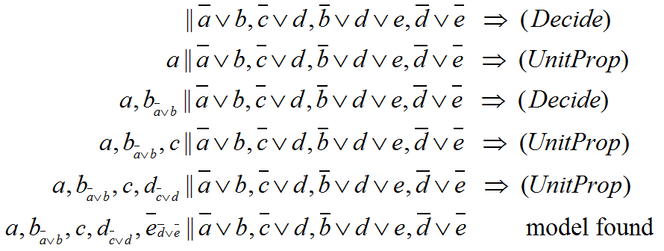
Abstract DPLL in Z3: Example 1

Slide 21

Abstract DPLL in Z3: Example 2
How about F’:

Slide 22
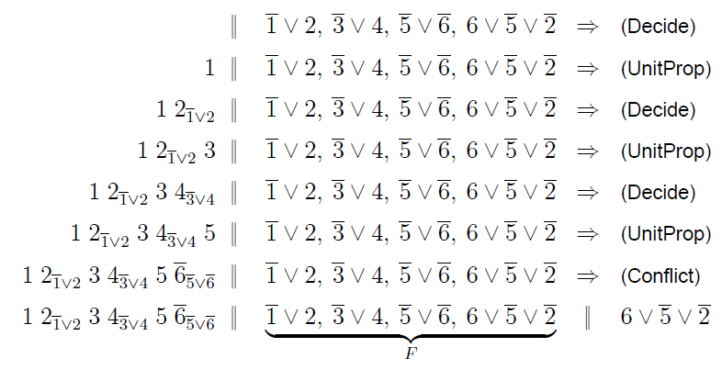
Abstract DPLL in Z3: Example 2

Slide 23
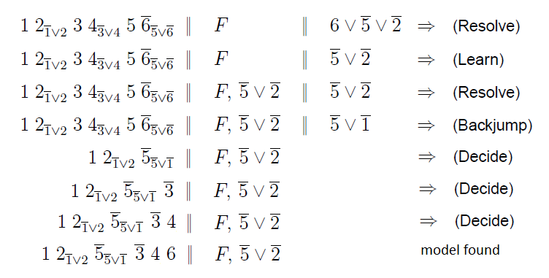
Abstract DPLL in Z3: Example 2

Slide 24
This Lecture
SAT and SMT
  Structure of SMT solver
  SAT solver
Theory solvers
Interface SAT solver with Theory solvers
Combine different theory solvers

Slide 25
Theory Solvers in Z3
A theory is essentially a set of sentences
Given a theory T, we say ϕ is satisfiable modulo T if T ∪ {ϕ} is satisfiable.
Theories are integrated with Z3
  Linear arithmetic
    can be decided using a procedure based on the dual simplex algorithm
  Difference arithmetic (of the form x−y ≤ c)
    by searching for negative cycles in weighted directed graphs
  Free functions, bit vectors, arrays, …

Slide 26
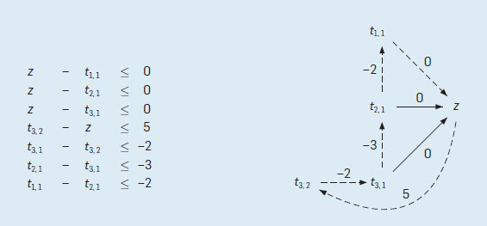
Theory Solvers in Z3: Example
In the graph representation,
each variable corresponds to a node, and
an inequality of the form t − s ≤ c corresponds to an edge from s to t with weight c.
Notes:
Here we use a simple example to illustrate how the solver for difference logics works. The difference logic is used to specify the satisfiability problem in job-shop-scheduling decision problem.
Given a set of inequalities of the form x-y<=constant, we need first to generate the weighted directed graphs.
The dash line represent a negative cycle (the sum of the weights on the edges in this cycle is negative)
If such a negative cycle is detected, the problem is unsatisfied.

Slide 27
This Lecture
SAT and SMT
  Structure of SMT solver
  SAT solver
Theory solvers
Interface SAT solver with Theory solvers
Combine different theory solvers

Slide 28
SAT + Theory Solvers
  Step 1: Create an abstraction that maps the atoms in an SMT formula into fresh Boolean variables
  Step 2: Pass the resulting propositional logic formula to SAT solver
    If SAT solver says Unsat, then the original problem is Unsat
    Else return a model

Slide 29
SAT + Theory Solvers
  Step 3: Represent the model using corresponding theory variables, and check the decision problem with the theory solver
    If the theory solver says Sat, then the problem is Sat
    Else return a conflict clause
  Step 4: Add the corresponding propositional logic formula representing the negation of the conflict clause to the original clauses, and go to Step 2.

Slide 30
This Lecture
SAT and SMT
  Structure of SMT solver
  SAT solver
Theory solvers
Interface SAT solver with Theory solvers
Combine different theory solvers

Slide 31
Theory Solvers Combination
Array Theory
Arithmetic
Uninterpreted Functions
wirte(a, i, v) means to write the ith element in array a as v.
Notes:
In reality, the SMT problem we encounter will not involve a single kind of theory. For example, for this formula, we have arithmetic theory, array theory, and uninterpreted functions. Here, wirte(a, i, v) means write the ith element in array a as v. Now, we need to consider anotherc essential problem in SMT that how to combine different theory solvers correctly and efficiently.

Slide 32
Theory Solvers Combination
  Purification
  Goal: convert a formula ϕ into ϕ1 ∧ ϕ 2, where
    ϕ1 is in T1’s language, and
    ϕ2 is in T2’s language.
  Purification step: replace term t by a fresh variable x
  Purification is satisfiability preserving and terminating.
  Example: purify f(x − 1) − 1 = x, f(y) + 1 = y
Notes:
Before going into details of algorithms used, we first need to understand some basic concepts.
This condition indicates that, except shared variables, ϕ1 and ϕ2 have no common symbols.
f(x − 1) − 1 = x, f(y) + 1 = y ->
f(u1) − 1 = x, f(y) + 1 = y, u1 = x − 1 ->
u2 − 1 = x, f(y) + 1 = y, u1 = x − 1, u2 = f(u1) ->
u2 − 1 = x, u3 + 1 = y, u1 = x − 1, u2 = f(u1), u3 = f(y)

Slide 33
Theory Solvers Combination
  Stably-Infinite Theories
  A theory is stably infinite if every satisfiable QFF is satisfiable in an infinite model.
  Example: finite model
  The union of two consistent, disjoint, and stably infinite theories is consistent.
Notes:
Theories with only finite models are not stably infinite.
Let DC(T) be the deductive closure of a set of sentences T.
T2 has only models with at most 2 elements

Slide 34
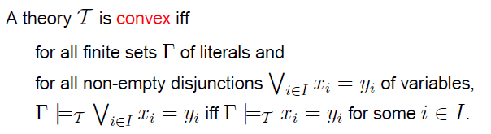
Theory Solvers Combination
  Convexity
  Example:
    linear integer arithmetic is not convex
      {0 ≤ x1 ≤ 1, 0 ≤ x2 ≤ 1, 0 ≤ x3 ≤ 1}
Notes:
Intuitively, a theory is convex if for every satisfiable set of literals there is a model where variables not implied to be equal have a distinct interpretation.
For example, linear integer arithmetic is not convex, because the set of literals {0 ≤ x1 ≤ 1, 0 ≤ x2 ≤ 1, 0 ≤ x3 ≤ 1} is satisfiable, no equality xi = xj for i = j is implied, but there is no model where x1, x2 and x3 are all distinct.

Slide 35
NO/Nelson-Oppen approach
  Conditions: Theories are
    Stably infinite
    Disjoint signatures
  Convex => Deterministic NO
  Non-Convex => Nondeterministic NO
Notes:
Nelson – Oppen approach is the most widely used method to combine different theory solvers.
NO provides a rather simple solution for the theory combination problem for theories that are stably infinite and have disjoint theories.

Slide 36
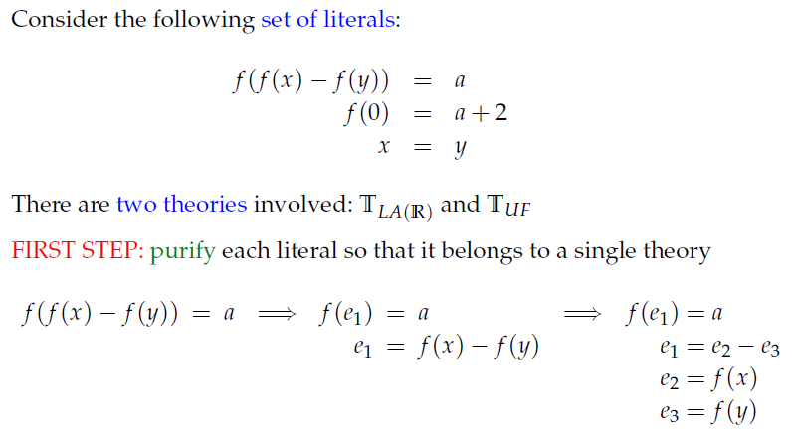
Convex Case _ Example
Notes:
Nelson – Oppen approach is the most widely used method to combine different theory solvers.
NO provides a rather simple solution for the theory combination problem for theories that are stably infinite and have disjoint theories.

Slide 37
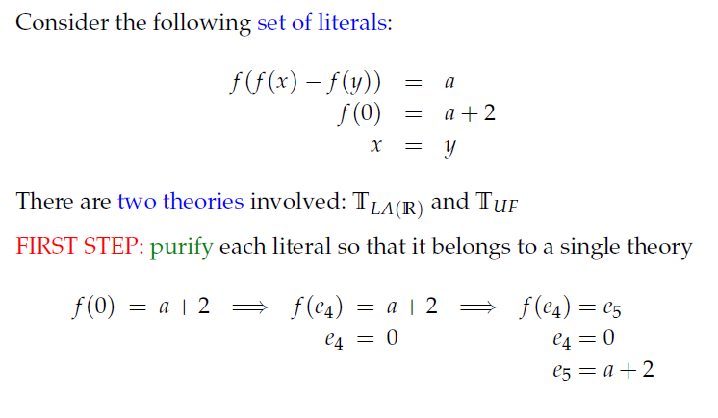
Convex Case _ Example
Notes:
Nelson – Oppen approach is the most widely used method to combine different theory solvers.
NO provides a rather simple solution for the theory combination problem for theories that are stably infinite and have disjoint theories.

Slide 38
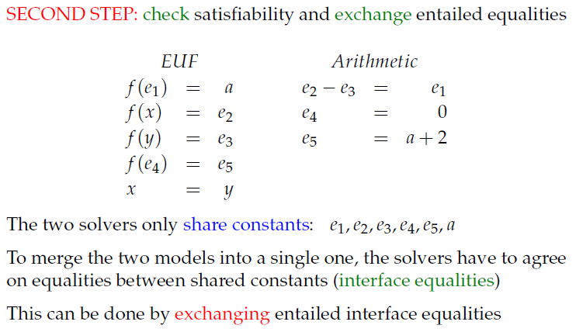
Convex Case _ Example
Notes:
Nelson – Oppen approach is the most widely used method to combine different theory solvers.
NO provides a rather simple solution for the theory combination problem for theories that are stably infinite and have disjoint theories.

Slide 39
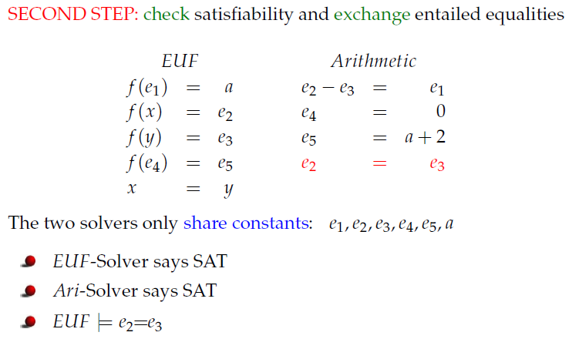
Convex Case _ Example
Notes:
Nelson – Oppen approach is the most widely used method to combine different theory solvers.
NO provides a rather simple solution for the theory combination problem for theories that are stably infinite and have disjoint theories.

Slide 40
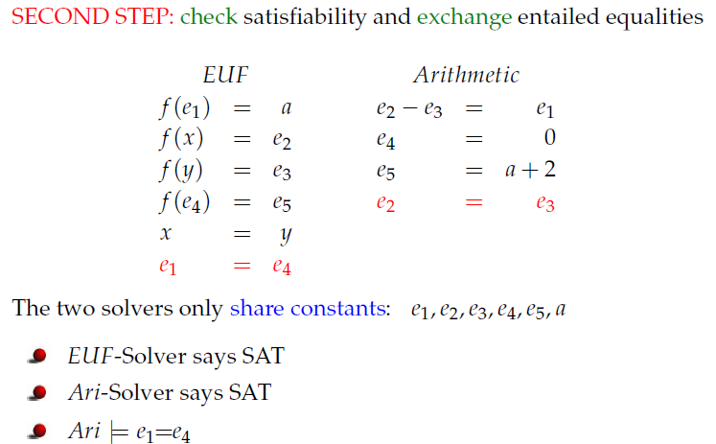
Convex Case _ Example
Notes:
Nelson – Oppen approach is the most widely used method to combine different theory solvers.
NO provides a rather simple solution for the theory combination problem for theories that are stably infinite and have disjoint theories.

Slide 41
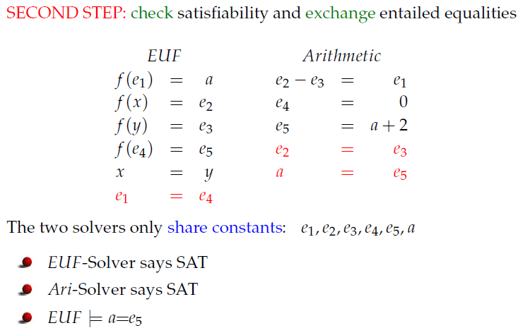
Convex Case _ Example
Notes:
Nelson – Oppen approach is the most widely used method to combine different theory solvers.
NO provides a rather simple solution for the theory combination problem for theories that are stably infinite and have disjoint theories.

Slide 42
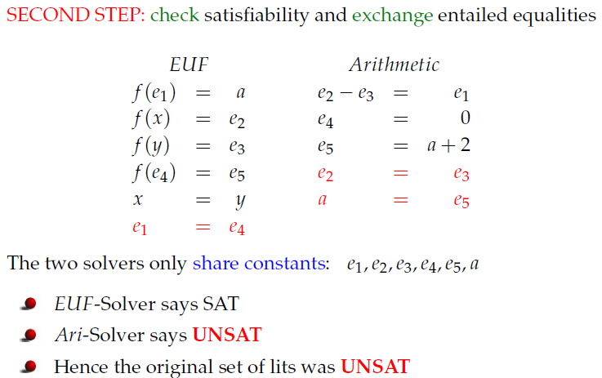
Convex Case _ Example
Notes:
Nelson – Oppen approach is the most widely used method to combine different theory solvers.
NO provides a rather simple solution for the theory combination problem for theories that are stably infinite and have disjoint theories.

Slide 43
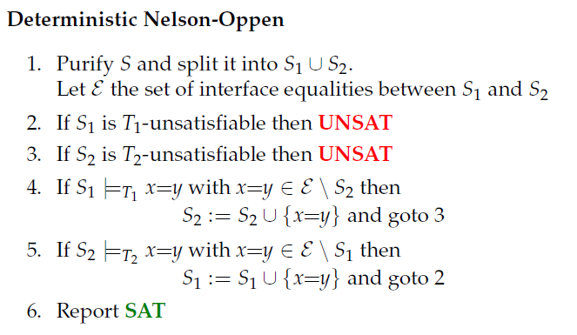
Deterministic NO
Notes:
Nelson – Oppen approach is the most widely used method to combine different theory solvers.
NO provides a rather simple solution for the theory combination problem for theories that are stably infinite and have disjoint theories.

Slide 44
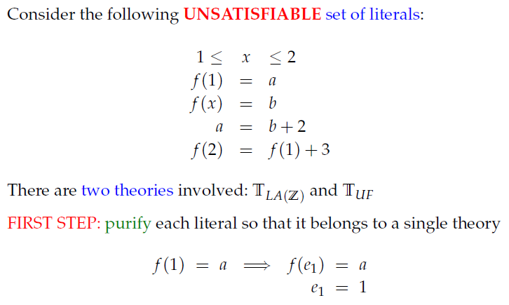
Nonconvex Case _ Example
Notes:
Nelson – Oppen approach is the most widely used method to combine different theory solvers.
NO provides a rather simple solution for the theory combination problem for theories that are stably infinite and have disjoint theories.

Slide 45
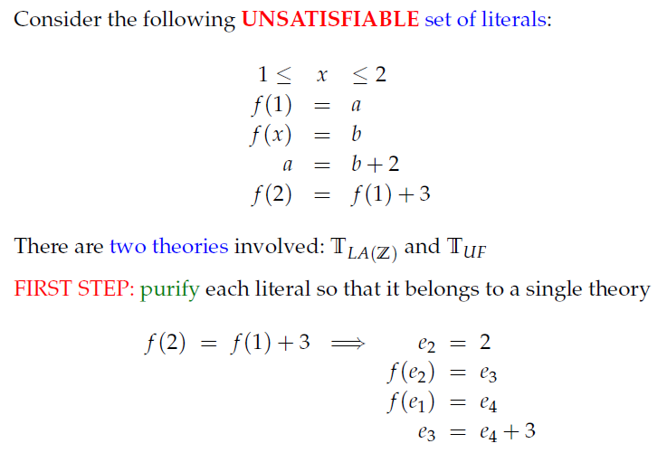
Nonconvex Case _ Example
Notes:
Nelson – Oppen approach is the most widely used method to combine different theory solvers.
NO provides a rather simple solution for the theory combination problem for theories that are stably infinite and have disjoint theories.

Slide 46
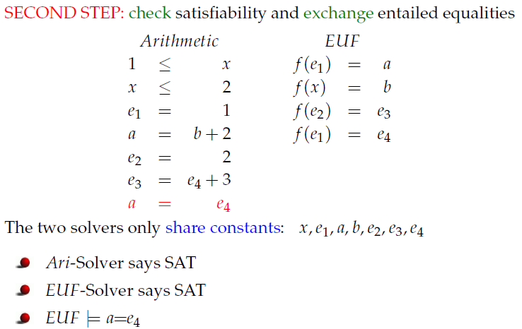
Nonconvex Case _ Example
Notes:
Nelson – Oppen approach is the most widely used method to combine different theory solvers.
NO provides a rather simple solution for the theory combination problem for theories that are stably infinite and have disjoint theories.

Slide 47
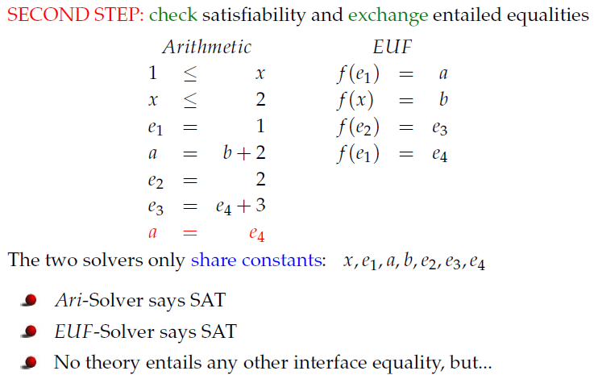
Nonconvex Case _ Example
Notes:
Nelson – Oppen approach is the most widely used method to combine different theory solvers.
NO provides a rather simple solution for the theory combination problem for theories that are stably infinite and have disjoint theories.

Slide 48
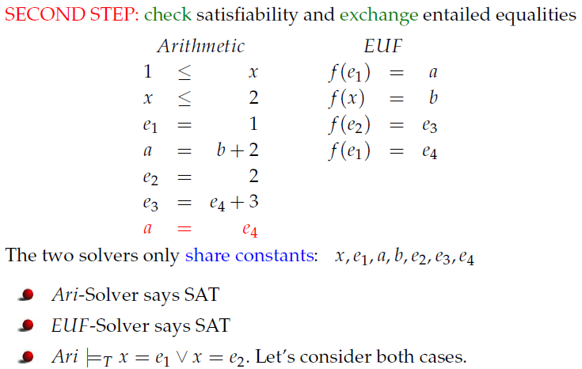
Nonconvex Case _ Example
Notes:
Nelson – Oppen approach is the most widely used method to combine different theory solvers.
NO provides a rather simple solution for the theory combination problem for theories that are stably infinite and have disjoint theories.

Slide 49
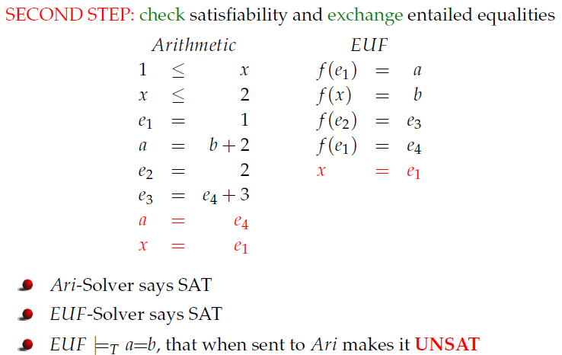
Nonconvex Case _ Example
Notes:
Nelson – Oppen approach is the most widely used method to combine different theory solvers.
NO provides a rather simple solution for the theory combination problem for theories that are stably infinite and have disjoint theories.

Slide 50
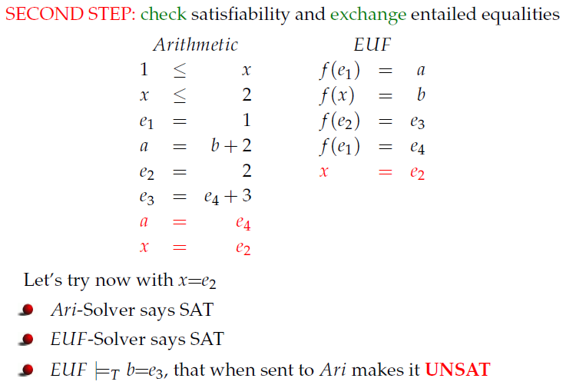
Nonconvex Case _ Example
Notes:
Nelson – Oppen approach is the most widely used method to combine different theory solvers.
NO provides a rather simple solution for the theory combination problem for theories that are stably infinite and have disjoint theories.

Slide 51
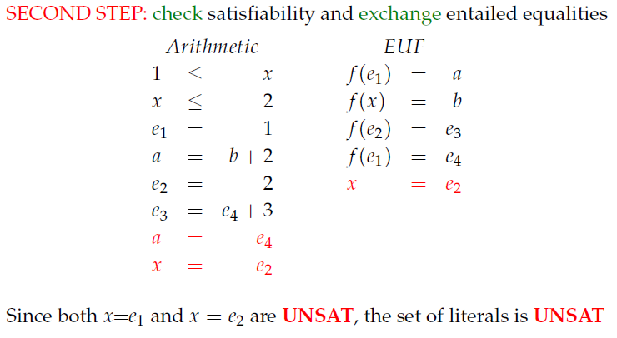
Nonconvex Case _ Example
Notes:
Nelson – Oppen approach is the most widely used method to combine different theory solvers.
NO provides a rather simple solution for the theory combination problem for theories that are stably infinite and have disjoint theories.

Slide 52
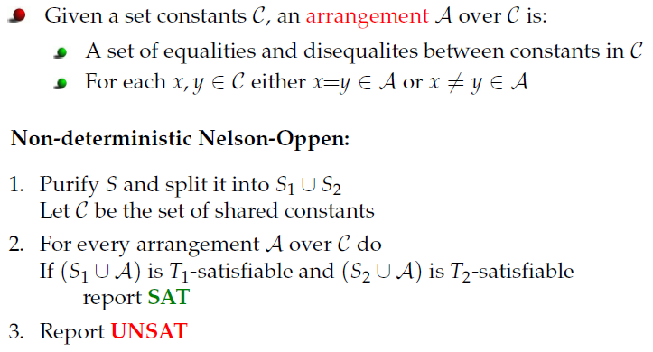
Nondeterministic NO
Notes:
In the latter example Deterministic NO does not work
This was because TLA(Z) linear arithmetic theory is not convex

Slide 53
Z3: Model-based Combination
NO relies on capabilities of the solvers to produce all implied equalities
  pessimistic about which equalities are propagated
Model-based Theory Combination
  Optimistic approach
Notes:
If someone wants to know what are the distinguish features of Z3 compared to other SMT solvers, here is one. Z3 uses the model-based combination method instead of NO or any variant of NO.

Slide 54
Model-based combination
Idea:
  Use a candidate model Mi for one of the theories Ti
  Propagate all equalities implied by the candidate model, hedging that other theories will agree.
  If not, use backtracking to fix the model.

Slide 55
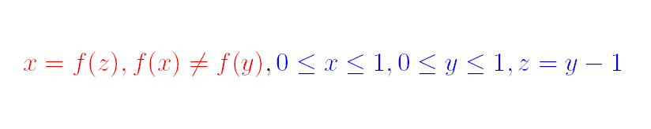
Model-based - Example

Slide 56
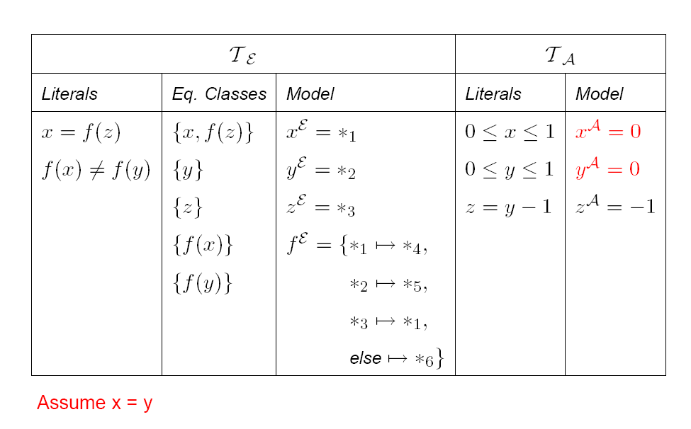
Model-based - Example

Slide 57
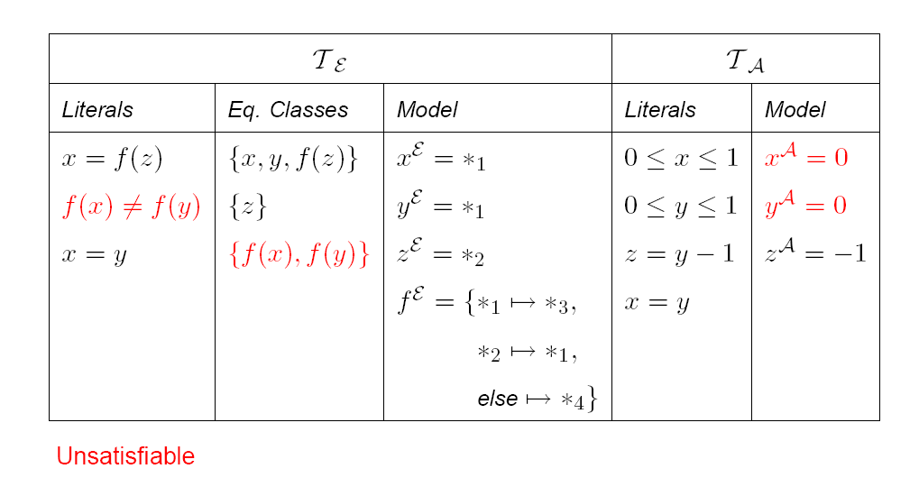
Model-based - Example

Slide 58
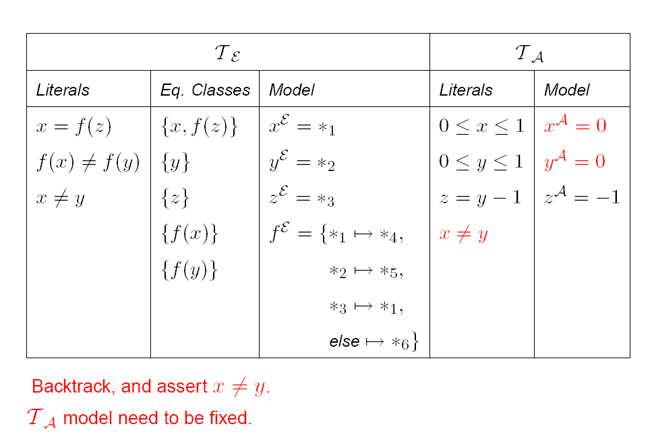
Model-based - Example

Slide 59
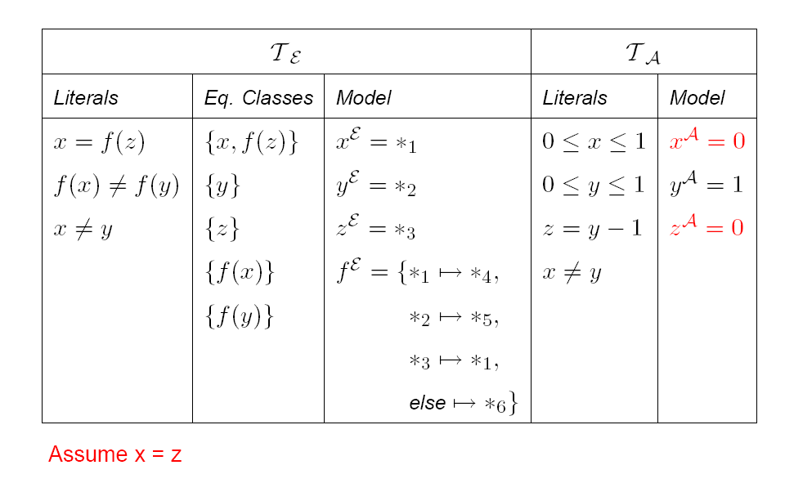
Model-based - Example

Slide 60
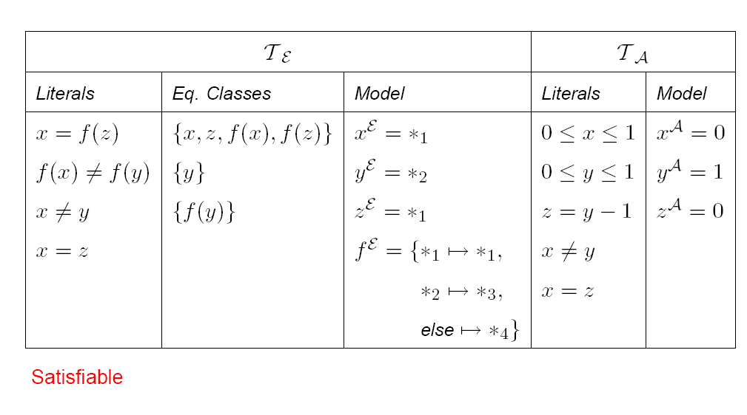
Model-based - Example

Slide 61
Model-based combination
☺: It is cheaper to enumerate equalities that are implied in a particular model than of all models.
☺: Works with non-convex theories

Slide 62
Reading materials
How to use Z3 (online tutorial)
  http://rise4fun.com/z3/tutorial/guide
Z3 programmatic API
  http://research.microsoft.com/en-us/um/redmond/projects/z3/documentation.html

