Slide 1


Efficient Temporal Consistency for Streaming Video Scene Analysis
Ondrej Miksik Daniel Munoz
J. Andrew Bagnell Martial Hebert

Slide 2
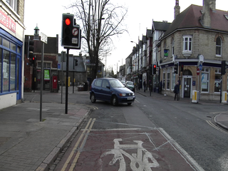
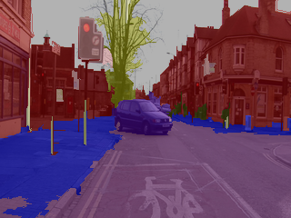
Scene Analysis/Parsing
Munoz ECCV 2010, Ladicky ECCV 2010, Tighe ECCV 2010, Sorcher ICML 2011, Farabet ICML 2012

Slide 3
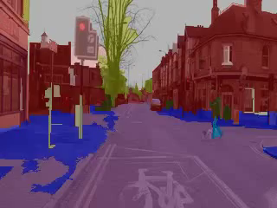
Temporal Inconsistency

Slide 4
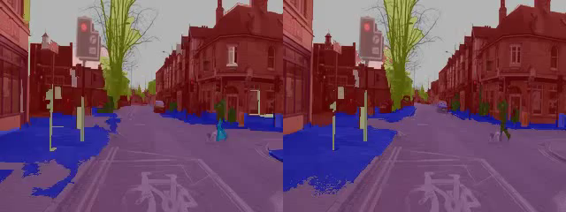
www.youtube.com/user/dmunozcmuri
Per-frame
Munoz ECCV 2010
Temporal
This Work
Notes:
Optical Flow (GPU): 0.02 s
Update (CPU): 0.75 s

Slide 5
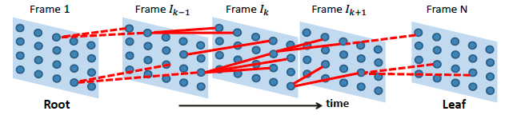
Spatio-temporal Graphical Model
Approximate inference
Typically the MAP labeling (no uncertainty)
Mini-batch processing
Wojek & Schiele ECCV 2008, Ess et al. BMVC 2009, Xiao & Quan ICCV 2009

Slide 6
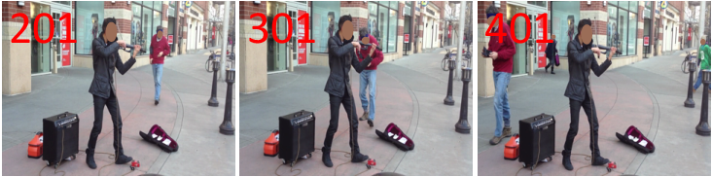
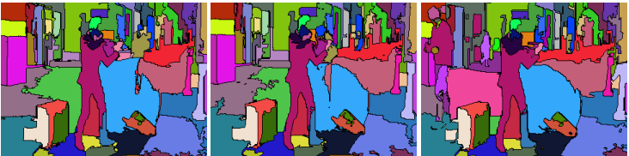
Spatio-temporal Segmentation
Hard decisions
Grundmann CVPR 2010, Brendel & Todorovic ICCV 2011, Xu & Corso ECCV 2012

Slide 7
Spatio-temporal Segmentation
Hard decisions
Grundmann CVPR 2010, Brendel & Todorovic ICCV 2011, Xu & Corso ECCV 2012

Slide 8
Spatio-temporal Segmentation
Causal/Online/Running-average Algorithm
Efficient and easy to implement
Complements your favorite scene parser
Outputs per-pixel probabilities
This Work
Hard decisions
Grundmann CVPR 2010, Brendel & Todorovic ICCV 2011, Xu & Corso ECCV 2012

Slide 9
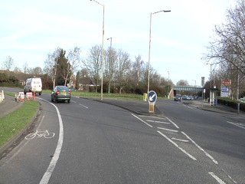
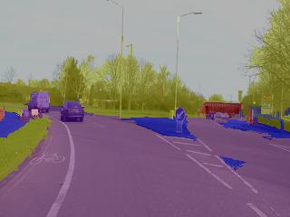
t-1
Temporally smoothed

Slide 10
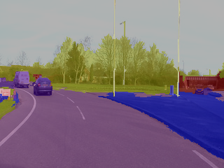
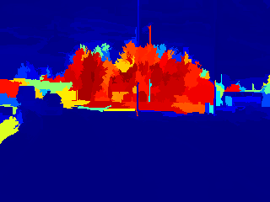
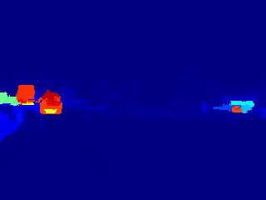

Per-pixel Probabilities
i
. . .
i
i
P(Tree)
P(Car)
[P_{i} (Tree), P_{i} (Sidewalk), …, P_{i}(Car)]^{T}

Slide 11
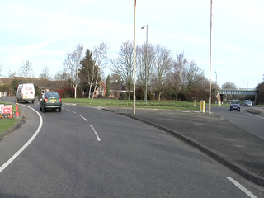
t-1
t
Scene Parser
Munoz 2010
Farabet 2011
Wojek 2008
Make Consistent!
Temporally smoothed
Per-frame

Slide 12
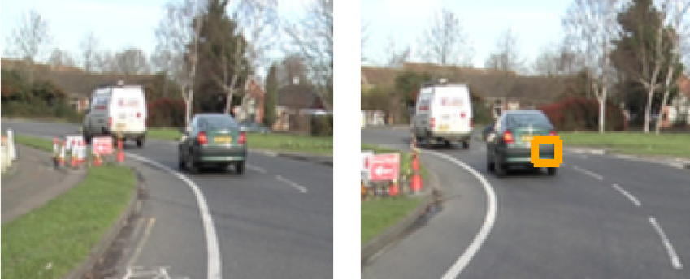

Ideally: Exact Correspondences
j
i
t-1
t

Slide 13
Ideally: Exact Correspondences
j
i
t-1
t

Slide 14

Ideally: Exact Correspondences
j
i
t-1
t

Slide 15
Approx. Correspondences via Optical Flow
Optical Flow
Werlberger 2009
t-1
t

Slide 16
Handling No/Imperfect Correspondences
t-1
t

Slide 17
Handling No/Imperfect Correspondences
t-1
t

Slide 18
Handling No/Imperfect Correspondences
t-1
t

Slide 19
Handling No/Imperfect Correspondences
t-1
t

Slide 20


Handling No/Imperfect Correspondences
t-1
t

Slide 21
Handling No/Imperfect Correspondences
t-1
t

Slide 22
Handling No/Imperfect Correspondences
t-1
t

Slide 23
Handling No/Imperfect Correspondences
t-1
t

Slide 24
Handling No/Imperfect Correspondences
t-1
t

Slide 25
Handling No/Imperfect Correspondences
t-1
t

Slide 26
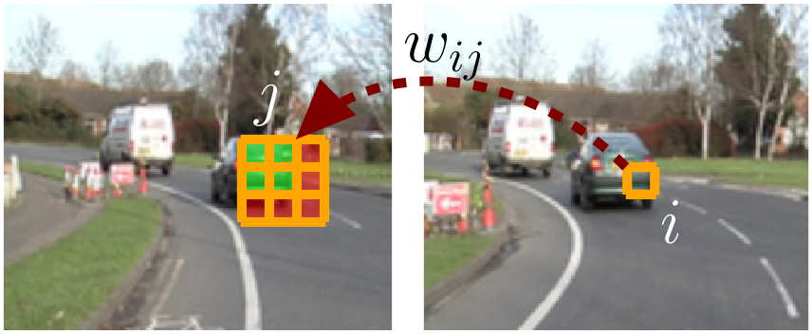
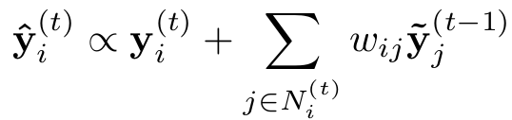
Causal/Running Update
t-1
t

Slide 27
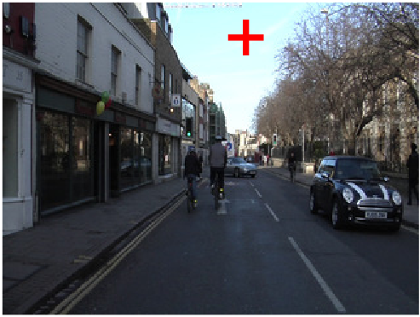
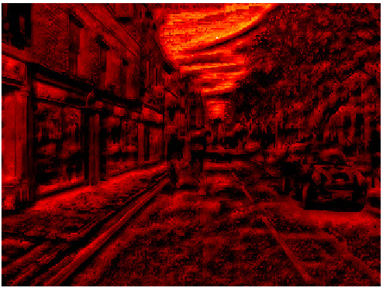
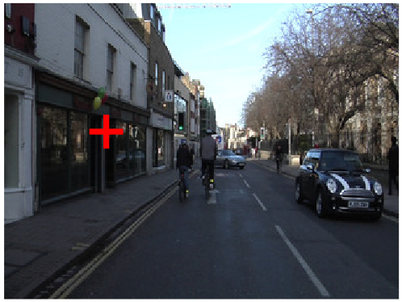
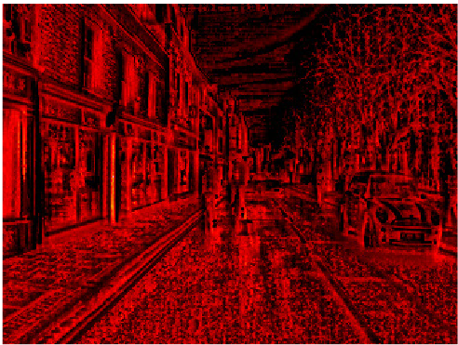



Slide 28
Metric Learning
j
i
k
Xing 2003, Goldberger 2004, Hadsell 2006, Davis 2007, Chechik 2009, Weinberger 2009

Slide 29

Metric Learning
j
i
k
Xing 2003, Goldberger 2004, Hadsell 2006, Davis 2007, Chechik 2009, Weinberger 2009

Slide 30
Metric Learning
j
i
k
Xing 2003, Goldberger 2004, Hadsell 2006, Davis 2007, Chechik 2009, Weinberger 2009

Slide 31
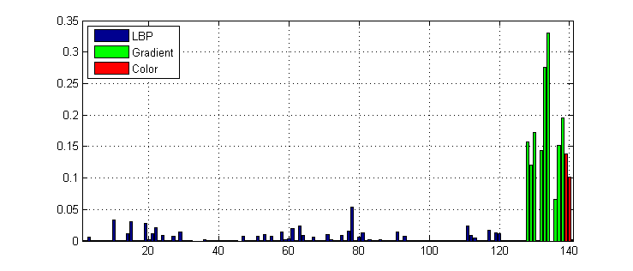
Learned Metric

Slide 32
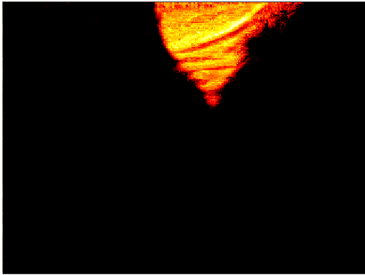
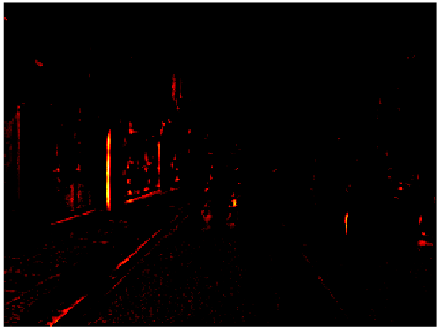
Euclidean vs. Learned

Slide 33
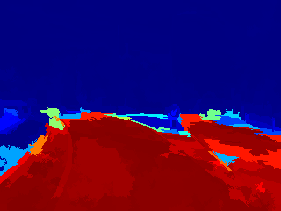
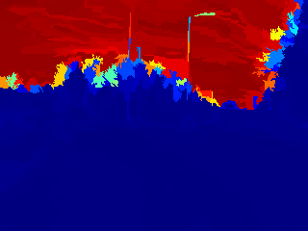
Summary
Input: images and per-pixel probabilities
Compute and apply optical flow (0.02 s)
Compute pixel similarities and average (0.75 s)
. . .
t-1
. . .
t

Slide 34
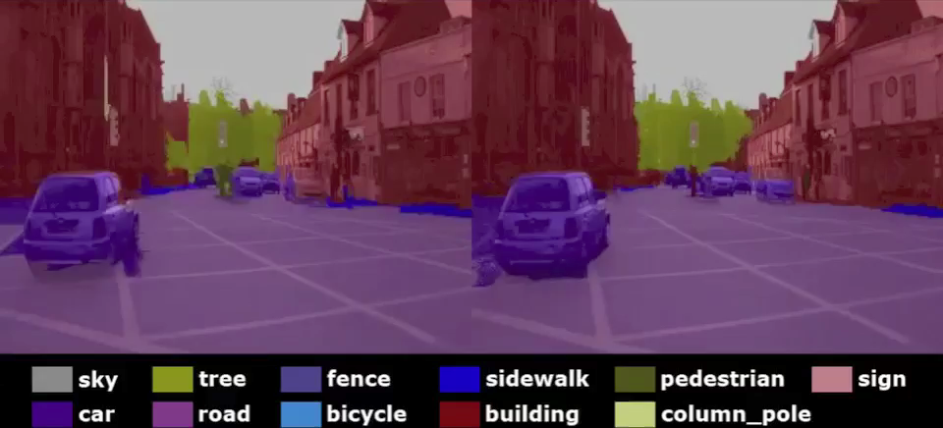
CamVid Dataset (8 labels)
Per-frame
Munoz ECCV 2010
Temporal
This Work

Slide 35
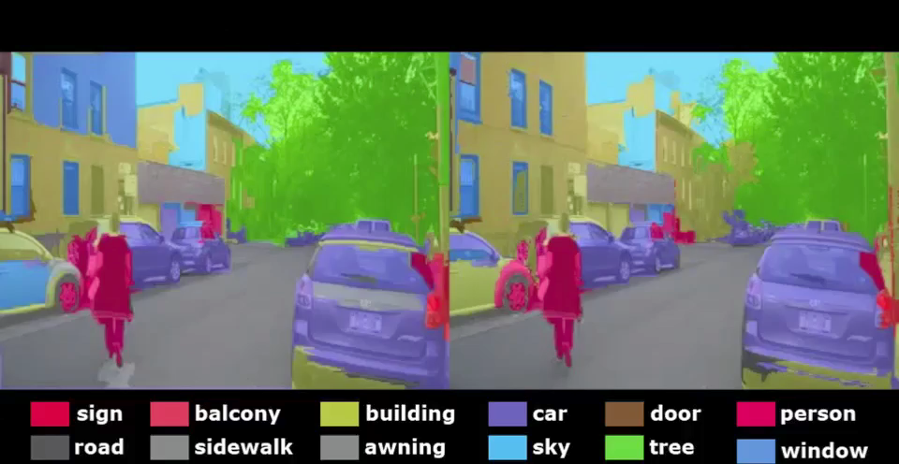
NYU Scenes Dataset (11 labels)
Per-frame
Farabet ICML 2012
Temporal
This Work
Notes:
Optical Flow (GPU): 0.02 s
Update (CPU): 0.75 s

Slide 36
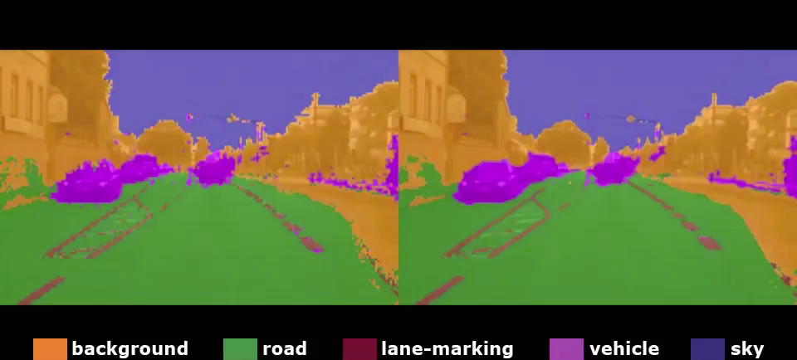
MPI-VehicleScenes Dataset (5 labels)
Per-frame
Wojek ECCV 2008*
Temporal
This Work
Notes:
Optical Flow (GPU): 0.02 s
Update (CPU): 0.75 s

Slide 37
Overall Pixel Accuracy
^{Dataset} | ^{Per-frame} | ^{Temporal}
^{CamVid-05VD} | ^{84.60} | ^{86.85}
^{CamVid-16E5} | ^{87.37} | ^{88.84}
^{NYUScenes} | ^{71.11} | ^{75.31}
^{MPI-Vehicle} | ^{93.10} | ^{93.55}

Slide 38
“Relative” Pixel Accuracy
Evaluate on pixels where Per-frame and Temporal predictions disagree
^{Dataset} | ^{Per-frame} | ^{Temporal}
^{CamVid-05VD} | ^{26.1} | ^{59.1}
^{CamVid-16E5} | ^{28.6} | ^{53.0}
^{NYUScenes} | ^{20.9} | ^{50.0}
^{MPI-Vehicle} | ^{40.7} | ^{53.3}

Slide 39
Conclusion
Pros:
Efficient temporal consistency
Use your favorite scene parsing output
Easy to implement
Cons:
Can’t fix major errors from the scene parser
Can over-smooth small objects

Slide 40
Thanks!

Slide 41
BACKUPS

Slide 42
CamVid (Sequence 05VD)

Slide 43
CamVid (Sequence 16E5)

Slide 44
CamVid
 | 05VD |  | 16E5
Class | Per-frame | Temporal | Per-frame | Temporal
Sky | .303 | .682 | .237 | .639
Tree | .352 | .563 | .336 | .518
Road | .197 | .546 | .150 | .529
Sidewalk | .277 | .512 | .188 | .357
Building | .165 | .232 | .275 | .395
Car | .127 | .456 | .304 | .597
Pole | .201 | .386 | .252 | .285
Person | .138 | .218 | .324 | .193
Bicycle | .323 | .165 | .348 | .043
Fence | .325 | .712 | .335 | .668
Sign | .367 | .029 | .378 | .039
Accuracy | .261 | .591 | .286 | .530

Slide 45
NYU Scenes Dataset (11 labels)

Slide 46
NYU Scenes Dataset (11 labels)
Class | Per-frame | Independent
Building | .231 | .547
Car | .207 | .630
Door | .046 | .000
Person | .094 | .080
Pole | .169 | .139
Road | .152 | .575
Sidewalk | .373 | .274
Sign | .127 | .000
Sky | .002 | .019
Tree | .353 | .630
Window | .102 | .101
Accuracy | .209 | .500

Slide 47
MPI-VehicleScenes Dataset (5 labels)

Slide 48
MPI-VehicleScenes Dataset (5 labels)
Class | Per-frame | Temporal
Background | .420 | .730
Road | .503 | .321
Lane-marking | .779 | .319
Vehicle | .075 | .276
Sky | .206 | .571
Accuracy | .407 | .533

