Slide 1

Efficient 3-D Scene Analysis from Streaming Data
Hanzhang Hu Daniel Munoz
J. Andrew Bagnell Martial Hebert

Slide 2
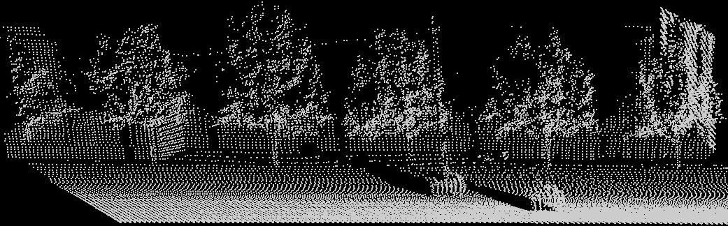
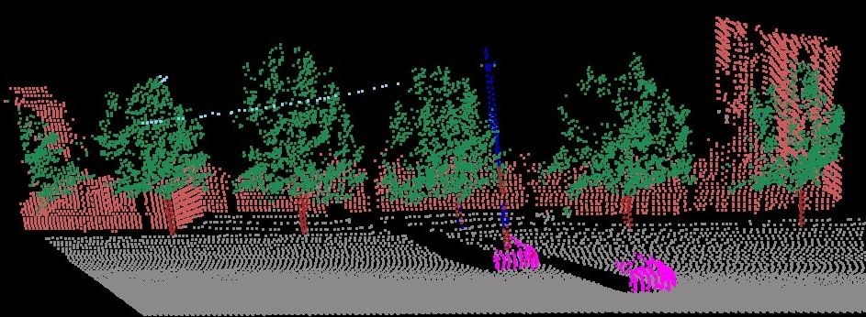
Scene Parsing
Input
Belief
Propagation
Output

Slide 3
Scene Parsing
Inference Machine
Input
f₁
f_{N}
Output
…
Munoz ECCV 2010, ICRA 2011

Slide 4

Region-based Scene Parsing

Slide 5

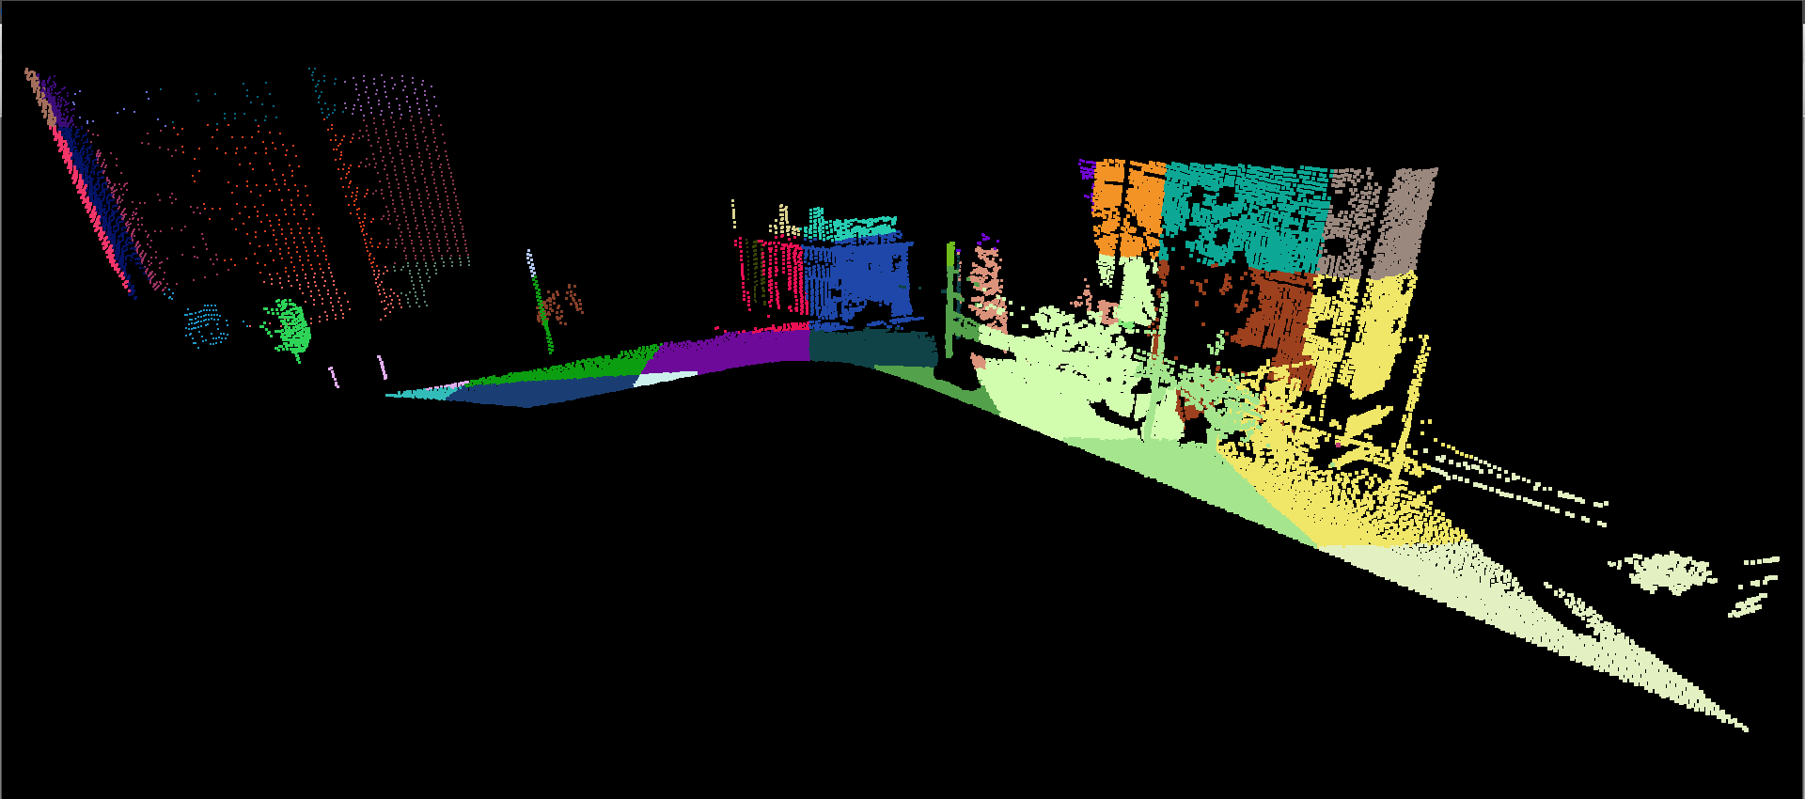
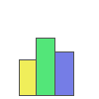
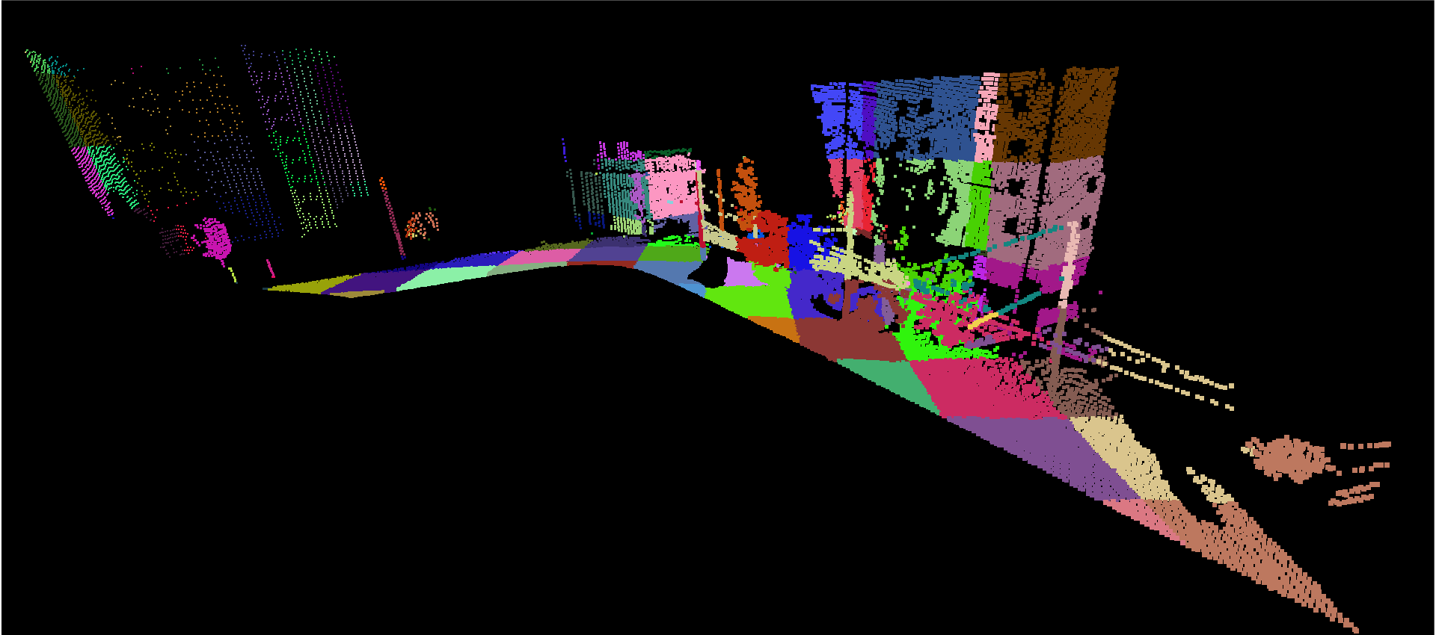
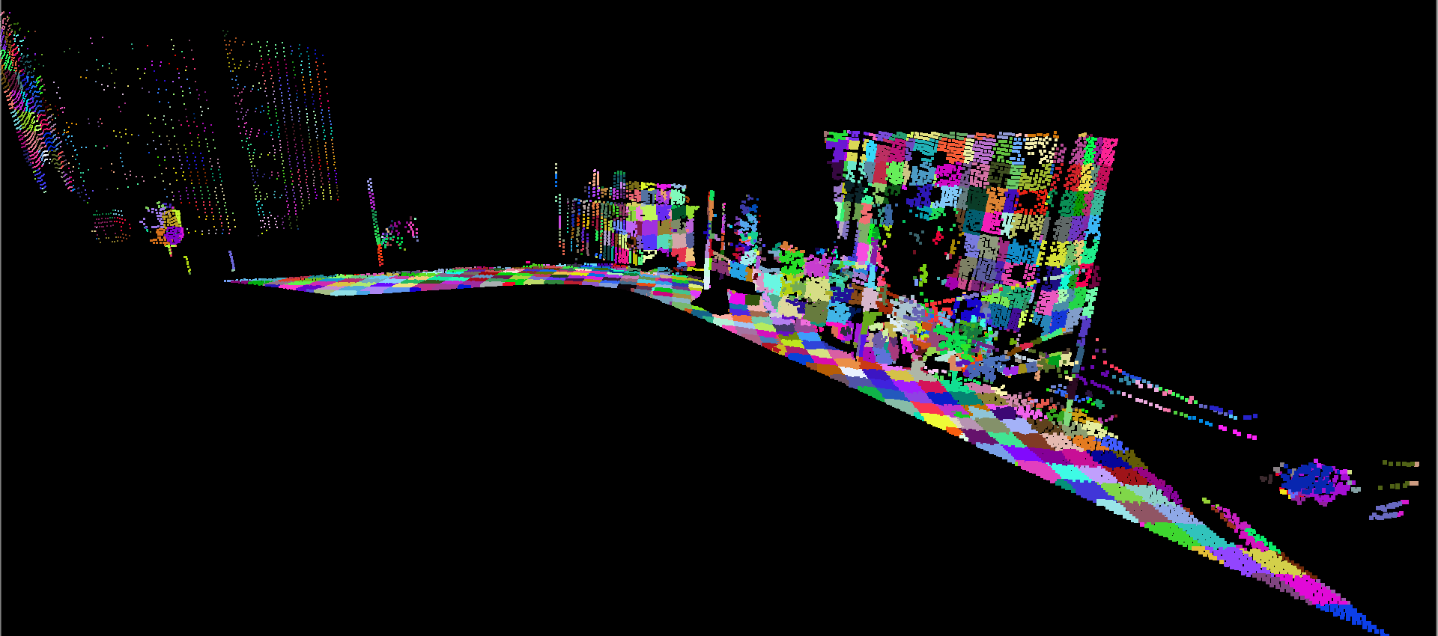
Level 3
Level 2
Level 1

Slide 6
Level 3
Level 2
Level 1

Slide 7
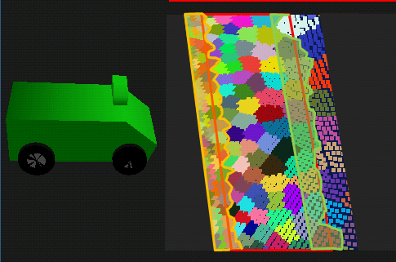
Streaming 3-D Data

Slide 8
Streaming Segmentation

Slide 9
Streaming Segmentation

Slide 10
Streaming Segmentation
?

Slide 11
Streaming Segmentation

Slide 12
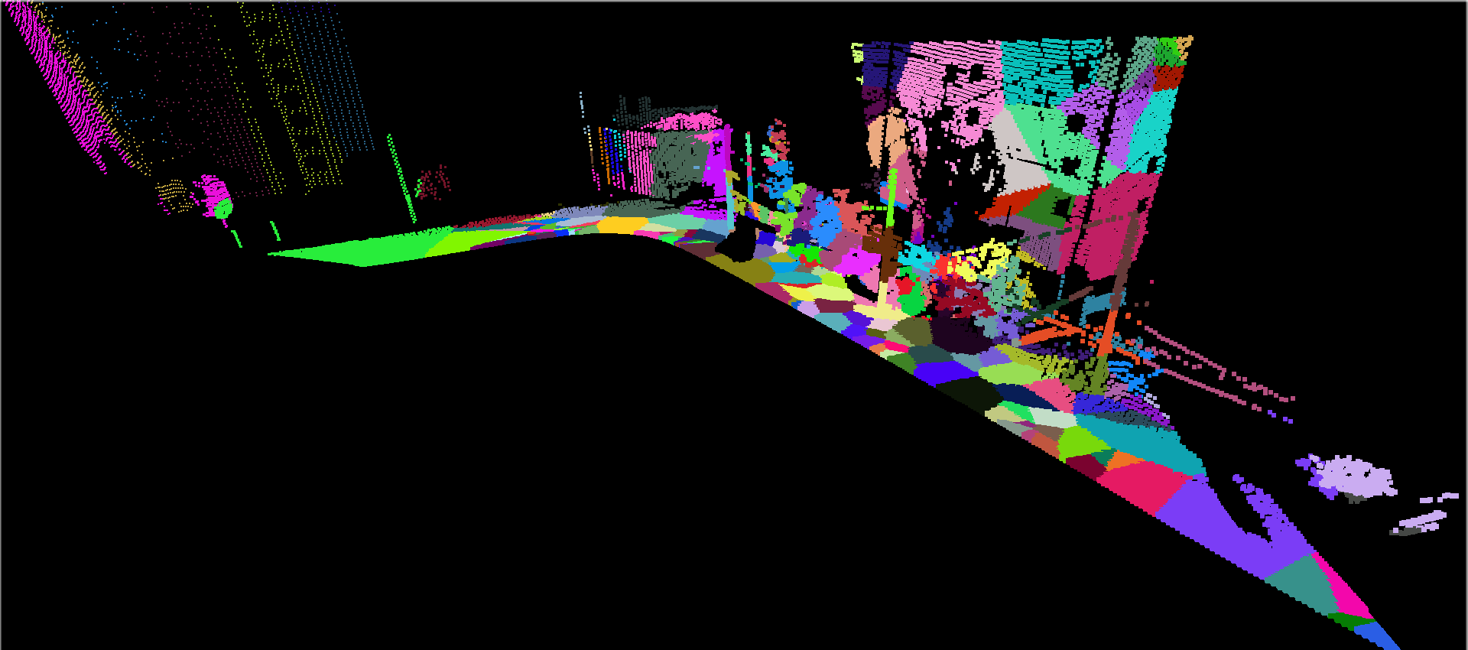
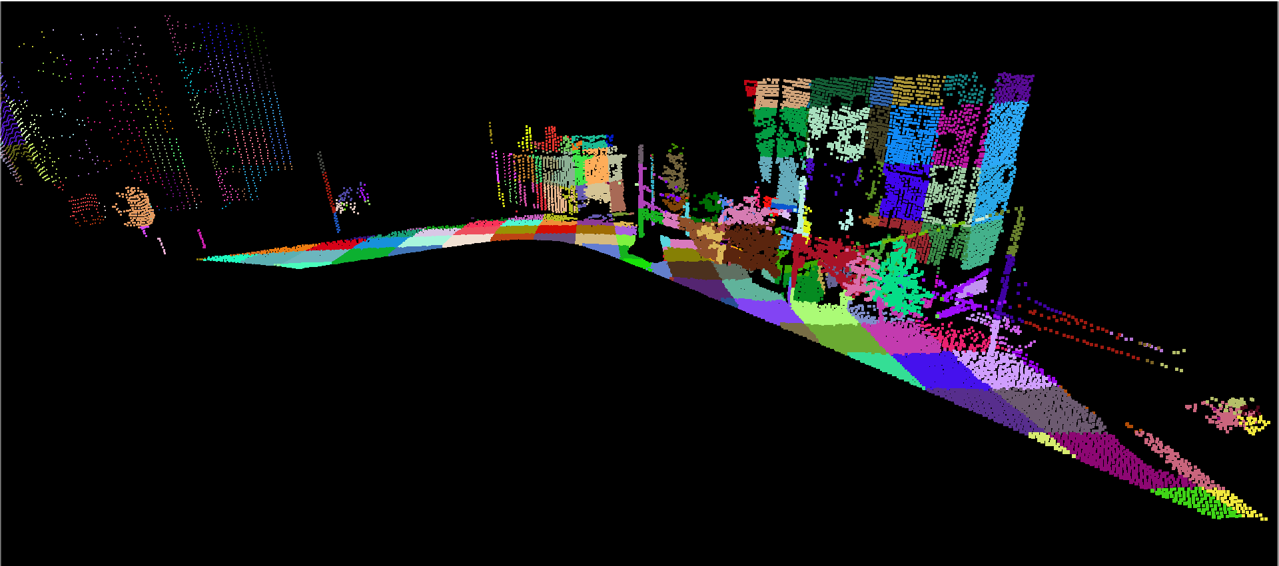
F-H
IJCV 2004
Grid

Slide 13
Streaming Segmentation
-Δx
-Δy
-Δz
+Δx
+Δy
+Δz

Slide 14
Streaming Segmentation

Slide 15
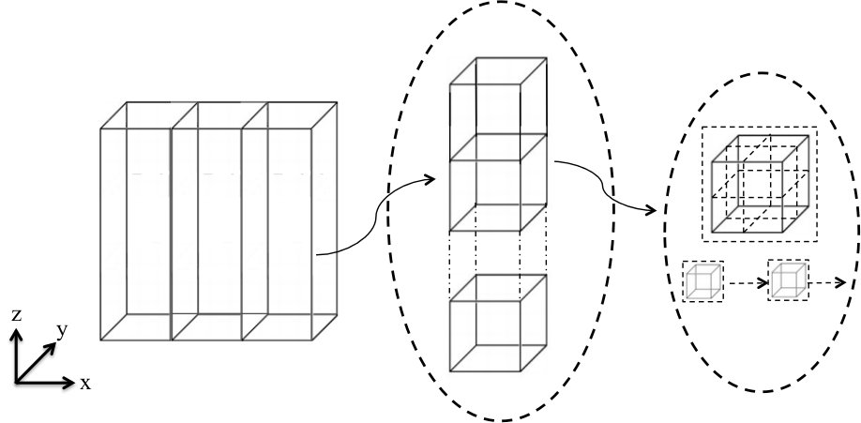
World Grid Map
“Pillars”
“Blocks”
Voxels

Slide 16
Loop over pillars

Slide 17

Loop over pillars

Slide 18
Loop over pillars

Slide 19
Loop over blocks

Slide 20
Loop over blocks

Slide 21
Loop over blocks

Slide 22
Loop over voxels

Slide 23
Loop over voxels

Slide 24
Loop over voxels

Slide 25



Average distribution for
Assigning final label
Each “dot” is
a voxel
Label Assignment
Green box is one of
the finest regions

