Slide 1
15-440 Distributed Systems
Lecture 20 – DNS and CDNs
Copyright ©, 2007-10 Carnegie Mellon University

Slide 2
Outline
DNS Design
DNS Today
Content Distribution Networks

Slide 3
Naming
How do we efficiently locate resources?
  DNS: name → IP address
Challenge
  How do we scale this to the wide area?

Slide 4
Obvious Solutions (1)
Why not use /etc/hosts?
Original Name to Address Mapping
  Flat namespace
  /etc/hosts
  SRI kept main copy
  Downloaded regularly
Count of hosts was increasing: machine per domain → machine per user
  Many more downloads
  Many more updates

Slide 5
Obvious Solutions (2)
Why not centralize DNS?
Single point of failure
Traffic volume
Distant centralized database
Single point of update
Doesn’t scale!

Slide 6
Domain Name System Goals
Basically a wide-area distributed database
Scalability
Decentralized maintenance
Robustness
Global scope
  Names mean the same thing everywhere
Don’t need
  Atomicity
  Strong consistency
Notes:
ACID
Atomic
Consistent
Isolated
Durable

Slide 7
Programmer’s View of DNS
Conceptually, programmers can view the DNS database as a collection of millions of host entry structures:
Functions for retrieving host entries from DNS:
  getaddrinfo: query key is a DNS host name.
  getnameinfo: query key is an IP address.
/* DNS host entry structure */
struct addrinfo {
int ai_family; /* host address type (AF_INET) */
size_t ai_addrlen; /* length of an address, in bytes */
struct sockaddr *ai_addr; /* address! */
char *ai_canonname; /* official domain name of host */
struct addrinfo *ai_next; /* other entries for host */
};

Slide 8
DNS Message Format
Identification
Flags
12 bytes
No. of Questions
No. of Answer RRs
No. of Authority RRs
No. of Additional RRs
Name, type fields for a query
Questions (variable number of answers)
RRs in response to query
Answers (variable number of resource records)
Records for authoritative servers
Authority (variable number of resource records)
Additional Info (variable number of resource records)
Additional “helpful info that may be used

Slide 9
DNS Header Fields
Identification
  Used to match up request/response
Flags
  1-bit to mark query or response
  1-bit to mark authoritative or not
  1-bit to request recursive resolution
  1-bit to indicate support for recursive resolution

Slide 10
DNS Records
RR format: (class, name, value, type, ttl)
DB contains tuples called resource records (RRs)
  Classes = Internet (IN), Chaosnet (CH), etc.
  Each class defines value associated with type
FOR IN class:
Type=A
  name is hostname
  value is IP address
Type=NS
  name is domain (e.g. foo.com)
  value is name of authoritative name server for this domain
Type=CNAME
  name is an alias name for some “canonical” (the real) name
  value is canonical name
Type=MX
  value is hostname of mailserver associated with name

Slide 11
Properties of DNS Host Entries
Different kinds of mappings are possible:
  Simple case: 1-1 mapping between domain name and IP addr:
    kittyhawk.cmcl.cs.cmu.edu maps to 128.2.194.242
  Multiple domain names maps to the same IP address:
    eecs.mit.edu and cs.mit.edu both map to 18.62.1.6
  Single domain name maps to multiple IP addresses:
    aol.com and www.aol.com map to multiple IP addrs.
  Some valid domain names don’t map to any IP address:
    for example: cmcl.cs.cmu.edu

Slide 12
DNS Design: Hierarchy Definitions
Each node in hierarchy stores a list of names that end with same suffix
  Suffix = path up tree
E.g., given this tree, where would following be stored:
  Fred.com
  Fred.edu
  Fred.cmu.edu
  Fred.cmcl.cs.cmu.edu
  Fred.cs.mit.edu
root
org
net
edu
com
uk
gwu
ucb
cmu
bu
mit
cs
ece
cmcl

Slide 13
DNS Design: Zone Definitions
Zone = contiguous section of name space
  E.g., Complete tree, single node or subtree
A zone has an associated set of name servers
  Must store list of names and tree links
root
org
ca
net
edu
com
uk
gwu
ucb
cmu
bu
mit
cs
ece
Subtree
cmcl
Single node
Complete Tree

Slide 14
DNS Design: Cont.
Zones are created by convincing owner node to create/delegate a subzone
  Records within zone stored multiple redundant name servers
  Primary/master name server updated manually
  Secondary/redundant servers updated by zone transfer of name space
    Zone transfer is a bulk transfer of the “configuration” of a DNS server – uses TCP to ensure reliability
Example:
  CS.CMU.EDU created by CMU.EDU administrators
  Who creates CMU.EDU or .EDU?

Slide 15
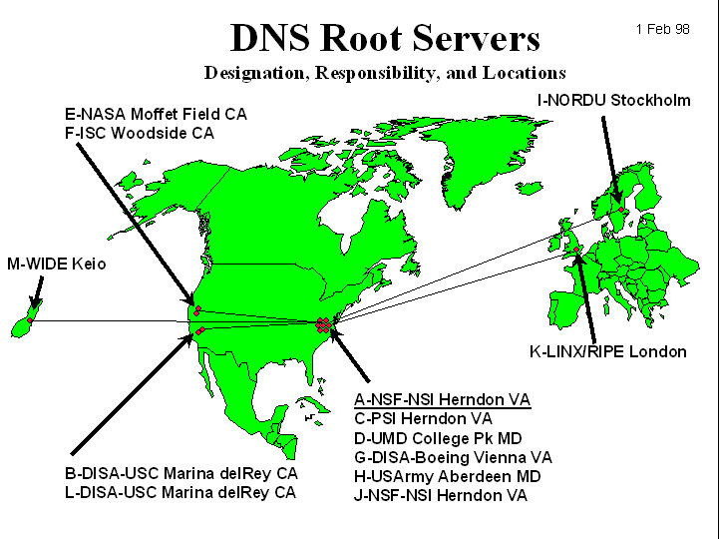
DNS: Root Name Servers
Responsible for “root” zone
Approx. 13 root name servers worldwide
  Currently {a-m}.root-servers.net
Local name servers contact root servers when they cannot resolve a name
  Configured with well-known root servers
  Newer picture → www.root-servers.org

Slide 16
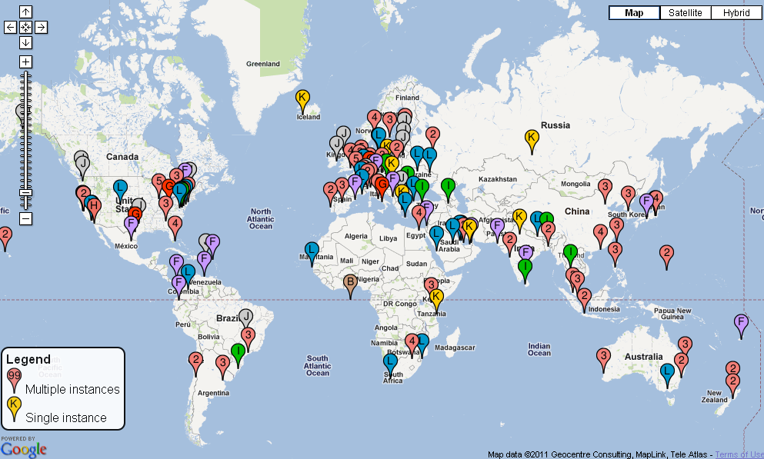
Physical Root Name Servers
  Several root servers have multiple physical servers
  Packets routed to “nearest” server by “Anycast” protocol
  346 servers total

Slide 17
Servers/Resolvers
Each host has a resolver
  Typically a library that applications can link to
  Local name servers hand-configured (e.g. /etc/resolv.conf)
Name servers
  Either responsible for some zone or…
  Local servers
    Do lookup of distant host names for local hosts
    Typically answer queries about local zone

Slide 18
Typical Resolution
root & edu
DNS server
www.cs.cmu.edu
www.cs.cmu.edu
NS ns1.cmu.edu
ns1.cmu.edu
DNS server
Local
DNS server
NS ns1.cs.cmu.edu
Client
ns1.cs.cmu.edu
DNS
server
A www=IPaddr

Slide 19
Typical Resolution
Steps for resolving www.cmu.edu
  Application calls gethostbyname() (RESOLVER)
  Resolver contacts local name server (S₁)
  S₁ queries root server (S₂) for (www.cmu.edu)
  S₂ returns NS record for cmu.edu (S₃)
  What about A record for S₃?
    This is what the additional information section is for (PREFETCHING)
  S₁ queries S₃ for www.cmu.edu
  S₃ returns A record for www.cmu.edu

Slide 20
Lookup Methods
Recursive query:
Server goes out and searches for more info (recursive)
Only returns final answer or “not found”
Iterative query:
Server responds with as much as it knows (iterative)
“I don’t know this name, but ask this server”
Workload impact on choice?
Local server typically does recursive
Root/distant server does iterative
root name server
2
iterated query
3
4
7
local name server
dns.eurecom.fr
intermediate name server
dns.umass.edu
5
6
1
8
authoritative name server
dns.cs.umass.edu
requesting host
surf.eurecom.fr
gaia.cs.umass.edu

Slide 21
Workload and Caching
Are all servers/names likely to be equally popular?
  Why might this be a problem? How can we solve this problem?
DNS responses are cached
  Quick response for repeated translations
  Other queries may reuse some parts of lookup
    NS records for domains
DNS negative queries are cached
  Don’t have to repeat past mistakes
  E.g. misspellings, search strings in resolv.conf
Cached data periodically times out
  Lifetime (TTL) of data controlled by owner of data
  TTL passed with every record

Slide 22
Typical Resolution
root & edu
DNS server
www.cs.cmu.edu
www.cs.cmu.edu
NS ns1.cmu.edu
ns1.cmu.edu
DNS server
Local
DNS server
NS ns1.cs.cmu.edu
Client
ns1.cs.cmu.edu
DNS
server
A www=IPaddr

Slide 23
Subsequent Lookup Example
root & edu
DNS server
ftp.cs.cmu.edu
cmu.edu
DNS server
Local
DNS server
Client
ftp.cs.cmu.edu
cs.cmu.edu
DNS
server
ftp=IPaddr

Slide 24
Reliability
DNS servers are replicated
  Name service available if ≥ one replica is up
  Queries can be load balanced between replicas
UDP used for queries
  Need reliability → must implement this on top of UDP!
  Why not just use TCP?
Try alternate servers on timeout
  Exponential backoff when retrying same server
Same identifier for all queries
  Don’t care which server responds

Slide 25
Reverse DNS
unnamed root
Task
  Given IP address, find its name
Method
  Maintain separate hierarchy based on IP names
  Write 128.2.194.242 as 242.194.2.128.in-addr.arpa
    Why is the address reversed?
Managing
  Authority manages IP addresses assigned to it
  E.g., CMU manages name space 128.2.in-addr.arpa
arpa
edu
in-addr
cmu
128
cs
2
cmcl
194
kittyhawk
128.2.194.242
242

Slide 26
.arpa Name Server Hierarchy
in-addr.arpa
a.root-servers.net • • • m.root-servers.net
chia.arin.net
(dill, henna, indigo, epazote, figwort, ginseng)
128
cucumber.srv.cs.cmu.edu,
t-ns1.net.cmu.edu
t-ns2.net.cmu.edu
2
194
mango.srv.cs.cmu.edu
(peach, banana, blueberry)
At each level of hierarchy, have group of servers that are authorized to handle that region of hierarchy
kittyhawk
128.2.194.242

Slide 27
Prefetching
Name servers can add additional data to response
Typically used for prefetching
  CNAME/MX/NS typically point to another host name
  Responses include address of host referred to in “additional section”

Slide 28
Tracing Hierarchy (1)
Dig Program
  Use flags to find name server (NS)
  Disable recursion so that operates one step at a time
  All .edu names handled by set of servers
unix> dig +norecurse @a.root-servers.net NS greatwhite.ics.cs.cmu.edu
;; ADDITIONAL SECTION:
a.edu-servers.net 172800 IN A 192.5.6.30
c.edu-servers.net. 172800 IN A 192.26.92.30
d.edu-servers.net. 172800 IN A 192.31.80.30
f.edu-servers.net. 172800 IN A 192.35.51.30
g.edu-servers.net. 172800 IN A 192.42.93.30
g.edu-servers.net. 172800 IN AAAA 2001:503:cc2c::2:36
l.edu-servers.net. 172800 IN A 192.41.162.30
IP v6 address

Slide 29
Tracing Hierarchy (2)
  3 servers handle CMU names
unix> dig +norecurse @g.edu-servers.net NS greatwhite.ics.cs.cmu.edu
;; AUTHORITY SECTION:
cmu.edu. 172800 IN NS ny-server-03.net.cmu.edu.
cmu.edu. 172800 IN NS nsauth1.net.cmu.edu.
cmu.edu. 172800 IN NS nsauth2.net.cmu.edu.

Slide 30
Tracing Hierarchy (3 & 4)
  3 servers handle CMU CS names
  Server within CS is “start of authority” (SOA) for this name
unix> dig +norecurse @nsauth1.net.cmu.edu NS greatwhite.ics.cs.cmu.edu
;; AUTHORITY SECTION:
cs.cmu.edu. 600 IN NS AC-DDNS-2.NET.cs.cmu.edu.
cs.cmu.edu. 600 IN NS AC-DDNS-1.NET.cs.cmu.edu.
cs.cmu.edu. 600 IN NS AC-DDNS-3.NET.cs.cmu.edu.
unix>dig +norecurse @AC-DDNS-2.NET.cs.cmu.edu NS greatwhite.ics.cs.cmu.edu
;; AUTHORITY SECTION:
cs.cmu.edu. 300 IN SOA PLANISPHERE.FAC.cs.cmu.edu.

Slide 31
DNS Hack #1
Can return multiple A records → what does this mean?
Load Balance
  Server sends out multiple A records
  Order of these records changes per-client

Slide 32
Server Balancing Example
DNS Tricks
  Different responses to different servers, short TTL’s
unix1> dig www.google.com
;; ANSWER SECTION:
www.google.com. 87775 IN CNAME www.l.google.com.
www.l.google.com. 81 IN A 72.14.204.104
www.l.google.com. 81 IN A 72.14.204.105
www.l.google.com. 81 IN A 72.14.204.147
www.l.google.com. 81 IN A 72.14.204.99
www.l.google.com. 81 IN A 72.14.204.103
unix2> dig www.google.com
;; ANSWER SECTION:
www.google.com. 603997 IN CNAME www.l.google.com.
www.l.google.com. 145 IN A 72.14.204.99
www.l.google.com. 145 IN A 72.14.204.103
www.l.google.com. 145 IN A 72.14.204.104
www.l.google.com. 145 IN A 72.14.204.105
www.l.google.com. 145 IN A 72.14.204.147

Slide 33
Outline
DNS Design
DNS Today
Content Distribution Networks

Slide 34
Root Zone
Generic Top Level Domains (gTLD) = .com, .net, .org, etc…
Country Code Top Level Domain (ccTLD) = .us, .ca, .fi, .uk, etc…
Root server ({a-m}.root-servers.net) also used to cover gTLD domains
  Load on root servers was growing quickly!
  Moving .com, .net, .org off root servers was clearly necessary to reduce load → done Aug 2000

Slide 35
gTLDs
Unsponsored
  .com, .edu, .gov, .mil, .net, .org
  .biz → businesses
  .info → general info
  .name → individuals
Sponsored (controlled by a particular association)
  .aero → air-transport industry
  .cat → catalan related
  .coop → business cooperatives
  .jobs → job announcements
  .museum → museums
  .pro → accountants, lawyers, and physicians
  .travel → travel industry
Starting up
  .mobi → mobile phone targeted domains
  .post → postal
  .tel → telephone related
Proposed
  .asia, .cym, .geo, .kid, .mail, .sco, .web, .xxx

Slide 36
New Registrars
Network Solutions (NSI) used to handle all registrations, root servers, etc…
  Clearly not the democratic (Internet) way
  Large number of registrars that can create new domains → However NSI still handles A root server

Slide 37
Do you trust the TLD operators?
Wildcard DNS record for all .com and .net domain names not yet registered by others
  September 15 – October 4, 2003
  February 2004: Verisign sues ICANN
Redirection for these domain names to Verisign web portal (SiteFinder)
What services might this break?

Slide 38
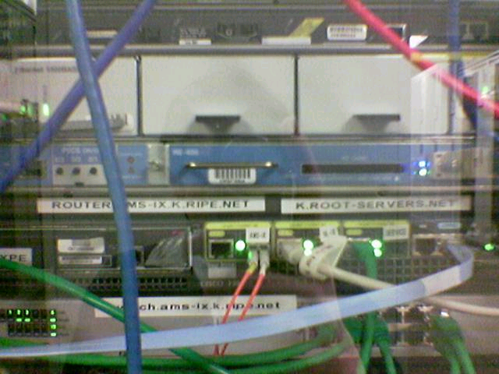
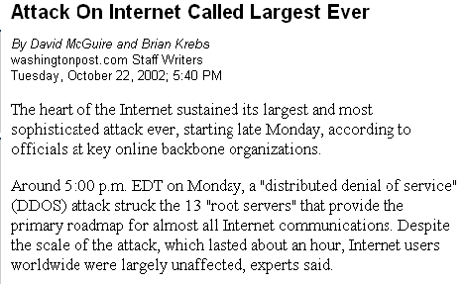
Protecting the Root Nameservers
Sophisticated?
Why did nobody notice?
seshan.org. 13759 NS www.seshan.org.
Defense Mechanisms
Redundancy: 13 root nameservers
IP Anycast for root DNS servers {c,f,i,j,k}.root-servers.net
  RFC 3258
  Most physical nameservers lie outside of the US

Slide 39
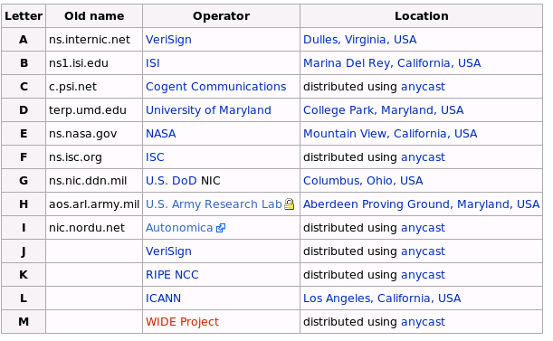
Defense: Replication and Caching
source: wikipedia

Slide 40
DNS (Summary)
Motivations → large distributed database
  Scalability
  Independent update
  Robustness
Hierarchical database structure
  Zones
  How is a lookup done
Caching/prefetching and TTLs
Reverse name lookup
What are the steps to creating your own domain?

Slide 41
Outline
DNS Design
DNS Today
Content Distribution Networks

Slide 42
Typical Workload (Web Pages)
Multiple (typically small) objects per page
File sizes are heavy-tailed
Embedded references
This plays havoc with performance. Why?
Solutions?
Lots of small objects & TCP
  3-way handshake
  Lots of slow starts
  Extra connection state
42
Notes:
3 way handshake, multiple slow starts

Slide 43
Content Distribution Networks (CDNs)
The content providers are the CDN customers.
Content replication
CDN company installs hundreds of CDN servers throughout Internet
  Close to users
CDN replicates its customers’ content in CDN servers. When provider updates content, CDN updates servers
origin server
in North America
CDN distribution node
CDN server
in S. America
CDN server
in Asia
CDN server
in Europe
43

Slide 44
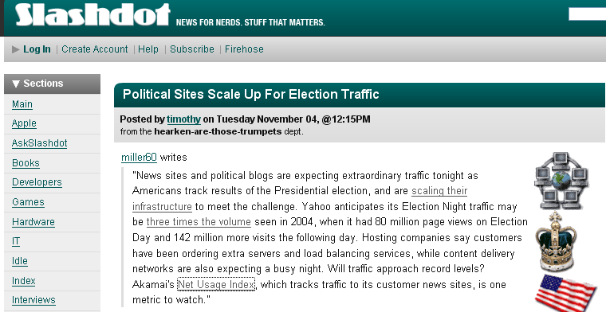
http://www.akamai.com/html/technology/nui/news/index.html
44

Slide 45
Content Distribution Networks &
Server Selection
Replicate content on many servers
Challenges
  How to replicate content
  Where to replicate content
  How to find replicated content
  How to choose among known replicas
  How to direct clients towards replica
45

Slide 46
Server Selection
Which server?
  Lowest load → to balance load on servers
  Best performance → to improve client performance
    Based on Geography? RTT? Throughput? Load?
  Any alive node → to provide fault tolerance
How to direct clients to a particular server?
  As part of routing → anycast, cluster load balancing
    Not covered ☹
  As part of application → HTTP redirect
  As part of naming → DNS
46

Slide 47
Application Based
47
HTTP supports simple way to indicate that Web page has moved
(30X responses)
Server receives Get request from client
  Decides which server is best suited for particular client and object
  Returns HTTP redirect to that server
Can make informed application specific decision
May introduce additional overhead →
multiple connection setup, name lookups, etc.
While good solution in general, but…
  HTTP Redirect has some design flaws – especially with current browsers

Slide 48
Naming Based
Client does name lookup for service
Name server chooses appropriate server address
  A-record returned is “best” one for the client
What information can name server base decision on?
  Server load/location → must be collected
  Information in the name lookup request
    Name service client → typically the local name server for client
48

Slide 49
How Akamai Works
Clients fetch html document from primary server
  E.g. fetch index.html from cnn.com
URLs for replicated content are replaced in html
  E.g. <img src=“http://cnn.com/af/x.gif”> replaced with <img src=“http://a73.g.akamaitech.net/7/23/cnn.com/af/x.gif”>
Client is forced to resolve aXYZ.g.akamaitech.net hostname
Note: Nice presentation on Akamai at
www.cs.odu.edu/~mukka/cs775s07/Presentations/mklein.pdf
49

Slide 50
How Akamai Works
How is content replicated?
Akamai only replicates static content (*)
Modified name contains original file name
Akamai server is asked for content
  First checks local cache
  If not in cache, requests file from primary server and caches file
* (At least, the version we’re talking about today. Akamai actually lets sites write code that can run on Akamai’s servers, but that’s a pretty different beast)
50

Slide 51
How Akamai Works
Root server gives NS record for akamai.net
Akamai.net name server returns NS record for g.akamaitech.net
  Name server chosen to be in region of client’s name server
  TTL is large
G.akamaitech.net nameserver chooses server in region
  Should try to chose server that has file in cache - How to choose?
  Uses aXYZ name and hash
  TTL is small → why?
51

Slide 52
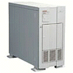

How Akamai Works
cnn.com (content provider)
DNS root server
Akamai server
Get foo.jpg
12
11
Get index.html
1
2
3
5
Akamai high-level DNS server
4
6
7
Akamai low-level DNS server
8
Nearby matching
Akamai server
9
End-user
10
Get /cnn.com/foo.jpg
52

Slide 53
Akamai – Subsequent Requests
cnn.com (content provider)
DNS root server
Akamai server
Get index.html
Assuming no timeout
on NS record
1
2
Akamai high-level DNS server
7
Akamai low-level DNS server
8
Nearby matching
Akamai server
9
End-user
10
Get /cnn.com/foo.jpg
53

Slide 54
Simple Hashing
Given document XYZ, we need to choose a server to use
Suppose we use modulo
Number servers from 1…n
  Place document XYZ on server (XYZ mod n)
  What happens when a servers fails? n → n-1
    Same if different people have different measures of n
  Why might this be bad?
54

Slide 55
Consistent Hash
“view” = subset of all hash buckets that are visible
Desired features
  Smoothness – little impact on hash bucket contents when buckets are added/removed
  Spread – small set of hash buckets that may hold an object regardless of views
  Load – across all views # of objects assigned to hash bucket is small
55

Slide 56
Consistent Hash – Example
Construction
  Assign each of C hash buckets to random points on mod 2^{n} circle, where, hash key size = n.
  Map object to random position on unit interval
  Hash of object = closest bucket
0
14
Bucket
12
4
8
Monotone → addition of bucket does not cause movement between existing buckets
Spread & Load → small set of buckets that lie near object
Balance → no bucket is responsible for large number of objects
56

Slide 57
Consistent Hash – Example
Construction
  Assign each of C hash buckets to random points on mod 2^{n} circle, where, hash key size = n.
  Map object to random position on unit interval
  Hash of object = closest bucket
0
14
Bucket
12
4
8
Monotone → addition of bucket does not cause movement between existing buckets
Spread & Load → small set of buckets that lie near object
Balance → no bucket is responsible for large number of objects
57

Slide 58
Consistent Hashing not just for CDN
Finding a nearby server for an object in a CDN uses centralized knowledge.
Consistent hashing can also be used in a distributed setting
P2P systems like BitTorrent, e.g., project 3, need a way of finding files.
Consistent Hashing to the rescue.
58

Slide 59
Summary
DNS
Content Delivery Networks move data closer to user, maintain consistency, balance load
  Consistent Caching maps keys AND buckets into the same space
  Consistent caching can be fully distributed, useful in P2P systems using structured overlays
59

Slide 60
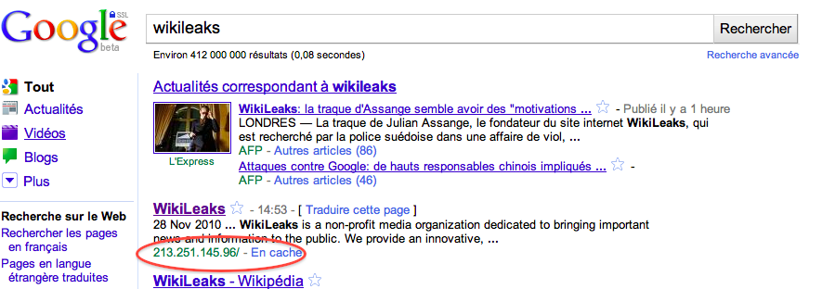
A rose by any other name….
“DNS Is Sexy: Making Things Go While Making It Fun”
(http://dyn.com/dns-is-sexy/)
  If you can convince yourself that something like DNS is sexy, then Dyn must be a great place to work
TheGoodThingAboutDomainNameJokesISThatAllTheGoodShortOnesHaveBeenTold.com unless you're being creati.ve

Slide 61
Tracing Hierarchy (1)
Dig Program
  Allows querying of DNS system
  Use flags to find name server (NS)
  Disable recursion so that operates one step at a time
  All .edu names handled by set of servers
unix> dig +norecurse @a.root-servers.net NS kittyhawk.cmcl.cs.cmu.edu
;; AUTHORITY SECTION:
edu. 172800 IN NS L3.NSTLD.COM.
edu. 172800 IN NS D3.NSTLD.COM.
edu. 172800 IN NS A3.NSTLD.COM.
edu. 172800 IN NS E3.NSTLD.COM.
edu. 172800 IN NS C3.NSTLD.COM.
edu. 172800 IN NS F3.NSTLD.COM.
edu. 172800 IN NS G3.NSTLD.COM.
edu. 172800 IN NS B3.NSTLD.COM.
edu. 172800 IN NS M3.NSTLD.COM.

Slide 62
Tracing Hierarchy (2)
3 servers handle CMU names
unix> dig +norecurse @e3.nstld.com NS kittyhawk.cmcl.cs.cmu.edu
;; AUTHORITY SECTION:
cmu.edu. 172800 IN NS CUCUMBER.SRV.cs.cmu.edu.
cmu.edu. 172800 IN NS T-NS1.NET.cmu.edu.
cmu.edu. 172800 IN NS T-NS2.NET.cmu.edu.

Slide 63
Tracing Hierarchy (3 & 4)
4 servers handle CMU CS names
Quasar is master NS for this zone
unix> dig +norecurse @t-ns1.net.cmu.edu NS kittyhawk.cmcl.cs.cmu.edu
;; AUTHORITY SECTION:
cs.cmu.edu. 86400 IN NS MANGO.SRV.cs.cmu.edu.
cs.cmu.edu. 86400 IN NS PEACH.SRV.cs.cmu.edu.
cs.cmu.edu. 86400 IN NS BANANA.SRV.cs.cmu.edu.
cs.cmu.edu. 86400 IN NS BLUEBERRY.SRV.cs.cmu.edu.
unix>dig +norecurse @blueberry.srv.cs.cmu.edu NS kittyhawk.cmcl.cs.cmu.edu
;; AUTHORITY SECTION:
cs.cmu.edu. 300 IN SOA QUASAR.FAC.cs.cmu.edu.
Notes:
Full SOA record…
cs.cmu.edu. 300 IN SOA QUASAR.FAC.cs.cmu.edu. GRIPE.cs.cmu.edu. 2004021352 3600 1800 604800 300

Slide 64
Web Proxy Caches
User configures browser: Web accesses via cache
Browser sends all HTTP requests to cache
  Object in cache: cache returns object
  Else cache requests object from origin server, then returns object to client
origin
server
Proxy
server
HTTP request
HTTP request
client
HTTP response
HTTP response
HTTP request
HTTP response
client
origin
server
64

Slide 65
No Caching Example (1)
Assumptions
Average object size = 100,000 bits
Avg. request rate from institution’s browser to origin servers = 15/sec
Delay from institutional router to any origin server and back to router = 2 sec
Consequences
Utilization on LAN = 15%
Utilization on access link = 100%
Total delay = Internet delay + access delay + LAN delay
= 2 sec + minutes + milliseconds
origin
servers
public
Internet
1.5 Mbps
access link
institutional
network
10 Mbps LAN
65

Slide 66
No Caching Example (2)
Possible solution
Increase bandwidth of access link to, say, 10 Mbps
Often a costly upgrade
Consequences
Utilization on LAN = 15%
Utilization on access link = 15%
Total delay = Internet delay + access delay + LAN delay
= 2 sec + msecs + msecs
origin
servers
public
Internet
10 Mbps
access link
institutional
network
10 Mbps LAN
66

Slide 67
W/Caching Example (3)
Install cache
Suppose hit rate is .4
Consequence
40% requests will be satisfied almost immediately (say 10 msec)
60% requests satisfied by origin server
Utilization of access link reduced to 60%, resulting in negligible delays
Weighted average of delays
= .6*2 sec + .4*10msecs < 1.3 secs
origin
servers
public
Internet
1.5 Mbps
access link
institutional
network
10 Mbps LAN
institutional
cache
67

Slide 68
HTTP Caching
Clients often cache documents
  Challenge: update of documents
  If-Modified-Since requests to check
    HTTP 0.9/1.0 used just date
    HTTP 1.1 has an opaque “entity tag” (could be a file signature, etc.) as well
When/how often should the original be checked for changes?
  Check every time?
  Check each session? Day? Etc?
  Use Expires header
    If no Expires, often use Last-Modified as estimate
68

Slide 69
Example Cache Check Request
GET / HTTP/1.1
Accept: */*
Accept-Language: en-us
Accept-Encoding: gzip, deflate
If-Modified-Since: Mon, 29 Jan 2001 17:54:18 GMT
If-None-Match: "7a11f-10ed-3a75ae4a"
User-Agent: Mozilla/4.0 (compatible; MSIE 5.5; Windows NT 5.0)
Host: www.intel-iris.net
Connection: Keep-Alive
69

Slide 70
Example Cache Check Response
HTTP/1.1 304 Not Modified
Date: Tue, 27 Mar 2001 03:50:51 GMT
Server: Apache/1.3.14 (Unix) (Red-Hat/Linux) mod_ssl/2.7.1 OpenSSL/0.9.5a DAV/1.0.2 PHP/4.0.1pl2 mod_perl/1.24
Connection: Keep-Alive
Keep-Alive: timeout=15, max=100
ETag: "7a11f-10ed-3a75ae4a"
70

Slide 71
Problems
71
Over 50% of all HTTP objects are uncacheable – why?
Not easily solvable
  Dynamic data → stock prices, scores, web cams
  CGI scripts → results based on passed parameters
Obvious fixes
  SSL → encrypted data is not cacheable
    Most web clients don’t handle mixed pages well →many generic objects transferred with SSL
  Cookies → results may be based on passed data
  Hit metering → owner wants to measure # of hits for revenue, etc.

Slide 72
Caching Proxies – Sources for Misses
Capacity
  How large a cache is necessary or equivalent to infinite
  On disk vs. in memory → typically on disk
Compulsory
  First time access to document
  Non-cacheable documents
    CGI-scripts
    Personalized documents (cookies, etc)
    Encrypted data (SSL)
Consistency
  Document has been updated/expired before reuse
72

Slide 73
Measurements of DNS
No centralized caching per site
  Each machine runs own caching local server
  Why is this a problem?
  How many hosts do we need to share cache? → recent studies suggest 10-20 hosts
“Hit rate for DNS = 80% → 1 - (#DNS/#connections)
  Is this good or bad?
  Most Internet traffic was Web with HTTP 1.0
    What does a typical page look like? → average of 4-5 imbedded objects → needs 4-5 transfers
    This alone accounts for 80% hit rate!
Lower TTLs for A records does not affect performance
DNS performance really relies more on NS-record caching

Slide 74
DNS Experience
23% of lookups with no answer
  Retransmit aggressively → most packets in trace for unanswered lookups!
  Correct answers tend to come back quickly/with few retries
10 - 42% negative answers → most = no name exists
  Inverse lookups and bogus NS records
Worst 10% lookup latency got much worse
  Median 85→97, 90th percentile 447→1176
Increasing share of low TTL records → what is happening to caching?

Slide 75
DNS Experience
Hit rate for DNS = 80% → 1-(#DNS/#connections)
  Most Internet traffic is Web
  What does a typical page look like? → average of 4-5 imbedded objects → needs 4-5 transfers → accounts for 80% hit rate!
70% hit rate for NS records → i.e. don’t go to root/gTLD servers
  NS TTLs are much longer than A TTLs
  NS record caching is much more important to scalability
Name distribution = Zipf-like = 1/xª
A records → TTLs = 10 minutes similar to TTLs = infinite
10 client hit rate = 1000+ client hit rate

Slide 76
Mail Addresses
MX records point to mail exchanger for a name
  E.g. mail.acm.org is MX for acm.org
Addition of MX record type proved to be a challenge
  How to get mail programs to lookup MX record for mail delivery?
  Needed critical mass of such mailers

Slide 77
Recursive DNS Name Resolution
Root
Server
unnamed root
Nonlocal Lookup
  Recursively from root server downward
  Results passed up
Caching
  Results stored in caches along each hop
  Can shortcircuit lookup when cached entry present
3
8
.edu
Server
9
edu
com
2
4
CMU
Server
7
Local
Server
cmu
someplace
5
1
6
CMU CS
Server
10
cs
www
208.216.181.15
ics
greatwhite
128.2.220.10

Slide 78
Iterative DNS Name Resolution
Root
Server
unnamed root
Nonlocal Lookup
  At each step, server returns name of next server down
  Local server directly queries each successive server
Caching
  Local server builds up cache of intermediate translations
  Helps in resolving names xxx.cs.cmu.edu, yy.cmu.edu, and z.edu
.edu
Server
3
edu
com
2
4
CMU
Server
5
cmu
Local
Server
6
someplace
7
8
1
CMU CS
Server
9
10
cs
www
208.216.181.15
ics
greatwhite
128.2.220.10

Slide 79
DNS Hack #2: Blackhole Lists
First: Mail Abuse Prevention System (MAPS)
  Paul Vixie, 1997
Today: Spamhaus, spamcop, dnsrbl.org, etc.
Different addresses refer to different reasons for blocking
% dig 91.53.195.211.bl.spamcop.net
;; ANSWER SECTION:
91.53.195.211.bl.spamcop.net. 2100 IN A 127.0.0.2
;; ANSWER SECTION:
91.53.195.211.bl.spamcop.net. 1799 IN TXT "Blocked - see http://www.spamcop.net/bl.shtml?211.195.53.91"

Slide 80
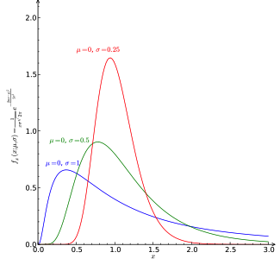
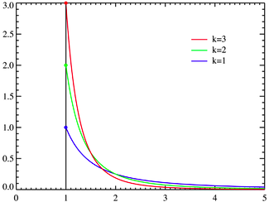
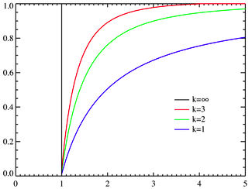
File Size and References Distributions
Pareto: kx_{m}^{k}/x^{k+1}
Pr(X < x) = 1 - (x_{m}/x)^{k}
Log-Normal
Probability density
function:
Cumulative distribution
function:
Probability density
function:
80
File sizes
  Pareto distribution for tail
  Lognormal for body of distribution
Number of embedded references also Pareto
Notes:
80
3 way handshake, multiple slow starts

Slide 81
Consistent Hashing
Main idea:
  map both keys and nodes to the same (metric) identifier space
  find a “rule” how to assign keys to nodes
Ring is one option.

Slide 82
Consistent Hashing
The consistent hash function assigns each node and key an m-bit identifier using SHA-1 as a base hash function
Node identifier: SHA-1 hash of IP address
Key identifier: SHA-1 hash of key

Slide 83
Identifiers
m bit identifier space for both keys and nodes
Key identifier: SHA-1(key)
Key=“LetItBe”
SHA-1
ID=60
Node identifier: SHA-1(IP address)
IP=“198.10.10.1”
SHA-1
ID=123
How to map key IDs to node IDs?

Slide 84
Consistent Hashing Example
Rule: A key is stored at its successor: node with next higher or equal ID
0
K5
IP=“198.10.10.1”
N123
K20
Circular 7-bit
ID space
K101
N32
N90
Key=“LetItBe”
K60

Slide 85
Consistent Hashing Properties
Load balance: all nodes receive roughly the same number of keys
For N nodes and K keys, with high probability
  each node holds at most (1+ε)K/N keys
  (provided that K is large enough compared to N)

Slide 86
Load Balance
Redirector knows all CDN server Ids
Can track approximate load (or delay)
To balance load:
  W_{i} = Hash(URL, ip of s_{i}) for all i
  Sort W_{i} from high to low
  find first server with low enough load
Benefits?
How should “load” be measured?
86

