Slide 1
Souflé:
A Three Dimensional Framework for Analysis of Social Positioning
in Dyadic and Group Discussions
Carolyn Penstein Rosé
Language Technologies Institute
Human-Computer Interaction Institute
School of Computer Science
With funding from the National Science Foundation and the Office of Naval Research

Slide 2
Outline
Introducing the Problem of Supporting Productive Discussion for Learning
Discussion of Souflé
Transactivity
Engagement
Authoritativeness

Slide 3
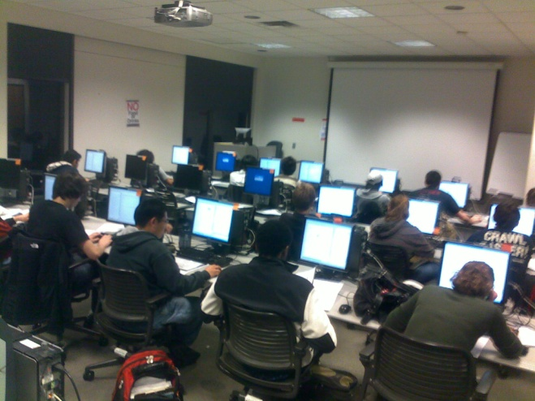
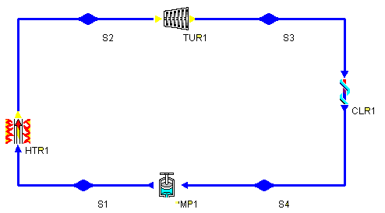
Second-Year Thermodynamics
End of Fall Semester: Students learn about Rankine Cycles
1 Week of lectures
Homework assignment on analysis of Rankine Cycles
Tutorial on using CyclePad software package (Developed at Northwestern University (Forbes et. al. 1999)
Allows students to construct and analyze a variety of Thermodynamic Cycles)
Instructed on Effects of Changing System Variables (Temperature, Pressure) on System Output (Power, Waste Heat)

Slide 4
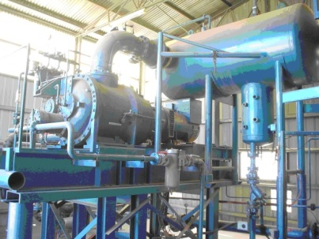
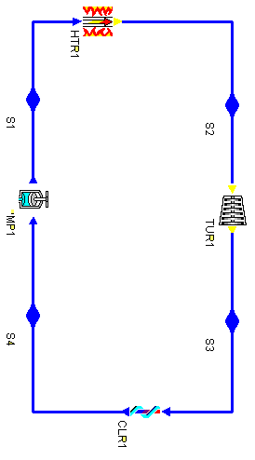
Collaborative Task
Learning Goal: Encourage students to reflect on interactions between cycle parameters
Design Goal: Design a power plant based on the Rankine Cycle paradigm
Competing Student Goals:
Power: Design a power plant that achieves maximum power output
Motivated by economic concerns
Green: Design a power plant that has the minimum impact on the environment
Motivated by environmental concerns
Each pair turns in exactly one design
Increasing heat increases power but also waste heat
Increasing pressure increases efficiency
Reduction in Steam Quality
Power
Waste Heat

Slide 5
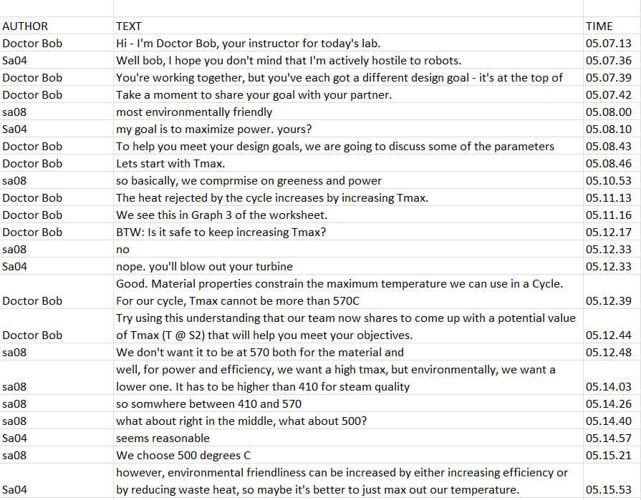

Slide 6
Souflé Framework (Howley et al., in press)
Souflé Framework (Howley et al., in press)
Person
Person
3 Dimensions:
Transactivity
Engagement
Authoritativeness

Slide 7
Souflé Framework (Howley et al., in press)
Transactive
Knowledge Integration
Person
Person

Slide 8
i
Definition of Transactivity
building on an idea expressed earlier in a conversation
using a reasoning statement
well, for power and efficiency, we want a high tmax, but environmentally, we want a lower one.
We don't want tmax to be at 570 both for the material and [the Environment]

Slide 9
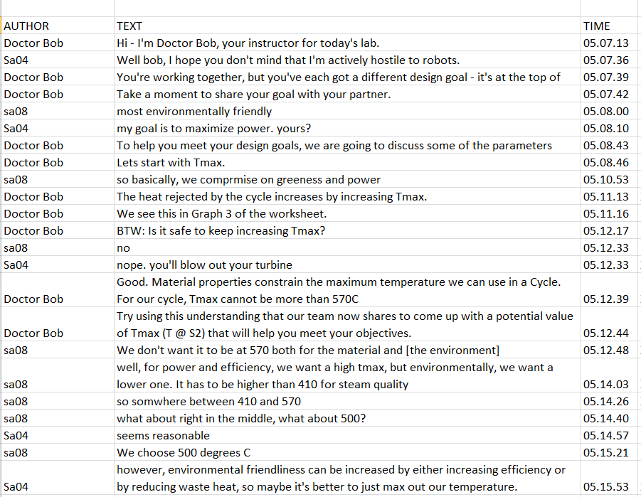

Slide 10
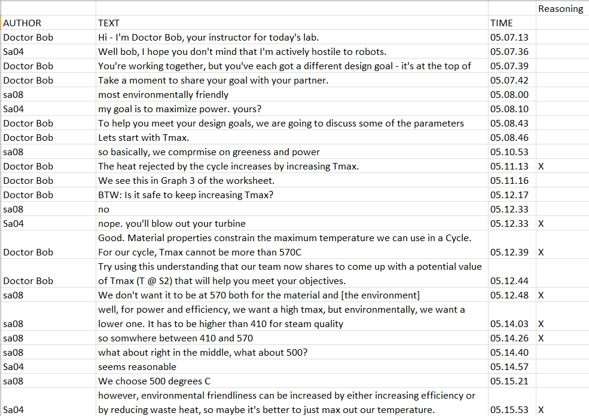

Slide 11
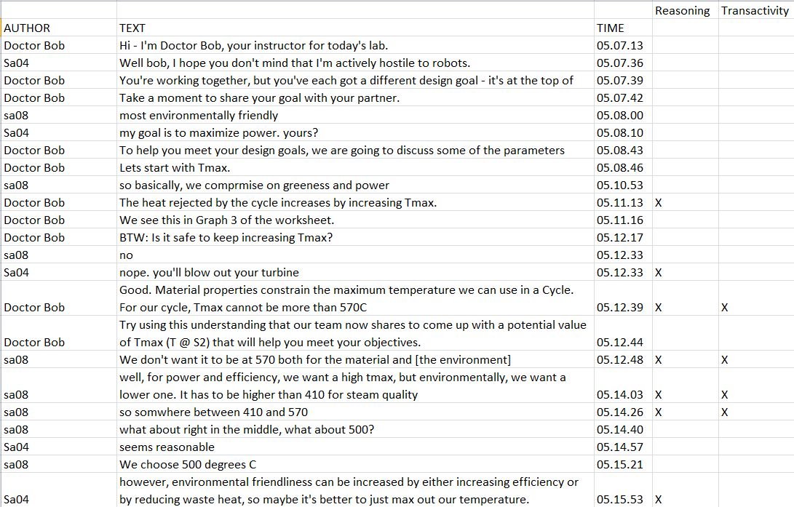

Slide 12
Transactivity (Berkowitz & Gibbs, 1983)
Findings
Moderating effect on learning (Joshi & Rosé, 2007; Russell, 2005; Kruger & Tomasello, 1986; Teasley, 1995)
Moderating effect on knowledge sharing in working groups (Gweon et al., 2011)
Computational Work
Can be automatically detected in:
Threaded group discussions (Kappa .69) (Rosé et al., 2008)
Transcribed classroom discussions (Kappa .69) (Ai et al., 2010)
Speech from dyadic discussions (R = .37) (Gweon et al., 2012)
Predictable from a measure of speech style accommodation computed by an unsupervised Dynamic Bayesian Network (Jain et al., 2012)

Slide 13
Souflé Framework (Howley et al., in press)
Transactive
Knowledge Integration
Engagement
Person
Person
Engagement

Slide 14
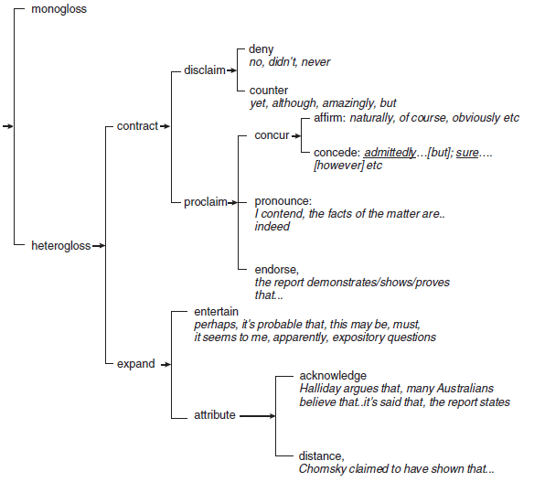
Engagement (Martin & White, 2005, p117)
System of Engagement
Showing openness to the existence of other perspectives
Less final / Invites more discussion
Example:
[M] Nuclear is a good choice
[HE] I consider nuclear to be a good choice
[HC] There’s no denying that nuclear is a superior choice
[NA] Is nuclear a good choice?

Slide 15
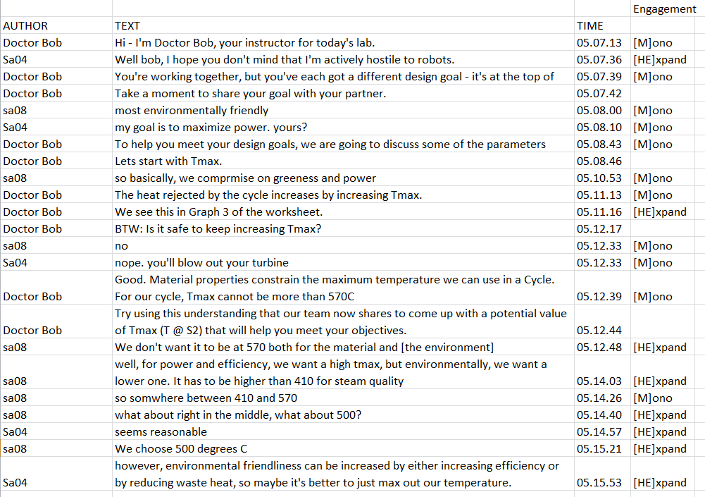

Slide 16
Engagement (Martin & White, 2005)
Findings
Correlational analysis: Strong correlation between displayed openness of group members and articulation of reasoning (R = .72) (Dyke et al., in press)
Intervention study: Causal effect on propensity to articulate ideas in group chats (effect size .6 standard deviations) (Kumar et al., 2011)
Mediating effect of idea contribution on learning in scientific inquiry (Wang et al., 2011)

Slide 17
Souflé Framework (Howley et al., in press)
Authority
Transactive
Knowledge Integration
Engagement
Person
Person
Engagement
Authority

Slide 18
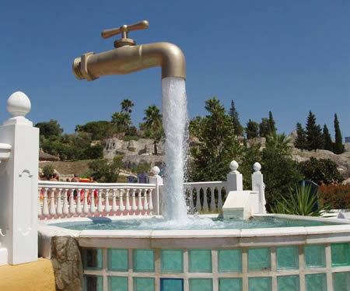
Analysis of Authoritativess
Water pipe analogy:
Water = Knowledge or Action
Source = Authoritative speaker
Sink = Non-authoritative Speaker
Authoritativeness Ratio = Source Actions
Actions
Notes:
Remove last two slides?

Slide 19
The Negotiation Framework (Martin & Rose, 2003)
K2
requesting knowledge, information, opinions, or facts
Source or Sink?
Primary Secondary
Type of Content?
Knowledge Action
K1
giving knowledge, information, opinions, or facts
A2
Instructing, suggesting, or requesting non-verbal action
A1
Narrating or performing your own non-verbal action
Additionally…
ch (direct challenge to previous utterance)
o (all other moves, backchannels, etc.)

Slide 20
The Negotiation Framework (Martin & Rose, 2003)
K2
requesting knowledge, information, opinions, or facts
Source or Sink?
Primary Secondary
Type of Content?
Knowledge Action
K1
giving knowledge, information, opinions, or facts
A2
Instructing, suggesting, or requesting non-verbal action
A1
Narrating or performing your own non-verbal action

Slide 21
The Negotiation Framework (Martin & Rose, 2003)
K2
requesting knowledge, information, opinions, or facts
Source or Sink?
Primary Secondary
Type of Content?
Knowledge Action
K1
giving knowledge, information, opinions, or facts
A2
Instructing, suggesting, or requesting non-verbal action
A1
Narrating or performing your own non-verbal action

Slide 22
The Negotiation Framework (Martin & Rose, 2003)
K2
requesting knowledge, information, opinions, or facts
Source or Sink?
Primary Secondary
Type of Content?
Knowledge Action
K1
giving knowledge, information, opinions, or facts
A2
Instructing, suggesting, or requesting non-verbal action
A1
Narrating or performing your own non-verbal action

Slide 23
The Negotiation Framework (Martin & Rose, 2003)
K2
requesting knowledge, information, opinions, or facts
Source or Sink?
Primary Secondary
Type of Content?
Knowledge Action
K1
giving knowledge, information, opinions, or facts
A2
Instructing, suggesting, or requesting non-verbal action
A1
Narrating or performing your own non-verbal action
Additionally…
ch (direct challenge to previous utterance)
o (all other moves, backchannels, etc.)

Slide 24
The Negotiation Framework (Martin & Rose, 2003)
K2
requesting knowledge, information, opinions, or facts
Source or Sink?
Primary Secondary
Type of Content?
Knowledge Action
K1
giving knowledge, information, opinions, or facts
A2
Instructing, suggesting, or requesting non-verbal action
A1
Narrating or performing your own non-verbal action
Additionally…
ch (direct challenge to previous utterance)
o (all other moves, backchannels, etc.)
Authoritativeness:
K1 + A2
K1 + K2 + A1 + A2

Slide 25
K2?

Slide 26
Set up!
K2
K1

Slide 27
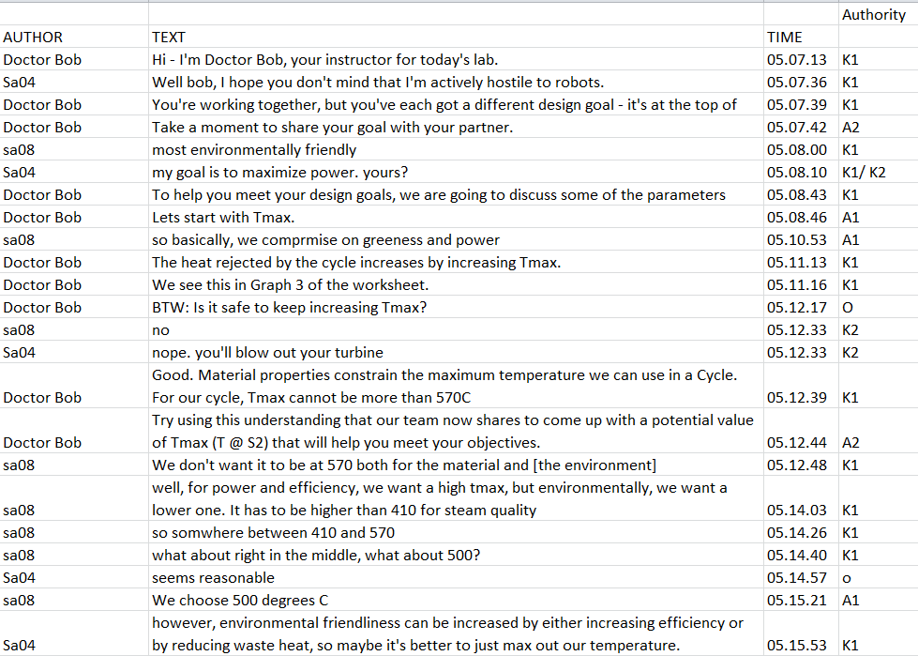

Slide 28
Authoritativeness (Martin & Rose, 2003)
Findings
Authoritativeness measures display how students respond to aggressive behavior in groups (Howley et al., in press)
Authoritativeness predicts learning (R = .64) and self-efficacy (R = .35) (Howley et al., 2011)
Authoritativeness predicts trust in doctor-patient interactions (R values between .25 and .35) (Mayfield et al., under review)
Computational Work
Detectable in collaborative learning chat logs (R = .86)
Detectable in transcribed dyadic discussions in a knowledge sharing task (R = .95) (Mayfield & Rosé, 2011)
Detectable in transcribed doctor-patient interactions (R = .96) (Mayfield et al., under review)

Slide 29
Thank You! Questions?

