Slide 1
Computing Game-Theoretic Solutions
Vincent Conitzer
Duke University
overview article: V. Conitzer. Computing Game-Theoretic Solutions and Applications to Security. Proc. AAAI’12.

Slide 2
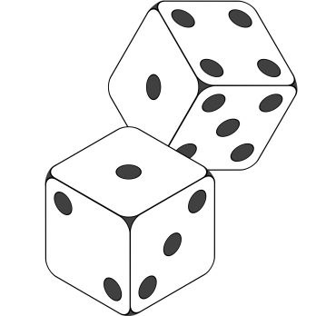
Game theory
Multiple self-interested agents interacting in the same environment
What is an agent to do?
What is an agent to believe? (What are we to believe?)
…

Slide 3
Penalty kick example
probability .7
probability .3
action
probability 1
action
Is this a “rational” outcome? If not, what is?
probability .6
probability .4

Slide 4


Multiagent systems
Goal: Blocked(Room0)
Goal: Clean(Room0)

Slide 5
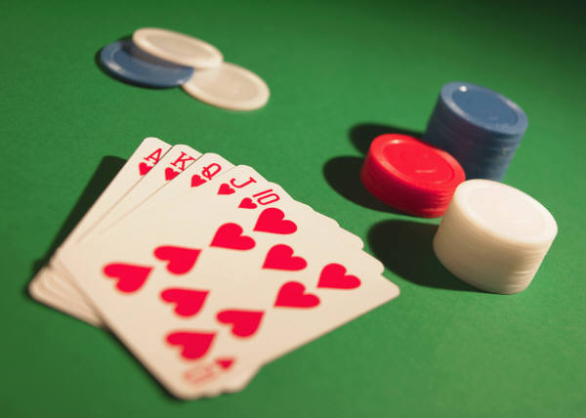
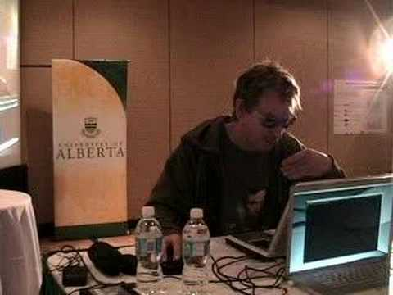
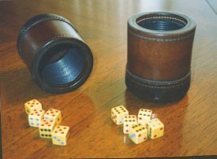
Game playing

Slide 6
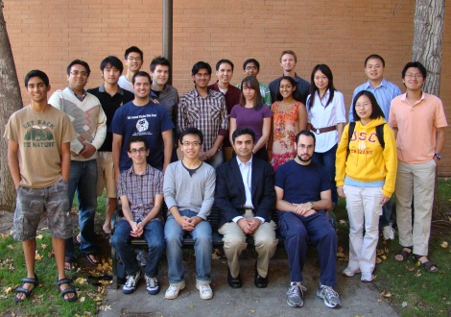
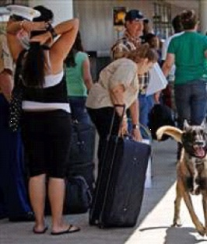



Real-world security applications
Airport security
  Where should checkpoints, canine units, etc. be deployed?
  Deployed at LAX airport and elsewhere
Milind Tambe’s TEAMCORE group (USC)
Federal Air Marshals
  Which flights get a FAM?
US Coast Guard
  Which patrol routes should be followed?
  Deployed in Boston, New York, Los Angeles

Slide 7

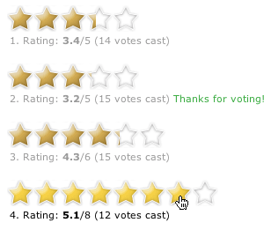
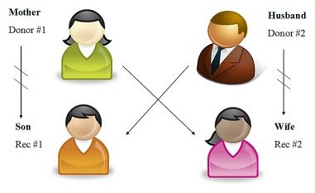
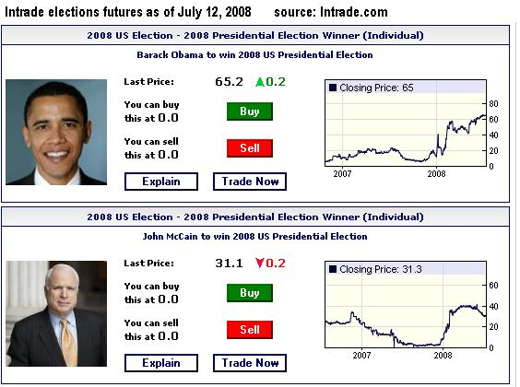

Mechanism design
Rating/voting systems
Auctions
Donation matching
Kidney exchanges
Prediction markets
overview: C., CACM March 2010

Slide 8
Outline
Introduction to game theory (from CS perspective)
  Representing games
  Standard solution concepts
    (Iterated) dominance
    Minimax strategies
    Nash and correlated equilibrium
Recent developments
  Commitment: Stackelberg mixed strategies
  Security applications
Learning in games (time permitting)
  Simple algorithms
  Evolutionary game theory
  Learning in Stackelberg games

Slide 9
Representing games

Slide 10
Rock-paper-scissors
Column player aka. player 2 (simultaneously) chooses a column
Row player aka. player 1 chooses a row
0, 0 | -1, 1 | 1, -1
1, -1 | 0, 0 | -1, 1
-1, 1 | 1, -1 | 0, 0
A row or column is called an action or (pure) strategy
Row player’s utility is always listed first, column player’s second
Zero-sum game: the utilities in each entry sum to 0 (or a constant)
Three-player game would be a 3D table with 3 utilities per entry, etc.

Slide 11
Penalty kick
(also known as: matching pennies)
.5
.5
L
R
0, 0 | -1, 1
-1, 1 | 0, 0
.5
L
.5
R

Slide 12
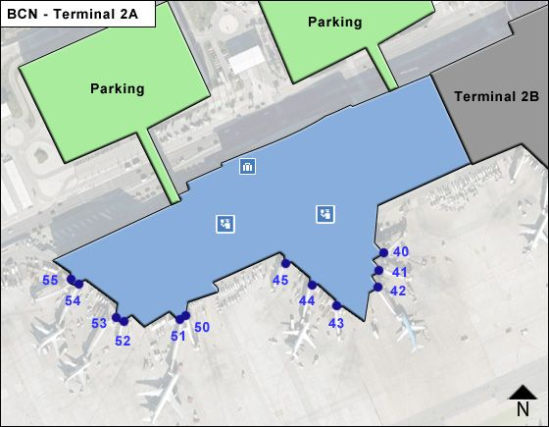
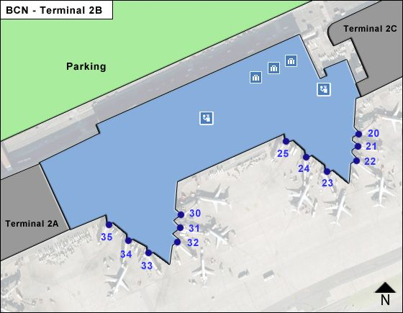
Security example
Terminal A
Terminal B
action
action

Slide 13
Security game
A
B
0, 0 | -1, 2
-1, 1 | 0, 0
A
B

Slide 14
“Chicken”
Two players drive cars towards each other
If one player goes straight, that player wins
If both go straight, they both die
D
S
S
D
D
S
0, 0 | -1, 1
1, -1 | -5, -5
D
not zero-sum
S

Slide 15
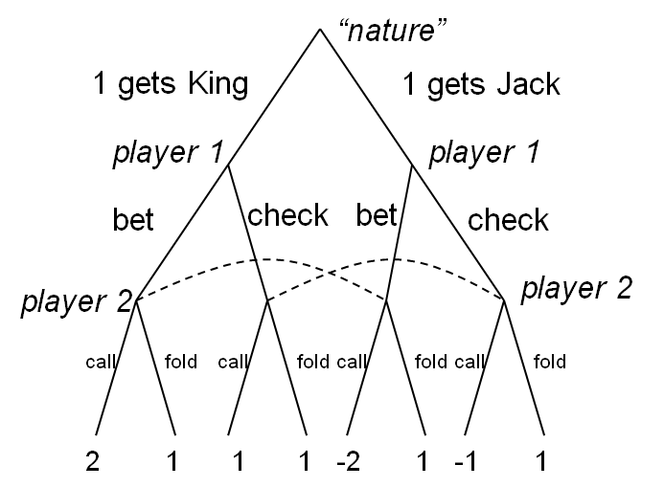
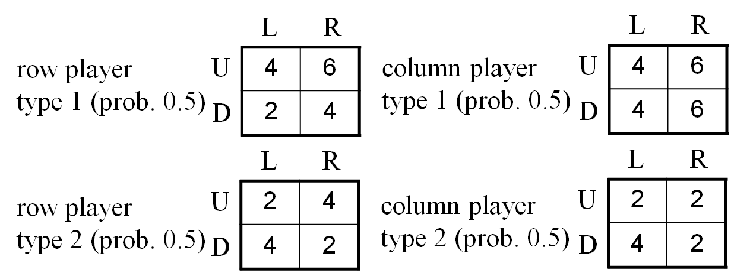
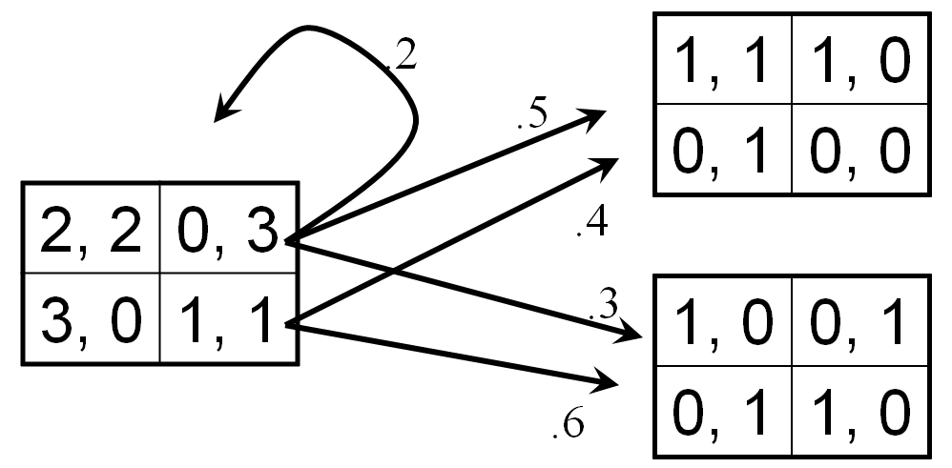
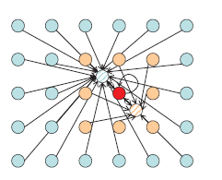
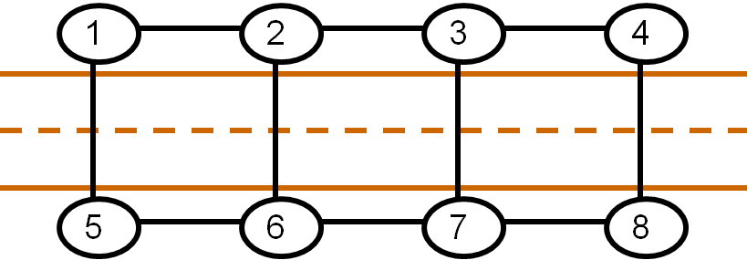
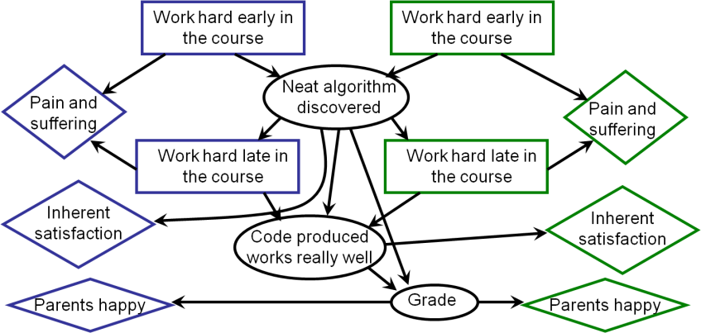
Modeling and representing games
THIS TALK
(unless specified otherwise)
2, 2 | -1, 0
-7, -8 | 0, 0
normal-form games
extensive-form games
Bayesian games
stochastic games
action-graph games
[Leyton-Brown & Tennenholtz IJCAI’03
[Bhat & Leyton-Brown, UAI’04]
[Jiang, Leyton-Brown, Bhat GEB’11]
graphical games
[Kearns, Littman, Singh UAI’01]
MAIDs
[Koller & Milch. IJCAI’01/GEB’03]
“nature”
1 gets King
1 gets Jack
.2
1, 1 | 1, 0
0, 1 | 0, 0
player 1
player 1
.5
bet
check
bet
check
2, 2 | 0, 3
3, 0 | 1, 1
.4
player 2
player 2
call
fold
call
fold
.3
1, 0 | 0, 1
0, 1 | 1, 0
call
fold
call
fold
2
1
1
1
-2
1
-1
1
.6
L
R
L
R
row player
type 1 (prob. 0.5)
U
4 | 6
2 | 4
column player
type 1 (prob. 0.5)
U
4 | 6
4 | 6
D
D
L
R
L
R
row player
type 2 (prob. 0.5)
U
2 | 4
4 | 2
column player
type 2 (prob. 0.5)
U
2 | 2
4 | 2
D
D

Slide 16
A poker-like game
Both players put 1 chip in the pot
Player 1 gets a card (King is a winning card, Jack a losing card)
Player 1 decides to raise (add one to the pot) or check
Player 2 decides to call
(match) or fold (P1 wins)
If player 2 called, player
1’s card determines
pot winner

Slide 17
Poker-like game in normal form
“nature”
1 gets King
1 gets Jack
cc
cf
fc
ff
player 1
player 1
rr
0, 0 | 0, 0 | 1, -1 | 1, -1
.5, -.5 | 1.5, -1.5 | 0, 0 | 1, -1
-.5, .5 | -.5, .5 | 1, -1 | 1, -1
0, 0 | 1, -1 | 0, 0 | 1, -1
raise
check
raise
check
rc
player 2
player 2
cr
call
fold
call
fold
call
fold
call
fold
cc
2
1
1
1
-2
1
-1
1

Slide 18
Our first solution concept: Dominance

Slide 19


Rock-paper-scissors – Seinfeld variant
MICKEY: All right, rock beats paper!
(Mickey smacks Kramer's hand for losing)
KRAMER: I thought paper covered rock.
MICKEY: Nah, rock flies right through paper.
KRAMER: What beats rock?
MICKEY: (looks at hand) Nothing beats rock.
0, 0 | 1, -1 | 1, -1
-1, 1 | 0, 0 | -1, 1
-1, 1 | 1, -1 | 0, 0

Slide 20
Dominance
Player i’s strategy s_{i} strictly dominates s_{i}’ if
  for any s_{-i}, u_{i}(s_{i} , s_{-i}) > u_{i}(s_{i}’, s_{-i})
s_{i} weakly dominates s_{i}’ if
  for any s_{-i}, u_{i}(s_{i} , s_{-i}) ≥ u_{i}(s_{i}’, s_{-i}); and
  for some s_{-i}, u_{i}(s_{i} , s_{-i}) > u_{i}(s_{i}’, s_{-i})
-i = “the player(s) other than i”
0, 0 | 1, -1 | 1, -1
-1, 1 | 0, 0 | -1, 1
-1, 1 | 1, -1 | 0, 0
strict dominance
weak dominance

Slide 21
Prisoner’s Dilemma
Pair of criminals has been caught
District attorney has evidence to convict them of a minor crime (1 year in jail); knows that they committed a major crime together (additional 2 years in jail) but cannot prove it
Offers them a deal:
  If both confess to the major crime, they each get a 1 year reduction
  If only one confesses, that one gets 3 years reduction
confess
don’t confess
confess
-2, -2 | 0, -3
-3, 0 | -1, -1
don’t confess

Slide 22
“Should I buy an SUV?”
purchasing (+gas, maintenance) cost
accident cost
cost: 5
cost: 5
cost: 5
cost: 8
cost: 2
cost: 3
cost: 5
cost: 5
-10, -10 | -7, -11
-11, -7 | -8, -8

Slide 23
Back to the poker-like game
“nature”
1 gets King
1 gets Jack
cc
cf
fc
ff
player 1
player 1
rr
0, 0 | 0, 0 | 1, -1 | 1, -1
.5, -.5 | 1.5, -1.5 | 0, 0 | 1, -1
-.5, .5 | -.5, .5 | 1, -1 | 1, -1
0, 0 | 1, -1 | 0, 0 | 1, -1
raise
check
raise
check
rc
player 2
player 2
cr
call
fold
call
fold
call
fold
call
fold
cc
2
1
1
1
-2
1
-1
1

Slide 24
Mixed strategies
Mixed strategy for player i = probability distribution over player i’s (pure) strategies
E.g.,1/3 , 1/3 , 1/3
Example of dominance by a mixed strategy:
3, 0 | 0, 0
0, 0 | 3, 0
1, 0 | 1, 0
1/2
Usage:
σ_{i} denotes a mixed strategy,
s_{i} denotes a pure strategy
1/2

Slide 25
Checking for dominance by mixed strategies
Linear program for checking whether strategy s_{i}* is strictly dominated by a mixed strategy:
maximize ε
such that:
  for any s_{-i}, Σ_{si} p_{si} u_{i}(s_{i}, s_{-i}) ≥ u_{i}(s_{i}*, s_{-i}) + ε
  Σ_{si} p_{si} = 1
Linear program for checking whether strategy s_{i}* is weakly dominated by a mixed strategy:
maximize Σ_{s-i}[(Σ_{si} p_{si} u_{i}(s_{i}, s_{-i})) - u_{i}(s_{i}*, s_{-i})]
such that:
  for any s_{-i}, Σ_{si} p_{si} u_{i}(s_{i}, s_{-i}) ≥ u_{i}(s_{i}*, s_{-i})
  Σ_{si} p_{si} = 1

Slide 26
Iterated dominance
Iterated dominance: remove (strictly/weakly) dominated strategy, repeat
Iterated strict dominance on Seinfeld’s RPS:
0, 0 | 1, -1 | 1, -1
-1, 1 | 0, 0 | -1, 1
-1, 1 | 1, -1 | 0, 0
0, 0 | 1, -1
-1, 1 | 0, 0

Slide 27
“2/3 of the average” game
Everyone writes down a number between 0 and 100
Person closest to 2/3 of the average wins
Example:
  A says 50
  B says 10
  C says 90
  Average(50, 10, 90) = 50
  2/3 of average = 33.33
  A is closest (|50-33.33| = 16.67), so A wins

Slide 28
“2/3 of the average” game solved
100
dominated
(2/3)*100
dominated after removal of (originally) dominated strategies
(2/3)*(2/3)*100
…
0

Slide 29
Iterated dominance: path (in)dependence
Iterated weak dominance is path-dependent: sequence of eliminations may determine which solution we get (if any)
(whether or not dominance by mixed strategies allowed)
Leads to various NP-hardness results [Gilboa, Kalai, Zemel Math of OR ‘93; C. & Sandholm EC ’05, AAAI’05; Brandt, Brill, Fischer, Harrenstein TOCS ’11]
0, 1 | 0, 0
1, 0 | 1, 0
0, 0 | 0, 1
0, 1 | 0, 0
1, 0 | 1, 0
0, 0 | 0, 1
0, 1 | 0, 0
1, 0 | 1, 0
0, 0 | 0, 1
Iterated strict dominance is path-independent: elimination process will always terminate at the same point
(whether or not dominance by mixed strategies allowed)

Slide 30
Solving two-player zero-sum games

Slide 31
How to play matching pennies
Them
L
R
1, -1 | -1, 1
-1, 1 | 1, -1
L
Us
R
Assume opponent knows our mixed strategy
If we play L 60%, R 40%...
… opponent will play R…
… we get .6*(-1) + .4*(1) = -.2
What’s optimal for us? What about rock-paper-scissors?

Slide 32
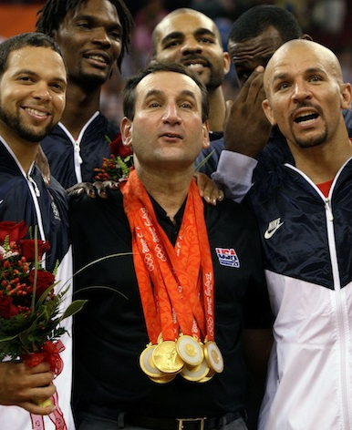
A locally popular sport
go for 3
go for 2
defend the 3
0, 0 | -2, 2
-3, 3 | 0, 0
defend the 2

Slide 33
Solving basketball
Them
3
2
0, 0 | -2, 2
-3, 3 | 0, 0
3
Us
2
If we 50% of the time defend the 3, opponent will shoot 3
  We get .5*(-3) + .5*(0) = -1.5
Should defend the 3 more often: 60% of the time
Opponent has choice between
  Go for 3: gives them .6*(0) + .4*(3) = 1.2
  Go for 2: gives them .6*(2) + .4*(0) = 1.2
We get -1.2 (the maximin value)

Slide 34
Let’s change roles
Them
3
2
0, 0 | -2, 2
-3, 3 | 0, 0
3
Us
2
Suppose we know their strategy
If 50% of the time they go for 3, then we defend 3
  We get .5*(0)+.5*(-2) = -1
Optimal for them: 40% of the time go for 3
  If we defend 3, we get .4*(0)+.6*(-2) = -1.2
  If we defend 2, we get .4*(-3)+.6*(0) = -1.2
This is the minimax value
von Neumann’s minimax theorem [1928]: maximin value = minimax value
(~ linear programming duality)

Slide 35
Minimax theorem [von Neumann 1928]
Maximin utility: max_{σi} min_{s-i} u_{i}(σ_{i}, s_{-i})
(= - min_{σi} max_{s-i} u_{-i}(σ_{i}, s_{-i}))
Minimax utility: min_{σ-i} max_{si} u_{i}(s_{i}, σ_{-i})
(= - max_{σ-i} min_{si} u_{-i}(s_{i}, σ_{-i}))
Minimax theorem:
max_{σi} min_{s-i} u_{i}(σ_{i}, s_{-i}) = min_{σ-i} max_{si} u_{i}(s_{i}, σ_{-i})
Minimax theorem does not hold with pure strategies only (example?)

Slide 36
Back to the poker-like game, again
“nature”
2/3
1/3
1 gets King
1 gets Jack
cc
cf
fc
ff
player 1
player 1
1/3
rr
0, 0 | 0, 0 | 1, -1 | 1, -1
.5, -.5 | 1.5, -1.5 | 0, 0 | 1, -1
-.5, .5 | -.5, .5 | 1, -1 | 1, -1
0, 0 | 1, -1 | 0, 0 | 1, -1
raise
check
raise
check
2/3
rc
player 2
player 2
cr
call
fold
call
fold
call
fold
call
fold
cc
2
1
1
1
-2
1
-1
1
To make player 1 indifferent between bb and bs, we need:
utility for bb = 0*P(cc)+1*(1-P(cc)) = .5*P(cc)+0*(1-P(cc)) = utility for bs
That is, P(cc) = 2/3
To make player 2 indifferent between cc and fc, we need:
utility for cc = 0*P(bb)+(-.5)*(1-P(bb)) = -1*P(bb)+0*(1-P(bb)) = utility for fc
That is, P(bb) = 1/3

Slide 37
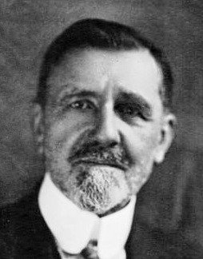
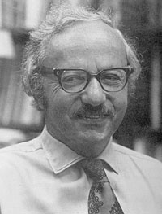
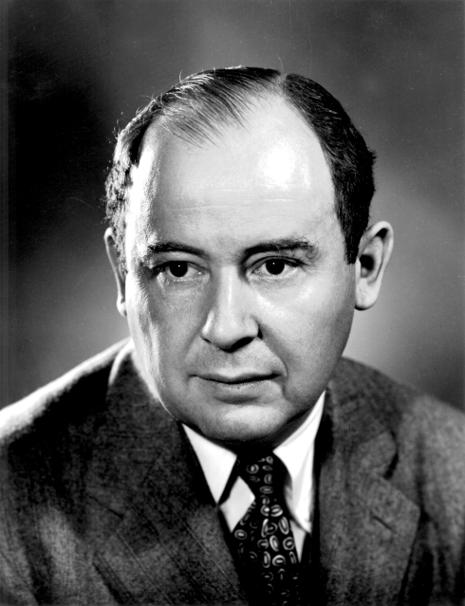
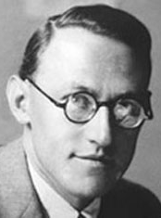
A brief history of the minimax theorem
Ville
new proof related to systems of linear inequalities
(in Borel’s book)
von Neumann
explains to Dantzig about strong duality of linear programs
Borel
some very special cases of the theorem
Émile Borel
George Dantzig
1921-1927
1928
1938
1944
1947
1951
von Neumann
complete proof
von Neumann & Morgenstern
Theory of Games and Economic Behavior
new proof also based on systems of linear inequalities, inspired by Ville’s proof
Gale-Kuhn-Tucker
proof of LP duality,
Dantzig
proof* of equivalence to zero-sum games,
both in Koopmans’ book
Activity Analysis
of Production and Allocation
John von Neumann
Oskar Morgenstern
E.g., John von Neumann's conception of the minimax theorem : a journey through different mathematical contexts. Kjeldsen, Tinne Hoff. In: Archive for History of Exact Sciences, Vol. 56, 2001, p. 39-68.

Slide 38
Computing minimax strategies
maximize v_{R}
subject to
for all c, Σ_{r} p_{r} u_{R}(r, c) ≥ v_{R}
Σ_{r} p_{r} = 1
Row utility
Column optimality
distributional constraint
Slide 7

Slide 39
Equilibrium notions for general-sum games

Slide 40
General-sum games
You could still play a minimax strategy in general-sum games
  I.e., pretend that the opponent is only trying to hurt you
But this is not rational:
0, 0 | 3, 1
1, 0 | 2, 1
If Column was trying to hurt Row, Column would play Left, so Row should play Down
In reality, Column will play Right (strictly dominant), so Row should play Up
Is there a better generalization of minimax strategies in zero-sum games to general-sum games?

Slide 41


Nash equilibrium [Nash 1950]
A profile (= strategy for each player) so that no player wants to deviate
D
S
0, 0 | -1, 1
1, -1 | -5, -5
D
S
This game has another Nash equilibrium in mixed strategies – both play D with 80%

Slide 42
Nash equilibria of “chicken”…
D
S
0, 0 | -1, 1
1, -1 | -5, -5
D
S
Is there a Nash equilibrium that uses mixed strategies? Say, where player 1 uses a mixed strategy?
If a mixed strategy is a best response, then all of the pure strategies that it randomizes over must also be best responses
So we need to make player 1 indifferent between D and S
Player 1’s utility for playing D = -p^{c}_{S}
Player 1’s utility for playing S = p^{c}_{D} - 5p^{c}_{S} = 1 - 6p^{c}_{S}
So we need -p^{c}_{S} = 1 - 6p^{c}_{S} which means p^{c}_{S} = 1/5
Then, player 2 needs to be indifferent as well
Mixed-strategy Nash equilibrium: ((4/5 D, 1/5 S), (4/5 D, 1/5 S))
  People may die! Expected utility -1/5 for each player

Slide 43


The presentation game
Do not pay attention (NA)
Pay attention (A)
2, 2 | -1, 0
-7, -8 | 0, 0
Put effort into presentation (E)
Do not put effort into presentation (NE)
Pure-strategy Nash equilibria: (E, A), (NE, NA)
Mixed-strategy Nash equilibrium:
((4/5 E, 1/5 NE), (1/10 A, 9/10 NA))
  Utility -7/10 for presenter, 0 for audience

Slide 44
The “equilibrium selection problem”
You are about to play a game that you have never played before with a person that you have never met
According to which equilibrium should you play?
Possible answers:
  Equilibrium that maximizes the sum of utilities (social welfare)
  Or, at least not a Pareto-dominated equilibrium
  So-called focal equilibria
    “Meet in Paris” game: You and a friend were supposed to meet in Paris at noon on Sunday, but you forgot to discuss where and you cannot communicate. All you care about is meeting your friend. Where will you go?
  Equilibrium that is the convergence point of some learning process
  An equilibrium that is easy to compute
  …
Equilibrium selection is a difficult problem

Slide 45

Computing a single Nash equilibrium
“Together with factoring, the complexity of finding a Nash equilibrium is in my opinion the most important concrete open question on the boundary of P today.”
Christos Papadimitriou, STOC’01
[’91]
  PPAD-complete to compute one Nash equilibrium in a two-player game [Daskalakis, Goldberg, Papadimitriou STOC’06 / SIAM J. Comp. ‘09; Chen & Deng FOCS’06 / Chen, Deng, Teng JACM’09]
  Is one Nash equilibrium all we need to know?

Slide 46
A useful reduction (SAT → game) [C. & Sandholm IJCAI’03, Games and Economic Behavior ‘08]
(Earlier reduction with weaker implications: Gilboa & Zemel GEB ‘89)
Formula:
(x₁ or -x₂) and (-x₁ or x₂)
Solutions:
x₁=true,x₂=true
x₁=false,x₂=false
Game:
x₁
x₂
+x₁
-x₁
+x₂
-x₂
(x₁ or -x₂)
(-x₁ or x₂)
default
x₁
-2,-2
-2,-2
0,-2
0,-2
2,-2
2,-2
-2,-2
-2,-2
0,1
x₂
-2,-2
-2,-2
2,-2
2,-2
0,-2
0,-2
-2,-2
-2,-2
0,1
+x₁
-2,0
-2,2
1,1
-2,-2
1,1
1,1
-2,0
-2,2
0,1
-x₁
-2,0
-2,2
-2,-2
1,1
1,1
1,1
-2,2
-2,0
0,1
+x₂
-2,2
-2,0
1,1
1,1
1,1
-2,-2
-2,2
-2,0
0,1
-x₂
-2,2
-2,0
1,1
1,1
-2,-2
1,1
-2,0
-2,2
0,1
(x₁ or -x₂)
-2,-2
-2,-2
0,-2
2,-2
2,-2
0,-2
-2,-2
-2,-2
0,1
(-x₁ or x₂)
-2,-2
-2,-2
2,-2
0,-2
0,-2
2,-2
-2,-2
-2,-2
0,1
default
1,0
1,0
1,0
1,0
1,0
1,0
1,0
1,0
ε, ε
Every satisfying assignment (if there are any) corresponds to an equilibrium with utilities 1, 1; exactly one additional equilibrium with utilities ε, ε that always exists
Evolutionarily stable strategies Σ₂^{P}-complete [C. WINE 2013]

Slide 47
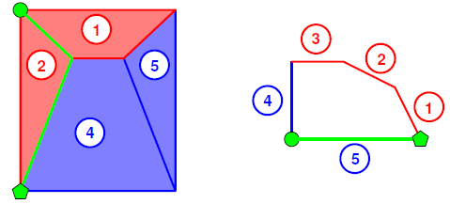
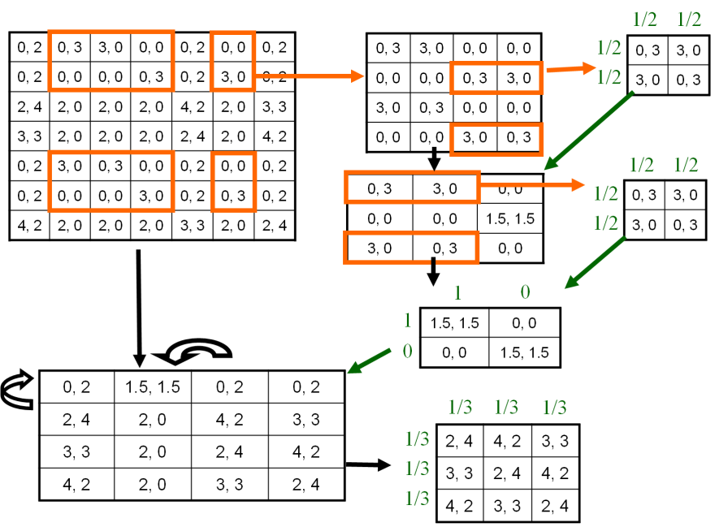
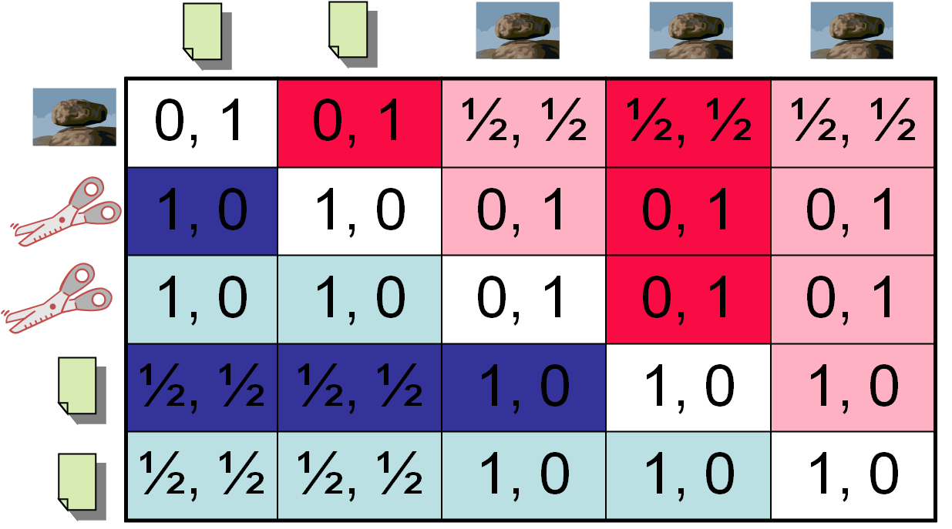
Some algorithm families for computing Nash equilibria of 2-player normal-form games
image from von Stengel
Search over supports / MIP
[Dickhaut & Kaplan, Mathematica J. ‘91]
[Porter, Nudelman, Shoham AAAI’04 / GEB’08]
[Sandholm, Gilpin, C. AAAI’05]
Lemke-Howson [J. SIAM ‘64]
Exponential time due to Savani & von Stengel [FOCS’04 / Econometrica’06]
Approximate equilibria
  [Brown ’51 / C. ’09 / Goldberg, Savani, Sørensen, Ventre ’11; Althöfer ‘94, Lipton, Markakis, Mehta ‘03, Daskalakis, Mehta, Papadimitriou ‘06, ‘07, Feder, Nazerzadeh, Saberi ‘07, Tsaknakis & Spirakis ‘07, Spirakis ‘08, Bosse, Byrka, Markakis ‘07, …]
Special cases / subroutines
[C. & Sandholm AAAI’05, AAMAS’06; Benisch, Davis, Sandholm AAAI’06 / JAIR’10; Kontogiannis & Spirakis APPROX’11; Adsul, Garg, Mehta, Sohoni STOC’11; …]
Notes:
More refs

Slide 48
Search-based approaches (for 2 players)
Suppose we know the support X_{i} of each player i’s mixed strategy in equilibrium
  That is, which pure strategies receive positive probability
Then, we have a linear feasibility problem:
  for both i, for any s_{i} ∈ S_{i} - X_{i}, p_{i}(s_{i}) = 0
  for both i, for any s_{i} ∈ X_{i}, Σp_{-i}(s_{-i})u_{i}(s_{i}, s_{-i}) = u_{i}
  for both i, for any s_{i} ∈ S_{i} - X_{i}, Σp_{-i}(s_{-i})u_{i}(s_{i}, s_{-i}) ≤ u_{i}
Thus, we can search over possible supports
  This is the basic idea underlying methods in [Dickhaut & Kaplan 91; Porter, Nudelman, Shoham AAAI04/GEB08]
Dominated strategies can be eliminated

Slide 49
Solving for a Nash equilibrium using MIP (2 players)
[Sandholm, Gilpin, C. AAAI’05]
maximize whatever you like (e.g., social welfare)
subject to
  for both i, for any s_{i}, Σ_{s-i} p_{s-i} u_{i}(s_{i}, s_{-i}) = u_{si}
  for both i, for any s_{i}, u_{i} ≥ u_{si}
  for both i, for any s_{i}, p_{si} ≤ b_{si}
  for both i, for any s_{i}, u_{i} - u_{si} ≤ M(1- b_{si})
  for both i, Σ_{si} p_{si} = 1
b_{si} is a binary variable indicating whether s_{i} is in the support, M is a large number

Slide 50
Lemke-Howson algorithm (1-slide sketch!)
GREEN
ORANGE
1, 0 | 0, 1
0, 2 | 1, 0
RED
BLUE
player 2’s utility as function of 1’s mixed strategy
best-response strategies
player 1’s utility as function of 2’s mixed strategy
redraw both
RED
BLUE
GREEN
ORANGE
unplayed strategies
Strategy profile = pair of points
Profile is an equilibrium iff every pure strategy is either a best response or unplayed
I.e. equilibrium = pair of points that includes all the colors
  … except, pair of bottom points doesn’t count (the “artificial equilibrium”)
Walk in some direction from the artificial equilibrium; at each step, throw out the color used twice

Slide 51
Correlated equilibrium [Aumann ‘74]
0, 0 | 0, 1 | 1, 0
1, 0 | 0, 0 | 0, 1
0, 1 | 1, 0 | 0, 0
0
1/6
1/6
1/6
0
1/6
1/6
1/6
0

Slide 52
Correlated equilibrium LP
maximize whatever
subject to
for all r and r’, Σ_{c} p_{r,c} u_{R}(r, c) ≥ Σ_{c} p_{r,c} u_{R}(r’, c)
for all c and c’, Σ_{r} p_{r,c} u_{C}(r, c) ≥ Σ_{r} p_{r,c} u_{C}(r, c’)
Σ_{r,c} p_{r,c} = 1
Row incentive constraint
Column incentive constraint
distributional constraint

Slide 53
Recent developments

Slide 54

Questions raised by security games
Equilibrium selection?
How should we model temporal / information structure?
What structure should utility functions have?
Do our algorithms scale?
D
S
D
0, 0 | -1, 1
1, -1 | -5, -5
S
2, 2 | -1, 0
-7, -8 | 0, 0

Slide 55
Observing the defender’s distribution in security
Terminal A
Terminal B
observe
Mo
Tu
We
Th
Fr
Sa
This model is not uncontroversial… [Pita, Jain, Tambe, Ordóñez, Kraus AIJ’10; Korzhyk, Yin, Kiekintveld, C., Tambe JAIR’11; Korzhyk, C., Parr AAMAS’11]

Slide 56
Commitment (Stackelberg strategies)

Slide 57
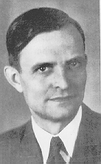
Commitment
1, 1 | 3, 0
0, 0 | 2, 1
Unique Nash equilibrium (iterated strict dominance solution)
von Stackelberg
Suppose the game is played as follows:
  Player 1 commits to playing one of the rows,
  Player 2 observes the commitment and then chooses a column
Optimal strategy for player 1: commit to Down

Slide 58
Commitment as an extensive-form game
For the case of committing to a pure strategy:
Player 1
Up
Down
Player 2
Player 2
Left
Right
Left
Right
1, 1
3, 0
0, 0
2, 1

Slide 59
Commitment to mixed strategies
0
1
.49
1, 1 | 3, 0
0, 0 | 2, 1
.51
Sometimes also called a Stackelberg (mixed) strategy

Slide 60
Commitment as an extensive-form game…
… for the case of committing to a mixed strategy:
Player 1
(1,0) (=Up)
(.5,.5)
(0,1) (=Down)
…
…
Player 2
Left
Right
Left
Right
Left
Right
1, 1
3, 0
.5, .5
2.5, .5
0, 0
2, 1
Economist: Just an extensive-form game, nothing new here
Computer scientist: Infinite-size game! Representation matters

Slide 61
Computing the optimal mixed strategy to commit to
[C. & Sandholm EC’06, von Stengel & Zamir GEB’10]
Separate LP for every column c*:
maximize Σ_{r} p_{r} u_{R}(r, c*)
subject to
for all c, Σ_{r} p_{r} u_{C}(r, c*) ≥ Σ_{r} p_{r} u_{C}(r, c)
Σ_{r} p_{r} = 1
Row utility
Column optimality
distributional constraint
Slide 7

Slide 62
On the game we saw before
x
1, 1 | 3, 0
0, 0 | 2, 1
y
maximize 1x + 0y
subject to
1x + 0y ≥ 0x + 1y
x + y = 1
x ≥ 0
y ≥ 0
maximize 3x + 2y
subject to
0x + 1y ≥ 1x + 0y
x + y = 1
x ≥ 0
y ≥ 0
Slide 7

Slide 63
Visualization
 | L | C | R
U | 0,1 | 1,0 | 0,0
M | 4,0 | 0,1 | 0,0
D | 0,0 | 1,0 | 1,1
(0,1,0) = M
C
L
R
(1,0,0) = U
(0,0,1) = D

Slide 64

Generalizing beyond zero-sum games
Minimax, Nash, Stackelberg all agree in zero-sum games
0, 0 | -1, 1
-1, 1 | 0, 0
zero-sum games
minimax strategies
zero-sum games
general-sum games
Nash equilibrium
zero-sum games
general-sum games
Stackelberg mixed strategies

Slide 65
Other nice properties of commitment to mixed strategies
0, 0 | -1, 1
1, -1 | -5, -5
No equilibrium selection problem
Leader’s payoff at least as good as any Nash eq. or even correlated eq. (von Stengel & Zamir [GEB ‘10]; see also C. & Korzhyk [AAAI ‘11], Letchford, Korzhyk, C. [JAAMAS’14])
≥
More discussion: V. Conitzer. Should Stackelberg Mixed Strategies Be Considered a Separate Solution Concept? [LOFT 2014]

Slide 66
Some other work on commitment in unrestricted games
2, 2 | -1, 0
-7, -8 | 0, 0
normal-form games
learning to commit [Letchford, C., Munagala SAGT’09]
correlated strategies [C. & Korzhyk AAAI’11]
uncertain observability [Korzhyk, C., Parr AAMAS’11]
extensive-form games
[Letchford & C., EC’10]
commitment in Bayesian games
[C. & Sandholm EC’06; Paruchuri, Pearce, Marecki, Tambe, Ordóñez, Kraus AAMAS’08; Letchford, C., Munagala SAGT’09; Pita, Jain, Tambe, Ordóñez, Kraus AIJ’10; Jain, Kiekintveld, Tambe AAMAS’11; …]
stochastic games
[Letchford, MacDermed, C., Parr, Isbell, AAAI’12]
“nature”
1 gets King
1 gets Jack
.2
1, 1 | 1, 0
0, 1 | 0, 0
player 1
player 1
.5
bet
check
bet
check
2, 2 | 0, 3
3, 0 | 1, 1
.4
player 2
player 2
call
fold
call
fold
.3
1, 0 | 0, 1
0, 1 | 1, 0
call
fold
call
fold
2
1
1
1
-2
1
-1
1
.6
L
R
L
R
row player
type 1 (prob. 0.5)
U
4 | 6
2 | 4
column player
type 1 (prob. 0.5)
U
4 | 6
4 | 6
D
D
L
R
L
R
row player
type 2 (prob. 0.5)
U
2 | 4
4 | 2
column player
type 2 (prob. 0.5)
U
2 | 2
4 | 2
D
D

Slide 67
Security games

Slide 68
Example security game
3 airport terminals to defend (A, B, C)
Defender can place checkpoints at 2 of them
Attacker can attack any 1 terminal
A
B
C
{A, B}
0, -1 | 0, -1 | -2, 3
0, -1 | -1, 1 | 0, 0
-1, 1 | 0, -1 | 0, 0
{A, C}
{B, C}

Slide 69
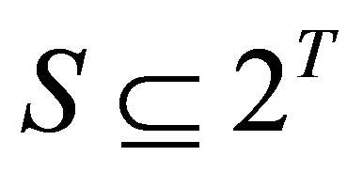
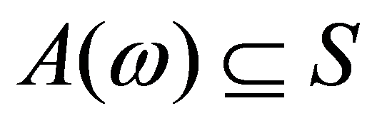
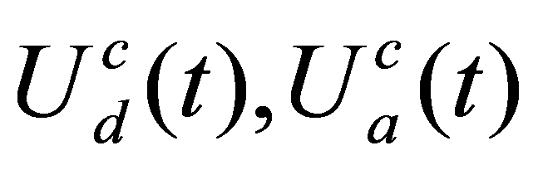
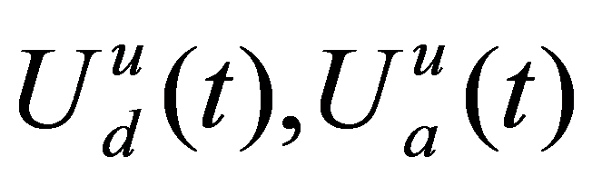
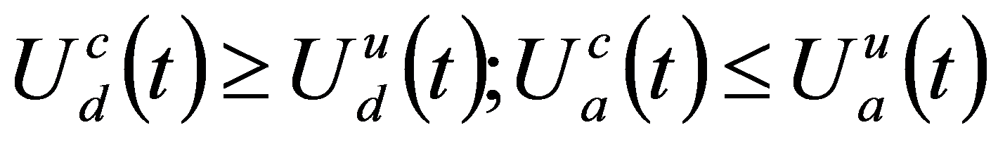
Security resource allocation games
[Kiekintveld, Jain, Tsai, Pita, Ordóñez, Tambe AAMAS’09]
Set of targets T
Set of security resources Ω available to the defender (leader)
Set of schedules
Resource ω can be assigned to one of the schedules in
Attacker (follower) chooses one target to attack
Utilities: if the attacked target is defended,
otherwise
t₁
s₁
ω ₁
t₂
t₃
s₂
ω ₂
t₅
t₄
s₃

Slide 70
Game-theoretic properties of security resource allocation games [Korzhyk, Yin, Kiekintveld, C., Tambe JAIR’11]
For the defender: Stackelberg strategies are also Nash strategies
  minor assumption needed
  not true with multiple attacks
Interchangeability property for Nash equilibria (“solvable”)
  no equilibrium selection problem
  still true with multiple attacks [Korzhyk, C., Parr IJCAI’11]
1, 2 | 1, 0 | 2, 2
1, 1 | 1, 0 | 2, 1
0, 1 | 0, 0 | 0, 1

Slide 71
Scalability in security games
games on graphs
(usually zero-sum)
[Halvorson, C., Parr IJCAI’09; Tsai, Yin, Kwak, Kempe, Kiekintveld, Tambe AAAI’10; Jain, Korzhyk, Vaněk, C., Pěchouček, Tambe AAMAS’11; Jain, C., Tambe AAMAS’13; Xu, Fang, Jiang, C., Dughmi, Tambe AAAI’14]
basic model
[Kiekintveld, Jain, Tsai, Pita, Ordóñez, Tambe AAMAS’09; Korzhyk, C., Parr, AAAI’10; Jain, Kardeş, Kiekintveld, Ordóñez, Tambe AAAI’10; Korzhyk, C., Parr, IJCAI’11]
Techniques:
compact linear/integer programs
strategy generation

Slide 72
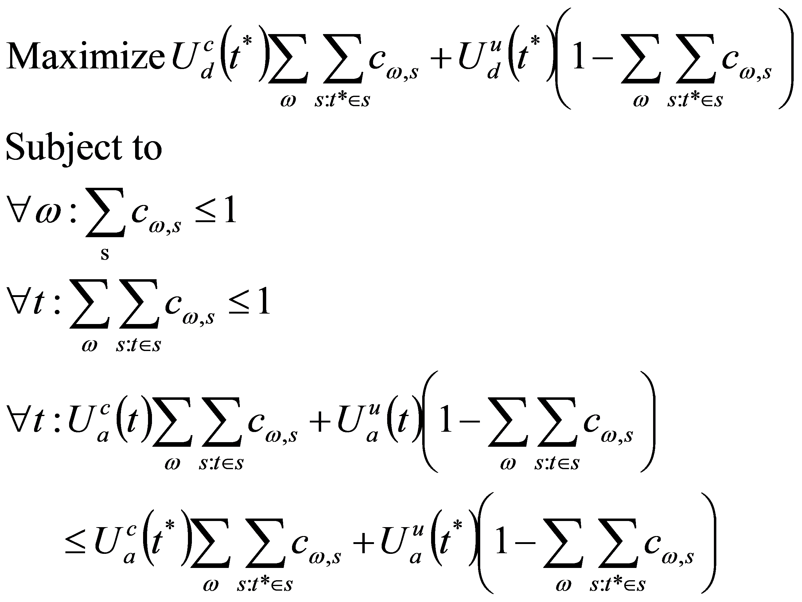
Compact LP
Cf. ERASER-C algorithm by Kiekintveld et al. [2009]
Separate LP for every possible t* attacked:
Defender utility
Marginal probability
of t* being defended (?)
Distributional constraints
Attacker optimality
Slide 11

Slide 73
Counter-example to the compact LP
ω₂
.5
.5
.5
t
t
ω₁
.5
t
t
LP suggests that we can cover every target with probability 1…
… but in fact we can cover at most 3 targets at a time
Slide 12

Slide 74
Birkhoff-von Neumann theorem
Every doubly stochastic n x n matrix can be represented as a convex combination of n x n permutation matrices
Decomposition can be found in polynomial time O(n^{4.5}), and the size is O(n²) [Dulmage and Halperin, 1955]
Can be extended to rectangular doubly substochastic matrices
.1 | .4 | .5
.3 | .5 | .2
.6 | .1 | .3
1 | 0 | 0
0 | 0 | 1
0 | 1 | 0
0 | 1 | 0
0 | 0 | 1
1 | 0 | 0
0 | 0 | 1
0 | 1 | 0
1 | 0 | 0
0 | 1 | 0
1 | 0 | 0
0 | 0 | 1
= .1
+.1
+.5
+.3
Slide 14

Slide 75
Schedules of size 1 using BvN
ω ₁
.7
t₁
.1
.2
 | t₁ | t₂ | t₃
ω₁ | .7 | .2 | .1
ω₂ | 0 | .3 | .7
.3
t₂
ω ₂
.7
t₃
.1
.2
.2
.5
0 | 0 | 1
0 | 1 | 0
0 | 1 | 0
0 | 0 | 1
1 | 0 | 0
0 | 1 | 0
1 | 0 | 0
0 | 0 | 1

Slide 76
Algorithms & complexity
[Korzhyk, C., Parr AAAI’10]
 |  | Homogeneous Resources | Heterogeneous resources
Schedules | Size 1 | P | P (BvN theorem)
 | Size ≤2, bipartite
 | Size ≤2
 | Size ≥3
P
(BvN theorem)
NP-hard
(SAT)
P
(constraint generation)
NP-hard
NP-hard
(3-COVER)
NP-hard
Also: security games on graphs
[Letchford, C. AAAI’13]
Slide 16

Slide 77
Security games with multiple attacks
[Korzhyk, Yin, Kiekintveld, C., Tambe JAIR’11]
The attacker can choose multiple targets to attack
The utilities are added over all attacked targets
Stackelberg NP-hard; Nash polytime-solvable and interchangeable [Korzhyk, C., Parr IJCAI‘11]
    Algorithm generalizes ORIGAMI algorithm for single attack [Kiekintveld, Jain, Tsai, Pita, Ordóñez, Tambe AAMAS’09]

Slide 78
Actual Security Schedules: Before vs. After
Boston, Coast Guard – “PROTECT” algorithm slide courtesy of Milind Tambe
Before PROTECT
After PROTECT
  Industry port partners comment:
“The Coast Guard seems to be everywhere, all the time."

Slide 79
Data from LAX checkpoints before and after “ARMOR” algorithm slide
slide courtesy of Milind Tambe
not a controlled experiment!

Slide 80
Placing checkpoints in a city
[Tsai, Yin, Kwak, Kempe, Kiekintveld, Tambe AAAI’10; Jain, Korzhyk, Vaněk, C., Pěchouček, Tambe AAMAS’11; Jain, C., Tambe AAMAS’13]

Slide 81
Learning in games

Slide 82
Learning in (normal-form) games
Learn how to play a game by
  playing it many times, and
  updating your strategy based on experience
Why?
  Some of the game’s utilities (especially the other players’) may be unknown to you
  The other players may not be playing an equilibrium strategy
  Computing an optimal strategy can be hard
  Learning is what humans typically do
  …
Does learning converge to equilibrium?

Slide 83
Iterated best response
In the first round, play something arbitrary
In each following round, play a best response against what the other players played in the previous round
If all players play this, it can converge (i.e., we reach an equilibrium) or cycle
0, 0 | -1, 1 | 1, -1
1, -1 | 0, 0 | -1, 1
-1, 1 | 1, -1 | 0, 0
-1, -1 | 0, 0
0, 0 | -1, -1
a simple congestion game
rock-paper-scissors
Alternating best response: players alternatingly change strategies: one player best-responds each odd round, the other best-responds each even round

Slide 84
Fictitious play [Brown 1951]
In the first round, play something arbitrary
In each following round, play a best response against the empirical distribution of the other players’ play
  I.e., as if other player randomly selects from his past actions
Again, if this converges, we have a Nash equilibrium
Can still fail to converge…
0, 0 | -1, 1 | 1, -1
1, -1 | 0, 0 | -1, 1
-1, 1 | 1, -1 | 0, 0
-1, -1 | 0, 0
0, 0 | -1, -1
a simple congestion game
rock-paper-scissors

Slide 85
Fictitious play on rock-paper-scissors
Row
Column
0, 0 | -1, 1 | 1, -1
1, -1 | 0, 0 | -1, 1
-1, 1 | 1, -1 | 0, 0
30% R, 50% P, 20% S
30% R, 20% P, 50% S

Slide 86
Does the empirical distribution of play converge to equilibrium?
… for iterated best response?
… for fictitious play?
3, 0 | 1, 2
1, 2 | 2, 1

Slide 87
Fictitious play is guaranteed to converge in…
Two-player zero-sum games [Robinson 1951]
Generic 2x2 games [Miyasawa 1961]
Games solvable by iterated strict dominance [Nachbar 1990]
Weighted potential games [Monderer & Shapley 1996]
Not in general [Shapley 1964]
But, fictitious play always converges to the set of ½-approximate equilibria [C. 2009; more detailed analysis by Goldberg, Savani, Sørensen, Ventre 2011]

Slide 88
Shapley’s game on which fictitious play does not converge
starting with (U, C):
0, 0 | 0, 1 | 1, 0
1, 0 | 0, 0 | 0, 1
0, 1 | 1, 0 | 0, 0

Slide 89
“Teaching”
Suppose you are playing against a player that uses one of these learning strategies
  Fictitious play, anything with no regret, …
Also suppose you are very patient, i.e., you only care about what happens in the long run
How will you (the row player) play in the following repeated games?
  Hint: the other player will eventually best-respond to whatever you do
4, 4 | 3, 5
5, 3 | 0, 0
1, 0 | 3, 1
2, 1 | 4, 0
Note relationship to optimal strategies to commit to
There is some work on learning strategies that are in equilibrium with each other [Brafman & Tennenholtz AIJ04]

Slide 90
Hawk-Dove Game
[Price and Smith, 1973]
Dove
Hawk
1, 1 | 0, 2
2, 0 | -1, -1
Dove
Hawk
Unique symmetric equilibrium:
50% Dove, 50% Hawk

Slide 91
Evolutionary game theory
Given: a symmetric 2-player game
Dove
Hawk
Dove
1, 1 | 0, 2
2, 0 | -1, -1
Hawk
Population of players; players randomly matched to play game
Each player plays a pure strategy
  p_{s} = fraction of players playing strategy s
  p = vector of all fractions p_{s} (the state)
Utility for playing s is u(s, p) = Σ_{s’}p_{s’}u(s, s’)
Players reproduce at rate proportional to their utility;
their offspring play the same strategy
dp_{s}(t)/dt = p_{s}(t)(u(s, p(t)) - Σ_{s’}p_{s’}u(s’, p(t)))
  Replicator dynamic
What are the steady states?

Slide 92
Stability
Dove
Hawk
Dove
1, 1 | 0, 2
2, 0 | -1, -1
Hawk
A steady state is stable if slightly perturbing the state will not cause us to move far away from the state
Proposition: every stable steady state is a Nash equilibrium of the symmetric game
Slightly stronger criterion: a state is asymptotically stable if it is stable, and after slightly perturbing this state, we will (in the limit) return to this state

Slide 93
Evolutionarily stable strategies
[Price and Smith, 1973]
Now suppose players play mixed strategies
A (single) mixed strategy σ is evolutionarily stable if the following is true:
  Suppose all players play σ
  Then, whenever a very small number of invaders enters that play a different strategy σ’,
  the players playing σ must get strictly higher utility than those playing σ’ (i.e., σ must be able to repel invaders)

Slide 94
Properties of ESS
Proposition. A strategy σ is evolutionarily stable if and only if the following conditions both hold:
(1) For all σ', we have u(σ, σ) ≥ u(σ', σ) (i.e., symmetric Nash equilibrium)
(2) For all σ' (≠ σ) with u(σ, σ) = u(σ', σ), we have u(σ, σ') > u(σ', σ‘)
Theorem [Taylor and Jonker 1978, Hofbauer et al. 1979, Zeeman 1980]. Every ESS is asymptotically stable under the replicator dynamic. (Converse does not hold [van Damme 1987].)

Slide 95
Invasion (1/2)
Dove
Hawk
1, 1 | 0, 2
2, 0 | -1, -1
Dove
Hawk
Given: population P₁ that plays σ = 40% Dove, 60% Hawk
Tiny population P₂ that plays σ' = 70% Dove, 30% Hawk invades
u(σ, σ) = .16*1 + .24*2 + .36*(-1) = .28 but
u(σ', σ) = .28*1 + .12*2 + .18*(-1) = .34
σ‘ (initially) grows in the population; invasion is successful

Slide 96
Invasion (2/2)
Dove
Hawk
1, 1 | 0, 2
2, 0 | -1, -1
Dove
Hawk
Now P₁ plays σ = 50% Dove, 50% Hawk
Tiny population P₂ that plays σ' = 70% Dove, 30% Hawk invades
u(σ, σ) = u(σ', σ) = .5, so second-order effect:
u(σ, σ') = .35*1 + .35*2 + .15*(-1) = .9 but
u(σ', σ') = .49*1 + .21*2 + .09*(-1) = .82
σ' shrinks in the population; invasion is repelled

Slide 97
Rock-Paper-Scissors
0, 0 | -1, 1 | 1, -1
1, -1 | 0, 0 | -1, 1
-1, 1 | 1, -1 | 0, 0
Only one Nash equilibrium (Uniform)
u(Uniform, Rock) = u(Rock, Rock)
No ESS

Slide 98
“Safe-Left-Right”
Safe
Left
Right
1, 1 | 1, 1 | 1, 1
1, 1 | 0, 0 | 2, 2
1, 1 | 2, 2 | 0, 0
Safe
Left
Right
Can 100% Safe be invaded?
Is there an ESS?

Slide 99
The ESS problem
Input: symmetric 2-player normal-form game.
Q: Does it have an evolutionarily stable strategy?
(Hawk-Dove: yes. Rock-Paper-Scissors: no. Safe-Left-Right: no.)
Thm. ESS is NP-hard [Etessami and Lochbihler 2004].
Σ₂^{P}
NP
coD^{P}
Thm. ESS is in Σ₂^{P} [Etessami and Lochbihler 2004].
P
Thm. ESS is coD^{P}-hard [Nisan 2006].
Thm. ESS is Σ₂^{P}-hard [C. 2013].
coNP
Thm. ESS is coNP-hard [Etessami and Lochbihler 2004].

Slide 100
The standard Σ₂^{P}-complete problem
Input: Boolean formula f over variables X₁ and X₂
Q: Does there exist an assignment of values to X₁
such that for every assignment of values to X₂
f is true?

Slide 101
Discussion of implications
Many of the techniques for finding (optimal) Nash equilibria will not extend to ESS
Evolutionary game theory gives a possible explanation of how equilibria are reached…
… for this purpose it would be good if its solution concepts aren’t (very) hard to compute!

Slide 102
Learning in Stackelberg games
[Letchford, C., Munagala SAGT’09]
See also here at NIPS’14: Blum, Haghtalab, Procaccia [Th54]
Unknown follower payoffs
Repeated play: commit to mixed strategy, see follower’s (myopic) response
 | L | R
U | 1,? | 3,?
D | 2,? | 4,?

Slide 103
Learning in Stackelberg games…
[Letchford, C., Munagala SAGT’09]
C
(0,1,0)
Theorem. Finding the optimal mixed strategy to commit to requires
O(Fk log(k) + dLk²)
samples
  F depends on the size of the smallest region
  L depends on desired precision
  k is # of follower actions
  d is # of leader actions
L
R
(1,0,0)
(0,0,1)

Slide 104
Three main techniques in the learning algorithm
Find one point in each region (using random sampling)
Find a point on an unknown hyperplane
Starting from a point on an unknown hyperplane, determine the hyperplane completely

Slide 105
Finding a point on an unknown hyperplane
Step 1. Sample in the overlapping region
Intermediate state
Step 2. Connect the new point to the point
in the region that doesn’t match
L
R
Step 3. Binary search along this line
C
L
R
R or L
Region: R

Slide 106
Determining the hyperplane
Step 1. Sample a regular d-simplex
centered at the point
Intermediate state
Step 2. Connect d lines between points on
opposing sides
L
R
Step 3. Binary search along these lines
C
Step 4. Determine hyperplane (and update the region estimates with this information)
L
R
R or L

Slide 107
In summary: CS pushing at some of the boundaries of game theory
learning in games
game theory
behavioral (humans playing games)
CS work in game theory
computation
representation
conceptual
(e.g., equilibrium selection)

Slide 108
Backup slides

Slide 109
Computational complexity theory
NP
problems for which “yes” answers can be efficiently verified
P
NP-hard
problems that can be efficiently solved
(incl. linear programming [Khachiyan 1979])
problems at least as hard as anything in NP
  (This picture assumes P ≠ NP.)
  Is P = NP? [Cook 1971, Karp 1972, Levin 1973, …]

Slide 110
Two computational questions for iterated dominance
1. Can a given strategy be eliminated using iterated dominance?
2. Is there some path of elimination by iterated dominance such that only one strategy per player remains?
For strict dominance (with or without dominance by mixed strategies), both can be solved in polynomial time due to path-independence:
  Check if any strategy is dominated, remove it, repeat
For weak dominance, both questions are NP-hard (even when all utilities are 0 or 1), with or without dominance by mixed strategies [C., Sandholm 05]
  Weaker version proved by [Gilboa, Kalai, Zemel 93]

Slide 111
Matching pennies with a sensitive target
Them
L
R
1, -1 | -1, 1
-2, 2 | 1, -1
L
Us
R
If we play 50% L, 50% R, opponent will attack L
  We get .5*(1) + .5*(-2) = -.5
What if we play 55% L, 45% R?
Opponent has choice between
  L: gives them .55*(-1) + .45*(2) = .35
  R: gives them .55*(1) + .45*(-1) = .1
We get -.35 > -.5

Slide 112
Matching pennies with a sensitive target
Them
L
R
1, -1 | -1, 1
-2, 2 | 1, -1
L
Us
R
What if we play 60% L, 40% R?
Opponent has choice between
  L: gives them .6*(-1) + .4*(2) = .2
  R: gives them .6*(1) + .4*(-1) = .2
We get -.2 either way
This is the maximin strategy
  Maximizes our minimum utility

Slide 113
Let’s change roles
Them
L
R
1, -1 | -1, 1
-2, 2 | 1, -1
L
Us
R
Suppose we know their strategy
If they play 50% L, 50% R,
  We play L, we get .5*(1)+.5*(-1) = 0
If they play 40% L, 60% R,
  If we play L, we get .4*(1)+.6*(-1) = -.2
  If we play R, we get .4*(-2)+.6*(1) = -.2
This is the minimax strategy
von Neumann’s minimax theorem [1927]: maximin value = minimax value
(~LP duality)

Slide 114
Practice games
20, -20 | 0, 0
0, 0 | 10, -10
20, -20 | 0, 0 | 10, -10
0, 0 | 10, -10 | 8, -8

Slide 115
Correlated equilibrium as Bayes-Nash equilibrium
θ₂=1
θ₂=2
θ₂=3
0, 0 | 0, 1 | 1, 0
1, 0 | 0, 0 | 0, 1
0, 1 | 1, 0 | 0, 0
0, 0 | 0, 1 | 1, 0
1, 0 | 0, 0 | 0, 1
0, 1 | 1, 0 | 0, 0
0, 0 | 0, 1 | 1, 0
1, 0 | 0, 0 | 0, 1
0, 1 | 1, 0 | 0, 0
θ₁=1
0
1/6
1/6
0, 0 | 0, 1 | 1, 0
1, 0 | 0, 0 | 0, 1
0, 1 | 1, 0 | 0, 0
0, 0 | 0, 1 | 1, 0
1, 0 | 0, 0 | 0, 1
0, 1 | 1, 0 | 0, 0
0, 0 | 0, 1 | 1, 0
1, 0 | 0, 0 | 0, 1
0, 1 | 1, 0 | 0, 0
θ₁=2
1/6
0
1/6
0, 0 | 0, 1 | 1, 0
1, 0 | 0, 0 | 0, 1
0, 1 | 1, 0 | 0, 0
0, 0 | 0, 1 | 1, 0
1, 0 | 0, 0 | 0, 1
0, 1 | 1, 0 | 0, 0
0, 0 | 0, 1 | 1, 0
1, 0 | 0, 0 | 0, 1
0, 1 | 1, 0 | 0, 0
θ₁=3
1/6
1/6
0

Slide 116

Stackelberg mixed strategies deserve recognition as a separate solution concept!
Seeing it only as a solution of a modified (extensive-form) game makes it hard to see…
  when it coincides with other solution concepts
  how utilities compare to other solution concepts
  how to compute solutions
  …
Does not mean it’s not also useful to think of it as a backward induction solution
Similar story for correlated equilibrium

Slide 117
Committing to a correlated strategy [C. & Korzhyk AAAI’11]
1, 1 | 3, 0
0, 0 | 2, 1
.4
.2
.1
.3

Slide 118
LP for optimal correlated strategy to commit to
maximize Σ_{r,c} p_{r,c} u_{C}(r, c)
subject to
for all c and c’, Σ_{r} p_{r,c} u_{C}(r, c) ≥ Σ_{r} p_{r,c} u_{C}(r, c’)
Σ_{r,c} p_{r,c} = 1
leader utility
Column incentive constraint
distributional constraint

Slide 119
Equivalence to Stackelberg
L
C
R
Proposition 1. There exists an optimal correlated strategy to commit to in which the follower always gets the same recommendation.
U
M
D

Slide 120




3-player example
Leader
2
Utilities
1
Unique optimal correlated strategy to commit to:
50%
Different from Stackelberg / CE
50%

Slide 121
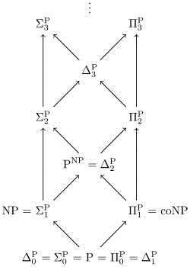
The Polynomial Hierarchy
∃^{p} L = { x in {0,1}* | (∃ w in {0,1}^{≤p(|x|)}) (x,w) in L }
∀^{p} L = { x in {0,1}* | (∀ w in {0,1}^{≤p(|x|)}) (x,w) in L }
∃^{P} C = { ∃^{p} L | p is a polynomial
and L in C }
∀^{P} C = { ∀^{p} L | p is a polynomial
and L in C }
Σ₀^{P} = Π₀^{P} = P
Σ_{i+1}^{P} = ∃^{P} Π_{i}^{P}
Π_{i+1}^{P} = ∀^{P} Σ_{i}^{P}
Σ₂^{P} = ∃^{P} Π₁^{P} = ∃^{P} ∀^{P} P

Slide 122
The ESS-RESTRICTED-SUPPORT problem
Input: symmetric 2-player normal-form game, subset T of the strategies S
Q: Does the game have an evolutionarily stable strategy whose support is restricted to (a subset of) T?

Slide 123
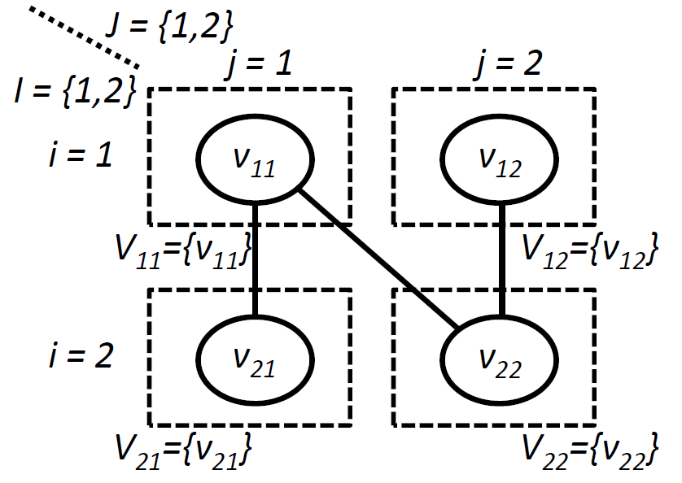
MINMAX-CLIQUE proved Π₂^{P}(=coΣ₂^{P})-complete by Ko and Lin [1995]
Input: graph G = (V, E), sets I and J, partition of V into subsets V_{ij} (for i in I and j in J), number k
Q: Is it the case that for every function t : I → J, U_{i} V_{i,t(i)} has a clique of size k?
Thank you, compendium by Schaefer and Umans!
, k=2

Slide 124
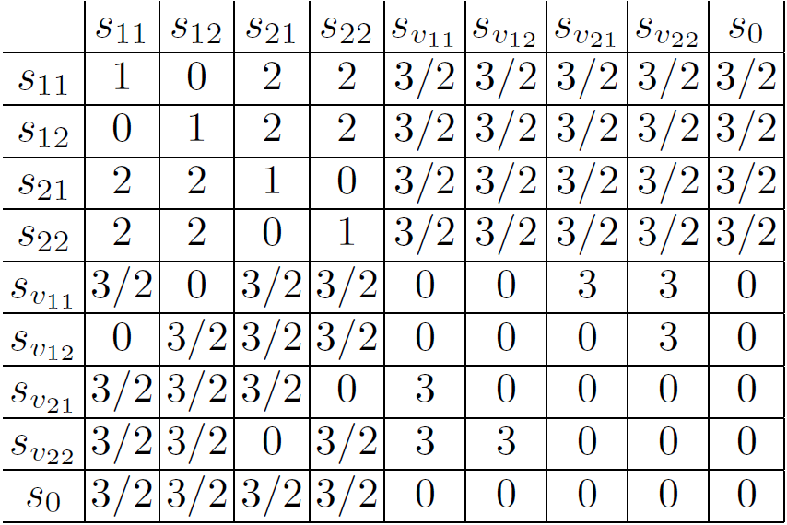
Illustration of reduction
T

Slide 125
Unrestricted support?
Just duplicate all the strategies outside T…
(Appendix: result still holds in games in which every pure strategy is the unique best response to some mixed strategy)

Slide 126
Bound on number of samples
Theorem. Finding all of the hyperplanes necessary to compute the optimal mixed strategy to commit to requires O(Fk log(k) + dLk²) samples
  F depends on the size of the smallest region
  L depends on desired precision
  k is the number of follower actions
  d is the number of leader actions

