Slide 1
CMU report
By
Christos Faloutsos
Rishi Chandy
Leman Akoglu
B. Aditya Prakash
U Kang

Slide 2
Q1) Critical Research Problems
C1) Patterns and anomalies
  C1.1) PICS -> community detection
  C1.2) Event Detection
C2) influence and virus propagation
  C2.1) Threshold conditions
  C2.2) Immunization
  C2.3) ‘winner takes all’
C3) scalability (‘Pegasus’) - gigaTensor

Slide 3
Q2) What are the most critical research issues in Network Discovery that will help military missions?
1) Anomaly Detection
2) Winner Takes All: competing viruses
Q3) Why is it critical to investigate inter-genre network discovery with cross-center efforts?
Q4) How may Network Discovery benefit from and help the research in other Thrusts?
1) Generalizable anomaly detection: CNARC
2) Influence propagation in networks: SNARC
Q5) What technology can be transferred successfully to military applications?
A: Pegasus System (downloaded by IBM, MSR, etc)

Slide 4
BACKUP SLIDES

Slide 5
Q1) Critical Research Problems
C1) Patterns and anomalies
  C1.1) PICS -> community detection
  C1.2) Event Detection
C2) influence and virus propagation
  C2.1) Threshold conditions
  C2.2) Immunization
  C2.3) ‘winner takes all’
C3) scalability (‘Pegasus’) - gigaTensor

Slide 6
Akoglu, Tong, Meeder, Faloutsos. PICS: Parameter-free Identification of Cohesive Subgroups in Large Attributed Graphs.
SDM 2012.

Slide 7
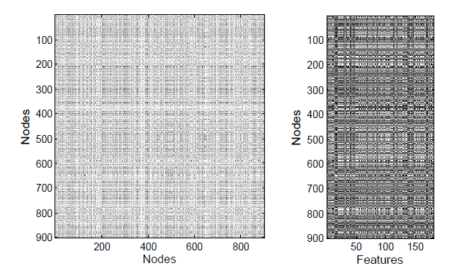
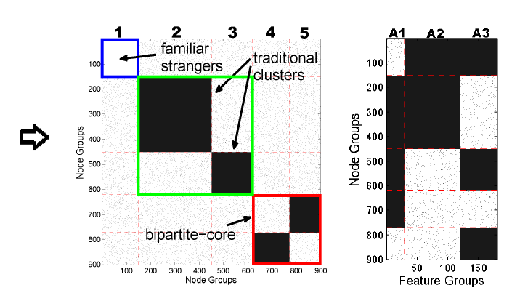

PICS: problem sketch
[SDM’12]
(Binary)
Features
Feature
Groups
People
People Groups
A
People
F
People
People Groups
People Groups
Given adjacency matrix A and feature matrix F
Find homogeneous blocks (clusters) in A and F
Spot anomalies, bridges
Notes:
Ex features

Slide 8
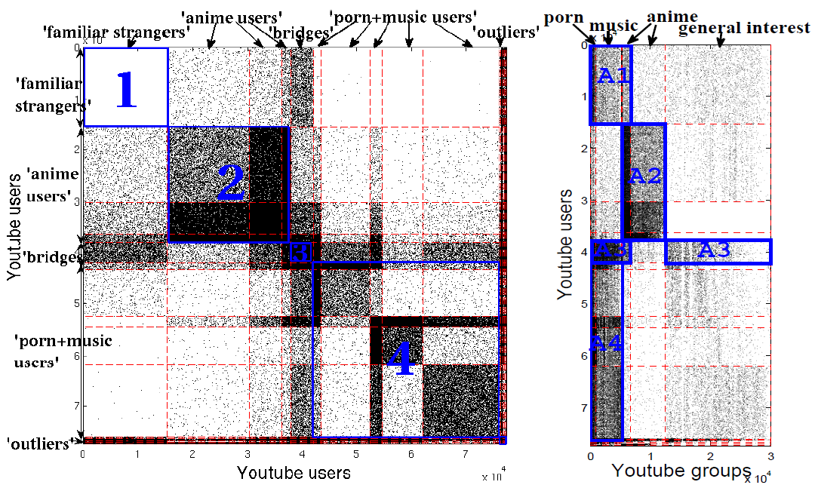
PICS at work (YouTube)
[SDM’12]
YouTube users
YouTube groups
77K users
30K groups

Slide 9
Akoglu, Faloutsos.
Event Detection in Time Series of Mobile Communication Graphs.
Army Science Conference 2010.

Slide 10



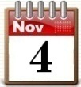
Event detection: problem
[Army Science’10]
Given a graph that changes over time
Find
“change-points”: time points at which many nodes change behavior significantly
“attribution”: top k nodes that cause change most

Slide 11
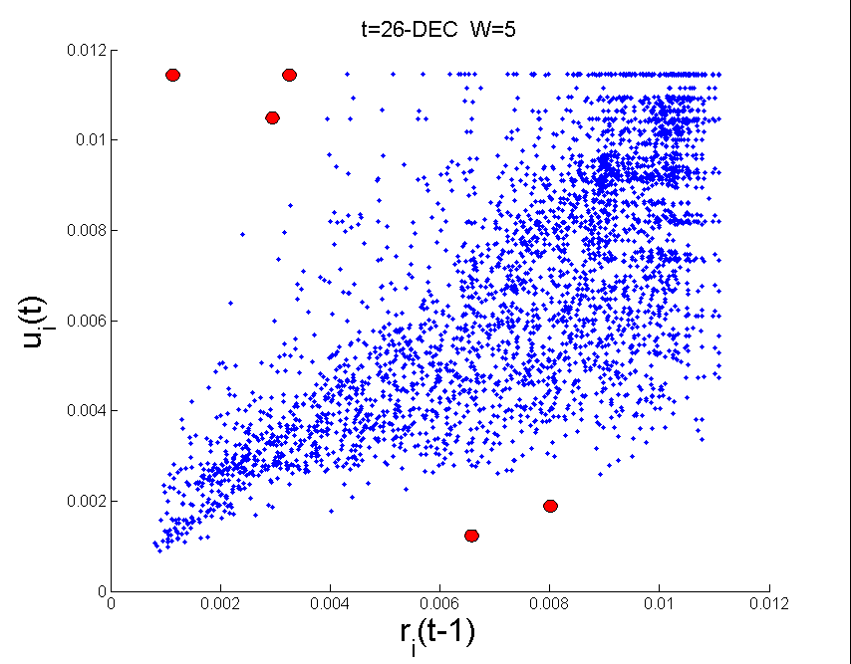
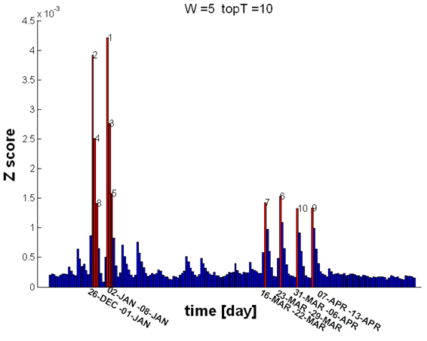
Event detection at work
[Army Science’10]
Christian New Year
DEC 26
“back to work”
Hindu New Year
no change zone
r(t-1)
(past)
u(t)
(current)
change detection
attribution

Slide 12
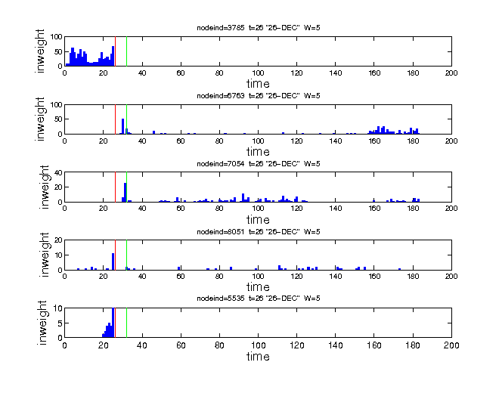
Event detection at work
[Army Science’10]
26 DEC
DEC 26
“back to work”
Hindi New Year
r(t-1)
no change zone
#SMS received
u(t)
change detection
attribution
time (days)

Slide 13
Q1) Critical Research Problems
C1) Patterns and anomalies
  C1.1) PICS -> community detection
  C1.2) Event Detection
C2) influence and virus propagation
  C2.1) Threshold conditions
  C2.2) Immunization
  C2.3) ‘winner takes all’
C3) scalability (‘Pegasus’) - gigaTensor

Slide 14
A. Prakash, D. Chakrabarti, M. Faloutsos, N. Valler, C. Faloutsos. Threshold Conditions for Arbitrary Cascade Models on Arbitrary Networks.
IEEE ICDM 2011.

Slide 15


A fundamental question
Strong Virus
Epidemic?

Slide 16
Static Graphs: Our Main Result
Informally,
For,
any arbitrary topology (adjacency
matrix A)
any virus propagation model (VPM) in
standard literature
the epidemic threshold depends only
on the λ, ﬁrst eigenvalue of A, and
some constant , determined by the virus propagation model
λ
No epidemic if λ * < 1
In Prakash+ ICDM 2011 (Selected among best papers).

Slide 17
Tong, B. Prakash, Tsourakakis, Eliassi-Rad, Faloutsos, Chau. On the Vulnerability of Large Graphs.
IEEE ICDM 2010.
Prakash, Adamic, Iwashyna (M.D.), Tong, Faloutsos. Fractional Immunization of Networks.
Under review.

Slide 18
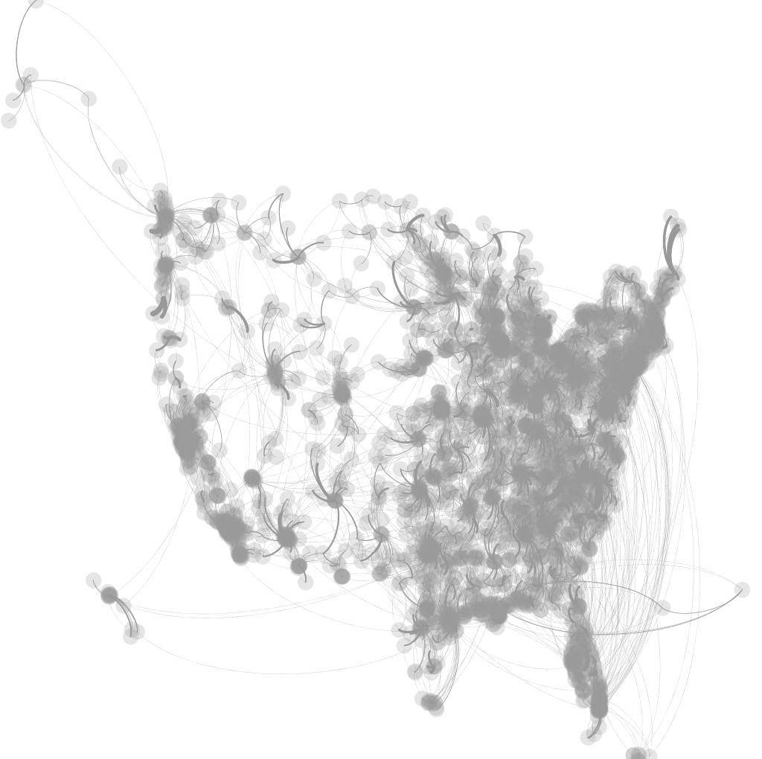
Epidemiology
Dynamical Processes over networks
Each circle is a hospital
~3000 hospitals
More than 30,000 patients transferred
[US-MEDICARE NETWORK 2005]
Problem: Given k units of disinfectant, whom to immunize?

Slide 19
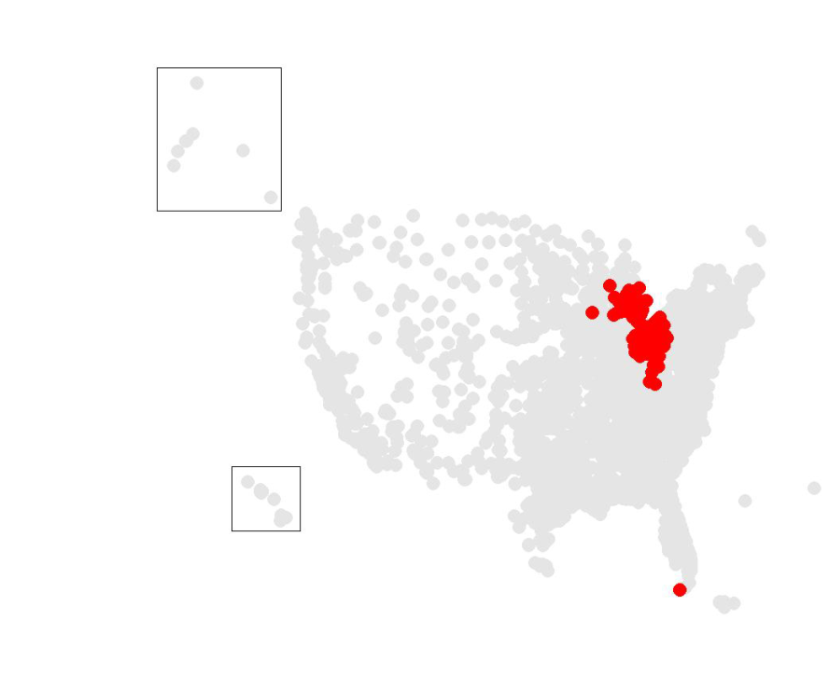
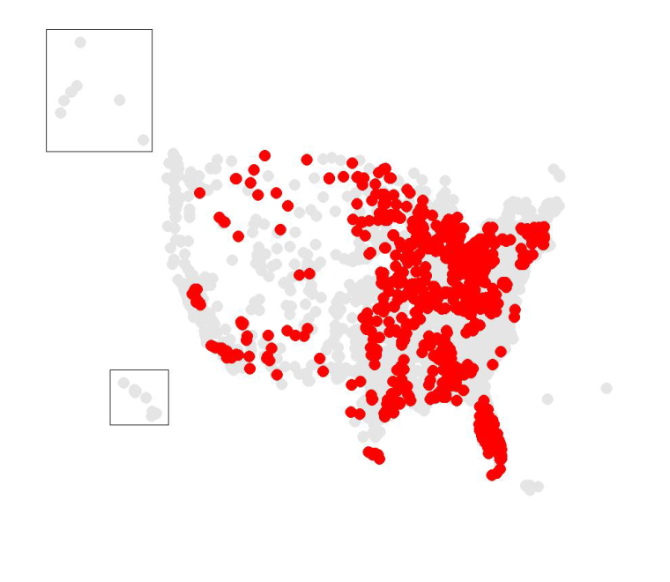
Epidemiology
~6x fewer!
[US-MEDICARE NETWORK 2005]
CURRENT PRACTICE
OUR METHOD
Hospital-acquired inf. took 99K+ lives, cost $5B+ (all per year)

Slide 20
Running Time
Wall-Clock Time
> 1 week
≈
> 30,000x speed-up!
Lower is better
14 secs
Simulations
SMART-ALLOC

Slide 21
Prakash, Beutel, Rosenfeld, Faloutsos
Winner-takes-all: Competing Viruses on fair-play networks.
WWW 2012.

Slide 22
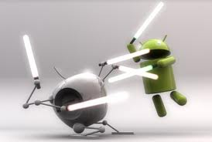

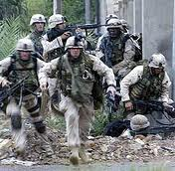
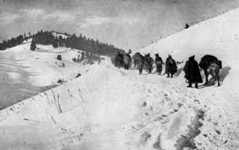
Competing Contagions
iPhone v Android
Blu-ray v HD-DVD
Attack
v
Retreat
Biological common flu/avian flu, pneumococcal inf etc

Slide 23
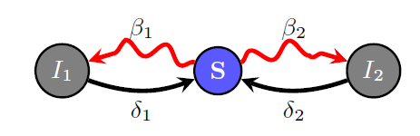


A simple model
Modified flu-like
Mutual Immunity (“pick one of the two”)
Susceptible-Infected1-Infected2-Susceptible
Virus 1
Virus 2

Slide 24
Our Result: Winner-Takes-All
Given our model, and any graph, the weaker virus always dies-out completely
Details
The stronger survives only if it is above threshold
Virus 1 is stronger than Virus 2, if:
strength(Virus 1) > strength(Virus 2)
Strength(Virus) = λ β / δ → same as before!
In Prakash+ WWW 2012

Slide 25
Q1) Critical Research Problems
C1) Patterns and anomalies
  C1.1) PICS -> community detection
  C1.2) Event Detection
C2) influence and virus propagation
  C2.1) Threshold conditions
  C2.2) Immunization
  C2.3) ‘winner takes all’
C3) scalability (‘Pegasus’) - gigaTensor

Slide 26
U Kang, Vagelis Papalexakis, Christos Faloutsos,
GigaTensor: Scaling Tensor Analysis Up By 100 Times - Algorithms and Discoveries
(under review)

Slide 27
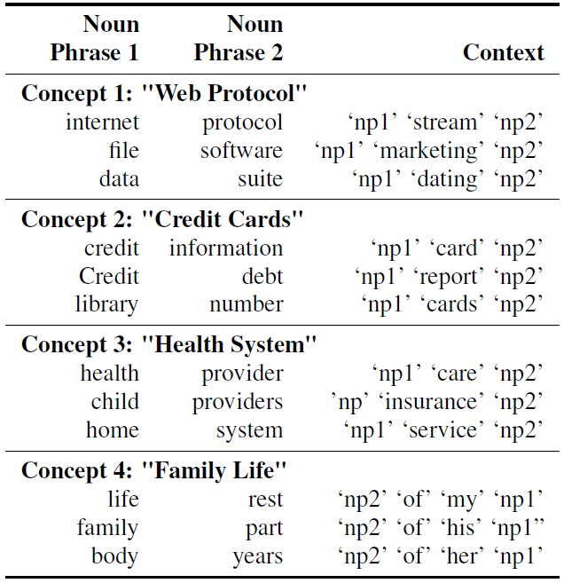
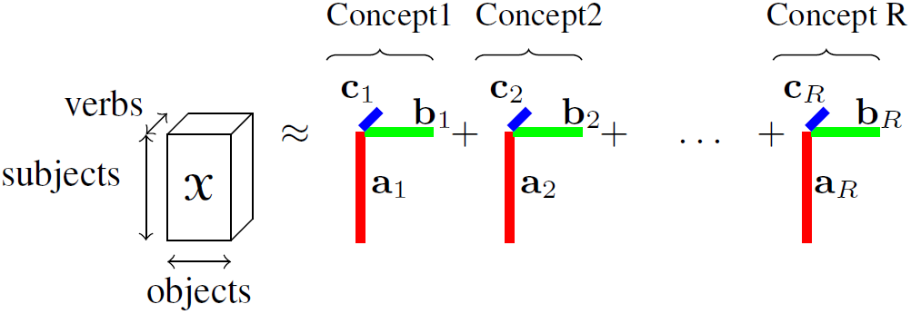
GigaTensor: Concept Discovery
Concept Discovery in Knowledge Base

Slide 28
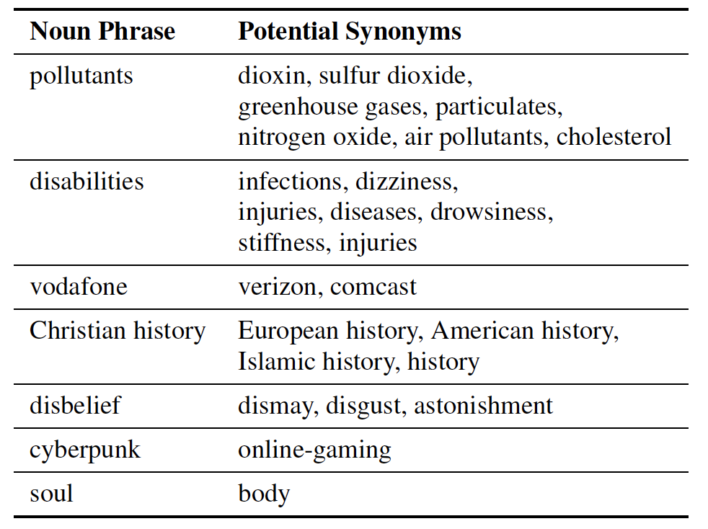
GigaTensor: synonym discovery

Slide 29
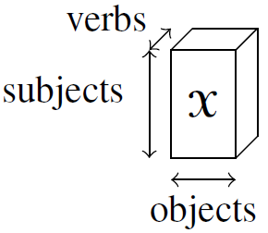
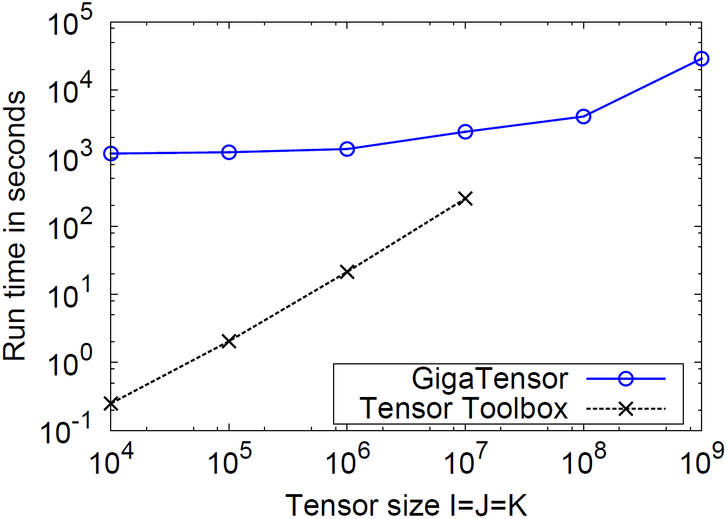
GigaTensor: Scalability
GigaTensor solves 100x larger problem
(K)
(J)
GigaTensor
(I)
100x
Number of
nonzero
= I / 50
Tensor
Out of
Toolbox
Memory

Slide 30
Kang, Meeder, and Faloutsos. Spectral Analysis for Billion-Scale Graphs: Discoveries and Implementation.
PAKDD 2011.

Slide 31


Pegasus System
Graph mining at massive scale
Apache open source license
Open Source Software World Challenge
  Silver Award winner

Slide 32
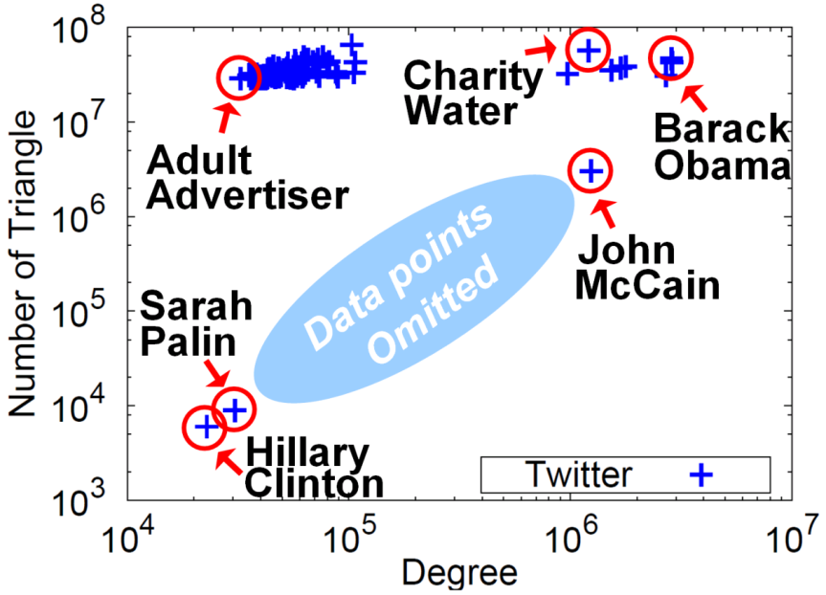
PEGASUS: Eigensolver
Triangle counting in Twitter social network
[Twitter 2009;
~ 60 million nodes
~ 3 billion edges]
U.S. politicians: moderate number of triangles vs. degree
Adult sites: very large number of triangles vs. degree

