Slide 1
Control of Instantaneously Coupled Systems Applied to Humanoid Walking
Eric C. Whitman & Christopher G. Atkeson
Carnegie Mellon University

Slide 2
Related Work
Trajectory generation + trajectory tracking
Takanishi 1990, Kajita 2003
Online regeneration of trajectories
Nishiwaki 2006
Model Predictive Control/Receding Horizon Control
Wieber 2006
Optimize footstep locations
Diedam 2008

Slide 3
Dynamic Programming
x₂
x₁
Bellman Equation:
Christopher G. Atkeson, “Randomly sampling actions in dynamic programming”, IEEE Symposium on Approximate Dynamic Programming and Reinforcement Learning, 2007.

Slide 4
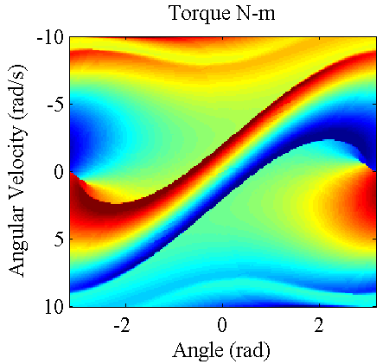
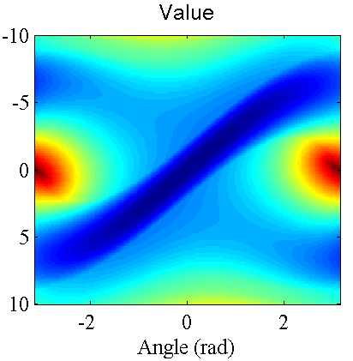
Dynamic Programming Output
Inverted Pendulum:
Swing-up

Slide 5
A Dynamic Programming Solution
Offline computation
Can optimize CoM motion and footstep timing/location
Even a simple model has a 10-D state space
Too high for DP
Decouple to reduce dimensionality
Add coordination variables to maintain optimality
100¹⁰=10²⁰ >> 100⁴+100⁴+100³+100³+100³=2.03x10⁸

Slide 6
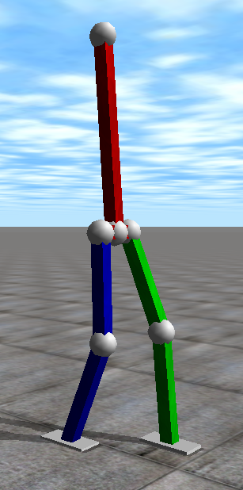
Simplify the System
DOFS:
12 + 6 = 18
DOFS:
12 + 6 – 3 = 15
Origin at foot
DOFS:
12 + 6 – 3 – 2*3 = 9
Origin at foot
Feet don’t rotate
DOFS:
12 + 6 – 3 – 2*3 – 3 = 6
Origin at foot
Feet don’t rotate
Torso doesn’t rotate
DOFS:
12 + 6 – 3 – 2*3 – 3 – 1 = 5
Origin at foot
Feet don’t rotate
Torso doesn’t rotate
Constant height CoM

Slide 7
The Simple System
3D LIPM
- 2 DOFS
Fully Controllable Swing Foot
- 3 DOFS
Kajita et. Al., “The 3d Linear Inverted Pendulum Model: A simple modeling for biped walking pattern generation”, ICRA 2001.

Slide 8
Instantaneously Coupled Systems (ICS)
Partition the state and action space
Normally dynamics are independent
Dynamics are coupled at specific instants
Additive cost -> Independent Policies

Slide 9
Decoupling the System
Sagittal Subsystem
Coronal Subsystem
Swing-Z
Subsystem
Z
Y
Z
Z
Z
X
Y
X
Panne et. Al., “A controller for the dynamic walk of a biped across variable terrain”, Conference on Decision and Control, 1992.
Yin et. Al., “Simbicon: simple biped locomotion control”, SIGGRAPH 2007.

Slide 10
Adding Coordination Variables
Solve for all possible and pick the best later
Add as an additional state to all sub-systems
Trivial dynamics:
DP produces
At run-time, we have , so we get

Slide 11
Value: V(t_{td})

Slide 12
t_{td}

Slide 13
Coordinating Footstep Time & Location
Split up stance & swing legs
5 Policies – one for each DoF
Replace with
Drop/combine unnecessary variables
DP produces
At run-time, we have , so we get
Pick optimal by minimizing

Slide 14
Full Controller
Subsystem Value
Functions
Optimize Coordination Variables
System
State
Stance Ankle Torque
Swing Foot Acceleration
Joint
Torques
Dynamic Balance
Force Control
Subsystem Policies
Benjamin J. Stephens, “Dynamic balance force control for compliant
humanoid robots”, IROS 2010.

Slide 15
Results – Push Recovery Video

Slide 16
Results – Push Recovery
Forward Pushes
Leftward Pushes
Rightward Pushes
Rearward Pushes

Slide 17
Results – Push Recovery

Slide 18
Results – Speed Control Video

Slide 19
Results – Speed Control

Slide 20
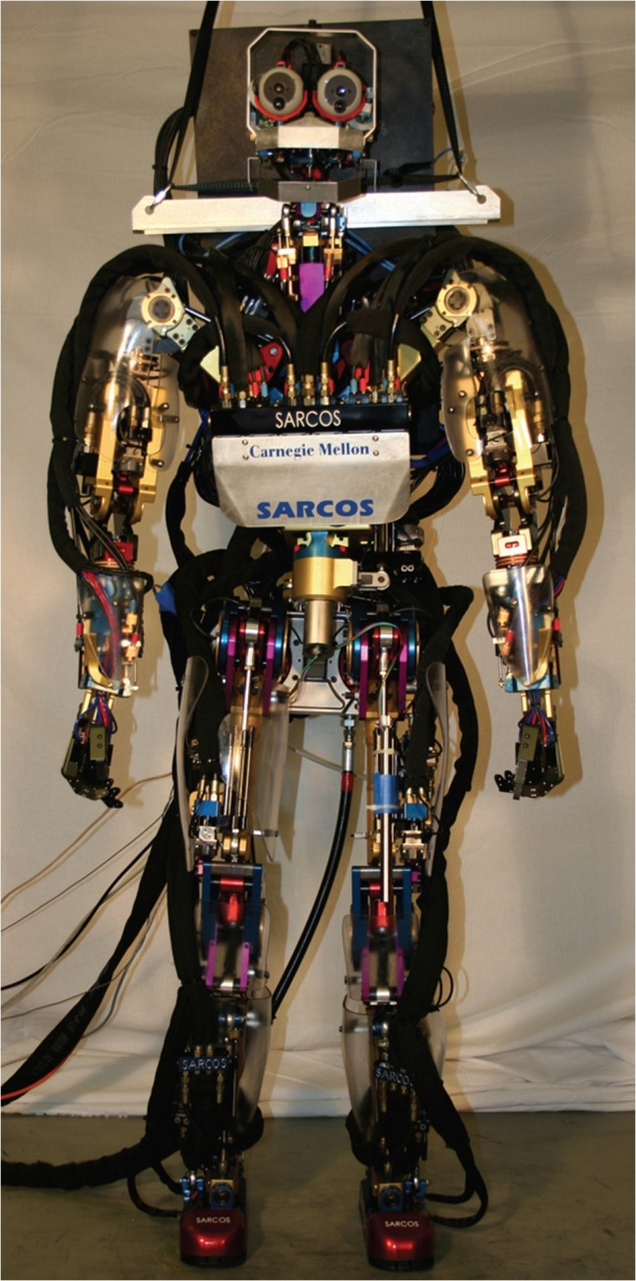
Future Work
Implement on hardware
Increase capability
Turning
Rough/uneven ground
Improve performance
Torso rotation
Non-LIPM walking
Arm swing
Toe off / Heel strike

Slide 21
Conclusion/Key Points
Dynamic programming is valid for large regions of state space and fast at run-time
Splitting the system into subsystems makes dynamic programming feasible
Augmenting the subsystems with coordination variables restores optimality
Simultaneously optimizes CoM motion, footstep timing, and footstep location
React in real-time to unexpected disturbances

Slide 22
Questions?

Slide 23
Walking as an ICS
Sagittal
Swing-Z
Coronal
Z
Z
Z
X
Y
States:
Actions:

Slide 24
Separate Policies for Stance & Swing Legs
States:
Actions:

Slide 25
The System
Bentivegna et. Al., “Compliant control of a compliant humanoid joint”, Humanoids 2007.

Slide 26
t_{td}/t_{lo} as a State
Trivial Dynamics:

Slide 27
Forward Push Video

Slide 28
Backward Push Videos

