Slide 1

System Identification
16-299 Intro to Feedback Control Systems Spring 2022
Wenzhen Yuan
4/12/2022

Slide 2
What is System Identification?
System
Input
Output
Goal: calculating the function f with the parameter theta
Typically, this is achieved based on the input and output data

Slide 3
Model of the system?
System
Input
Output
White box: A physical/analytical description of the dynamics of a system for which a lot of information is known a priori
Black box: A completely empirical description of the dynamics of a system for which essentially no information is known a priori
Gray box: A combination of the two
  If the “known” white-box part can be subtracted out

Slide 4
System identification: model from data
System
Input
Output
In general, system ID is experimental and heuristic
Experiment design
Selection of model structure – based on prior knowledge and trial and error
Choice of the criterion to fit
Parameter estimation
Model validation

Slide 5
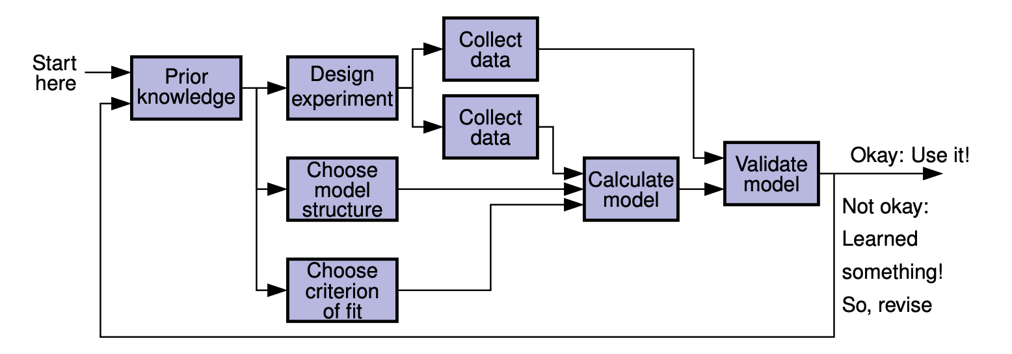
System identification process: Iterative on many levels
Figure credit: Gregory Plett

Slide 6


Revisit the topic of transfer function
Impulse response:
0
A way to identify the system!
So, when the input signal is an impulse signal, the output response equals to the system’s transfer function
It’s generalized, works for all LTI systems
Unfortunately, it’s difficult to experimentally generate an impulse signal

Slide 7
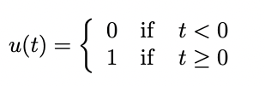
Revisit the topic of transfer function
Non-parametric methods for system ID
1
Step response
0
Getting a generic model of the system
Input signal much easier to generate

Slide 8


Revisit the topic of transfer function
gain
Phase shift

Slide 9
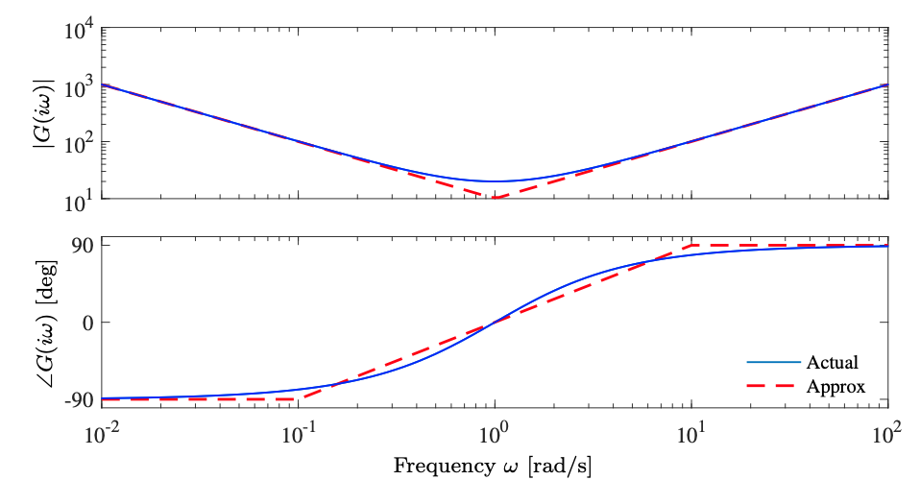

The Bode Plot
A method that visualizes the frequency response
(Typically use a log/log scale for the gain curve and a log/linear scale for the phase curve)
Notes:
Ideal PID controller

Slide 10
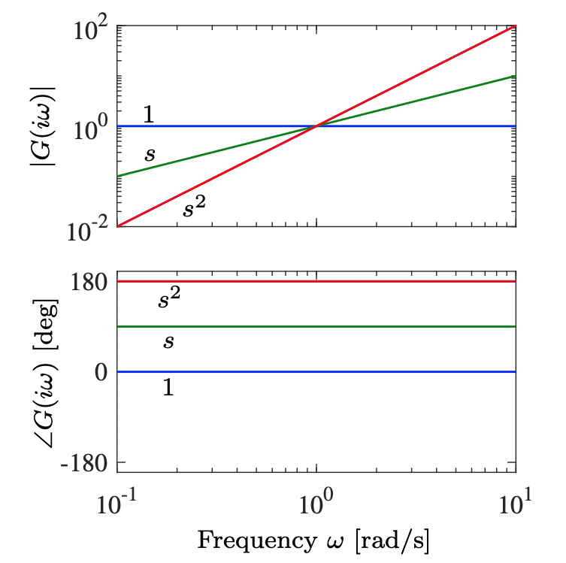
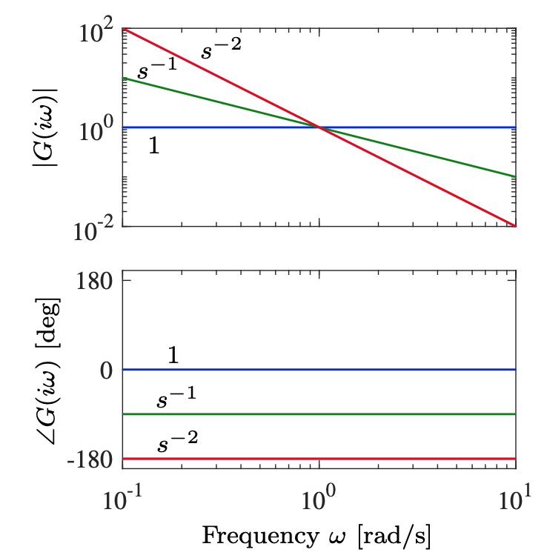
The Bode Plot
What’s the bold plot for s⁻¹, 1, and s?
What’s the gain and phase shift?

Slide 11
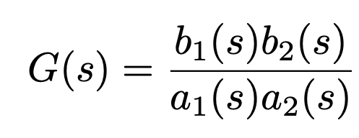
The Bold Plot
Considering a transfer function:
How to calculate the gain and phase shift?

Slide 12
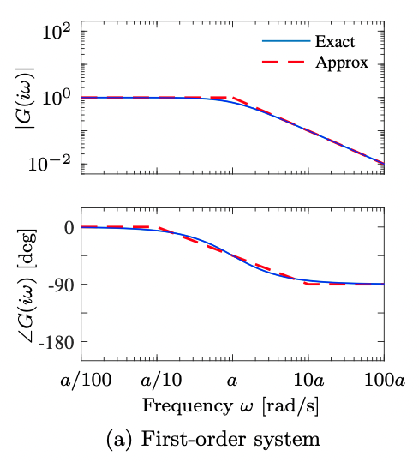
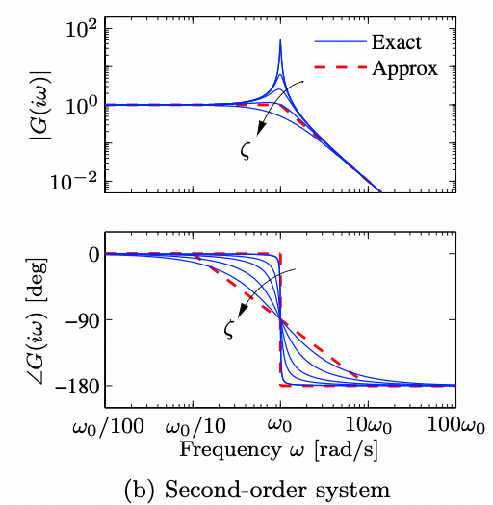
The Bode Plot

Slide 13
Revisit the topic of transfer function
To get the transfer function, we can sweep through all the possible frequencies, and measure the corresponding gain and phase shift
gain
Phase shift
ISSUE: impossible to cover all frequencies from 0 to infinite
ISSUE: For very low frequency inputs, this can take hours or days
-- In practice, we can select only a few frequencies and interpolate between the measured data

Slide 14
Parametric models
Based on an exiting model. Fitting parameters based on experimental data.
Each of these methods has their own advantages and disadvantages and is commonly used in real-world applications. choice of the model structure to use depends on the dynamics and the noise characteristics of the system

Slide 15
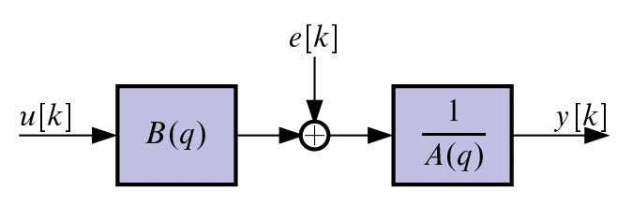

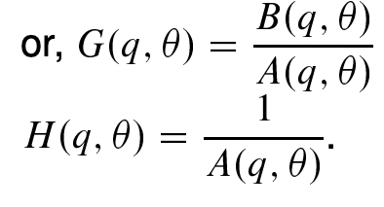
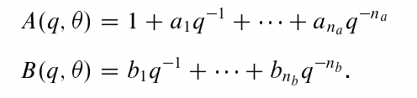

Parametric model: ARX model
Transfer function
Filters are defined as polynomials
The ARX model is parametrized by
Need to assume the order (n_{a} and n_{b})

Slide 16
State Space model
X – state vector
Y – system output
U – system input
E – stochastic error
A, B, C, D, K: system matrics
Commonly used in modern control methods; a more complete representations of the system
Parameter settings are simpler – only need to select the order/ states, of the model
May require large number of data points so that could be slow

Slide 17
Summary
System identification: build the model of the system based on input and output sampling
Experiment-based: design the process of data collection
Non-parametric methods and parametric methods
Various model structures available
  Choice of the model is based on an understanding of the system and the system ID algorithm
Disturbance!
Identification tools (Matlab, Matrix or LabVIEW) are available for developing, prototyping and deploying control algorithms

