Slide 1

Model Predictive Control for Humanoid Balance and Locomotion
Benjamin Stephens
Robotics Institute

Slide 2
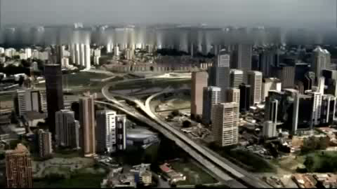

Slide 3
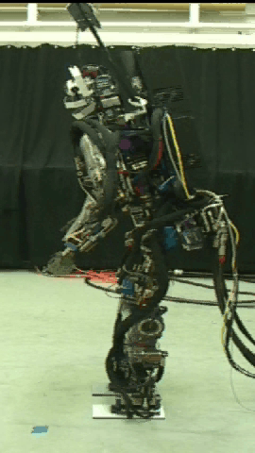
Compliant Balance and Push Recovery
Full body compliant control
Robustness to large disturbances
Perform useful tasks in human environments

Slide 4
Motivation
Improve the performance and usefulness of complex robots, simplifying controller design by focusing on simpler models that capture important features of the desired behavior
Enabling dynamic robots to interact safely with people in everyday uncertain environments
Modeling human balance sensing, planning and motor control to help people with disabilities

Slide 5
Outline
Optimal Control Formulation
Humanoid Robot Control
Examples and Problems

Slide 6
Outline
Optimal Control Formulation
Formulate balance and foot
placement control as an
optimal control problem

Slide 7
Linear Inverted Pendulum Model
Assumptions:
  Zero vertical acceleration
  No torque about COM
Constraints:
  COP within the base
  of support
REFERENCE:
Kajita, S.; Tani, K., "Study of dynamic biped locomotion on rugged terrain-derivation and application of the linear inverted pendulum mode," ICRA 1991

Slide 8
LIPM State Space Dynamics

Slide 9
LIPM State Space Trajectories

Slide 10
Optimal Control Objective

Slide 11
Optimal Control Constraints

Slide 12
Optimal Control of Walking
Objective Function
Must provide footstep locations and timings
Double support is largely ignored
Wieber, P.-B., "Trajectory Free Linear Model Predictive Control for Stable Walking in the Presence of Strong Perturbations," Humanoid Robots 2006

Slide 13
Optimal Control with Foot Placement
Next 3 Footsteps:
Time of step is encoded in U₀ and U₁
Diedam, H., et. al., "Online walking gait generation with adaptive foot positioning through Linear Model Predictive control," IROS 2008

Slide 14
Optimal Step Recovery
Objective Function
1.
2.
3.
Must provide footstep timing
Must decide which foot to step with
Constraints in double support are nonlinear due to variable foot location

Slide 15
Optimal Step Recovery
a=1e-6 b=0.1 c=0.01 d=1e-6
X0 = [0,0,0.4,-0.1]
T=0.05 Tstep=0.4 N=20

Slide 16
Initial double support phase
Tdsp = 0.0s Tstep = 0.45s
Tdsp = 0.1s Tstep = 0.35s

Slide 17
Re-planning after each step (3-step)

Slide 18
Walking

Slide 19
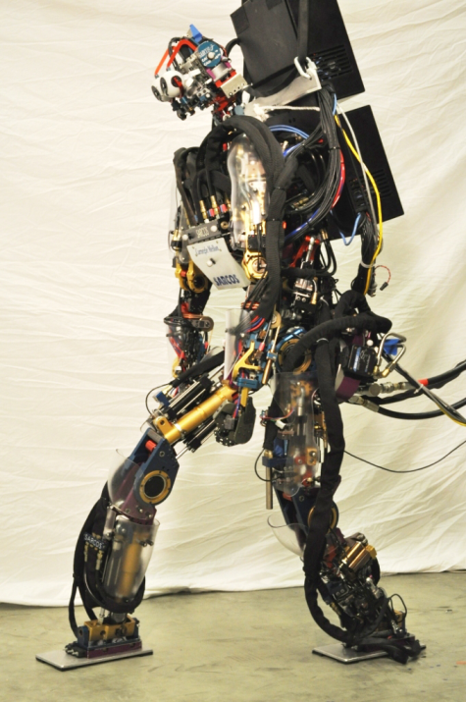
Outline
Optimal Control Formulation
Humanoid Robot Control
Examples and Problems

Slide 20
Outline
Humanoid Robot Control
Use MPC inside feedback loop
to generate desired contact
forces and joint torques

Slide 21
Simple Biped Dynamics
Instantaneous 3D biped dynamics form a linear system in contact forces.
Center of pressure (COP)
Angular momentum
Foot locations
Center of mass (COM)

Slide 22
Simple Biped Inverse Dynamics
The contact forces can be solved for generally using constrained quadratic programming
Least squares problem
(quadratic programming)
Linear Inequality Constraints
COP under each foot
Friction

Slide 23
Controlling a Complex Robot with a Simple Model
Full body balance is achieved by
controlling the COM using the policy
from the simple model.
The inverse dynamics chooses from
the set of valid contact forces the forces
that result in the desired COM motion.

Slide 24
General Humanoid Robot Control
Dynamics
Contact constraints
Control Objectives
Desired
COM Motion
Pose Bias

Slide 25
General Humanoid Robot Control

Slide 26
Feed-forward Force Inverse Dynamics
Pre-compute contact forces using simple model and substitute into the dynamics

Slide 27
Other Tasks
Posture Control
Angular Momentum Regulation
Swing Foot Control
Task Control (e.g. lifting heavy object)
Benjamin Stephens, Christopher Atkeson, "Push Recovery by Stepping for Humanoid Robots with Force Controlled Joints,"Accepted to 2010 International Conference on Humanoid Robots, Nashville, TN.
Benjamin Stephens, Christopher Atkeson, "Dynamic Balance Force Control for Compliant Humanoid Robots,“ 2010 International Conference on Intelligent Robots and Systems (IROS), Taipei, Taiwan.

Slide 28
Outline
Optimal Control Formulation
Humanoid Robot Control
Examples and Problems

Slide 29
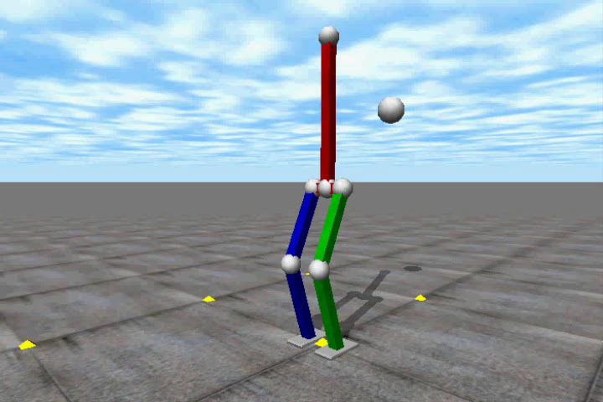

Slide 30
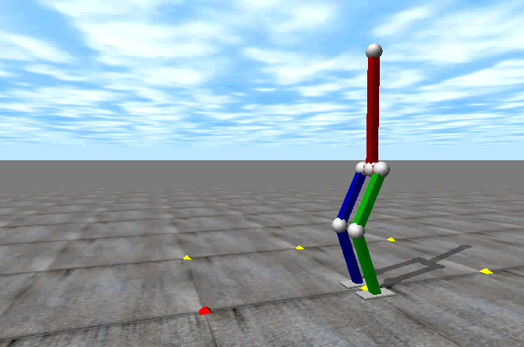

Slide 31
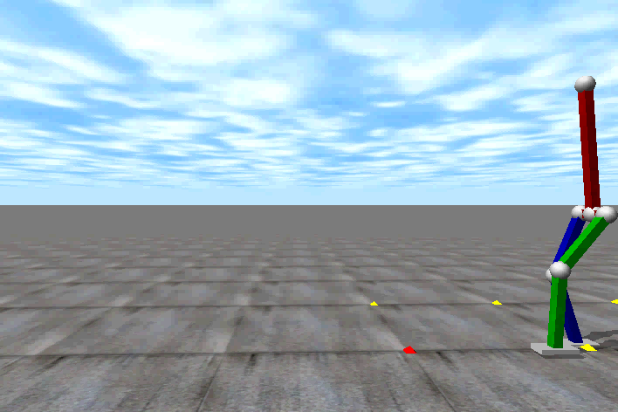

Slide 32
Unperturbed Walking In Place

Slide 33
Large Mid-Swing Push While Walking in Place

Slide 34
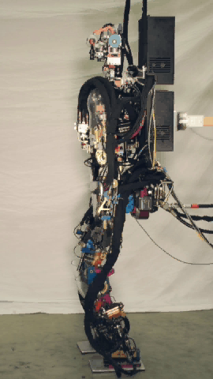
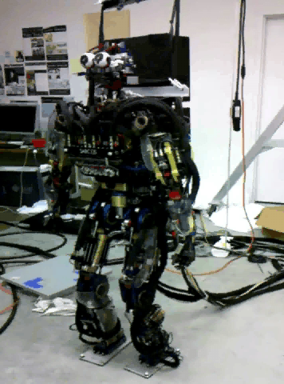

Slide 35
Extensions
Different Models
  Swing Leg
  Torso
  Angular Momentum
Different Objective Functions
  Capture Point
  Minimum Variance Control
Step Time Optimization

Slide 36
Open Problems
Learning from experience
Using human motion capture
Higher-level planning
State Estimation and Localization

