Slide 1
Control of Full Body Humanoid Push Recovery Using Simple Models
Benjamin Stephens
Thesis Proposal
Carnegie Mellon, Robotics Institute
November 23, 2009
Committee:
Chris Atkeson (chair)
Jessica Hodgins
Hartmut Geyer
Jerry Pratt (IHMC)

Slide 2
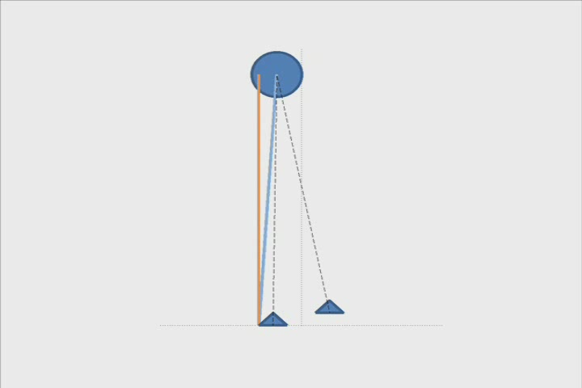

Slide 3
Thesis Proposal Overview
Simple models can be used to simplify control of full-body push recovery for complex robots
Simple approximate dynamics model with COM and two feet
Strategy decisions and optimization over future actions
Reactive full-body force control

Slide 4
Motivations
Improve the performance and usefulness of complex robots, simplifying controller design by focusing on simpler models that capture important features of the desired behavior
Enabling dynamic robots to interact safely with people in everyday uncertain environments
Modeling human balance sensing, planning and motor control to help people with balance disabilities

Slide 5
Approaches to Humanoid Balance
Proposed Work
Inverse-Dynamics-Based Control
Hyon, et. al., ’07
Sentis, ‘07
Reflexive Control
Pratt, ‘98
Yin, et. al., ’07
Geyer ‘09
Examples
ZMP Preview Control
S. Kajita, et.al., ‘03
Passive Dynamic Walking
McGeer ’90
Utilizes Simple Model(s)
Reactive to Pushes
Controls Complex Robot
Optimizes Over the Future

Slide 6
Expected Contributions
Analytically-derived bounds on balance stability defining unique recovery strategies
Optimal control framework for planning step recovery and other behaviors involving balance
Transfer of dynamic balance behaviors designed for simple models to complex humanoid through force control

Slide 7
Outline
Simple Models of Biped Balance
Push Recovery Strategies
Optimal Control Framework
Humanoid Robot Control
Proposed Work and Timeline

Slide 8
Outline
Simple Models of Biped Balance
Push Recovery Strategies
Optimal Control Framework
Humanoid Robot Control
Proposed Work and Timeline

Slide 9
Outline
Simple Models of Biped Balance
Push Recovery Strategies
Optimal Control Framework
Humanoid Robot Control
Proposed Work and Timeline

Slide 10
Outline
Simple Models of Biped Balance
Push Recovery Strategies
Optimal Control Framework
Humanoid Robot Control
Proposed Work and Timeline

Slide 11
Outline
Simple Models of Biped Balance
Push Recovery Strategies
Optimal Control Framework
Humanoid Robot Control
Proposed Work and Timeline

Slide 12
Outline
Simple Models of Biped Balance
Push Recovery Strategies
Optimal Control Framework
Humanoid Robot Control
Proposed Work and Timeline

Slide 13
Simple Models
Very simple dynamic models approximate full body motion

Slide 14
Simple Biped Dynamics
The sum of forces on the COM results in an acceleration of the COM
Foot locations
Center of mass (COM)

Slide 15
Simple Biped Dynamics
The COP is the origin point on the ground of the force that is equivalent to the
contact forces
Center of pressure (COP)

Slide 16
Simple Biped Dynamics
Ground torques can be used to move the COP or apply moments to the COM
Angular momentum

Slide 17
Simple Biped Dynamics
The base of support defines the limits of the COP and, consequently, the maximum
force on the COM

Slide 18
Simple Biped Dynamics
Instantaneous 3D biped dynamics form a linear system in contact forces.

Slide 19
Simple Biped Inverse Dynamics
The contact forces can be solved for generally using constrained quadratic programming
Least squares problem
(quadratic programming)
Linear Inequality Constraints
COP under the feet
Friction

Slide 20
3D Linear Biped Model
The Linear Biped Model is a special case derived by making a few additional assumptions:
  Zero vertical acceleration
  Sum of moments about COM is zero
  Forces/moments are distributed linearly
REFERENCE:
Stephens, “3D Linear Biped Model for Dynamic Humanoid Balance,” Submitted to ICRA 2010

Slide 21
Linear Double Support Region
Using a fixed double support-phase transition policy, the weights can be defined by linear functions
Rotated Coordinate Frame
Linear Weighting Functions
REFERENCE:
Stephens, “Modeling and Control of Periodic Humanoid
Balance using the Linear Biped Model,” Humanoids 2009

Slide 22
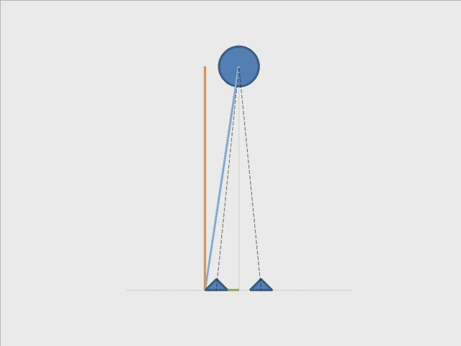
Using Linear Biped Model
Analytic solution of contact forces and phase transition allows for explicit modeling of balance control.

Slide 23
Push Recovery Strategies For Simple Models
Simple model dynamics define unique human-like recovery strategies

Slide 24

Three Basic Strategies
From simple models, we can describe three basic push recovery strategies that are also observed in humans
1.
2.
3.

Slide 25
Ankle Strategy
Assumptions:
  Zero vertical acceleration
  No torque about COM
Constraints:
  COP within the base
  of support
REFERENCE:
Kajita, S.; Tani, K., "Study of dynamic biped locomotion on rugged terrain-derivation and application of the linear inverted pendulum mode," ICRA 1991

Slide 26
Ankle Strategy
Linear constraints on the COP define a linear stability region for which the ankle strategy is stable
COM Velocity
COM Position
REFERENCE:
Stephens, “Humanoid Push Recovery,” Humanoids 2007

Slide 27
Hip Strategy
Assumptions:
  Zero vertical acceleration
  Treat COM as a flywheel
Constraints:
  Flywheel “angle” has limits
REFERENCE:
Pratt J, Carff J., Drakunov S., Goswami A., “Capture Point: A Step toward Humanoid Push Recovery” Humanoids, 2006

Slide 28
Hip Strategy
Linear bounds for the hip strategy are defined by assuming bang-bang control of the flywheel to maximum angle
COM Velocity
COM Position
Stephens, “Humanoid Push Recovery,” Humanoids 2007

Slide 29
Stepping
Stepping can move the base of support to recover from much larger pushes. Simple models can predict step time, step location and the number of steps required to recover balance.
COM Velocity
1.
2.
3.
4.
REFERENCE:
Pratt J, Carff J., Drakunov S., Goswami A., “Capture Point: A Step toward Humanoid Push Recovery” Humanoids, 2006
COM Position

Slide 30
Stepping
Stepping can move the base of support to recover from much larger pushes. Simple models can predict step time, step location and the number of steps required to recover balance.
COM Velocity
1.
2.
3.
4.
REFERENCE:
Pratt J, Carff J., Drakunov S., Goswami A., “Capture Point: A Step toward Humanoid Push Recovery” Humanoids, 2006
COM Position

Slide 31
Stepping
Stepping can move the base of support to recover from much larger pushes.
COM Velocity
1.
2.
3.
4.
COM Position
REFERENCE:
Pratt J, Carff J., Drakunov S., Goswami A., “Capture Point: A Step toward Humanoid Push Recovery” Humanoids, 2006

Slide 32
Stepping
Analytic models can predict step time, step location and the number of steps required to recover balance.
Capture Region
Location of capture step that results in stable recovery
Reaction Region
Location of COP during capture swing phase
REFERENCE:
Pratt J, Carff J., Drakunov S., Goswami A., “Capture Point: A Step toward Humanoid Push Recovery” Humanoids, 2006

Slide 33
Strategy State Machine
Analytic push recovery strategies can be incorporated into a finite state machine framework that then generates appropriate responses.
Ankle Strategy
Hip
Strategy
Stepping
Simple Model Look-up

Slide 34
Optimal Control For Simple Model Push Recovery
Efficient optimal control performed on simple models approximates desired behavior of the full system.

Slide 35
Optimal Control of Simple Model
The dynamics of the simple model can be used to efficiently perform optimal control over an N-step horizon.
LIPM Dynamics
COP Output
N-step LIPM Dynamics
N-step COP Output
REFERENCE:
Kajita, S., et. al., "Biped walking pattern generation by using preview control of zero-moment point," ICRA 2003

Slide 36
Optimal Control of Simple Model
Given footstep location, optimal control can solve for the optimal trajectory of the COM
Objective Function
REFERENCE:
Wieber, P.-B., "Trajectory Free Linear Model Predictive Control for Stable Walking in the Presence of Strong Perturbations," Humanoid Robots 2006

Slide 37
Optimal Control for Stepping
Footstep location can be added to the optimization to determine optimal step location and COM trajectory.
REFERENCE:
Diedam, H., et. al., "Online walking gait generation with adaptive foot positioning through Linear Model Predictive control," IROS 2008

Slide 38
Optimal Step Recovery (Example)

Slide 39
Optimization of Swing Trajectory
The optimization can be augmented to generate natural swing foot trajectories.

Slide 40
Optimization of Torso Lean
Similarly, a third mass corresponding to the torso can be added. This can be used to model small rotations of the torso and hip strategies.

Slide 41
Angular Momentum Regulation
Large angular momentum about the COM must be dissipated quickly to regain balance
There are two simple possibilities for dissipating angular momentum:
Asymptotically decrease angular momentum using a fixed controller
Include change of angular momentum in the optimization
REFERENCE:
M. Popovic, A. Hofmann, and H. Herr, "Angular momentum regulation during human walking: biomechanics and control,“ ICRA 2004

Slide 42
Minimum Variance Control
As opposed to minimizing jerk trajectories, it has been suggested that a more human-like objective function minimizes the variance at the target.
REFERENCE:
Harris, Wolpert, “Signal-dependent noise determines motor planning” Nature 1998

Slide 43
Humanoid Robot Control Using Simple Models
Dynamics, strategies and optimal control of simple models can be combined to control full-body push recovery

Slide 44
Controlling a Complex Robot with a Simple Model
Full body balance is achieved by
controlling the COM using the policy
from the simple model.
The inverse dynamics chooses from
the set of valid contact forces the forces
that result in the desired COM motion.
Variable
Fixed
Contact Force Selection

Slide 45
General Humanoid Robot Control
Dynamics
Contact constraints
Control Objectives
Desired
COM Motion
Pose Bias
Variable
Fixed
Contact Force Selection

Slide 46
General Humanoid Robot Control
Variable
Fixed
Contact Force Selection

Slide 47
General Solution To Inverse Dynamics
Weighted least-
squares solution
Linear Inequality Constraints:
COP under the feet
Friction
Fully general solution
Many “weights” to tune
May choose undesirable forces
Variable
Fixed
Contact Force Selection

Slide 48
Feed-forward Force Inverse Dynamics
Pre-compute contact forces using simple model and substitute into the dynamics
Linear System
Easier to solve
Less “weights” to tune
More model/task-specific
Pre-computing forces may be difficult
Variable
Fixed
Contact Force Selection

Slide 49
Simple Model Policy-Weighted
Inverse Dynamics
Automatically generate weights according to the optimal controller.
  2nd order model of the value function determines cost function for applying non-optimal controls.
Variable
Fixed
Contact Force Selection

Slide 50
Simple Model Policy-Weighted
Inverse Dynamics
Using the simple model, the cost function can be converted into weights on inverse dynamics.
Variable
Fixed
Contact Force Selection

Slide 51
Task Control During Balance
Modeled as a virtual external force/torque on the system
Virtual COM Dynamics
Virtual Humanoid Dynamics
REFERENCE:
Pratt J., et.al., “Virtual Actuator Control," IROS 1996

Slide 52
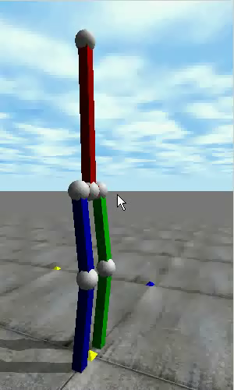
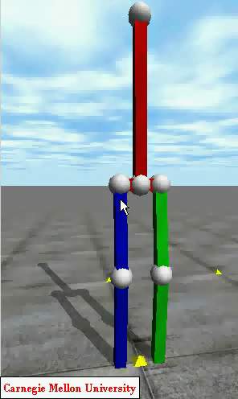
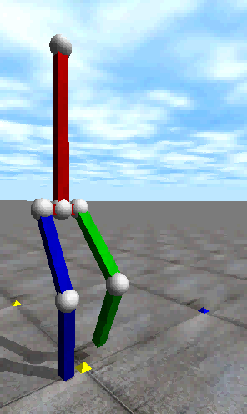
Simulation of Full Body Push Recovery

Slide 53

Robot Push Recovery Experiments

Slide 54
Proposed Work

Slide 55
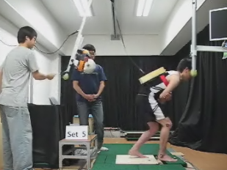
Proposed Work
Implementation of human-like push recovery strategies on the Sarcos humanoid robot

Slide 56
Proposed Work
Simple model dynamics
Simple model inverse dynamics
Completed
In Progress
Standing balance strategies
Stepping strategies
Strategy switching state machine
To be completed
Optimal control of stepping
Extensions to model (swing leg dynamics, hip strategy, etc.)
Sequential quadratic programming to determine optimal step time
2nd order optimization generating local value function approximation
Full-body inverse kinematics tracking of optimal plan
Force feed-forward inverse dynamics for standing balance
Force feed-forward inverse dynamics for stepping
Policy-weighted inverse dynamics
Integral control for robustness

Slide 57
Receding Horizon Control of Simple Model
The full body will not exactly agree with the simple model , but by re-optimizing over a receding horizon, control can be robust to small errors.

Slide 58
2nd Order Optimization of Simple Model
A 2nd order optimization method produces a local approximation of the value function along the trajectory
Initial State
Optimal Trajectory
Local 2nd order model of value function
The 2nd order model describes the relative cost of applying an action other than the optimal action
Simple Model Policy-Weighted Inverse Dynamics
Goal

Slide 59
Sequential Quadratic Programming
SQP used to solve non-linear problems:
  Step Time Optimization
    Existing optimal control framework is only linear if a fixed step time is assumed.
  Double Support Constraints
    Because the step location is variable, the true double support constraints are nonlinear.
Analytic models can be used to estimate fixed values or provide good initial guesses.

Slide 60
Integral Balance Control
Integral Balance Control, related to 2nd-order sliding mode control, was previously applied to control of humanoid balance.
Can this method be used to transfer robust control of simple system to the full body?
REFERENCE:
Stephens, “Integral Control of Humanoid Balance," IROS 2007
Levant, “Sliding order and sliding accuracy in sliding mode control”, Journal of Control, 1993

Slide 61
Timeline
November ‘09 – Thesis Proposal
  6 months – Controller theory/refinement
    1 month – Open loop planning
    2 months – Receding horizon planning
    3 months – Policy-weighted inverse dynamics
  4 months – Experiments
    1 month - Step recovery robot experiments
    2 month - Multiple strategy robot experiments
    1 month – Comparison to human experiments
  2 months – Thesis writing
December ‘10 - Defense

Slide 62
Conclusion

Slide 63
Thesis Proposal Overview
Simple models can be used to simplify control of full-body push recovery for complex robots
Simple approximate dynamics model with COM and two feet
Strategy decisions and planning over future actions
Reactive full-body force control

Slide 64
Acknowledgements
Questions?
Committee:
  Chris Atkeson (Advisor/Chair)
  Jessica Hodgins
  Hartmut Geyer
  Jerry Pratt (IHMC/External)
Stuart Anderson
People who helped with practice talk

