Slide 1

Modeling and Control of Periodic Humanoid Balance Using the Linear Biped Model
Benjamin Stephens
Carnegie Mellon University
9th IEEE-RAS International Conference on Humanoid Robots
December 8, 2009

Slide 2

Introduction

Slide 3
Motivation
Simple models for complex systems
Make complex robot control easier
Models for human balance control
Achieve stable balance on force-controlled robot

Slide 4
Force Controlled Balance
How to handle perturbations when using low-impedance control on a torque-controlled humanoid robot

Slide 5
Force Controlled Balance
How to handle perturbations when using low-impedance control on a torque-controlled humanoid robot

Slide 6
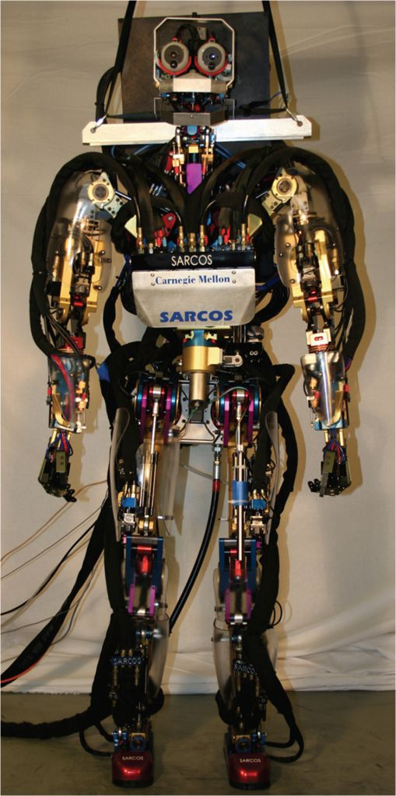
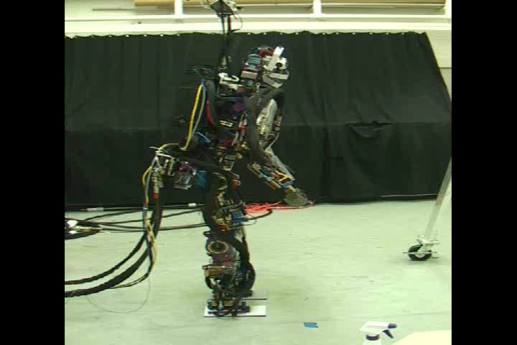
Sarcos Humanoid Robot
Hydraulic Actuators
Force Feedback Joint Controllers
33 major DOFs (Lower body = 14)
Total mass 94kg
Off-board pump (3000 psi)
Sarcos Hydraulic Humanoid Robot

Slide 7
Contributions
Linear biped model for force control of balance
Simple description of periodic balance control
Application of model to estimation and control of Humanoid robot

Slide 8
Outline
Modeling Balance
Controlling Balance
Applications to Humanoid Robot Control
Conclusion

Slide 9
Modeling Balance

Slide 10
General Biped Balance
Assumptions:
  Zero vertical acceleration
  No torque about COM
Constraints:
  COP within the base
  of support
REFERENCE:
Kajita, S.; Tani, K., "Study of dynamic biped locomotion on rugged terrain-derivation and application of the linear inverted pendulum mode," ICRA 1991

Slide 11
General Biped Balance Stability
Linear constraints on the COP define a linear stability region for which the ankle strategy is stable
COM Velocity
COM Position
REFERENCE:
Stephens, “Humanoid Push Recovery,” Humanoids 2007

Slide 12
The Linear Biped Model
Contact force is distributed linearly to the two feet.

Slide 13
The Linear Biped Model
Biped dynamics resemble two superimposed linear inverted pendulums.

Slide 14
The Double Support Region
We define the “Double Support Region” as a fixed fraction of the stance width.

Slide 15
Dynamics of Double Support
The dynamics during double support simplify to a simple harmonic oscillator
LIPM Dynamics

Slide 16
Controlling Balance

Slide 17
Phase Space of LiBM
Double Support Region
Location of feet

Slide 18
Periodic Balance
Goal: Balance while moving in a cyclic motion, returning to the cycle if perturbed.
Slow Swaying
Fast Swaying
Marching in Place or Walking

Slide 19
Orbital Energy Control
Orbital Energy:
Solution is a simple harmonic oscillator:
We control the energy:

Slide 20
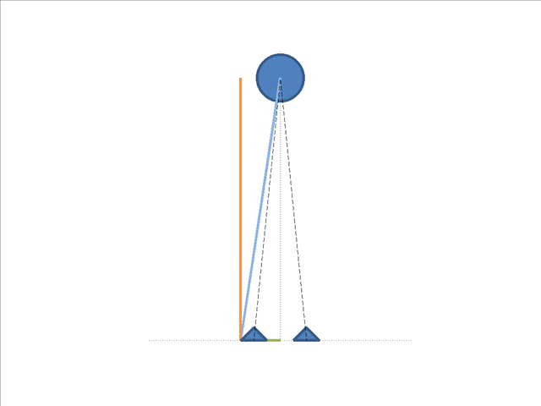

Slide 21
Energy Control Trajectories

Slide 22
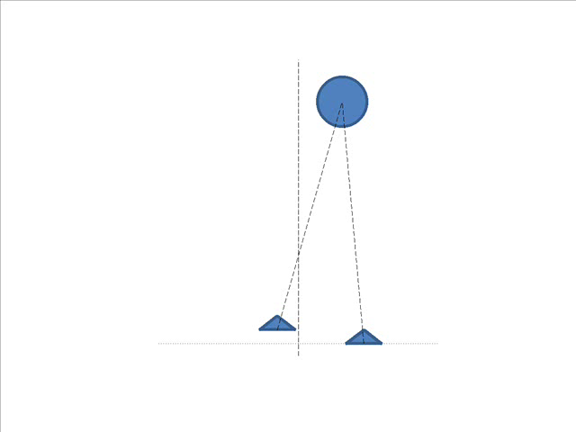

Slide 23
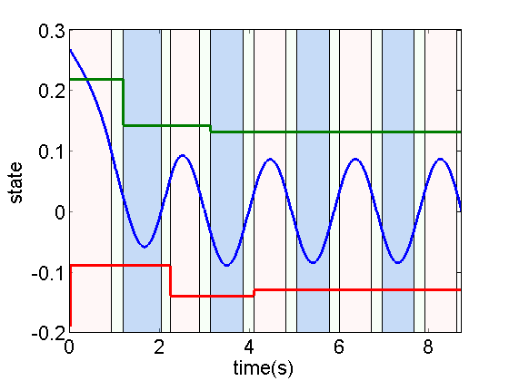
Notes:
colors
regions

Slide 24
Application to Humanoid Balance

Slide 25
Humanoid Applications
Linear Biped Model predicts gross body motion and determines a set of forces that can produce that motion
State Estimation
Combine sensors to predict important features, like center of mass motion.
Feed-Forward Control
Perform force control to generate the desired ground contact forces.

Slide 26
Center of Mass Filtering
A (linear) Kalman Filter can combine multiple measurements to give improved position and velocity center of mass estimates.
Joint Kinematics
Hip
Accelerometer
Periodic Humanoid Balance
Kalman Filter
CoM State
Feet
Force Sensors

Slide 27
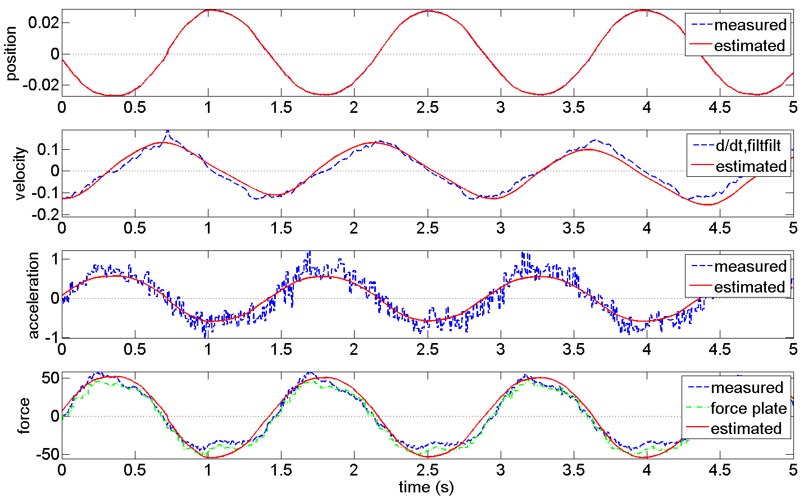

Slide 28
Feed-Forward Force Control
LiBM can be used for feedforward control of a complex biped system.
Full-body inverse dynamics can be reduced
to force control of the COM with respect
to each foot
Additional controls are applied to bias
towards a home pose and to keep the
torso vertical.

Slide 29
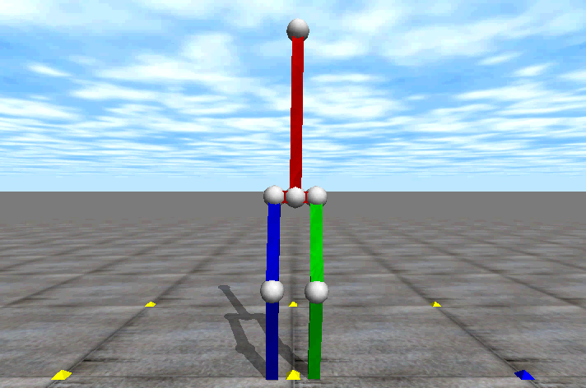

Slide 31
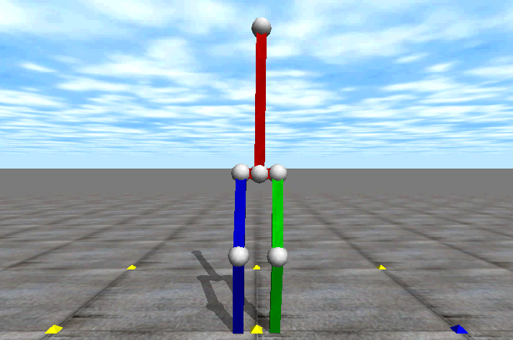

Slide 32
Limit Cycle
Impulsive Push

Slide 33

Robot Experiments

Slide 34
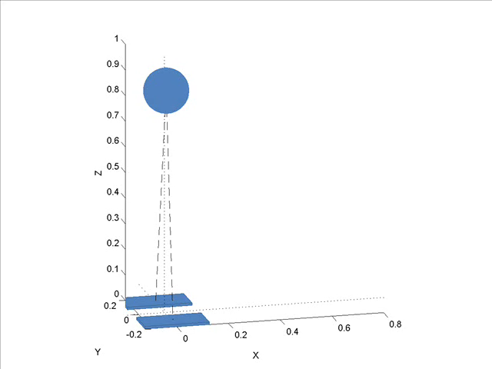
Future Work
3D Linear Biped Model
Robot Behaviors
  Foot Placement
  Push Recovery
  Walking
Robust Control/Estimation
  Push Force Estimation
  Robust control of LiBM

Slide 35
Conclusion
Linear biped model for force control of balance
Simple description of periodic behaviors and balance control
Applied to estimation and control of humanoid robot
Joint Kinematics
Slow Swaying
Fast Swaying
Hip
Accel
Kalman Filter
Periodic Humanoid Balance
CoM State
Force Sensors
Thank you. Questions?
Marching in Place or Walking

Slide 36
Thank you
Questions?
Special thanks to supporters:
  National Science Foundation
  Quality of Life Technology Engineering Research Center

Slide 37
The Linear Biped Model
Contact force is distributed linearly to the two feet.

