Slide 1
Navigation Method for VTOL Type UAV using a Limit-cycle Navigation Method and Fuzzy Logic Control
Byung-Cheol Min
Kyung Hee University
(Thesis Advisor : Prof. Donghan Kim)

Slide 2
Contents
Introduction
Path Planning Algorithm
UAV (Unmanned Aerial Vehicle)
Path Tracking Method
Conclusion
Introduction

Slide 3

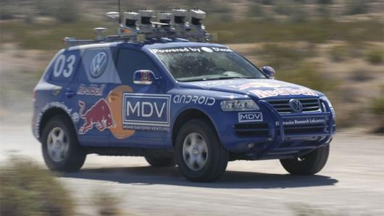
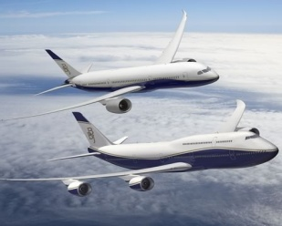
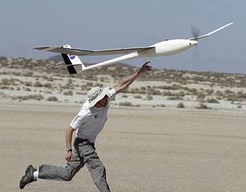
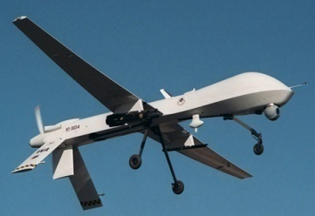
- What is a navigation method?
1. Introduction
Path Planning
Path Tracking
Navigation
- Applications
(a) Unmanned Aerial Vehicles
(b) Unmanned Ground Vehicles
(c) Commercial Airplanes
Introduction

Slide 4
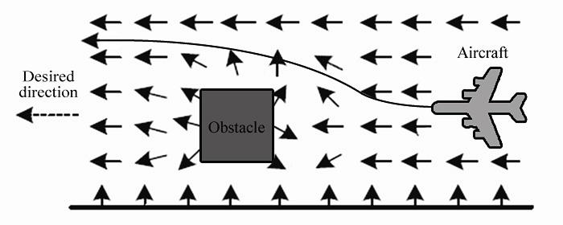
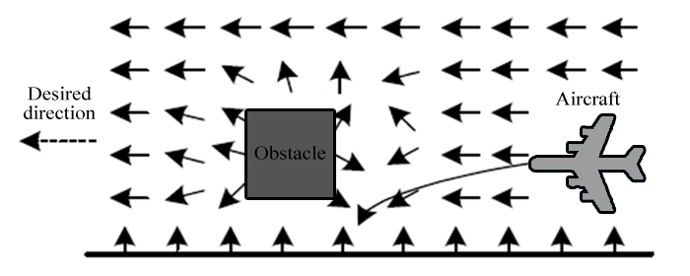

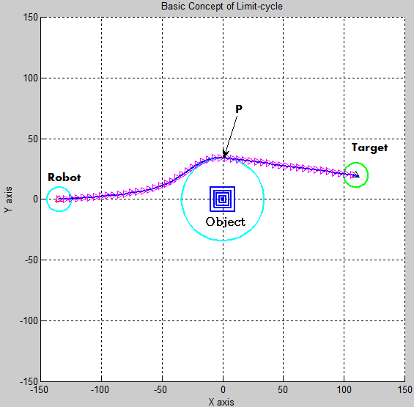
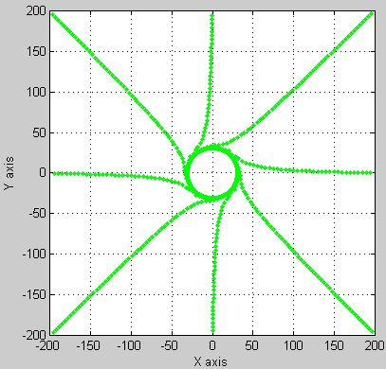
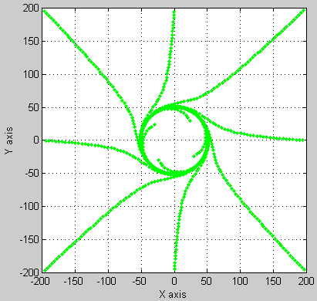
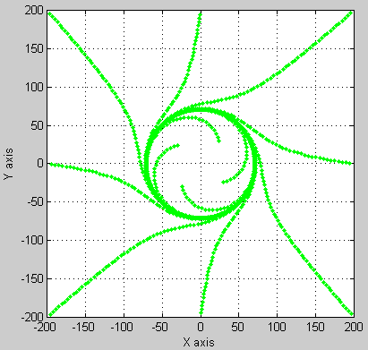
Classic Path Planning Approach
1. Introduction
- Potential Field Method
- Limit-cycle Navigation Method
(d) Simulation on the Limit-Cycle navigation method
(a) r = 30
(b) r = 50
(c) r = 70
Introduction

Slide 5
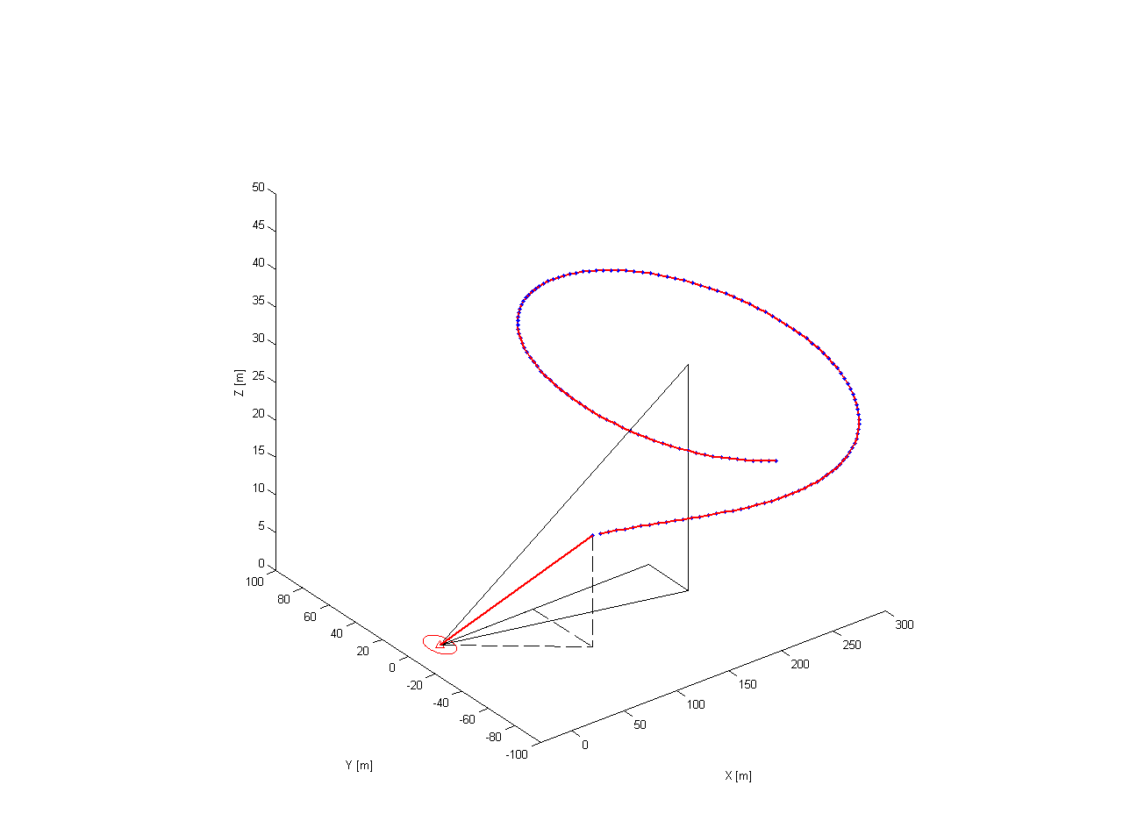
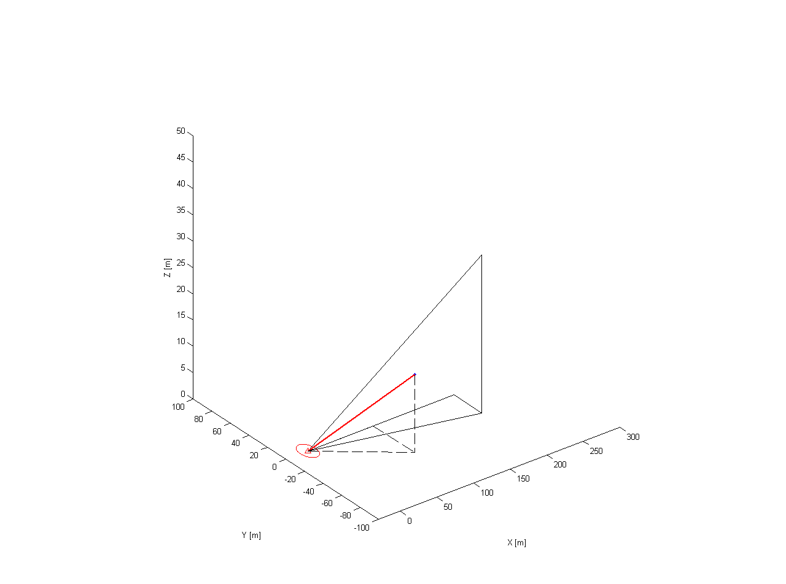
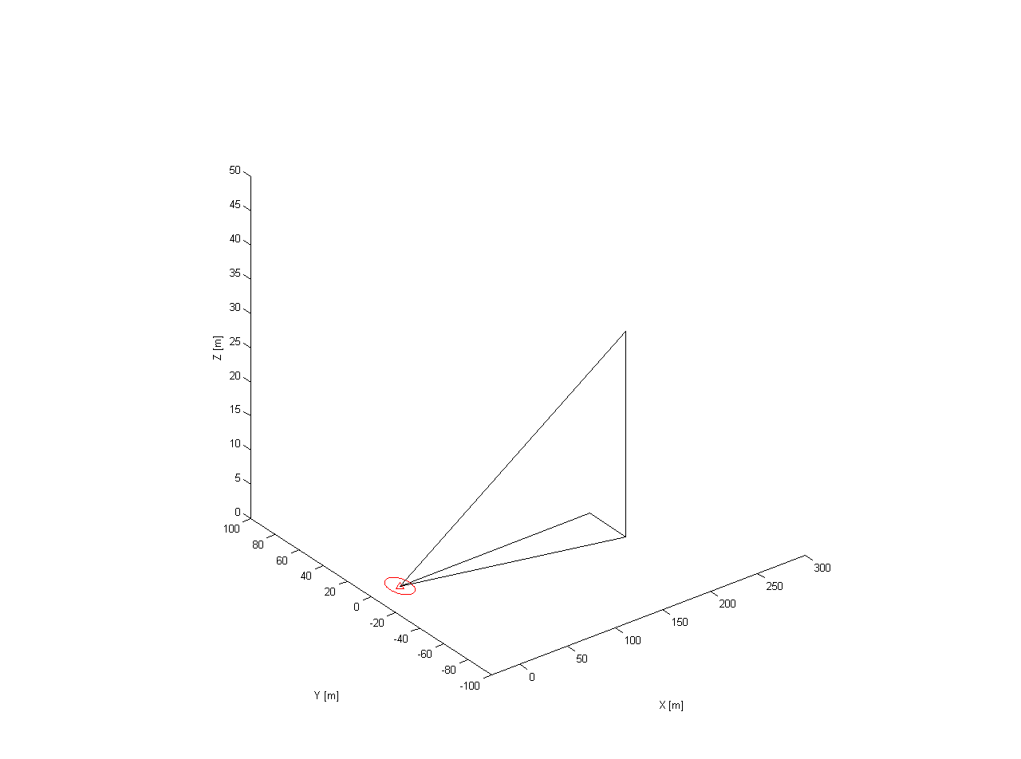
The Basic Concept of Limit-cycle method in three dimensions (3D)
2. Path Planning Algorithm
dx = current x position – obstacle x position
dy = current y position – obstacle y position
dz = current z position – center of the obstacle z position
Dh is a tangent line between the current position and the tangent point of an obstacle circle.
center of the obstacle
With this obtained angle, the input of the z-value can be calculated as
dz
dx
dy
Δx
Δy
Dh
Δh
current position
Δx and Δy values are obtained by the original limit-cycle navigation method.
Path Planning Algorithm

Slide 6
2. Path Planning Algorithm
Problem Statement
Although the proposed method verified a variety of merits in 3D, it also showed several drawbacks.
1. The method usually draws the path with setting previous along the center of obstacle’s height, depicted in (a).
2. The method generates the path only by avoiding to the side of the obstacle, depicted in (c).
(a) unsuitable path
(b) possible paths
(c) unsuitable path
(d) suitable path
Path Planning Algorithm

Slide 7
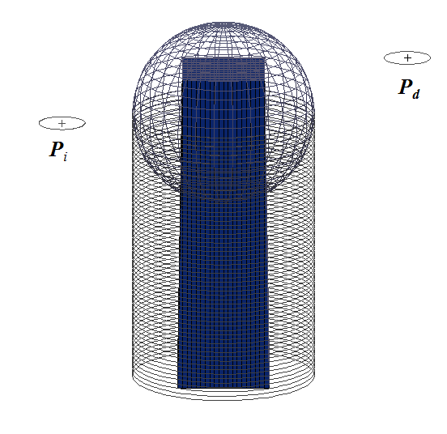
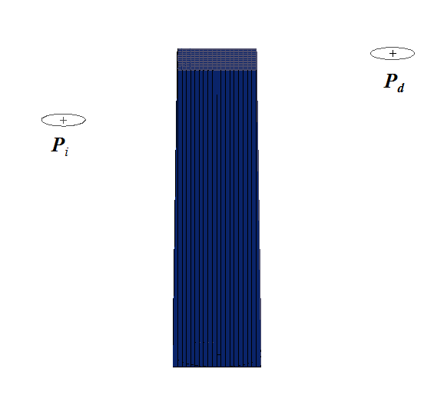
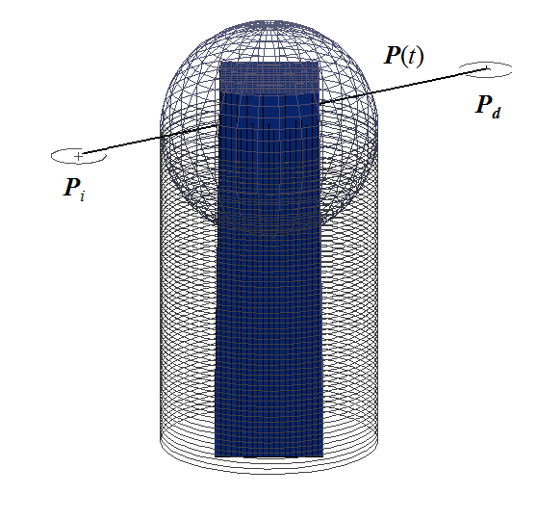
2. Path Planning Algorithm
Path Planning Based on the Methods of Ray Tracing and Limit-Cycle
START
Ray tracing is
an algorithm that shoots beams of light to determine the accurate location and the size of the objects.
In this paper, however, the method is used for the aircraft to find the shortest path to reach the destination while avoiding the obstacle.
Put the initial point for P_{i} and
the destination point for P_{d}
Render the obstacle
Ray
Tracing
Draw a line P(t) between P_{i} and P_{d}
Path
Planning
Path Planning Algorithm

Slide 8
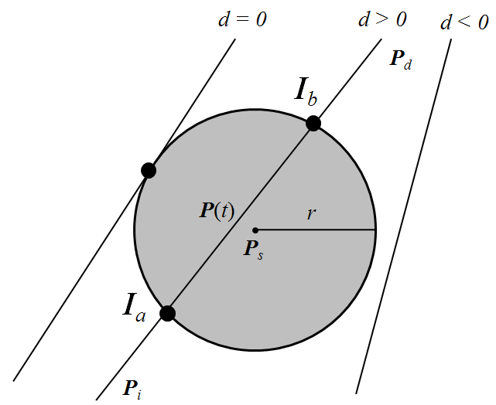
2. Path Planning Algorithm
Path Planning Based on the Methods of Ray Tracing and Limit-Cycle
START
(1)
Put the initial point for P_{i} and
the destination point for P_{d}
Eq. (1) can be expressed as
Render the obstacle
(2)
Ray
Tracing
Draw a line P(t) between P_{i} and P_{d}
The coefficients a, b, and c in Eq. (2) can be expressed as follows.
Does two Intersections exist?
No
(3)
Yes
By solving the discriminant, we can know whether the line P(t) intersects the sphere or not.
Generate a straight path
Path
Planning
END
Path Planning Algorithm

Slide 9
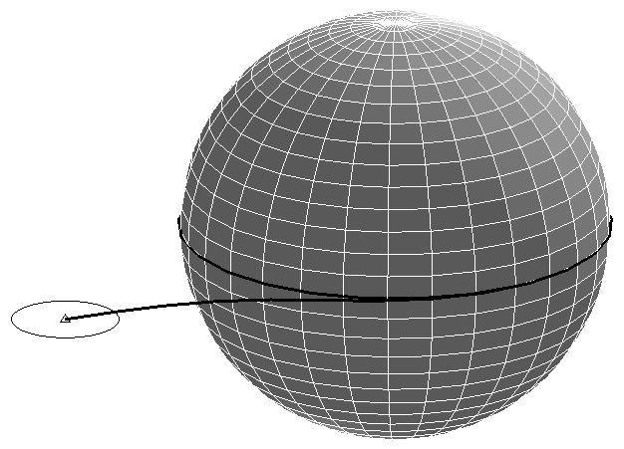
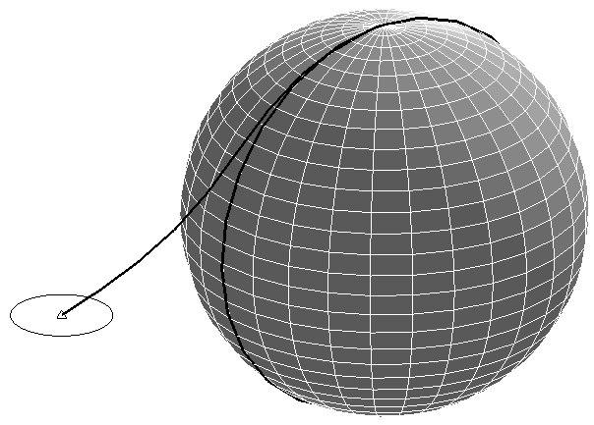
2. Path Planning Algorithm
Path Planning Based on the Methods of Ray Tracing and Limit-Cycle
START
Put the initial point for P_{i} and
the destination point for P_{d}
Render the obstacle
Ray
Tracing
Draw a line P(t) between P_{i} and P_{d}
(a) line P(t) from P_{i} to P_{d}
Does two Intersections exist?
No
When the horizontal direction is chosen, limit cycle is generated on the x-y plane.
When the vertical direction is chosen, limit cycle is generated on the x-z plane.
Yes
Generate a straight path
Decide the path between a horizontal direction and a vertical direction
Path
Planning
END
(b) x-y plane, z=0
(c) x-z plane, y=0
Path Planning Algorithm

Slide 10
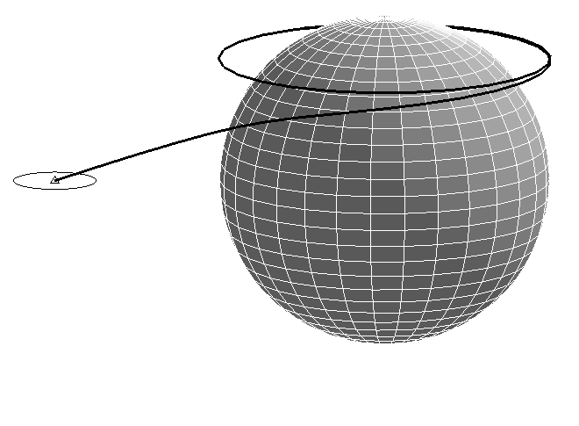
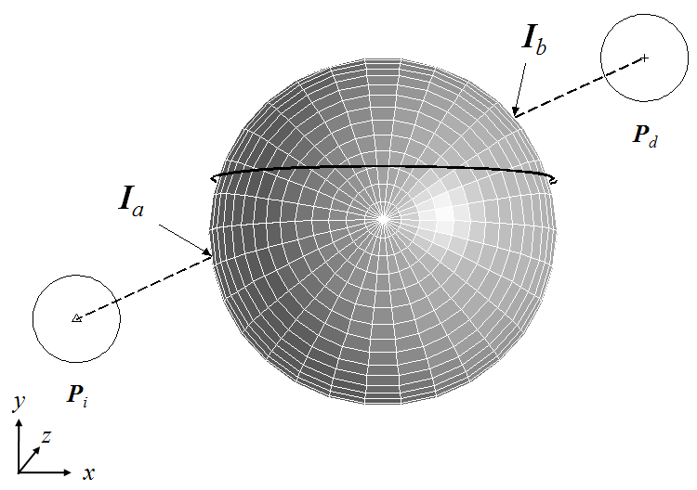
2. Path Planning Algorithm
Path Planning Based on the Methods of Ray Tracing and Limit-Cycle
START
Put the initial point for P_{i} and
the destination point for P_{d}
Render the obstacle
Ray
Tracing
Draw a line P(t) between P_{i} and P_{d}
The huge gap occurs if the radius of limit cycle is calculated based on the center of the obstacle.
Does two Intersections exist?
No
Yes
Generate a straight path
Decide the path between a horizontal direction and a vertical direction
Path
Planning
Calculate a radius of the limit cycle
based on the line
Generate a path by limit cycle
Only slight difference occurs between the hypothetical limit cycle in 3D and the proposed limit cycle in 2D.
END
Path Planning Algorithm

Slide 11
2. Path Planning Algorithm
Simulation Result 1
Two suitable paths were generated among numerous paths that can be planned by limit cycle method.
And then, the shortest path was decided by comparing two distances depicted as a solid line.
82.43 m
89.1 m
(a)
Path Planning Algorithm

Slide 12
2. Path Planning Algorithm
Simulation Result 2
The three paths from different initial points is successfully generated.
There are no gaps between the sphere and three paths. Thus, each of paths is smooth enough for UAVs to fly because of limit cycle characteristics.
(a)
(b)
Path Planning Algorithm

Slide 13
2. Path Planning Algorithm
Path Planning for Dynamic Obstacle Avoidance: collision detection method
An algorithm to generate a path to avoid dynamic obstacles is mainly comprised of a collision detection method and standard rules of airplane traffic.
(1) Velocity vector
(2) Position of moving object
(3) Calculate the time t whenthe distance d
between P(t) and O(t) equals to r_{P} + r_{O}
(a)
Path Planning Algorithm

Slide 14
2. Path Planning Algorithm
Path Planning for Dynamic Obstacle Avoidance: standard rules of airplane traffic
In case there are more than two UAVs in the same operation area, standard rules to control their traffic are necessary.
“Right of way” of Federal Aviation Regulation (FAR) 91.113 to collision avoidance
“Rules of the air” of the International Civil Aviation Organization (ICAO) annex 2
“If both airplanes approach from opposite sides, they are supposed to give way by turning right away from each other to avoid a collision, and if flying airplanes come into conflicting paths side by side, the left airplane turns right to yield.”
Path Planning Algorithm
Notes:
국제민간항공기구 부속서 2권의 , 미국연방항공규칙 91.113의

Slide 15
2. Path Planning Algorithm
Collision Detection Method
Similarly, we set up the standard rules of airplane traffic as follows:
If two UAVs approach from opposite sides (i,e., more than 90 degrees), the UAV is supposed to give way by turning right away from the moving obstacle to avoid a collision.
(b)
Path Planning Algorithm

Slide 16
2. Path Planning Algorithm
Standard Rules of Airplane Traffic
If the dynamic obstacle comes into conflicting the UAV's path within less than 90 degrees, the UAV waits for a while to yield.
(c)
Path Planning Algorithm

Slide 17
2. Path Planning Algorithm
Simulation Result 3
the angle between the moving direction of the UAV and the obstacle was set for bigger than 90 degrees.
The path was generated at the predicted position of a collision (42, 52) with the supposition that an obstacle exists at that position.
(a)
Path Planning Algorithm

Slide 18
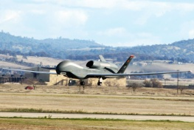
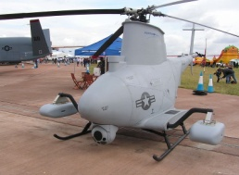
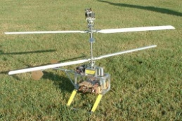
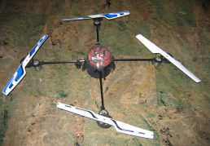
3. UAV(Unmanned Aerial Vehicle)
Common UAV Configurations
Configuration | Picture | Application | Advantages & Drawbacks
fixed-wing (Predator) |  | military reconnaissance combat | - high endurance flights silent no hovering
single (Fire Scout) |  | meteorology research reconnaissance | good controllability and maneuverability - complex mechanics - large rotor
coaxial rotors (Airscooter) |  | -research -surveillance | - compactness simple mechanics complex aerodynamics
quad rotors (DraganFlyer) |  | -research -surveillance | - good maneuverability Increased payload - high energy consumption - large size
Fixed-wing Type
Vertical Take-Off and Landing Type
(VTOL Type)
UAV

Slide 19
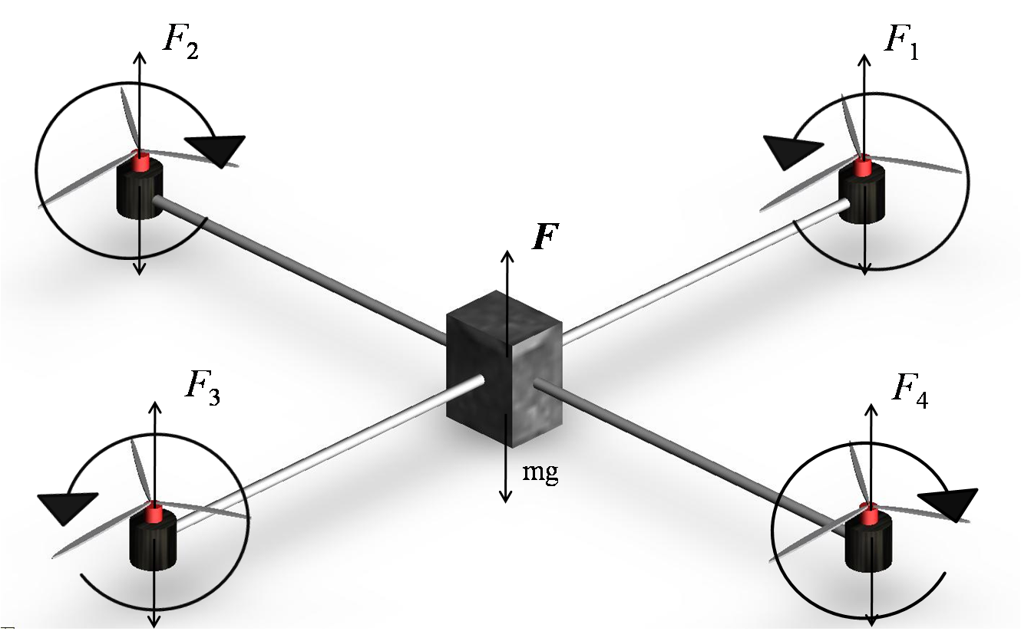
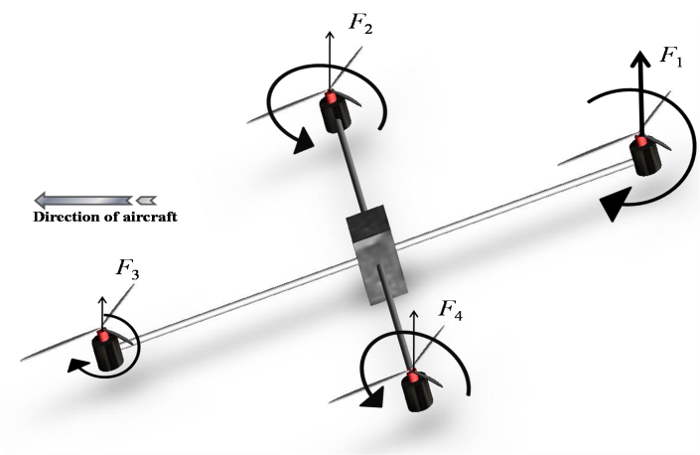
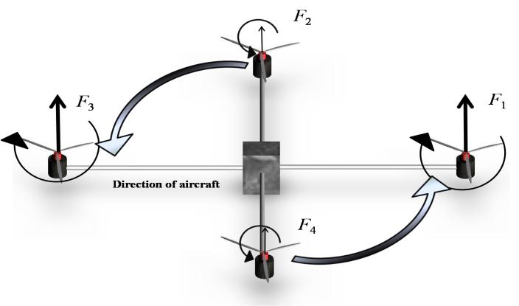
3. UAV(Unmanned Aerial Vehicle)
Basic Principles of the Quad-rotor UAV
(b) Pitching & rolling configuration
(a) Hovering configuration
For a hovering flight, the four driven forces are
F₁(0) + F₂ (0) + F₃ (0) + F₄(0) =
(c) Yawing configuration
UAV

Slide 20
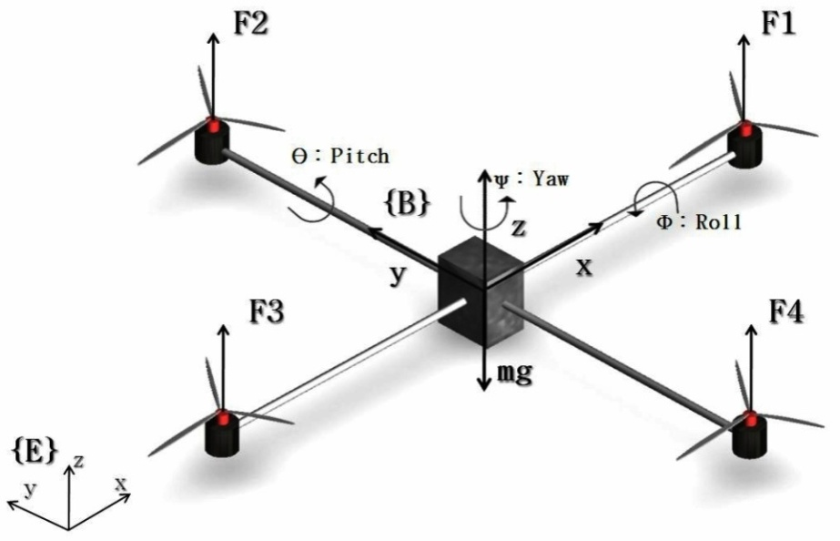
3. UAV(Unmanned Aerial Vehicle)
The Dynamic Modeling of the Quad-rotor UAV
1) The rotational transformation matrix between the earth-frame {E} and the body frame {B}
2) Equations of the translational motion in the earth frame are derived by the Newton’s laws
3) Resultant equations of motion as follows
4) Control inputs of the model
(a) The coordinate system with an earth frame {E} and a body frame {B}
UAV

Slide 21
4. Path Tracking Method
Fuzzy Logic Control
To control thrust and attitude of the VTOL Type UAV, which mostly affect its position, fuzzy logic control (FLC) is proposed.
The FLC, which is activated after generating the path, will be in charge of controlling the overall system of the quad-rotor UAV so that it can move to any desired position effectively.
(a) Typical Fuzzy Logic Control (FLC)
(b) The path tracking scheme
Path Tracking Method

Slide 22
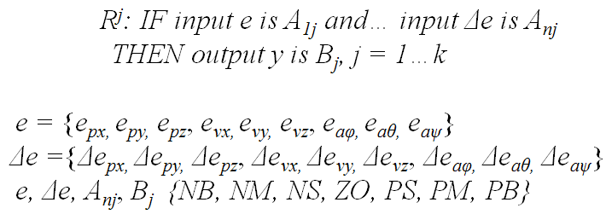
4. Path Tracking Method
Fuzzy Logic Control
Nine Fuzzy Logic Controllers (FLCs) were used to handle nonlinear system.
e/Δe | NB | NM | NS | ZO | PS | PM | PB
NB | NB | NB | NB | NB | NM | NS | ZO
NM | NB | NB | NB | NM | NS | ZO | PS
NS | NB | NB | NM | NS | ZO | PS | PM
ZO | NB | NM | NS | ZO | PS | PM | PB
PS | NM | NS | ZO | PS | PM | PB | PB
PM | NS | ZO | PS | PM | PB | PB | PB
PB | ZO | PS | PM | PB | PB | PB | PB
Path Tracking Method

Slide 23
4. Path Tracking Method
Simulation Result 1
(b) The each velocity ratio of x-y-z axes per time axis based while the quad-rotor UAV is ascending.
(a) The traces of path tracking by the quad-rotor UAV while ascending using FLC.
(c) The each position of x-y-z axes per time axis based while the quad-rotor UAV is ascending.
Path Tracking Method

Slide 24
4. Path Tracking Method
Simulation Result 2
(e) The each velocity ratio of x-y-z axes per time axis based while the quad-rotor UAV is descending.
(d) The traces of path tracking by the quad-rotor UAV while descending using FLC.
(f) The each position of x-y-z axes per time axis based while the quad-rotor UAV is descending.
Path Tracking Method

Slide 25
4. Path Tracking Method
Simulation Result 3
(a) The result of a simulation on the proposed navigation method: There are three different initial positions and the same destination. ‘’ indicates way points from the initial position of the UAV to its destination.
Path Tracking Method

Slide 26
4. Path Tracking Method
Problem with Simulation Result 3
(b) An enlarged portion of the problem of path tracking.
(c) The each velocity ratio of x-y-z axes per time axis based while the quad-rotor UAV is flying toward the destination. There is a problem that the UAV repeats stop-and-go at regular intervals.
Path Tracking Method

Slide 27
4. Path Tracking Method
Method to Solve the Problem with Simulation Result 3
Spheres centered at the way points are drawn in the form of ,where x, y, and z represent the position of the way point (desired position), and i means the order of way points, and r means a radius of sphere.
When the UAV passes the i_{th} sphere, the current desired position (x_{i}, y_{i}, z_{i}) is changed to the following desired position (x_{i+1}, y_{i+1}, z_{i+1}).
Path Tracking Method

Slide 28
4. Path Tracking Method
Simulation Result 4
(a) The result of a simulation on the new path tracking solving the problem that the UAV repeats stop-and go around the way points
Path Tracking Method

Slide 29
4. Path Tracking Method
Simulation Result 5
(b) An enlarged portion of the simulation result
(c) The each velocity ratio of x-y-z axes per time axis based while the quad-rotor UAV is flying toward the destination
Path Tracking Method

Slide 30
4. Path Tracking Method
Simulation on Dynamic Obstacle Avoidance: the Second Standard Rule of Airplane Traffic
(b) Dynamic Obstacle Avoidance: the Second Standard Rule of Airplane Traffic
(a) The result of dynamic obstacle avoidance in a case where the obtacle comes into a conflicting the UAV's path within less than 90 degree
Path Tracking Method

Slide 31
4. Path Tracking Method
Simulation on Dynamic Obstacle Avoidance: the Second Standard Rule of Airplane Traffic
(a) Obstacle
(c) The each position of the UAV
(b) UAV
Path Tracking Method

Slide 32
5. Conclusion
Extension of the original limit-cycle navigation method of three dimensional spaces
New path planning algorithm based on the methods of ray tracing and the extended limit-cycle navigation method
Algorithm comprised of a collision detection method and standard rules of airplane traffic that generates a path to avoid collisions with dynamic obstacles
Fuzzy logic control method in order for the UAV to converge quickly on the desired position
Solving the problem that the UAV repeats stop-and go around the way points, using virtual spheres
Conclusion

Slide 33
Limit-cycle Matlab Source
function [x, y, z] = limtcycle(Pos_x, Pos_y, Pos_z, ObPosx , ObPosy, ObPosz, r, direct)
dx = (Pos_x -ObPosx);
dy = (Pos_y -ObPosy);
dz = (ObPosz - Pos_z);
Dh = sqrt(dx^2 + dy^2);
if(direct == -1)
ddx = -dy*r^2 + dx * (r^2 - dx^2 - dy^2);
ddy = dx*r^2 + dy * (r^2 - dx^2 - dy^2);
else
ddx = dy*r^2 + dx * (r^2 - dx^2 - dy^2);
ddy = -dx*r^2 + dy * (r^2 - dx^2 - dy^2);
end
theta_xy = atan2(ddy,ddx);
Theta_z = atan2(dz,Dh);
Del = 5;
Del_x = Del*cos(theta_xy);
Del_y = Del*sin(theta_xy);
Del_h = Del*tan(Theta_z);
x = Del_x + Pos_x;
y = Del_y + Pos_y;
z = Del_h + Pos_z;
end

Slide 34
Publications - 5 Journal Publications, 5 Conference & Symposium Proceedings
- Journal Publications
B.C. Min, and D.H. Kim, “A Navigation Method for VTOL type UAV Using Limit-cycle Navigation Method and Fuzzy Logic Control," IEEE Transactions on Systems, Man, and Cybernetics, 2010. (in preparation)
B.C. Min, M. Kim, and D. Kim, "Fuzzy Logic Path Planner and Motion Controller by Evolutionary Programming for Mobile Robots," International Journal of Fuzzy Systems, Vol. 11, No. 3, September 2009.
B.C. Min, D. Kim, Y.H. Kim, K.Y. Kim, and C. Park, "Development of Violin Self-Training Algorithm Using Fuzzy Logic," Journal of Korean Institute of Intelligent Systems, Vol. 19, No. 4, August 2009. (in Korean)
B.C. Min, C.H. Cho, K.M. Choi, and D. H. Kim, "Development of a Micro Quad-Rotor UAV for Monitoring an Indoor Environment,", Lecture Notes in Computer Science (LNCS), FIRA CIRAS 2009, Vol. 5744, pp. 262-271, August 2009.
C.H. Cho, B.C. Min, and D. H. Kim, "A Gait Generation for an Unlocked Joint Failure of the Quadruped Robot with Balance Weight," Lecture Notes in Computer Science (LNCS), FIRA CIRAS 2009, Vol. 5744, pp. 251-261, August 2009.
- Conference & Symposium Proceedings
B.C. Min, H.Y. Kwon, and D.H. Kim, "Path Planning Algorithm for VTOL Type UAVs Based on the Methods of Ray Tracing and Limit Cycle," IEEE International Symposium on Computational Intelligence in Robotics and Automation (CIRA 2009), December 2009.
B.C. Min, E.J. Lee, S.H. Kang, and D.H. Kim, "Limit-cycle Navigation Method for a Quad-rotor Type UAV," Industrial Electronics, 2009. ISIE 2009, IEEE International Symposium on, pp. 1352-1357, July 2009.
S.H. Kang, B.C. Min, C.H. Cho, S.Y. Nam, and D.H. Kim, "The Position Control for Three Wheel Omni-directional Mobile Robot Using FLC," IEEK Summer Conference 2009, Vol. 32, No. 1, pp. 691-692, July 2009. (in Korean)
Y.W. Lim, B.C. Min, J.W. Kim, S.Y. Nam, and D.H. Kim, “Local-Path Planning Using the Limit-cycle Navigation Method Applied to the Edge of an Obstacle with the Edge Detection Method”, International Conference On Electronics, Information, & Communication (ICEIC 2010), April 2010.
Y.H. Kim, J.W. Kim, B.C. Min, and D.H. Kim, “Dynamic Obstacle Avoidance Using Vector Function Algorithm”, International Conference On Electronics, Information, & Communication (ICEIC 2010), April 2010.

