Slide 1
CTC Recitation
3/9/19

Slide 2
Speech recognition using Recurrent Nets
$$P_{1}$$
$$P_{2}$$
$$P_{3}$$
$$P_{4}$$
$$P_{5}$$
$$P_{6}$$
$$P_{7}$$
X(t)
t=0
Time
Recurrent neural networks (with LSTMs) can be used to perform speech recognition
Input: Sequences of audio feature vectors
Output: Phonetic label of each vector

Slide 3
Speech recognition using Recurrent Nets
$$W_{1}$$
$$W_{2}$$
X(t)
t=0
Time
Alternative: Directly output phoneme, character or word sequence
Challenge: How to define the loss function to optimize for training
Future lecture
Also homework

Slide 4
Problem: Ambiguous labels
Speech data is continuous but the labels are discrete.
Forcing a one-to-one correspondence between time steps and output labels is artificial.

Slide 5
Enter: CTC (Connectionist Temporal Classification)
A sophisticated loss layer that gives the network sensible feedback on tasks like speech recognition.

Slide 6
The idea
Add “blanks” to the possible outputs of the network.
Effectively serve as a pass on assigning a new label to the data meaning if a label has already been outputted it “leaves it as is”
Analogous to a transcriber pausing in writing.

Slide 7
The implementation: Cost
Define the Label Error Rate as the mean edit distance.
Where S’ is the test set.

Slide 8
The implementation: Cost
This causes it to only indirectly learn a language model but also makes it more suitable for use with RNNs since they can Simply output the character or a blank.

Slide 9
The implementation: Path
The formula for the probability of a path π is given by
For sequence x and outputs y^{t}_{πt} at time step t for the value in path π

Slide 10
The implementation: Probability of Labeling
Where l is a labeling of x and Beta is the set of possible labeling of length less than or equal to the length of l

Slide 11
The implementation: Path
Great we have a closed for solution for the probability of a labeling!

Slide 12
The implementation: Path
Great we have a closed form solution for the probability of a labeling!
Problem: This is exponential in size.
It is on the order of the number of paths through the labels.

Slide 13
The implementation: Efficiency
The Solution: Dynamic programming
The probability of each label in the labeling is dependent on all other labels.
These can be computed with two variable Alpha and Beta corresponding to the probabilities of a valid prefix and suffix respectively.

Slide 14
The implementation: Efficiency
Alpha is the forward probability for s. It is defined as the sum over the probabilities of all possible prefixes for which s is a viable label in position t.

Slide 15
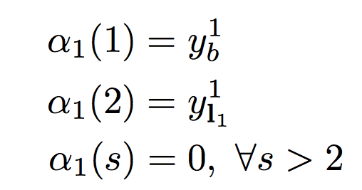
The implementation: Efficiency
This can be implemented recursively as follows on l’ the modified target label sequence with a blank in-between every symbol and at the beginning and end.

Slide 16
The implementation: Efficiency
The backwards pass:

Slide 17
The implementation: Efficiency
The backwards pass:
Analogous to forward pass

Slide 18
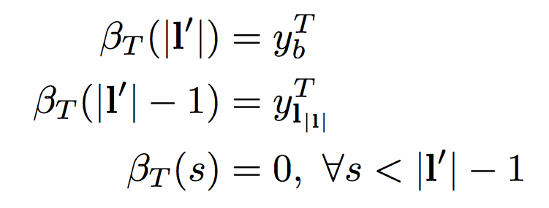
The implementation: Efficiency
Recursive definition

Slide 19
The implementation: Efficiency
Recursive definition

Slide 20
The implementation: Efficiency
What this gets us and intuition

Slide 21
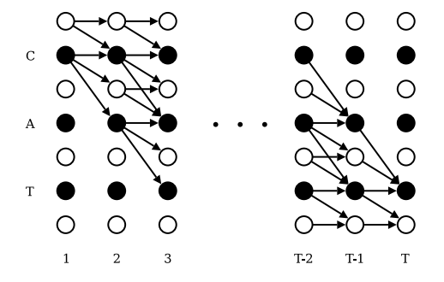
The implementation: Efficiency
What this gets us and intuition
Illustration of CTC

Slide 22
Implementation
Rescale to avoid underflow
By substituting Alpha for Alpha-hat and Beta for Beta-hat

Slide 23
Implementation
Returning to the task at hand the maximum likelihood objective function is:

Slide 24
Implementation
Recall

Slide 25
Implementation
Recall
Consider
This is the product of the forward and backwards probabilities.
By substitution

Slide 26
Implementation
Recall
Thus
This is a cost we can compute

