Slide 1
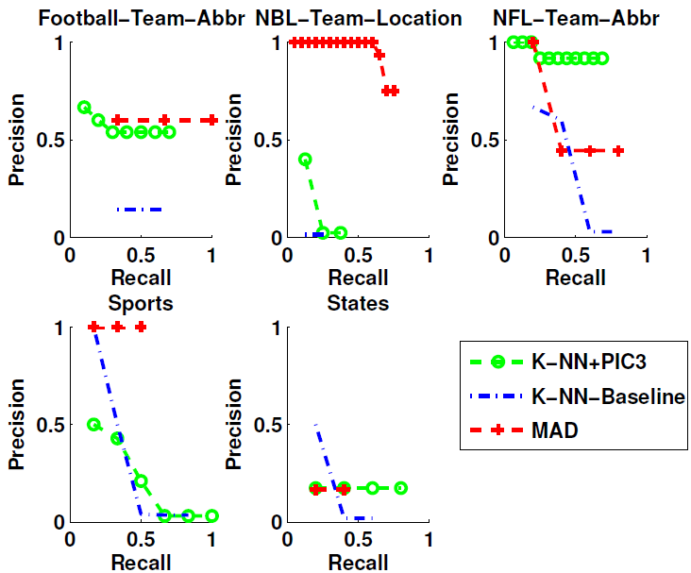
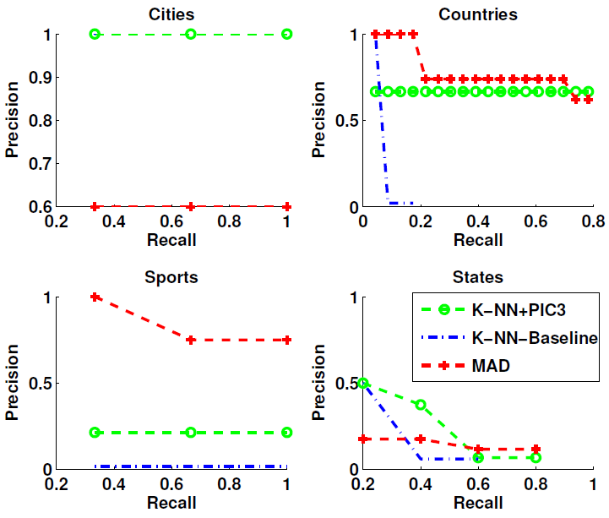
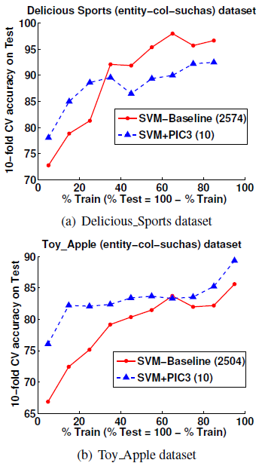
Collectively Representing Semi-Structured Data from the Web
Bhavana Dalvi , William W. Cohen and Jamie Callan
Language Technologies Institute, Carnegie Mellon University
Motivation
Entities on the Web
Experiments II
Entities on the Web can be present in multiple datasets.
We propose a low-dimensional representation for such entities.
With a small number of primitive operations on this representation we can do :
Semi-supervised Learning (SSL)
Set Expansion (SE)
Automatic Class Instance Acquisition (ASIA)
Hypothesis : Entities co-occurring in multiple table columns or with similar suchas concepts probably belong to the same class label.
Method | Total Query Time (sec)
 | Set Expansion | ASIA
K-NN + PIC3 | 12.7 | 0.5
K-NN-Baseline | 80.1 | 1.4
MAD | 38.2 | 150.0
# Set Expansion Queries = 881
# ASIA Queries = 25
Creating PIC3 representation = 0.02 sec
Entity-suchas bipartite graph
Entity-column bipartite graph
Country
USA
TC-1
India
TC-2
Experiments
Location
Football
Set Expansion
Input :
PIC3 embedding ,
Set of seed entities
Output :
Expanded set of entities
TC-3
Datasets : Publicly available semi-structured datasets
(http://rtw.ml.cmu.edu/wk/WebSets/wsdm_2012_online)
Sports
Hockey
TC-4
Property | Description | Dataset
 |  | Toy_Apple | Delicious_Sports
|X| | # Entities | 14,996 | 438
|C| | # table columns | 156 | 925
|(x,c)| | # (x, c) edges | 176,598 | 9,192
|Ys| | # suchas concepts | 2,348 | 1,649
|(x, Ys)| | # (x, Ys) edges | 7,683 | 4,799
|Yn| | # NELL classes | 11 | 3
|(x, Yn)| | # (x, Yn) edges | 419 | 39
|Yc| | # manual column labels | 31 | 30
|(c, Yc)| | # (c, Yc) pairs | 156 | 925
Baseball
Hyponym | Concept:count
USA | Country:1000, Location:500
India | Country:450
Hockey | Sports:100
Baseball | Sports:60
TC-2
TC-3
Country | Capital City
India | Delhi
USA | Washington DC
Canada | Ottawa
France | Paris
Country | National Sport
USA | Baseball
India | Hockey
Sweden | Football
Example : Hyponym Concept Dataset
Example : Table columns
Automatic Set
Instance Acquisition
Input :
PIC3 embedding,
Hyponym Concept Dataset,
Query concept ‘q’
Output :
Set of entities of type ‘q’
PIC3 Representation
Semi-Supervised Learning
Input : PIC3 embedding , Few labeled entities per class
Output : Labels for unlabeled entities
n * m PIC embedding, m << t
Hypothesis :
PIC3 embeddings will cluster similar entities (entities belonging to same class) together.
n * t
Entity – tableColumn
Bipartite graph
PIC
n * 2m PIC3
embedding
concatenate
Country | X1 | X2
USA | 0.23 | 0.76
India | 0.21 | 0.79
Football | 0.36 | 0.80
Hockey | 0.35 | 0.82
Baseball | 0.34 | 0.79
Y1 | Y2
0.43 | 0.66
0.41 | 0.69
0.66 | 0.35
0.16 | 0.92
0.14 | 0.89
n * s
Entity – suchas
Bipartite graph
PIC
Conclusions
n * m PIC embedding, m << s
Example : PIC3 embedding, m = 2
Presented a novel low-dimensional PIC3 representation for entities on the Web using Power Iteration Clustering (PIC).
Simple primitive operations on PIC3 to perform following tasks :
Semi-Supervised Learning
Set Expansion
Automatic Set Instance Acquisition
Future work : Use PIC3 representation for
Named entity disambiguation and
Unsupervised class-instance pair acquisition
Task | Training | Testing
Semi-Supervised Learning | PIC3 + train SVM classifier | Predict using learnt SVM model
Set Expansion | PIC3 | Centroid(entity set) + K-NN (centroid)
Automatic Set Instance Acquisition | PIC3 + Index HCD | seeds = top-k-entities(lookup concept in HCD) + Set Expansion (seeds)
Acknowledgements : This work is supported by Google and the Intelligence Advanced Research Projects Activity (IARPA) via Air Force Research Laboratory (AFRL) contract number FA8650-10-C-7058.

