Slide 1
Lecture 25: Past to Future: Artificial Intelligence (AI) in Interaction Techniques
Brad Myers
05-899A/05-499A: Interaction Techniques
Spring, 2014

Slide 2
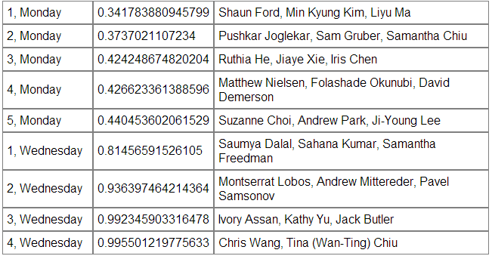
Announcements
Evaluate each other’s presentations
Schedule for final presentations posted in http://www.cs.cmu.edu/~bam/uicourse/2014inter/FinalProjects.html

Slide 3
Intelligent User Interfaces
Lots of work in Intelligent User Interfaces in general
http://www.iuiconf.org/ - yearly since 1997
But most are not “interaction techniques”
Also, lots of work on AI to build UIs
E.g., automatic selection of interaction techniques
Not covered here. See slides from 05-830
I selected a few interaction techniques to cover:
Speech and natural language user interfaces
“Data detectors”
Squiggly underlining
Intelligent agents (“Clippy”)

Slide 4
What makes a UI “Intelligent”?

Slide 5
What makes a UI “Intelligent”?
“a user interface (UI) that involves some aspect of Artificial Intelligence (AI or Computational Intelligence) …. Generally, an IUI involves the computer-side having sophisticated knowledge of the domain and/or a model of the user.” – Wikipedia
Using heuristics that may be wrong
Using elaborate pattern matching algorithms
Recognition-based interfaces
Knowledge based interfaces
Evaluate partially based on accuracy
“False negatives” – misses something it should do
“False positives” – does something it should not
“Smarter” interface lowers all errors
Often can reduce one by increasing the other

Slide 6
Speech and natural language user interfaces
Speech recognition and natural language understanding has been a CS research topic since at least the 1960’s
Very slow & steady progress with machine speeds and new algorithms
Now “reasonably” accurate for conventional requests for people with conventional speech
Speech: two phases
Recognition into a transcript
Problems with words sounding alike, accents, background noise, pauses, etc.
Natural ways to correct are to hyper-articulate & talk slower, which often makes recognition do worse
Natural language processing
Problems with common sense, references (pronouns), sentence structure, etc.
It turns out that dictating is difficult while thinking
Especially given the need to be error free
Special “sub-languages” difficult to learn
Not clear what you are allowed to say
Interface needs to guide the user into saying things that will work.

Slide 7
Speech & NL
Key advantages:
Average humans fastest output mechanism
Able to “jump around” and combine tasks
Can handle ambiguity and partial descriptions
Versus direct manipulation
Example: “Schedule a meeting the day before CHI with everyone in my group.”
Key disadvantages
Inaccuracies, misrecognitions, unclear scope
Difficulties of corrections when wrong
Apple Siri, Google Now
Microsoft’s new “Cortana” -- ref

Slide 8
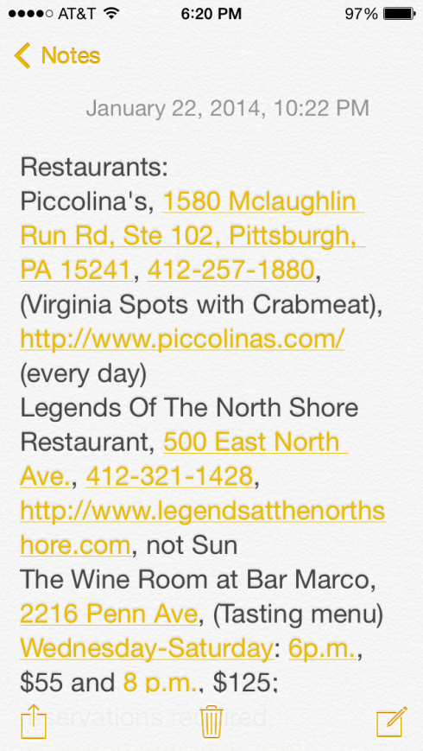
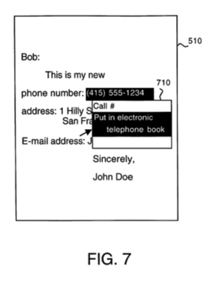
“Data Detectors”
Pattern matcher that looks for specific kinds of data in plain text
Enables various operations on that text
E.g., recognizing phone numbers, people names, URLs, email and physical addresses, etc.
Nardi, B.A., Miller, J.R., and Wright, D.J. “Collaborative, programmable intelligent agents.” Commun. ACM 41, 3 (1998), pp. 96–104.
“Apple Data Detectors”
US 5,946,647 – “System and method for performing an action on a structure in computer-generated data” by Thomas Bonura, James R. Miller, Bonnie Nardi, David Wright, Filed: Feb 1, 1996, https://www.google.com/patents/US5946647
In the current Apple v. Samsung case

Slide 9
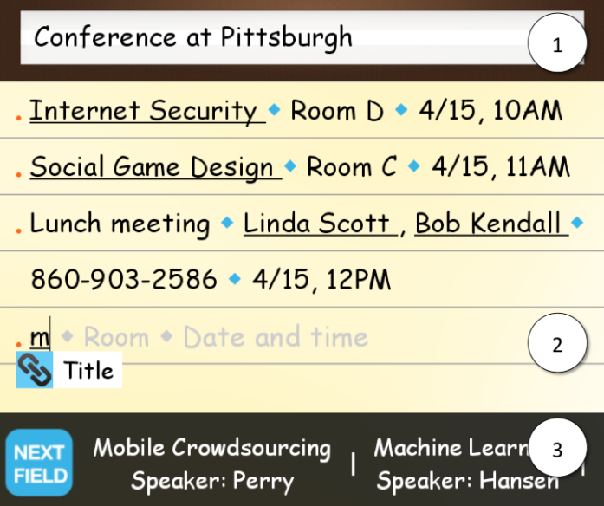
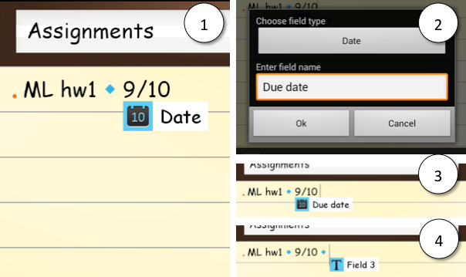
Research related to Data Detectors
Grammex
Lieberman, H., Nardi, B.A., and Wright, D. Grammex: defining grammars by example. Demo at CHI'98, ACM (1998), pp. 11–12. http://web.media.mit.edu/~lieber/Lieberary/Grammex/Grammex-Intro.html
Define the pattern by giving a bunch of examples
Listpad – use data detectors to recognize structure in plain text lists
Kerry S. Chang, Brad A. Myers, Gene M. Cahill, Soumya Simanta, Edwin Morris and Grace Lewis. "Improving Structured Data Entry on Mobile Devices", ACM Symposium on User Interface Software and Technology, UIST'13, October 8-11, 2013, St. Andrews, UK. pp. 75-84. acm dl or local pdf and video (5:00) or local copy
Combine with web services to make data entry easier

Slide 10
Squiggly (Wavy) underlining
In Word: for misspellings (red), grammar problems (green), and formatting problems (Blue) – reference
Introduced in Word 95 for Windows – cite
Originally, grammar checker was quite bad, but significantly improved over time
Too many “false positives”
AI researchers at Microsoft Research helped with better language models
Now used for errors in code as well as regular documents

Slide 11
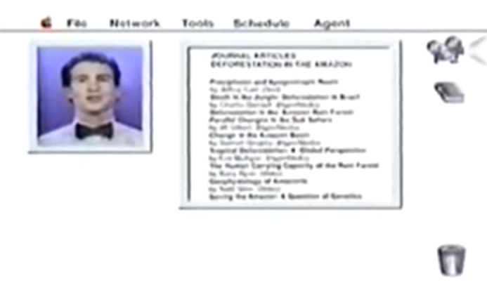
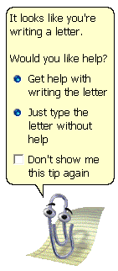
Intelligent Agents
A common aspiration of AI is a personified agent
E.g., “Knowledge Navigator” video from Apple, 1987
Microsoft’s “Office Assistant”, known as “Clippy” – video
Office 1997 to 2003
“Smithsonian Magazine called Clippy “’one of the worst software design blunders in the annals of computing’". – cite
Too often useless and wrong (false positives)
Animates even when you are not supposed to use it.
Whole thesis on “Why People Hate the Paperclip: Labels, Appearance, Behavior and Social Responses to User Interface Agents” – pdf
<

