Slide 1
05-899D: Human Aspects of Software Development Spring 2011, Lecture 28
Apr 26th, 2011
Reporting and Triaging Bugs
YoungSeok Yoon
(youngseok@cs.cmu.edu)
Institute for Software Research
Carnegie Mellon University

Slide 2
Bug tracking system
Example systems
Bugzilla, Radar, Trac
Integrated in OSS project hosting sites
Integrated in development team collaboration tools
IBM Rational Concert
MS Team Foundation Server
Has many different names
Bug tracking system
Defect tracking system
Bug repository
Issue tracking system
Change tracking system
…
Different usage
Bug reporting & triaging ← Today’s focus
Focal point for communication and collaboration

Slide 3
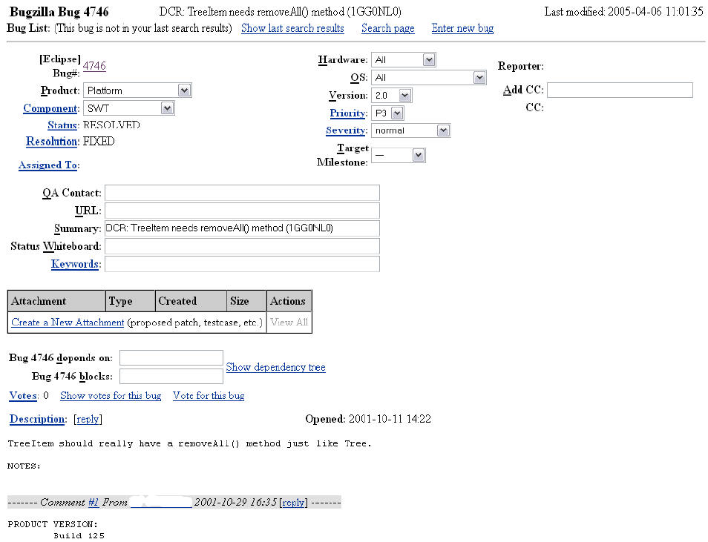

Slide 4
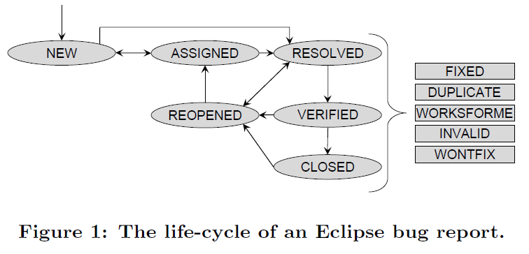
Life-cycle of a bug report (Bugzilla)

Slide 5
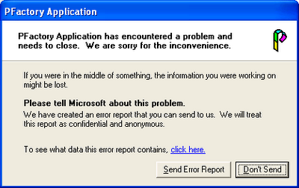
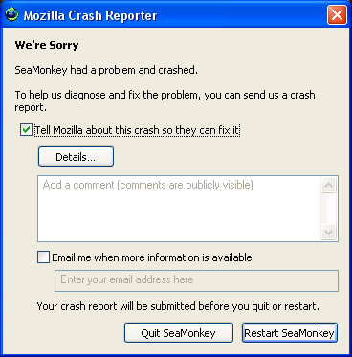
Different sources of bug reports
Developers
Testers
Internal users
Microsoft’s “dogfooding” practice
Alpha testing
End-users
Beta testing
Crash reports
Dr. Watson (Windows)
Breakpad (developed by Google, used in Mozilla projects)
Automatically generated reports
e.g. from static analysis tools

Slide 6
Bug Triaging
The process of deciding
whether if a given bug report is appropriate (meaningful new problem?, enhancement?, …)
which bugs should get fixed
who should fix the bugs
Who is in charge of bug triaging?
Dedicated triagers (OSS drivers, QA volunteers…) [Anvik 06]
A developer becomes triager when he/she is assigned a bug
Bug triaging itself is very time-consuming and difficult
3426 reports over 4 mon. (Jan 05 ~ Apr 05) for Eclipse project (avg 29/day)
39% of them were inappropriate reports [Anvik 06]

Slide 7
Problems with Bug Triaging
Hard to notice the problematic
bug patterns (e.g. ping pong,
zombie bugs, …)
It takes effort to find an
appropriate developer
who can resolve the problem
Many bug reports turn out to
be inappropriate (not a bug,
cannot reproduce, …)
Reassignments of the bugs
lengthen the time to get them
fixed
Many bug reports are in low
quality (e.g. contains not
enough information)

Slide 8
Problems with Bug Triaging
Hard to notice the problematic
bug patterns (e.g. ping pong,
zombie bugs, …)
It takes effort to find an
appropriate developer
who can resolve the problem
Many bug reports turn out to
be inappropriate (not a bug,
cannot reproduce, …)
Reassignments of the bugs
lengthen the time to get them
fixed
Many bug reports are in low
quality (e.g. contains not
enough information)

Slide 9
Designing Task Visualizations
Study performed at IBM T.J. Watson Research Center [Halverson 06, Ellis 07]
Call the systems as “change tracking systems”, the bug reports as “change requests (CRs)”
Four data sources to get insights
9 interviews via email and instant messaging (programmers, managers)
Analyses of 4 existing change tracking systems
Additional 11 interviews with programmers
Analyses of particular CR samples from Bugzilla

Slide 10
Designing Task Visualizations: Findings from the analyses
Problematic bug patterns
Ping pong patterns
Reassignment (or bug tossing)
Resolve – Reopen
Important bugs that are falling through the cracks
Severity + Age
Unevaluated Patches
Zombie Bugs
Difficult to detect these patterns
Fortunately, most of the information needed to detect these problems is already in the CRs
Bugs that block others too much
Popular Bugs

Slide 11
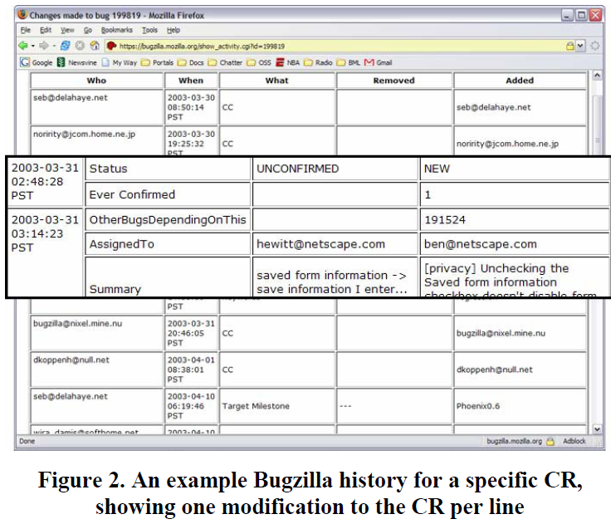
Problem detecting process with conventional bug tracking systems
Find a report of interest
Navigate to the history page of the report
often a long date-ordered list of every modification
Filter the history
throw out everything except the state changes
Read through the data and decide if a problem exists

Slide 12
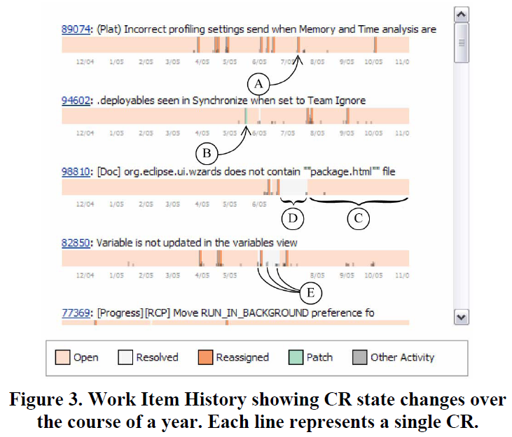
Designing Task Visualizations 1st prototype: Work Item History
reassign
patch
open
resolved
others
Notes:
others:

Slide 13
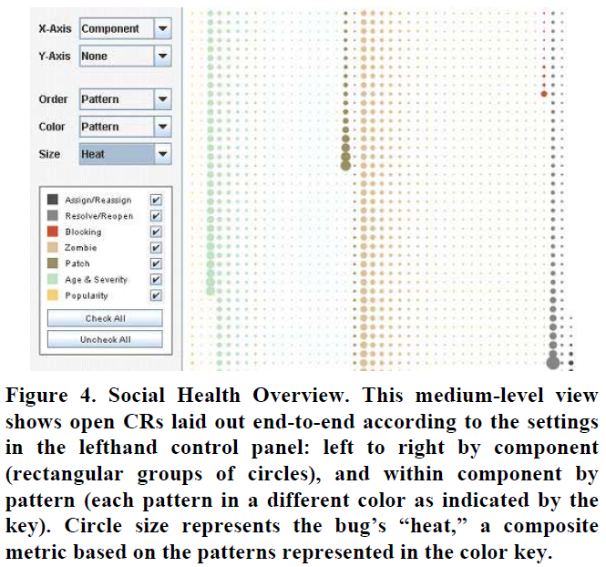
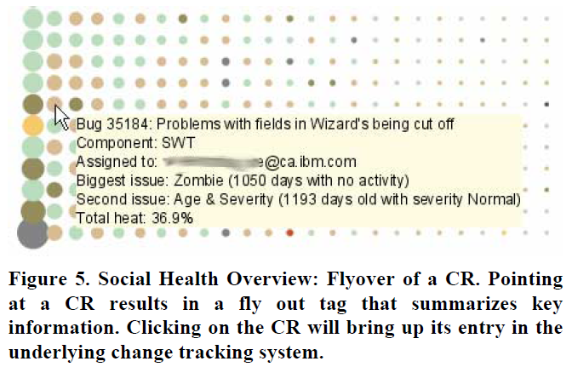
Designing Task Visualizations 2nd prototype: Social Health Overview
Notes:
This view can be highly customized. The X, Y-axes, sort order, color and size can be customized so that the user of this tool can focus on what she is interested.
For example, when the user wants to see the current workload for each developer, she can do that by coloring and ordering by assignee

Slide 14
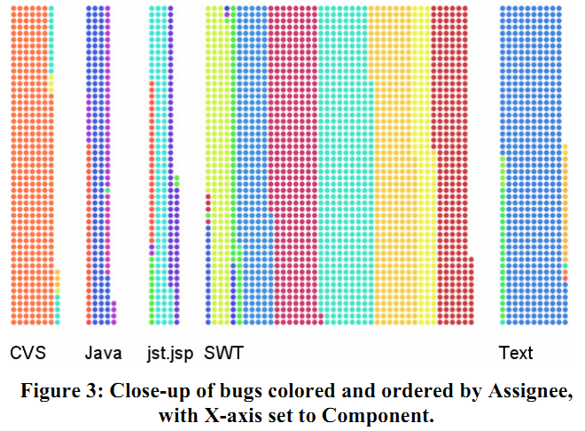
Designing Task Visualizations 2nd prototype: Social Health Overview
Notes:
This view can be highly customized. The X, Y-axes, sort order, color and size can be customized so that the user of this tool can focus on what she is interested.
For example, when the user wants to see the current workload for each developer, she can do that by coloring and ordering by assignee

Slide 15
Designing Task Visualizations 2nd prototype: Social Health Overview
Evaluation study
8 people
3 tasks with and without SHO (“Participants were asked to carry out the same three tasks using Bugzilla and SHO”)
Tasks (5 mins / task)
“Assign / Reassign”: Bugzilla (0/8), SHO (8/8)
“Developer in Trouble”: Bugzilla (6/8), SHO (8/8)
“Next 3 Bugs”: Bugzilla (6/8), SHO (8/8)
Notes:
This view can be highly customized. The X, Y-axes, sort order, color and size can be customized so that the user of this tool can focus on what she is interested.
For example, when the user wants to see the current workload for each developer, she can do that by coloring and ordering by assignee

Slide 16
Problems with Bug Triaging
Hard to notice the problematic
bug patterns (e.g. ping pong,
zombie bugs, …)
It takes effort to find an
appropriate developer
who can resolve the problem
Many bug reports turn out to
be inappropriate (not a bug,
cannot reproduce, …)
Reassignments of the bugs
lengthen the time to get them
fixed
Many bug reports are in low
quality (e.g. contains not
enough information)
Notes:
A closely related research topic is “finding and recommending experts of a software artifact”

Slide 17
Who Should Fix This Bug? [Anvik 06]
Semi-automated approach to find appropriate assignees
Show several potential resolvers
The user has to choose one from the candidates (this is why it’s called semi-automated)
Use machine learning algorithm
Treated as text classification problem in ML
Text documents ↦ Bug reports (summary & text description)
Categories ↦ Names of developers
Precision: Eclipse (57%), Firefox (64%), gcc (6%)

Slide 18
Who Should Fix This Bug? [Anvik 06]
Process
Characterizing bug reports
remove stop words, non-alphabetic tokens
extract feature vector (# of terms in the text)
Assigning a label to each report (for training)
not very simple to do this because each project tends to use the status and assigned-to fields differently (cultural issue. not easily generalizable.)
Choosing reports to train the ML algorithm
remove the reports from any developer that has not contributed at least 9 bug resolutions in recent 3 months of the project
Applying the algorithm
Notes:
different use of fields examples
In the case of Firefox project, if a report is resolved as FIXED, it was fixed by whoever submitted the last approved patch.
On the other hand, in the case of Eclipse project, if a report is resolved as FIXED, it was fixed by whoever marked the report as resolved.
Filtering?
Sometimes, the heuristics fails to provide a useful label. they should be excluded. (Eclipse 1%, Firefox 49%)
Developers no longer work on the project
Developers who fixed only a small number of bugs

Slide 19
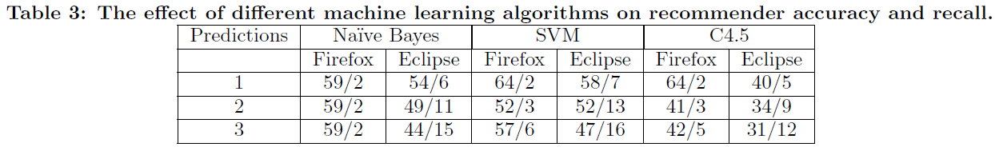
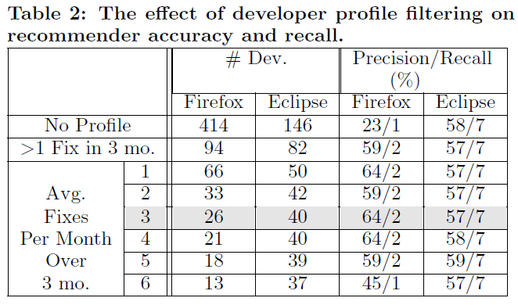
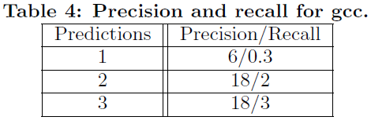
Who Should Fix This Bug? [Anvik 06] Evaluation
??
Notes:
SVM: Support Vector Machines

Slide 20
Who Should Fix This Bug? [Anvik 06] Evaluation
Why it did not work for gcc?
Project specific characteristics
One developer dominate the bug resolution activity (1st developer: 1394 reports, 2nd: 160)
Labeling heuristics may not be sufficiently accurate
Spread of bug resolution activity was low (only 29 developers left after filtering out 63)
Problem of building up the oracle
Difficulty in matching the CVS usernames and the email addresses in Bugzilla (failed to map 32 of the 84 usernames found in CVS)
Implication: It is not easy to generalize such an automated process due to the varying project characteristics

Slide 21
Problems with Bug Triaging
Hard to notice the
problematic bug patterns
(e.g. ping pong, zombie bugs)
It takes effort to find an
appropriate developer
who can resolve the problem
Many bug reports turn out to
be inappropriate (not a bug,
duplicate, cannot reproduce, …)
Reassignments of the bugs
lengthen the time to get them
fixed
Many bug reports are in low
quality (e.g. contains not
enough information)

Slide 22
Which Bugs Get Fixed? [Guo 10]
An empirical study of Microsoft Windows Vista and Windows 7, along with survey
Results
Characterization of which bugs get FIXED
Qualitative validation of quantitative findings
Statistical model to predict which bugs get fixed

Slide 23
Which Bugs Get Fixed? [Guo 10]
Only considers
if the bug is FIXED or not
Notes:
The other resolution types indicate the existence of some degree of inefficiency.

Slide 24
Which Bugs Get Fixed? [Guo 10] Influences on bug-fix likelihood
Quantitative analysis of which factors affect the likelihood of a bug being fixed
Data sources
Windows Vista bug database (~07/09, 2.5yrs after release)
Extracted each event and which field is altered (e.g., editor, state, component, severity, assignee, …)
Geographical / organizational data from MS
MS employee survey (358 responses / 1773 (20%))
“In your experience, how do each of these factors affect the chances of whether a bug will get successfully resolved as FIXED?” 7-point Likert scale
3 free-response questions
Notes:
3 free-response questions:
1. What are reasons why a bug might be reassigned multiple times
2. Why a bug might be closed then reopened multiple times
3. Any other comments about what factors influence whether a bug gets fixed
Also, they used Windows 7 bug database to replicate this study

Slide 25
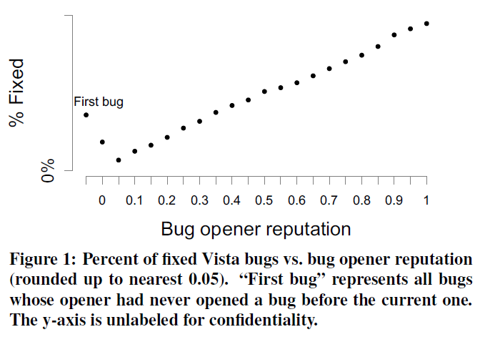

Which Bugs Get Fixed? [Guo 10] Influences on bug-fix likelihood
Reputations of bug opener and 1st assignee
"People who have been more successful in getting their bugs fixed in the past (perhaps because they wrote better bug reports) will be more likely to get their bugs fixed in the future"
Notes:
There are a number of factors that affect the bug-fix likelihood. The first, and the most influential factor is the reputations of bug opener and 1st assignee

Slide 26
Which Bugs Get Fixed? [Guo 10] Influences on bug-fix likelihood
BR edits and editors
BR reassignments
BR reopenings
Organizational and geographical distance
“The more people who take an interest in a bug report, the more likely it is to be fixed”
“Reopenings are not always detrimental to bug-fix likelihood; bugs reopened up to 4 times are just as likely to get fixed”
“Reassignments are not always detrimental to bug-fix likelihood; several might be needed to find the optimal bug fixer”
“Bugs assigned across teams or locations are less likely to get fixed, due to less communication and lowered trust”

Slide 27
Which Bugs Get Fixed? [Guo 10] Statistical models
Statistical models
Two different models
Descriptive statistical model
Predictive statistical model
Performance: Precision of 68% and Recall of 64% (trained with Vista data and tested on Windows 7 data)
Logistic regression model is used

Slide 28
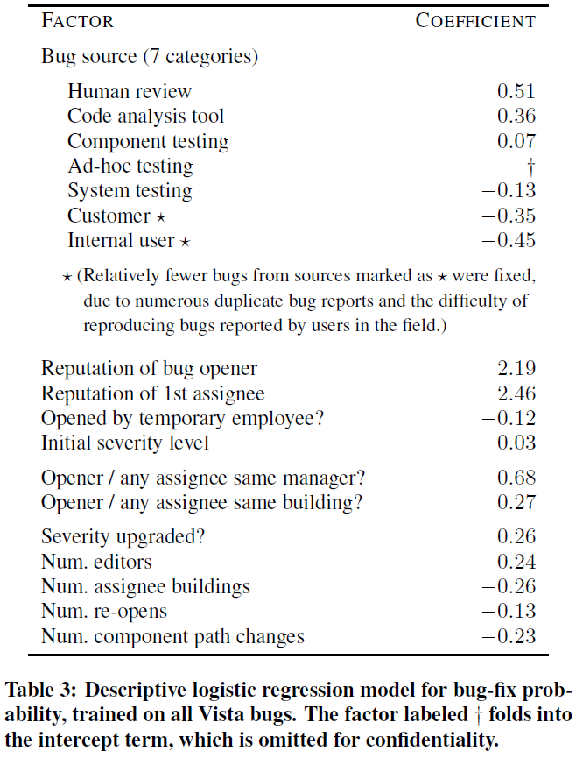
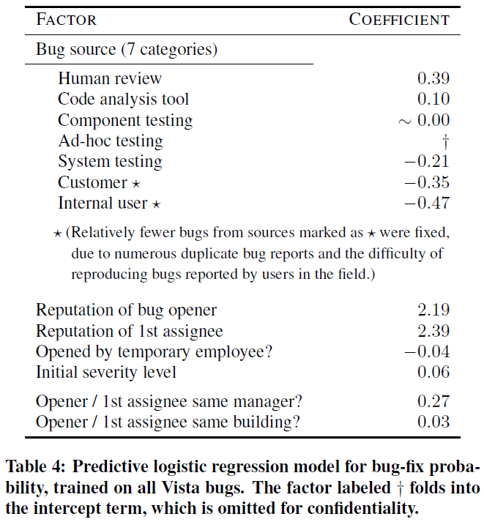
Which Bugs Get Fixed? [Guo 10] Statistical models
These values cannot be obtained when a bug is initially filed
Notes:
Left: Descriptive, Right: Predictive.
Meanings of the coefficient? – intuitive.
positive numbers mean that the corresponding factor is positively correlated with the bug-fix likelihood,
and the negative numbers indicate the negative correlation.
Also, the bigger absolute values indicate that they are more strongly correlated.
Threats to validity?
External validity concern is the most crucial. We don’t know that if this prediction model will work for OSS projects, commercial projects in other companies, and even the projects other than Windows within Microsoft. It might be the case that this model worked pretty well because the Windows Vista and Windows 7 projects have similar characteristics.

Slide 29
Problems with Bug Triaging
Hard to notice the problematic
bug patterns (e.g. ping pong,
zombie bugs, …)
It takes effort to find an
appropriate developer
who can resolve the problem
Many bug reports turn out to
be inappropriate (not a bug,
cannot reproduce, …)
Reassignments of the bugs
lengthen the time to get them
fixed
Many bug reports are in low
quality (e.g. contains not
enough information)
Any other issues such as
social, cultural issues,
physical locations, …

Slide 30
Reasons for Reassignments [Guo 11]
Quantitative & qualitative analysis of the bug reassignment process using the same data as before
Windows Vista bug databases
MS employee Survey (358 responses / 1773 (20%))
free-response question
Used card-sorting to categorize the answers for the above question
In your experience, what are some reasons why a bug would be reassigned multiple times before being successfully resolved as Fixed?
E.g., why wasn’t it assigned directly to the person who ended up fixing it?

Slide 31
Reasons for Reassignments [Guo 11] Findings
Reassignments are not necessarily bad
Five reasons for reassignments
Finding the root cause (the most common)
Determining ownership (which is often unclear)
Poor bug report quality
Hard to determine proper fix
Workload balancing

Slide 32
Reasons for Reassignments [Guo 11] Recommendations for bug tracking systems
Tool support for finding root causes and owners
Integrate a knowledge DB of top experts
Better tools for finding code ownership and expertise (Covered in Lecture 13.)
Degree of Knowledge [Fritz 10]
Expertise Browser [Mockus & Herbsleb 02]
Assign bugs to arbitrary artifacts rather than just people
e.g., components, files, keywords, etc.
A bug can be assigned to multiple people
Tool support for awareness and coordination
In the case of “A → B → C”, A won’t know that B has reassigned the bug to C

Slide 33
Bug Tossing Graphs [Jeong 09]
Analyzed 445,000 bug reports from Eclipse and Mozilla projects
Formalized the bug tossing (reassignment) model
Approximate the bug tossing graph as Markov model
Use the bug tossing graph to:
Identify developer structure
Reduce tossing path lengths
Improve automatic bug triage

Slide 34
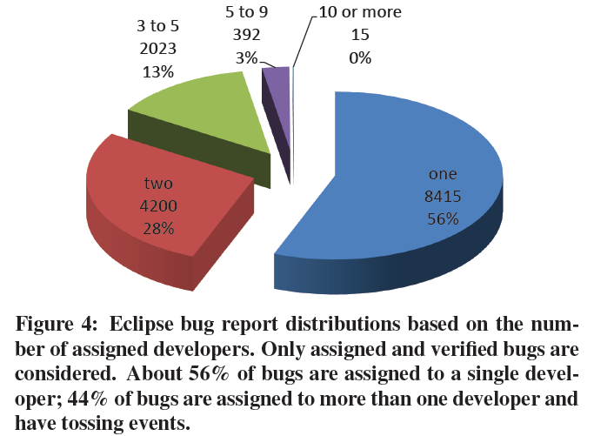
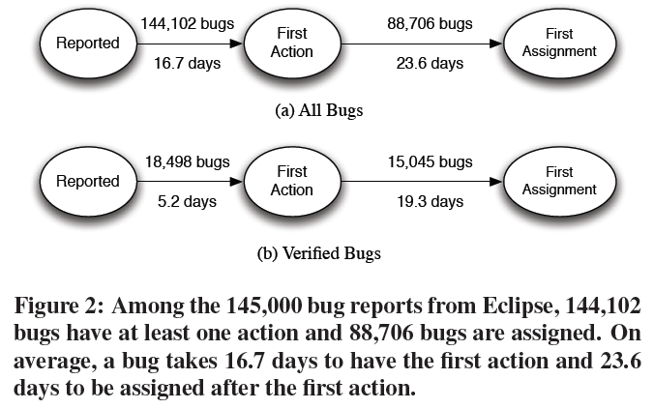
Bug Tossing Graphs [Jeong 09] Simple statistics

Slide 35
Bug Tossing Graphs [Jeong 09] Tossing graph model
Intermediate assignees
A simple tossing path
Decompose each path into N-1 pairs
actual path model
goal oriented model
A → B → C → D
Initial assignee
Fixer (resolver)
A → B
A → D
B → C
B → D
C → D
C → D

Slide 36
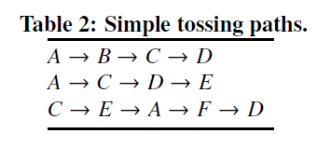
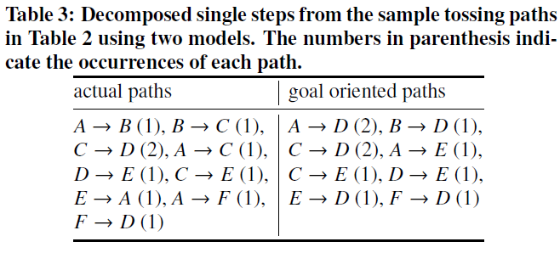
Bug Tossing Graphs [Jeong 09] Tossing graph model
How do we calculate
the probabilities?
C → D: 67%
C → E: 33%

Slide 37
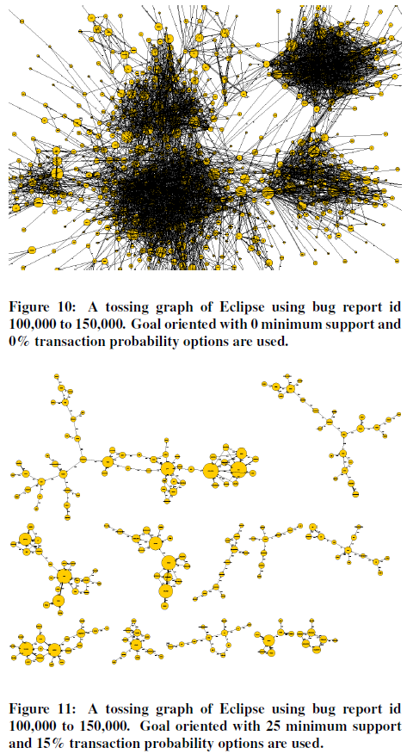
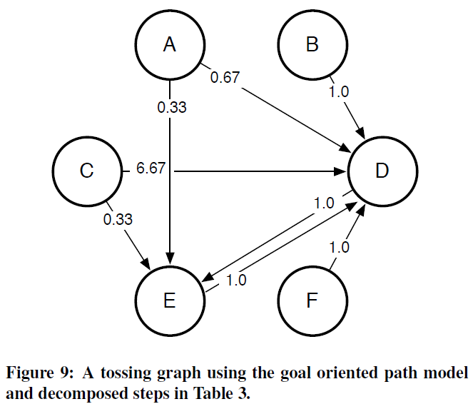

Slide 38
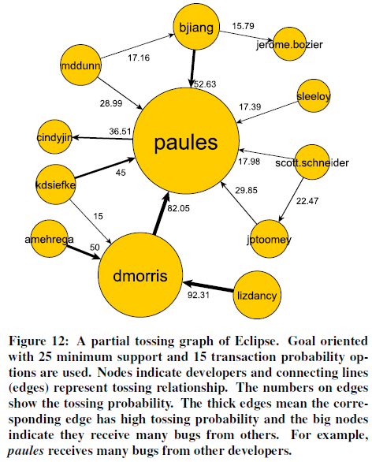
Uses of Tossing Graphs (1)
Identifying developer structure within a project
Actual path model works better in this case

Slide 39
Uses of Tossing Graphs (2)
Reducing tossing paths (i.e., automated tossing)
Use weighted breadth first search (WBFS) algorithm along with the tossing graph
The tossing lengths are reduced significantly
12 steps of Eclipse tossing length → avg. 4 steps
9 steps of Mozilla tossing length → avg. 2.5 steps

Slide 40
Uses of Tossing Graphs (3)
Improving automatic bug triage such as [Anvik 06]
Given that the existing prediction algorithm suggested P = {p₁, p₂, …, p_{n}}, create a new prediction set RP = {p₁, t₁, p₂, t₂, …, p_{n}, t_{n}}, and then choose first n candidates. (where t_{i} is the developer who has the strongest tossing relationship with p_{i})

Slide 41
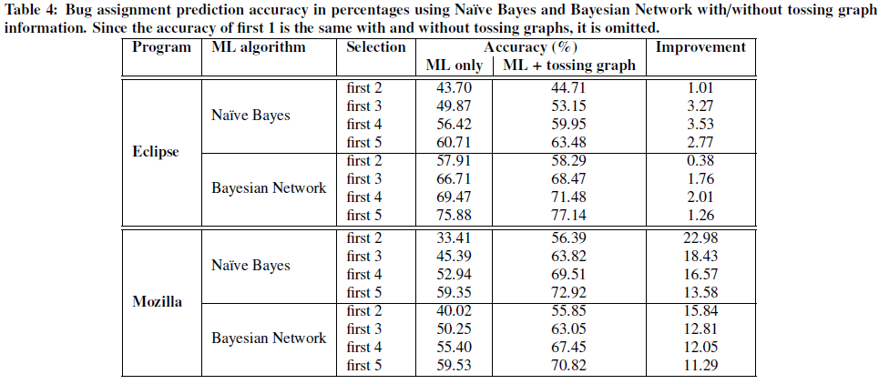
Uses of Tossing Graphs (3)

Slide 42
Problems with Bug Triaging
Hard to notice the problematic
bug patterns (e.g. ping pong,
zombie bugs, …)
It takes effort to find an
appropriate developer
who can resolve the problem
Many bug reports turn out to
be inappropriate (not a bug,
cannot reproduce, …)
Reassignments of the bugs
lengthen the time to get them
fixed
Many bug reports are in low
quality (e.g. contains not
enough information)

Slide 43
What Makes a Good Bug Report? [Bettenburg 08]
Survey among developers and users of APACHE, ECLIPSE, and MOZILLA (466 responses)
Information mismatch between what developers need and what users supply
Tool prototype “CUEZILLA”
Measures the quality of a bug report
Makes suggestions to improve the report quality

Slide 44
What Makes a Good Bug Report? [Bettenburg 08]
Survey Method
Participants
experienced developers (D): those assigned to at least 50 bug reports in their respective projects
experienced reporters (R): having submitted at least 25 bug reports and not being developers themselves
Paired questions

Slide 45
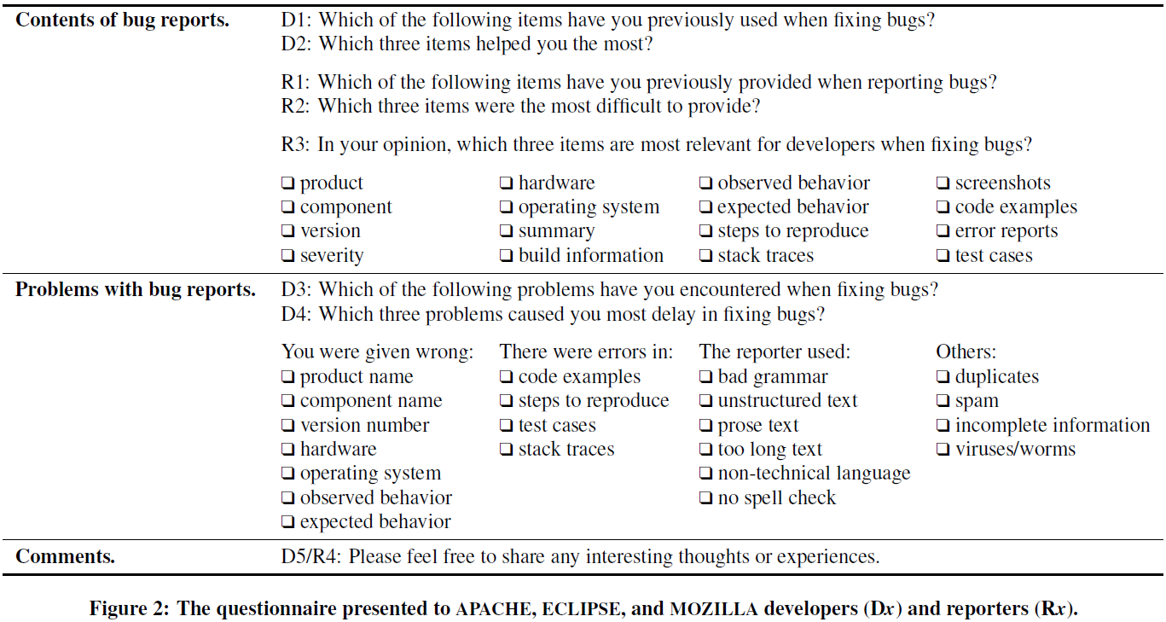
What Makes a Good Bug Report? [Bettenburg 08]

Slide 46
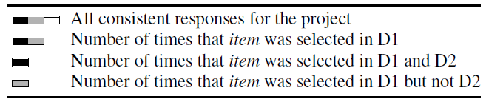
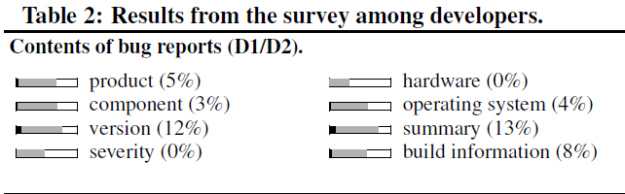
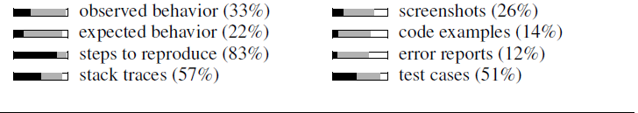
What Makes a Good Bug Report? [Bettenburg 08]

Slide 47
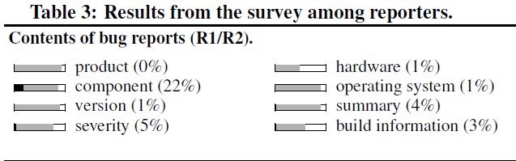
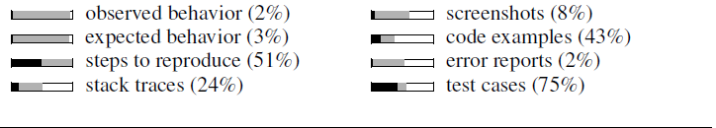
What Makes a Good Bug Report? [Bettenburg 08]

Slide 48
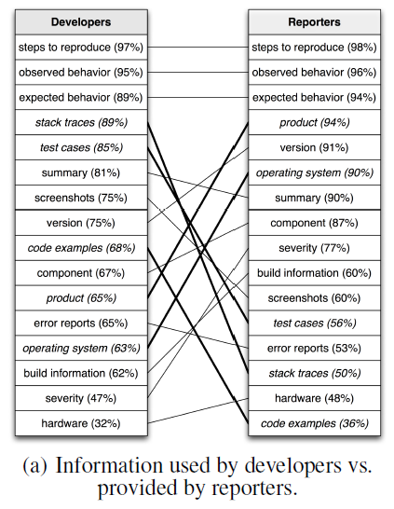
What Makes a Good Bug Report? [Bettenburg 08] Information Mismatch (1)

Slide 49
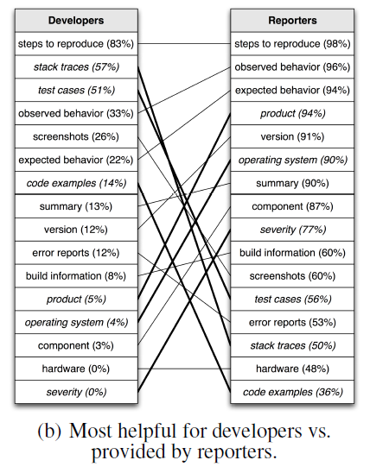
What Makes a Good Bug Report? [Bettenburg 08] Information Mismatch (2)

Slide 50
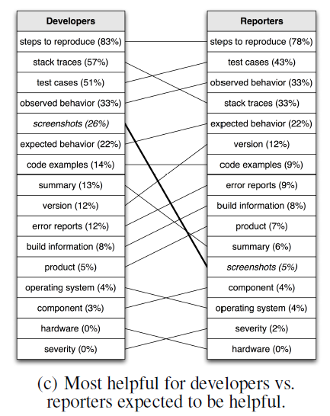
What Makes a Good Bug Report? [Bettenburg 08] Information Mismatch (3)
Notes:
Pretty much consistent

Slide 51
What Makes a Good Bug Report? [Bettenburg 08]
CUEZILLA Prototype
Measure the quality of a bug report based on:
Itemizations (recognized by -, *, +, etc.)
Keyword completeness
Code Samples
Stack Traces
Patches
Screenshots
Readability
Make suggestions to improve bug report quality

Slide 52
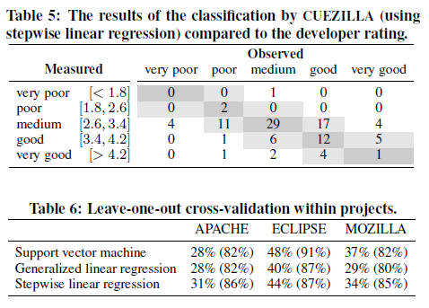
What Makes a Good Bug Report? [Bettenburg 08]

Slide 53


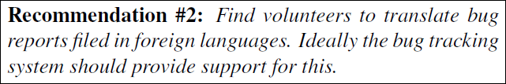


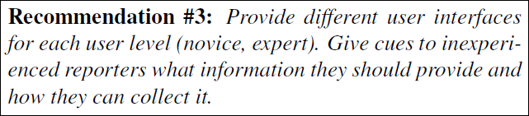
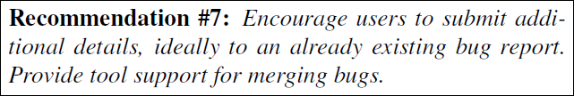
Towards the Next Generation of Bug Tracking Systems [Just 08]
Qualitative analysis of the comments from the same survey which was used for CUEZILLA (card-sorting used)
7 recommendations for better bug tracking systems

Slide 54
Recap
Hard to notice the problematic
bug patterns (e.g. ping pong,
zombie bugs, …)
It takes effort to find an
appropriate developer
who can resolve the problem
Many bug reports turn out to
be inappropriate (not a bug,
cannot reproduce, …)
Reassignments of the bugs
lengthen the time to get them
fixed
Many bug reports are in low
quality (e.g. contains not
enough information)

Slide 55
Conclusion
Bug triaging is a labor-intensive process which has many problems
Visualizations of the bug reports might help the people see the big picture of the project status, and notice the problematic patterns
There have been attempts to automate some parts of the bug triaging process
Many of them use ML algorithms to predict
Not practically usable yet, but still promising
The algorithms cannot be easily generalized due to the project specific characteristics and the cultures

Slide 56
Questions?

