Slide 1
textual languages & editors
stephen oney

Slide 2
outline
textual languages
particular difficulties
paradigms
structured programming
object-oriented programming
aspect-oriented programming
textual editors
structured editors
syntax customization
compare & contrast tools for textual languages & editors

Slide 3
outline
textual languages
particular difficulties
paradigms
structured programming
object-oriented programming
aspect-oriented programming
textual editors
structured editors
syntax customization
compare & contrast tools for textual languages & editors

Slide 4
textual languages
primarily use a textual representation
(mostly exclusively)
as opposed to visual languages
focus: on paradigms and tools for textual languages
will try to not repeat information in other classes

Slide 5
good things about text
many text editors
even most visual languages convert to text
round tripping is rarely an issue in textual langs
large set of tools for textual programs

Slide 6
difficulties of textual languages
memorization burden
efficiency issues
error proneness
viscosity
readability
structuring code
Notes:
without talking about specific languages

Slide 7
does visual programming help?
C. Hundhausen, S. Douglas, J. Stasko
A meta-study of algorithm
visualization effectiveness
Journal of Visual Languages & Computing, 2002
Notes:
these studies all are for textual languages, so you may wonder if visual languages help…
I remind you of this slide, presented by brad a while ago, which indicates…probably not

Slide 8
outline
textual languages
particular difficulties
paradigms
structured programming
object-oriented programming
aspect-oriented programming
textual editors
structured editors
syntax customization
compare & contrast tools for textual languages & editors

Slide 9
outline
textual languages
particular difficulties
paradigms
structured programming
object-oriented programming
aspect-oriented programming
textual editors
structured editors
syntax customization
compare & contrast tools for textual languages & editors

Slide 10
programming paradigms
e.g.: structured programming, object-oriented programming, aspect-oriented programming
add structure to code
encourage production of clear code
steer programmers towards the “right structure”
improve readability
code follows more consistent conventions
paradigms influence languages influence editors
Notes:
put these together because they all have the idea that the flexibility afforded by textual languages is either not used or is used improperly

Slide 11
if(count > 5) {
goto jmp1;
}
jmp2:
printf(“count is %d”, count);
jmp1:
goto jmp2;

Slide 12
goto considered harmful
“The go to statement as it stands is just too primitive, it is too much an invitation to make a mess of one’s program.”
Edsger Dijkstra (March 1968). Go To Statement Considered Harmful. Communications of the ACM 11 (3): 147–148.
Notes:
Idea: choice is not always such a good thing
We want flexibility, but to an extent
Don Norman: Guide users down the right path
Designers: like working within constraint boundaries
TED Talk: choice doesn’t make us happy

Slide 13
structured programming
sequence: ordered execution of statements
selection: if, else, switch, case
repetition: while, for, do {}while
Edsger W. Dijkstra. 1972. Chapter I: Notes on structured programming. In Structured programming, O. J. Dahl, E. W. Dijkstra, and C. A. R. Hoare (Eds.). Academic Press Ltd., London, UK, UK 1-82.

Slide 14
 | SP
reduce memorization
improve efficiency
reduce errors | ?
reduce viscosity
improve readability | +
improve structure | +

Slide 15
program structure
structured programming reduced the amount of interdependence in code
still the problem of structuring textual code on a larger scale
languages began to provide separate syntaxes for specifying the structure of data

Slide 16
program comprehension
maintainers switch between top-down and bottom-up comprehension
top-down if code or code type is familiar
bottom-up if code or code type is unfamiliar
A. von Mayrhauser and A.M. Vans
From Program Comprehension to Tool Requirements for an Industrial Environment
IEEE Workshop on Program Comprehension, 1993
Margaret-Anne Storey
Theories, Methods, and Tools in Program Comprehension: Past, Present, and Future
Int. Workshop on Program Comprehension, 2005

Slide 17
object-oriented programming
 | OOP
reduce memorization
improve efficiency | +
reduce errors
reduce viscosity | ?
improve readability
improve structure | +

Slide 18
aspect-oriented programming
the problem:
some implementation concerns often “cross-cut” across many different parts of a system
programmers often write “cross-cutting code,” or code that is spread out across many different places
examples:
session management
logging
profiling

Slide 19
AOP terminology
join point: a point in the control flow of a program
pointcut: a set of join points
advice: code to be executed at a join point
aspect: combination of the above to address cross-cutting concerns

Slide 20
AOP example
http://www.eclipse.org/aspectj/doc/released/progguide/starting-aspectj.html

Slide 21
join point
call(void Point.setX(int))
http://www.eclipse.org/aspectj/doc/released/progguide/starting-aspectj.html

Slide 22
pointcuts
pointcut move():
call(void FigureElement.setXY(int,int)) ||
call(void Point.setX(int)) ||
call(void Point.setY(int)) ||
call(void Line.setP1(Point)) ||
call(void Line.setP2(Point));
http://www.eclipse.org/aspectj/doc/released/progguide/starting-aspectj.html
Notes:
join points can be joined with OR, AND, NOT, etc.

Slide 23
advice
before(): move() {
System.out.println("about to move");
}
after() returning: move() {
System.out.println("just successfully moved");
}
http://www.eclipse.org/aspectj/doc/released/progguide/starting-aspectj.html

Slide 24
aspect
aspect Logging {
OutputStream logStream = System.err;
before(): move() {
logStream.println("about to move");
}
}
http://www.eclipse.org/aspectj/doc/released/progguide/starting-aspectj.html

Slide 25
aspect-oriented programming
another step towards enabling separation of concerns
claim: easier to reason about, develop, and maintain code that cross-cuts across multiple modules

Slide 27
Terry Hon and Gregor Kiczales. 2006. Fluid AOP join point models. In Companion to the 21st ACM SIGPLAN symposium on Object-oriented programming systems, languages, and applications(OOPSLA '06). ACM, New York, NY, USA, 712-713.

Slide 28
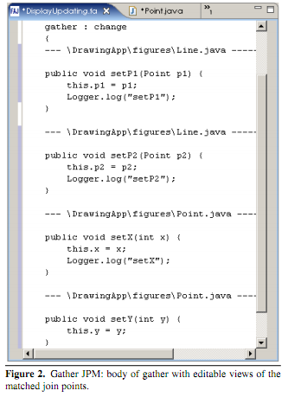
Terry Hon and Gregor Kiczales. 2006. Fluid AOP join point models. In Companion to the 21st ACM SIGPLAN symposium on Object-oriented programming systems, languages, and applications(OOPSLA '06). ACM, New York, NY, USA, 712-713.

Slide 29
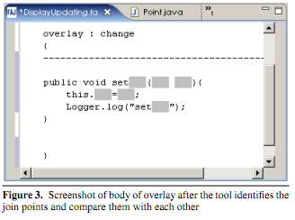
Terry Hon and Gregor Kiczales. 2006. Fluid AOP join point models. In Companion to the 21st ACM SIGPLAN symposium on Object-oriented programming systems, languages, and applications(OOPSLA '06). ACM, New York, NY, USA, 712-713.

Slide 30
 | AOP
reduce memorization
improve efficiency | +
reduce errors
reduce viscosity | +
improve readability | ?
improve structure | ?

Slide 31
command objects
object used to encapsulate all pieces of information relevant to an action
pattern often used for undo
built into some toolkits, like Amulet
Brad A. Myers, Richard G. McDaniel, Robert C. Miller, Alan Ferrency, Andrew Faulring, Bruce D. Kyle, Andrew Mickish, Alex Klimovitski, and Patrick Doane. "The Amulet Environment: New Models for Effective User Interface Software Development", IEEE Transactions on Software Engineering, Vol. 23, no. 6. June, 1997. pp. 347-365. IEEE pdf

Slide 32
constraints
a <- b + c
a changes as b and c change
relationship maintained across methods, modules, etc.
Brad A. Myers, Richard G. McDaniel, Robert C. Miller, Alan Ferrency, Andrew Faulring, Bruce D. Kyle, Andrew Mickish, Alex Klimovitski, and Patrick Doane. "The Amulet Environment: New Models for Effective User Interface Software Development", IEEE Transactions on Software Engineering, Vol. 23, no. 6. June, 1997. pp. 347-365. IEEE pdf

Slide 33
interactors
introduced by Garnet
objects that may be attached to other objects to add functionality
Am_New_Points_Interactor.Create(“create_line”)
.Set(Am_AS_LINE, true) //want to create a new line .Set(Am_FEEDBACK_OBJECT, lfeedback)
//feedback while dragging
.Set(Am_CREATE_NEW_OBJECT_METHOD, create_new_line)
.Set(Am_ACTIVE, line_tool_is_selected)
Brad A. Myers, Richard G. McDaniel, Robert C. Miller, Alan Ferrency, Andrew Faulring, Bruce D. Kyle, Andrew Mickish, Alex Klimovitski, and Patrick Doane. "The Amulet Environment: New Models for Effective User Interface Software Development", IEEE Transactions on Software Engineering, Vol. 23, no. 6. June, 1997. pp. 347-365. IEEE pdf

Slide 34
outline
textual languages
particular difficulties
paradigms
structured programming
object-oriented programming
aspect-oriented programming
textual editors
structured editors
syntax customization
compare & contrast tools for textual languages & editors

Slide 35
outline
textual languages
particular difficulties
paradigms
structured programming
object-oriented programming
aspect-oriented programming
textual editors
structured editors
syntax customization
compare & contrast tools for textual languages & editors

Slide 36
cornell program synthesizer
for intro. to programming students
always presented a set of possible commands
always had a working program
limited LOC

Slide 37
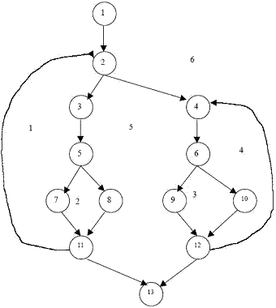
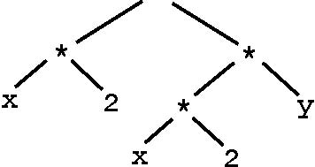
cornell program synthesizer
main() {
//source
//code
}
05 f1 a4
3a be ef
38 51 85
12 32 67
…
Source code
AST
Control Flow Graph
Executable

Slide 38
cornell program synthesizer
main() {
//source
//code
}
05 f1 a4
3a be ef
38 51 85
12 32 67
…
Source code
AST
Control Flow Graph
Executable

Slide 39
structured editors
main() {
//source
//code
}
05 f1 a4
3a be ef
38 51 85
12 32 67
…
Source code
AST
Control Flow Graph
Executable

Slide 40
GNOME
Notes:
$ symbolizes places that can be edited

Slide 41
programmers’ editing strategies: names (declarations & refs)
Creating a name, by typing it from left to right (59%) or using code-completion (5%).
Replacing part of the internal structure of a name (13%), as in replacing colorPanel with strokePanel.
Correcting typos, by using the backspace key (10%).
Replacing a name, by backspacing or selecting and deleting the entire old name first (4%).
Removing a name, by backspacing, overwriting, or selecting and deleting (4%).
Splitting a name(3%), as in splitting padd into p.add.
Renaming (2%) a variable, method, or class and its uses.
About 25% of name edits resulted in semantically invalid names, because the edit was an intermediate change (49%), the name was undeclared (20%), or because of a typo (26%) or misspelling (5%).

Slide 42
programmers’ editing strategies: keywords (if, while, class, etc.)
Typing a required keyword (71%), in the process of typing a complete keyword structure from left to right.
Typing an optional keyword (16%), such as public or extends, into an existing or new structure.
Creating optional structure (7%), such as an initialization statement in a variable declaration.
Creating a declaration with refactoring tools (4%).
Removing an entire keyword structure (2%) by selecting its left and right extents and backspacing.

Slide 43
programmers’ editing strategies: comments
Temporarily commenting out statements (60%) by typing a // before a statement, as in “//repaint;” and often creating an alternative statement above or below.
Creating annotations (37%), which often referenced named program elements such as variables and classes, using either type of comment.
Temporarily replacing an expression (3%), often in unstructured ways, but with structured intent, as in “(a + 2);//b);”. These unstructured edits were likely due to the hassle of typing /**/ comments within a line.

Slide 44
programmers’ editing strategies
small number of editing patterns
programmers don’t make use of freedom of unstructured text
structured editors
support editing patterns
make each pattern more efficient

Slide 45
citrus
A. Ko & B. Myers
Citrus; A Language & Toolkit for Simplifying the Creation of Structured Editors for Code & Data
UIST, 2005

Slide 46
barista
A. Ko & B. Myers
Barista: A Framework for Enabling New Tools, Interaction Techniques, and Views in Code Editors
CHI, 2006

Slide 47
barista
A. Ko & B. Myers
Barista: A Framework for Enabling New Tools, Interaction Techniques, and Views in Code Editors
CHI, 2006

Slide 48
barista
A. Ko & B. Myers
Barista: A Framework for Enabling New Tools, Interaction Techniques, and Views in Code Editors
CHI, 2006

Slide 49
barista
A. Ko & B. Myers
Barista: A Framework for Enabling New Tools, Interaction Techniques, and Views in Code Editors
CHI, 2006

Slide 50
barista
A. Ko & B. Myers
Barista: A Framework for Enabling New Tools, Interaction Techniques, and Views in Code Editors
CHI, 2006

Slide 51
barista
A. Ko & B. Myers
Barista: A Framework for Enabling New Tools, Interaction Techniques, and Views in Code Editors
CHI, 2006

Slide 52
barista
A. Ko & B. Myers
Barista: A Framework for Enabling New Tools, Interaction Techniques, and Views in Code Editors
CHI, 2006

Slide 53
barista
A. Ko & B. Myers
Barista: A Framework for Enabling New Tools, Interaction Techniques, and Views in Code Editors
CHI, 2006

Slide 54
structured editors: ALICE
Alice: Lessons Learned from Building a 3D System for Novices (PDF), Matthew Conway, Steve Audia, Tommy Burnette, Dennis Cosgrove, Kevin Christiansen, Rob Deline, Jim Durbin, Rich Gossweiler, Shuichi Kogi, Chris Long, Beth Mallory, Steve Miale, Kristen Monkaitis, James Patten, Jeffrey Pierce, Joe Schochet, David Staak, Brian Stearns, Richard Stoakley, Chris Sturgill, John Viega, Jeff White, George Williams, and Randy Pausch, CHI 2000

Slide 55
structured editors: Scratch

Slide 56
 | SE
reduce memorization | +
improve efficiency | ?
reduce errors | +
reduce viscosity | ?
improve readability | ?
improve structure

Slide 57
outline
textual languages
particular difficulties
paradigms
structured programming
object-oriented programming
aspect-oriented programming
textual editors
structured editors
syntax customization
compare & contrast tools for textual languages & editors

Slide 58
outline
textual languages
particular difficulties
paradigms
structured programming
object-oriented programming
aspect-oriented programming
textual editors
structured editors
syntax customization
compare & contrast tools for textual languages & editors

Slide 59
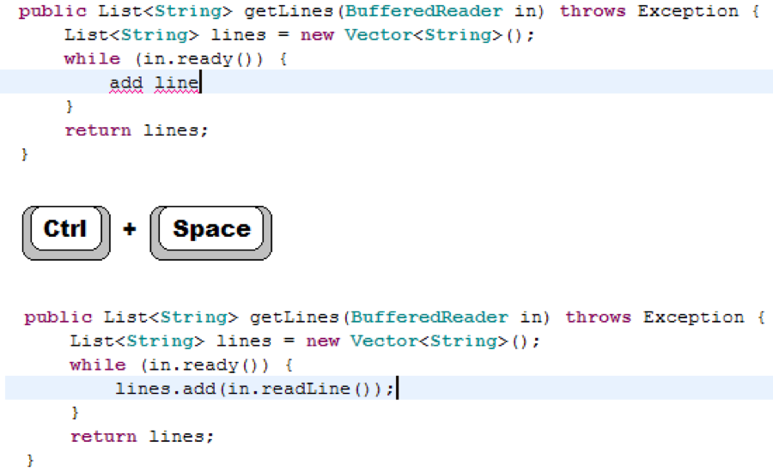
keyword programming
G. Little & R. Miller
Keyword Programming in Java
ACM ASE, 2007
Notes:
reduce the burden of remembering language details

Slide 60
 | IDE Completion
reduce memorization | +
improve efficiency | ?
reduce errors | ?
reduce viscosity
improve readability
improve structure

Slide 61
customizing syntax
reduce burden of memorization
improve readability

Slide 62
operator overloading
meaning of operation changes depending on arguments

Slide 63
operator overloading
from…
a.plus(b.times(c))
to…
a + b * c
concerns:
arbitrariness of code?
harder to infer behaviors?
B. Liblit, A. Begel, and E. Sweetser
Cognitive Perspectives on the Role of Naming in Computer Programs
Psychology of Programming Interest Group, 2006

Slide 64
Andrew D. Eisenberg and Gregor Kiczales. 2007. Expressive programs through presentation extension. In Proceedings of the 6th international conference on Aspect-oriented software development (AOSD '07). ACM, New York, NY, USA, 73-84

Slide 65
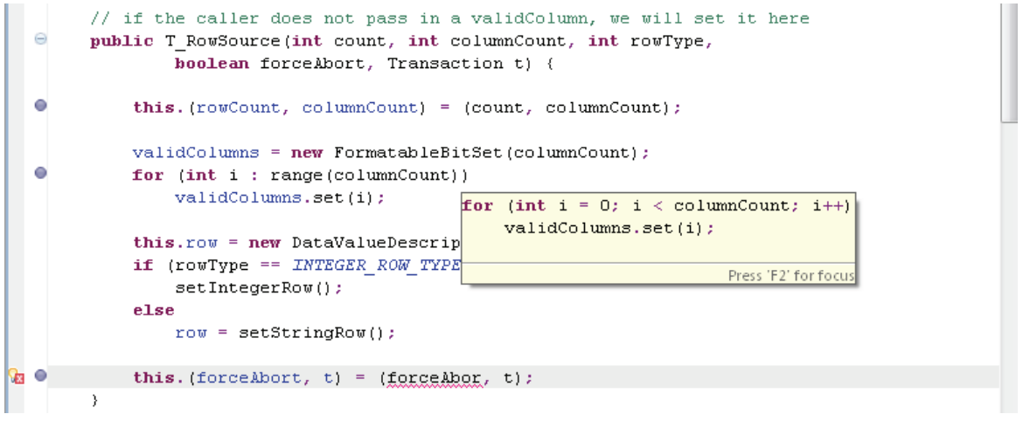
language abstractions
S. Davis & G. Kiczales
Registration-Based Language Abstractions
ACM Onward!, 2010

Slide 67
 | Custom Syntax
reduce memorization | +
improve efficiency | ?
reduce errors
reduce viscosity
improve readability | +
improve structure

Slide 68
outline
textual languages
particular difficulties
paradigms
structured programming
object-oriented programming
aspect-oriented programming
textual editors
structured editors
syntax customization
compare & contrast tools for textual languages & editors

Slide 69
outline
textual languages
particular difficulties
paradigms
structured programming
object-oriented programming
aspect-oriented programming
textual editors
structured editors
syntax customization
compare & contrast tools for textual languages & editors

Slide 70
 | SP | OOP | AOP | Interactor | SE | IDE Completion | Custom Syntax
reduce memorization |  |  |  |  | + | + | +
improve efficiency |  | + | + | + | ? | ? | ?
reduce errors | ? |  |  | ? | + | ?
reduce viscosity |  | ? | + | + | ?
improve readability | + |  | ? |  | ? |  | +
improve structure | + | + | ? | +

Slide 71
 | Examples | Exploring | Refactoring | Processes
reduce memorization | +
improve efficiency |  |  | + | +
reduce errors | +
reduce viscosity |  |  | +
improve readability |  | +
improve structure | ? |  | ?

