Slide 1
Programming by Demonstration
Kerry Chang
Human-Computer Interaction Institute Carnegie Mellon University
05-899D: Human Aspects of Software Development (HASD)
Spring 2011 – Lecture 25

Slide 2
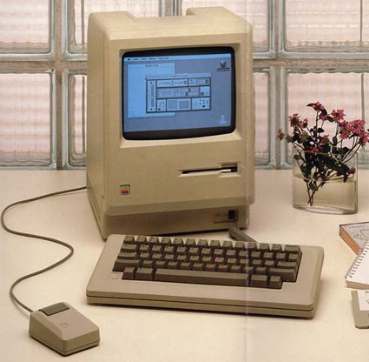
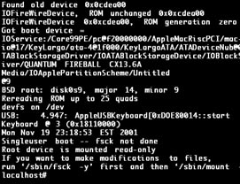
History
Direct Manipulation: Allows users to interact with the computer by pointing to objects on the screen and manipulating them using a mouse and keyboard. (Ben Shneiderman, 1983)

Slide 3
Direct Manipulation
Advantages:
Novice can learn basic functionality quickly.
Users can immediately see whether their actions are furthering their goals.
Users experience less anxiety because the system is comprehensible, and because the actions are easily reversible.
Limitations:
Do not provide convenient mechanisms for expressing abstractions and generalizations. Ex. “Remove all the objects of type y”
Experience users find commonly occurring complex tasks more difficult to perform.

Slide 4
Programming by Demonstration:
“A technique that enable ordinary end users to create programs without needing to learn the arcane details of programming languages, but simply by demonstrating what their program should do.”

Slide 5
Demonstration Interface
Let the user perform actions on concrete example objects (often by direct manipulation), while constructing an abstract program.
The user demonstrates the desired results using example values.
Ex. “Remove all the ‘.ps’ file”
The user is able the create parameterized procedures and objects without learning a programming language.

Slide 6
Application Area
A demonstration interface might be appropriate for an application if there is…
Some high-level domain knowledge that could be represented in the program.
Some low-level commands that users repeatedly perform in some situations.
Some programming features that are available in the textual, command-line interface but not in the graphical, direct-manipulation interface.
A user interface or program output with limited options, which users want to customize.
Notes:
A demon- strational interface might be appropri- ate for an application with one or more of the following characteristics:

Slide 7
Classification & Definition
The ability to guess user’s intention
A system that is “intelligent”: be able to guess the generalization using heuristics, based on the examples the user demonstrates.
“Inferencing”
The ability to support full programming
A system that is “programmable”: be able to handle variables, conditionals, and iterations (not just be able to let user enter or define a program).
Programming-by-example systems: Interfaces that provide both programing and inferencing.
Programming-with-example systems: Interfaces that only provide programing ability but not doing any inferencing.

Slide 8
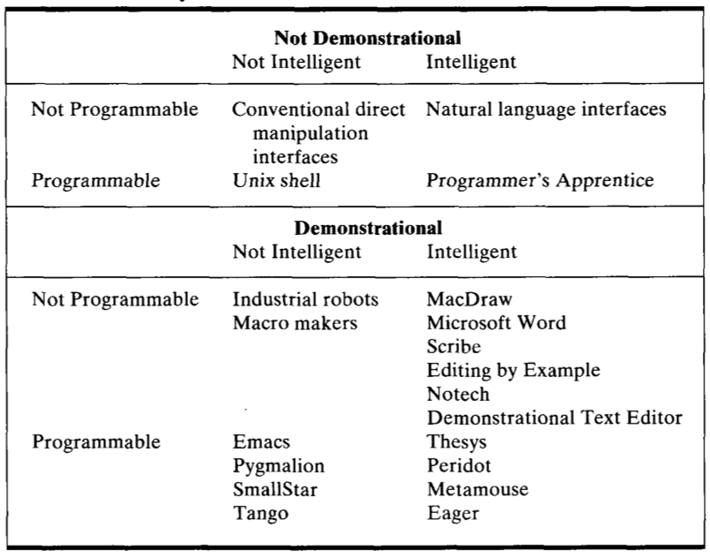
Classification & Definition

Slide 9
Outline
Introduction
Survey of several “old systems”
Gamut
Challenges in designing programming-by-example systems
CHINLE

Slide 10
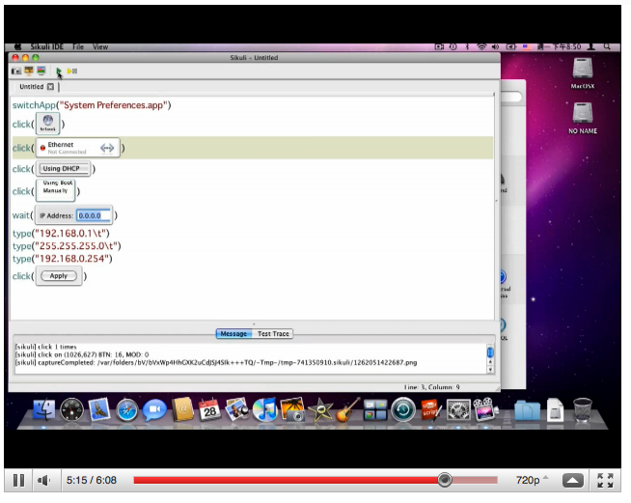
Not programmable demonstration system
Not intelligent
Robot arms
Macro maker (Sikuli)

Slide 11
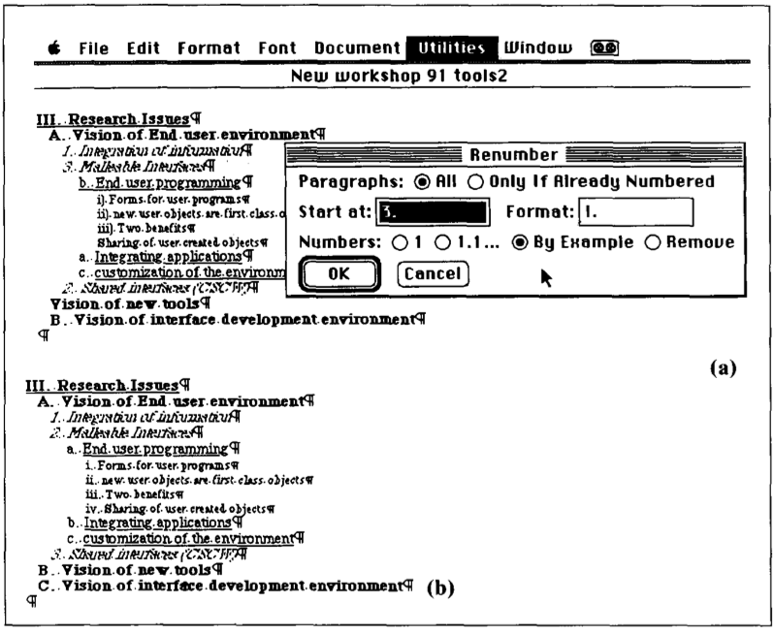
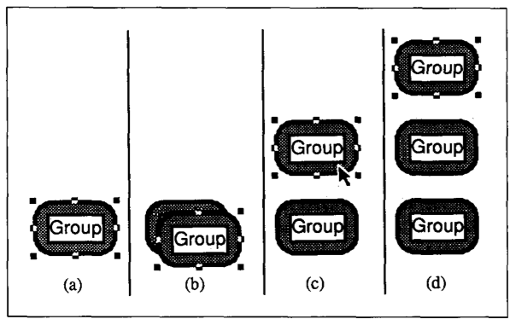
Not programmable demonstration system
Intelligent (try to guess something about what the user is doing)
MacDraw
MS Word

Slide 12
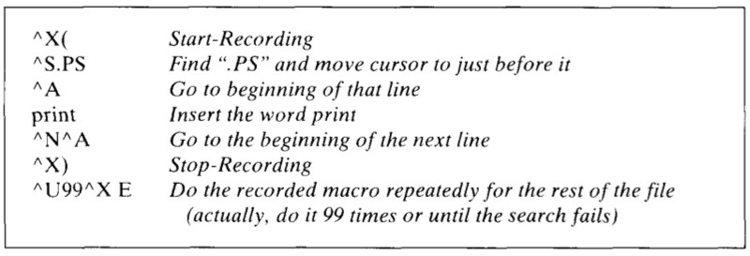
Programming-with-examples systems
The system does no inferencing – does exactly (and only) things that the user specifies.
Emacs

Slide 13
Programming-by-examples systems
The system is both programmable and intelligent (does inferencing).
Peridot
How do various graphic elements depend on the example parameters (ex. the menu’s border should be big enough for all the strings.)
When an iteration is needed (ex. to place the rest of the menu items after the user has demonstrated the positions for two.)
How the mouse should control the interface (ex. to move the indicator in the scroll bar.)
Notes:
Interface building tool

Slide 14
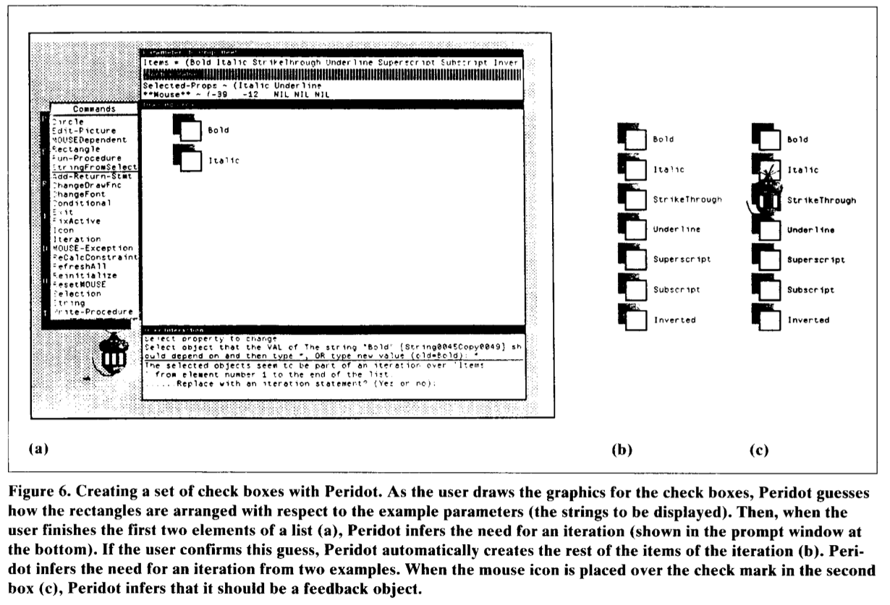
Programming-by-examples systems

Slide 15
Programming-by-examples systems
Eager
Inferring an iterative program to complete a task after the user has performed the first two or three iterations.
Providing feedback to the user about how the system has generalized the user’s actions.
“Anticipation” – Inferring what the user’s next action will be after recognizing a pattern.
Highlighting using colors or a special icon.
Notes:
A smart macro tool for the hypercard environment. Hypercard is a macintosh program that let users build custom, direct-manipulation applications.

Slide 16
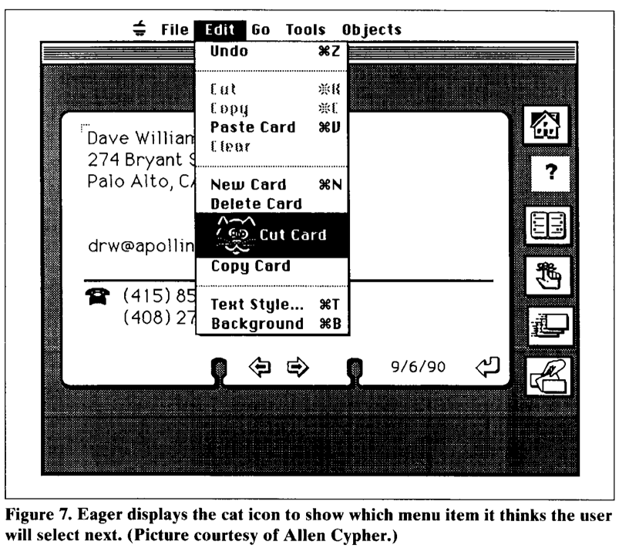
Programming-by-examples systems
Notes:
Eager provides feedback by anticipation:When it rec- ognizes a pattern, it infers what the us- er's next action will be and uses color and a special icon to highlight the loca- tion where the user will next click the mouse (if it is on a menu item or a button on the screen) - or it displays the text that it expects the user to type next. (Most other systems –for example, Peridot and Metamouse - explain in text what the user is expected to do.) If the user performs the action Eager anticipated,this confirms the inference; if the user performs a different action, this provides a new example for Eager to use in determining a better inference about how to generalize the user’s ac- tions.

Slide 17
Outline
Introduction
Survey of several “old systems”
Gamut
Challenges in designing programming-by-example systems
CHINLE

Slide 18
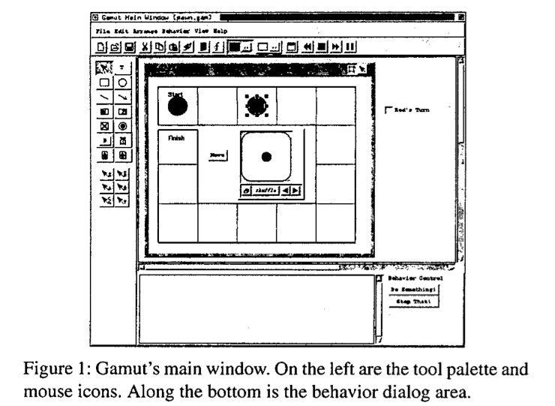
Gamut
A PBD tool for nonprogrammers to create interactive software.
Ex. Board game, educational software…
The developer builds the program by providing examples of the intended interactions between the user and the application.

Slide 19
Gamut
Guide Objects
Graphical objects and widgets that are visible while the developer is creating an application, but are hidden when the application runs.
Onscreen guild objects: show graphical relationships between other objects on the screen.
Can be used to demonstrate distances, locations, speeds…
Offscreen guild objects: represent the application’s data that is not stored directly on the board.
Times, counters, toggle buttons…

Slide 20
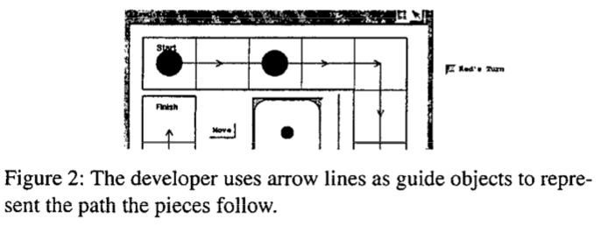
Gamut

Slide 21
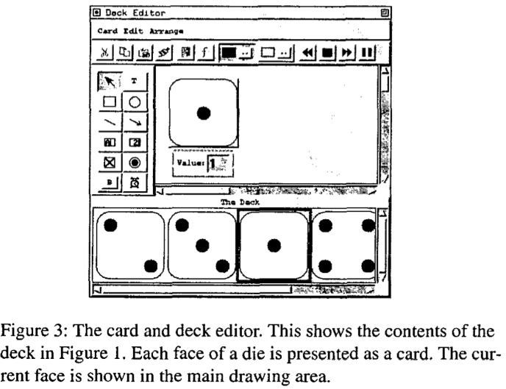
Gamut
Deck Objects
The major data structure in Gamut.
Can be used to present lists of numbers, objects, colors…
Can produce video games behaviors.
Has a “shuffle” feature
Notes:
Randomize feature: shuffle.

Slide 22
Gamut
Demonstrating behavior
Nudges: Developers give the system a “nudge” telling the system immediately where it went wrong.
“Do something”
Used to demonstrate new behaviors
“Stop that”
Tells the system that one or more objects did something wrong.
Notes:
In other words, when the application is supposed to do something but does nothing, or does something when it is not supposed to, the developer nudges the system and corrects the behavior.
In our example, the developer wants to demonstrate that when the player pushes the application’s “Move” ‘button, the game will respond by moving the current player’s piece. The developer first pushes the Move button (it is to the left of the die in Figure 1). Though the developer pushes the but- ton, the application will do nothing because no behavior has yet been demonstrated. So the developer pushes Do Some- thing at which point the system prepares to accept a new example. The system displays temporal ghosts to show how objects have changed from the previous state, activates hint highlighting so the developer may give hints, and presents a dialog asking the developer to complete the example and press the Done button when complete.

Slide 23
Gamut
Demonstrating behavior
Hint highlighting: a special form of selection where the author points out key elements that are important to a demonstration thereby focusing the system’s attention on those objects.
Temporal ghost: a technique for keeping objects that change onscreen so that they may be highlighting.
Ghosts are semi-transparent.
Question Dialogs: occurs when the system suspects that there is a relationship, where an object was not highlighted.
Notes:
Click on the object to highlight

Slide 24
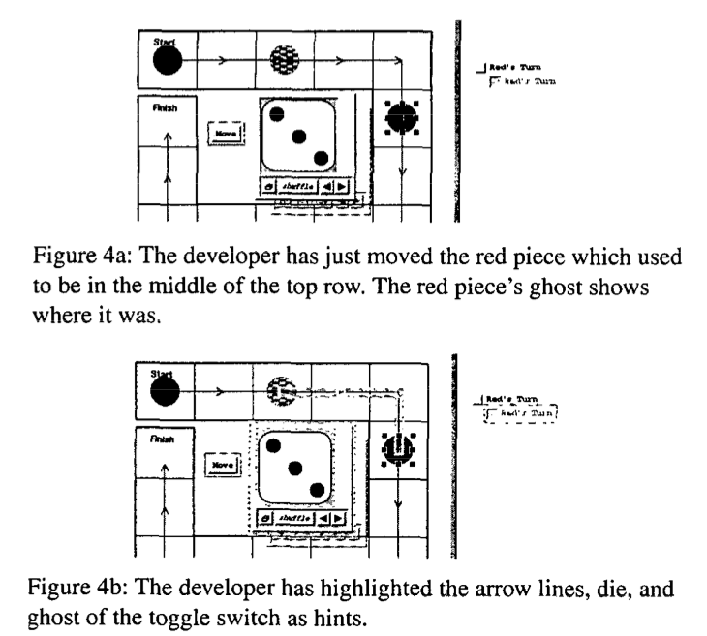
Gamut (Video)
Notes:
In the example, the developer knows that the path of the piece is important as well as number shown on the die; so, the developer highlights the lines in the path and the die object. The developer will also need to highlight something that shows what value to set the current player checkbox. The checkbox only toggles back and forth between true and false so its only dependency is its own value. Thus, the new value of the checkbox depends on its original value. To highlight the original value, the developer highlights the checkbox’s temporal ghost which is shown on the right in Figure 4b.

Slide 25
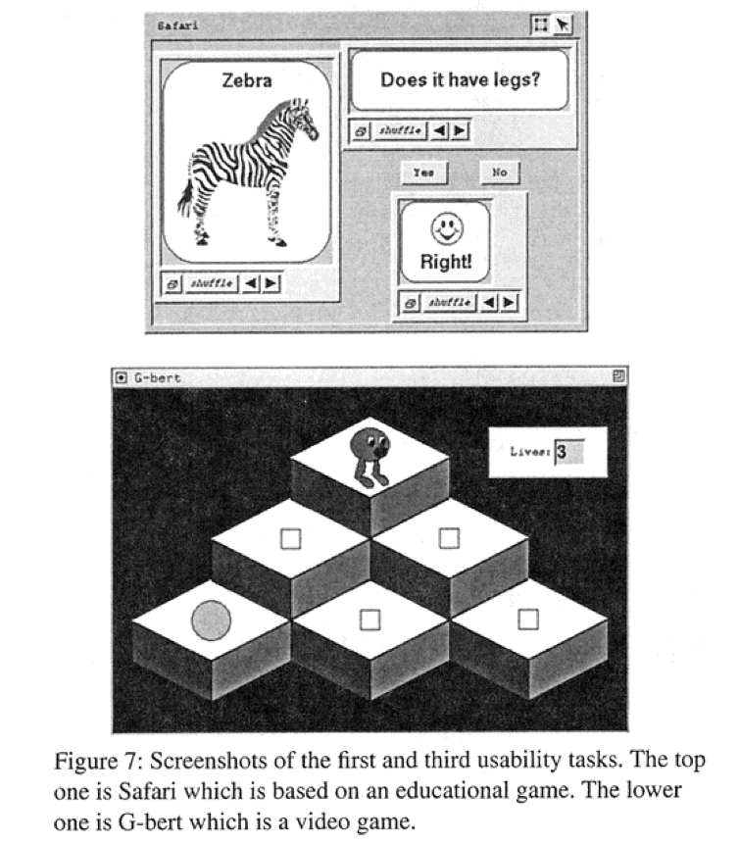
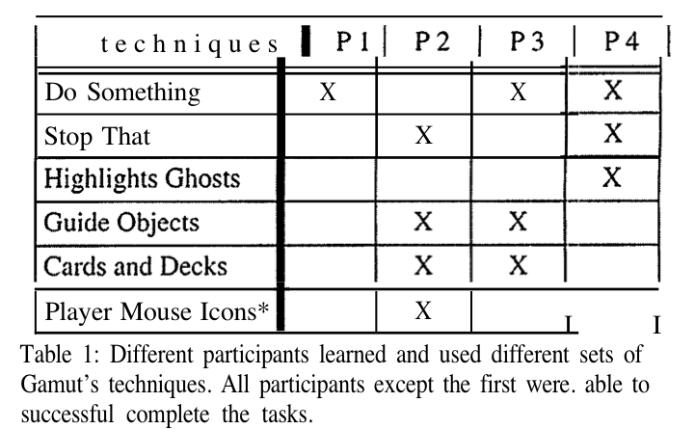
Gamut
User Testing
Four participants, all nonprogrammers.
Tasks
Result
Notes:
Click on the object to highlight
The first task was based on a matching test similar to some educational games like Reader Rabbit and is shown in Fig- ure 7. It was called Safari and it consists of two decks of cards. One contained a list of animals like “Zebra,” and the other contained a list of questions about animals like “Does it have stripes?” The goal of the task was to put guide objects into the deck that would tell Gamut the correct answers and to demonstrate the behavior of a pair of buttons labelled “Yes” and “No.”
The second task was the board game task that we used in this paper as an example and can be seen in Figure 1. The participants did not have to draw the board or create the die, but did have to create guide objects to represent the path the pieces followed, create something to represent the turn indi- cator, and demonstrate all the behaviors.
The third task which only one participant attempted was based on the video game Q*bert and is also shown in Figure 7. It had a character which jumps from cube to cube in a pyramid and collects objects. There is also an enemy ball which falls down from the top of the pyramid in random directions. The third task required a longer time to complete than the others so it had its own session. The participant was given a shortened tutorial which described the new interac- tion techniques required in the third task.

Slide 26
Gamut
Problems found:
Participants were reluctant to highlight ghost objects.
Participants were reluctant to create guild objects.
Participants highlighted inappropriate objects as hits when Gamut asked a question.
Chose to highlight objects that were “not that obvious” instead of the obvious ones.
Notes:
Most participants showed a peculiar reluctance to highlight a ghost object. Several preferred to highlight the original object and not its ghost even though the original was modified and displayed a different state from what the participant wanted the system to learn. The “Highlight Ghosts” line on the table shows that only one participant was truly comfortable highlighting ghosts while the others would choose not to most of the time.
The most significant problem we discovered in Gamut con- cerns guide objects. Developers were always reluctant to create guide objects to use in their demonstrations. The pilot study showed we had to include specific instructions to tell the participant to draw guide objects. However, once told, participants were usually able to create objects that were suitable for the task they needed to demonstrate. The only successful participant who had difficulty creating guide objects after being told to do so was P4. It turns out P4 even- tually did create all the needed guide objects, but only after asking the experimenter so many questions that it was not clear whether P4 had designed the objects herself or whether the experimenter had given away the answers.
When the system needed to have an object highlighted that was too obvious for the participant’s taste, the participant would often choose to highlight an object which had a less obvious connection to the behavior.

Slide 27
Outline
Introduction
Survey of several “old systems”
Gamut
Challenges in designing programming-by-example systems
CHINLE

Slide 28
Challenges
Detect failure and fall gracefully.
Handle noise in training examples. (ex. when the users perform a wrong action.)
One wrong prediction in the middle of the process will lead the entire script to astray.
Make it easy to correct the system.
Notes:
we have observed that users are confused because the system says it has completed the script successfully, even though it diverged from the correct path midway through the script and did not actually complete the desired task. Few users monitor the system's behavior closely enough to detect when it has not done what it said it was going to do.

Slide 29
Challenges
Encourage trust by presenting a model user can understand.
Inferencing algorithm is use as a black box.
Users can’t trust the system to do serious thing (ex. cleaning a disk), especially when the system sometimes goes wrong.
Enable partial automation.
Consider the perceived value of automation.
What kind of tasks should be (or are worth to be) automated?
Notes:
Intelligent systems should be able to cope with interruptions, and allow users to modify the automated system's behavior without derailing the automation.

Slide 30
Outline
Introduction
Survey of several “old systems”
Gamut
Challenges in designing programming-by-example systems
CHINLE

Slide 31
CHINLE
Problems observed in most PBD system:
Heavy domain engineering work
Inscrutability of the learning process
Difficulty recovering from training errors
All-or-nothing learning
CHINLE: a system that 1) automatically constructs PBD systems for an application program from its high-level interface description, and 2) addresses these issues with novice interaction techniques.

Slide 32
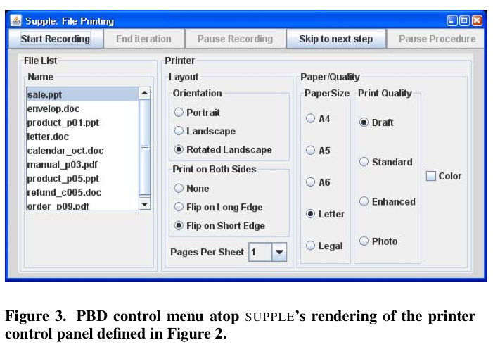
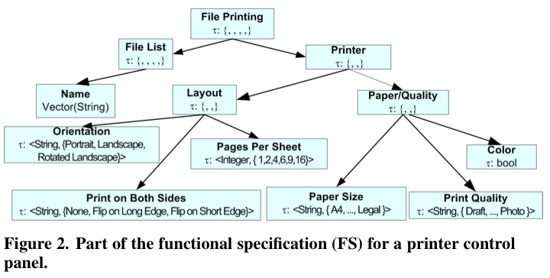
CHINLE
Built upon SUPPLE: an open-source model-based interface-generation toolkit.
SUPPLE represents an interface functionally e.g. , specifying what capabilities the interface should expose, instead of how to present those features.
Notes:
S U P P L E represents an interface functionally, e.g., specify- ing what capabilities the interface should expose, instead of how to present those features
As a running example, consider the functional specification of a Windows-style printer control panel (Figure 2). Interior nodes, such as paper quality, are represented as container types, while leaves are primitives, such as the switch for color vs. black and white printing, which is represented as a Boolean. S U P P L E renders this specification as shown in Figure 3.

Slide 33
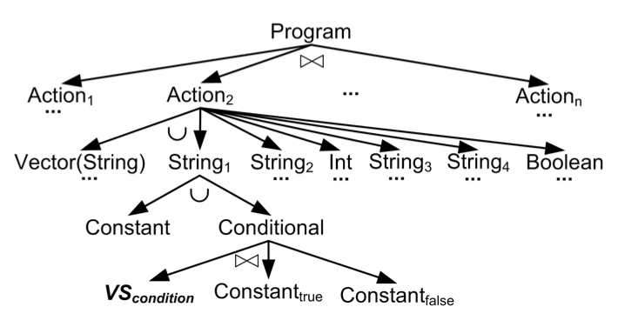
CHINLE
Version space

Slide 34
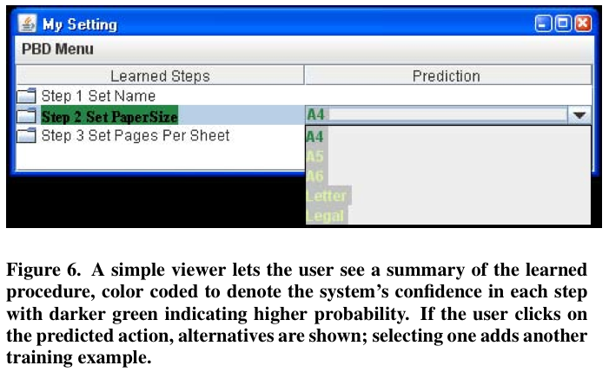
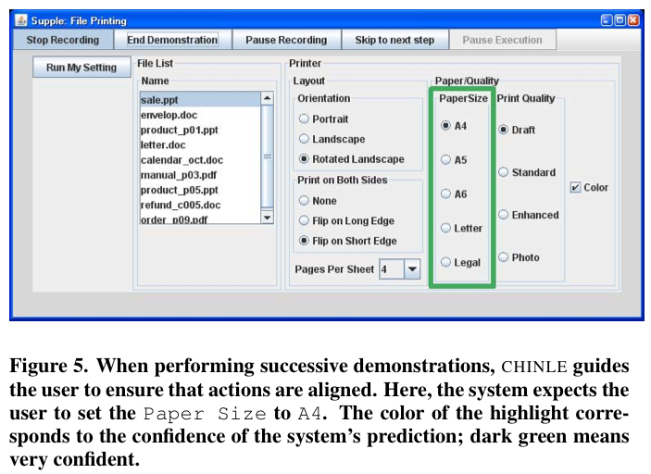
CHINLE
Visualizing system confidence
Using a six-level sequential color scheme.
The higher, the darker.
Notes:
To elaborate our running example, suppose that Sue regu- larly prints files of different formats sent from her European clients. She typically changes the paper size, paper per sheet and color settings according to the properties of the file to be printed. Because her clients are European, she often uses A4 paper; however, she prefers Letter size for her own doc- uments. She prefers Pages Per Sheet to be 1, except for PowerPoint presentations, where she uses 4. Unless the file is in color, she prefers the cheaper Black-And-White setting. Sue finds it annoying to manually change these print- ing settings, since she often forgets and wastes paper. So, she wants to automate this repetitive task. Since she needs to print sale.ppt, she starts the PBD recorder and changes Paper Size from Letter to A4. Next, she changes Pages Per Sheetfrom1to4.Finally,shepressesEnd Demonstration on the PBD menu to stop recording.
A bit later, Sue needs to print envelop.doc so she re- sumes recording. Since the PBD system knows the rough flow of actions, it guides her to ensure that the actions in the two demonstrations are aligned. It does this by high- lightingtheexpectedstep4(setPaper Size)andfillingin the anticipated value A4; see Figure 5. To indicate the sys- tem’s confidence in its predictions, CHINLE uses a 6-level sequential color scheme [5], generated by COLORBREWER; its confidence in A4 is very high (72%), which maps to dark green.

Slide 35
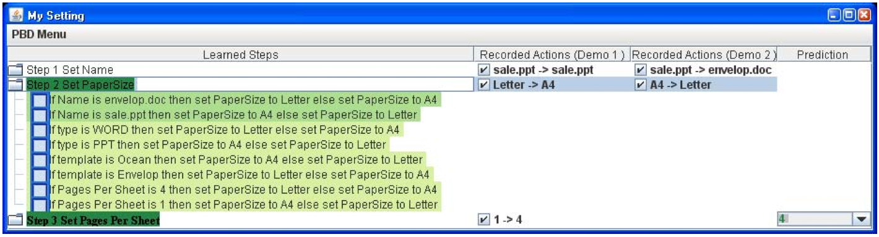
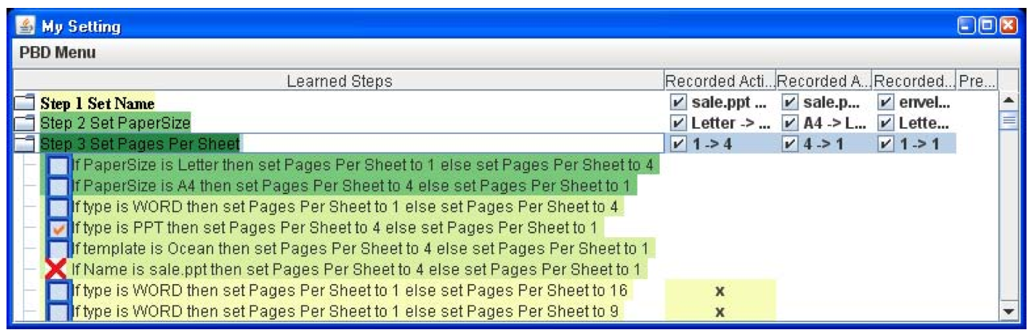
CHINLE
Correcting demonstration errors

Slide 36
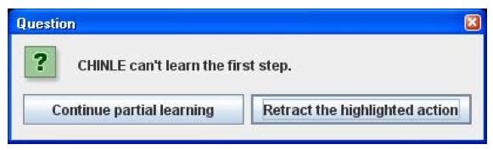
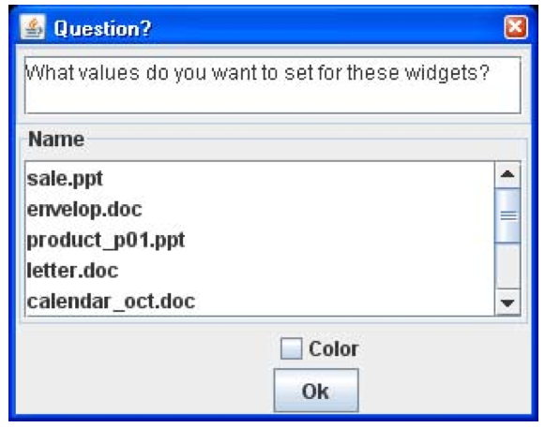
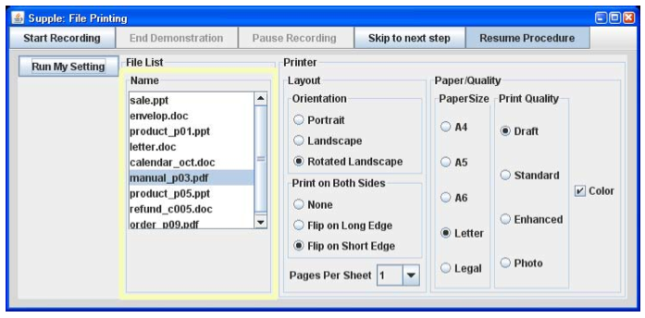
CHINLE
Partial learning
Notes:
To elaborate our running example, suppose that Sue regu- larly prints files of different formats sent from her European clients. She typically changes the paper size, paper per sheet and color settings according to the properties of the file to be printed. Because her clients are European, she often uses A4 paper; however, she prefers Letter size for her own doc- uments. She prefers Pages Per Sheet to be 1, except for PowerPoint presentations, where she uses 4. Unless the file is in color, she prefers the cheaper Black-And-White setting. Sue finds it annoying to manually change these print- ing settings, since she often forgets and wastes paper. So, she wants to automate this repetitive task. Since she needs to print sale.ppt, she starts the PBD recorder and changes Paper Size from Letter to A4. Next, she changes Pages Per Sheetfrom1to4.Finally,shepressesEnd Demonstration on the PBD menu to stop recording.
A bit later, Sue needs to print envelop.doc so she re- sumes recording. Since the PBD system knows the rough flow of actions, it guides her to ensure that the actions in the two demonstrations are aligned. It does this by high- lightingtheexpectedstep4(setPaper Size)andfillingin the anticipated value A4; see Figure 5. To indicate the sys- tem’s confidence in its predictions, CHINLE uses a 6-level sequential color scheme [5], generated by COLORBREWER; its confidence in A4 is very high (72%), which maps to dark green.

Slide 37
CHINLE
No evaluation…

Slide 38
Summary – Demonstration Tools
Direct Manipulation, classification, definition
Early demonstration tools
Gamut & CHINLE
Current system?
Adobe Catalyst (?)
What else?

Slide 39
Thanks!

