Slide 1

Languages and Tools for Novice and End-User Programmers
Brad Myers
05-899D: Human Aspects of Software Development (HASD)
Spring, 2011
Copyright © 2011 – Brad Myers

Slide 2
General Goals
Make programming easier
Make learning programming easier
Make EUP easier
Reduce barriers
Make programming more “accessible”
My group → Make programming more “natural”

Slide 3
Many Other Topics are Related
Lecture 1: Why programming is hard, what EUPs are
Lecture 4: Making APIs easier to use
Lecture 11: How people think about programming; why is that hard?
Lecture 19: Visual Programming
Lecture 25: Programming by Example
Lecture 26: Textual languages and editors
Etc.

Slide 4
Caitlin Kelleher’s Taxonomy
Systems that (1) teach programming or (2) help people do programming
Not PBE systems

Slide 5
Systems to Facilitate Teaching
Help students learn the basic concepts
Help them transition to “real” languages
Teach the “real” way to do C/C++/Java for-loops
Help with mechanics of programming
Entering: syntax, expressing intent
Understanding: Tracing, debugging

Slide 6
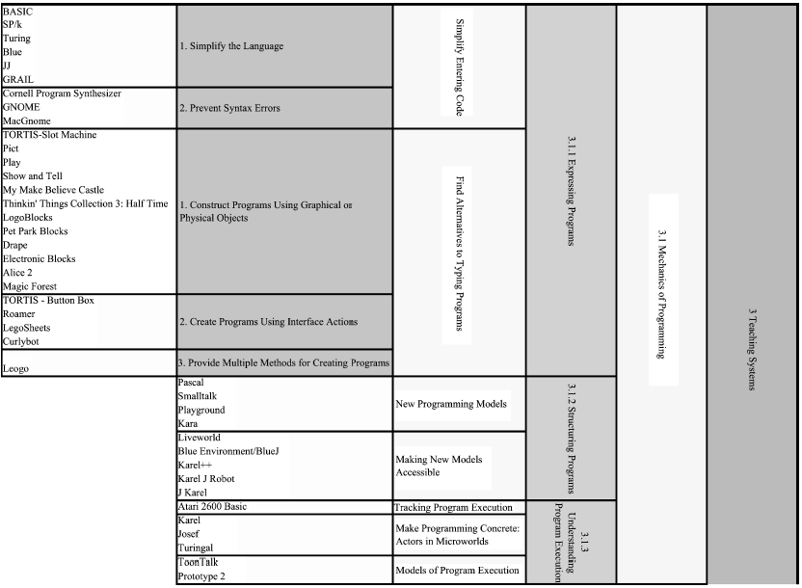

Slide 7
Simplifying Entering Code
Simpler programming language
Basic (1963), etc.
Also:
Logo (1966)
Pascal (1970)
Hypertalk (1987)
Hands (2002)
Chickenfoot (2005)

Slide 8
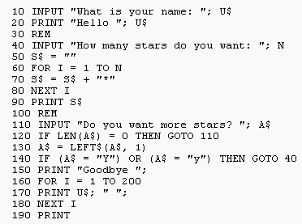
Basic
Designed in 1963, by John George Kemeny and Thomas Eugene Kurtz at Dartmouth College
Beginner's All-purpose Symbolic Instruction Code
To allow students not in science fields to use computers
Timesharing and then personal computers
(Microsoft’s first product, in 1975)
Notes:
In 1975, Microsoft (then only two people — Bill Gates and Paul Allen)

Slide 10

Simplifying Entering Code
Prevent Syntax Errors
Cornell Program Synthesizer (1981)
GNOME (CMU)
Navigate using syntax tree
Cannot leave an expression until no syntax errors
MacGnome (CMU)
Also: IDEs from Brown previously covered (PECAN, GARDEN, FIELD, DESERT), Alice
Have to compose and edit hierarchically

Slide 11
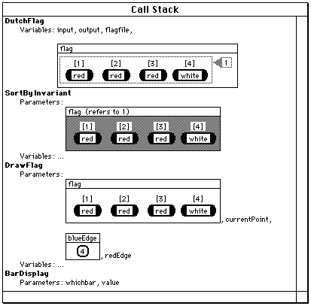
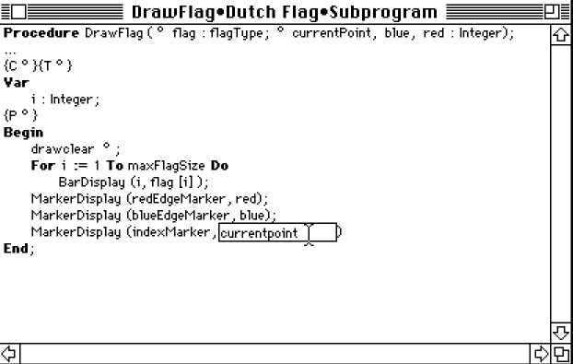
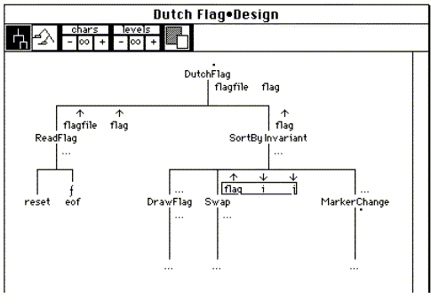
MacGnome
[Miller, 1988]
Structured editing
But could edit as plain text for flexibility
Also added data and code visualization

Slide 12
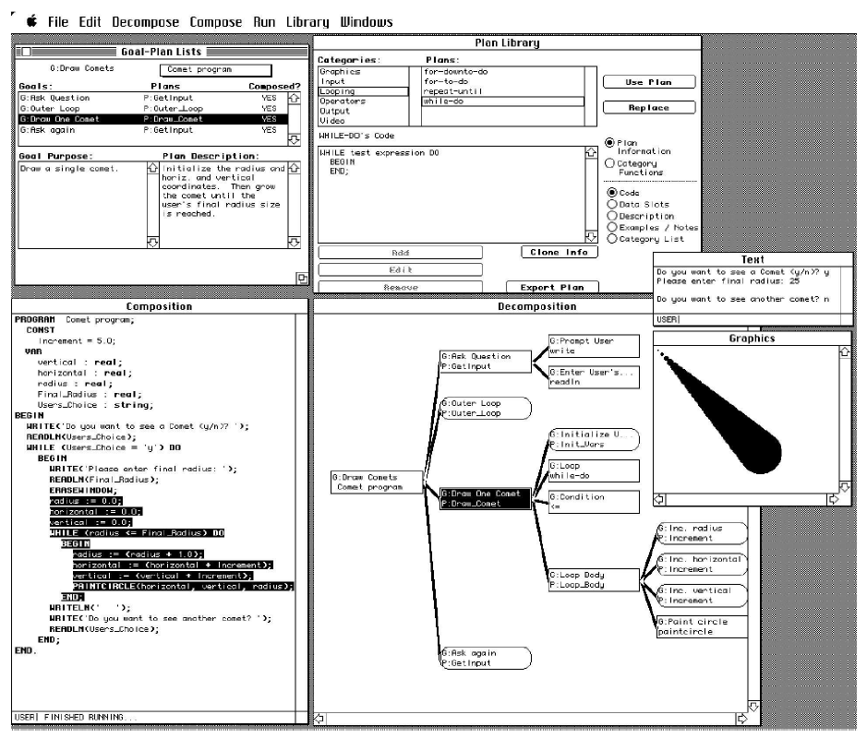
Goal-Plan-Code Editor [Guzdial 98]
More task- based decomposition
Extensive eval. showed transfer
No evidence that easier

Slide 13
Observations on Structured Editing
Studies show such editors can help novices construct correct programs
Acquiring language syntax is a barrier to novices, especially for children
But, make it very difficult to edit programs after created
E.g., re-organizing code, re-using arbitrary-size pieces

Slide 15
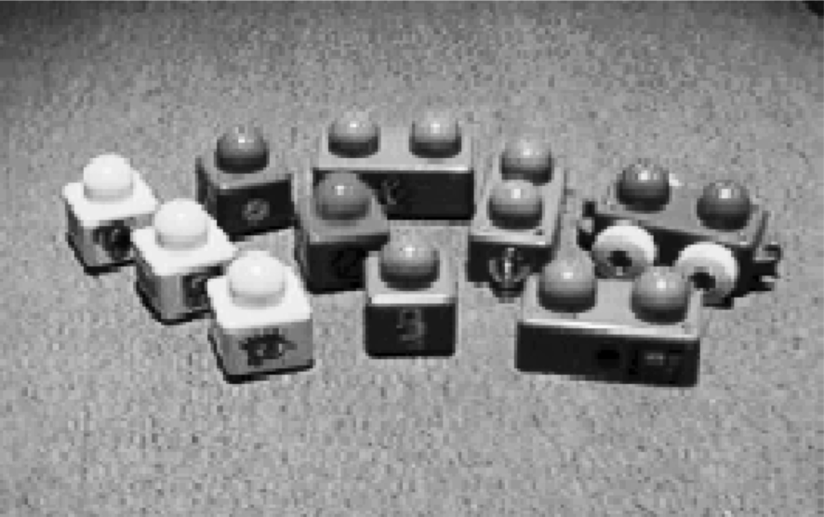
Avoid Typing in Code Textually
Construct programming graphically
Visual Programming Systems
Some designed for little kids
Drag-and-drop of code elements
Alice 2
Construct programs with physical objects
E.g., Electronic Blocks [Wyeth and Purchase 2000]

Slide 16
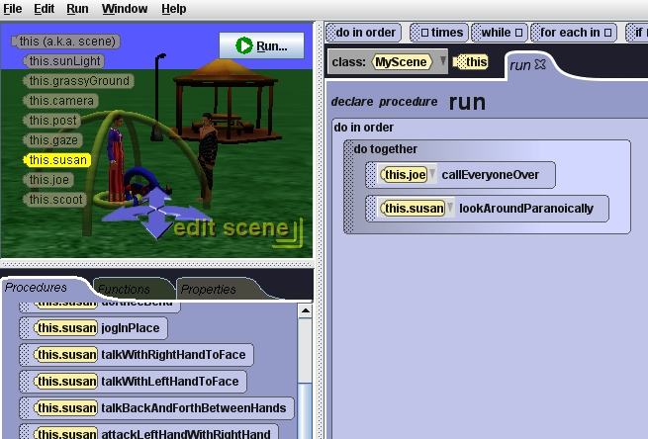
Alice
Alice 2 [Pausch] (2002)
Drag-and-drop program parts
Pop-up menus for parameters
Dramatic impact on learning and attitude
Also, novel control structures and APIs
Do-Together
Better 3-D models

Slide 17
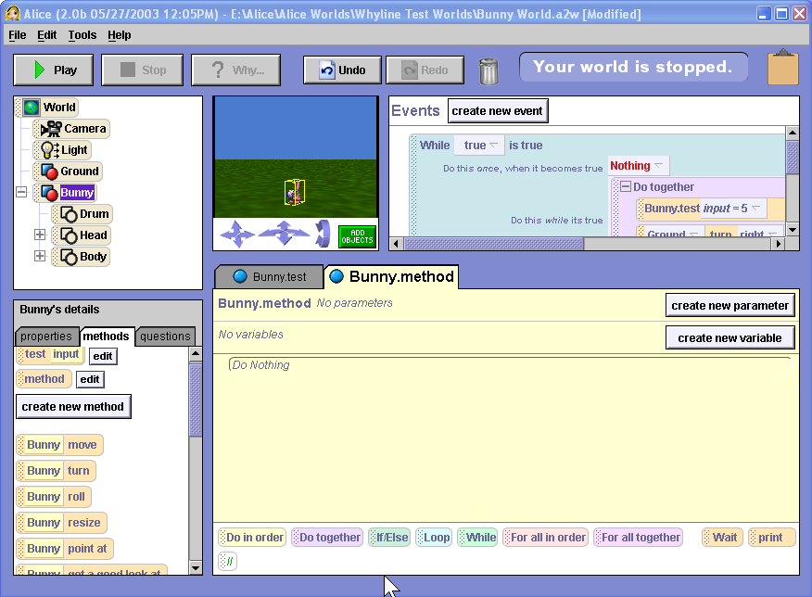
Alice Movie
Notes:
0:30 seconds

Slide 19
Create Programs Using Interface Actions
Macro recorders – do the same thing I just did
Often using physical operations on blocks/switches
Are simple programming by example systems
Leogo [Cockburn and Bryant 1997] → textual, iconic (VP) and by example
Multiple representations
Multiple Methods

Slide 20
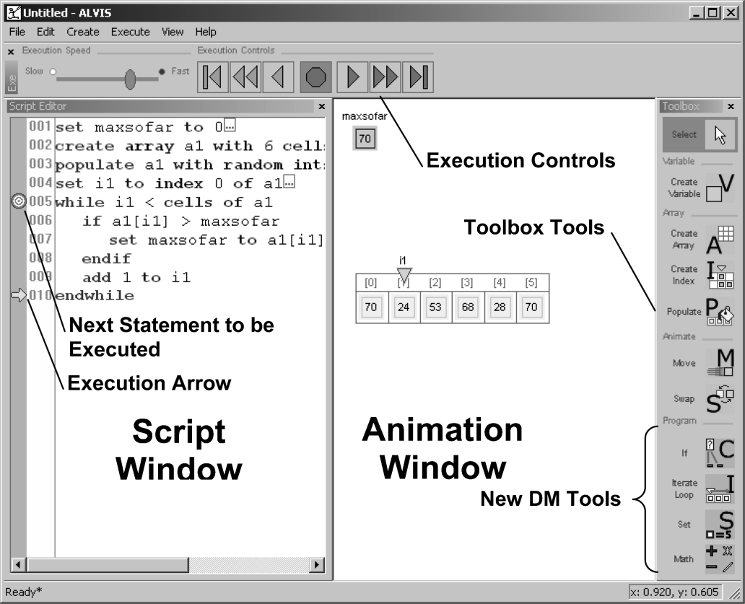
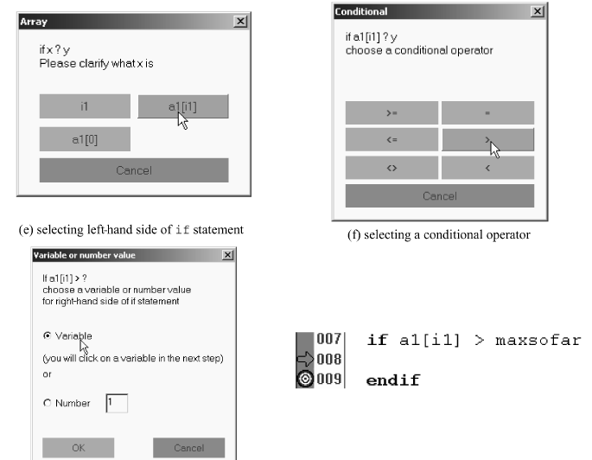
Hundhausen’s “ALVIS Live!” [2009]
Also provides multiple ways to create
Typing “pseudo-code”
“Direct manipulation” of icons and representations to data structures
Dialog boxes for details

Slide 22
Structured Programming
“These systems concentrate on the structure of code and how it is organized rather than on the syntax of short segments of code”
(Seems like an awkward distinction to me)

Slide 23
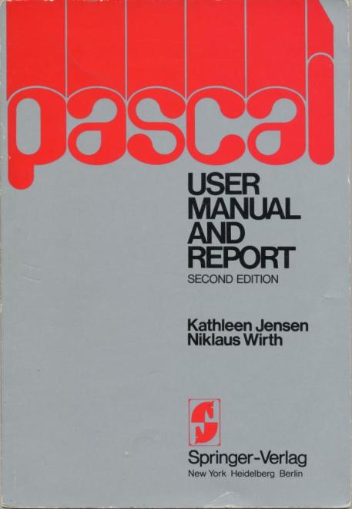

Pascal
Created in 1970 by Niklaus Wirth to teach structured programming

Slide 24
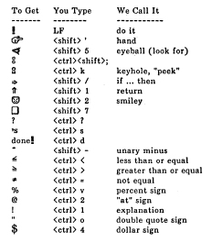

Smalltalk
Alan Kay’s attempt to make programming easier through uniformity – everything was an object
Only 6 special keywords
Objects almost “all the way down”
Also invented the first covered window manager, multi-pane code browsing, etc.
Important versions in 1972, 1980
Special characters for the 1972 syntax
Weird asymetric syntax:
“5” + 3 = “53”
3 + “5” = 8

Slide 26
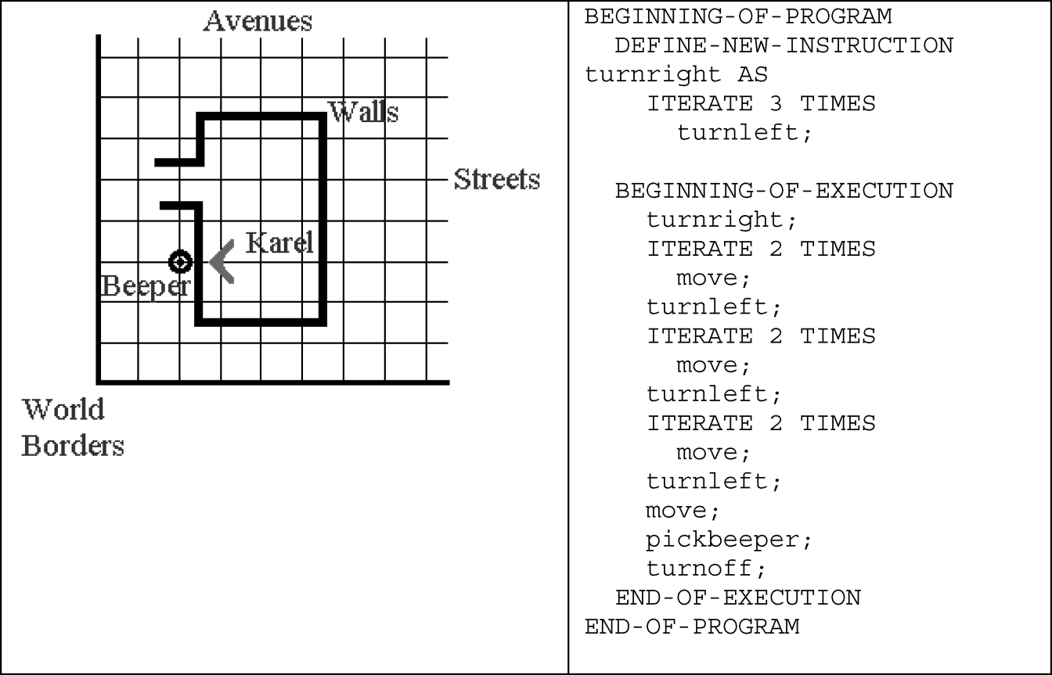
Helping with Understanding
Karel the Robot (CMU - [Pattis 1981] )
Simplified language for first weeks of CS-1
Text book
Also, visual languages
Toontalk

Slide 27
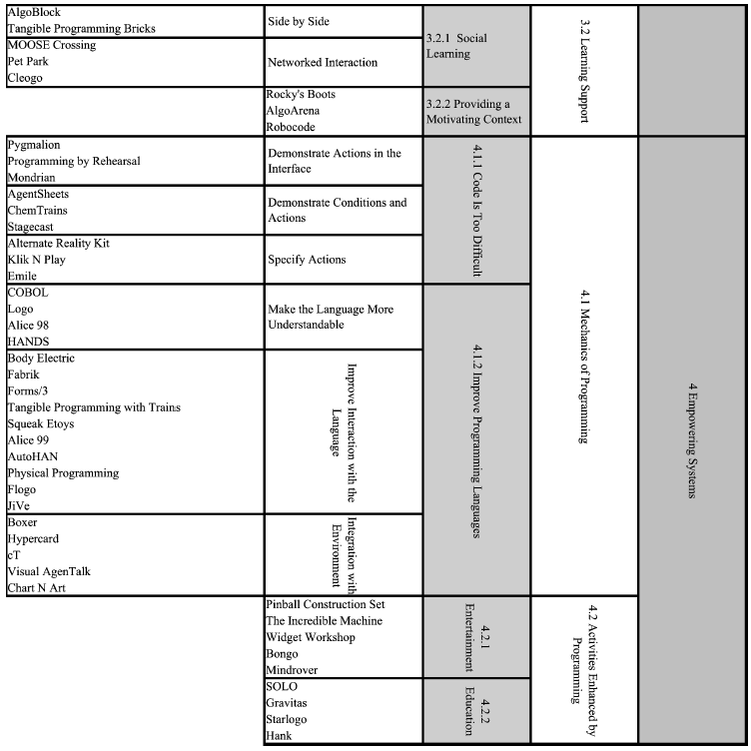

Slide 28
Empowering Systems
Enable people to program
Don’t worry as much about transfer to “real” languages
Remove barriers
Examples:
Lots of VP and PBE systems
Make the Language More Understandable
COBOL (1960)
English-like with “noise words”
ADD X TO Y

Slide 29

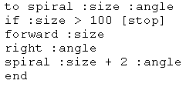
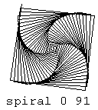
Logo
Created in 1966 at BBN by Wally Feurzeig and Seymour Papert
Like Lisp without parentheses
First turtle was physical device with wheels and a pen

Slide 30
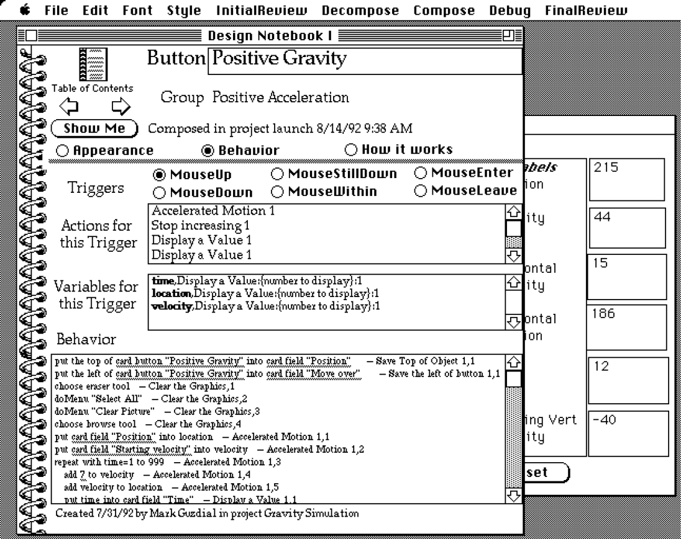
HyperCard
Atkinson (1987) tried to make user’s first experience with the tool effective (“low threshold”)
Metaphor of designing cards
Background, foreground objects
Change cards in-place
Now familiar from WWW and PowerPoint
Successfully enabled significant EUP
Programmed in HyperTalk

Slide 31
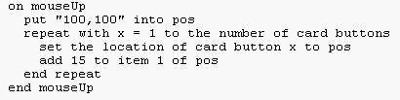
HyperTalk
Programmers were called “authors” and programs called “scripting”
Event-based programming model
HyperTalk designed to be similar to English
Studies inconclusive on whether this helps
Lots of problems with consistency
Evolved into AppleScript

Slide 32
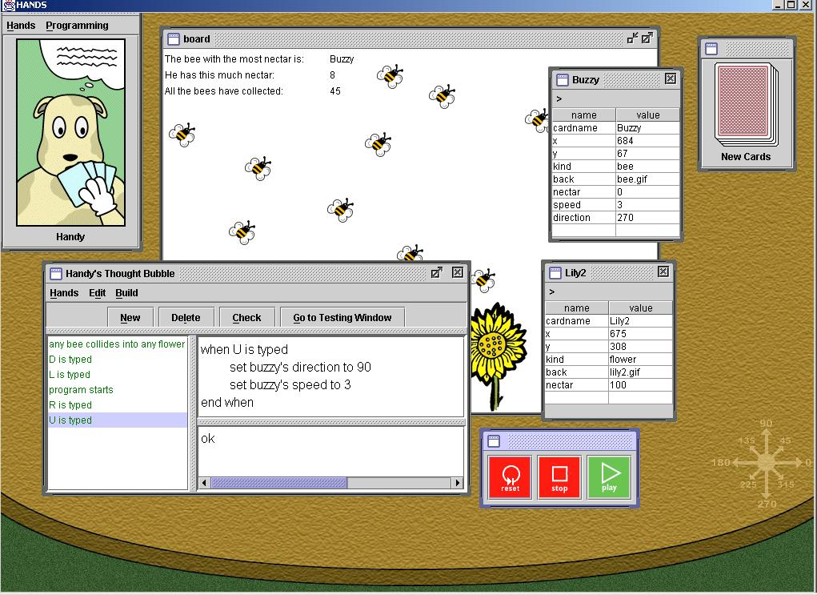
HANDS
PhD of John Pane, 2002
Designed based on studies
Properties:
All data visible on cards
Metaphor of agent (Handy the dog) operating on cards
Event-based
Natural language style for code
Domain-specific operations, like movement in a direction
All operations can operate on single items or sets of items
Sets can be dynamically constructed and used
“Set all bees direction to 90”
Video (local copy)

Slide 33
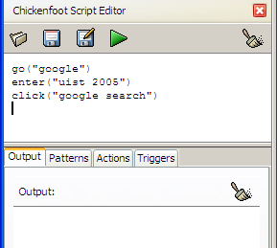
Chickenfoot
[Bolin and Miller, 2005]
EUP for the web
Automating repetitive operations
Integrating multiple web sites
Transforming a web site's appearance
Simpler version of JavaScript
Adds pattern-matching to find parts of web page
Descendant = Allen Cypher’s CoScripter language
Notes:
Bolin, M., et al. “Automation and Customization of Rendered Web Pages,” in ACM Conference on User Interface Software and Technology (UIST). 2005. Seattle, WA: pp. 163-172.

Slide 34
Tools
IDEs and tools focused on improved programming
(that are not covered elsewhere)
May help users learn to program
Looking Glass
Blueprint [Brandt 10]
Remove some of the programming
Interface builders

Slide 35
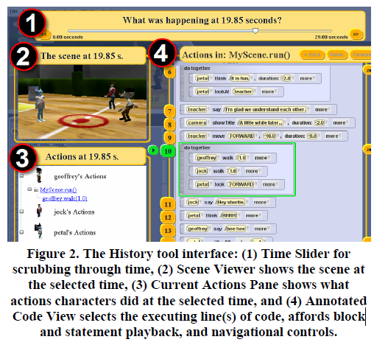
Looking Glass [Gross 10]
Study [09] showed difficulty indentifying relevant code
So created add-on to IDE for Storytelling Alice
Help users under- stand examples
Connect behaviors and code using traces
Tries to help users extract the code for reuse
Analysis to include decl. of used variables
Replace actors

Slide 36
Visual Basic
Microsoft, first released, 1991
1997, VB5 Debuts – replaces Word Basic, Excel Basic, etc.
2002, VB.NET Debuts
For scripting, connecting components, database access, etc.
Interactive tool for placing widgets (controls) such as buttons (= “Interface Builder”)
Event-based version of the Basic language

Slide 37
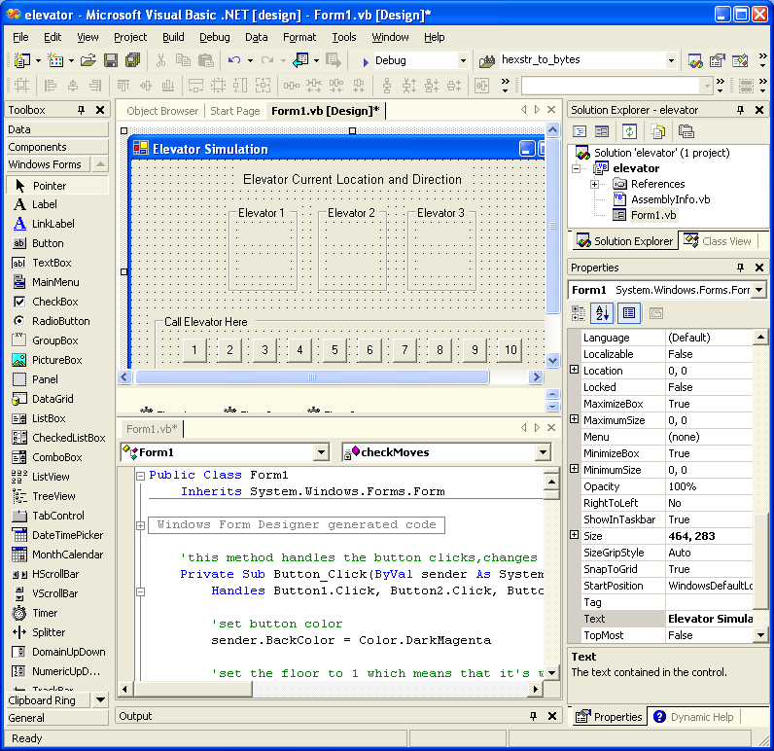
Visual Basic Picture
VB.Net
Interface builder part

Slide 38
Director
MacroMedia (now Adobe) 1988
Most people now use Flash
Scripting language (“Lingo”) for animations, with IDE
Metaphor of a timeline “Score”, for when animations start and stop
Effective for animations and parallel activities
Awkward for user-driven interactions

Slide 39
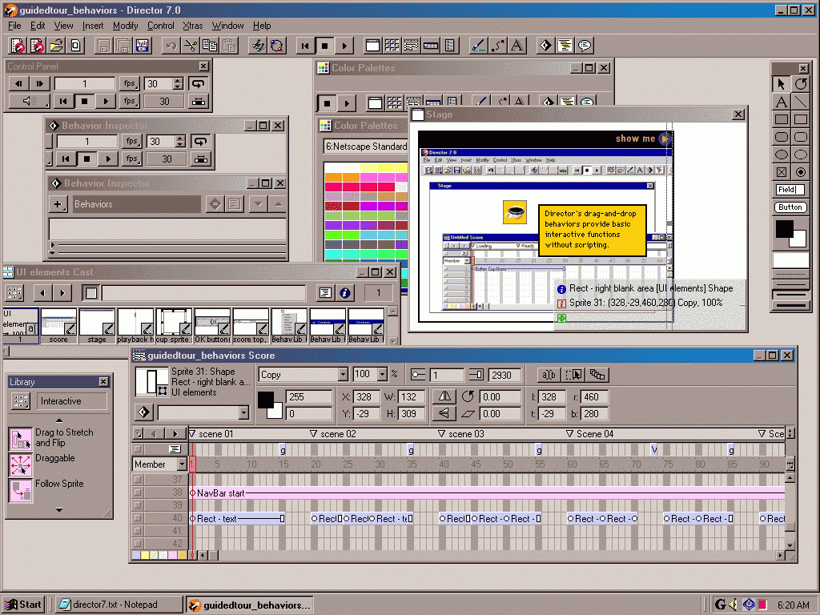
Director Picture

Slide 40
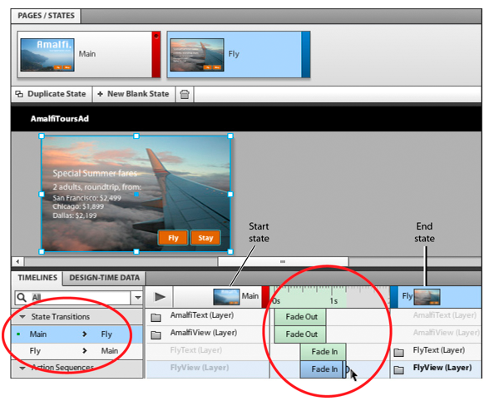
Flash Catalyst & Microsoft Expression Blend
Extend what can be done by direct manipulations
Built-in support for state transitions
Changes can be animated

