Slide 1

End-User Programming by Scientists
Cyrus Omar
Computer Science Department Carnegie Mellon University
05-899D – Human Aspects of Software Development (HASD)
Spring 2011
03/29/2011

Slide 2
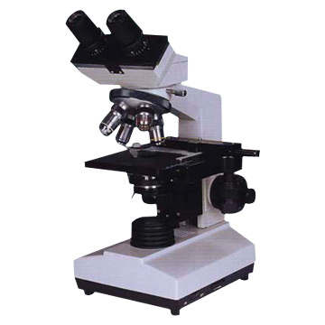


Notes:
Science!

Slide 3
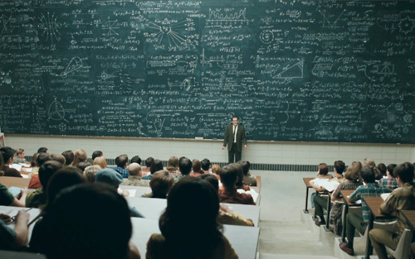
Notes:
Whoa… this got complicated.

Slide 4
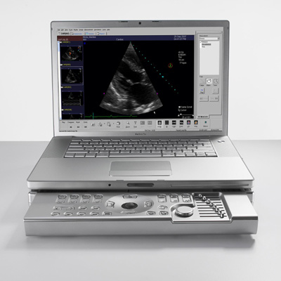

Notes:
Increasingly, science is being done on or with computers.

Slide 5
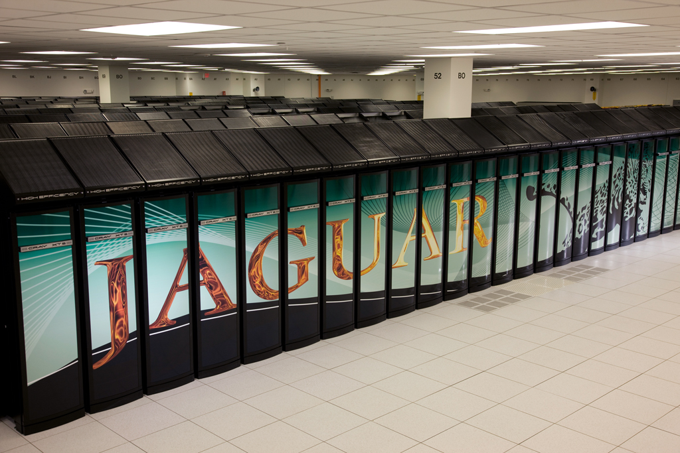
About 5% of scientists develop supercomputer applications right now. [Hanney et al, 2009]
Notes:
…and supercomputers.

Slide 6
The science of scientific software development
In which contexts is scientific software developed?
Are the developers domain experts?
Are the domain experts professional developers?
What is the size of the development group?
Who is the target audience for the code?
What is the lifespan of the code?
What development practices are currently in use?
What languages and tools are currently in use?
How likely are errors? How significant are errors?
For each context, what kinds of techniques and tools may assist scientific software developers?
How might scientists be made aware of those software engineering techniques and tools that might be relevant to their software development practices?
[adapted from Segal, 2008; Glass, 2004]
Notes:
A flock of geese, a murder of ravens, a… beaker of scientists?

Slide 7
The science of scientific software development
In which contexts is scientific software developed?
Are the developers domain experts?
Are the domain experts professional developers?
What is the size of the development group?
Who is the target audience for the code?
What is the lifespan of the code?
What development practices are currently in use?
What languages and tools are currently in use?
How likely are errors? How significant are errors?
For each context, what kinds of techniques and tools may assist scientific software developers?
How might scientists be made aware of those software engineering techniques and tools that might be relevant to their software development practices?
[adapted from Segal, 2008; Glass, 2004]
Notes:
A flock of geese, a murder of ravens, a… beaker of scientists?

Slide 8
Developer Classifications
Professional developers
People whose primary job function is to write or maintain software; typically have significant training, experience.
Professional developers are sometimes employed in science, but not ubiquitously [Howison and Herbsleb, 2011]
By funding agencies seeking to create a shared resource (mostly Dept. of Energy; BLAST; not very common)
By consortiums of labs or universities (e.g. SBGrid Linux distribution run by a full-timer)
Often, but not always, have some relevant domain knowledge
Notes:
…and supercomputers.

Slide 9
Developer Classifications
Professional end-user programmers
Up to 40% of a scientist’s time is spent writing or using specialized software for scientific analysis
Expectation of many scientists is that this will decrease over the course of their career as they become principal investigators (PIs)
People working in highly technical, knowledge rich professions, such as financial mathematicians, scientists and engineers, who develop their own software in order to advance their own professional goals. [Segal, 2008]
[Hanney et al, 2009; Howison and Herbsleb, 2011]
Notes:
…and supercomputers.

Slide 10
Motivation & Incentives
The goal of scientists is to do science, not execute software.
[Basili et al, 2008]
It is “all about getting the plots”.
[interviewee in Howison and Herbsleb, 2011]
Notes:
…and supercomputers.

Slide 11
The science of scientific software development
In which contexts is scientific software developed?
Are the developers domain experts?
Are the domain experts professional developers?
What is the size of the development group?
Who is the target audience for the code?
What is the lifespan of the code?
What development practices are currently in use?
What languages and tools are currently in use?
How likely are errors? How significant are errors?
For each context, what kinds of techniques and tools may assist scientific software developers?
How might scientists be made aware of those software engineering techniques and tools that might be relevant to their software development practices?
[adapted from Segal, 2008; Glass, 2004]
Notes:
A flock of geese, a murder of ravens, a… beaker of scientists?

Slide 12
Scientists often work in small groups
[Nguyen-Hoan et al, 2010]
Notes:
A flock of geese, a murder of ravens, a… beaker of scientists?

Slide 13
Typical scenarios
One person writing complex software for use by self or locals
(IT professionals may do this, but few other scenarios)
Portions shared with local group and collaborators in many cases, for use by same
Outside people may ask to see the code.
Common etiquette is to share it, especially if used in a published paper. Not always followed, see the anecdote in Howison and Herbsleb, 2011.
Amount of guidance given to recipients varies widely.
Lifespans of functions vary from a single day to many years
Undisciplined
Version control is not ubiquitously used (< 1/3) [Nguyen-Hoan et al, 2010]
Many scientists who have only operated in this mode and have never done team development projects only have a vague idea of what version control, refactoring tools and IDEs are [Wilson, 2006; Sarkar et al, 2004]
An “expertise gap” [Sarkar et al, 2004], “software chasm” [Kelly, 2007]
Basically no studies analyzing whether having scientists take a software engineering course helps (see [Segal, 2008]; [Kelly, 2007])
I finally asked a friend who was pursuing a doctorate in particle physics why he insisted on doing everything the hard way. Why not use an integrated development environment with a symbolic debugger? Why not write unit tests? Why not use a version-control system? His answer was, "What's a version-control system?” [Wilson, 2006 – American Scientist]
Notes:
A flock of geese, a murder of ravens, a… beaker of scientists?

Slide 14
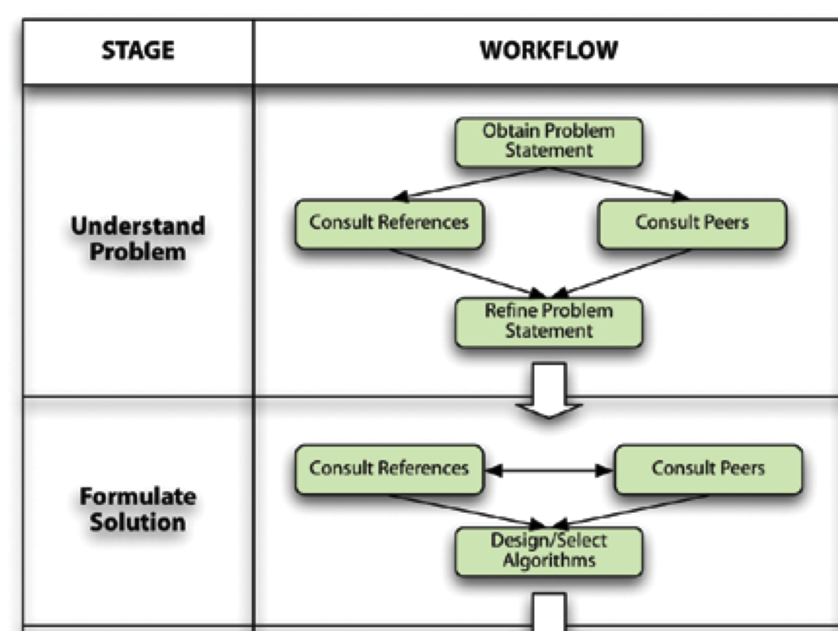
Typical development process
[Squires et al, 2006]
Notes:
A flock of geese, a murder of ravens, a… beaker of scientists?

Slide 15
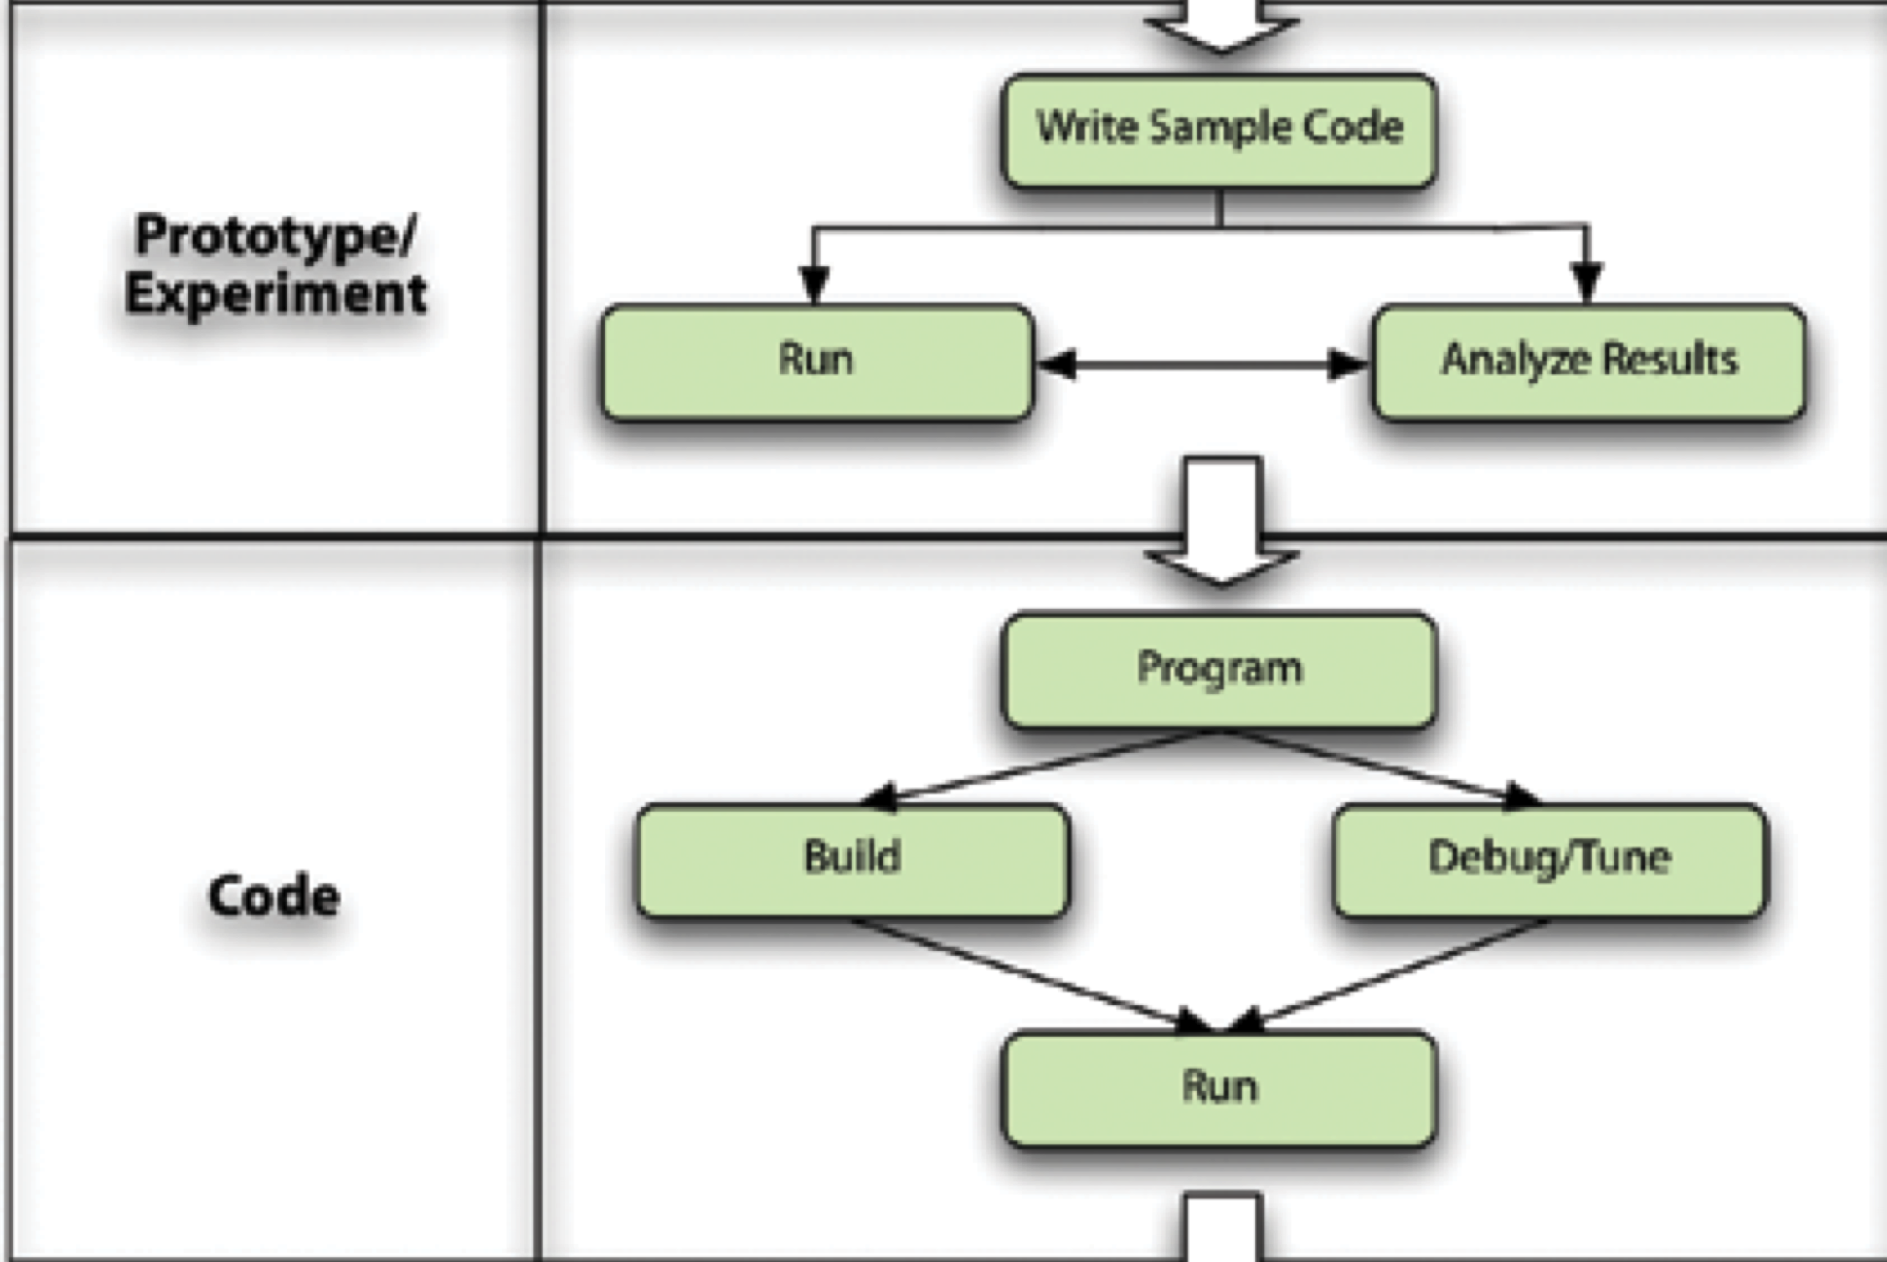
Typical development process
[Squires et al, 2006]
Notes:
A flock of geese, a murder of ravens, a… beaker of scientists?

Slide 16
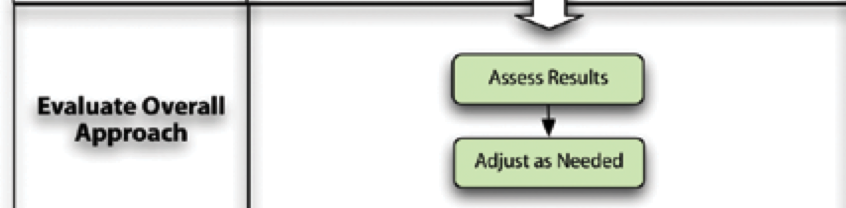
Typical development process
[Squires et al, 2006]
Notes:
A flock of geese, a murder of ravens, a… beaker of scientists?

Slide 17
Typical development process
No single requirements specification phase
Requires repeatedly and rapidly iterating
‘In most of the types of things we ... think of a requirement to do, we don’t know the requirements at a precise exact level, we don’t know the answer in any way, we can define the problem basically in half a page of text …’
[Segal, 2008]
Notes:
A flock of geese, a murder of ravens, a… beaker of scientists?

Slide 18
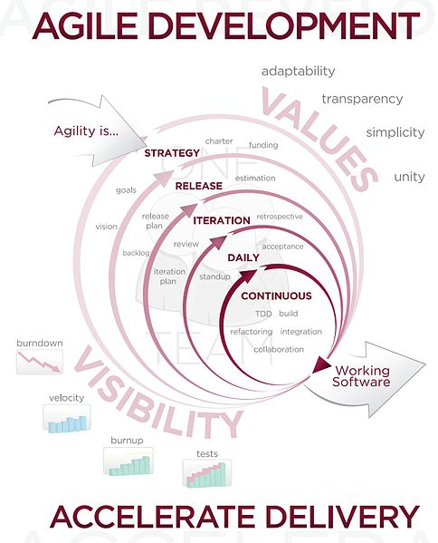
Agile software development methods have been suggested as appropriate [Segal, 2005; 2008; Boehm and Turner, 2004]
Scientists sometimes equate their existing practices with agile development, and are not aware that there are disciplined practices associated with it [Segal, 2008]
A few case studies have shown that explicitly adopting them has been helpful [Bache, 2003; Kane, 2003]

Slide 19
Another typical scenario
Loosely coupled individuals and groups working on a common core codebase
(Some open source development looks like this)
Often grow organically from small individual projects that are gradually shared between collaborators
Other times there is an explicit aim to develop such libraries
In all of these cases, it takes many (4-6) years for a large library to become widely used and considered robust [Sarkar et al, 2004]
More disciplined
Version control is used more often in these cases [Nguyen-Hoan et al, 2010]
Working with others, especially software engineers, on a codebase helps (anecdotally) with internalizing important concepts:
‘... it does come down to maintainability and portability and that is something I had been only dimly aware of previously’ [Segal, 2008]
Notes:
A flock of geese, a murder of ravens, a… beaker of scientists?

Slide 20
Emerging scenarios
Giant multidisciplinary collaborations
High-energy physics (colliders, etc.)
Weather and climate modeling
Multiscale physics and engineering
May look like large enterprise projects, though unique in that:
Need to be extracting findings continuously, concurrently with software development (streams of data, might not be stored!)
Development is largely being done by professional end-user developers (with some professional software architects at the top), lots of churn as interns and students and post-docs come and go
Observed that simply being a part of a large physics experiment did not necessarily result in improved development practices – some met project requirements for using version control at final integration time [Howison and Herbsleb, 2011]
Attributed to skepticism of relevance of learning good software development practices if career trajectory is purely scientifically focused
Notes:
A flock of geese, a murder of ravens, a… beaker of scientists?

Slide 21
Emerging scenarios
Agency-funded large software development projects
Department of Energy high-performance computing initiatives
Other DOE initiatives in other computational science fields
ASCI projects served as good case studies
Several projects with nearly identical requirements, large and difficult
Different risk and project management methodologies (see [Sanders and Kelly, 2008])
Gull turned into an ‘overly ambitious’ CS ‘research project’ instead of a development project
Key factor: a few all-rounders who understand the science, engineering and project management skills exceptionally well at the helm
[see Squires et al, 2006 for discussion]
Notes:
A flock of geese, a murder of ravens, a… beaker of scientists?

Slide 22
All are atypical use cases for SE!
Very few scientific software development projects look like a typical industry/enterprise development project (i.e. lots of professional developers working in the same physical location on a task that is relatively well-defined and comprehensible to all the developers)
This suggests that studies and best practices that target scientific software development more specifically are rich avenues for future work and could have an impact.
But it remains unclear how to translate this information into practice, – most scientists don’t read software engineering or computer science literature (or even sites like Slashdot for that matter.)
Putting software engineers into labs (like the ubiquitous experimental lab technicians) seems to help quite a lot [Segal, 2008]
But many scientists are also weary of the history of false promises of computer science and software engineering tools and techniques – too many have been underdeveloped (toy projects), unusable or poorly conceived
Notes:
A flock of geese, a murder of ravens, a… beaker of scientists?

Slide 23
The science of scientific software development
In which contexts is scientific software developed?
Are the developers domain experts?
Are the domain experts professional developers?
What is the size of the development group?
Who is the target audience for the code?
What is the lifespan of the code?
What development practices are currently in use?
What languages and tools are currently in use?
How likely are errors? How significant are errors?
For each context, what kinds of techniques and tools may assist scientific software developers?
How might scientists be made aware of those software engineering techniques and tools that might be relevant to their software development practices?
[adapted from Segal, 2008; Glass, 2004]
Notes:
A flock of geese, a murder of ravens, a… beaker of scientists?

Slide 24
Scientific Programming Languages
Performance critical code: C and Fortran (with MPI for HPC)
Direct access to memory, data layout, low-level primitives (e.g. vector primitives)
A given line of code in an HPC program may be run tens of trillions of times!
Optimizing compilers have yet to be shown to be reliably better than code optimized by a motivated expert
Domain knowledge
Knowledge about details of hardware (caches) and operating system (parallel primitives)
New architectures are even more difficult to optimize for (both automatically and manually) – GPUs, hybrid-core CPUs, etc.
Cross-platform compatibility is important – new architectures and operating systems show up more regularly in HPC than in mainstream software [Nguyen-Hoan et al, 2010]
x86, various variants of the POWER architecture, Cell BE, various GPUs, accelerators, BlueGene architecture
Various versions of UNIX that IBM builds specifically for HPC, all have subtle differences
Windows keeps trying to jump in the game with marketing muscle
C++ is a thorn in the side of HPC because of its well-known compatibility issues
Few innovations have occurred in low-level programming languages – most programming language research has focused on higher-level abstractions
Only a few of these have seen any significant adoption, e.g. Charm++
Mostly seen with extreme skepticism

Slide 25
Scientific Programming Languages
For supercomputer projects:
[Squire et al, 2006]

Slide 26
Scientific Programming Languages
More broadly in science:
[Basili et al, 2008]

Slide 27
Scientific Programming Languages
Glue and productivity-critical analyses: Dynamic languages
MATLAB, Python, R (statistics), Perl (informatics), Shell scripts
Convenient minimal syntax, large library of easy-to-find functions, “killer libraries”, commercial support and marketing, historical accident + inertia
Relatively easy-to-use foreign-function interface (FFI) to call native code – performance competes with other important goals! [Carver et al, 2007]
Popular statically-typed object-oriented languages are also used
Mostly C++, some Java – familiar and widely supported
Share syntactic overhead with C. Additional run-time overhead (dynamic dispatch) can be a hurdle.
Charm++ is also an OO language built on C++ that uses a managed run-time to distribute objects over a cluster, used for major molecular dynamics package and some other things
Other examples occasionally developed, often research languages that are not developed enough for deployment
Functional languages are used rarely, almost exclusively by computer scientists (current or former)
Stronger invariants and more algorithmic style of programming useful in some circumstances, but few languages support science-specific invariants (e.g. scientific units) or domain-specific invariants
Immutability can be major hurdle for performance – often end up with imperative code to work around compiler defects. Compiler is unpredictable.
May not have great library support.
Difficult to teach to people without a basic discrete math / formal logic background.

Slide 28
Scientific Programming Languages
Domain-Specific Languages
Many scientific software projects, even small projects, create small domain-specific languages to facilitate rapid prototyping and scripting (e.g. Brian)
The languages described do not support this style of programming well
Clear empirical evidence in favor of this approach in science remains sparse
Novel parallel programming models
For some applications, extensions to existing languages that enable a global address space across a cluster is useful (Global Arrays for C/C++/Fortran)
Data parallel primitives have been shown to be useful in some application domains
MapReduce/Hadoop
May have promise on GPGPUs (e.g. Copperhead, Data Parallel Haskell)
Some efforts have been made on programming against plug-and-play machine models so the algorithm specification is decoupled from the implementation (e.g. Sequioa)
Readability is important in the parts of the code that are running the mathematics from their papers

Slide 29
Scientists are Skeptics
"I hate MPI, I hate C++. If I had to choose again, I would probably choose the same."
"Our codes are much larger and more complex than the toy programs normally used in [classroom settings]. We would like to see a number of large workhorse applications converted and benchmarked."
Scientists are willing to use new languages iff …
you show them it will really help them solve problems
you can teach it to them quickly
the language can be integrated gradually into their existing codebase
(MPI was developed alongside prior message passing libraries)
they can be confident that it won’t disappear
Commercial backing or major government funding and development
Open source with a liberal license (BSD-like) is critical to bring many major players on board (Defense, Finance, etc.)
[Basili et al, 2008]

Slide 30
IDEs in Scientific Computing
One perceived strength of MATLAB is its IDE
Shows workspace (files and global variables, along with metadata)
Centered around a read-eval-print loop (REPL)
Basic code completion support
Dynamically typed languages are hard to do code completion for
Little support for refactoring, unit testing and other practices
Increasing support for trivial parallelization via multiple panes, some primitives for communication between them
Many scientists continue to use basic Unix tools
Some don’t know about graphical debuggers, profilers and other tools [Nguyen-Hoan et al, 2010]
Others dislike the perceived rigidity of IDEs [Carver et al, 2007]
Do not support remote code execution and debugging and other features unique to the scientific workflow

Slide 31
DARPA High-Productivity Computing
Major DARPA initiative to rethink the whole HPC stack
Hardware – Processors, memory organization, networking
Basic operating system design
Programming language design
X11 (IBM), Fortress (Sun, eliminated), Chapel (Cray) – all involve managed memory and higher-level abstractions, but with some allowances to bypass
Development tools and development environments
Eclipse Parallel Tools Platform (PTP) has improved support for parallel and high-performance computing
Some companies are exploring nice interfaces to cloud computing infrastructure, but very early still
Methodologies

Slide 32
The science of scientific software development
In which contexts is scientific software developed?
Are the developers domain experts?
Are the domain experts professional developers?
What is the size of the development group?
Who is the target audience for the code?
What is the lifespan of the code?
What development practices are currently in use?
What languages and tools are currently in use?
How likely are errors? How significant are errors?
For each context, what kinds of techniques and tools may assist scientific software developers?
How might scientists be made aware of those software engineering techniques and tools that might be relevant to their software development practices?
[adapted from Segal, 2008; Glass, 2004]
Notes:
A flock of geese, a murder of ravens, a… beaker of scientists?

Slide 33
Errors in scientific code
Sources of error
Adequacy of an implementation against the algorithm that was being implemented
Numerical errors, particular those that build up
Optimization correctness (-O3)
Overall fault rate is similar to other programming disciplines
Seven faults per 1000 lines of Fortran [Hatton and Roberts, 1994]
Formal verification is rarely done
Unit tests and integration tests are only done in large projects
Most testing is done by entering inputs, manually computing expected outputs and verifying that the results match
Edge cases are often neglected [Morris, 2008]

Slide 34
Errors in scientific code
[Hatton and Roberts, 1994]

Slide 35
Code Quality
Non-functional requirements [Nguyen-Hoan et al, 2010]: reliability, functionality, maintainability, availability, performance, flexibility, testability, usability, reusability, traceability, portability
Very high complexity metrics for many functions [Morris, 2008]
High levels of duplicated code [Morris, 2008]
Documentation is poor [Segal, 2004; Segal and Kelly, 2008]
About half of the time there are inline comments in code
User manuals and guides are next most common
Requirements and specifications are very rare
Major reason: time and effort required

Slide 36
Data and Code Sharing
Resisted in most cases
Too much time and effort
Too hard to explain exactly how an experiment was run
Reproducibility does not require this
Increasingly desired by funding agencies
NIH requires it now
Other agencies making rumblings
Concern that there will simply be useless code and data drops

Slide 37
Interaction of Theory & Experiments
Long history of interaction in physics and chemistry
Theoreticians make predictions, experimentalists test them
In biology, the systems are very complex, the experiments are particularly limited and the scientists are not equally trained
Many theoretical biologists have no formal biology training
Most experimental biologists have very little quantitative training outside of basic statistics and calculus
Many different kinds of models, levels of abstraction, and so on.
There is a lot of data coming out continuously in paper format (60,000/yr in neuroscience!)
Bibliometrics and data mining techniques are being applied, but few tools have been developed as a result
Semantic information is not explicitly available, ontologies do not exist or are not widely used or valued

Slide 38
Conclusion
Scientists are decidedly not professional software engineers
Software engineering has not taken into account the unique circumstances of scientific enterprise as well as it could have
More studies are needed in nearly every area
More interaction is needed and better tools must be developed
Take into account usability, ease of learning and the performance and compatibility requirements of science
Better meta-level methodologies might be needed to make sense of the increasingly huge scale and complexity of the systems we study

Slide 39
References
Basili, V.R.; Carver, J.C.; Cruzes, D.; Hochstein, L.M.; Hollingsworth, J.K.; Shull, F.; Zelkowitz, M.V.; , "Understanding the High-Performance-Computing Community: A Software Engineer's Perspective," Software, IEEE , vol.25, no.4, pp.29-36, July-Aug. 2008.
Luke Nguyen-Hoan, Shayne Flint, and Ramesh Sankaranarayana. 2010. A survey of scientific software development. In Proceedings of the 2010 ACM-IEEE International Symposium on Empirical Software Engineering and Measurement (ESEM '10). ACM, New York, NY, USA, , Article 12 , 10 pages. Jeffrey C. Carver, Richard P. Kendall, Susan E. Squires, and Douglass E. Post. 2007. Software Development Environments for Scientific and Engineering Software: A Series of Case Studies. In Proceedings of the 29th international conference on Software Engineering (ICSE '07). IEEE Computer Society, Washington, DC, USA, 550-559. Judith Segal. 2007. Some Problems of Professional End User Developers. In Proceedings of the IEEE Symposium on Visual Languages and Human-Centric Computing (VLHCC '07). IEEE Computer Society, Washington, DC, USA, 111-118. Judith Segal. 2008. Models of Scientific Software Development. In Proc. 2008 Workshop Software Eng. in Computational Science and Eng. (SECSE08). 13 May 2008, Leipzig, Germany. Judith Segal. 2009. Software Development Cultures and Cooperation Problems: A Field Study of the Early Stages of Development of Software for a Scientific Community. Comput. Supported Coop. Work 18, 5-6 (December 2009), 581-606. Jo Erskine Hannay, Carolyn MacLeod, Janice Singer, Hans Petter Langtangen, Dietmar Pfahl, and Greg Wilson. 2009. How do scientists develop and use scientific software?. In Proceedings of the 2009 ICSE Workshop on Software Engineering for Computational Science and Engineering (SECSE '09). IEEE Computer Society, Washington, DC, USA, 1-8. Rebecca Sanders and Diane Kelly. 2008. Dealing with Risk in Scientific Software Development. IEEE Softw. 25, 4 (July 2008), 21-28. Les Hatton and Andy Roberts. 1994. How Accurate is Scientific Software? IEEE Trans. Softw. Eng. 20, 10 (October 1994), 785-797. Daniel Hook and Diane Kelly. (2009). Testing for trustworthiness in scientific software. In Proceedings of the 2009 ICSE Workshop on Software Engineering for Computational Science and Engineering (SECSE '09). IEEE Computer Society, Washington, DC, USA, 59-64. James Howison and Jim Herbsleb. (2011). "Scientific software production: incentives and collaboration". CSCW 2011.

Slide 40
References
Sarkar, V., & Williams, C. 2004. Application development productivity challenges for high-end computing. Workshop on Productivity and Performance in High-End Computing (P-PHEC).
Kelly, D. (2007). A software chasm: Software engineering and scientific computing. Software.
Glass, R. (2004). Matching methodology to problem domain. Communications of the ACM.
Wilson, G. (2006). Where's the real bottleneck in scientific computing. American Scientist.
Squires, S., & De Vanter, Van, M. (2006). Software productivity research in high performance computing. CTWatch Quarterly.
Segal, J. (2005). When software engineers met research scientists: a case study. Empirical Software Engineering.
Boehm, B., & Turner, R. (2004). Balancing agility and discipline: Evaluating and integrating agile and plan-driven methods. Proceedings of the 26th international Conference on Software Engineering.
Bache, E. 2003. Building software for scientists: a report about incremental adoption of XP. XP2003, Genoa, Italy (2003)
David Kane, "Introducing Agile Development into Bioinformatics: An Experience Report," adc, pp.132, Agile Development Conference (ADC '03), 2003.
Morris, Chris. Some lessons learned reviewing scientific code. In Proceedings of the International Conference on Software Engineering, (2008).

