Slide 1
05-899D: Human Aspects of Software Development Spring 2011, Lecture 20
Mar 24th, 2011
Software Evolution
- Evolving and Improving Code -
YoungSeok Yoon
(youngseok@cs.cmu.edu)
Institute for Software Research
Carnegie Mellon University

Slide 2
Outline
Copy & Paste, Code Clones
Two different thoughts about code clones
Clone detection tools
Tools to help making, managing code clones
Refactoring
What is refactoring, and how it is supported
Studies about refactoring
Program Differencing
Different types of program differencing
Logical Structural Diff

Slide 3
Cloning Considered Harmful
There has been a common wisdom about code cloning
Making code clones should be avoided because they tend to introduce maintenance problems.
(i.e. It is difficult to update all the code clones consistently)

Slide 4
Cloning Considered Harmful
“It has long been known that copying can make the code larger, more complex, and more difficult to maintain” [Baker95]
“Code duplication is one of the factors that severely complicates the maintenance and evolution of large software systems” [Ducasse99]
“Number one in the stink parade is duplicated code. If you see the same code structure in more than one place, you can be sure that your program will be better if you find a way to unify them.” [Fowler99] – well known “bad smell” of a program code
Every other clone detection tool papers somehow claim that code clones are bad.

Slide 5
Two Different Research Directions
“How can we find the code clones in the code base effectively?”
Automatic code clone detection tools
“How can we help developers help avoid code cloning?”
Refactoring

Slide 6
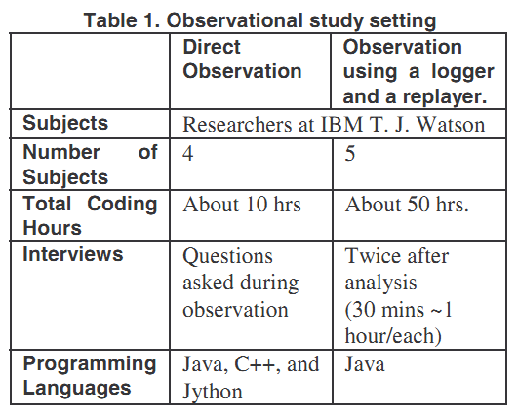
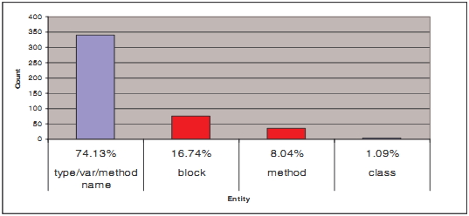
An Ethnographic Study of Copy and Paste Programming Practices in OOPL [M. Kim04]
Study Settings
A programmer produces 4 non-trivial C&P/hr (total 16/hr)
Taxonomy of C&P usage in three different aspects
Intention
Design
Maintenance
M. Kim, L. Bergman, T. Lau, and D. Notkin (2004), “An ethnographic study of copy and paste programming practices in OOPL,” in Proceedings of International Symposium on Empirical Software Engineering (ISESE’04), pp. 83-92.

Slide 7
An Ethnographic Study of Copy and Paste Programming Practices in OOPL [M. Kim04]
C&P Intentions
structural template (the most common intention)
relocate, regroup, reorganize, restructure, refactor
semantic template
design pattern
usage of a module (following a certain protocol)
reuse a definition of particular behavior
reuse control structure (nested if~else or loops)
M. Kim, L. Bergman, T. Lau, and D. Notkin (2004), “An ethnographic study of copy and paste programming practices in OOPL,” in Proceedings of International Symposium on Empirical Software Engineering (ISESE’04), pp. 83-92.

Slide 8
An Ethnographic Study of Copy and Paste Programming Practices in OOPL [M. Kim04]
Other Insights
Unavoidable duplicates (e.g., lack of multiple inheritance)
Programmers use their memory of C&P history to determine when to restructure code
delaying restructuring helps them discover the right level of abstraction
C&P dependencies are worth observing and maintaining
M. Kim, L. Bergman, T. Lau, and D. Notkin (2004), “An ethnographic study of copy and paste programming practices in OOPL,” in Proceedings of International Symposium on Empirical Software Engineering (ISESE’04), pp. 83-92.

Slide 9
“Cloning Considered Harmful” Considered Harmful [Kasper06]
Provides list of patterns of cloning
(similar to the style of design patterns)
For each pattern, the followings are described
Name
Motivation
Advantages
Disadvantages
Management
Long term issues
Structural manifestations
Examples
C. Kapser and M. W. Godfrey (2006), “‘Cloning Considered Harmful’ Considered Harmful,” in 13th Working Conference on Reverse Engineering (WCRE ’06), 2006, pp. 19-28.

Slide 10
List of Copy & Paste Patterns
Forking
Hardware variations
Platform variation
Experimental variation
Templating
Boiler-plating due to language in-expressiveness
API/Library protocols
General language or algorithmic idioms
Customization
Bug workarounds
Replicate and specialize
C. Kapser and M. W. Godfrey (2006), “‘Cloning Considered Harmful’ Considered Harmful,” in 13th Working Conference on Reverse Engineering (WCRE ’06), 2006, pp. 19-28.
Notes:
Boilder-plating <-> Unavoidable clones in Kim04 paper
API/Library protocols <-> Usage of a module

Slide 11
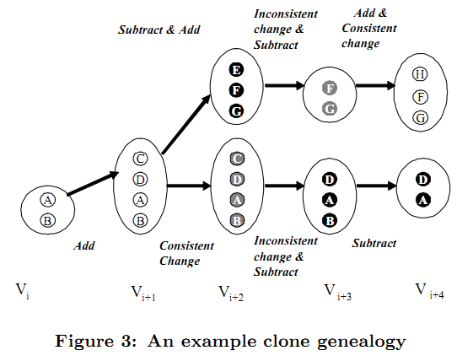
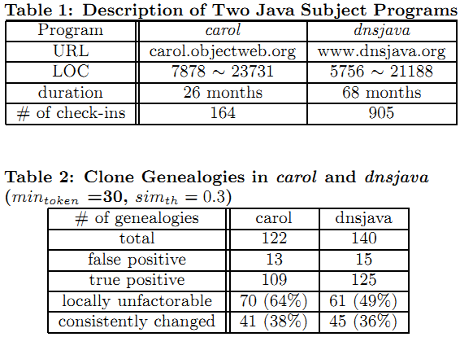
Code Clone Genealogies [M. Kim05]
Investigates the validity of the assumption that code clones are bad
Defines clone evolution model
Built an automatic tool to extract the history of code clones from a software repository
Code Snippet
Clone Group
Clone Lineage
M. Kim, V. Sazawal, D. Notkin, and G. Murphy (2005), “An empirical study of code clone genealogies,” in Proceedings of the 10th European software engineering conference held jointly with 13th ACM SIGSOFT international symposium on Foundations of software engineering (ESEC/FSE-13).

Slide 12
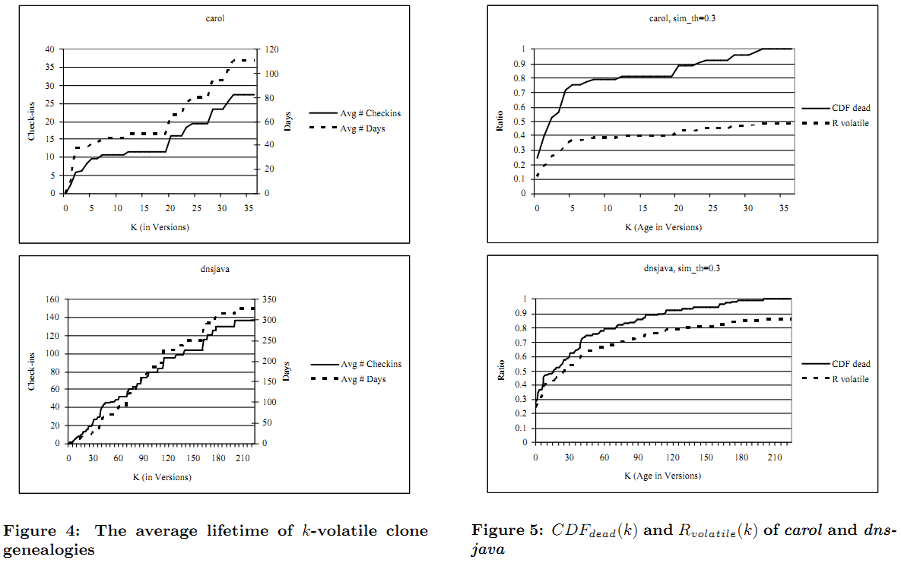
Code Clone Genealogies [M. Kim05]
M. Kim, V. Sazawal, D. Notkin, and G. Murphy (2005), “An empirical study of code clone genealogies,” in Proceedings of the 10th European software engineering conference held jointly with 13th ACM SIGSOFT international symposium on Foundations of software engineering (ESEC/FSE-13).

Slide 13
Code Clone Genealogies [M. Kim05]
Observations
In both systems, a large number of clones were volatile
26% ~ 34% of dead lineages were discontinued because of divergent changes in the clone group ➔ Aggressive, immediate refactoring may not be cost-effective.
M. Kim, V. Sazawal, D. Notkin, and G. Murphy (2005), “An empirical study of code clone genealogies,” in Proceedings of the 10th European software engineering conference held jointly with 13th ACM SIGSOFT international symposium on Foundations of software engineering (ESEC/FSE-13).

Slide 14
Types of Clones
Types | Description
Type 1 | exact copy without modifications (except for white space and comments)
Type 2 | syntactically identical copy; only variable, type, or function identifiers were changed
Type 3 | copy with further modifications; statements were changed, added, or removed
Type 4 | semantically similar code snippets, which might be written independently
S. Bellon, R. Koschke, G. Antoniol, J. Krinke, and E. Merlo (2007), “Comparison and Evaluation of Clone Detection Tools”, IEEE Transactions on Software Engineering, vol. 33, no. 9, pp. 577-591.
C. K. Roy and J. R. Cordy (2007), “A Survey on Software Clone Detection Research,” SCHOOL OF COMPUTING TR 2007-541, QUEEN’S UNIVERSITY, vol. 115.

Slide 15
Types of Clone Detection Tools
Types | Example Tools & Research
Textual | Dup Loc [Ducasse99], [Johnson93], [Karp & Rabin87]
Token | Dup [Baker95, 96], CCFinder [Kamiya02]
Metric | [Kontogiannis95, 96], [Mayrand96]
AST¹⁾ based | CloneDR [Baxter98]
PDG²⁾ based | Duplix [Krinke01], [Komondoor01]
1) AST: Abstract Syntax Tree
2) PDG: Program Dependence Graph
S. Bellon, R. Koschke, G. Antoniol, J. Krinke, and E. Merlo (2007), “Comparison and Evaluation of Clone Detection Tools”, IEEE Transactions on Software Engineering, vol. 33, no. 9, pp. 577-591.

Slide 16
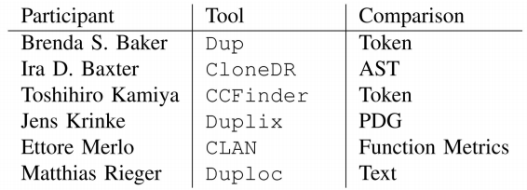
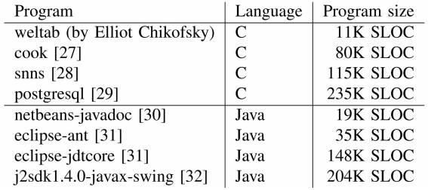
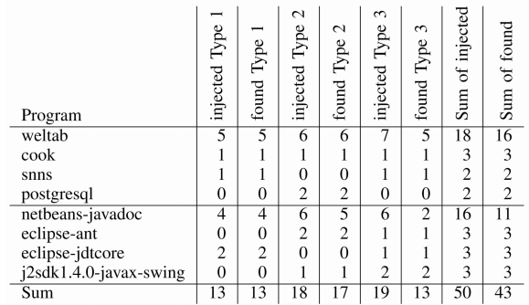
Comparison and Evaluation of Clone Detection Tools
An experiment conducted by Bellon et al.
Reference corpus (oracle)
Oracle was built manually. An independent person looked at 2 percent of all 325,935 submitted candidates.
Clone injection
S. Bellon, R. Koschke, G. Antoniol, J. Krinke, and E. Merlo (2007), “Comparison and Evaluation of Clone Detection Tools”, IEEE Transactions on Software Engineering, vol. 33, no. 9, pp. 577-591.
Notes:
Note that in this experiment, Type-4 clones are not considered.

Slide 17
Comparison and Evaluation of Clone Detection Tools
Conclusion
The two token-based (Baker, Kamiya) and text-based (Rieger) behave astonishingly similarly.
The tools based on tokens and text have higher recall
Merlo’s tool and Baxter’s AST-based tool have higher precision (but considerably higher costs in terms of execution time)
The PDG-based tool (Krinke) does not perform too well (sensible only for type-3 clones).
Large number of rejected candidates (24% ~ 77%)
Many injected clones were missed (24% ~ 46% found)
S. Bellon, R. Koschke, G. Antoniol, J. Krinke, and E. Merlo (2007), “Comparison and Evaluation of Clone Detection Tools”, IEEE Transactions on Software Engineering, vol. 33, no. 9, pp. 577-591.

Slide 18

MeCC [H. Kim11]
Detects semantic clones
Use path-sensitive semantic-based static analyzer to symbolically estimate the memory effects of procedures
Compare the abstract memory states
path-insensitive analysis will ignore this difference
H. Kim, Y. Jing, S. Kim, and K. Yi (2011), “MeCC: Memory Comparison-based Clone Detector”, in Proceedings of the 33rd International Conference on Software Engineering (ICSE2011).

Slide 19
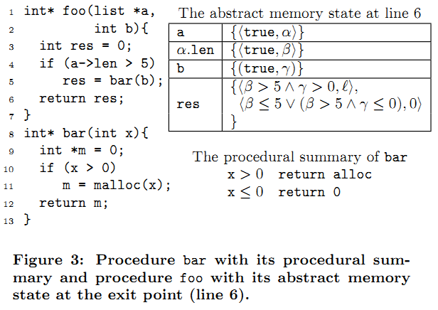
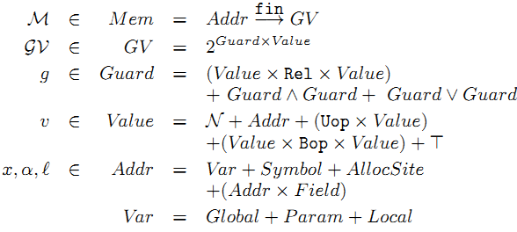
MeCC [H. Kim11]
Abstract memory state example
H. Kim, Y. Jing, S. Kim, and K. Yi (2011), “MeCC: Memory Comparison-based Clone Detector”, in Proceedings of the 33rd International Conference on Software Engineering (ICSE2011).

Slide 20
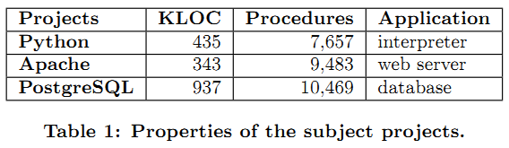
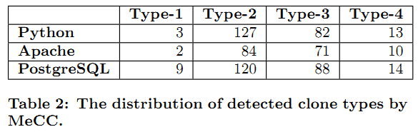
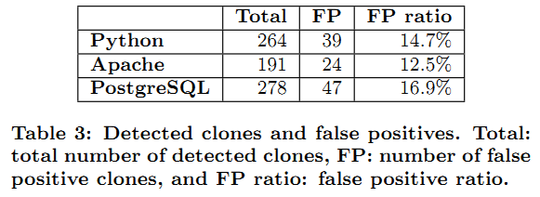
MeCC [H. Kim11]
Evaluation
H. Kim, Y. Jing, S. Kim, and K. Yi (2011), “MeCC: Memory Comparison-based Clone Detector”, in Proceedings of the 33rd International Conference on Software Engineering (ICSE2011).

Slide 21
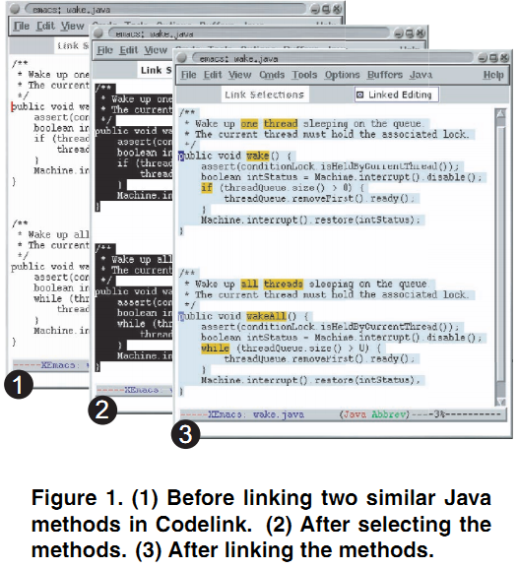

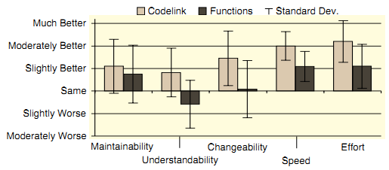
Linked Editing [Toomim04]
Solves several problems
unobservable inconsistencies
tedious, repetitive edits
Evaluation study
Within subject design
Compare functional abstraction vs. linked editing
M. Toomim, A. Begel, and S. L. Graham (2004), “Managing Duplicated Code with Linked Editing,” in Proceedings of IEEE Symposium on Visual Languages and Human Centric Computing (VL/HCC'04), 2004, pp. 173-180.
Notes:
unobservable inconsistencies -> by highlighting
tedious, repetitive edits -> by linked editing
still available to make inconsistent changes by turning off the linked editing feature
13 subjects from UCB from CS graduate students ~ introductory-level undergraduate.

Slide 22
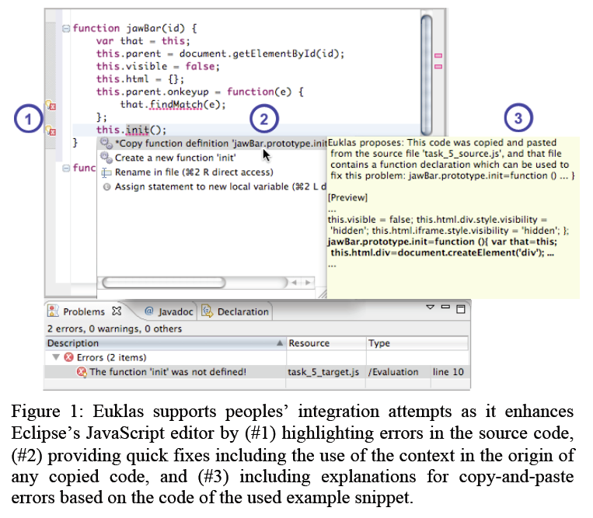
EUKLAS [Dörner11]
Detects following C&P errors in JavaScript code
missing parameter definitions
missing local/global variable definitions
missing function definitions
missing CSS imports
missing JavaScript imports
missing HTML elements accessed by getElementById
Provide quick fixes for 1~3.
C. Dörner and B. Myers (2011), “EUKLAS: Supporting Copy-and-Paste Strategies for
Integrating Example Code”. (submitted to IEEE Symposium on Visual Languages and Human Centric Computing, VL/HCC 2011)

Slide 23
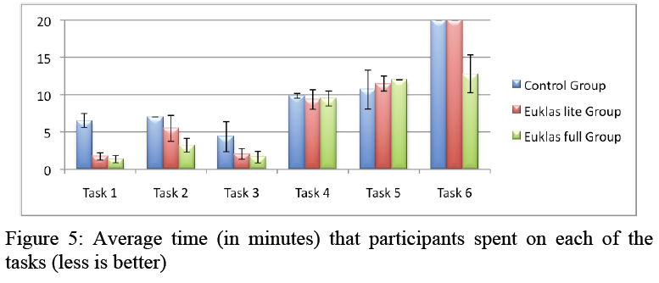
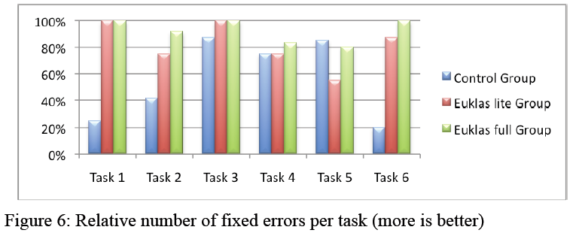
EUKLAS [Dörner11]
Evaluation
C. Dörner and B. Myers (2011), “EUKLAS: Supporting Copy-and-Paste Strategies for
Integrating Example Code”. (submitted to IEEE VL/HCC 2011)

Slide 24
Summary of C&P, Code Clones
There has been a common wisdom that code clones are inherently bad (since before 1990’s)
Many different types of code clone detectors has been built
Recent empirical studies (since 2004) have shown that nevertheless developers create code clones and they are not always bad
There are tools to help developers create and manage code clones more effectively and correctly

Slide 25
Outline
Copy & Paste, Code Clones
Two different thoughts about code clones
Clone detection tools
Tools to help making, managing code clones
Refactoring
What is refactoring, and how it is supported
Studies about refactoring
Program Differencing
Different types of program differencing
Logical Structural Diff

Slide 26
Refactoring
“Refactoring is the process of changing a software system in such a way that it does not alter the external behavior of the code yet improves its internal structure.” [Fowler 1999]
Popular refactoring examples
Rename
Extract Method
Pull Up Method / Push Down Method
M. Fowler, K. Beck, J. Brant, W. Opdyke, and D. Roberts (1999), “Refactoring: Improving the Design of Existing Code”, 1st ed. Addison-Wesley Professional.

Slide 27
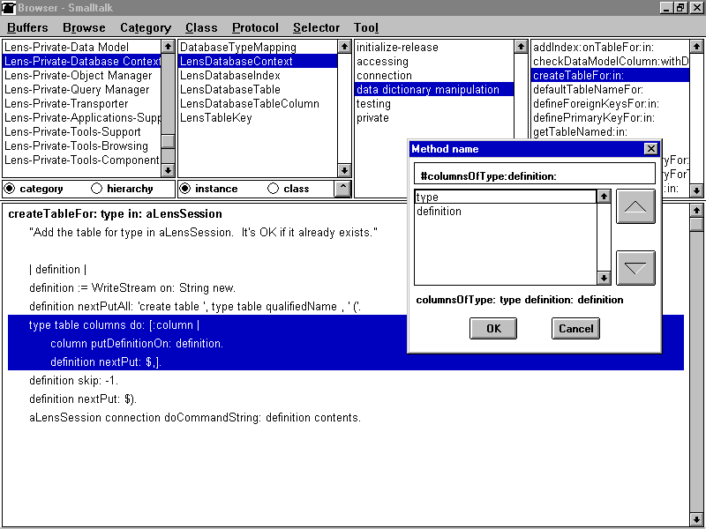
A Refactoring tool for Smalltalk [Roberts97]
Refactoring tool integrated in an IDE
Most of the recent IDEs have this feature
D. Roberts, J. Brant, and R. Johnson (1997), “A refactoring tool for smalltalk,” Theory and Practice of Object Systems, vol. 3, no. 4, pp. 253-263.

Slide 28
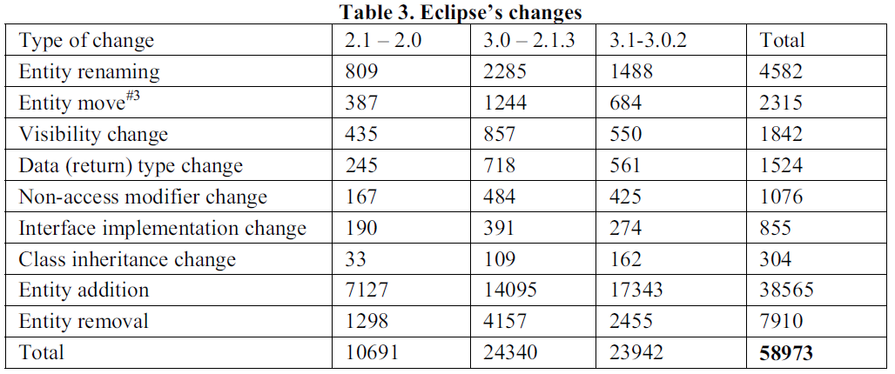
Refactoring Practice (Eclipse Case Study) [Xing06]
Compared three pairs of Eclipse releases using UMLDiff [Xing05] technique
Z. Xing and E. Stroulia (2005), “UMLDiff: an algorithm for object-oriented design differencing,” in Proceedings of the 20th IEEE/ACM international Conference on Automated software engineering (ASE’05), p. 54–65.
Z. Xing and E. Stroulia (2006), “Refactoring Practice: How it is and How it Should be Supported - An Eclipse Case Study,” in Proceedings of 22nd IEEE International Conference on Software Maintenance (ICSM ‘06), 2006, pp. 458-468.
Notes:
UMLDiff:
Additions/Removals of new packages, classes, interfaces, methods, and fields
Movements of methods, fields, classes, interfaces
Renamings of packages, classes, interfaces, methods (including parameter list changes), and fields
Modification of signature such as visibility, modifiers, return type, parameter list

Slide 29
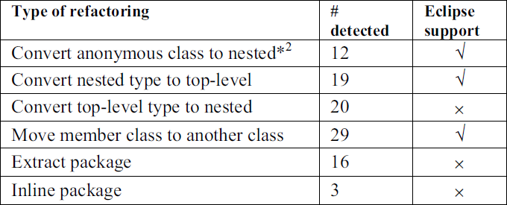
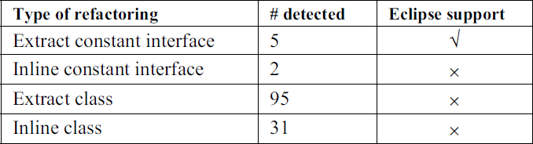
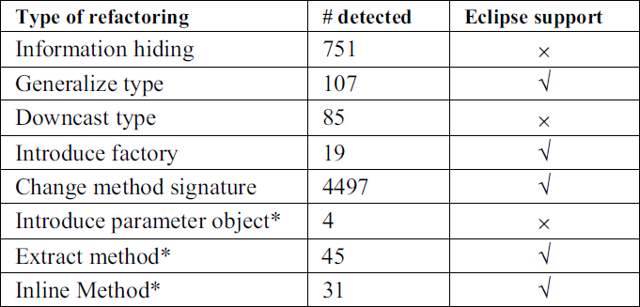
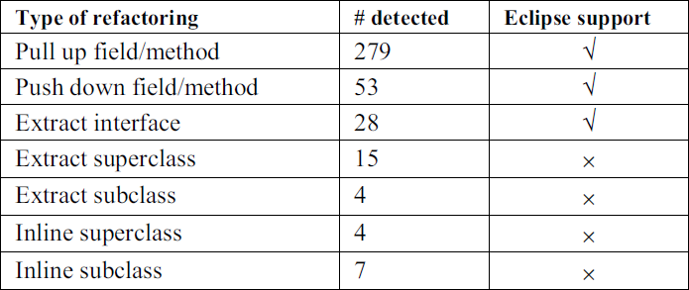
Refactoring Practice (Eclipse Case Study) [Xing06]
Observations
About 70% of structural changes may be due to refactorings
About 60% of these changes, the references to the affected entities in a component-based application can be automatically updated
State-of-the-art IDEs only support a subset of common low-level refactorings, and lack support for more complex ones
Z. Xing and E. Stroulia (2006), “Refactoring Practice: How it is and How it Should be Supported - An Eclipse Case Study,” in Proceedings of 22nd IEEE International Conference on Software Maintenance (ICSM ‘06), 2006, pp. 458-468.

Slide 30
How We Refactor, and How We Know It [Murphi-Hill09]
Extensive study using 4 data sets spanning
> 13,000 developers, > 240,000 refactorings > 2500 developer hours, > 3400 commits
Data sets
Users (collected by Murphy et al. in 2005)
Everyone (collected by Eclipse Usage Collector)
Toolsmiths (refactoring tool developers)
Eclipse CVS
Casts doubt on some of the previously stated assumptions
E. Murphy-Hill, C. Parnin, and A. P. Black (2009), “How we refactor, and how we know it,” in Proceedings of the 31st International Conference on Software Engineering (ICSE 2009), p. 287–297.

Slide 31
How We Refactor, and How We Know It [Murphi-Hill09]
Observations
The Rename refactoring tool is used much more frequently by ordinary programmers than by the toolsmiths
About 40% of refactorings performed using a tool occur in batches (i.e., refactorings of the same kind within 60 secs)
About 90% of configuration defaults or refactoring tools remain unchanged when programmers use the tools
Messages written by programmers in commit logs do not reliably indicate the presence of refactoring
Programmers frequently floss refactor (i.e., interleave refactoring with other programming activities)
E. Murphy-Hill, C. Parnin, and A. P. Black (2009), “How we refactor, and how we know it,” in Proceedings of the 31st International Conference on Software Engineering (ICSE 2009), p. 287–297.

Slide 32
How We Refactor, and How We Know It [Murphi-Hill09]
Observations (cont’d)
About half of the refactorings are not high-level. → refactoring detection tools that look exclusively for high-level refactorings will not detect them
Refactorings are performed frequently
Almost 90% of refactorings are performed manually, without the help of tools
The kind of refactoring performed with tools differ from the kind performed manually
E. Murphy-Hill, C. Parnin, and A. P. Black (2009), “How we refactor, and how we know it,” in Proceedings of the 31st International Conference on Software Engineering (ICSE 2009), p. 287–297.
Notes:
high-level: rename class, move static field, add parameter (usually don’t change block of code significantly)
medium-level: extract method, inline constant, convert anonymous type to nested type
low-level: extract local variable, rename local variable, add assertion

Slide 33
Roles of API-level Refactorings [M. Kim11]
Investigate the role of refactoring by observing the correlation between refactoring and bug fixing
Study Approach
Study Subjects: Eclipse JDT, jEdit, and Columba
Identify refactoring revisions
Use automatic refactoring reconstruction technique
Identify bug fix revisions
Heuristically mine by searching for keywords such as “bug” or “fixed”, or bug report ID
Identify bug-introducing changes
From the bug fix revisions, trace back when was the code fragment that had bug introduced
M. Kim, D. Cai, and S. Kim (2011), "An Empirical Investigation into the Role of API-Level Refactorings during Software Evolution", in Proceedings of the 33rd International Conference on Software Engineering (ICSE2011).

Slide 34
Roles of API-level Refactorings [M. Kim11]
Observations
The number of bug fixes increases after API-level refactoring
The time taken to fix bugs is shorter after API-level refactoring
A large number of refactoring revisions include bug fixes at the same time or related to later bug fixes
API-level refactorings occur more frequently before than after major software releases
M. Kim, D. Cai, and S. Kim (2011), "An Empirical Investigation into the Role of API-Level Refactorings during Software Evolution", in Proceedings of the 33rd International Conference on Software Engineering (ICSE2011).

Slide 35
Outline
Copy & Paste, Code Clones
Two different thoughts about code clones
Clone detection tools
Tools to help making, managing code clones
Refactoring
What is refactoring, and how it is supported
Studies about refactoring
Program Differencing
Different types of program differencing
Logical Structural Diff

Slide 36
Types of Program Differencing
Longest Common Sequence (Textual)
Abstract Syntax Tree (AST) Based
Control Flow Graph (CFG) Based
Program Dependence Graph (PDG) Based
Rule Based

Slide 37
LSDiff [M. Kim 09]
LSDiff: Logical Structural Diff
Infer the systematic structural differences as logic rules
Detects exceptions to the logic rules
M. Kim and D. Notkin, “Discovering and representing systematic code changes”, Proceedings of the 31st International Conference on Software Engineering, p. 309–319, 2009.

Slide 38
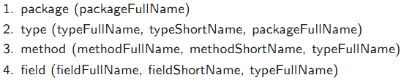
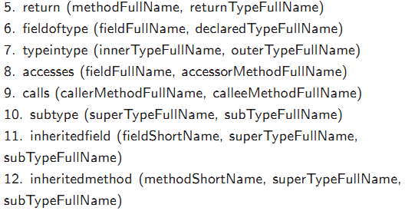
LSDiff [M. Kim 09]
Represent a program version as a set of predicates which describe structural information (also called as “fact-based representation”)
M. Kim and D. Notkin, “Discovering and representing systematic code changes”, Proceedings of the 31st International Conference on Software Engineering, p. 309–319, 2009.

Slide 39
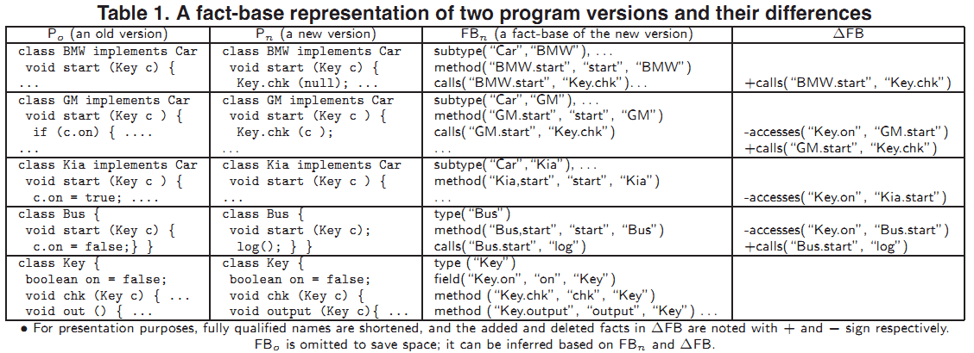
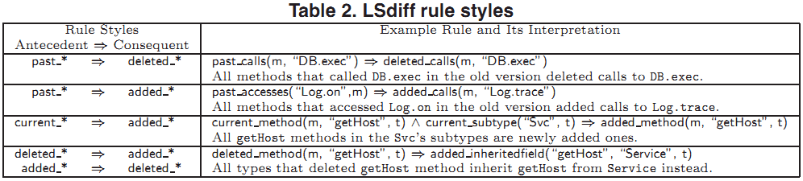
LSDiff [M. Kim 09]
M. Kim and D. Notkin, “Discovering and representing systematic code changes”, Proceedings of the 31st International Conference on Software Engineering, p. 309–319, 2009.

Slide 40
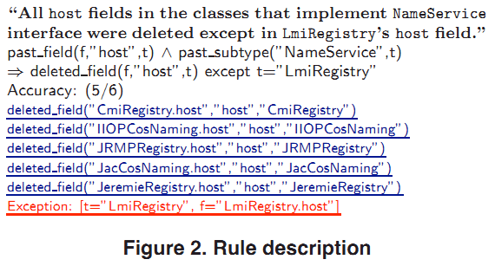
LSDiff [M. Kim 09]
Exception is also shown, which might be a mistake made by the developer while refactoring
M. Kim and D. Notkin, “Discovering and representing systematic code changes”, Proceedings of the 31st International Conference on Software Engineering, p. 309–319, 2009.

Slide 41
Conclusion
Code clones are generally considered bad, but recent studies has shown that they are not always bad
Many types of code clone detection tools has been developed since 1990’s, and still being actively developed
There are tools that help developers to manage code clones effectively and correctly
Refactoring is widely used, but the refactoring tools only support relatively low-level refactorings
There are many different approaches of program differencing, which help reviewing and understanding code changes

Slide 42
Other Closely Related Topics
Keyword: “Software Evolution”
Mining Software Repositories
6.2 Reverse Engineering
Crosscutting Concerns, AOP
Delta Debugging

Slide 43
Questions?

