Slide 1

Navigating Working Sets
Brad Myers
05-899D: Human Aspects of Software Development (HASD)
Spring, 2011
Copyright © 2011 – Brad Myers

Slide 2
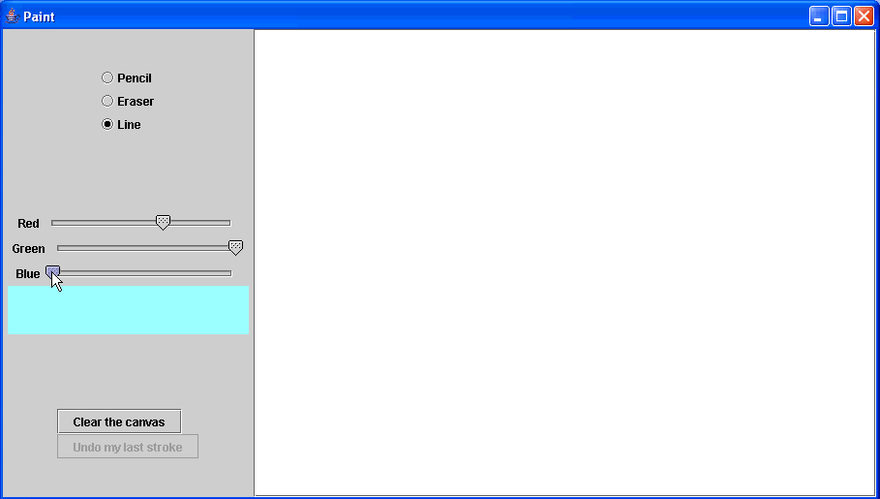

Study of Design Requirements for
Maintenance-Oriented IDEs [Ko 2005]
10 “expert” Java programmers
1 program to maintain
5 tasks, do in any order
the internet
$10
Eclipse 2.0 IDE
for documentation, examples, etc.
for each task completed
Notes:
- We recruited 10 Java programmers, who reported expertise with Java.
- We designed 1 program and 5 maintenance tasks for it, both of which I’ll describe shortly.
- They used the Eclipse 2.0 IDE. We used Eclipse because we wanted to identify inadequacies of even the best of modern Java IDEs.
- Programmers were also given an internet connection and were free to use any resources they saw fit.
- Programmers were paid $10 per task competed.

Slide 3
Time Spent on Different Activities
Reading task descriptions
3%
Switching environments
Reading code
5%
Testing Paint
22%
6%
Reading the Java API
13%
Editing code
13%
20%
16%
Searching for task-related words
Navigating dependencies
Notes:
The first thing we’ll look at is the average division of labor.
- Most of programmers time was spent reading and editing code.
- Almost as much time was spent navigating dependencies in the code, such as going from a variable’s use to its declaration.
- The next biggest chunk of time was spent searching for variables, classes, methods and comments that referred to a particular concept, such as undo or color.
- Just as much time was spent testing the Paint application.
We also looked at how programmers structured their tasks.

Slide 4
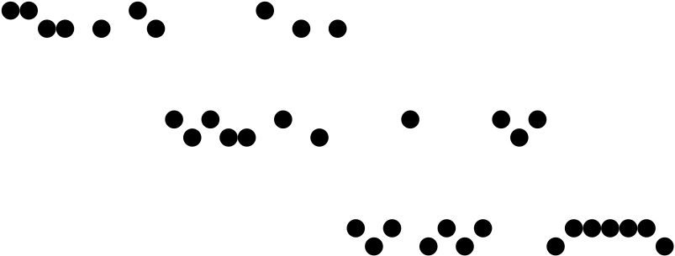
A Programmer’s Task
Form working set of task-relevant code
Find
Read
Navigate...
Navigate dependencies in working set
within file
between files
Modify code in
working set
Edit
Test
task started
task complete
Notes:
This is one programmer’s sequence of work, divided up by the categories of events we saw on the previous slide.
There are a few of things to notice:
- There are three major groupings of work.
- The first has to do with browsing code, the second has to do with navigating dependencies in a subset of the code browsed, and the third has to do with modifying these dependencies.
- These three basic activities overlapped in time, suggesting that they feed into each other. Browsing leads to dependencies, dependencies lead to modifications.
We saw this task structure throughout all of the programmers’ work and tasks. This led us to generalize maintenance tasks into three major activities.

Slide 5
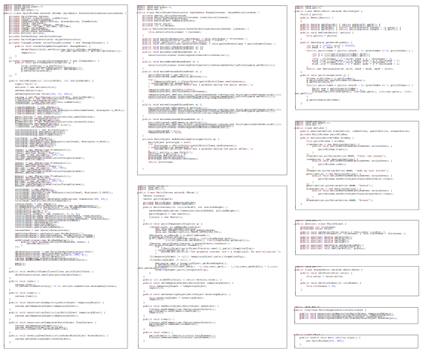
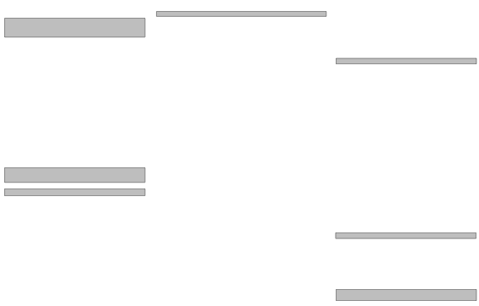
A Programmer’s Working Set
A collection of task-relevant code fragments
In modern software development, dependencies are distributed and non-local
Notes:
To better illustrate a working set, here is all of the code in the Paint program. The grey regions indicate the code that one programmer included in their working set as part of the stroke thickness task.
This makes sense: in modern software development, dependencies are distributed and non-local.
Given this idea of a working set, we’ll now take a more detailed look at how programmers formed, represented, and navigated their working sets, and how the IDE helped or hindered them.

Slide 6
Forming Working Sets
How does ____ work?
  Searched for seemingly task-relevant words
  Only 50% of searches led to relevant code
Why did(n’t) ____ happen?
  Formed hypotheses about potential causes of unexpected behavior
  88% of hypotheses were false
Programmers had trouble relating the behavior they saw (or didn’t see) to the code responsible for it.
Notes:
In general, programmers formed working sets by starting with a question.
- For example, for the debugging tasks, asking why did or why didn’t something happen
- For augmenting tasks, asking how is some similar existing behavior implemented
Answering these questions was inefficient and error-prone because programmers couldn’t relate the behavior they saw or didn’t see when testing the program to the code that was responsible for it.
After they finally overcame these problems...

Slide 7
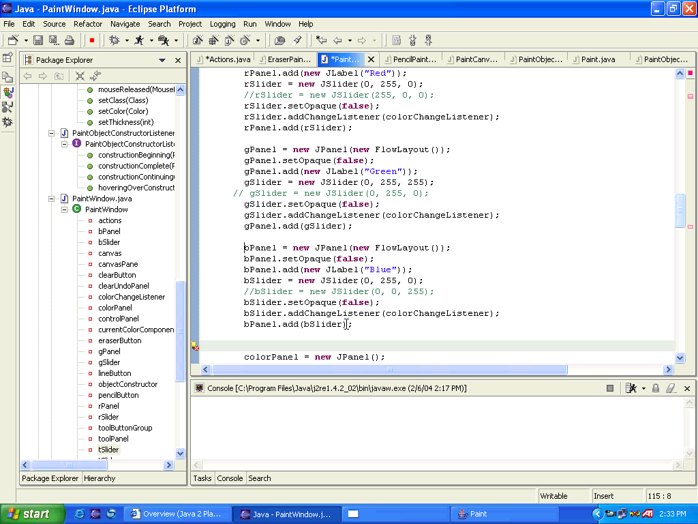
Representing Working Sets
Represented by explorer and file tabs
When changing tasks, working sets were lost as tabs and nodes changed
“Including” code in the working set by opening a file or expanding a node made it more difficult to navigate to other code in the working set
Notes:
Programmers used Eclipse’s tabs and package explorer to approximate the set of code fragments that were in their working sets. They left the tabs and explorer nodes that contained task-relevant fragments open and closed irrelevant ones.
Obviously, this isn’t the most efficient way of representing code fragments.
- For example, opening a single file tab makes all of the other file names tabs more inscrutable, hindering navigation.
- Expanding an explorer node, just to include one or two relevant methods, increasing the amount of navigation required to find any other relevant fragment.
It’s usually very small pieces of the file and not the whole file, so they have to keep refinding.

Slide 8
Navigating in a Working Set
Navigated ~65 dependencies over 70 minutes
58% direct:
  Declaration of…
  Use of…
  Called by…
  Definition of…
Some direct reference
navigation supported
by Eclipse commands
42% indirect:
  The method that computes the value that is passed to this method and used in this expression…
Supported only by scroll bars, package explorer, tabs, and find
Notes:
As programmers formed and represent their working sets, the majority of their work was in navigating and understanding dependencies in the code.
There were two major types of dependency navigations.
- Direct, for example, many of these were supported directly by Eclipse, and they were used when available.
- Indirect, for example, these navigations had to be performed manually, and because most indirect relationships were between files, incurred significant interactive overhead.

Slide 9
Times for Bottlenecks
Each instance of an interactive bottleneck cost only a few seconds, but . . .
= 35% of uninterrupted work time!
Interactive Bottleneck | Overall Cost
Navigating to fragment in same file (via scrolling) | ~ 11 minutes
Navigating to fragment in different file (via tabs and explorer) | ~ 7 minutes
Recovering working set after returning to a task | ~ 1 minute
Total Costs | ~19 minutes

Slide 10
DeLine’s study of 7 developers
[SoftViz 2005]
Unfamiliar code, 4 tasks in lab for game of Tetris
2 subjects did top-down reasoning, 5 did bottom-up searching
Confirmed Ko’s observation that:
  Navigating and “re-finding” areas of the code that had already been visited was frequent, difficult and distracting
  Textual searching and returning
  Tabs got problematic when many opened
All subjects wanted better inline comments and overview documentation.
Wanted code annotations
All subjects agreed that finding the entry point and understanding the control flow was the most difficult task

Slide 11
de Alwis Study of Eclipse [2006]
8 IBM developers doing their own tasks using Eclipse for Java
Interviews and 2-hour observations of actual use
Experts do become disoriented
  Did use Eclipse’s advanced navigation tools, like find-all-callers
  No trace of how got to the current file, or how to get back
  Thrashing to view necessary context
No support for switching tasks (digressions)

Slide 12
Multi-Dimensional
Separation of Concerns [Tarr 1999]
Software comprehensibility tends to degrade over time
“Concern” – anything people want to consider as a conceptual unit
  Features, non-functional requirements, design idioms, and implementation mechanisms (e.g., caching)
New features, such as saving to a file, can affect every class
  Invasive – into each class and interface
  Scattering – a single requirement affects multiple design and code modules
  Tangling – material pertaining to multiple requirements is interleaved within a single module
Even though seem simple and orthogonal to express
Subclassing and design patterns only work if is a pre-planned change
  “Tyranny of the dominant decomposition.”
Introduces idea of “hyperslices” – decompose system separately along different dimensions
  May include same objects
  Doesn’t say how to implement them

Slide 13
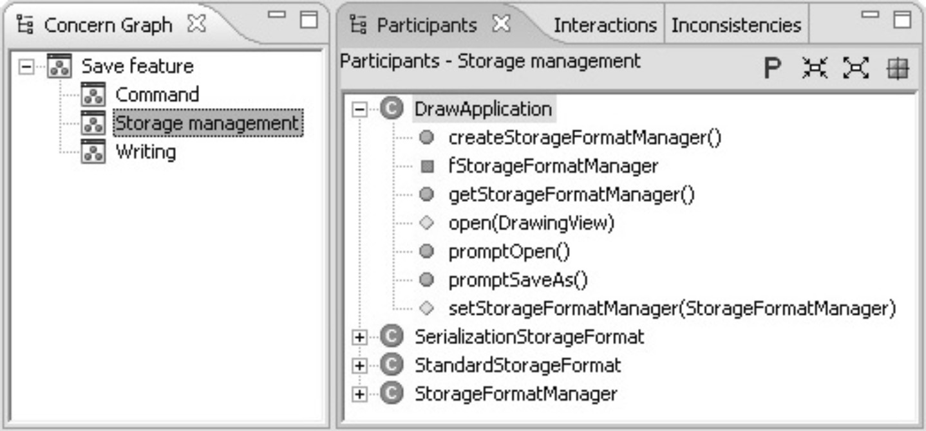
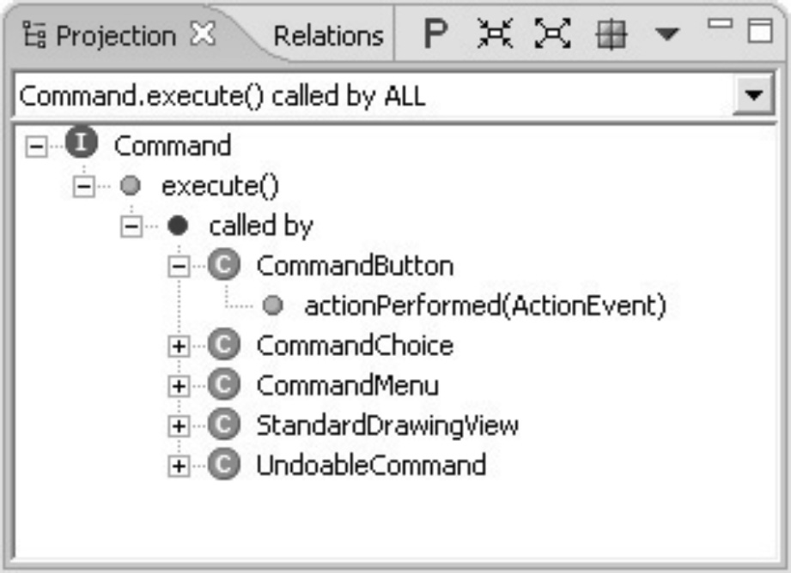
Concern Graphs [Robillard 2007]
Abstract (formal) model that describe which parts of the source code are relevant to different concerns
FEAT tool builds concern graphs “semi-automatically”
Shows only code relevant to the selected concern
User-specified or detected using intra-concern analysis
User can make queries
Eval. using auth; 3 users; 4 users, auth

Slide 14
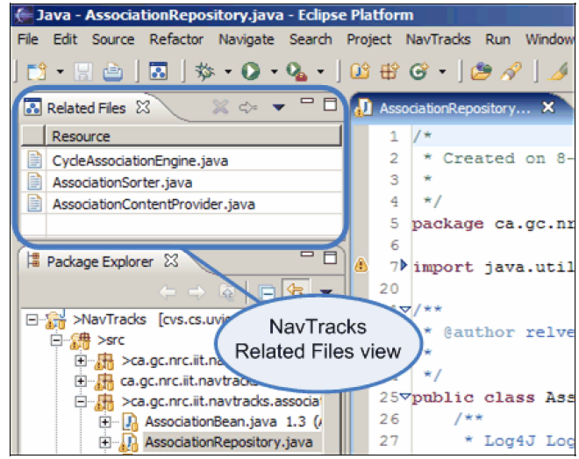
NavTracks [Singer 2005]
Keeps track of navigations of developers
Shows other files often navigated to from the current code file
Evaluated on corpus
of navigations
  29% of the time, the
  file was in the list
  Case study of
  experiences of 5
  users – 4 found it
  helpful
    Discusses why

Slide 15
Mylar – Kersten [2006]
Over 90% of the changes committed to the Eclipse and Mozilla source repositories over a period of one year involved changes to more than one file
  25% were significantly non-local changes
Developers constantly switching tasks
Mylar has explicit representation of the information related to a task
  Degree-of-interest (DOI) weighting for each program element
User identifies tasks, Mylar keeps track of what relevant
  Files viewed, edited, saved
  Propagation (e.g., refactoring), prediction for indirect relationships
Prediction based on searches using elements with high DOI

Slide 16
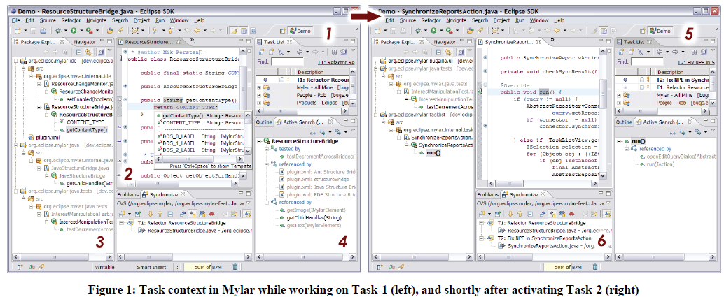
Mylar views
1 – task list
3 – package explorer filters to show what relevant to this task
  Most relevant are bold
4 – active search shows what might be relevant
5 – switch to different task

Slide 17
Mylar Evaluation
Evaluation: longitudinal field study
  99 (!) people used tool for 4 months (!)
  1 week of training (control), then 1 week of active use
  Only 16 users resulted in sufficient data
  Edit ratio: edits/selections
  Mostly, quite positive change in edit ratio (p < 0.005)
  84.17% of the selections events were of elements in the model with a positive DOI
Observations:
  Mylar in active use by 1000s of people
  Tasks are not independent – need to share info. across tasks
  Different parts of lifecycle of tasks have different patterns

Slide 18
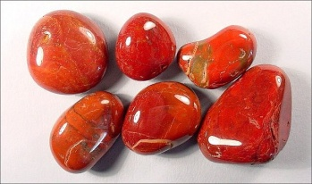
Jasper: Working Set Tool
CSD MS thesis of Michael Coblenz [2006]
Jasper = Java Aid with Sets of Pertinent Elements for Recall
Allow programmers to grab arbitrary fragments of code to represent working sets
  Also notes, documentation, and other meta-information about code
Allow programmers to view in one place, one screen
Use for navigation, reminders, bookmarks
Multiple working sets for different tasks

Slide 19
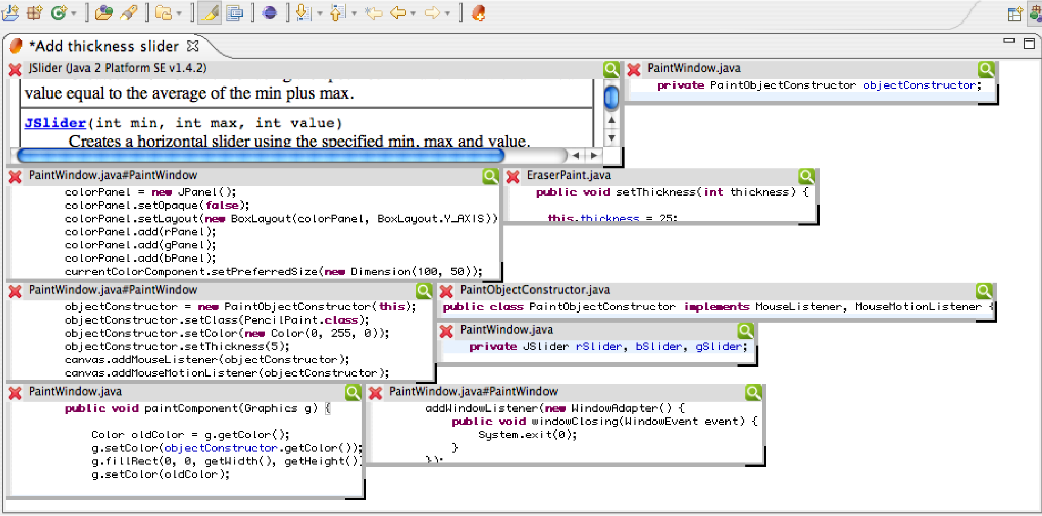
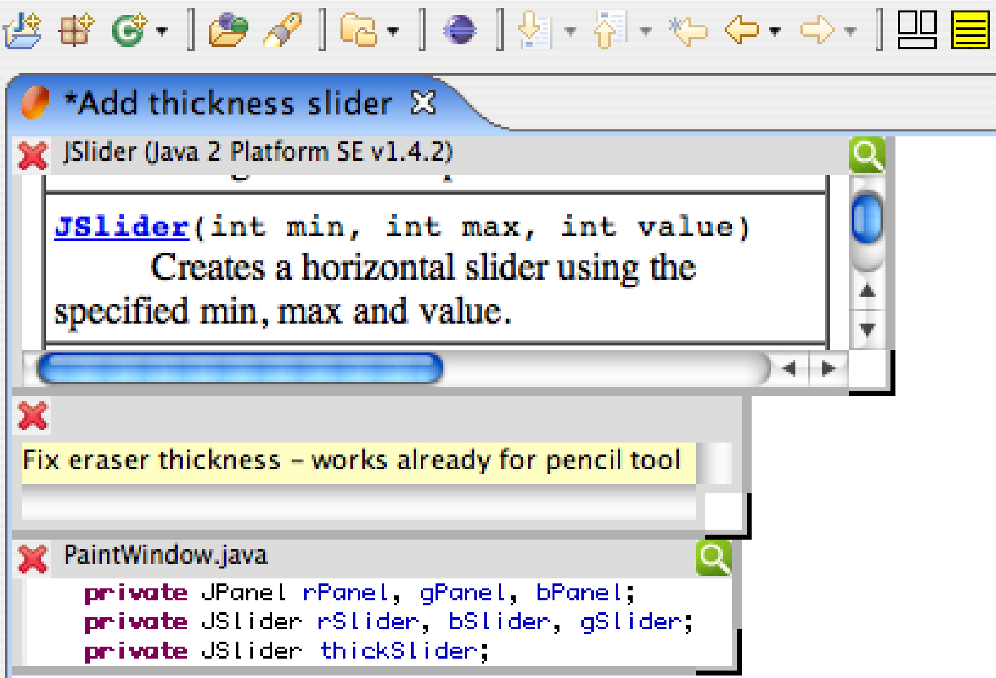
Implementation
Eclipse plug-in
Notes:
Here is one possible maintenance-oriented IDE. Don’t worry about reading the details.
Notice how all of the relevant code fragments are on one screen, instead of distributed amongst multiple files. Relationships between code fragments are shown with arrows. Other working sets are listed on the right. More details and design ideas are given in the paper.

Slide 20
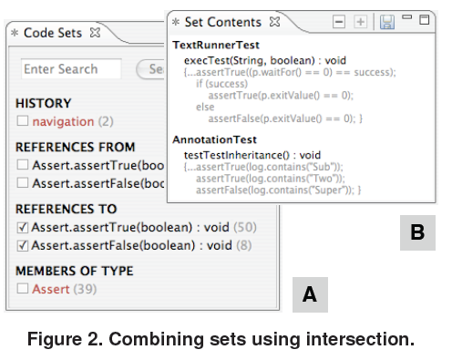
Code Set tool [Fraser 2008]
Based on same observations as others
Fields or methods that reference or are referenced from the current position
Results of searches,
breakpoints, etc.
form searches
Combine sets
Informal lab study
of 6 users

Slide 21
TeamTracks [DeLine 2005]
Shows source code navigation patterns of other people on your team
  Related Items – most frequently visited either just before or after the selected item
  Favorite Classes – hide less frequently used
Informal user study of 9 developers on Tetris game
Deployed for real use – 5 developers for 3 weeks
Successful, but usability issues, seemed most useful for newcomers

Slide 22
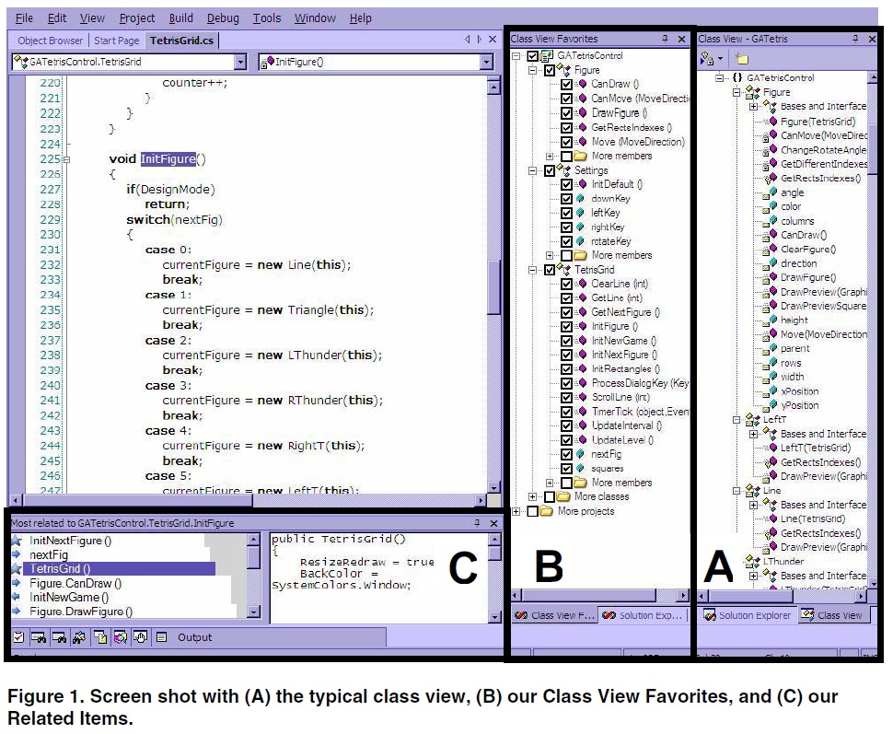

Slide 23
TagSEA [Storey 2009]
Tags for Software Engineering Activities
Allow people to tag (annotate) software
  Reminding – often use comments for this
  Refinding – can use bookmarks, but not used by 84% of developers
Shared among developers
Added as //@Tag comments into the code
Hierarchical, easily refactored
Longitudinal study of 6 users’ real use over 8 weeks
  ½ adopted & used it actively
  Main use: Informational in support of future tasks navigation
Artifact study of other kinds of tags in large codebases

Slide 24
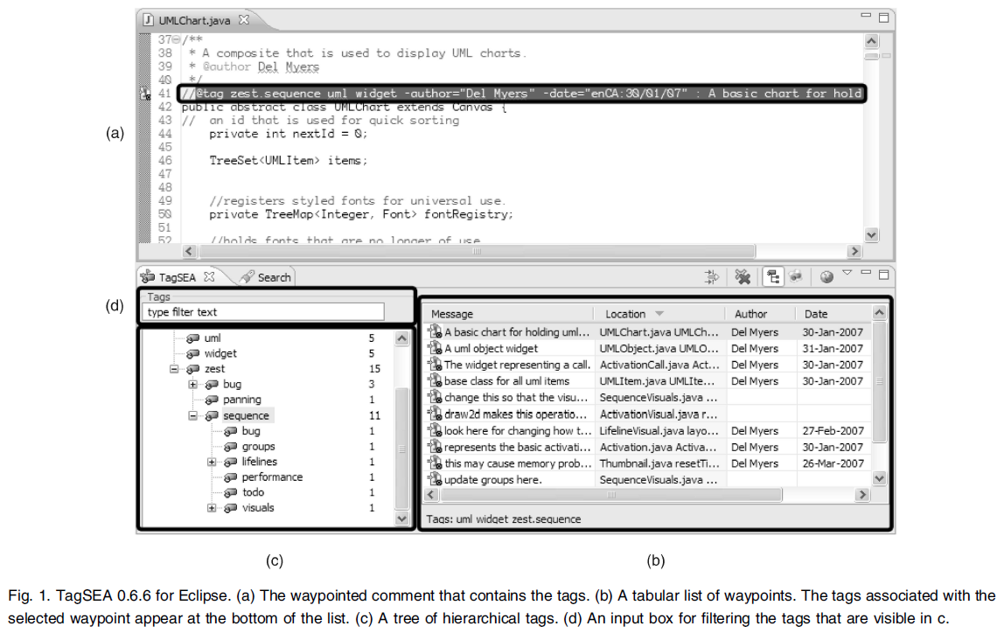
TagSEA

Slide 25
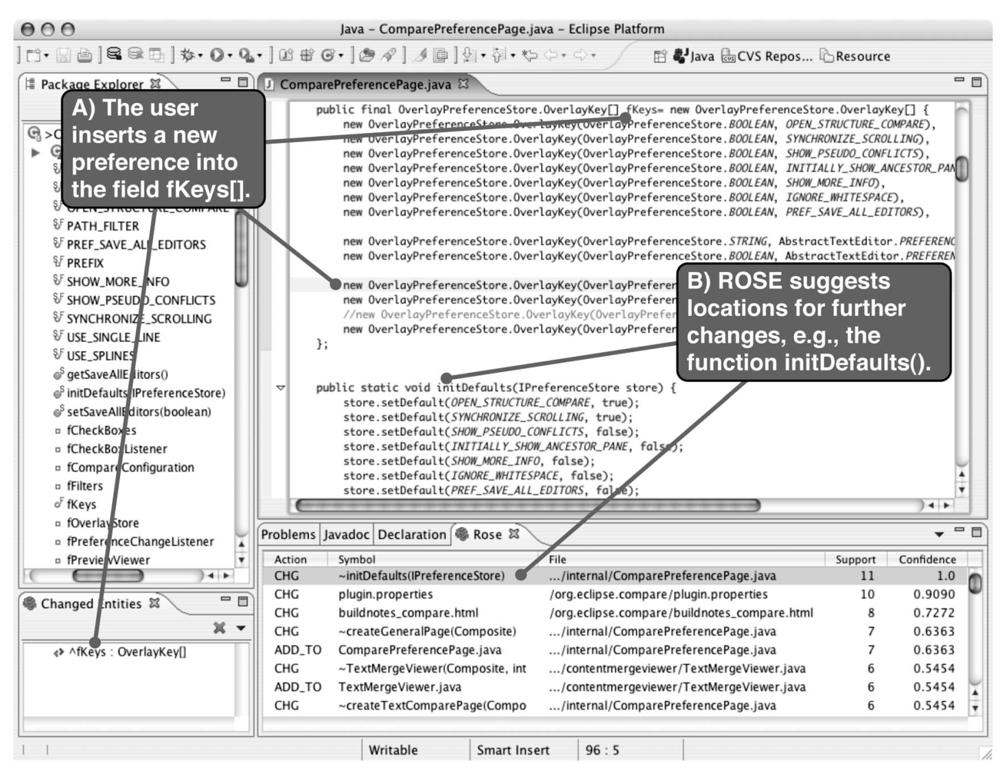
ROSE [Zimmermann, 2005]
Use version histories to determine show what usually edited at the same time

Slide 26
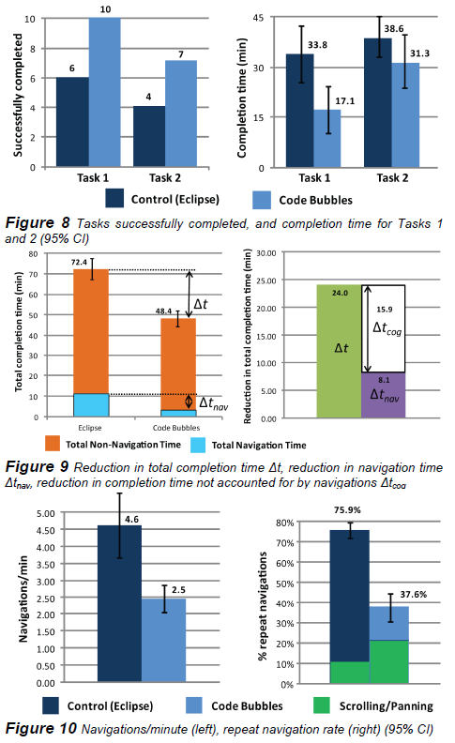
Code Bubbles [Bragdon 2010]
Lightweight editable fragments
Automatic layout & grouping (for working sets)
Reflow of code so efficient space
usage
Use different areas for different tasks
Eval: more code visible w/ fewer UI operations
Lab study: 23 prof. dev. for creating, reading, debugging
  Think alouds & discussion
20 students doing debugging tasks
Built on top of Eclipse

Slide 27
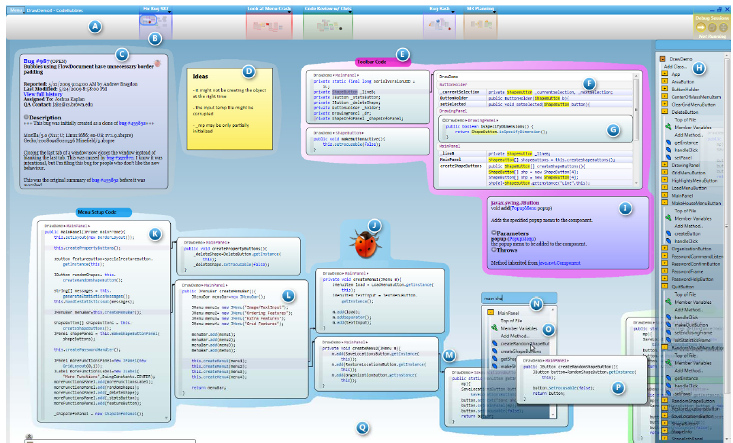
Code Bubbles
Video

