Slide 1
Software Visualization
Brad Myers
05-899D: Human Aspects of Software Development (HASD)
Spring, 2011
Copyright © 2011 – Brad Myers

Slide 2
Visualization
In general: “the use of computer-supported, interactive, visual representations of data to amplify cognition” [Card’98]
But sometimes includes sounds from data (“auralization”)
Software Visualization (Program Visualization)
“Enhance the human understanding of computer programs using graphics” – [Price, 1993]
Code visualization: actual implemented code is visualized
Meta-data visualization
E.g., change logs
Data visualization
Algorithm Visualization (also “Algorithm Animation”)
Visualization of a high-level description of a piece of software – how it works
Abstractions of the data and transformations of the data
Not Scientific Visualization, Information Visualization, Visual Programming

Slide 3
Reorganized
Used to be 3.2 under “Learning to program”
Moved to be 6.4 under “Finding and understanding code”
Generalized to be “Software Visualization” instead of just “Algorithm Visualization”
Note that there are “visualization” papers in lots of other topics too
Especially:
“4.1 Design, designing with diagrams” (Chris)
“6.2. Reverse Engineering” (no-one)
“7.3 Visual languages” (Vishal)

Slide 4
Soft Vis Publications
ACM Symposium on Software Visualization
www.softvis.org
Approximately alternate years since 2003
October 2010 with “VisWeek” (program)
So still an active area of research
Related to “Model-Driven Engineering” (Wikipedia)
Models are usually diagrams
From a workshop at CHI’94
Also at CHI, ICSE, etc.

Slide 5
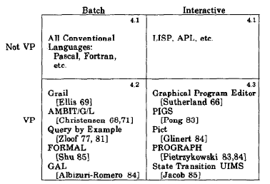
“Visual” Taxonomy
Confusion about the terminology
I did a taxonomy at CHI’86 that helped solidify the definitions of the terms
VP vs. PV – specify vs. illustrate program
PBE vs. PWE
Zloof’s query-by-example

Slide 6
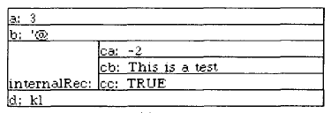
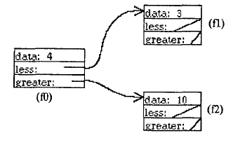
Early History
Earliest generation of flowcharts from Fortran code [Haibt, 1959] = code viz.
Sorting out Sorting video by Baecker (1981) = alg. viz
9 algorithms in a race
Google video
My Incense system (1983)
First to automatically create viz. of data structures
Produce pictures “like you might drawn them on a blackboard”
Goal: help with debugging

Slide 7
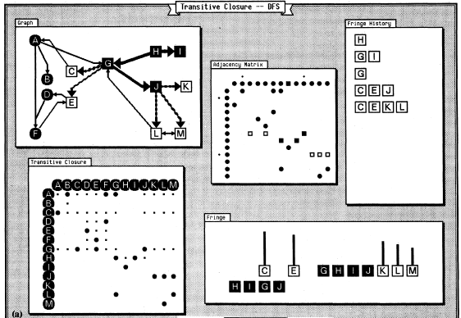
BALSA
Major interactive integrated system (Marc Brown & Sedgewick, 1985)
Brown University Algorithm Simulator and Animator
Extensively used for teaching at Brown Univ.
Lots of algorithms visualized
Architecture for attaching the graphics with code
Still required significant programming for each viz.
Marc followed up with Zeus (‘91) at DEC SRC

Slide 8
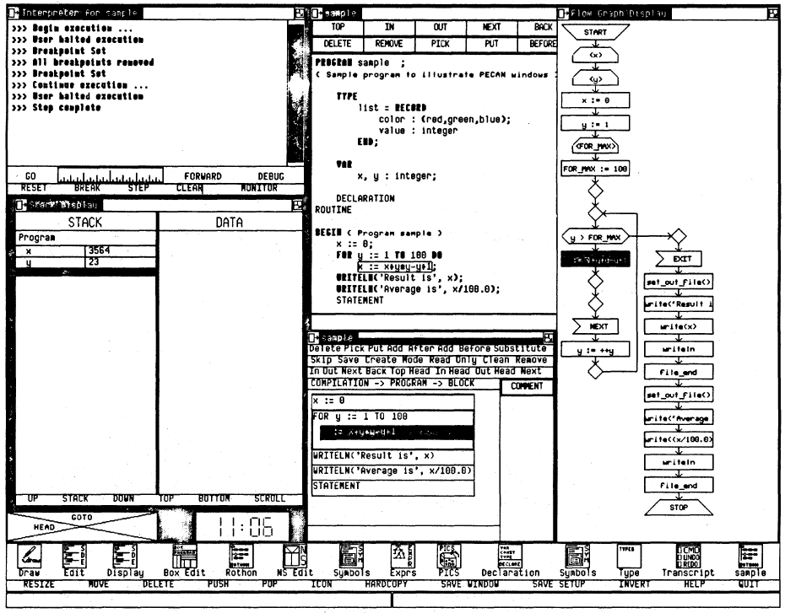
PECAN and Field
Steven Reiss at Brown’s code & data visualization systems
Take advantage of new Apollo workstation capabilities
PECAN (1985) – automatic graphics about the program
Multiple views
Integrates Balsa data visualization
Syntax directed editing
Drag and drop
Flowcharts of code
Code highlighting while executing
Data viz. like Incense
Incremental compilation
Could handle up to 1000 LOC

Slide 9
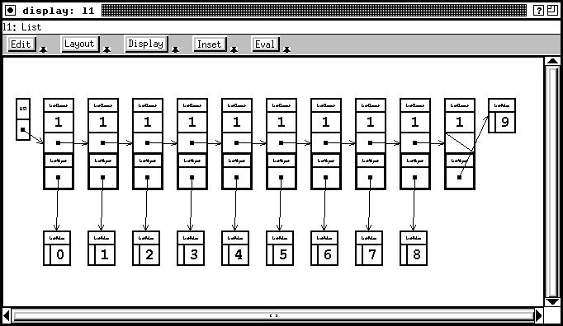
Field (1990)
Field (1990) – IDE, wrappers for Unix tools
Friendly Integrated Environment for Learning and Development
Code and data viz.
Message-based (control) integration
Basis for most other Unix IDEs
Widely used
Followed by DESERT, …
Now: Code Bubbles (in 7.6.5)

Slide 10
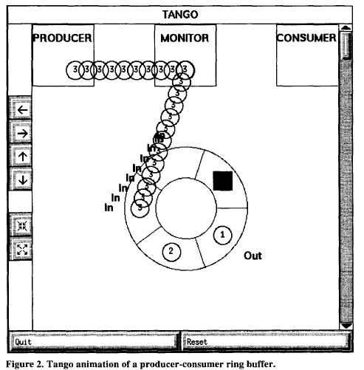
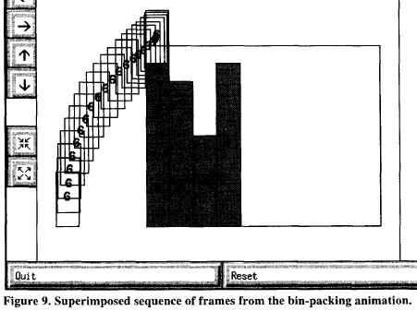
Tango
Transition-based Animation Generation
John Stasko PhD thesis at Brown Univ. (1990)
Continued with XTango as faculty at GA-Tech
Smooth animations between states
Paths & transitions
Make it easier to author algorithm visualizations
Events inserted into the code tied to animations

Slide 11
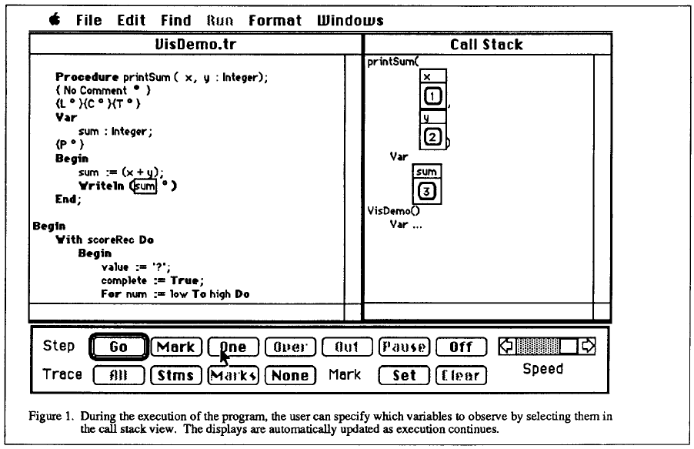
CMU MacGnome & Amethyst
Structured editor for Pascal for Mac
Used for all intro CS courses for many years
Habermann & Notkin’s “Genie” idea for structured editing from Gandalf project
Pascal Genie
Structured top-down decomposition for code creation
My Incense idea for data structure visualization
A MacGNOME Environment That Helps You See Types

Slide 12
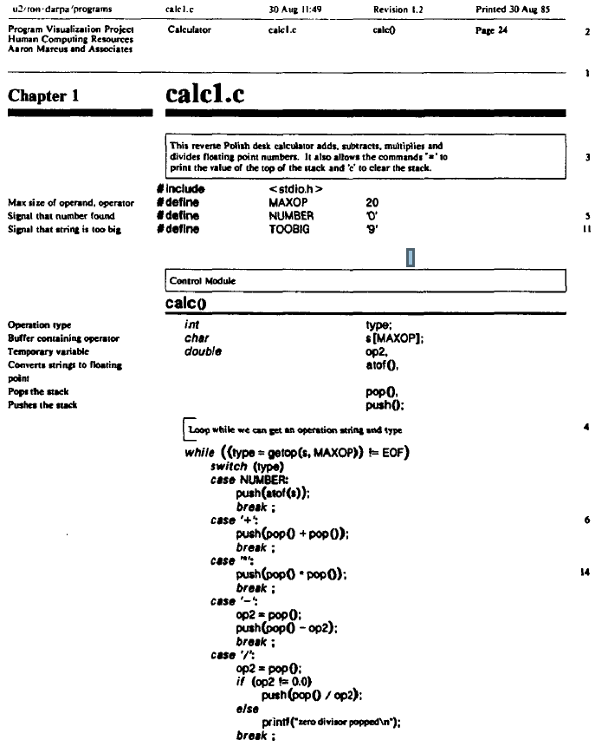
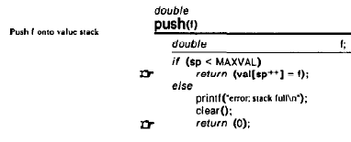
SEE – code viz.
Pretty-printed source code
Baecker collaborated with a graphic designer (Marcus) (1988)
Used troff output for highly formatted (but not real-time)
Focus on what is really useful and important
Opposite of what usually highlighted
Omitted redundant encodings (like {})
Call-outs for important features

Slide 13
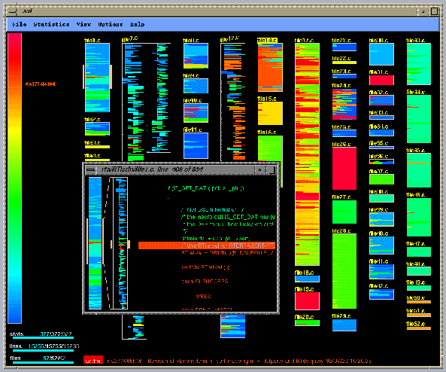
SeeSoft
AT&T Bell Labs [Eick, 1992]
Visualization for performance
“Hot spots” in red
Large volumes of code
Image is of 15,255 LOC
Up to 50,000 LOC
Can indent like original source files
Also, recently changed,
Version control systems
Static, dynamic analyses
Interactive investigation
Video (10min)

Slide 14
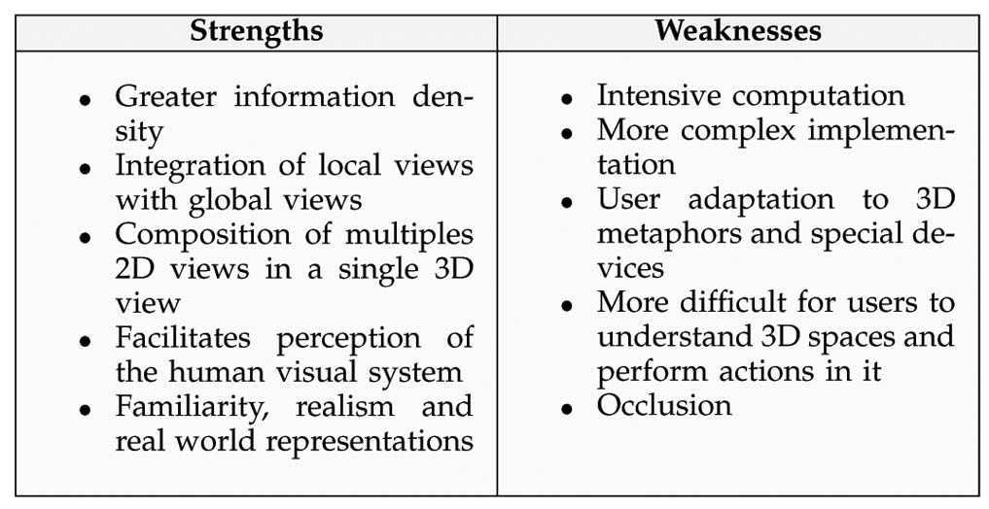
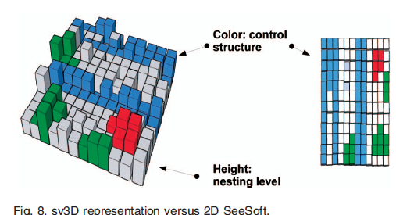
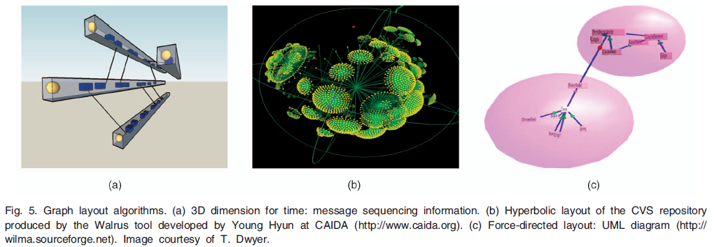
3D Software Visualization
[Teyseyre 2009]

Slide 15
Marwan Abi-Antoun
http://www.cs.wayne.edu/~mabianto/ [Abi-Antoun 2009]
SCHOLIA – visualization of hierarchical runtime architecture from an existing object-oriented system
As-built vs. as-designed architecture
Requires extensive annotations of the original source code
Too difficult to get actual users to add annotations, so Marwan added them and iterated resulting diagrams
Exposed some previously unknown dependencies

Slide 16
Thomas LaToza’s REACHER
Already presented need for reachability questions, but how to allow users to express them, and how show the answers?
With an interactive diagram, generated automatically from a static analysis of the code!

Slide 17
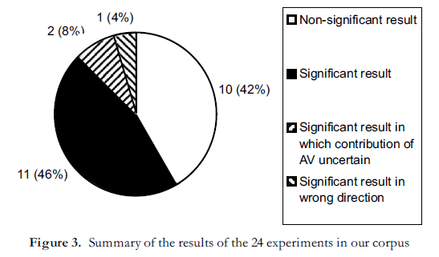
Studies of Algorithm Visualization Effectiveness
[Hundhausen’02] meta-study of 24 experimental studies
All on use of algorithms for CS education
Only ones that have used empirical evaluation
Hypothesized benefits for algorithm development and debugging never evaluated
Mixed results
Dependencies on individual learning styles
Better results when students construct their own vis.
“Cognitive Constructivism”

Slide 18
Study of Diagramming for Reverse Engineering
[Lee, Murphy, … 2008] (short paper)
Interview of 19 developers
Key need: to focus on interesting features
“Interesting” highly variable, and depends on situation
Need “highly flexible, adaptive, interactive tool support”
“Diagram’s efficacy depended on standardization (e.g., UML), spatial layout, information content and links to source code.”
Scalability and dealing with complexity

Slide 19
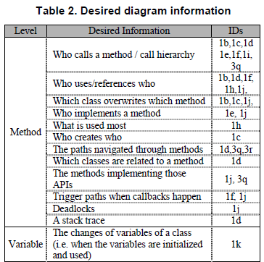
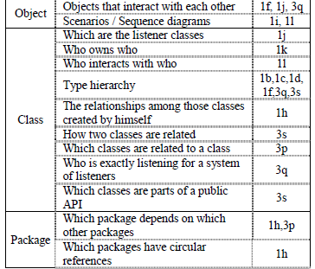
Results of Desires in Diagrams

Slide 20
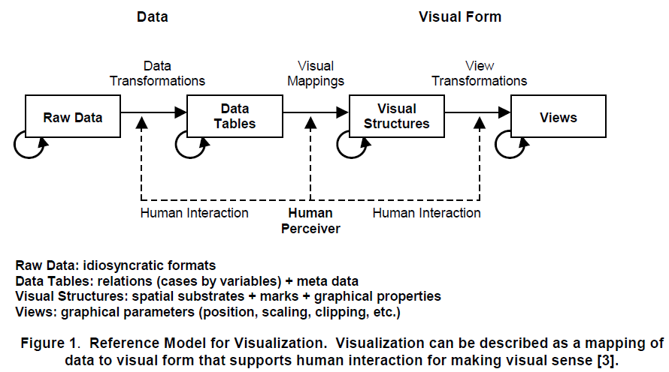
A Task Oriented View of Software Visualization
[Maletic, 2002]
Task (purpose)
Which dev. activity? (reverse engineering, coding, debugging, testing, etc.)
Audience (students, instructors, prof. programmers)
Target (what properties of system?)
Abstraction level
Representation (Form of diagram, 3D?)
Medium
Paper, screen, sound

Slide 21
User Needs
Based on Shneiderman’s info. viz [VL,1996]
Overview – of full space, and to re-orient
Zoom – focus on items of interest
Filter – remove items not of interest
Details on demand
Relate – relationships among items, compare, navigate from one to another
History – support replay, backtrack, explore
User tasks:
Exploratory – discovery, don’t know what looking for
Analytical – decision making, hypothesis testing
Descriptive – verification, explanation

Slide 22
Dimensions of Visualization Systems
(Criteria on which to evaluate visualization systems)
What visualized?
Code, Data, Algorithms, Architecture, Meta-Data (e.g., change logs, performance)?
What properties are visualized? What analyses are used?
Code itself, dataflow, control flow, static vs. dynamic properties
How interactive? – (old: Batch, Interactive)
Dynamic exploration? Fixed diagrams? Questions?
What kind of graphical presentation?
Decorated text, diagrams: graphs, UML, flowcharts
Expressiveness, effectiveness
Task
Audience
Usability
Evaluation – how valid? Effectiveness?

