Slide 1

Designing and Documenting APIs
Brad Myers
05-899D: Human Aspects of Software Development (HASD)
Spring, 2011
Copyright © 2011 – Brad Myers

Slide 2
APIs
“Application Programming Interface”
Frameworks, Libraries, Toolkits, SDK (Software Development Kits), etc.
Also, internal APIs in a large software project
User interface to the developer for the body of functionality
Also relevant: API documentation, IDE support
Support code reuse, information hiding and security/protection
Virtually all coding today is done with APIs

Slide 3
Why Are APIs hard to use?
Very large:
Java 1.5 JDK: 4,000 classes with 30,000 methods
Microsoft .NET 2.0: 140,000 classes, methods, properties & fields
Services supplied by APIs are increasingly complex
UI toolkits: buttons have gradients, hover highlights, animations
Networking protocols
Using APIs often requires adhering to complex protocols
E.g., a method that can only be called after object is initialized
Coordinating multiple objects together:
Java Mail: Message and Transport
APIs can be badly designed
Poor names
Inconsistent

Slide 4
Studies of API Usability
Issue: confounded with functionality of API
Can it even do what I want?
“Work-arounds”
But usually, it can – you just have to find it
Various types of studies
Not discussing “how to’s” based on “experience” and opinion
Joshua Bloch about Java [2001] and Krzysztof Cwalina from Microsoft [2005]
Modern studies started with Steven Clarke of Microsoft

Slide 5
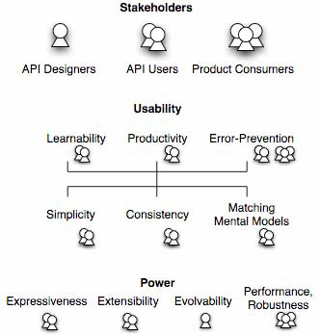
Quality attributes of APIs
Ref: Stylos PhD thesis or Stylos Design Dimensions paper
Attributes affect different stakeholders
Tradeoffs

Slide 6
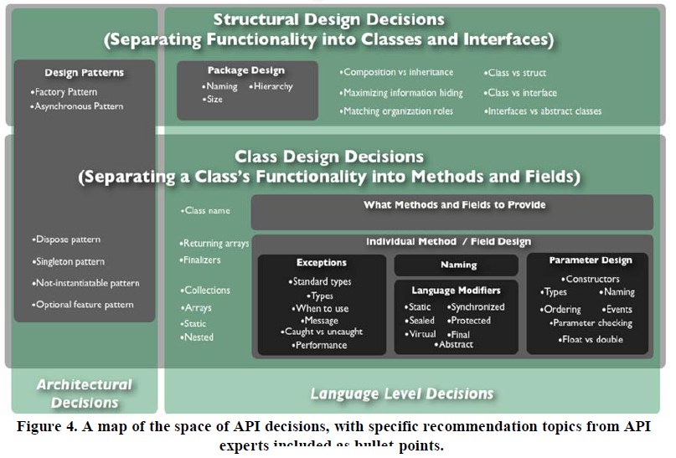
API Design Decisions

Slide 7
Steven Clarke’s card-sort study
Steven Clarke. (2011). How usable are your APIs? In Making Software: What really works and why we believe it, Andy Oram and Greg Wilson (eds), 545 - 565.
Wrote functionality for APIs on cards, asked developers to sort into classes
Result: no agreement among sortings
Lesson: usability is not about the API as a whole
Developers rarely need to deal with the overall “architecture” of an API
Not an issue of “scale”
Question is: how does the API work for a particular task
Supported by Stylos study
Number of methods in a class does not correlate with complexity, but rather is the guessability of the name and where the methods are

Slide 8
Study of Visual Basic .Net
8 experienced Visual Basic 6 programmers all failed to be able use Visual Basic .Net
Classic Usability techniques: video analysis, highlight tapes to design team, (blame the user, blame the documentation)
Used cognitive dimensions to analyze why it was so difficult
Abstraction level, learning style, working framework, work-step unit, progressive evaluation, premature commitment, penetrability, elaboration, viscosity, consistency, role expressiveness, domain correspondence
E.g., StreamWriter, StreamReader instead of FileObject

Slide 9
“Personas” of Developers
Opportunistic Developers
Rapid experimentation, task-focused
Prefer APIs with aggregate, high-level functions
Pragmatic Developers
Code-focused approach, used tools that helped focus on robustness and correctness of code
Systematic Developers
Defensive approach, want deep understanding before start working with it
Prefer low-level, primitive functions
Very different needs in APIs, and documentation

Slide 10
Stylos and Clarke’s Required Parameters in Constructors
[Stylos & Clarke, ICSE’07]
Compared create-set-call (default constructor)
var foo = new FooClass();
foo.Bar = barValue;
foo.Use();
vs. required constructors:
var foo = new FooClass(barValue);
foo.Use();
Tried to recruit Opportunistic (VB), Pragmatic (C#) and Systematic Developers (C++)
Task 1: write the code in NotePad – elicited expectations
Task 2 & 3: Use VS to create real code
Different versions of File, Mail and Generic APIs (with and without required parameters) – real File class as no default constructors
Task 4: Debug: bug is wrong value to the constructor
Task 5: Programmers choose which constructor to use
Task 6: reading code

Slide 11
Results:
All informal – no measures were evaluated
All participants assumed there would be a default constructor
opportunistic and pragmatic would assume syntax error for compiler messages
Required constructors interfered with learning
Want to experiment with what kind of object to use first
Did not insure valid objects – passed in null
Preferred to not use temporary variables
No effect on debugging or reading
Optional extra constructors were useful

Slide 12
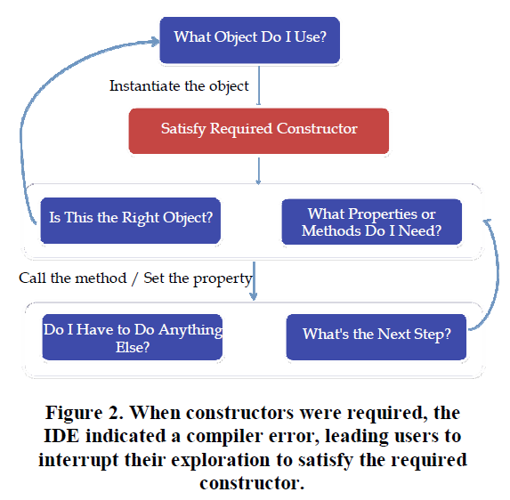
Results, cont: Model of Behavior

Slide 13
“Factory” Pattern
Ref: [Ellis 2007]
Instead of “normal” creation: Widget w = new Widget();
Objects must be created by another class: AbstractFactory f = AbstractFactory.getDefault(); Widget w = f.createWidget();
Also, factory method: Widget w = Widget.create();
Used frequently in Java (>61) and .Net (>13) and SAP
Designed to get both descriptive and numeric results
Within subject and between subject measures
Lab study with expert Java programmers
Five programming and debugging tasks
1: Notepad design of Email API
2: Use email API – only factory pattern constructors
3: “Thingy” – with 2 subclasses, one with and one without
4. Debug task – between subjects
5. Use (almost) real Sockets

Slide 14
Results
Notepad: no one designed a factory
When no constructor, tried anyway, and even tried creating a subclass
Time to develop using factories took 2.1 to 5.3 times longer compared to regular constructors (20:05 v 9:31, 7:10 v 1:20)
All subjects had difficulties getting using factories in APIs
Implications
Avoid the factory pattern in APIs
Documentation and tools can help developers find factories

Slide 15
Object Method Placement
Ref: [Stylos FSE, 2008]
Where to put functions when doing object-oriented design of APIs
mail_Server.send( mail_Message ) vs. mail_Message.send( mail_Server )
Similar study design to previous
When desired method is on the class that they start with, users were between 2.4 and 11.2 times faster (p < 0.05)
Starting class can be predicted based on user’s tasks

Slide 16

Study of APIs for eSOA
Ref: [Beaton, VL/HCC’08]
Sponsored by SAP
Study APIs for Enterprise Service-Oriented Architectures (“Web Services”)
Client-server architecture
organized into services using
XML to communicate
Enormously complex
Requires significant flexibility and customizability
Server
Services
WSDL
XML
XML
Client
Stub Code

Slide 17
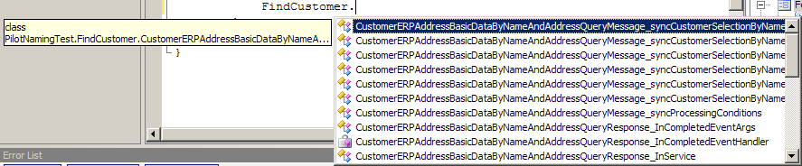
eSOA Studies Results
“Stub generators” that connect code to XML introduce complexities
No sample code since multiple targets
Naming problems:
Too long
Not understandable
Differences in middle are frequently missed
CustomerAddressBasicDataByNameAndAddressRequestMessageCustomerSelectionCommonName
CustomerAddressBasicDataByNameAndAddressResponseMessageCustomerSelectionCommonName

Slide 18
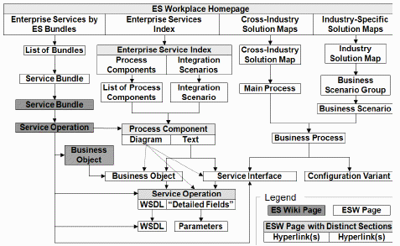
Diagram of Documentation
We made this diagram to understand doc.

Slide 19
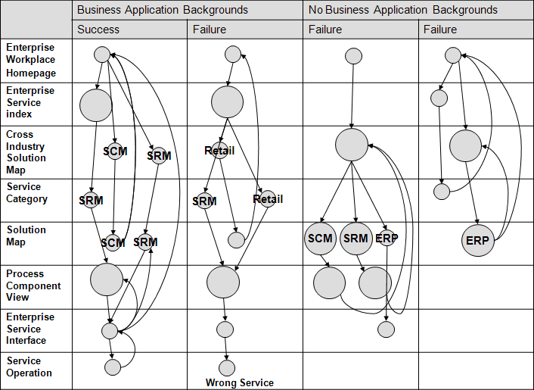
eSOA Documentation Results
Ref: [Jeong, IS-EUD 2009]
Multiple paths: unclear which one to use
Some paths were dead ends
Inconsistent look and feel caused immediate abandonment of paths
Hard to find required info.
Business background helped

Slide 20
Another SAP study
[Ref: Stylos, VL/HCC’08]
Jeff Stylos studied SAP “Business Rules Framework Plus” API (BRFplus) as an intern in Walldorf, in summer 2007
Business rules allow EUD to specify behaviors, such as how tax is computed
Identified customers’ real needs
Found mismatch of abstraction level
Designed wrapper API
Dramatically better success than original

Slide 21
Robillard API Learning Studies [2009]
Obstacles at Microsoft to learning APIs
Surveys and in-person interviews of 440 developers
Exploratory survey, qualitative interviews, follow-up survey
Found mostly documentation problems
Documentation of intent
How supposed to be used; why designed a particular way
Code examples needed, but must be right size = 1 task
Matching APIs with scenarios (developer’s tasks)
Penetrability of the API – about internal workings; performance
Format and presentation – too thorough when obvious
Also, API structure & naming itself

Slide 22
Tools to Help with API Understanding – Documentation and IDE

Slide 23

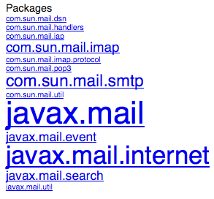
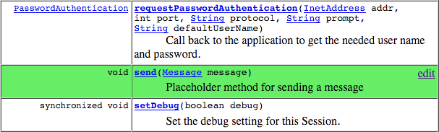
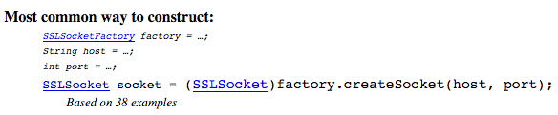

Jadeite
Ref: [Stylos, VL/HCC’09]
Jadeite: Java API Documentation with Extra Information Tacked-on for Emphasis
http://www.cs.cmu.edu/~jadeite
Fix JavaDoc to help address these problems
Focus attention on most popular packages and classes using font size
“Placeholders” for methods that users want to exist
Automatically extracted code examples for way to create classes and related classes
Improved performance by factor of 3

Slide 24
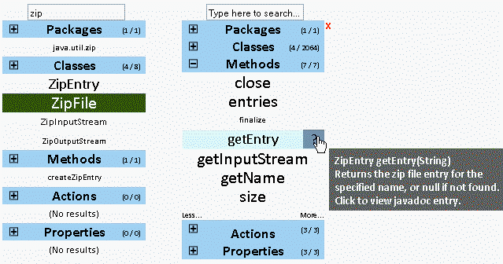
Apatite Documentation Tool
Ref: [Eisenberg, VL/HCC’10]
Apatite: Associative Perusing of APIs That Identifies Targets Easily
http://www.cs.cmu.edu/~apatite
Start with verbs (actions) and properties and find what classes implement them
Find things associated with other things
E.g., classes that are often used together
Classes that implement or are used by a method

Slide 25
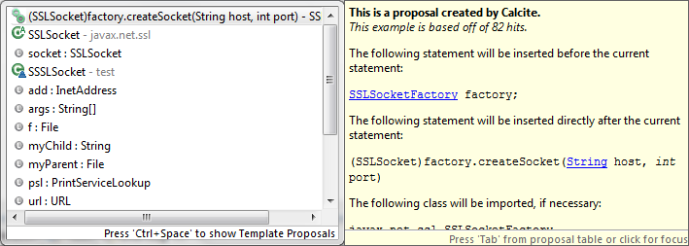
Calcite: Eclipse Plugin
Ref: [Mooty, VL/HCC’10]
Calcite: Construction And Language Completion Integrated Throughout
http://www.cs.cmu.edu/~calcite
Code completion in Eclipse augmented with Jadeite’s information
How to create objects of specific classes SSLSocket s = ???

Slide 26
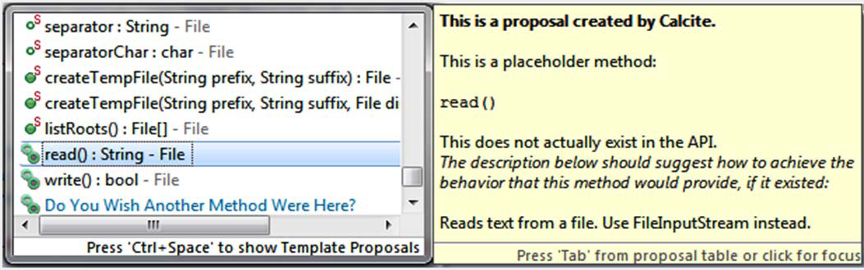
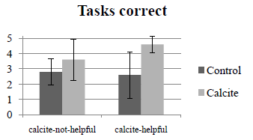
Calcite, cont.
Also for placeholders
Study
improved users’ success rate by 40%
Didn’t hurt when not helpful

Slide 27
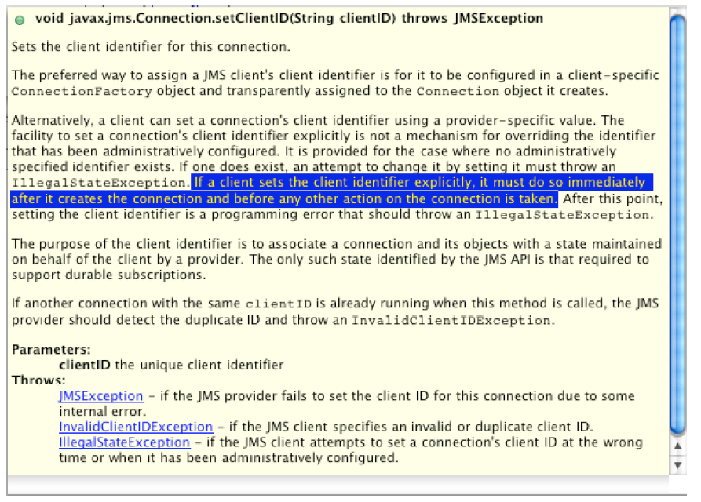
Uri Dekel’s eMoose [ICSE’09]
Pushes directives (rules or caveats) to users
E.g., setClientId must be called first
Often are requirements of protocols
Also restrictions on parameters, locking, alternatives, limitations, side effects, performance, security, etc.
He hand-tagged “several thousand” directives

Slide 28
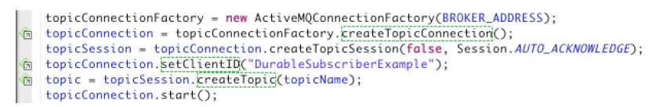
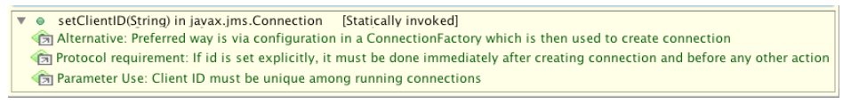
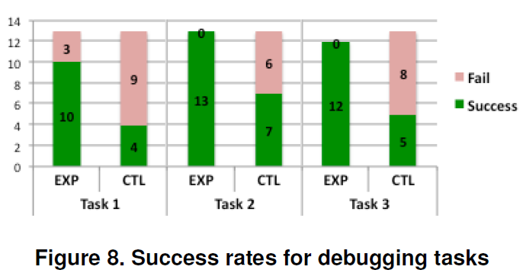
eMoose, cont.
Eclipse plug-in provides icon and tooltip when methods encountered
User study: debugging and writing code where directives would help
eMoose users much more successful

Slide 29
CodeTrail
Ref: [Goldman & Miller, VL/HCC 2008]
Collected field data using a recorder of four programmer’s Eclipse and Firefox use for 1-3 weeks
Found 646 development-related web pages
Reports a taxonomy of uses of web pages
Connect Firefox browsing of documentation of APIs while in Eclipse
Connects various sites as the documentation for methods
Bookmarks between code and documentation
Automatically changes peripheral views

Slide 30
Future Work
Many open issues in API usability
Controversial design issues discussed in forums:
Java Exceptions: Whether to use checked versus unchecked exceptions.
Returning null versus throwing an exception.
Returning null versus returning an empty object (i.e., an empty string).
Returning error codes versus throwing exceptions.
Naming: using “Hungarian” notation.
Naming: using namespaces to disambiguate name collisions.
Naming: how to name an updated version of an old class or method.

