Slide 1



05-899D: Human Aspects of Software Development (HASD).
Introduction
Brad Myers
Human Computer Interaction Institute (HCII)
Thomas LaToza
Institute for Software Research (ISR)
School of Computer Science
Carnegie Mellon University
Spring, 2011
Copyright © 2011 – Brad Myers

Slide 2
Course:
Time: Tuesdays and Thursdays
12:00noon – 1:20pm
Room: NSH 3002

Slide 3

Instructors
Brad Myers
  Human Computer Interaction Institute
  Office: Newell-Simon Hall (NSH) 3517
  Phone: x8-5150
  E-mail: bam@cs.cmu.edu
  http://www.cs.cmu.edu/~bam
  Office hours: By appointment.
Secretary: Brandy Renduels,
  NSH 3526A
  x8-7099

Slide 4

Instructors
Thomas LaToza
  Institute for Software Research
  Office: NWean 4130
  Phone: x8-5150
  E-mail: tlatoza@cs.cmu.edu
  http://www.cs.cmu.edu/~tlatoza/
  Office hours: By appointment.

Slide 5
Course Web page:
Course Web page:
http://www.cs.cmu.edu/~bam/uicourse/2011hasd/
  Link to GoogleDocs of Topics
  Also, the schedule of classes, lecture topics, vacations and conflicts
    http://www.cs.cmu.edu/~bam/uicourse/2011hasd/schedule.html
    To be filled in
    Let me know when you are out-of-town

Slide 6
Course Scope
Treating software developers as people
  Primarily focus on individual development (rather than processes for groups)
  Primarily focus on development activities (vs. planning, requirements analysis, etc.)
Key aspects:
  Studies of programmers
  Tools to help programmers
  Evaluating those tools
Focus on research
  Seminar course

Slide 7
Goals
Cover the major topics in HASD
Give each student a strong understanding and experience with the HCI techniques relevant to studying software development activities and to validating software development tools
Develop a high-quality, well-organized survey of the field
  Topic list
  Organized and comprehensive reading list
  Key articles that all (?) researchers should be familiar with for each topic

Slide 8
Homeworks
(Try to achieve those goals)
Each student will study and present two (2) topics in depth
  Read the literature we selected
  Find additional important literature we missed
  Identify the one or two key articles for the class to read
    At least 1 week before your scheduled presentation date
  Update the reading list accordingly
  Prepare an 80 minute overview of the area including slides (e.g., PowerPoint or Keynotes)
  See overall list of topics on GoogleDocs, & vote:
    If there are topics missing
    Which topics you want to have included in the course (pick 15)
    Which topics you personally would want to present (rank your top 4 choices)
    Enter your votes here: http://www.surveymonkey.com/s/TVSTMD7

Slide 9
Homeworks: Projects
Form groups of two or three people
  Preferably 3 people
Each group will do 3 projects, plus a planning document (see more details on web page)
  1. Project plan document: Due: Tuesday, February 1
    Group members
    What 3 projects will do
    Background literature review
    About 5 single spaced pages
  2: Study of Existing Practice: Due: Tuesday, March 1
    Study of how programmers perform some existing practice, or some existing problem that programmers have.
    CI, Field Study, Survey
    Report, presentation in class

Slide 10
Homeworks: Projects, cont.
  3: Prototype of a New Tool: Due: Tues, April 5
    A new tool or language, for example an Eclipse plug-in or a stand-alone tool, that aims to help with some aspect of programming.
    Working prototype, a video of your demonstration of it working, a short written report, presentation in class
  4. Lab study comparing two versions: Due: Thurs, April 28
    A lab study comparing (at least) two versions, or two different systems
    E.g., comparing your system against current techniques
    Final report, presentation

Slide 11
Grading
In-class Lecture 1 | 15%
In-class Lecture 2 | 15%
Planning document | 10%
Study of Existing Practice | 20%
Prototype | 20%
Lab study | 15%
In-class participation | 5%
Total | 100%

Slide 12
Definitions
(adapted from: Brad’s talk at IBM Almaden's "New Paradigms for Using Computers" Workshop on The Future of Design and Software Development (NPUC'2009), July 9, 2009, San Jose, CA, "End-User Design and Development". video of the talk, or another video of the talk)
“Program”
  ‘‘A set of statements that can be submitted as a unit to some computer system and used to direct the behavior of that system’’
  – Oxford Dictionary of Computing
“Programming”
  ‘‘The process of transforming a mental plan of desired actions for a computer into a representation that can be understood by the computer’’ – Jean-Michel Hoc and Anh Nguyen-Xuan
Notes:
Ref: Hoc, J.-M. and Nguyen-Xuan, A., “Language Semantics, Mental Models and Analogy,” in Psychology of Programming, J.-M. Hoc, et al., Editors. 1990, Academic Press. London. pp. 139-156.

Slide 13
Definitions, cont.
“Professional Programmer”
  Someone whose primary job function is to write or maintain software
  Typically have significant training in programming (e.g., BS in CS)
“Novice Programmer”
  Someone who is learning to be a professional programmer

Slide 14
Definitions, cont.
“End-User Programmer” (EUP)
  People who write programs, but not as their primary job function
  Instead, they must write programs in support of achieving their main goal, which is something else
  Covers a wide range of programming expertise
    Business executives and secretaries
    Physicists

Slide 15

Definitions, cont.
“Design”
  Deciding things about the program
  What to program
    “Getting the right design” – Buxton
  How the program will work
    Architecture, algorithms
  User interface from the program
    “Getting the design right” – Buxton
Notes:
Buxton, B., Sketching User Experiences: Getting the Design Right and the Right Design. 2007, San Francisco, CA: Morgan Kaufmann.

Slide 16

Definitions, cont.
“Development”
  All programmer activities involved in software (except use)
  Includes design, programming (coding), testing, documentation, etc.
Software Engineering
  Development + Requirements Analysis + processes
“End-User Development” (EUD)
  End users doing any of these activities themselves
Europeans prefer “End-User Development” (EUD)
  As in European Commission’s (2002-3)

Slide 17
Definitions, cont.
Developer
  Person doing the development activities for the system
End-User
  Person using a system created by a developer
    Note that this becomes confusing in tool papers since a developer is an end-user of a development tool, like an IDE.
      Need to be clear about who being talked about
Human Aspects of Software Development
  All the parts of development that affect the developer
  Not the parts that affect the end user

Slide 18
Definitions, cont.
Domain-Specific Languages (DSL)
  Programming languages designed for a particular audience
Visual Programming
  Programming using graphics
  2D layout is significant (beyond indentation)
Programming-by-Example (PBE), Programming-by-Demonstration (PBD)
  Developer gives examples on which program runs as part of the development process
  Often, PBE system tries to generate some of the code by generalizing the example
Interface Builders
  Draw the layout of static parts of a user interface, and code is generated to create that layout at run-time
Node
Bigger Node

Slide 19
Definitions, cont.
IDE = Interactive Development Environment
  Code editor that also helps with debugging
  May also include an interface builder, etc.
  Examples: Eclipse, Visual Studio, Flash Professional
API = Application Programming Interface
  Any library, toolkit, framework, software development kit (SDK), etc.
  A body of code providing reusable functionality that is intended to be used without looking inside at the internal implementation
… any many other terms to follow

Slide 20
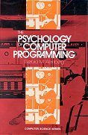


Historical Context
Long History of study with other names
  Original HCI!
    1973 “Psychology of Programming” (PoP)
  “Software Psychology”
    Ben Shneiderman book, 1980
  “Empirical Studies of Programming” (ESP)
    Workshops from 1986 through 1999
  “Psychology of Programming”
    Psychology of Programming Interest Group (PPIG)
      from 1987 and PPIG’10 = 22th workshop
  “Empirical Software Engineering”
Much of the early CSCW research as well
  Computer-Supported Cooperative Work

Slide 21
Why Study This Area?
Human aspects are important for research and development about software
  Field studies of programmers reveal interesting new areas for tool research and development
    Can focus research on important problems
    Design from Data about real problems, barriers, opportunities
  Following HCI methods will result in better quality tools
    More usable, effective, etc.
  Software Engineering tools and methods often benefit from valid evaluation with people
    Need real evidence to answer questions about what is better/faster/easier
    Often demanded by reviewers
    Relevant to any claims of better/faster/easier for people
    There are valid evaluation criteria beyond “Taste”, “Intuition”, “My experience”, “just the same as old languages”, anecdotes
  The whole area of “empirical software engineering”?
Notes:
Thomas: 21 - You've often mentioned that most early evaluations of HCI systems
did not show any significant benefits. Could use this to motivate why
really understanding the problem is importnat to figure out what the
problem really is. The Contextual Design book also has a whole chapter
or two on why designing from data about what users is doing is a good
idea. And a real example or two of how this has worked in our research
could also be useful. We've identified strategies developers use
(asking why questions, searching across control flow paths, how
developers reuse APIs...) and problems that make this hard. And
identifying these directly leads to ideas for tools to help solve
these problems. So identifying the strategies can often directly lead
to novel ideas for tools.

Slide 22
Why Study This Area, cont.
Human aspects are important for research and development about software, cont.
  Large number of programmers are EUPs - [Scaffidi, Shaw and Myers 2005]
    90 million computer users at work in US
    55 million will use spreadsheets or databases at work (and therefore may potentially program)
    13 million will describe themselves as programmers
    3 million professional programmers

Slide 23
Why Study This Area, cont.
Software development is an interesting focus area for HCI
  Software development is one of the most difficult tasks humans can do with a computer
    How can it be made easier?
  Studies of learning to program are relevant to learning other complex tasks
  Many challenging problems translate to other skilled tasks
    E.g., Fogarty’s study of interruptions
  Many complex UIs are actually EUP
    Setting programs on a VCR, authoring for the web, etc.
  Gender issues: getting more people interested in computing
  Easy to find subjects for studies ☺
Notes:
Thomas:
23 - Judy Olson had a CHI talk with grand challenges for the future of
HCI. Several of these were relevant to SE - doing HCI for professional
with domain expertise, supporting tasks that last long periods of
time. So devising better HCI techniques to study such SE problems
could also contribute to HCI. Could also make the traditional business
argument - lots of developers, much of the cost of technology is in
software, many of the problems in technology are software problems,
etc. And could maybe have a separate slide on novice and EUSE and why
these are important. Novices are important because related to issues
of convincing people to study CS - the whole Alice getting people to
like programming story. And can give a EUSE motivation slide - there's
lots of them that do all sorts of stuff (Chris' study).

Slide 24
Why is Development Difficult?
Some difficulty may be intrinsic to programming
  Problem solving
  Precise specification of algorithms
  Concepts like abstraction, recursion
How much difficulty can be attributed to usability problems?
  Programming languages, IDEs, APIs are all user interfaces
  Most designs do not emphasize (or even consider!) usability

Slide 25
Unnecessary (?) Complexity
class HelloWorldApp {
public static void main(String[] args) {
System.out.println("Hello World!");
}
}
3 kinds of parentheses and 9 special words!
Compared to click and type: “Hello World!”
Notes:
Java

Slide 26
Goal: Gentle Slope Systems
Java
Visual Basic
Flash
HyperCard
Swing
Backend
Programming
C# Programming
Difficulty
of
Use
xCmds
ActionScript
HyperTalk
Goal
Low
Threshold
Basic
Email
Filters
High
Ceiling
Program Complexity and Sophistication
Notes:
Originally appeared in:
Myers, B.A., Smith, D.C., and Horn, B. “Report of the `End-User Programming' Working Group,” in Languages for Developing User Interfaces. 1992. Boston, MA: Jones and Bartlett. pp. 343-366.

Slide 27
Allen Newell and Stuart Card, 1985:
“Millions for compilers but hardly a penny for understanding human programming language use. Now, programming languages are obviously symmetrical, the computer on one side, the programmer on the other. In an appropriate science of computer languages, one would expect that half the effort would be on the computer side, understanding how to translate the languages into executable form, and half on the human side, understanding how to design languages that are easy or productive to use.... The human and computer parts of programming languages have developed in radical asymmetry.”
Notes:
[Newell, A. and S. K. Card (1985). "The Prospects for Psychological Science in Human-Computer Interaction." Human-Computer Interaction. 1(3): 209-242].

Slide 28
Criteria for Topics
Topics in Software Development that have a human aspect
  Not general HCI
  Not algorithms for Software Engineering
  Not language design issues devoid of human studies
Must have at least 10 papers in the area to be “important enough” to be a top-level topic
  If lots of papers, then we tried to pick influential ones
Usually has a user study, either an exploratory or evaluation study

Slide 29
Topics
Meta topics:
  Why is software development difficult for people in general? (see above)
  HCI Techniques relevant to Software Development
    And how to perform those techniques correctly (next 2 lectures)
  What it means to do good research in this area
  Where to look for research in this area?
Notes:
Add slides on each meta topic ****

Slide 30
  What it means to do good research in this area
Contextual inquiry or lab study to discover an interesting issue that has not previously been known
Survey to validate that is actually widespread
A model that represents and generalizes what is happening
Tool developed that embodies interesting technical contributions and addresses the problems
Lab study of the tool, compared to the way it is done now, that shows dramatic improvements

Slide 31
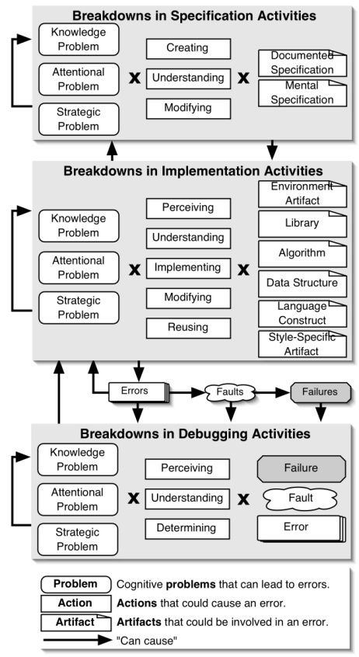
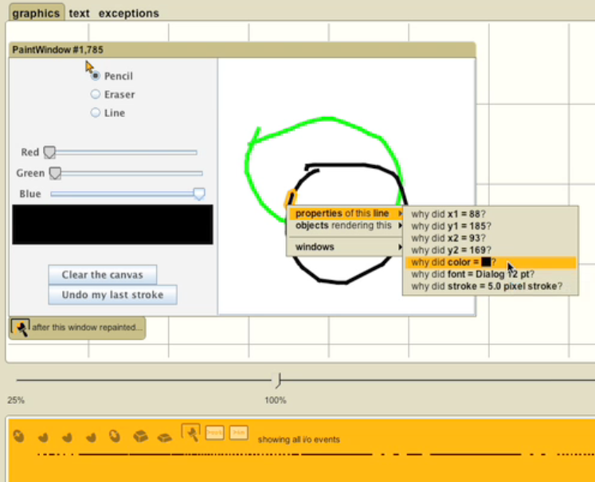
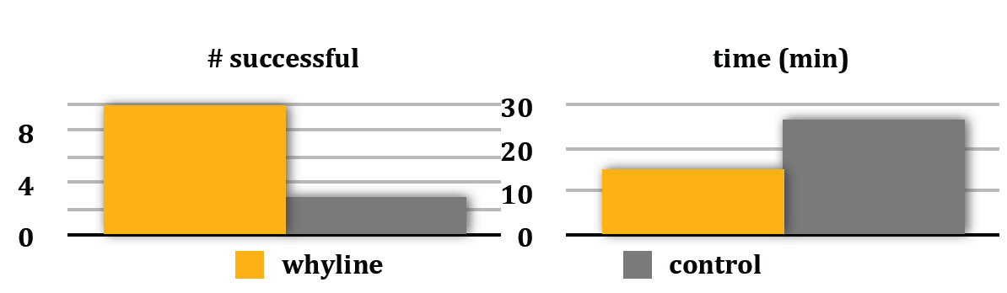
Example 1: WhyLine
Andy Ko’s PhD thesis
Field studies of beginning programmers and identified barriers, including debugging [Ko, VL’04]
Lab study of people doing maintenance tasks with Java [Ko, ICSE’05 – Winner best paper]
WhyLine tool for Alice, then
Java [Ko, ICSE’08 –
Winner best paper]
User study of Java Tool
[Ko, CHI’09]

Slide 32
Example 2: Reacher
PhD work of Thomas LaToza

Slide 33
  Where to look for research in this area?
Lots of conferences and journals will publish this work
  PPIG primarily focused on this topic
    Get on the mailing list! www.ppig.org
  VL/HCC (!!)
  Some at: ICSE, CHI, FSE, UIST, CSCW, TSE, TOSEM, ICSM, ICPC, JVLC, Journal of Systems & Software
  Workshops:
    CHASE at ICSE
    PLATEAU at Splash (OOPSLA)

Slide 34
Meta-Issue: Organization
Lots of ways to organize this area:
  By HCI method: field study, tool development, lab study
  By types of developers targeted: novice, EUP, professional
  By paradigm: OO, functional, textual, PBE, spreadsheets, VP, …
  By activity: understanding, design, coding, test, debugging, etc.
  By research group/person: our Natural Programming results, Gail Murphy’s group, Rob Deline’s at MSR, Scott Klemmer’s group (“opportunistic” programming), …
Our list on GoogleDocs

