Slide 1
Lecture 13:
Other HCI Methods
Brad Myers
05-863 / 08-763 / 46-863: Introduction to
Human Computer Interaction for
Technology Executives
Fall, 2015, Mini 2

Slide 2
Logistics
Exam information:
  Thursday, Dec 17 at 8:30am, in Hamerschlag Hall room B103
  Monday, Dec. 21 at 2:00pm, in room Tepper 152
  Anyone can go to either
  See: http://www.cs.cmu.edu/~bam/uicourse/08763fall15/homework.html#7
Final date for late homeworks: TODAY
Wednesday, December 16, 2015
Please fill out questionnaires:
  https://cmu.smartevals.com or Tepper equivalent
  https://www.surveymonkey.com/r/08763fall15

Slide 3
Some Usability Methods
Contextual Inquiry
Contextual Analysis (Design)
Paper Prototypes
Low-Fidelity Prototypes
Think-aloud protocols
Heuristic Evaluation
Affinity diagrams (WAAD)
Personas
Wizard of Oz
Task analysis
Questionnaires
Cultural Probes
Diary studies
Card sorting
Body storming
KLM and GOMS (CogTool)
“Speed Dating”
Cognitive Walkthrough
Cognitive Dimensions
Video prototyping
Expert interviews
Surveys
Interaction Relabeling
Log analysis
Focus groups
Improvisation
Use cases
Scenarios
A vs. B studies
…
(6)
(5)
(8)
Notes:
Green- homeworks
Blue – in the Textbook and lectures
Red – covered today and in other lectures
Black – more useful methods

Slide 4
Other Methods
Other methods I have used:
  Cognitive Walkthroughs, Cognitive Dimensions
Taught to the HCI Masters students:
  Cultural Probes & Diary Studies, Card Sorting, "Bodystorming", Keystroke Model & GOMS, "Speed Dating”
Design methods vs. evaluation methods
  When are they useful?
  What kind of information is produced?

Slide 5
Design Methods
Use along side of CIs to find out more about your users, domains, etc.
  Also called generative methods – generate data & designs; also “formative” methods – help form the system
Many focused more on “feelings” and less on tasks and work
  Culture, aesthetics, etc.
Others get at rare and intermittent occurrences
Design methods:
  Cultural Probes & Diary Studies
  Card Sorting
  Bodystorming

Slide 6
“Cultural Probes”
Bill Gaver, Tony Dunne, & E Pacenti, Design: Cultural Probes, ACM Interactions. vol. 6, no. 1, 1999, pp. 21-29
Goal – learn more about the users’ culture and feelings
  capture general attitudes and social trends
Give users a variety of recording devices (paper, maps, postcards, disposable cameras, audio-recorders) that they keep for a while
Users are asked to record various aspects of their lives
Examples:
  On postcards: “Please tell us a piece of advice or insight that has been important to you.”; “Tell us about your favorite device.”
  On a map: “Where would you like to go, but can’t”
  On a camera: “Please take pictures of: Your home; Something desirable; Something boring; whatever you want to show us”
Looking for “Inspiration, not Information”
  Beliefs and desires, aesthetic preferences, and cultural concerns
Game-like & fun, but also respectful & interactive
Video (6:23)

Slide 7
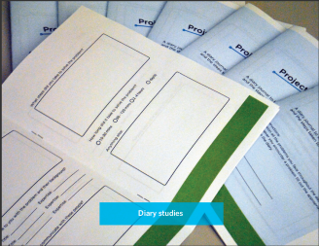
Diary Studies
A variation on Cultural Probes
Give users a diary and ask them to write about relevant events
  E.g., each time they have a problem with the system
  E.g., whenever a rare event happens, write about aspects of it
Good for rare events that users
might not remembers the details
of afterwards
  Must happen when users can take
  the time to write down

Slide 8
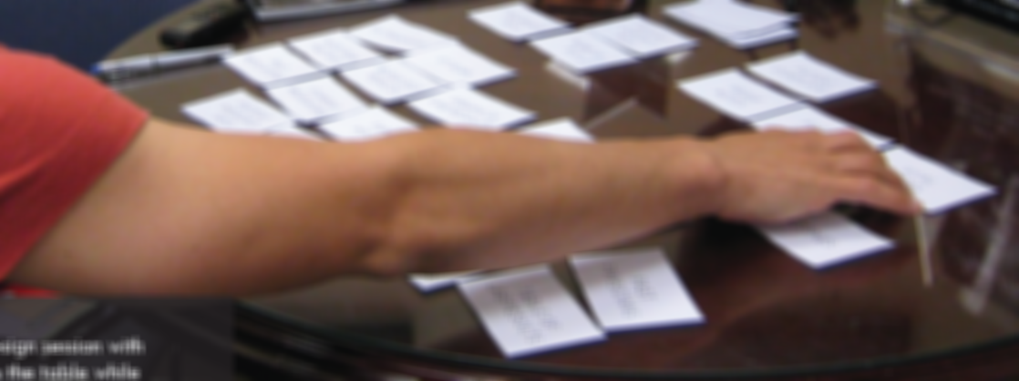
Card Sorting
Write important concepts on cards
Get users to help organize them
Hartson-Pyla text says same as Affinity Diagrams, but not necessarily
Can find out:
  What concepts go together? Groupings?
  What is a reasonable hierarchy?
  What would
  be better
  names for
  items? For
  groups?
Video (1:40)

Slide 9
“Bodystorming”
Marion Buchenau and Jane Fulton Suri. 2000. "Experience prototyping." In Proceedings of the 3rd conference on Designing interactive systems: processes, practices, methods, and techniques (DIS '00), pp. 424-433. ACM DL PDF
Term coined by Interval Research ~ for physically-situated brainstorming
Designers pretend to be users, and act out the usage experience
  In context, with as much fidelity as possible
  Discover constraints of the context
  Play different roles in a collaborative situation
Example: buying a ticket at a kiosk
  Now with gloves on, collaborating with another, etc.
Example: radio for use in shower, close eyes

Slide 10
Example from our paper
Kursat Ozenc, Miso Kim, John Zimmerman, Stephen Oney, and Brad Myers. "How to Support Designers in Getting Hold of the Immaterial Material of Software". Proceedings CHI'2010: Human Factors in Computing Systems. Atlanta, GA, April 10-15, 2010. pp. 2513-2522. local pdf
The Radio team provides a good example of gesture through embodiment. In the process of designing the controls, they lay down on the floor, simulating the experience of lying in bed. From this position they sketched different interactions with their body, in one instance conceiving of a control that operates by continuously flipping the bedspread, and in another creating an expression that involved using both hands to wrap a pillow around the ears to communicate a desire for volume change. In all cases, these actions focused on how users might express their intentions to the system.

Slide 11
Evaluation Methods
Use along side or instead of user testing & heuristic analyses
Also called “summative” methods
  To assess or compare the level of usability that has been achieved by the design
Get at different kinds of information
  Maximum expert performance
  How much learning is required?
  What concepts are needed?
Evaluation Methods:
  Human Performance Modeling: KLM & GOMS
  “Speed Dating”
  Cognitive Walkthroughs
  Cognitive Dimensions

Slide 12
Human Performance Modeling
John, B. E. (2003) "Information processing and skilled behavior." Chapter 4 In J. M. Carroll, (Ed.), Toward a multidisciplinary science of human computer interaction. Morgan Kaufman. pp. 55-101. Local CMU-only copy
Hartson & Pyla, section 1.6.5
Goal: Compute measures of human performance without needing to do user tests
Use a “model” of how people work, that has been validated to be reasonably accurate, given certain assumptions
Works well for low-level, expert tasks
  “How long will it take to enter this sequence of commands?”
  Errors (both novice and skilled)
Research on higher-level, problem solving tasks
  Visual search, figure out how to do things, etc.

Slide 13
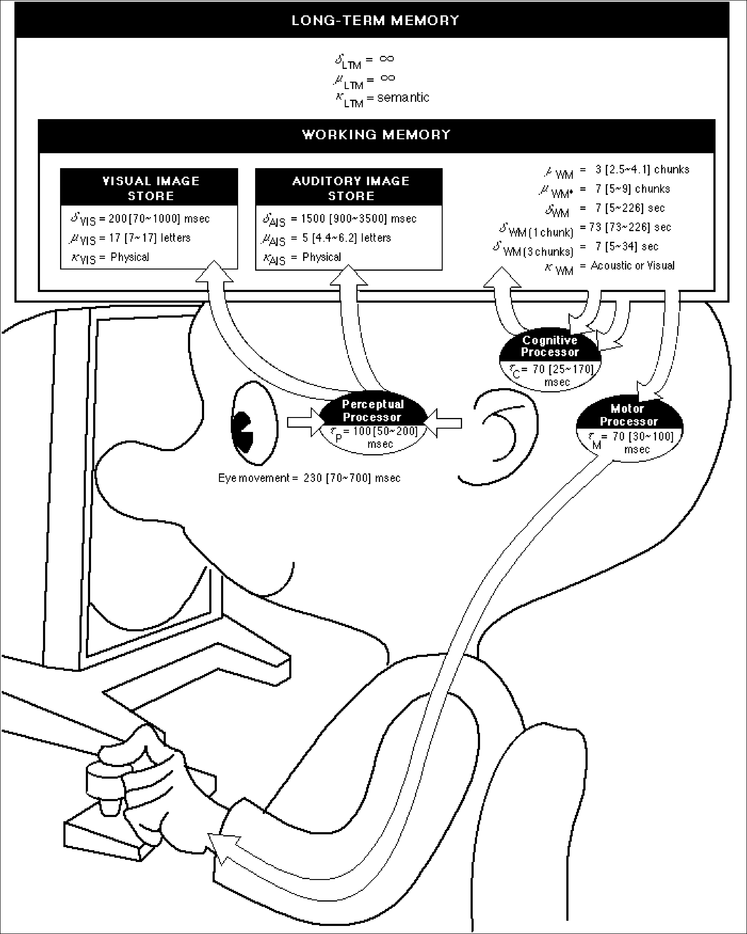
Wouldn’t it be great…
Just point Mr. Bubblehead (the Model Human Processor) at a system, automatically generate performance measures, in context, AND see what’s inside its “mind” and “heart”?
Better yet, point Mr. Bubblehead at design ideas (systems that haven’t been built yet)
Fast, cheap, easy to interpret
Quantitative measures to help persuade

Slide 14
Time
Constants

Slide 15
The simplest model: the Keystroke-Level Model (KLM)
Card. Moran & Newell, 1980, 1983 (CMN)
  Pre-defined level of detail:
  K (keystroke), P (point with mouse), H (home between devices), M (mental operator), R (system response time)
  Procedure for constructing a sequence of operators that perform a task
  Heuristics for placing mental operators
Input:
  A suite of benchmark tasks that are important to your design or evaluation
  A specification of the proposed system
Output:
  A prediction of the time it would take a skilled user to perform the benchmark tasks on the proposed system
  Accurate to within about 20% of observed performance
Appropriate for skilled performance, without problem solving

Slide 16
GOMS models
Goals, Operators, Methods, and Selection rules (GOMS)
  Also originally from Card, Moran, and Newell
  Significant advances by Bonnie John in HCII and others
Multiple strategies (“methods”) possible to do an operation (to reach a “goal”) (e.g., delete a character)
  Each strategy uses a variety of “operators”
  “Selection rules” to pick which method
    E.g., use backspace when previous character, use arrow keys when a few characters away, but use mouse when far away
Write these in a special language (e.g., ACT-R, SOAR) and system predicts how long tasks will take.

Slide 17

CogTool
Bonnie John’s tool to help
with Cognitive Modeling
http://cogtool.hcii.cs.cmu.edu/
Mock-up an interface in a storyboard
  States & transitions between those states
Use interactive widgets on a blank canvas
  Useful as a prototyping tool
Outputs performance predictions

Slide 18
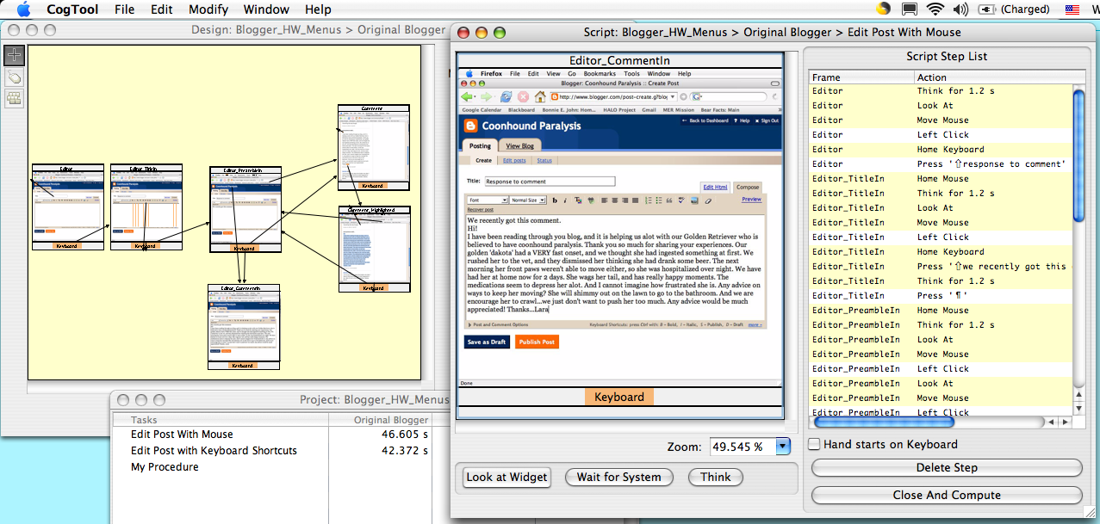
CogTool produces predictions

Slide 19
CogTool produces predictions through demonstrating tasks on a storyboard
1. Mock-up design in a storyboard
3. Predictions appear in a spreadsheet
2. Demonstrate the tasks

Slide 20
Speed Dating
Invented by CMU PhD students & faculty; now widely used
Scott Davidoff, Min Kyung Lee, Anind K. Dey, and John Zimmerman. 2007. Rapidly exploring application design through speed dating. In Proceedings of the 9th international conference on Ubiquitous computing (UbiComp '07), Springer-Verlag, Berlin, Heidelberg, 429-446. pdf
  (Thanks to Prof. Zimmerman for some of these slides)
“Low-cost, rapid comparison of design opportunities and situated applications by creating structured, bounded, serial engagements.”
Usually used with sketches & storyboards of various designs that users can react to
  “Highly-disposable creations to support user enactments”
Users discuss advantages and disadvantages of different designs/approaches
Especially for when no existing product to evaluate
  “Field work in the future”

Slide 21
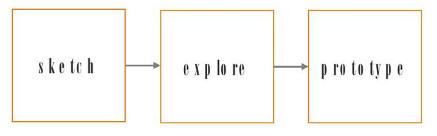
Designer’s hunches
Leverage people’s familiarity with their current experiences in order to:
  infer how they might react to new products
  uncover desires they cannot expressed because they cannot imagine the future
  understand social boundaries
the challenge is to connect them with their
past experience
Insert new step!

Slide 22
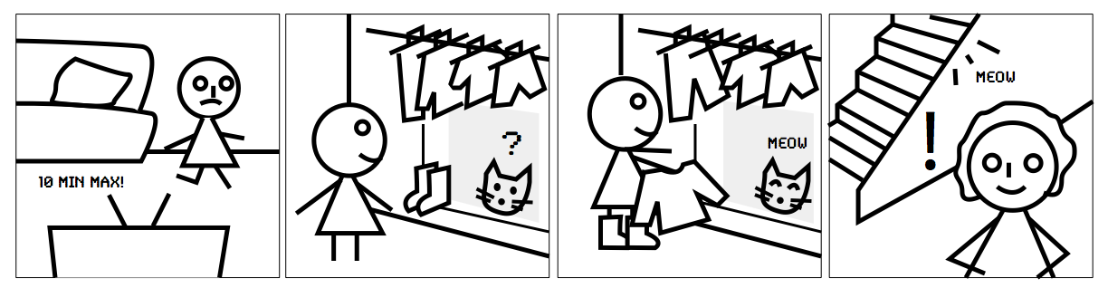
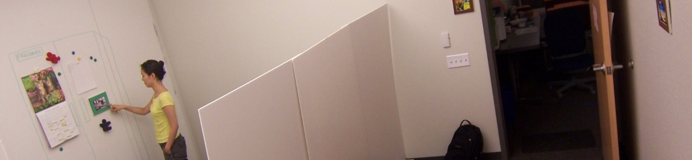
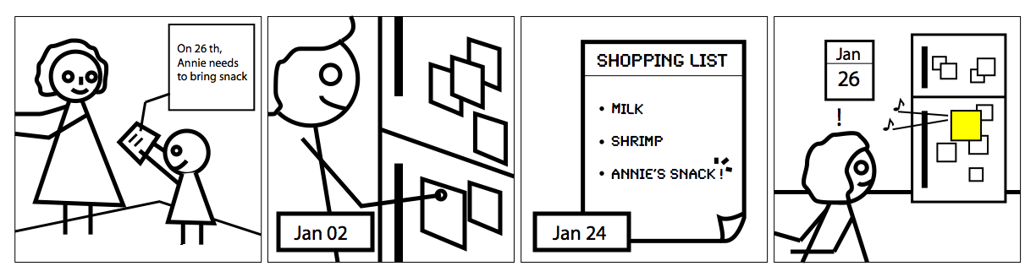
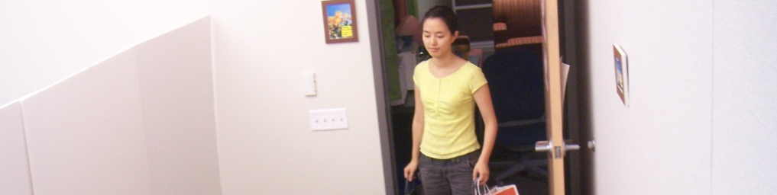
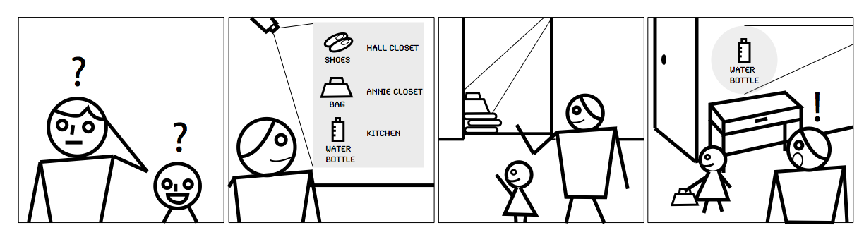
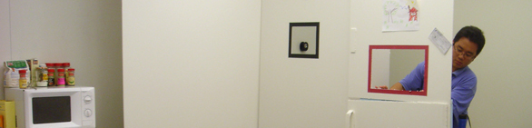
Really Two Methods
validation of needs
user enactments
(like bodystorming for users)
Notes:
changed concept validation to needs validation…because it really is about the need, not the concept

Slide 23
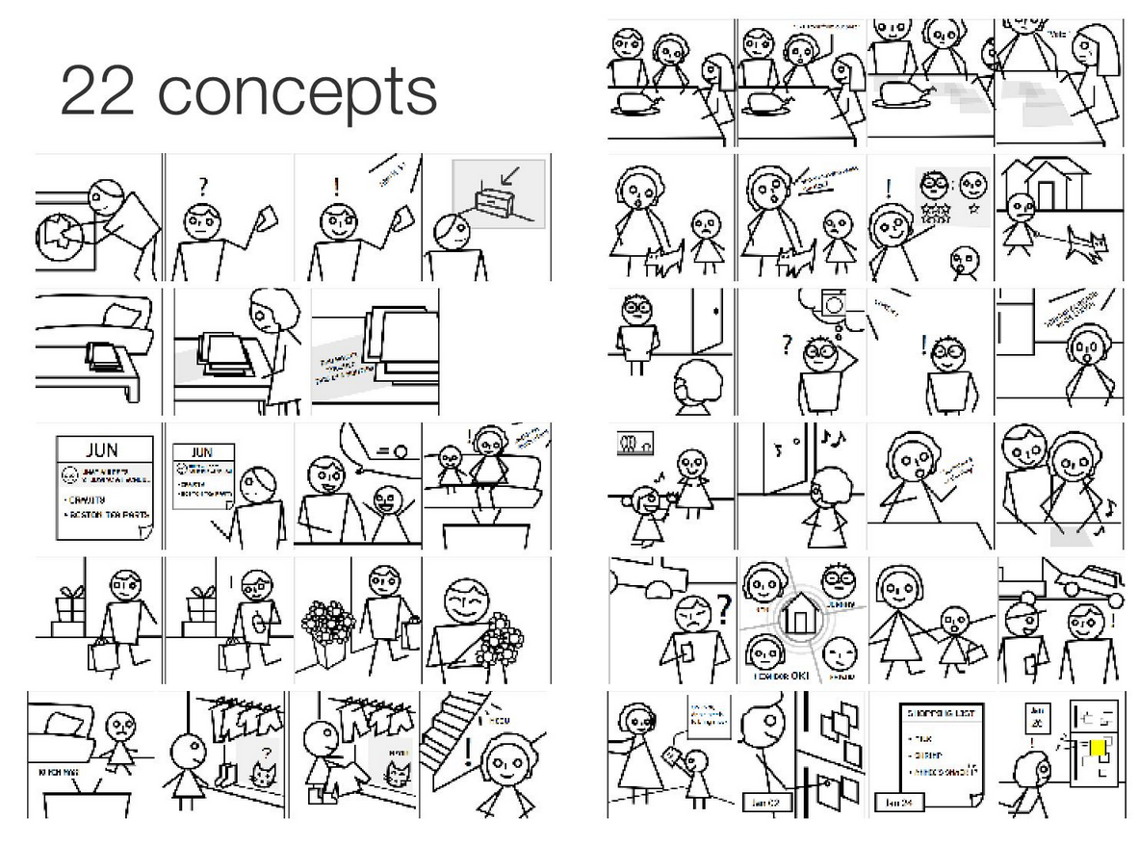
Example: 22 “Smart Home” scenarios

Slide 24
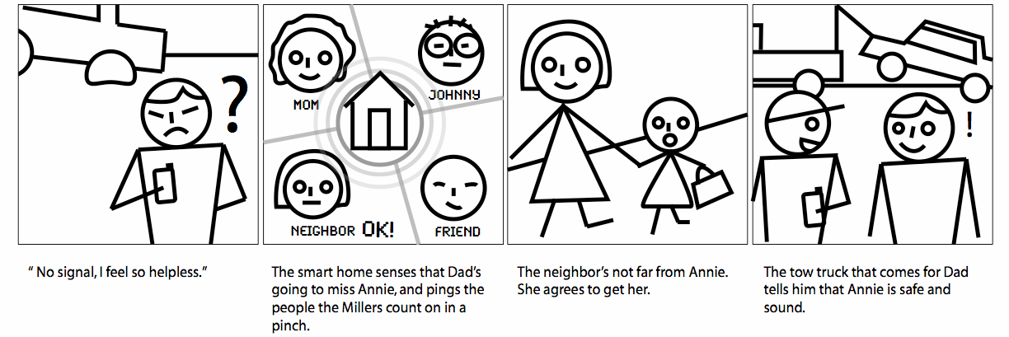
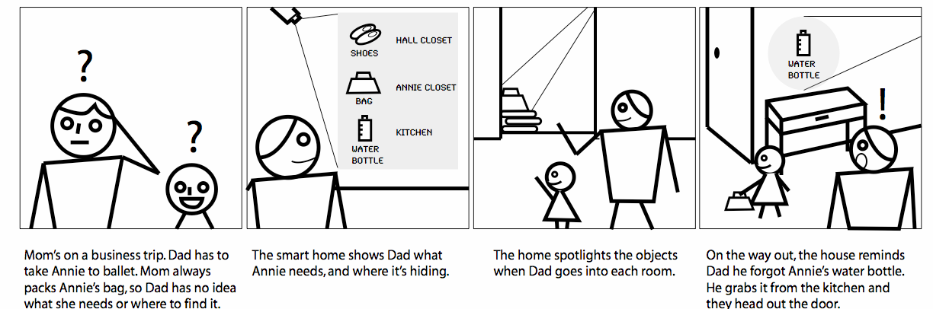
Users pick some that resonate

Slide 25
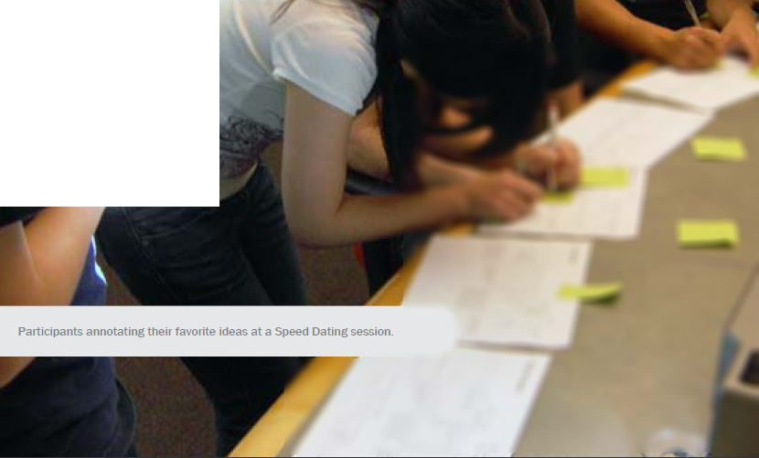
Another Example
From an
M-HCI 2010 report
Each sheet has one scenario
Pass around and annotate

Slide 26
Cognitive Walkthroughs
Clayton Lewis and John Rieman, "4.1. Cognitive Walkthroughs", in Task-Centered User Interface Design; A Practical Introduction (on-line book), 1994. html
Cognitive Walkthroughs: Simulates user problem solving process
  For addressing ease of exploration
  Requires specific tasks
Expert analysis
Determine what knowledge the user would have to have to take each step of the task
  Ask questions at each step
  Will users be trying to produce whatever effect the action has?
  Will users see the control (button, menu, switch, etc.) for the action?
  Once users find the control, will they recognize that it produces the effect they want?
  After the action is taken, will users understand the feedback they get, so they can go on to the next action with confidence?

Slide 27
Cognitive Dimensions
T. R. G. Green and M. Petre. Usability analysis of visual programming environments: A ‘cognitive dimensions’ framework. Journal of Visual Languages and Computing, 7:131—174, 1996. pdf
See also: http://www.cl.cam.ac.uk/~afb21/CognitiveDimensions/
14 heuristics for evaluating usability of programming systems
    Abstraction gradient
    Closeness of mapping
    Consistency
    Diffuseness / terseness
    Error-proneness
    Hard mental operations
    Hidden dependencies
    Juxtaposability
    Premature commitment
    Progressive evaluation
    Role-expressiveness
    Secondary notation and escape from formalism
    Viscosity
    Visibility

Slide 28
#2: Closeness of mapping
Closeness of representation to domain
How much problem solving does the user need to do to map task into the interface
“Programming is the process of transforming a mental plan into one that is compatible with the computer.” — Jean-Michel Hoc

Slide 29
No closeness-of-mapping
class HelloWorldApp {
public static void main(String[] args) {
System.out.println("Hello World!");
}
}
3 kinds of parentheses and 9 special words!
Compared to click and type: “Hello World!” in PowerPoint
Notes:
Java

Slide 30
#7 Hidden Dependencies
Relationship between two components where the dependency is not fully visible
E.g., html links -> no back links
IDEs may (or may not) help with finding uses of a variable, e.g., to change it
Formulas are hidden in spreadsheets, and dependencies on cells is doubly hidden
Dataflow is hidden in regular languages, and control flow is hidden in dataflow languages

Slide 31
#9 Premature commitment
Constraints on the order of doing things force the user to make a decision before the proper information is available.
In C, the need to have procedures in a particular order in the file
Phone menus require you to pick a number before hearing all the options
Alice requires that you know whether you are going to want a control structure before knowing what goes in it

Slide 32
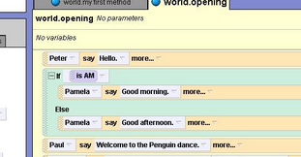
#13 Viscosity
Resistance to change, the cost of making small changes
Low: editing text to change “if” to “for”
High: same edit in Alice
Repetition viscosity:
when difficult due to
need to do it a lot
  E.g., no search/replace
  for graphics (change all to be )

Slide 33
Thank you!

