Slide 1
Lecture 11:
International and Mobile
User Interfaces
Brad Myers
05-863 / 08-763 / 46-863: Introduction to
Human Computer Interaction for
Technology Executives
Fall, 2015, Mini 2

Slide 2

Logistics
Exam information:
  Thursday Dec 17 at 8:30am, in Hamerschlag Hall room B103
  Monday, Dec. 21 at 2:00pm, in room Tepper 152
  Anyone can go to either
  See: http://www.cs.cmu.edu/~bam/uicourse/08763fall15/homework.html#7
Guest lecture on Monday
  David Bishop, Maya Design
  Please attend!
Final date for late homeworks:
Wednesday, December 16, 2015
Today is evaluation day – please fill out questionnaires
  https://cmu.smartevals.com or Tepper equivalent
  https://www.surveymonkey.com/r/08763fall15

Slide 3
Do Evaluations Now
Today is evaluation day – please fill out questionnaires
  https://cmu.smartevals.com or Tepper equivalent
  https://www.surveymonkey.com/r/08763fall15
First few minutes of class will be for you to fill these out!

Slide 4
International User Interfaces

Slide 5
International User Interfaces
Note: These are in addition to all the previous recommendations / guidelines
Used in more than one country
Not just language translation
English versions of products may be used all over the world
Reviews of products may mention international usability issues

Slide 6
Web Sites Accessed World-Wide
Internationalization
  All web sites are globally accessible
  Providing multiple language versions
  Making the English version more accessible
Less than 10% of Internet users in US (cite – live table)
Internationalization
  One design that can be used world-wide
Localization
  Different designs customized to different languages

Slide 7




Icon International Design Issues
Mailbox icons?
No icons with fingers or feet or other gestures
Light switches on or off?
No visual puns
  Table of numbers as:
  (In Danish, use bord and tabel)
No baseball metaphors
Arbitrary icons are even harder
  Red cross for help

Slide 8
Translation Issues
Standard terms for “File”, “Edit”, etc. in each language
  There are probably hundreds of computer words
What about “Viewport”, “Canvas”, “Front”
  Across the industry, and in a company’s other products
  Keep glossaries of words to be used
Often need to know the rationale behind why names were chosen
  E.g. “Find” vs. “Find File” both translated to “Rechercher” in French
Notes:
Scroll bar, clipboard, View, Window, pane
Nudge,

Slide 9
Wording issues
Character Sets
  Supporting extra characters, like ¿ Á ñ æ ç ß Å, and many accents: ć ĉ ċ č ö
  Asian alphabets
  Sort order?
Avoid abbreviations and slang
  “MI” for middle initial
  “N/A” for not available or not applicable
  “Under the hood” for how something works
  “No cows on the ice”
Ask for child’s age not school grade
  Brazil restarts the name for grades at "Primeiro Ano" at ages 15-16
  Japan restarts the name for grades at "Year 1" for ages 12-13 and again at 15-16
  http://en.wikipedia.org/wiki/Educational_stage
Notes:
“No cows on the ice” = no serious difficulties to be overcome (from Nielsen’s text, p. 245

Slide 10
Wording issues, cont.
Holidays can be different
  Mother’s day, Thanksgiving, Independence Day can be at different times
People’s names: “First” name, “Last” name
  Which is which? -- cite
  Also, sometimes, First+Last not very unique
    1/5th of Korean's have "Kim" as their surname.
      Kim, Lee, and Park account for nearly half the surnames in Korea. – cite
    Email address usually globally unique
Paper size issues for printing
  A4 vs. 8.5”x11” vs. ???

Slide 11
Number issues
Paying in international currency
  Currency symbols: $1000 (US, Canada), vs. ¥1000
Weights and sizes and clothing sizes in metric and U.S. units
Billion: thousand million or million million?
Number formats: 4.567 vs. 4,567
  Ask if ambiguous (not “illegal number”)
Time formats: 2:30 pm vs. 14:30; time zones: EDT
Date formats: 10/11/12? use October 11, 2012 instead
  Europeans say “Week 25”
Telephone number formats
  +45 47 17 17 17 vs. (412) 268-5150 vs. 1-412-268-5150
  Allow +, (), -, . etc.
Locations: England is on both sides of 0° Longitude
  US software couldn't deal with negative positions

Slide 12
Localization
Not just translating the interface
  Web sites may have different content
    e.g. German yahoo has “Local (Lokales) ” on front tab, compared to US Yahoo “Autos”, etc.
  Different sizes of language may require redesign
    But automatic layout can help
Indicate content that is not translated
  Bad example: News stories on http://www.kit.edu/study/
When there is a choice of language
  Don’t use flags to indicate language
    US vs. Canada vs. England – example: https://www.discovermongolia.mn/
  Use language’s own name for itself (ENGLISH, ESPAÑOL, )
    See: https://de.yahoo.com/ - flag actually means the country, not the language
  Good place for pictures of text (if fonts aren’t loaded)
First page in default language first so many won’t need extra click
  Make links for other languages easy to find (e.g., www.knto.or.kr/)
  Not: http://thai.tourismthailand.org/home

Slide 13
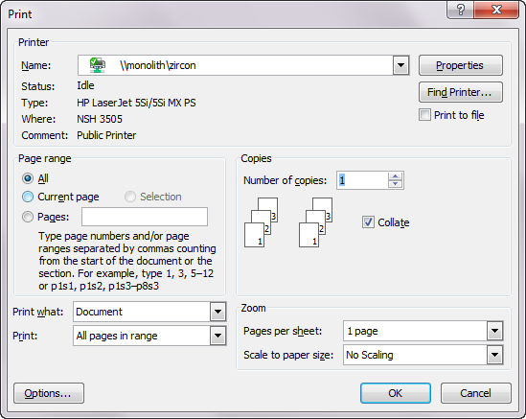
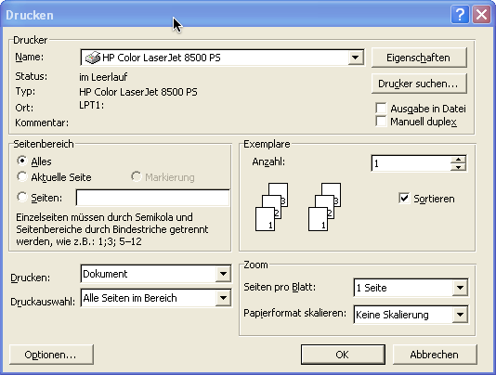
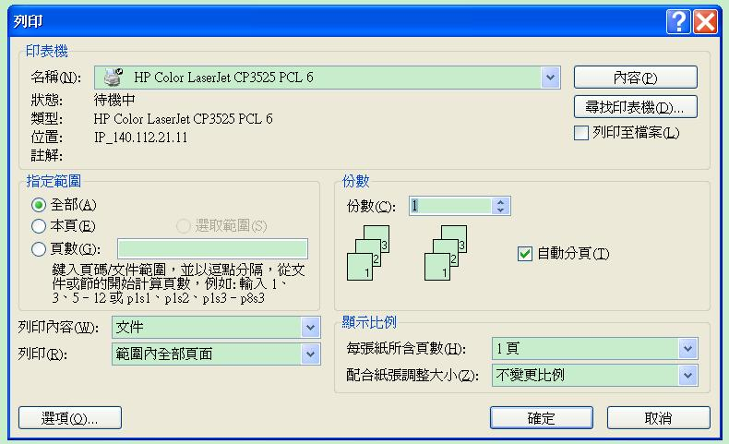
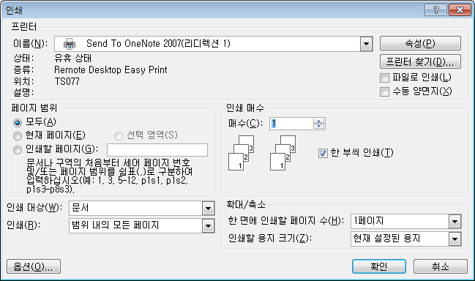
Dialog Box Layouts: Print

Slide 14
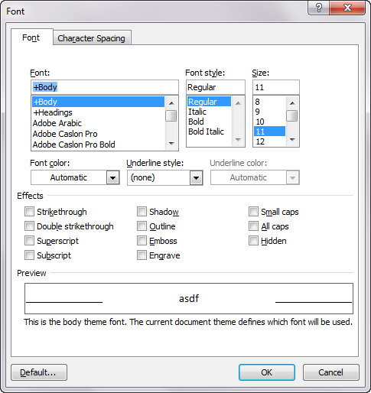
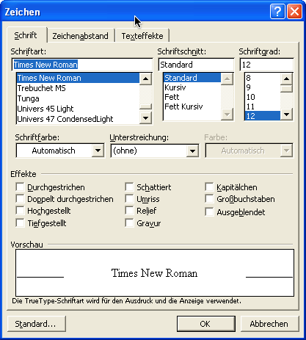
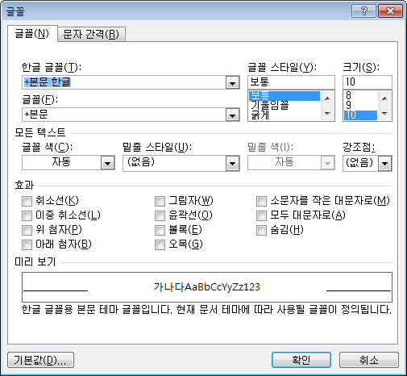
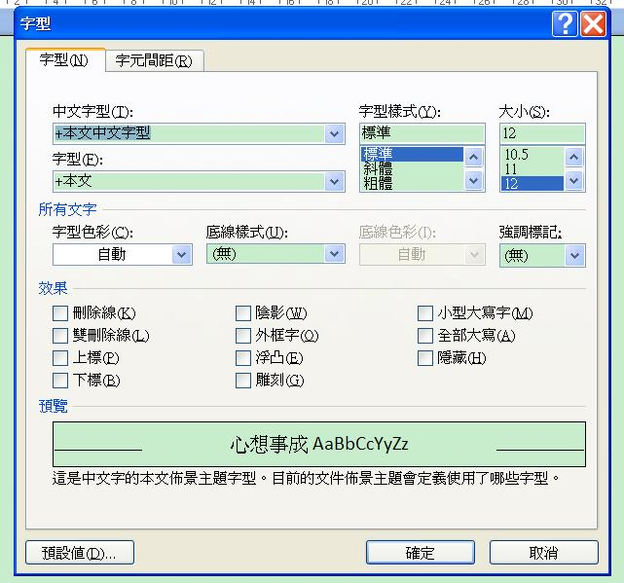
Dialog Box Layouts: Fonts

Slide 15
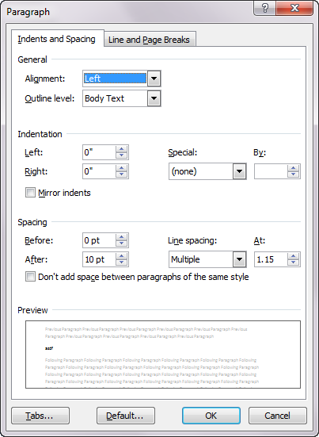
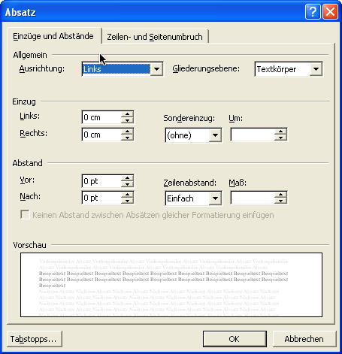
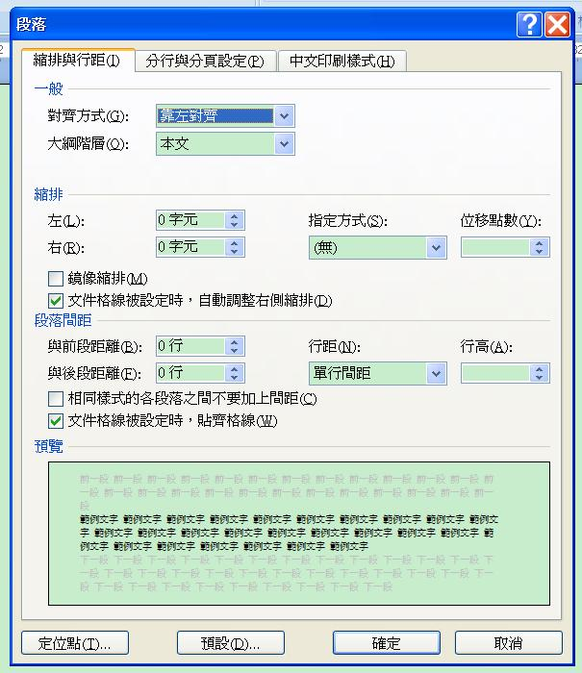
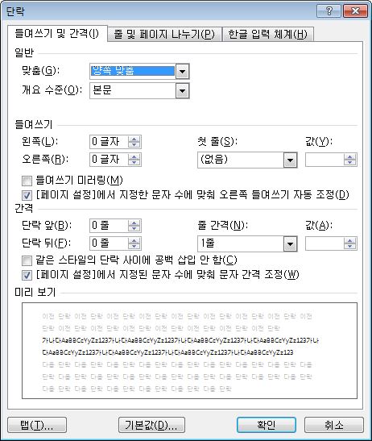
Dialog Box Layouts: Paragraph

Slide 16
Shipping Issues
Shipping charges and options for overseas
  Sales taxes?
Accept entry of non-US characters in fields
  May be an issue for sorting, etc.
Consider have separate US and overseas shipping pages
Otherwise:
  Use “zip / postal code” as prompt
  Different organization of postal address (postal code after city or after state?)
  In “state/province” field,
    Full-length state names
    Option for “other countries” in state field

Slide 17
URL issues
Use www.company.com for English language version
Use www.company.co.XX (.uk, .de, .kr) for foreign site
Use local (country specific) URL also for sites of only local interest

Slide 18
Implementation Issues
Separate “resource files”
  Put strings, etc. in separate file so can be easily changed without recompiling
  Not as part of the code
    Including error messages, etc
    Difficult due to constructed messages
      “Cannot copy file <#1> to directory <#2> due to <#err>”
      Even the order of the words may need to be different
  Also put in locations and sizes, since may change with the language
OS features help
  Automatic formatting and input for dates, etc.
  Toolkit support for layout, conversions, Unicode, etc.
  “Locale”
  But does changing it convert values or just show them differently?
    OK for date, not for currency!

Slide 19
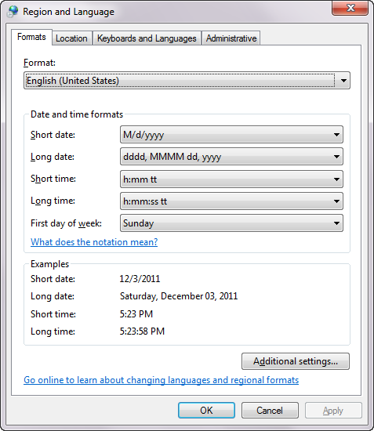
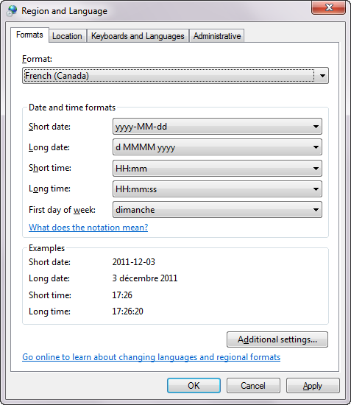
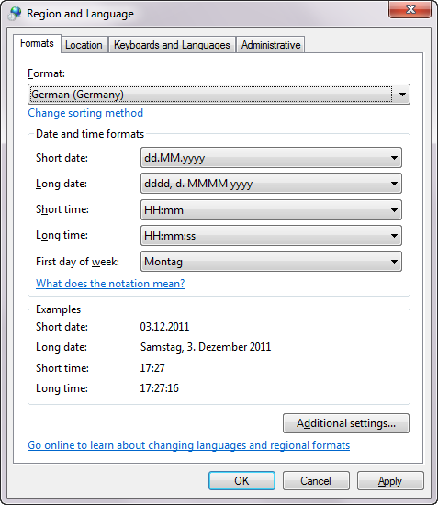
Windows “Region and Language”
Formerly called “Locale”

Slide 20
International User testing
Localized interface can have new and different usability problems
  Not sufficient to test one version and then translate
Should perform heuristic analysis by usability specialists familiar with target culture and language
Should test with native speakers in different countries
Use international or national usability consultants
Use “remote testing” with instrumented web sites

Slide 21
Mobile User Interfaces

Slide 22
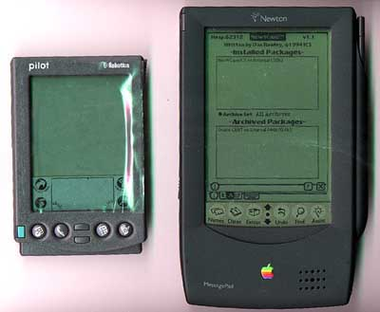
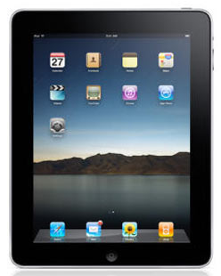
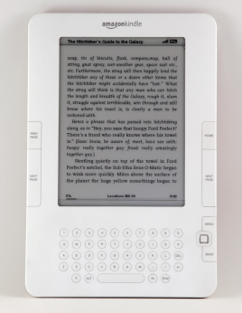
Why Important?
Now: Handheld = Mobile = Cell Phone
  Old: PDA = Personal Digital Assistant
Tablets: iPads, Android’s, e-readers
Big numbers of mobile phones
  Over 6.8 billion mobile phones in use (Wikipedia)
  About 64% of Americans now own smartphones (Pew)
  “Mobile phones are rapidly becoming the preferred means of personal communication, creating the world's largest consumer electronics industry.”
  More mobile devices purchased each year than PCs and cars combined!

Slide 23
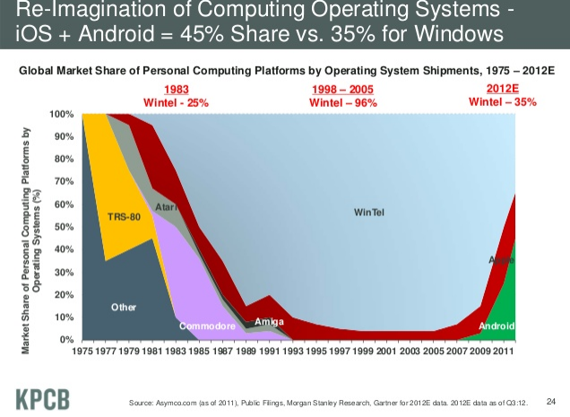
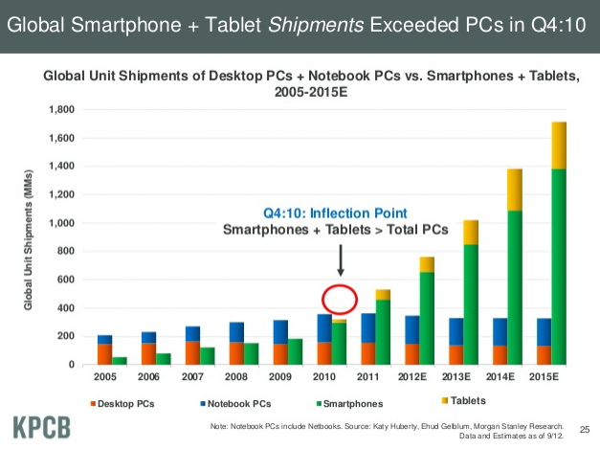
“Computers”
(cite,
slide 24, 25)

Slide 24
mCommerce Importance
Nielsen: “Mobile access will be the third ‘killer app’ for the Internet, after email and web browsing”
  “Anyone, anytime, anywhere, connected”
Mobile Devices are “Life Accessories”
  --Panu Korhonen, Usability Group Lead, Nokia
  Interact with mobile devices in a more “intimate” way than regular PCs

Slide 25
Mobile Usability
In 2009, was really bad - citation
  Tested various tasks on 36 websites
  Average success rate was 59%
    vs. 80% for regular desktop UIs
Much improved today
  Have 9 years of experience with designing for mobile
  More standard idioms

Slide 26
Usage Model Different for
Handhelds than PCs or Web
Immediate requests
Short interactions, frequently interrupted
Public use
Fashion statement
  Less business-oriented
  More value to design
Little engagement
Must always be able to answer the phone

Slide 27
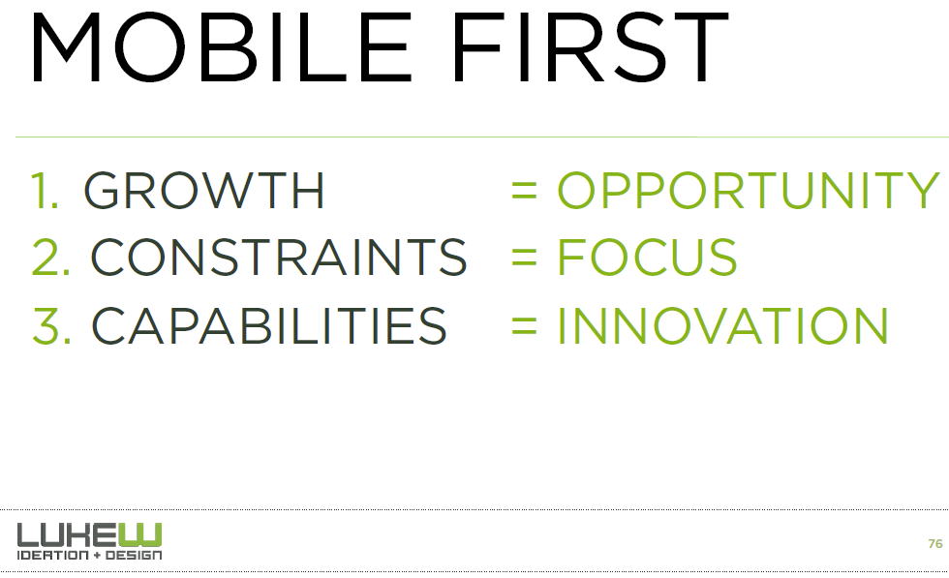
Design for Mobile First
Consultants recommend web sites designed for mobile first:
http://static.lukew.com/mmdd_workshop_11142012.pdf, slide 76

Slide 28
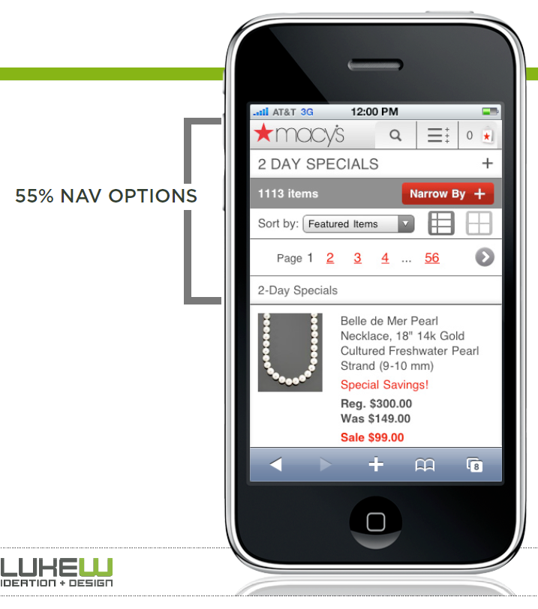
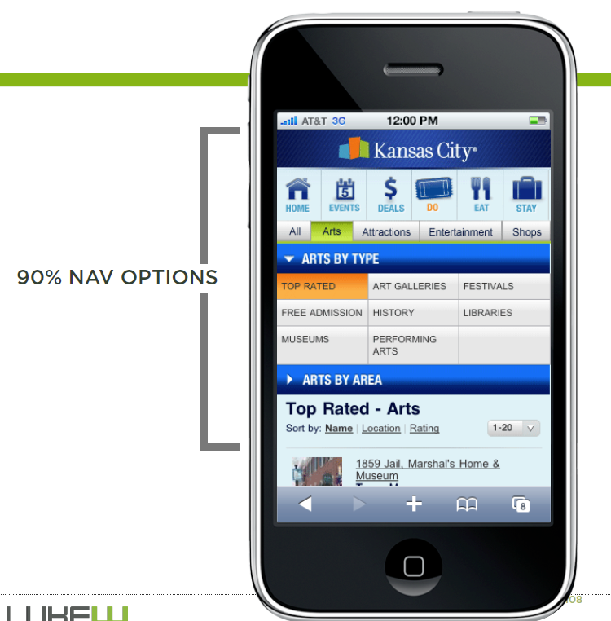
Focus on Navigation or Content?
http://static.lukew.com/mmdd_workshop_11142012.pdf, slides 107-8

Slide 29
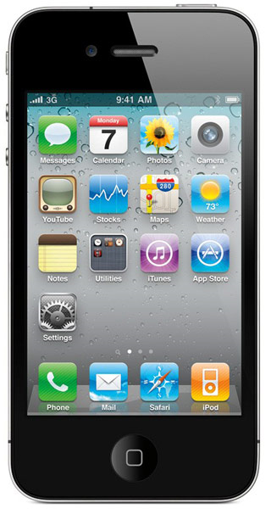
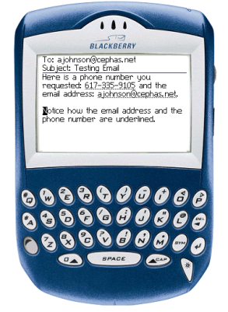
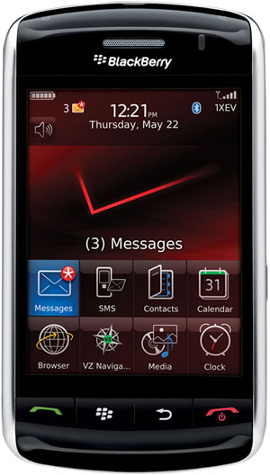
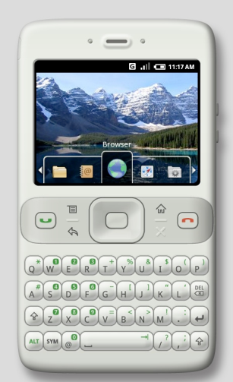
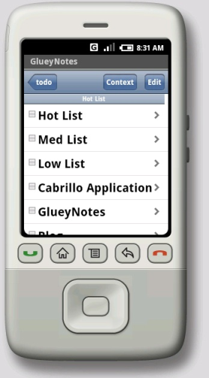
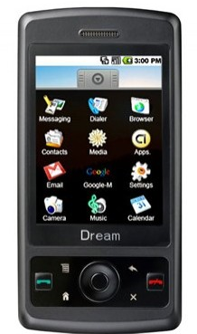
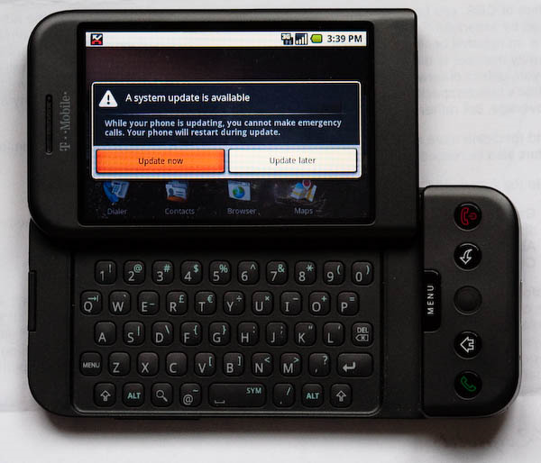
Issues with Handheld Designs
Must follow the device’s style guidelines
  May depend on OS, Hardware and carrier
    Verizon, AT&T, Sprint ….
  May be different hardware configurations
    Not with Apple iPhone – closed platform
    RIM’s Storm
    How many buttons?
    Windows Mobile has minimum requirements
    Android?

Slide 30
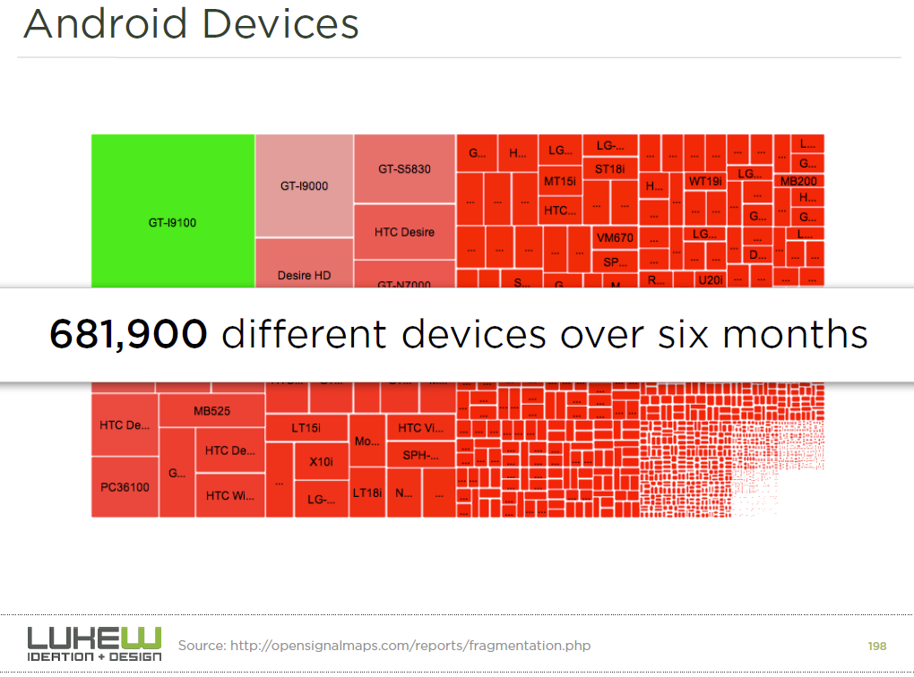
http://static.lukew.com/mmdd_workshop_11142012.pdf, slide 198

Slide 31
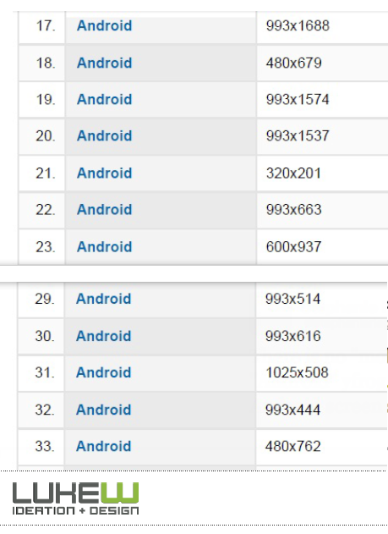
Many screen sizes
http://static.lukew.com/mmdd_workshop_11142012.pdf, slide 197

Slide 32
Design for Small Devices
Principles from the Palm’s designers
“Designing the Palm Pilot: A conversation with Rob Haitani”, by Eric Bergman and Rob Haitani, chapter 4 in Information Appliances and Beyond, Eric Bergman, ed. (2000)
  Fast access to key features on small screens ->
    Only a few commands used a lot
    Leave commands off main screen, even if not symmetric
      new vs. delete
      (think stapler and stapler remover)
    Note that violates consistency
    Tap and then type in schedule and to-do
    Only four buttons – which ones?
    Vs. Windows CE -> if know PC, this is familiar
      But usage models are different
        PC: infrequent long usage
        Palm: frequent short bursts of usage

Slide 33
Design for Small Devices, 2
  Analogy: people like to eat in a car
    Palm design is like adding the cup holder
    Have a house with the other appliances (like the PC)
  They did lots of user testing with prototypes created using HyperCard
  Usage scenarios

Slide 34
Studies for Original Windows CE
“The Interaction Design of Microsoft Windows CE”, by Sarah Zuberec, chapter 5 in Information Appliances and Beyond, Eric Bergman, ed. (2000)
Studies: minimum target: stylus = 5.04mm², finger = 9.04mm²
Drag between down and up for “tap” = 2mm
Many usage scenarios
User tests identified Tahoma 10 bold as best system font, but couldn’t be used because not enough content fit in the dialogs
  So used Tahoma 9
Novice users did better with keyboard, but experts preferred character recognizer
Problem with initial designs: too many taps
  Achieved “walk up and use” but too slow for experts
Double tap with stylus difficult and unnatural
  “Consistency worked against learning and use.”

Slide 35
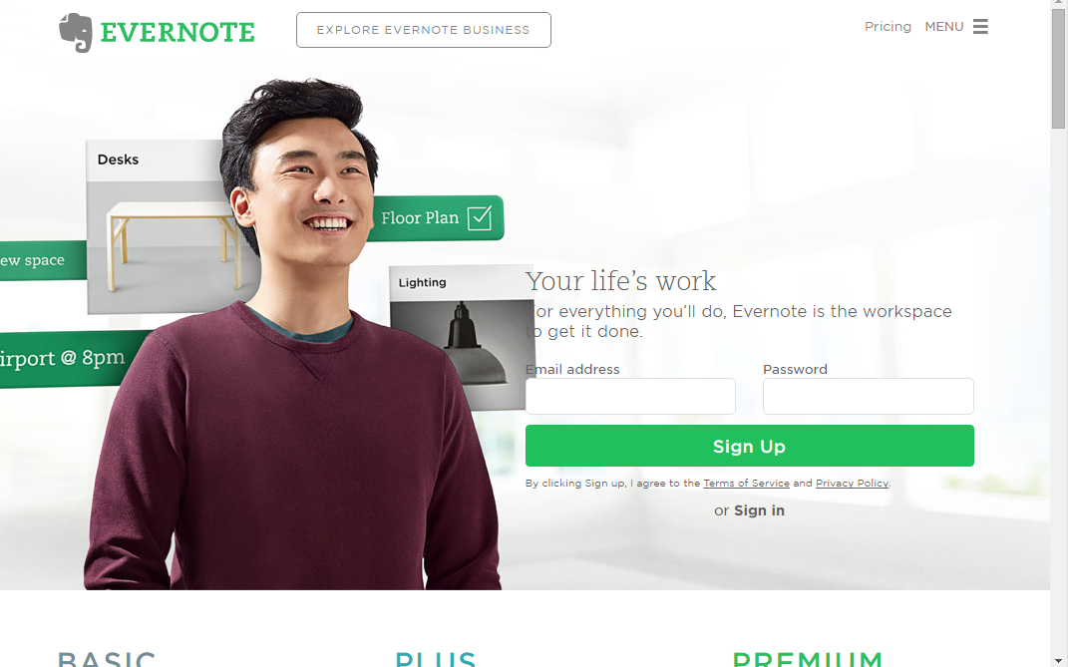
“Responsive Design”
Web sites adjust themselves based on size of screen
Programmed into the html of each page
  Mobile vs. desktop versions
  Vs. providing different pages based on browser/device request
Html and CSS have built-in features
Dreamweaver, etc. let you design for different ranges of sizes
Fewer options & elements (faster downloading)
Designed for smaller screen
Responsive design works
better for search-engine
optimization (SEO) – cite
But tends to make desktop
UIs worse - cite
  No need for hamburger icon
  on desktop - example

Slide 36
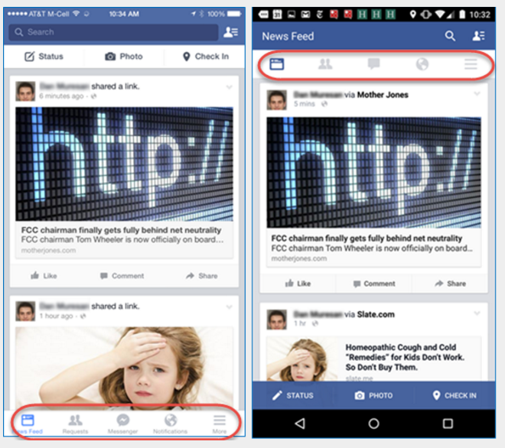

Mobile Navigation
Navigation especially important on mobile
  Larger barrier to search (typing costs)
    Shorter phrases generally work worse
Need fewer options
  Hide in a “hamburger” icon
  (origins)
  Provide a few options in
  navigation bar or “tab bar”
    Top or bottom – depending on
    Android or iOS
citation

Slide 37
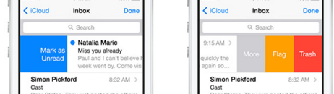

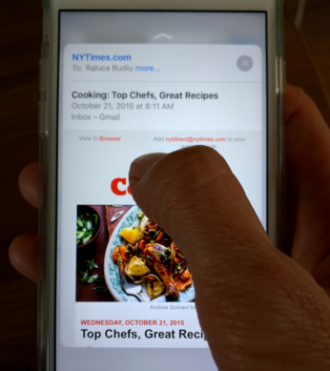
Gestures on Mobile
If more options – scrolling menus, swipe from side, etc.
Proliferation of “gestures”
  Swipe from left edge vs. left-to-right over an object
  Swipe from bottom/top
  Tap
  Press and hold
  Press hard (new)
  Often no “affordances” for
  what gestures are available or where can tap
  Some gestures also used for iOS actions – e.g., “back”
Force on iPhone 6S - citation
  Previews, “quick-actions” or “peek-and-pop”
  Hard to differentiate between press hard and press long
    E.g., main screen preview vs. edit
Can’t tell if did gesture wrong or no gesture available
Can’t see what is under the finger while pressing

Slide 38
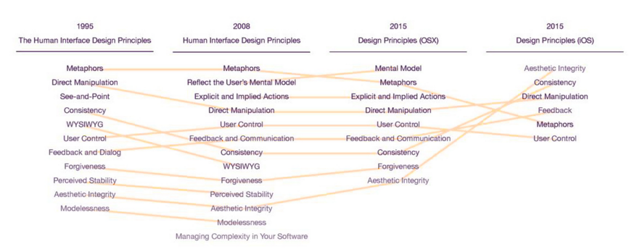
Fun article
“How Apple Is Giving Design A Bad Name”
  Don Norman and Bruce Tognazzini
  http://www.fastcodesign.com/3053406/how-apple-is-giving-design-a-bad-name
Products are “even more beautiful than before, [but] that beauty has come at a great price. Gone are the fundamental principles of good design: discoverability, feedback, recovery, and so on.”
Change in design principles:

