Slide 1
Lecture 10:
Designing for the Web
Brad Myers
05-863 / 08-763 / 46-863: Introduction to
Human Computer Interaction for
Technology Executives
Fall, 2015, Mini 2

Slide 2
Logistics
Homework 5 due today
Homework 6 available – due next Monday
  Should get your classmate’s comments by noon tomorrow (Tuesday)
Reminder: 2 lectures next week
Final exam information is available:
http://www.cs.cmu.edu/~bam/uicourse/08763fall15/finalexam.html
Wednesday’s lecture – first few minutes for course evaluations

Slide 3

Web and Mobile Topics
Norman-Nielsen Group (NN/g) Alertbox E-Mail Newsletter
  Excellent source for data-backed recommendations for web and mobile usability and design
  Once a week, 1 or 2 articles
  Always concise and interesting and relevant
  Subscribe here: http://www.nngroup.com/articles/subscribe/

Slide 4
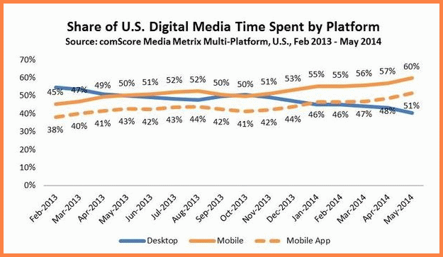
Note: Focus on Desktop Web
Mobile web will be covered in next lecture
Source: http://smallbiztrends.com/2014/07/online-traffic-report-mobile.html

Slide 5
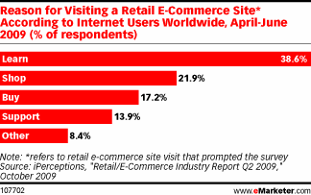
E-Commerce Usability
Web sites are a requirement for all companies
Usability of web sites improving, but still bad
  Failure rate: in 2000: 39%; vs. in 2010: 22%. (78% success)
  http://www.useit.com/alertbox/usability-progress-rate.html
38.6% of e-commerce visitors were there for information-gathering
Source: Keys to E-Commerce Success, Nov. 2, 2009 http://www.emarketer.com/Article.aspx?R=1007358

Slide 6
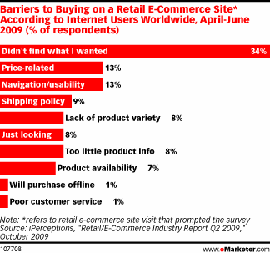
Navigating sites is often difficult
Studies find 58% or 74% failure at achieving a task at a site!
  Lower rate when
  need a sequence
  of steps
  eMarketer study:
  61.5% success rate
    Source:
    Keys to E-Commerce
    Success, Nov. 2, 2009
    http://www.emarketer.com/Article.aspx?R=1007358

Slide 7
Importance of Web Usability
“Nearly 9 of 10 of Americans Have Negative Feelings About Brands with Poorly Performing Websites and Mobile Apps, New SOASTA Study Reveals” – June 20, 2013
  https://www.bulldogreporter.com/dailydog/article/user-unfriendly-pr-nearly-9-of-10-of-americans-have-negative-feelings-about-brands-
  “For those Americans who said they have a negative reaction when a website takes too long, 28% would visit a competitor’s website, 27% would not trust the website, 18% would not visit that page again, and 13% would think the site may have been hacked.”

Slide 8
Report on Intranet Web Usability
http://www.useit.com/alertbox/intranet-usability.html (12/2012)
“Employees' average success rate when attempting basic intranet tasks:
  10 years ago: 75%
  Now: 74%
By comparison, today's average success rate on public websites is around 80%. Website usability has improved dramatically over the past decade…”
“Based on time-on-task metrics from our recent study, a company with 10,000 employees can save $4 million per year by going from bad intranet usability (defined as being among the worst 25% we tested) to average intranet usability.”

Slide 9
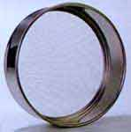
The Customer Sieve
Article by UIE (2002)
  Out of original 100 purchase-ready shoppers, only 34 people actually got what they wanted.
1) The Home Page Stage
2) The Location Stage
  Loose 9%
3) The Product List Stage
  Loose 8%
4) The Product Evaluation Stage
  Loose 25%
5) The Checkout Stage
  Loose 13%
6) The Receipt and Acceptance Stage
  Loose 11%

Slide 10

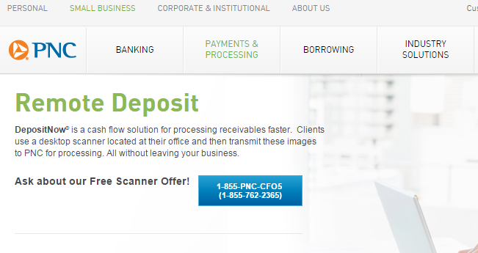
Navigation
Where am I?
  Make sure each page identifies site
    Logo, standard structure and consistent design
Where have I been?
  Trails (also called
  “breadcrumbs”)
  Or shown by highlighting the menu structure
  Link coloring

Slide 11
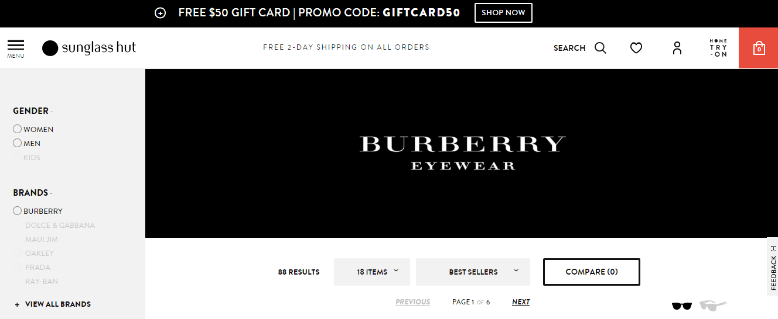
Navigation 2
Where can I go?
  Visible links on page
    This has gotten dramatically worse with “flat design”
  Standard navigation-bar is good
    Show where you are
  Don’t use pop-ups for links
  Links should have meaningful labels

Slide 12
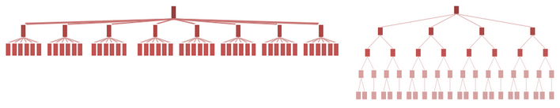
Navigation, 3
Site Structure that maps into user’s ideas and tasks
    Nielsen reports 80% vs. 9% success rates depending on structure
Product lists
  Make it easy to compare
Flat vs. Deep Website Hierarchies
  Tradeoffs –
  depends on “natural” structure of infomation
Never say “under construction”
  The web is always changing
  Except for prototypes (obviously)

Slide 13
Design for multiple browsers
Cross platform design
You don’t control the layout or navigation
  People use various browsers, window sizes, etc.
  Various languages and fonts installed
  Even cell phones, PDAs, pagers, etc.
  Users can jump in middle, go back and forward
Test your pages in Chrome, Safari, Internet Explorer, and Firefox
Test in all (recent) versions
  People don’t update

Slide 14
Design for multiple browsers, 2
“Responsive Design” - definition
  One design fits all, or
  Compute design based on window width - example
    Change size, position, and even which elements are present
Resolution-independent design
  Fixed column widths for appropriate length lines
    Pittsburgh Tribune-Review (http://triblive.com/) has fixed column sizes
  Icons that work at different resolutions
Don’t put text in pictures
  http://www.ing.unisannio.it/icpc2013/index.html vs http://www.program-comprehension.org/icpc16/
  Also can’t be selected for copy/paste
  Exceptions

Slide 15
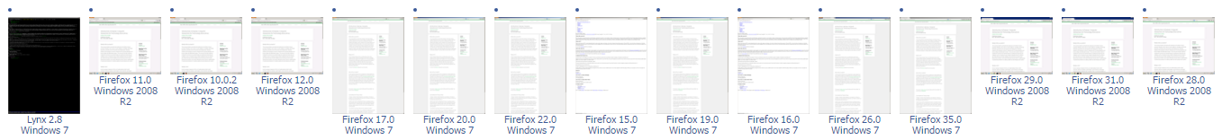
Design for multiple browsers, 3
Use “semantic” tags instead of markup tags
  <H3> instead of <B>
    Some of these are deprecated with HTML5
      <big>, <center>, <strike>, <tt>, <i>
      Typically, can get the same effect with
      <span class="italic">xxxx</span>
      Enables translation by “special” browsers
  Speech interfaces, screen readers
Tools for checking:
  “BrowserLab” built into Dreamweaver
  http://browsershots.org/ (Thanks to Kevin McEachern for finding this link)

Slide 16
Design for quick downloading
Users #1 complaint is slow downloading
  HCII’s slow website: http://www.hcii.cmu.edu/ ☹
Users want response times of less than 1 second
  Longer than 10 seconds, users cannot stay focused on the task
  Forwards and backwards
Predictable is important
  Always mark pages that may be slow due to multimedia content

Slide 17
Design for quick downloading, 2
Arrange for first screen full to display immediately
  Requires pictures to have sizes, layout to be computable without full page, tables that have specified sizing

Slide 18
Rules for links
Provide links to related items of interest
Misleading link names are a “broken promise” – erodes trust and credibility
Link text should be descriptive
  Not: “For the schedule, click here”
  Better: “See the schedule and homeworks”
    Easier to tell what link will get to
    Underlined words are visually highlighted
    Handicapped, etc. users won’t “click”
People will guess URLs of interior sites
  http://www.microsoft.com/pocketpc -> still goes to right place
  Will try to navigate by removing words

Slide 19
Rules for links, 2
Be cautious about opening up new browser windows or tabs
  Can’t go back
  Lose track of all the windows
  Example: ACM dl search: pdf vs. link for results
Advertising links go to “payoff” pages rather than to general pages
  Users don’t explore to find the advertised item
  Users want information now not 5 clicks from now
  Make sure the links stay valid

Slide 20
Design for credibility
Don’t look amateurish
  Nice, clean designs
  Good graphic design and color choices
  Links and code that work
Ability to find out privacy policy
Obvious way to provide feedback to the company

Slide 21
Why Focus on Content?
“Publishing is about getting the right content to the right person at the right time at the right cost. It's about selecting the best content and editing it really well, so that it makes compelling reading…. My approach doesn't ignore the software or the visuals, but focuses fundamentally on the words on the page. That's because, it is *words* that drive *actions* on a web page.”
-- Gerry McGovern, Content Critical

Slide 22
Web is an Attention Economy
Ultimate currency is the user’s time
There is too much content on the WWW
In traditional media, inertia helps keep people reading
On the web, it is almost as easy to go to the competitor as to go to your next page
Web content must give immediate benefits to the users or they will allocate their time to other sites

Slide 23
Content Study
In a study of 24 web sites, content-related issues caused 40.2% of the usability obstacles.
  Inaccuracies or missing information in the sites' text
  Text that didn't do its job
  -- Jared Spool, www.uie.com

Slide 24
Writing for the Web
Different than manuals, papers, reports
  Keep text short, succinct
  Copyedit and proofread (spell-check)
    Typos: “Garantee”
  Design for legibility – new metric “Readability”
  Write for scannability
    Nielsen study: “Users scarcely read anything during an average website visit.”
      Eye tracking studies
    Begin Link Names with the Most Important Keyword
      (scanning in CI video of CDW)
    Multiple heading levels
    Bulleted lists
    Hypertext links and other highlighting for important words
    Provide sufficient information on source page to avoid needing to follow links

Slide 25
Writing for the Web, 2
Plain language
  Limit use of metaphors
  Caution on use of humor, sarcasm, puns
  International audience
Relatively short pages

Slide 26
Page Titles
Remember to title your pages
Don’t use URL, codes in title
Make different pages have different titles
  Page history, bookmarks
Make first word most important
  Shows up in icon, abbreviations, etc.
  “MyCompany” instead of “Welcome to MyCompany”

Slide 27
Headlines
Different from headlines in paper, reports
Often used out of context as links, search engine results, etc.
  People scan using headlines
  Must be readable on its own
Don’t start with “a”, “an”, “the”
Good Example: Slashdot

Slide 28
Legibility
Good color choice
  Optimal: black text on white background
  Need good contrast
  Color blind people
  Background: plain-color or extremely subtle pattern
    Busy background
    Bad color choice, a commercial example
  NOT IN ALL CAPS. READ 10% SLOWER
    Seems like shouting

Slide 29

Form Fields
Provide formats and prompts that help
  Even better: be flexible: ignore spaces, ,-(), etc.
    4122685150 vs. (412) 268-5150 vs 1-412-268-5150
  Phone numbers, social security numbers, etc.
Tradeoff: plain text type-in vs. fields
  With type-in, need auto-complete
  E.g., for dates:

Slide 30
Why Follow Conventions?
“Now, if you're designing a website, wouldn't you want to put the 'Home' link in the position where people are used to finding it? Implementing web convention means that the person who visits your website has less to learn in order to successfully navigate around your website.”
-- Gerry McGovern, Content Critical

Slide 31
Why Home Page Design is Important
“Homepages are the most valuable real estate in the world”
  “Space on a big company's homepage is worth 1,300 times as much as land in the center of Tokyo.“
  http://www.nngroup.com/articles/homepage-real-estate-allocation/
“A homepage's impact on a company’s bottom line is far greater than simple measures of e-commerce revenues: The homepage is your company's face to the world. Increasingly, potential customers will look at your company's online presence before doing business with you.”

Slide 32
Home Page
Design differently than inside pages
Larger logo and company name (upper left corner)
Should be obvious what company does
  Novabase has pretty people!
  Good example: allrecipes
Provide good entry into site’s navigation
  Also news that of general interest
    Secondary
    Reason to return to site

Slide 33
Home Page, 2
Provide direct access to most important functions (Delta example)
  Vs. www.AA.com – picture is too tall
No “splash screens” – waste time
Don’t require pop-ups for site to work
One click access to home from all interior pages
Good title for home page (used by search engines)
Nielsen’s “Top Ten Guidelines for Homepage Usability”

Slide 34
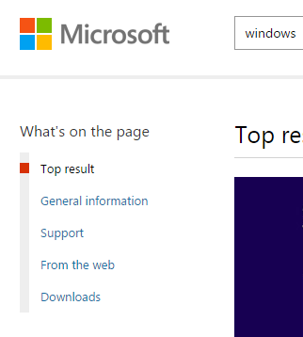
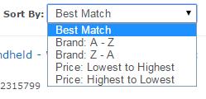
Search
Nielsen: ½ users go straight for the search option
  Search in upper right, especially on home page
CDW focused on improved search results (2008):
  “The results are in: CDW has realized a 4.5% increase in sales driven through site search and a 16% increase in shoppers clicking through from results pages to product pages.” -- http://www.internetretailer.com/article.asp?id=28897
Jumps right to pages, so need to be clear where ended up
Show what searched for
Offer scoped search if large space, also Amazon
Larger search box -> type more terms -> better results
Don’t use Boolean queries
  Men and Women
  Replace with ability to filter results
Search results
  Allow user to change sort order
  Sorted by quality and relevance
  Only give what asked for
    http://www.uie.com/articles/three_perils_search

Slide 35
Search, 2
UIE: searching again doesn’t help
  First time: 23% of the users got a "no results" message.
  Of those users who kept going, 44% got a "no results" on the second attempt.
  If they still persisted, 50% got a "no results" on the third attempt.
  And if they were really persistent, it didn't help because 100% got a "no results" on the fourth attempt.
  Encouraging users to continue with helpful hints doesn't actually seem to help.
  So: get users relevant results on the first try!
  Reference

Slide 36
Picking your URLs
Company.com and www.company.com
  Pick a new company name that can be the URL
  Easy to remember and spell
Put “index.html” file in every directory
  Use directory name as main URL
Allow URLs to be archived and emailed
  Make site friendly for incoming links
  Current vs. permanent reference (ACM Technews)
  Even for products and steps of a purchasing process
  Add links or “redirects” so old URLs still work

Slide 37
Fun!
http://www.webpagesthatsuck.com/

