Slide 1
Lecture 7:
Implementing a Prototype:
Overview of Using PowerPoint, Balsamiq, InVision, html, etc.
Brad Myers
05-863 / 08-763 / 46-863: Introduction to
Human Computer Interaction for
Technology Executives
Fall, 2015, Mini 2

Slide 2

Happy Thanksgiving!
No class Wednesday
Homework 2 grades
are on Blackboard
Homework 3 due today
Homework 4 due
next Monday –
no extensions!
Go back

Slide 3
Implementing your Prototype
How “complete” an implementation for HW4?
  Screen transitions must work
  All buttons should do something, even if go to a “not implemented yet” page – facilitates user testing
  Search, other computation does not have to work
  “Click-through” level of behaviors
  Must show any external reactions
    E.g., taking a picture, starting microwave, making a copy…
    Pop-up a dialog box saying what’s happening…
Level of complexity required:
  (Same as listed on homework0 page)
  At least 30 “controls” (widgets: buttons, text fields)
  About 10 different screens/pages/windows/modes
Must be done in one (1) week – no extensions!
  Will be given to your classmates for HW 5

Slide 4
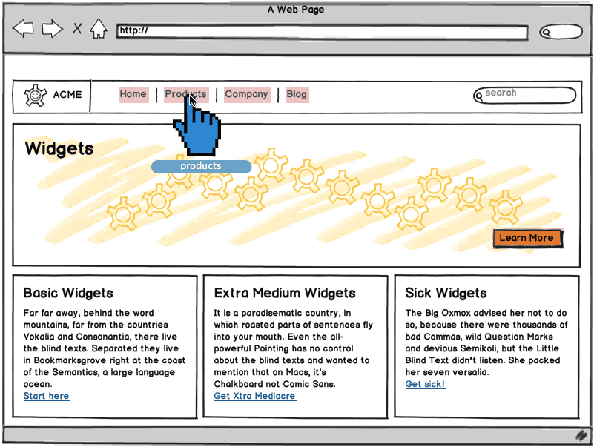
“Wireframe” Level Prototype
Outlines of the buttons and controls
No need for final graphics
Our requirement:
sufficient
functionality to
support your tasks
Labels should be
the real ones
  So can test that
  users understand
  what they do
Source: http://support.balsamiq.com/customer/portal/articles/107999-specifying-interaction-with-mockups

Slide 5
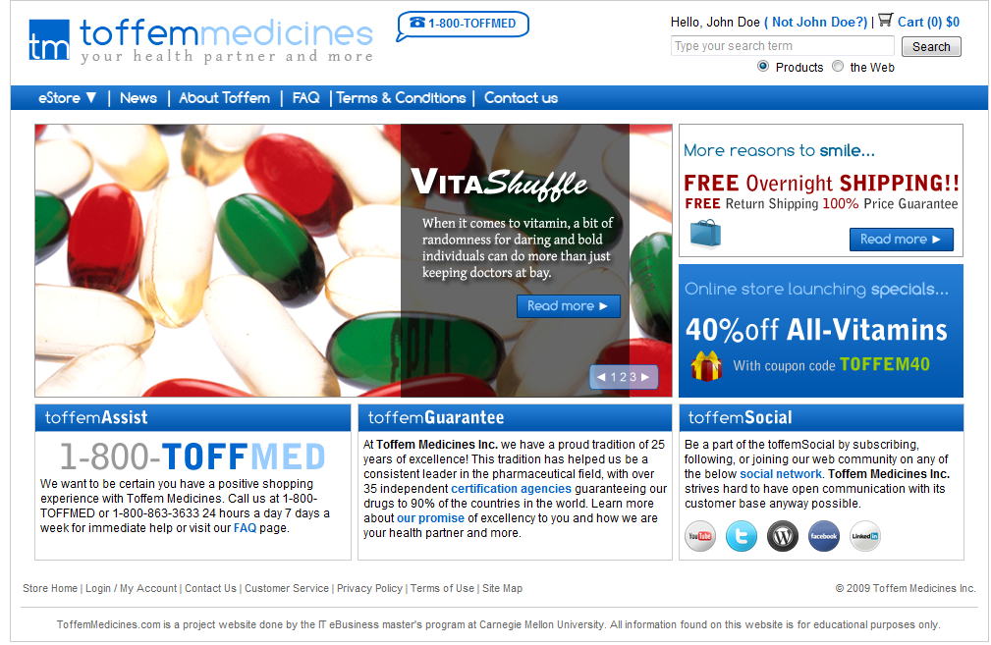
Or, Produce Final-Looking Graphics
Alternatively, could use Photoshop, Illustrator, etc. and produce final graphics
  Designers want to show what real UI will look like
  Details of the “look”
Web pages often use final graphics
  E.g., Toffem Medicines
Add “click-through”
behaviors
  Usually limited mostly
  to screen transitions
Notes:
Search for “vitamins” on Toffem page
Note that all the buttons go to somewhere – most to the NIY page

Slide 6
All Buttons must be labeled and should “work”
User should be able to be equally confused by your prototype as by the real interface.
For each screen on the prototype that you create, that screen should have every control that would be on the real screen.
Each control should do something
  Most will go to a “not implemented yet” page

Slide 7
Implementation Options for HW4
Pretty much any way you want
  Must “work” – not just paintings
  “Click-through prototypes”
We recommend you do not use Java, C++, Objective C (iPhone) or other “professional” language
Note: you must be able to create software that is easy for others to run
  Must work on both PC and Mac
  Output a set of web pages, or a pdf file
If you use OmniGraffle (Mac only) or Visio (PC only) or Visual Studio (PC only), you must output as clickable pdf or html or something.
  Do NOT use ActiveX controls that are PC only

Slide 8
Recommended Options
These are easiest to use:
  PowerPoint – Brad demo
  Html – demo
    Using editor like Dreamweaver
    Dreamweaver has a free 30-day trial
  Html + Javascript (more programming)
Balsamiq – demo
  Free accounts to Balsamiq on line – email bam@cs.cmu.edu
InVision – demo
  Free student accounts

Slide 9
Lots of other choices…
Axure is a popular commercial tool
  www.axure.com
  Advantage – only one with components that can be used on multiple pages
https://moqups.com/
JustInMind - http://www.justinmind.com/
Flinto - https://www.flinto.com/ - prototype Smartphone apps
Adobe Flash
new tool: https://popapp.in/videos/home/landing.mp4?v=20140724
Old tools:
  Visual Basic
  HyperCard (1998) & similar
  Flash Catalyst (2010)

Slide 10
Tool use by Verizon
According to MHCI alumni Jack Lam:
  Mainly use these for design
    Adobe Photoshop
    Adobe Illustrator
    Sketch 3 (our team doesn’t use this but I heard great reviews from other designers)
  This for animation
    Adobe After Effects
  These for working prototypes
    Flinto
    InVision
    Proto.io

Slide 11
Lots of Lists of Tools
One of our MHCI Alum compares prototyping tools in 2013:
  http://www.cooper.com/journal/2013/07/designers-toolkit-proto-testing-for-prototypes
Search for “Prototyping tools” or “Wireframing Tools”
  http://www.cooper.com/prototyping-tools (kept up to date)
  http://uxdesignweekly.com/ux-resources/prototyping-tools/
  http://uxmovement.com/resources/3-best-vector-wireframing-tools-for-designers/ (2014)
  http://www.fuelyourcreativity.com/17-great-wireframing-tools-for-web-designers/ (2012)

Slide 12
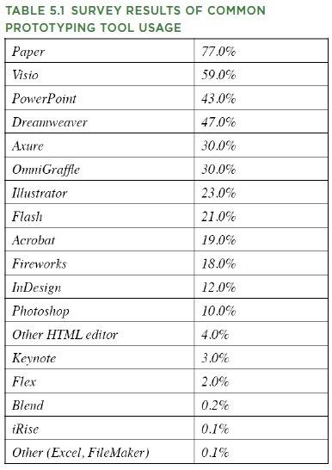
What Are People
Using?
  http://www.uie.com/articles/prototyping_tools/?link=tips100318_6
    Mar 18, 2010
  My survey results are similar (2007)

Slide 13
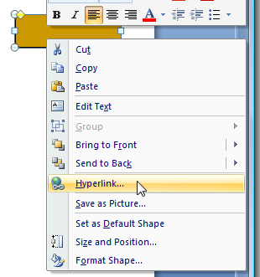
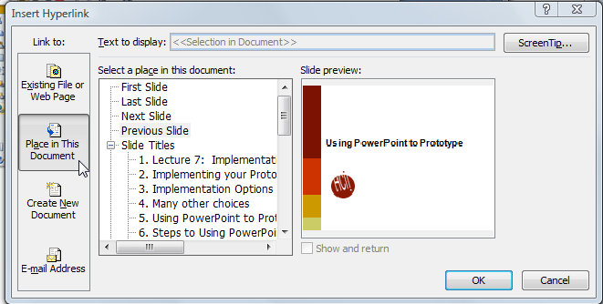
Using PowerPoint to Prototype
Go back
Add a shape, with a label
Right click menu - Add a “Hyperlink”:
  Select “Place in this document”
button

Slide 14
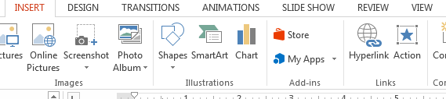
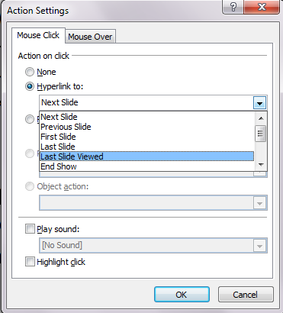
Using PowerPoint to Prototype
On “Insert” tab, add
“Action”
  More options, including
  “last slide viewed”
    Useful for “under
    construction” page
  Use Insert / Action also to edit it
Create a slide for each
mode of the application
Can add nice animations

Slide 15

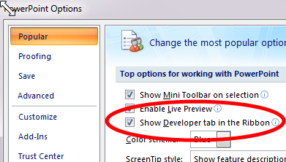
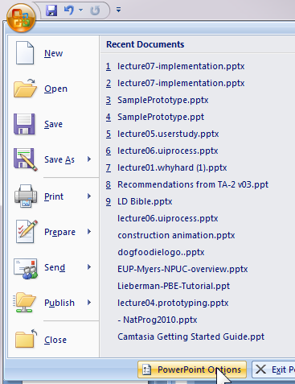

Adding Controls in PowerPoint
Turn on “Developer Toolbar”
  Can add buttons, text entry, etc.
  (Office 2007)

Slide 16
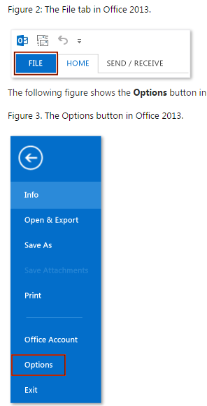
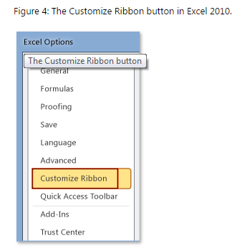
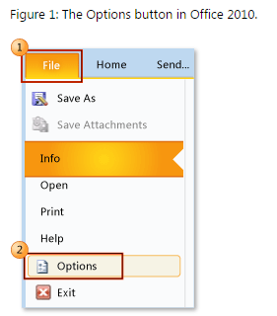
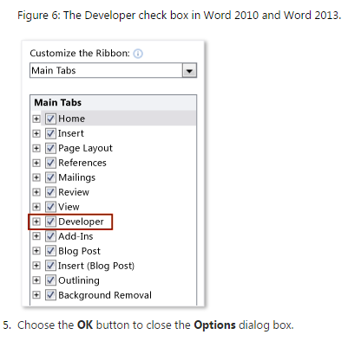
Adding PowerPoint Controls
Source: http://msdn.microsoft.com/en-us/library/bb608625.aspx

Slide 17
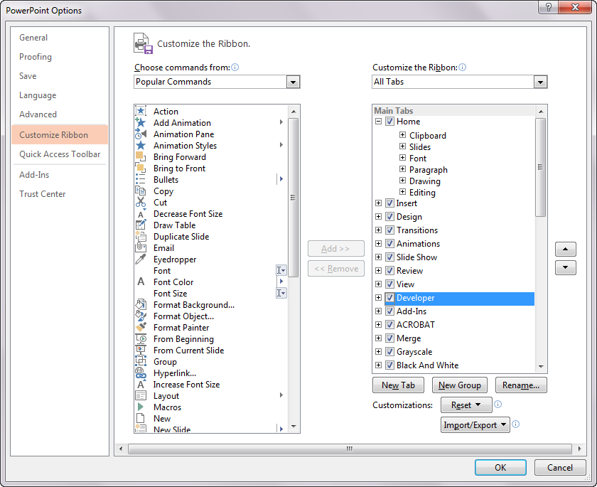
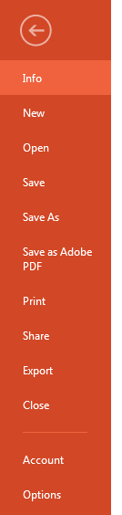
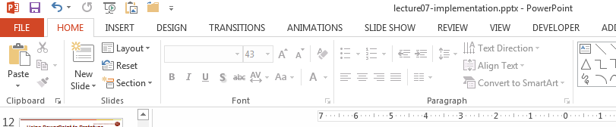
Developer Tool Bar, Office 2013

Slide 18
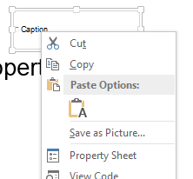
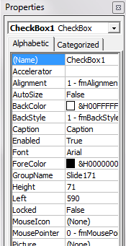
Some controls
Select control, drag out
for position and size
Change Caption with
property sheet from
right-click menu
Can only have behaviors by
writing Visual Basic code
Can add text boxes that
users can enter text into

Slide 19
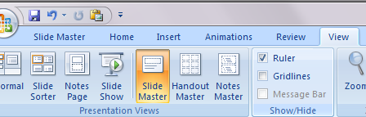
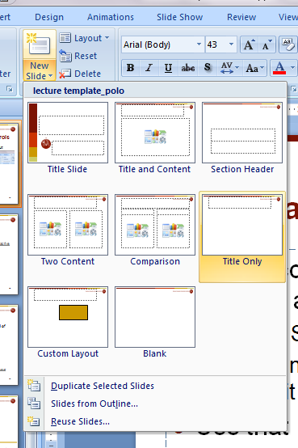
Use “Master” for Shared Controls
If want controls on multiple pages, can put them on a “Master”
  “View / Slide Master”
  Create new master slide
  and edit as with any other slide
Use that master for new slides
  Drop down from “New Slide”
Controls like check boxes, text
boxes in Master use same value
across all slides

Slide 20
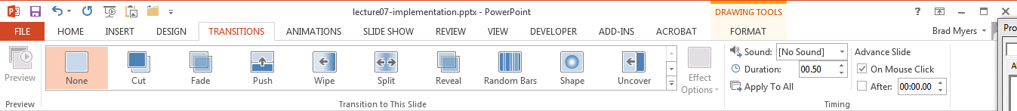
PowerPoint – turn off auto-advance
Make sure that clicking does not advance slide
Office 2007 – on “Animations” ribbon
Office 2010 & 2013 – now on “Transitions” ribbon
http://blogmines.com/blog/how-to-disable-advance-slide-on-mouse-click-in-powerpoint-2010/

Slide 21
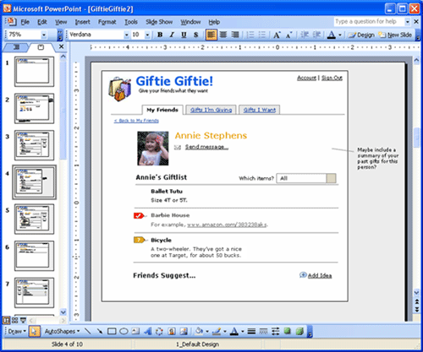
PowerPoint examples
Great training in using PowerPoint:
  http://www.boxesandarrows.com/view/interactive
    by Maureen Kelly on 2007/08/06
  Includes hover behaviors
Local copy

Slide 22
TA-Run Demos
Balsamiq – Ajayan Subramanian
InVision – Stephanie Chen
Axure – Ryan Donegan and Angela Liu
Html – Angela Liu

Slide 23
Balsamiq
Ajayan Subramanian
Rapid wire framing tool with an easy drag and drop interface
Can create click-throughs and export as PDFs
Web version: Email Prof. Myers and he’ll make a project for you
Desktop app: 30 day free trial - https://balsamiq.com/
Good for prototyping; Illustrator and Sketch are better suited for high fidelity mockups

Slide 24
Balsamiq Demo
Adding some clickable elements and input fields
Sketch view vs wireframe view
Adding color, icons, and creating symbols
Finding additional symbols online - MockupsToGo
Exporting to PDF
Documentation and tutorials

Slide 25
INVISION
free web & mobile prototyping tool
stephanie chen

Slide 26
HOW IT WORKS
create new prototype
select device
upload screens
go to build mode
  link
  gesture
  transition
share & user test!
Notes:
jpeg, png -- cannot make screens using invision, must use another application like illustrator or photoshop
device type (mobile, web, tablet etc)
upload screens of the right dimensions, but scrolling is supported
important to name the screens so you know which one is which - makes things easier when you link the screens

Slide 27
DEMO
http://www.invisionapp.com/

Slide 28
+ pros
quick and easy to use
basic gestures and transitions
supports sharing and collaboration
- cons
cannot create or modify images
limited functionality
Notes:
free but limit of 1 project
upgrade to a student plan for free if you’re a college student

Slide 29
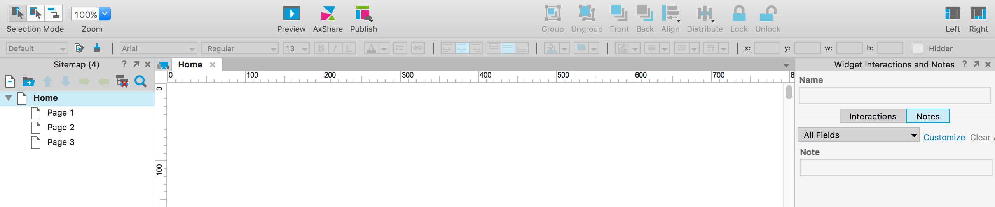
Axure
wireframe and prototyping tool
Slides by Ryan Donegan
Presented by Angela Liu

Slide 30
What is Axure?
A tool for creating dynamic wireframes from low to high fidelity
With Axure you can…
  Translate initial sketches from paper to digital
  Utilize Axure’s library of widgets and fields to experiment with different interactions
  Export your designs to HTML without any coding and test

Slide 31
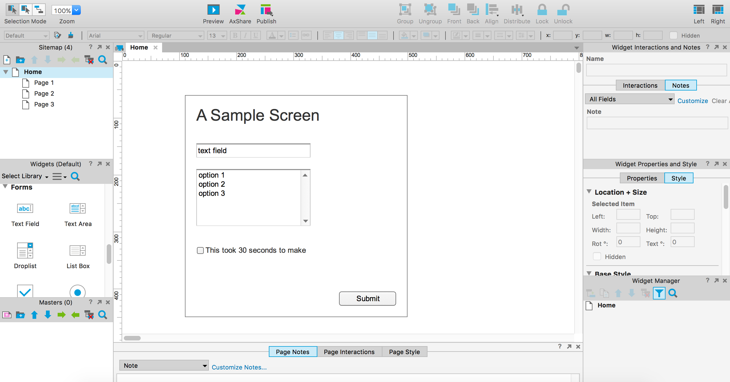
Create a design…
Make it
interactive
Sitemap
Widgets
Page area
Widget properties
Master Panel

Slide 32
Important Features
Widgets
  Pre-made app components (buttons, forms, menus, fields, etc) that can be quickly added to a project
Master Pages
  Page templates or custom components that can be reused
Dynamic Panels
  Make your screens interactive so users can test prototypes in action
Preview / Publish
  Use Axure to quickly view an interactive preview of your app in the browser, or export your wireframes as HTML & CSS

Slide 33
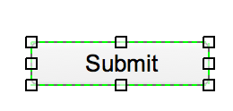
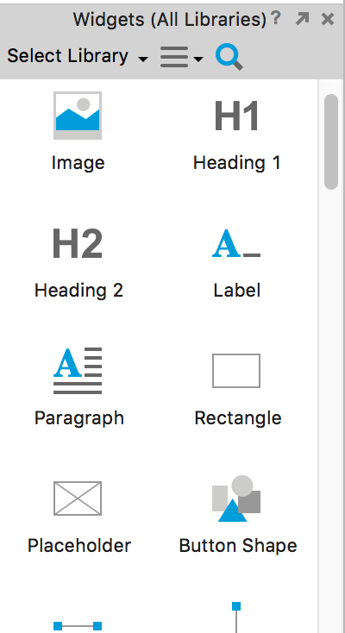
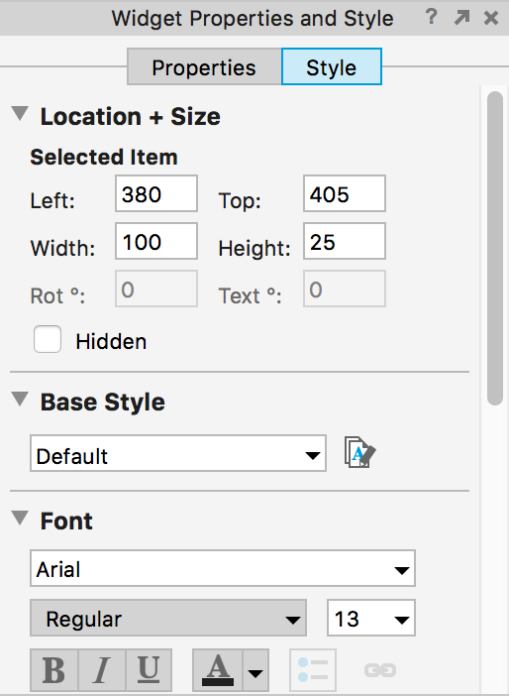
Widgets
Drag and drop onto the pages of your project
Edit the content & style of each object after adding to a page

Slide 34
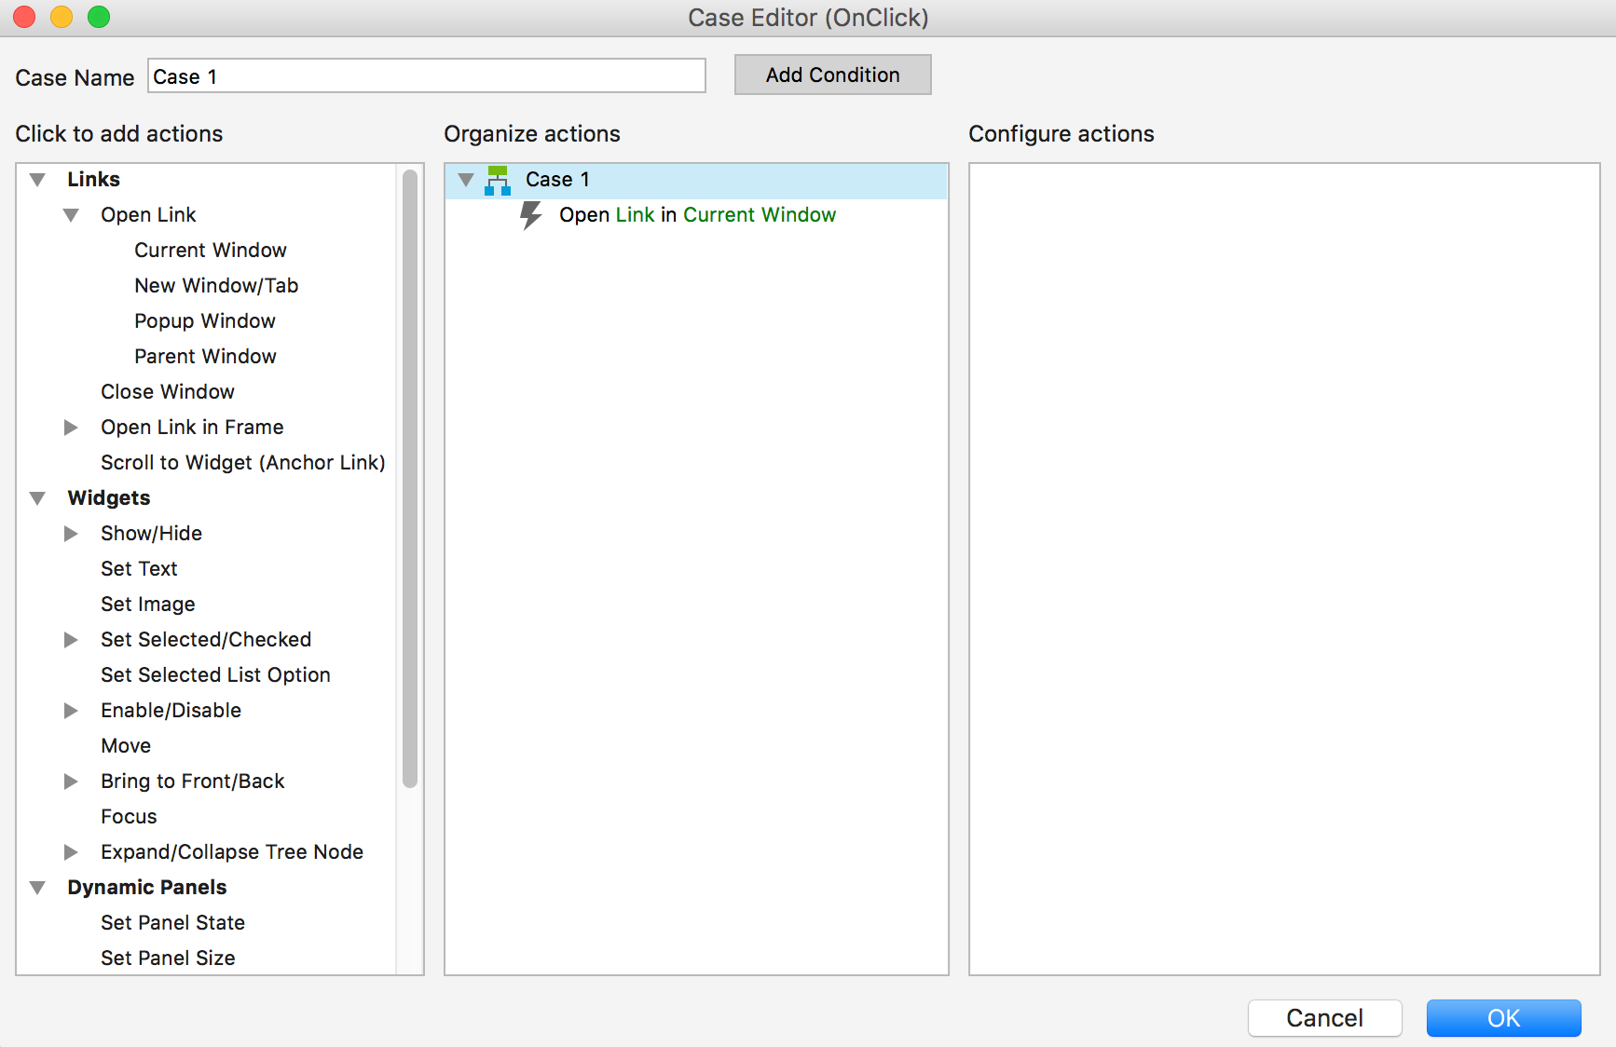
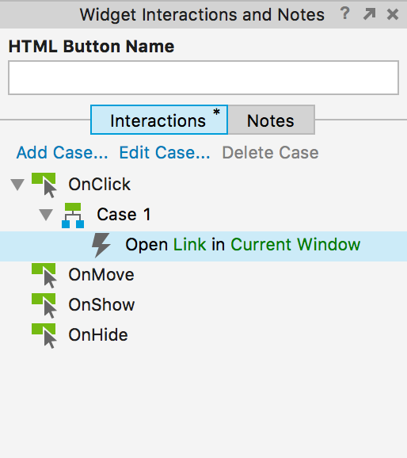
Widgets
Add interaction to widgets by specifying the case (e.g. onClick, onMove, onHide, etc) and the interaction(s) that occur
Link to other pages, screens, content, views, etc.
Click to open modal

Slide 35
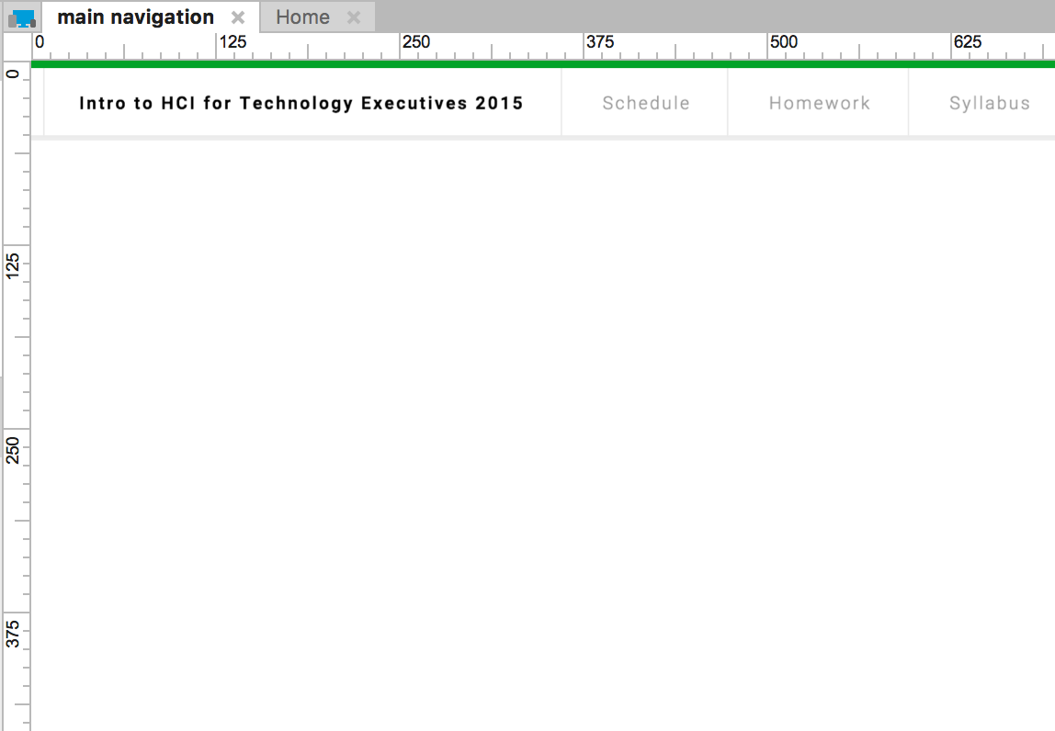
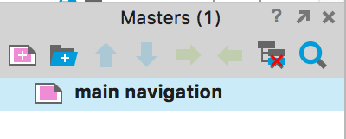
Master Pages
Reusable components that can be added to many screens/other masters
Make global changes to a component quickly
Great for navigation, headers, footers, search bar
Edit master component in the content panel

Slide 36
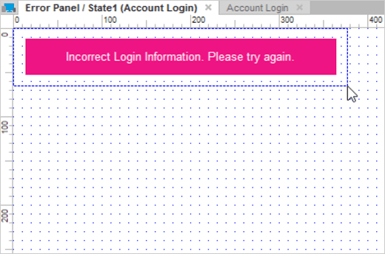
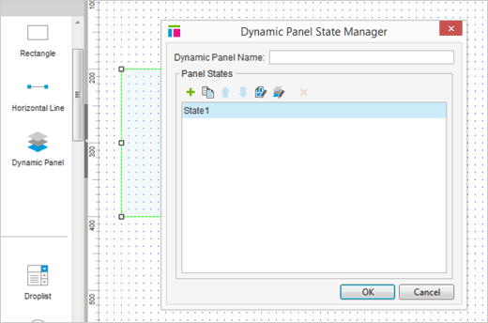
Dynamic Panels
Allows you to change, hide, swap, or move content in wireframes without creating a new screen or changing to a different page.
Functionality can be basic (tooltip) or advanced (drag-and-drop, carousel)
Can get complicated: Help here
Drag-and-drop dynamic panels into the content area from the widget library.
Change the visual state that is shown for the panel.

Slide 37
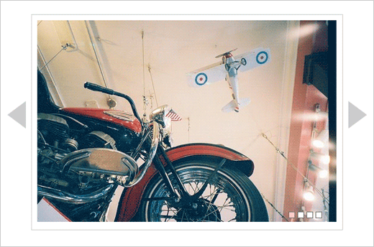
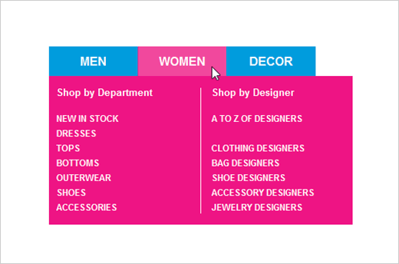
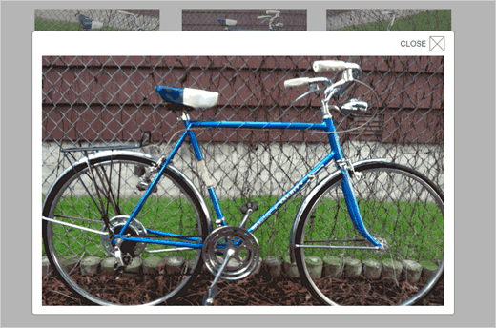
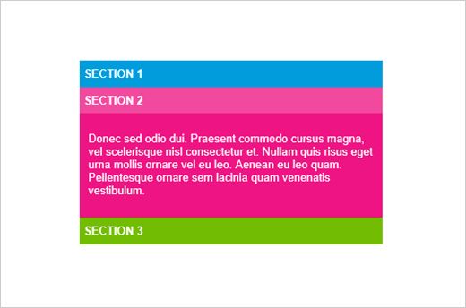
Dynamic Panels in Action

Slide 38

Testing Your UI
Export your project as basic HTML/CSS/JS if desired for further testing or possibly development.
View your project in your browser to test the buttons, panels, and interactions you’ve incorporated as they would appear in practice.

Slide 39
Reasons To Try Axure
Versatility: Axure lets you take designs from low (sketchy) fidelity to more refined, high level interactions
Efficiency: Dynamic panels and widget states allow you to quickly create different views and interfaces
It’s FREE (kind of)
  You can start out with a free 30-day trial
  Or get a free student license

Slide 40
Need Help?
Axure has some pretty extensive documentation and tutorials
Or feel free to email me with other questions: rdonegan@andrew.cmu.edu

Slide 41
Prototyping with HTML/CSS

Slide 42
HTML

Slide 43
First thing’s first: Tags
Everything is wrapped in a tag
<tag_name options = “”></tag_name>
    options can be:
          class names (can be applied to multiple items in the same file)
          id names (can only be applied to 1 item per file)
          styling
          specific arguments for certain tags

Slide 44
Types of Tags
headers
paragraphs
divs
buttons
links
tables
form fields
images
etc etc

Slide 45
General File Structure
<!DOCTYPE html>

Slide 46
General File Structure
<!DOCTYPE html>
<html>
</html>

Slide 47
General File Structure
<!DOCTYPE html>
<html>
    <head>
    </head>
</html>

Slide 48
General File Structure
<!DOCTYPE html>
<html>
    <head>
        <title>Page Title</title>
        <link src = “css.html”></link>
        <script src = “js.html”></script>
    </head>
</html>

Slide 49
General File Structure
<!DOCTYPE html>
<html>
    <head>
        <title>Page Title</title>
        <link rel="stylesheet" type="text/css" href=“theme.css">
        <script src = “js.html”></script>
    </head>
</html>

Slide 50
General File Structure
<!DOCTYPE html>
<html>
    <head>
        <title>Page Title</title>
        <link rel="stylesheet" type="text/css" href=“theme.css">
        <script src = “js.html”></script>
    </head>
</html>

Slide 51
General File Structure
<!DOCTYPE html>
<html>
    <head>
        <title>Page Title</title>
        <link rel="stylesheet" type="text/css" href="theme.css">
        <script src = “js.html”></script>
    </head>
    <body>
        <!—most of your html code will go here —>
    </body>
</html>

Slide 52
CSS

Slide 53
CSS Selectors
Use generic html tag names to address all applicable
      .class_name
Use the class names and ids to address specific items
      #id_name

Slide 54
What does css do?
describes how the html will look
    height and width
    font (type, size, color, weight)
    color
    padding / margins
    background-images
    vertical/horizontal spacing
    opacity
    positioning (item, text)
    shadowing
    display properties

Slide 55
CSS Structure
#id_name {
      height: 100px; (px = pixel)
      width: 100px;
      padding: 10px;
      background-color: red;
      text-align: center;
}

Slide 56
Text Editors

Slide 57
Some popular ones
Sublime Text
Brackets
Adobe Dreamweaver
Terminal

Slide 58
Example

Slide 59
Questions?

