Slide 1
Lecture 6: How to Design a Good Usability Evaluation
Brad Myers
05-863 / 08-763 / 46-863: Introduction to Human Computer Interaction for Technology Executives
Fall, 2015, Mini 2

Slide 2
Homeworks
HW #1 graded on Blackboard
Can download annotated pdf files
HW #2 due today
Generous late policy
Start on HW #3 – note that due on Monday
Shorter time to do it
Warning: cannot be easily done quickly – two phases
Not diagrams this time – instead use table in the template document

Slide 3
Why Evaluate with “Usability Evaluations”?
Following guidelines never sufficient for good UIs
Need both good design and user studies
(Similar to users with CI)
Note: users, subjects → participants
Good designers
Average designers
Quality, before and after user studies

Slide 4
“Don’ts” of Usability Evaluations
Don’t evaluate whether it works (quality assurance)
Don’t have experimenters evaluate it – get users
Don’t (just) ask user questions. Not an “opinion survey.” Instead, watch their behavior.
Don’t evaluate with groups: see how well system works for each person individually (not a “focus group”)
Don’t train users: want to see if they can figure it out themselves.
Don’t test user → evaluate the system
Not a “user test” → call it Usability Evaluation instead
Don’t put your ego as a designer on the line

Slide 5
Issue: Reliability
Do the results generalize to other people?
Individual differences
Up to a factor of 10 in performance
If comparing two systems
Statistics for confidence intervals, p<.01
But rarely are doing A vs. B studies
Also, small number of users cannot evaluate an entire site
Just a sample

Slide 6
Issue: Validity
Did the evaluation measure what we wanted?
Wrong users
“Confounding” factors, etc,
Issues which were not controlled but not relevant to the evaluation
Other usability problems, setting, etc.
Ordering effects
Learning effects
Too much help given to some users

Slide 7
Plan your Evaluation
Goals:
Formative – help decide features and design ← CIs
Summative – evaluate system ← Now
Pilot evaluations
Preliminary evaluations to check materials, look for bugs, etc.
Evaluate the instructions, timing
Users do not have to be representative

Slide 8
Evaluation Design
“Between subjects” vs. “within subjects”
For comparing different conditions
Within:
Each user does all conditions
Removes individual differences
Add ordering effects
Between
Each user does one condition
Quicker for each user
But need more users due to huge variation in people
Randomized assignment of conditions
To people, or order

Slide 9
Some Measurements
Learnability: Time to learn how to do specific tasks (at a specific proficiency)
Efficiency: (Expert) Time to execute benchmark (typical) tasks. Throughput.
Errors: Error rate per task. Time spent on errors. Error severity.
Lots of measures from web analytics:
Abandonment rates, Completion rates, Clickthroughs, % completions, etc.
Subjective satisfaction: Questionnaire.

Slide 10
Performance Measurements
Time, number of tasks completed, number of errors, severity of errors, number of times help needed, quality of results, emotions, etc.
Decide in advance what is relevant
Can get quantifiable, objective numbers
“Usability Engineering”
Can instrument software to take measurements
Or try to log results “live” or from videotape
Some available from web analytics
Emotions and preferences from questionnaires and apparent frustration, happiness with system

Slide 11
Goal Levels
Pick Levels for your system:
Minimum acceptable level
Desired (planned) level
Theoretical best level
Current level or competitor's level
Minimum Acceptable
Current
Best
Desired
0
1
2
5
Errors

Slide 12
Questionnaire Design
Collect general demographic information that may be relevant
Age, sex, computer experience, etc.
Evaluate feelings towards your product and other products
Important to design questionnaire carefully
Users may find questions confusing
May not answer the question you think you are asking
May not measure what you are interested in

Slide 13
Questionnaire, 2
“Likert scale”
Propose something and let people agree or disagree:
agree disagree
The system was easy to use: 1 .. 2 .. 3 .. 4 .. 5
“Semantic differential scale”
Two opposite feelings:
difficult easy
Finding the right information was: -2 .. -1 .. 0 .. 1 .. 2
If multiple choices, rank order them:
Rank the choices in order of preference (with 1 being most preferred and 4 being least):
Interface #1 Interface #2 Interface #3 Interface #4
(in a real survey, describe the interfaces)

Slide 14
Question Design
Very hard to design questions that are hard to misunderstand or misread
Clear writing, simple sentences
If users make mistakes, then questionnaire is invalid
For example, all positive answers in a column
Do not alternate (ref: http://www.measuringu.com/positive-negative.php)
This website was easy to use.
It was difficult to find what I needed on this website.
User confusion overrides trying to make people pay attention (doesn’t work)

Slide 15
Questionnaire, examples
Examples of problems:
“How big is the codebase for this project?”
300
50k SLOC
342658
2000 files
Big
Revised: have ranges instead of a textbox:
Up to 1000 LOC
1000 – 10,000
10,000 – 100,000
100,000 – 1,000,000
Bigger than 1,000,000

Slide 16
Standard (Validated) Questionnaires
“Questionnaire for User Interface Satisfaction” (QUIS)
Chin, J.P., Diehl, V.A., Norman, K.L. (1988) Development of an Instrument Measuring User Satisfaction of the Human-Computer Interface. ACM CHI'88 Proceedings, 213-218.
http://lap.umd.edu/quis/
Short version: http://hcibib.org/perlman/question.cgi?form=QUIS
License costs money, but can be downloaded for free.
Long version has 16 pages of questions
“System usability scale” – short questionnaire (10-12 items)
Brooke, J. (1996). "SUS: a "quick and dirty" usability scale". In P. W. Jordan, B. Thomas, B. A. Weerdmeester, & A. L. McClelland. Usability Evaluation in Industry. London: Taylor and Francis.
http://www.usabilitest.com/uxxc4jP

Slide 17
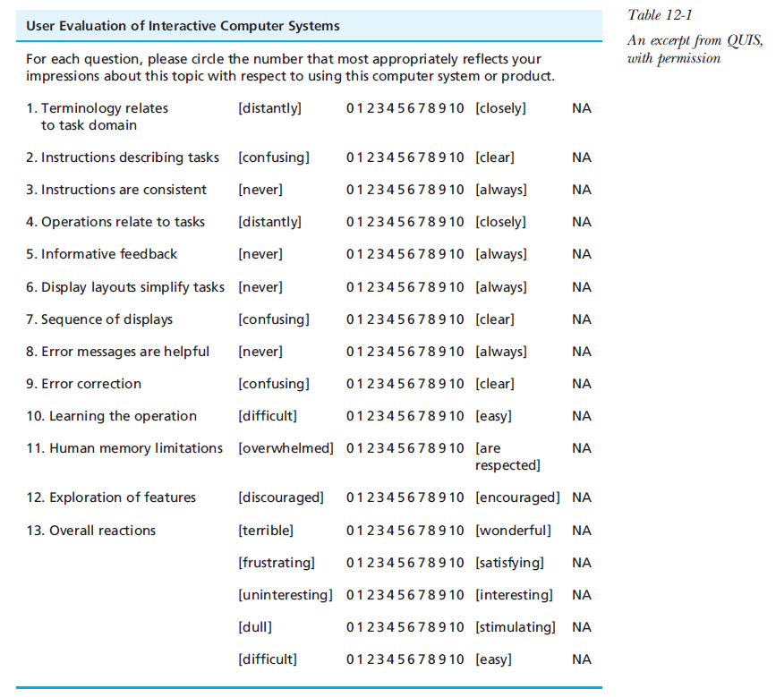
Survey example
Hartson & Pyla, p. 446

Slide 18
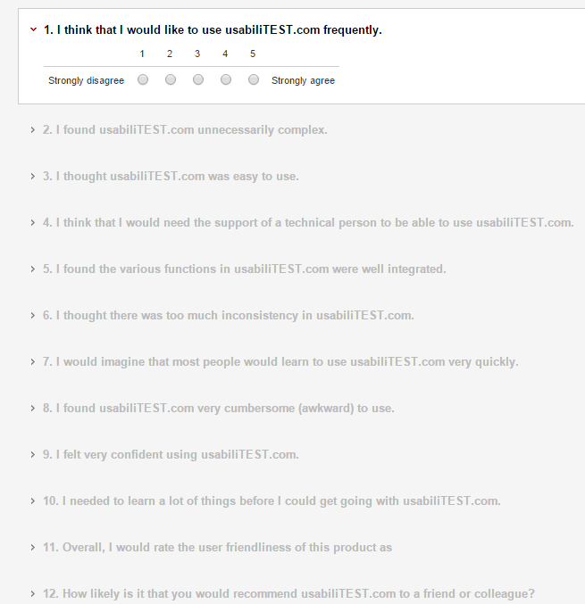
http://www.usabilitest.com/uxxc4jP

Slide 19
Videotaping
Often useful for measuring after the evaluation
But very slow to analyze and transcribe
Useful for demonstrating problems to developers, management
Compelling to see someone struggling
Facilitate Impact analysis
Which problems will be most important to fix?
How many users and how much time wasted on each problem
But careful notetaking will often suffice when usability problems are noticed

Slide 20
“Think Aloud” Protocols
“Single most valuable usability engineering method” – Nielsen
Get user to continuously verbalize their thoughts
Find out why user does things
What thought would happen, why stuck, frustrated, etc.
Encourage users to expand on whatever interesting
But interferes with timings
May need to “coach” user to keep talking
Unnatural to describe what thinking
Ask general questions: “What did you expect”, “What are you thinking now”
Not: “What do you think that button is for”, “Why didn’t you click here”
Will “give away” the answer or bias the user
Alternative: have two users and encourage discussion

Slide 21
Getting Users
Should be representative
If multiple groups of users
Representatives of each group, if possible
Issues:
Managers will pick most able people as participants
Getting users who are specialists
E.g., doctors, dental assistants
Maybe can get students, retirees
Paying users
Novices vs. experts
Very different behaviors, performance, etc.

Slide 22
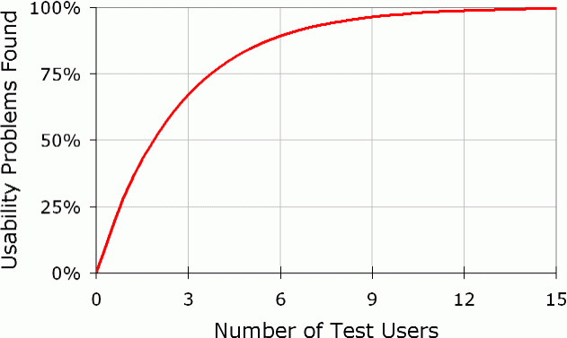
Number of participants
About 10 for statistical studies
As few as 5 for usability evaluation
Can update after each user to correct problems
But can be misled by “spurious behavior” of a single person
Accidents or just not representative
Five users cannot evaluate all of a system

Slide 23
Ethical Considerations
No harm to the users
Emotional distress
Highly trained people especially concerned about looking foolish
Emphasize system being evaluated, not user
Results of evaluation and users’ identities kept secret
Stop evaluation if user is too upset
At end, ask for comments, explain any deceptions, thank the participants
At universities, have “Institutional Review Board” (IRB)

Slide 24
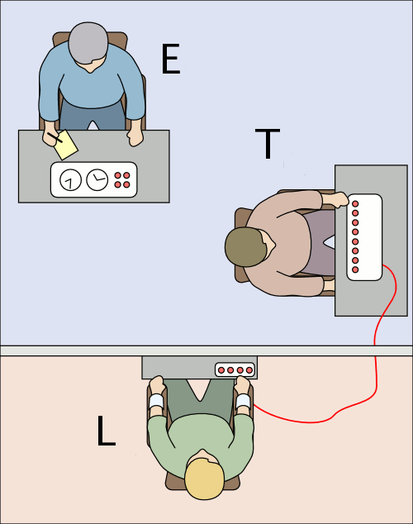
Milgram Psychology Experiments
Stanley Milgram 1961-1962
Subject (“teacher” T) told by experimenter (E) to shock another person ("Learner" L, an actor) if L gets answers wrong
> 65% of subjects were willing to give apparently harmful electric shocks – up to 450 volts – to a pitifully protesting victim
Study created emotional distress
Some subjects needed significant counseling afterward
http://www.stanleymilgram.com/
Image from Wikipedia

Slide 25
Authoring the Evaluation
Set up realistic situation
Write up task scenarios
Write detailed script of what you will say
PRACTICE
Recruit users

Slide 26
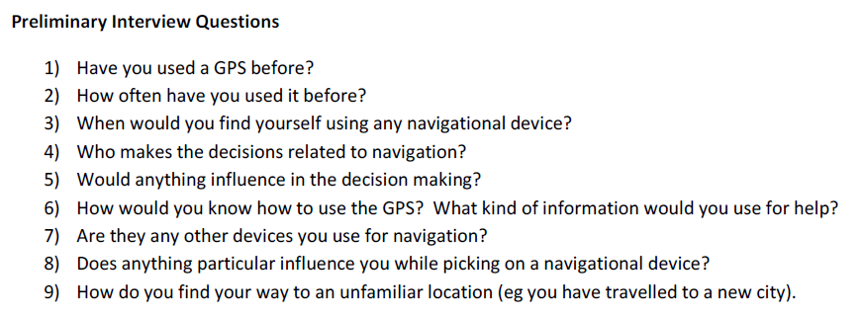
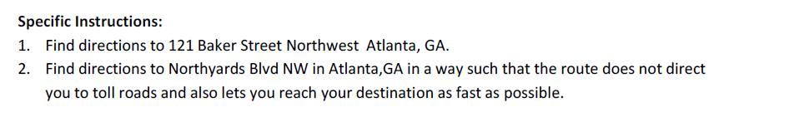
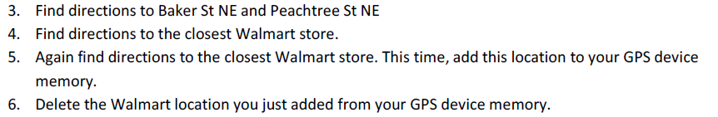
Example Script (copied from lecture 3)

Slide 27
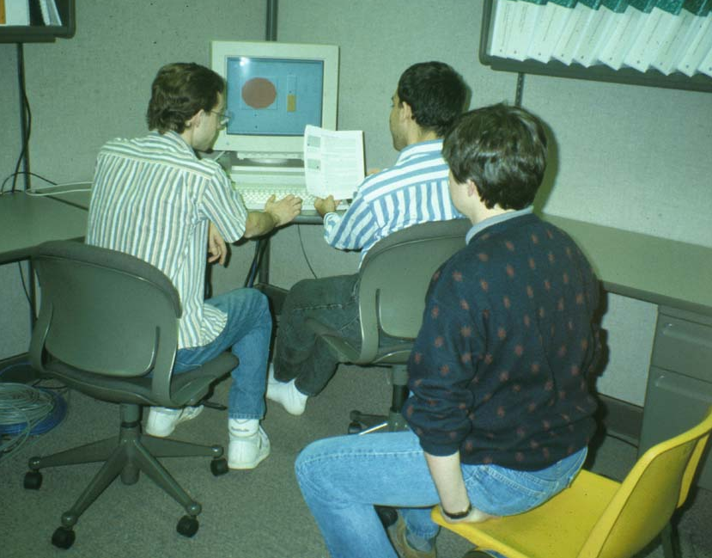
Who runs the experiment?
Trained usability engineers know how to run a valid usability evaluation
Called “facilitators”
Good methodology is important
2-3 vs. 5-6 of 8 usability problems found
But useful for developers & designers to watch
Available if system crashes or user gets completely stuck
But have to keep them from interfering
Randy Pausch’s strategy
Having at least one observer (notetaker) is useful
Common error: don’t help too early!

Slide 28
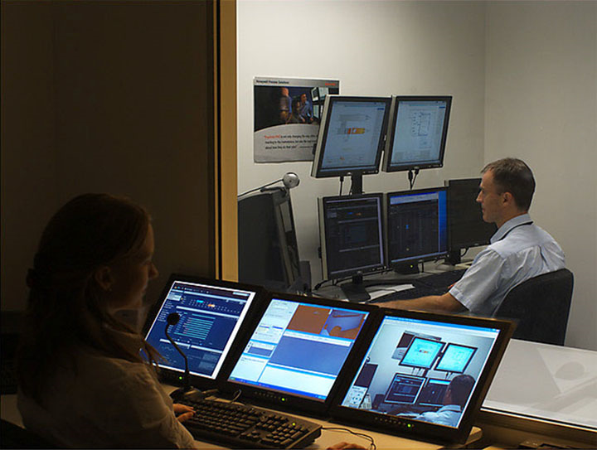
Where Evaluate?
Usability Labs
Cameras, 2-way mirrors, specialists
Separate observation and control room
Should disclose who is watching
Having one may increase usability evaluations in an organization
Can usually perform an evaluation anywhere
Can use portable video recorder, screen recorder, etc.

Slide 29
Stages of an Evaluation
Preparation
Introduction
Running the evaluation
Cleanup after the evaluation

Slide 30
Preparation and Introduction
Make sure evaluation is ready to go before user arrives
Introduce the observation phase
Say purpose is to evaluate software
Consent form
Pre-test questionnaire
Give instructions
Instruct them on how to do a think aloud
Write down script to make sure consistent for all users
Final instructions (“Rules”):
Say that you won’t be able to answer questions during, but if questions cross their mind, say them aloud
If you forget to think aloud, I’ll say “Please keep talking”
Notes:
Introduce the observation phase
Begin observation <play DateTime3.scm>
Conclude observation <play conclusion.scm>

Slide 31
Cleaning up After an Evaluation
For desktop applications
Remove old files, recent file lists, etc.
Harder for evaluations of web sites:
In evaluations of web sites, need to remove history to avoid hints to next user
Browser history, “cookies”, etc.

Slide 32
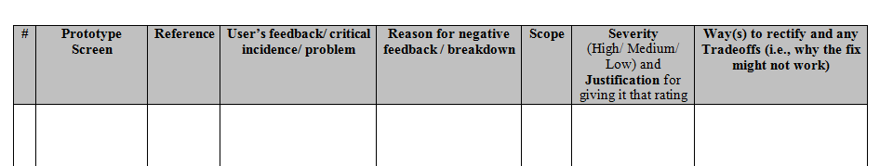
Analyzing the data
Numeric data
Example: times, number of errors, etc.
Tables and plots using a spreadsheet
Look for trends and outliers
Organize problems by scope and severity
Scope: How widespread is the problem?
Severity: How critical is the problem?
http://www.cs.cmu.edu/~bam/uicourse/UsabilityEvalReport_template2015.docx

Slide 33
Scope and Severity Separately
 |  | Proportion of users experiencing the problem
 |  | Few | Many
Impact of the problem on the users who experience it | Small | Low Severity | Medium Severity
 | Large | Medium Severity | High Severity

Slide 34
Write a Summarizing Report
“Executive” summary
Conceptual re-designs are most important
If just “tuning”, then a “top ten” list
Levels of severity help rank the problems
“Highlights” video is often a helpful communications device

Slide 35
What to do with Results
Modify system to fix most important problems
Can modify after each user, if don’t need statistical results
No need for other users to “suffer”
But remember: user is not a designer
Don’t necessarily adopt the user’s proposed fixes

