Slide 1
Lecture 3:
Contextual Analysis
Brad Myers
05-863 / 08-763 / 46-863: Introduction to
Human Computer Interaction for
Technology Executives
Fall, 2015, Mini 2

Slide 2
Initial Questions for the Users
First, assure the users that not testing them
  You are testing the product, and you want to find problems
Find out the context through initial questions
  When would you normally do this kind of task?
  Who would be involved in making the decisions?
  What would influence any decisions?
  How would you know what to do?
    What information would you use to help decide?

Slide 3
Test Script
Useful to have a script
  Make sure say everything you want
  Make sure all users get same instructions
Should read instructions out loud
  Ask if users have any questions
Often, different tasks for different parts of UI
Make sure instructions provide goals only in a general way, and does not give away information
  Describe the result and not the steps
  Avoid product names and technical terms that appear on the web site
    Don’t give away the vocabulary
Example:
  “The clock should have the right time”;
  not: “Use the hours and minutes buttons to set the time”

Slide 4
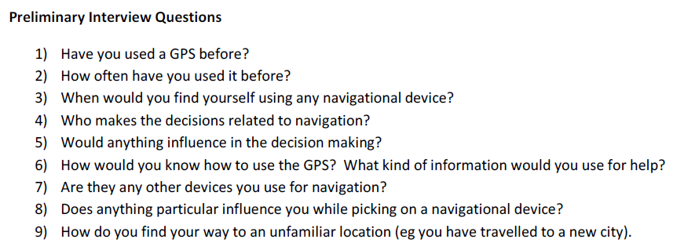
Example from a previous year
Garmin Nuvi 200 portable automobile GPS by Puja Subramanyam

Slide 5
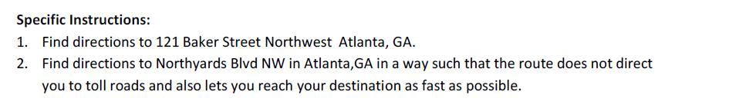
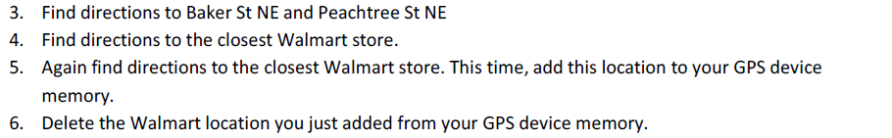
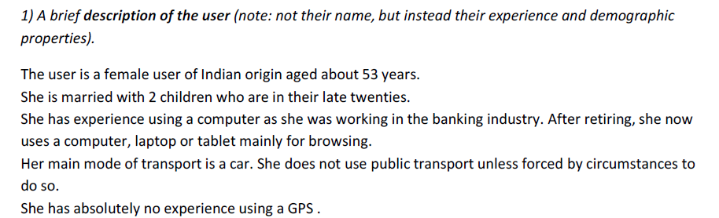
Example, cont.: Tasks & User

Slide 6
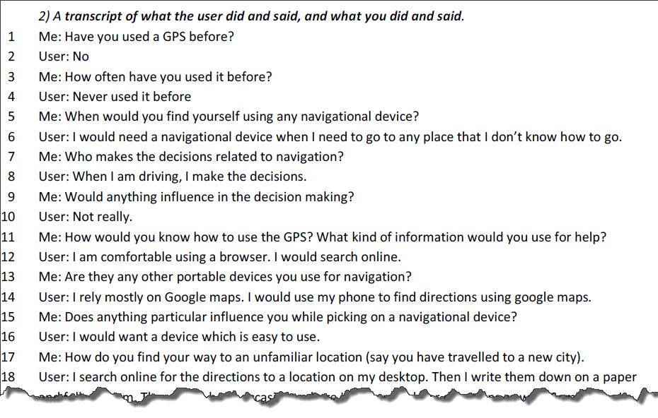
Start of Transcript

Slide 7
Example of CI
Video of sample session with a eCommerce site:
http://www.cs.cmu.edu/~bam/uicourse/EHCIcontexualinquiry.mpg
Issues to observe
  Interview of work in progress, in “context”
  Actual session of doing a task
    Not an interview asking about possible tasks, etc.
    Note that focusing on expert behavior & breakdowns
  Questions to clarify about routine, motivations
    Why do certain actions: need intent for actions
    Notice problems (“breakdowns”)
  Notice what happens that causes users to do something (“triggers”)
    E.g. appearance of error messages, other feedback, external events (phone ringing), etc.

Slide 8
Screen shots of important points in video
http://www.cs.cmu.edu/~bam/uicourse/EHCIcontexualinquiryScreens.ppt

Slide 9
What to do with all the data?
How organize and use data from contextual inquiry?
Recommended technique: Use Graphical Models (diagrams)
  Integrate
  Summarize
  Point back to the data
  Help inspire and guide design
  Provide shared focus
  Provide an intermediate deliverable outside design team
“Opinions are cheap but insights are priceless.”

Slide 10
Why Graphical?
Displays whole picture at once
Reveals patterns
Forces summarization and conciseness
Multiple models provides different perspectives

Slide 11
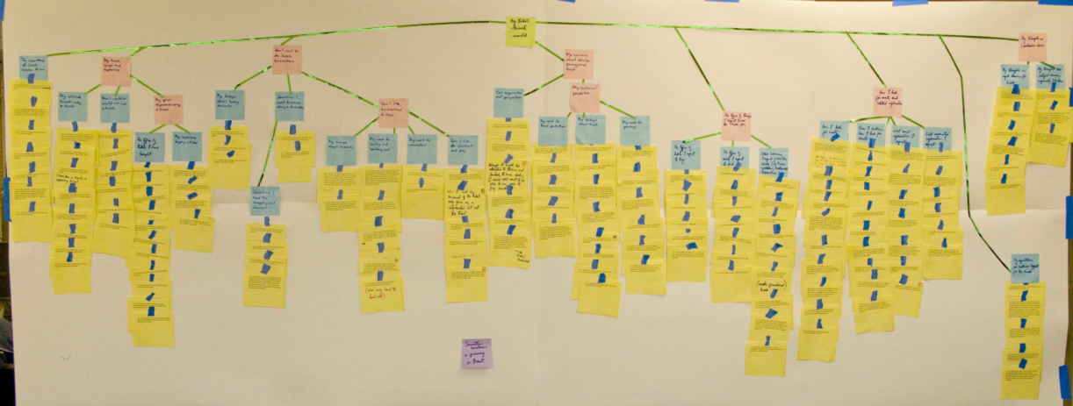
Analysis
Beyer & Holtzblatt call this process “Contextual Design”
But Hartson & Pyla call it “Analysis”
  Better name!
Hartson & Pyla recommend doing a Work Activity Affinity Diagram (WAAD) first, but we go right from data → models
  Affinity diagrams are more important for teams and when there are lots of ideas
You will make the models directly from your transcripts

Slide 12
Models:
Flow Model
  Communication and coordination necessary to perform task
Social / Cultural Model
  Constraints on work due to policy, culture, or values
Artifact Model
  Physical things used and created
Physical Model
  Layout of work environment as it affects the work.
Sequence / Step-by-Step Model
  Detailed work steps
  Sequence in Beyer & Holtzblatt expanded in multiple models
  “Step by Step Task Interaction Model”

Slide 13
More Models
Other models are in Hartson & Pyla but not covered further here (not in homeworks or on exam)
  Task decompositions
  Usage Scenarios (narratives about tasks)
  Essential Use Cases (user and system steps)
  Information Object Models (information needed and generated)
Providing both “current” and “envisioned” versions of the models
  We are only doing the current version

Slide 14
In ALL Models
ALWAYS label everything you put on the model with the line-number in the transcript (or time on the video/audio, if no transcript).
This allows you to get back to the raw data to see if a different interpretation is possible.
If there is no pointer back, then it is an unsupported Assumption and subject to additional scrutiny.
Don’t make things up – show only what is available in the data

Slide 15
“Breakdowns” / “Barriers”
Problems that interfere with normal operation
Represented in most models
Key opportunities and issues for design
Often shown in red with a “lightning bolt”
Can’t see
the screen

Slide 16
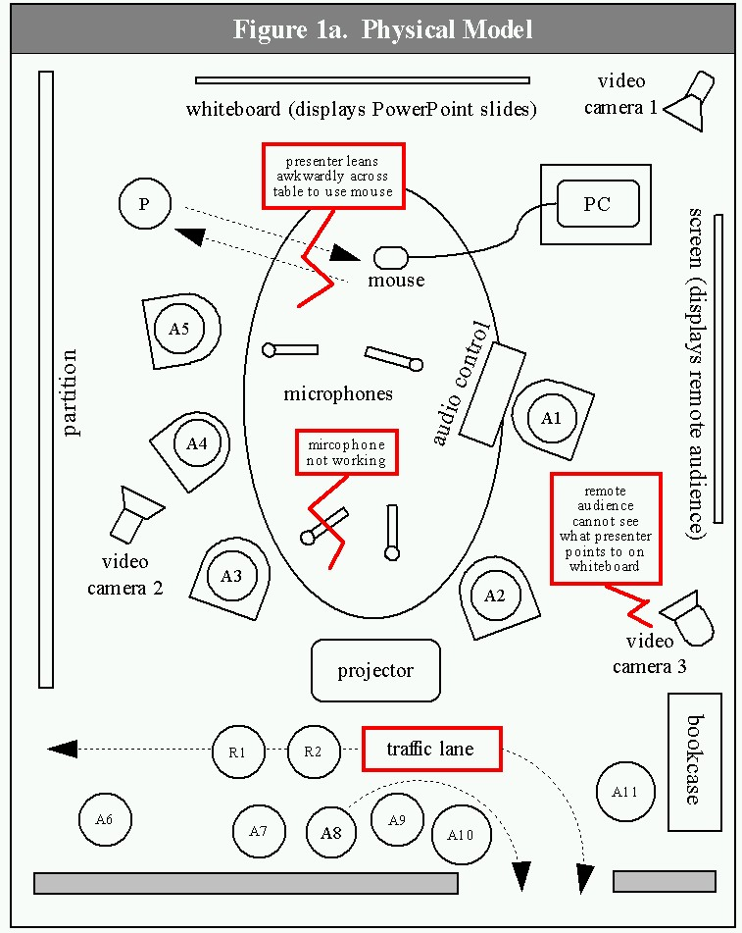
Additional Example
New example: Giving a presentation
From our paper:
  Karen Cross, Adrienne Warmack, and Brad Myers. "Lessons Learned: Using Contextual Inquiry Analysis to Improve PDA Control of Presentations“
  Results influenced design of SlideShow Commander remote control product for mobile phones
Used in the Hartson-Pyla textbook

Slide 17
Flow Model
Communication and coordination necessary to perform tasks
  Work flow
  Who talks to whom? Who gives what to whom?
Key roles of individuals or groups
Key responsibilities of that person with respect to the tasks
Flow of communication and artifacts, shown as arrows
Artifacts passed around
Actions along the way
Places that things or people go
Breakdowns

Slide 18
Flow Model structure
Circles and/or icons = people or groups by role
Boxes = things (artifacts), places, files, etc.
Arrows = flow
Red lightening bolts = breakdowns
Times refer to time codes in video
  Could also refer to lines of a transcript
  For homework, approximate times are OK
  “(A)” = Assumption = interpretation
    Note: not for team-member's opinions about the UI
    Instead (A) is for assumptions about what user did
Note: you (interviewer) are never in any model

Slide 19
Flow Model components
General
  How do job responsibilities get assigned to people?
  How do they get help?
  How do new tasks get assigned, and how are they carried out?
  Coordination: where did each artifact come from and where does it go?
    Problems with coordination: forgetting, timing, steps
  Creates the “bird’s eye view” of organizational structure
Web
  NOT flow chart of pages visited
  How information and command flow among the site(s)

Slide 20
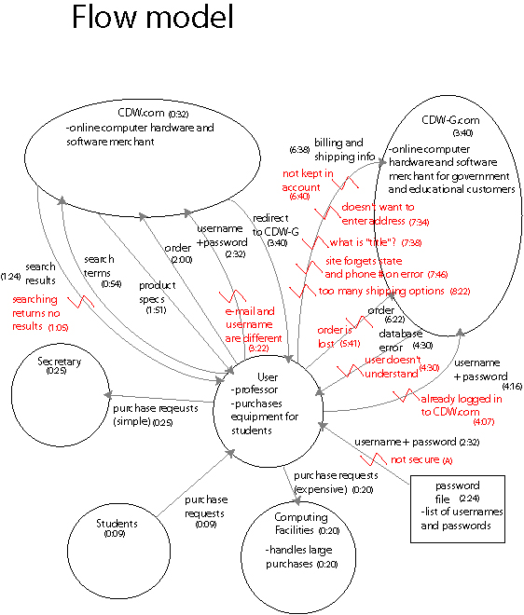


Flow
Model
Example
(CDW)

Slide 21
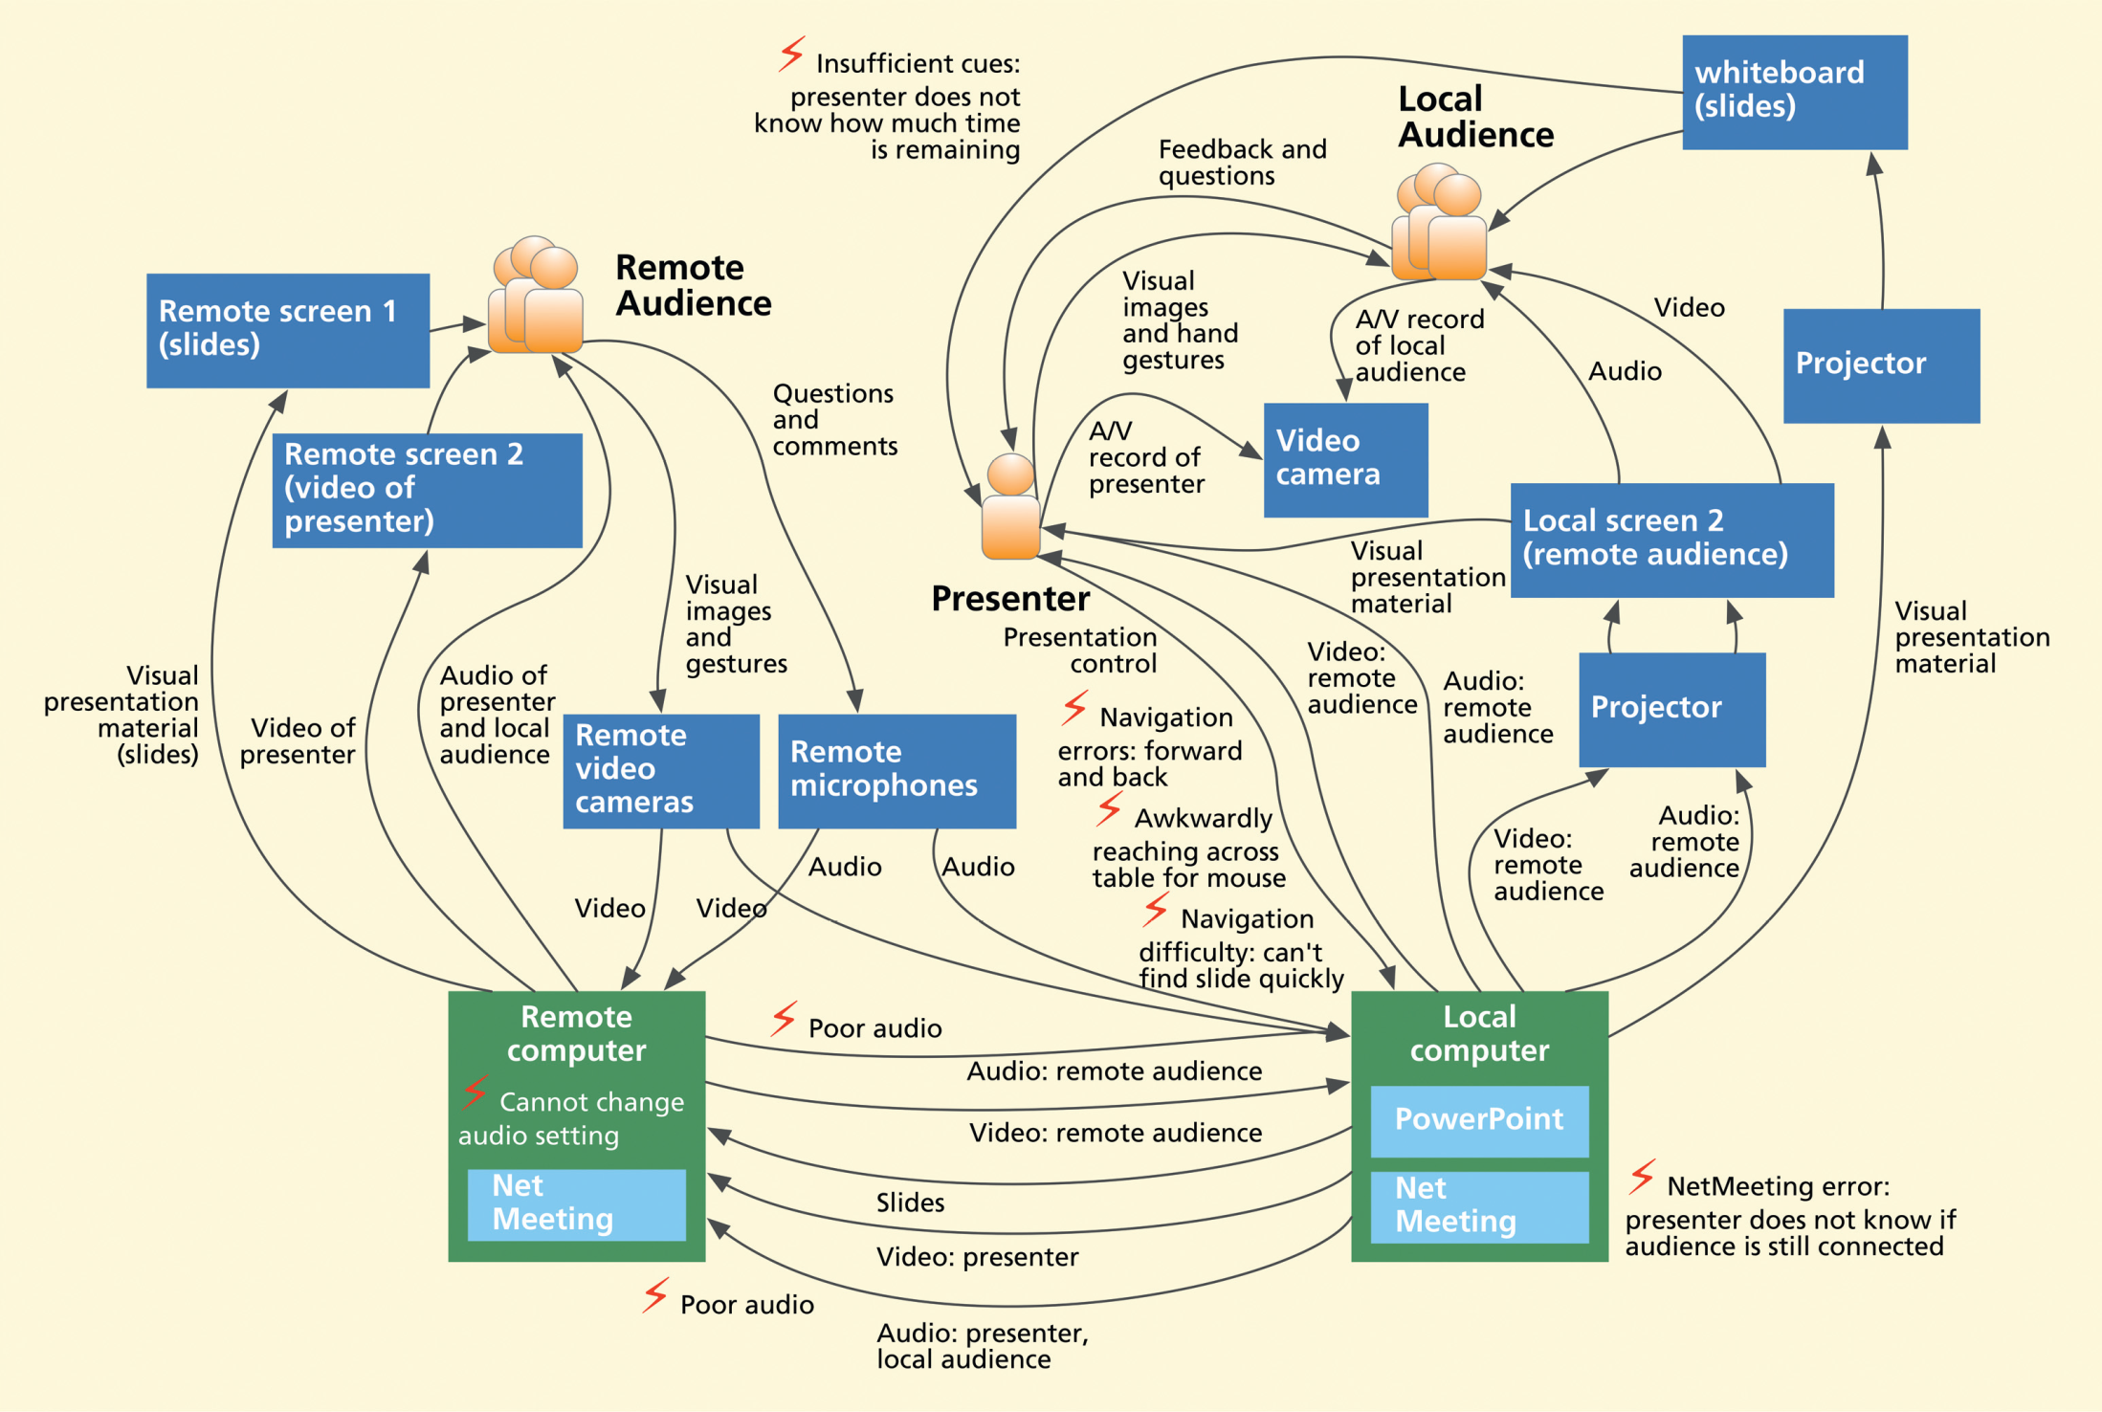
Flow Model Example (SSC)
Fig 6-8 in text

Slide 22
Social Model
Beyer & Holtzblatt call this “Cultural Model”
Culture of organization, family, community defines expectations, desires, policies, values and approach
“Culture is as invisible as water to a fish”
  Pervasive, inescapable; yet invisible and intangible
Types of influences:
  Formal and informal policies
  Power of individuals and groups over each other
  Values of company or team
  Work domain constraints
  Group’s sense of identity
  People’s emotions about what they do
  The style, values and preferences of individuals or teams
More examples of what goes on social model:
  When acceptable to use a recording device
  What friends might think

Slide 23
Social Model Structure
Ovals for “Influencers”: individuals or groups, internal or external
Thought bubbles for feelings/concerns that they actually expressed
  Note: often from the preliminary questions or opinions during the CI
Arrows for direction of influence
  Labels for samples of dialog showing type of influence and attitudes
    Worded as commands
  Also show “pushback” – influence in other direction
Breakdowns
  In relationships among people
  No need to repeat previously shown problems
NOTE: Not allowed to make stuff up!
  Just what you actually have data to support!

Slide 24
Social Model Contents
What to put into social model for appliances:
  Context of use: when used, other people around, whether OK to record other people, what it looks like
  Feelings: proud to own it, embarrassed
  Influences: why buy one vs. another, qualities desired
But need data to support all claims
  From initial interview questions or other evidence
Can’t just make stuff up!

Slide 25
Social Model
Example (CDW)
Handle my small purchases (0:25)
Secretary
CDW/CDWG
Orders wrong item (A)
Provide me with reliable service and good prices (0:43)
I will make my own purchases when I want a specific item (0:28)
Students
User
Handle my large purchases (0:20)
Buy us the equipment we need (0:09)
Computing
Facilities
Takes too long to make a purchase (A)
Want to get right unit (0:28)
Reliability is important (0:42)
Good prices are important (0:46)

Slide 26
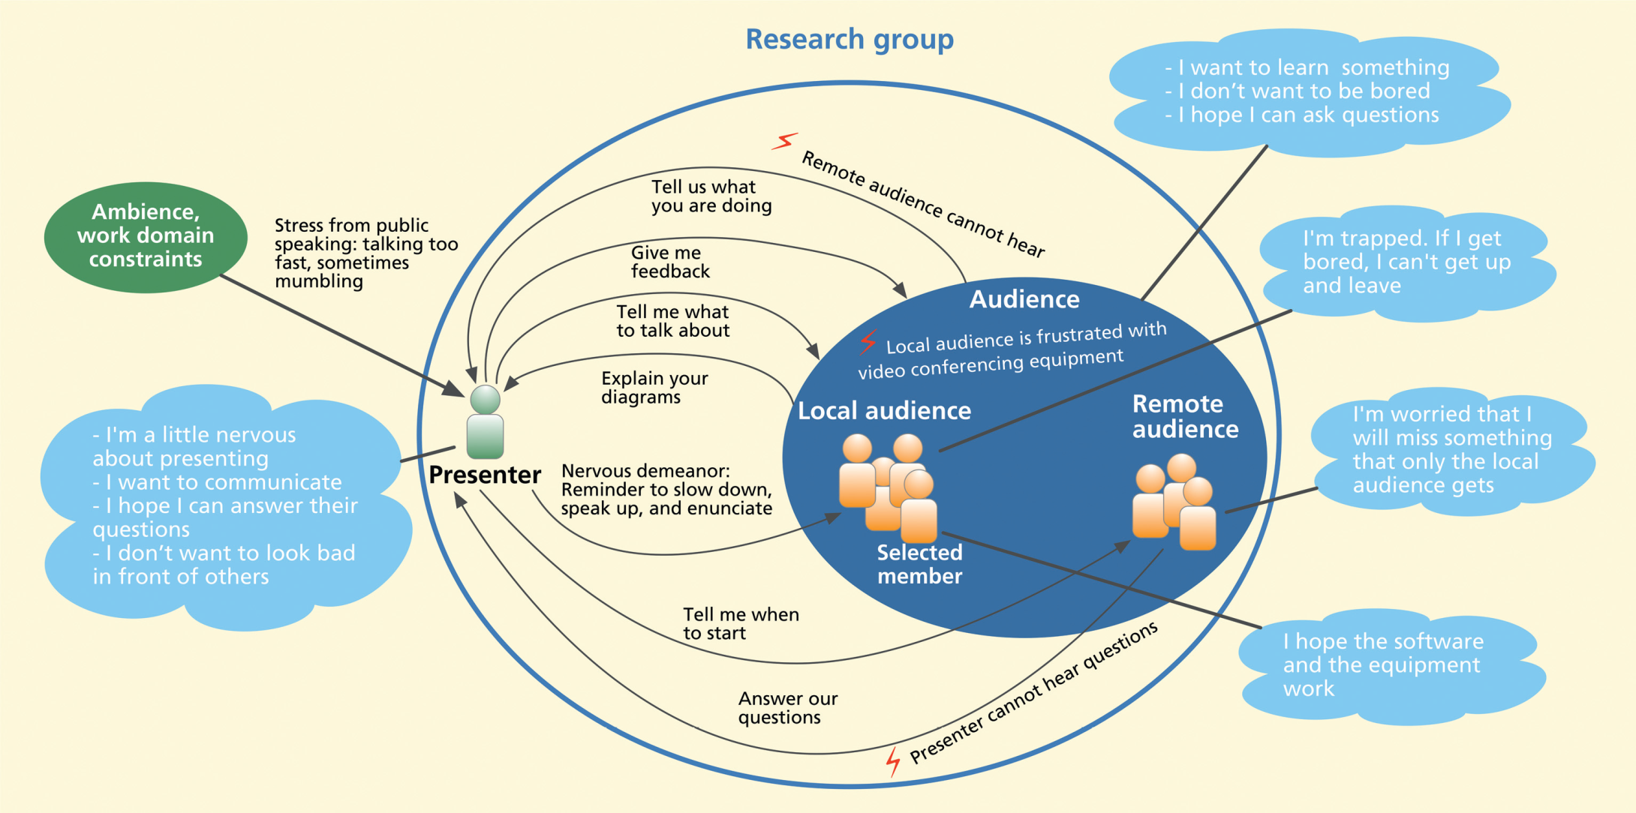
Social Model Example (SSC)
Fig 6-6 from text

Slide 27
Artifact Model
Artifacts: What people create, modify and use as part of tasks
Reveal traces of people’s work practices
Examples:
  Handwritten notes and signatures on hardcopy project plans -> information flow and approval
  Fancy formatting on spreadsheet -> looks are important
  Screen shots showing problematic features
Model = drawing, photograph or copy of real artifact
Annotate with observations

Slide 28
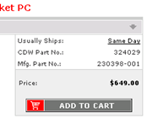
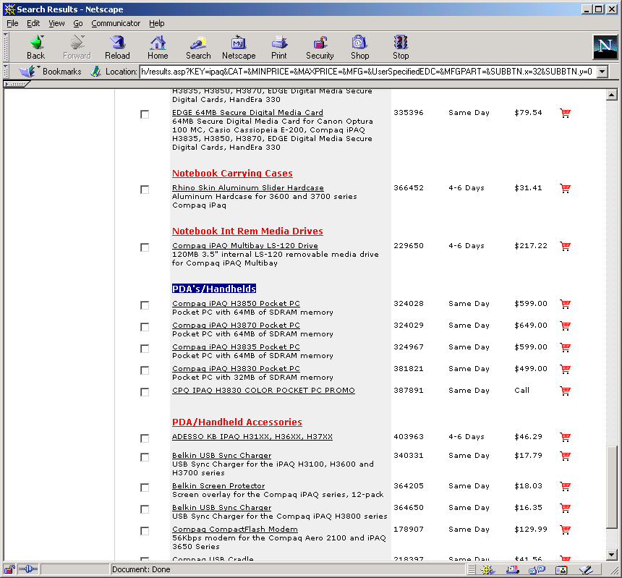
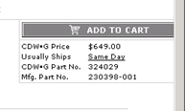
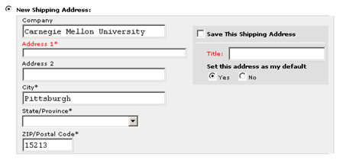
Artifact Model
Examples (CCW)
Inconsistent placement of “Add to Cart” buttons
(1:52, 6:23)
Search results are too long, and categories labels should start with differentiating word (1:46)
Confusing label (07:22)

Slide 29
Physical Model
Way the physical environment affects tasks
  E.g, placement of items on a desk
  Proximity of printers
  Can’t hold a device with a keyboard while standing up
In presentation example, where people are and layout of environment
Note: Physical model not always relevant or needed
  Seems less important for web, unless mobile
Not required for homework 1, but please do one if environment affects your system

Slide 30
Components of Physical Model
Places in which work occurs
Physical structures which limit or define the space
Usage and movement within the space
Hardware and other artifacts used
Layout of tools and artifacts
Positions of people within environment
Breakdowns due to physical environment

Slide 31
Physical
Model, example

Slide 32
Beyer&Holtzblatt’s Sequence Model
Similar to Hartson&Pyla’s “Step-by-Step Task Interaction Model”
Steps taken to complete a task
Triggers that cause the step to happen
  E.g., at a particular time; when something else happens
Intent is key to understanding the steps
  Also called the goal
  Why each step is performed, and why in that order
Arrows to show order of the steps
  Can have loops
Breakdowns in communication or coordination
(Note: this model not in homeworks or exam)

Slide 33
Sequence Model Components
Can choose level of detail depending on focus (what investigating)
  E.g., for writing a letter:
    High-level (functional level): Find most recent letter written to same person, open it, delete date, replace with new date, delete contents, type new contents, …
    Low level (user interface level): Switch windows explorer to details view, Sort files by date, double-click on top item, check “To:” to see if correct person, click and drag across date field, …
Notice hesitations and errors
  Interrupt and ask why or what expected

Slide 34
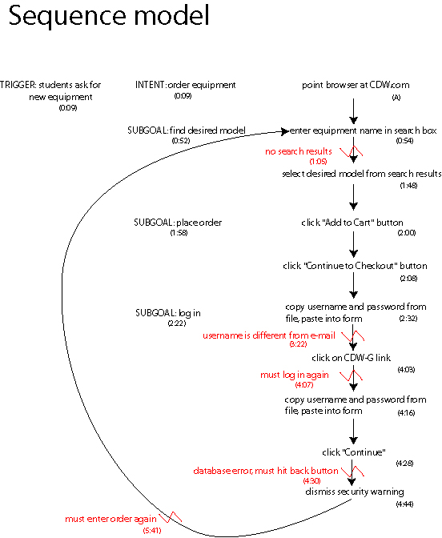
Sequence
Model example

Slide 35
Hartson&Pyla’s
Task Structure Models
Their replacement for Sequence Model
Tasks that need to be supported by the system
You need to decide the important tasks in order to:
  Optimize interface & design – what is important?
  Design user study tasks – what will participants do?
Understanding tasks can help with better designs because organize UI by task, not by function
  What to do, not how
  Information needs – what need to know to do task
Unlike sequence models, task models try to capture all requirements, not just the ones in the data

Slide 36
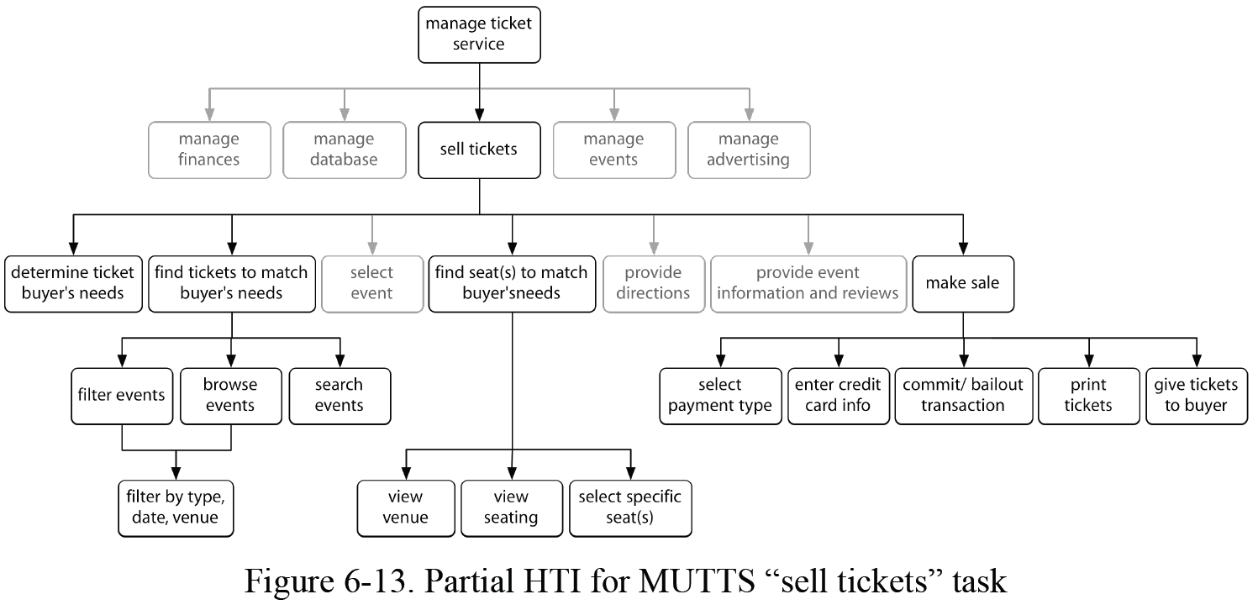
Hartson&Pyla’s
Hierarchical Task Inventory
Hierarchical Task Inventory (HTI) shows tasks and subtasks
  Doing a subtask is part of doing the parent task

Slide 37
Creating Models
Create models generalizing over all interviewees
  “Consolidated” models
  Barrier summaries
  Key Idea: Induce generalizations from concrete data
    Don’t rely on intuition alone
    Don’t deduce from logical abstractions
    Example:
      Logic says system manager will diagnose the reason behind a system failure. Actual practice: System manager tries standard fixes first (like reboot) & diagnoses only if necessary
Main goal: Deduce the intent

Slide 38
What To Do With Models
User data drives innovation
  Solve problems (breakdowns) identified in models
  Grounded brainstorming
Flow model
  Eliminate flows, roles, redundant data entry
Social / Cultural model
  Increase communication, reinforce positive values
Artifact model:
  Guide requirements, metaphors, remove screen problems
Physical model:
  Depend only on what is available, reduce motion, improve flow of artifacts
Sequence model:
  Eliminate, automate steps

