Slide 1
Lecture 7:
Implementing a Prototype:
Overview of Using PowerPoint, Balsamiq, InVision, html, etc.
Brad Myers
05-863 / 08-763 / 46-863: Introduction to
Human Computer Interaction for
Technology Executives
Fall, 2014, Mini 2

Slide 2
Implementing your Prototype
How “complete” an implementation for HW4?
  Screen transitions must work
  All buttons should do something, even if go to a “not implemented yet” page – facilitates user testing
  Search, other computation does not have to work
  “Click-through” level of behaviors
  Must show any external reactions
    E.g., taking a picture, starting microwave, making a copy…
    Pop-up a dialog box saying what’s happening…
Level of complexity required:
  (Same as listed on homework0 page)
  At least 30 “controls” (widgets: buttons, text fields)
  About 10 different screens/pages/windows/modes
Must be done in one (1) week – no extensions!
  Will be given to your classmates for HW 5

Slide 3
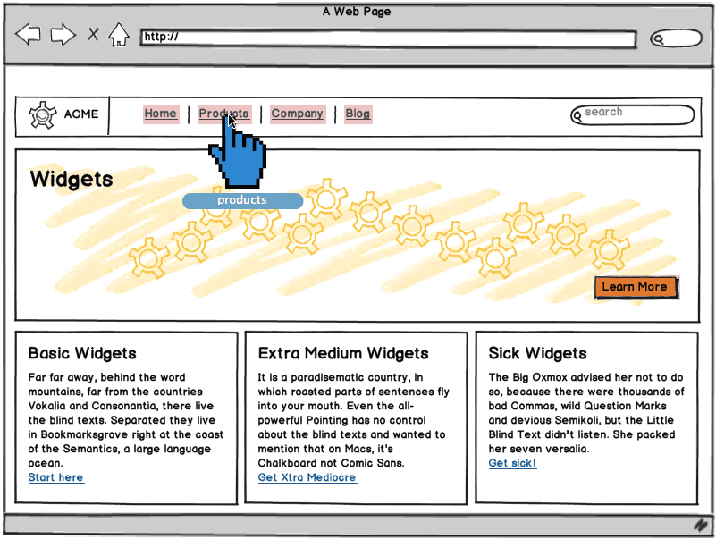
“Wireframe” Level Prototype
Outlines of the buttons and controls
No need for final graphics
Our requirement:
sufficient
functionality to
support your tasks
Labels should be
the real ones
  So can test that
  users understand
  what they do
Source: http://support.balsamiq.com/customer/portal/articles/107999-specifying-interaction-with-mockups

Slide 4
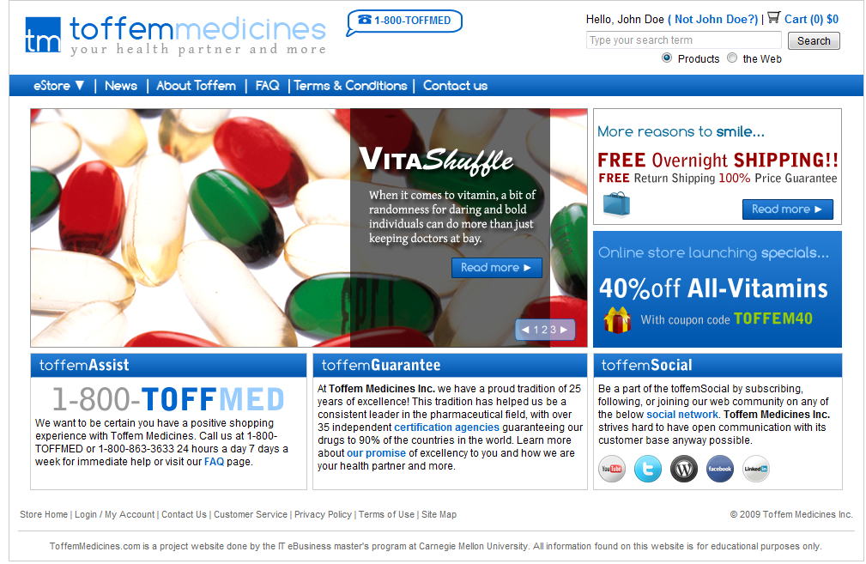
Or, Produce Final-Looking Graphics
Alternatively, could use Photoshop, Illustrator, etc. and produce final graphics
  Designers want to show what real UI will look like
  Details of the “look”
Web pages often use final graphics
  E.g., Toffem Medicines
Add “click-through”
behaviors
  Usually limited mostly
  to screen transitions
Notes:
Search for “vitamins” on Toffem page
Note that all the buttons go to somewhere – most to the NIY page

Slide 5
All Buttons must be labeled and should “work”
User should be able to be equally confused by your prototype as by the real interface.
For each screen on the prototype that you create, that screen should have every control that would be on the real screen.
Each control should do something
  Most will go to a “not implemented yet” page

Slide 6
Implementation Options for HW4
Pretty much any way you want
  Must “work” – not just paintings
  “Click-through prototypes”
We recommend you do not use Java, C++, Objective C (iPhone) or other “professional” language
Note: you must be able to create software that is easy for others to run
  Must work on both PC and Mac
  Output a set of web pages, or a pdf file
If you use OmniGraffle (Mac only) or Visio (PC only) or Visual Studio (PC only), you must output as clickable pdf or something.

Slide 7
Recommended Options
These are easiest to use:
  PowerPoint – Brad demo
  Html – demo
    Using editor like Dreamweaver
    Dreamweaver has a free 30-day trial
  Html + Javascript (more programming)
Balsamiq – demo
  Free accounts to Balsamiq on line
InVision – demo
  Free student accounts

Slide 8
Lots of other choices…
Axure is a popular commercial tool
  www.axure.com
  Advantage – only one with components that can be used on multiple pages
https://moqups.com/
JustInMind - http://www.justinmind.com/
Flinto - https://www.flinto.com/ - prototype smartphone apps
Adobe Flash
Old tools:
  Visual Basic
  HyperCard (1998) & similar
  Flash Catalyst (2010)

Slide 9
Lots of Lists of Tools
Search for “Prototyping tools” or “Wireframing Tools”
  http://uxmovement.com/resources/3-best-vector-wireframing-tools-for-designers/ (2014)
  http://www.cooper.com/journal/2013/07/designers-toolkit-proto-testing-for-prototypes?utm_source=Cooper&utm_campaign=017b6536a1-Newsletter_Sept13&utm_medium=email&utm_term=0_162d77b95f-017b6536a1-85381653 (2013)
  http://www.fuelyourcreativity.com/17-great-wireframing-tools-for-web-designers/ (2012)
  http://www.creativebloq.com/wireframes/top-wireframing-tools-11121302 (2012)
  http://mashable.com/2010/07/15/wireframing-tools/
  - “10 free wireframing tools” (2010)
  http://www.uxbooth.com/blog/15-desktop-online-wireframing-tools/ (2010)
  http://www.uie.com/articles/prototyping_tools/?link=tips100318_6 (2010)

Slide 10
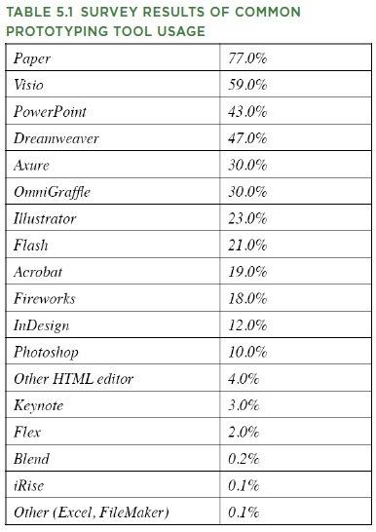
What Are People
Using?
  http://www.uie.com/articles/prototyping_tools/?link=tips100318_6
    Mar 18, 2010
  My survey results are similar (2007)

Slide 11
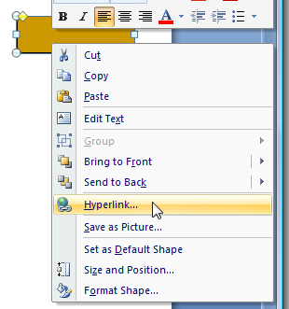
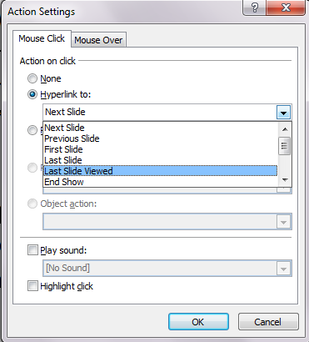
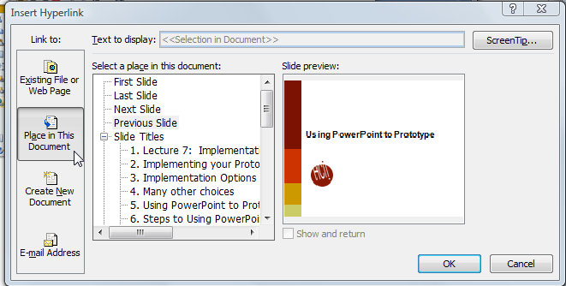
Using PowerPoint to Prototype
Add a shape, with a label
Add a “Hyperlink”:
  Select “Place in this document”
Add an “Action”
  More options, including
  “last slide viewed”
    Useful for “under
    construction” page
Create a slide for each
mode of the application
Can add nice animations
Go back
Go first
Return

Slide 12

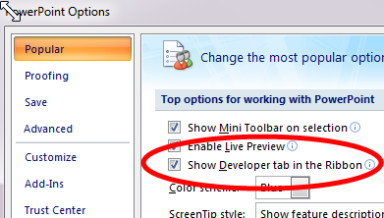
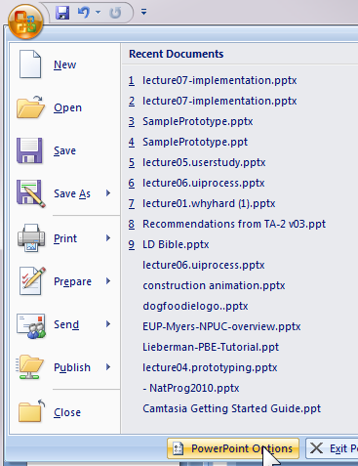

Adding Controls in PowerPoint
Turn on “Developer Toolbar”
  Can add buttons, text entry, etc.
  Script with VB
  (Office 2007)

Slide 13
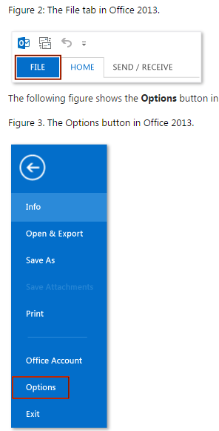
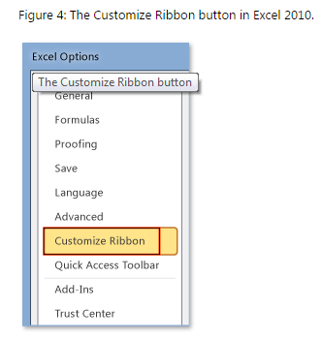
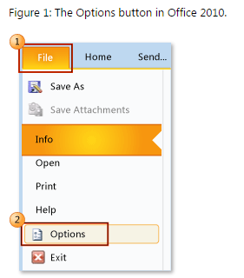
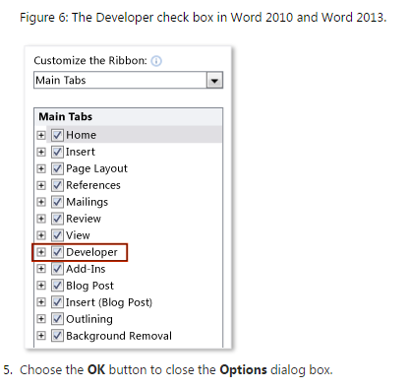
Adding PowerPoint Controls
Source: http://msdn.microsoft.com/en-us/library/bb608625.aspx

Slide 14
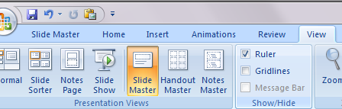
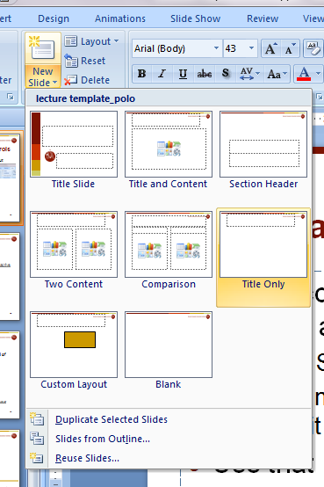
Use “Master” for Shared Controls
If want controls on multiple pages, can put them on a “Master”
  “View / Slide Master”
  Create new master slide
  and edit as with any other slide
Use that master for new slides
  Drop down from “New Slide”
Controls like check boxes, text
boxes in Master use same value
across all slides

Slide 15
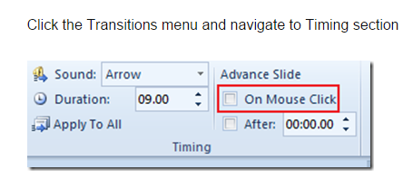
PowerPoint – turn off auto-advance
Make sure that clicking does not advance slide
Office 2007:
http://blogmines.com/blog/how-to-disable-advance-slide-on-mouse-click-in-powerpoint-2010/
Office 2010 & 2013:

Slide 16
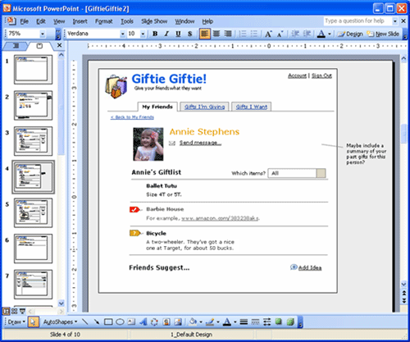
PowerPoint examples
Great training in using PowerPoint:
  http://www.boxesandarrows.com/view/interactive
    by Maureen Kelly on 2007/08/06
Local copy

Slide 17
TA-Run Demos
HTML prototyping – Michael Loffredo
Balsamiq – Julie Eckstrom
  Professor Myers can get free on-line accounts for Balsamiq online for anyone in class
  – send email
OmniGraffle → pdf – Julie Eckstrom
InVision – Sabrina Li
  Free for students

Slide 18
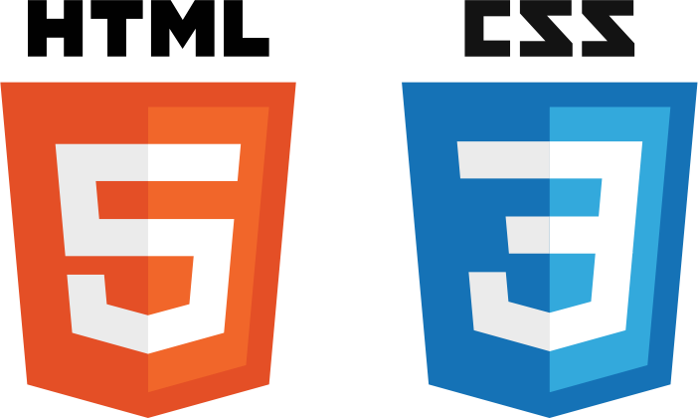
Prototyping with

Slide 19
Why prototype with HTML and CSS?
Provides a realistic experience
Can be used for any fidelity
Allows absolute control over appearance
Good for making quick changes

Slide 20
Why HTML5 and CSS3?
More powerful in terms of interactivity than
it ever used to be
  CSS3 Transitions provide you with options to create interactions that used to require JavaScript or jQuery
  Learn CSS3 transitions

Slide 21
Drawbacks of HTML5 and CSS3
Might be hard to pick up if not familiar
  Can take longer to create interfaces when compared
  with tools like Balsamiq
Many features not compatible with all browsers
  Go to caniuse.com

Slide 22
What to use
For wireframes:
  Adobe Photoshop
  Adobe Illustrator
  Adobe InDesign
For coding:
  Adobe Dreamweaver (free 30-day trial)
  Sublime
  TextEdit
  (any text editor will work)
Alternatives:
  Google Web Designer
  Google Sites

Slide 23
Learn to Code
W3schools
Codecademy

Slide 24
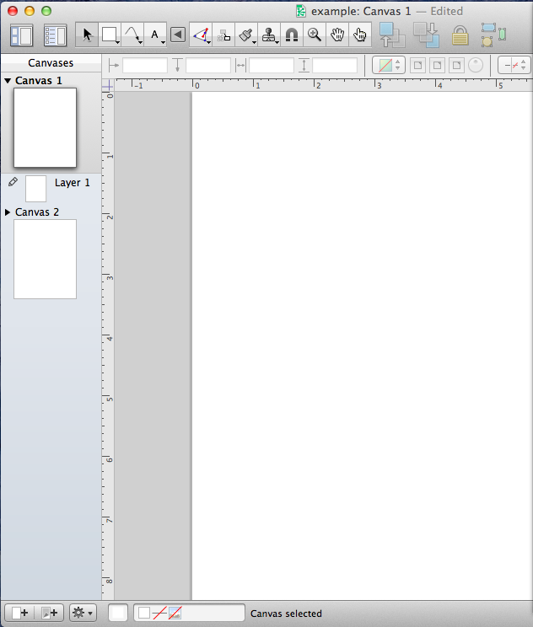
OmniGraffle
Interactive Prototyping Tool
Julie Eckstrom

Slide 25
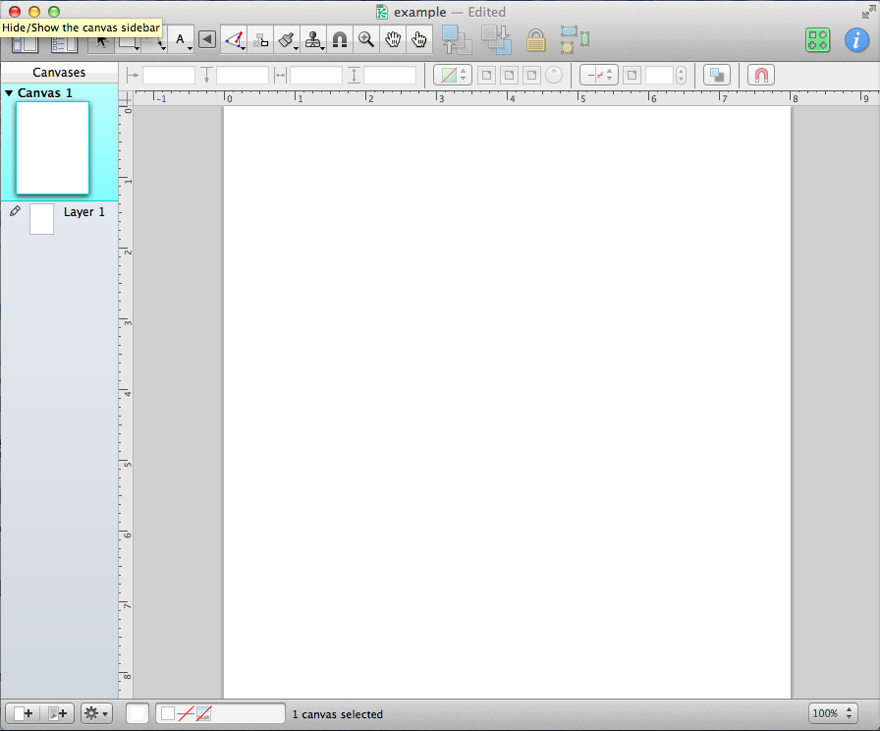
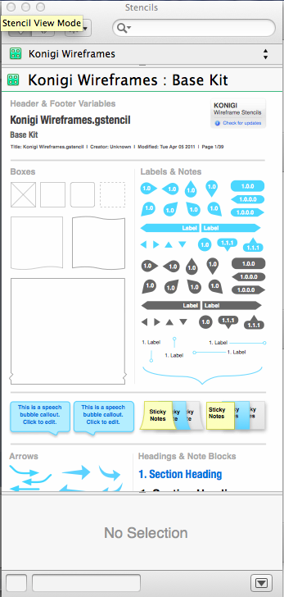
Drag and drop interface for creating wireframes

Slide 26
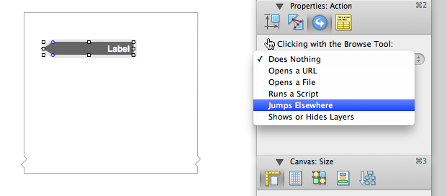
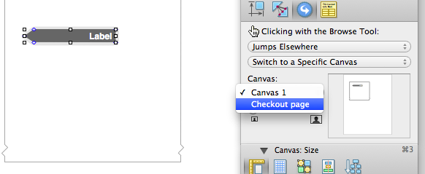
Add links between canvases to create a clickable PDF

Slide 27
Drawbacks
Have to download other libraries to have a sketchy feel
Cannot collaborate easily
No transition effects, can only create a clickable PDF
Not as rapid as other tools

Slide 28
Get It Here
14 Day Trial
https://www.omnigroup.com/omnigraffle

Slide 29
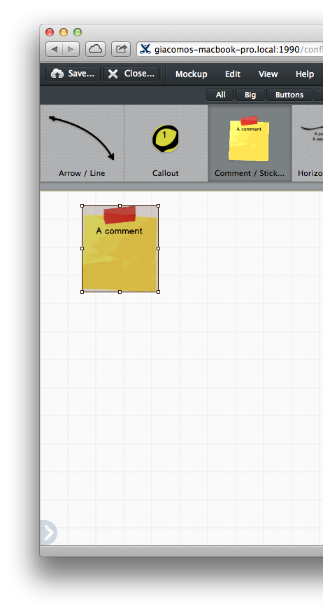
balsamiq
Rapid Wireframing and Mock-Up Tool
Julie Eckstrom

Slide 30
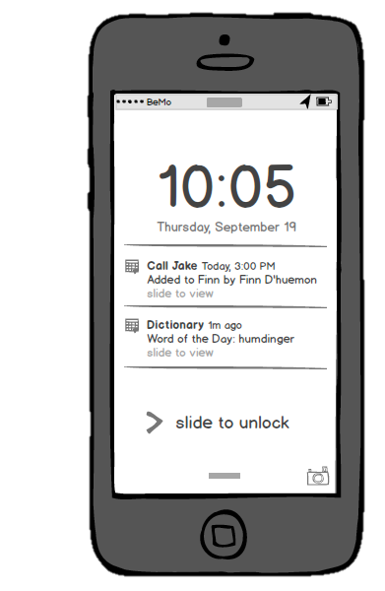
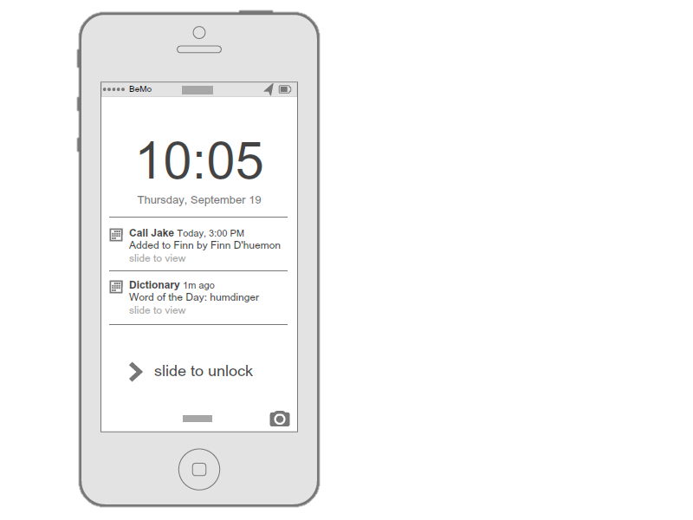
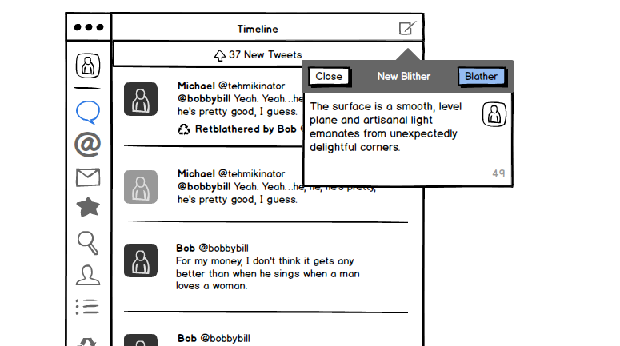
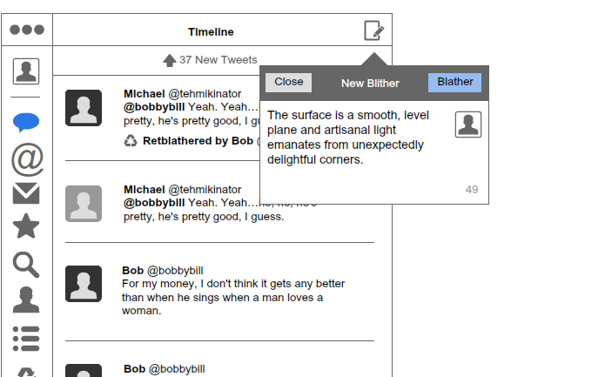
Low-fidelity prototypes,
Sketchy look and feel

Slide 31

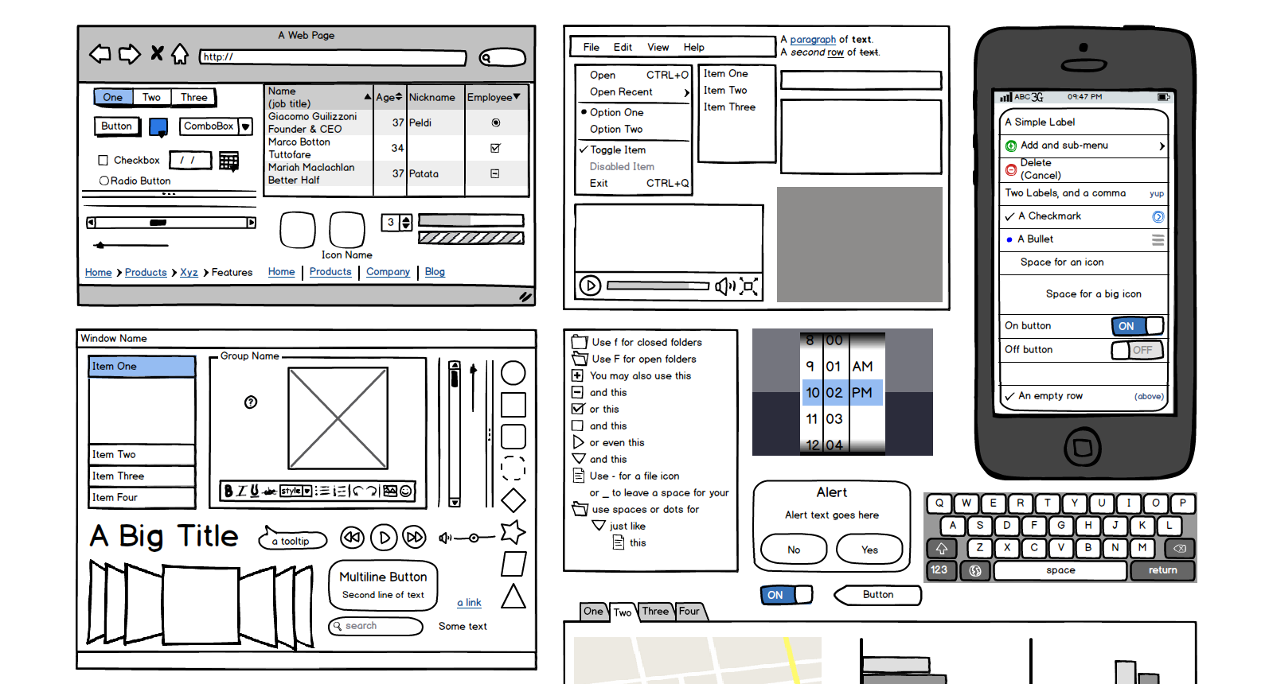
Drag and drop UI libraries

Slide 32
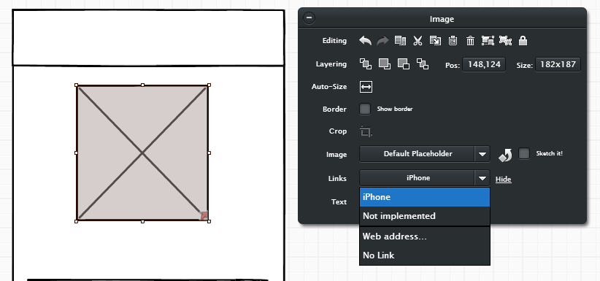
Add click-throughs using “Links” on the property sheet that appears when you select an object. You can go to any screen (mockup) you have made

Slide 33
Drawbacks
Limited to low-fidelity
Cannot export as HTML
Does not support transitions or gesture effects
Rigid controls for complex elements

Slide 34
Get It Here
Sign Up or Download
https://www.mybalsamiq.com/signup
http://balsamiq.com/download/

Slide 35
Additional Resources
Tutorials and Videos
http://support.balsamiq.com/customer/portal/articles/1335124
Additional UI Libraries
http://support.balsamiq.com/customer/portal/articles/131430
User Testing with myBalsamiq Prototypes
http://support.balsamiq.com/customer/portal/articles/433253

Slide 36

Design Prototyping Tool
Sabrina Li

Slide 37
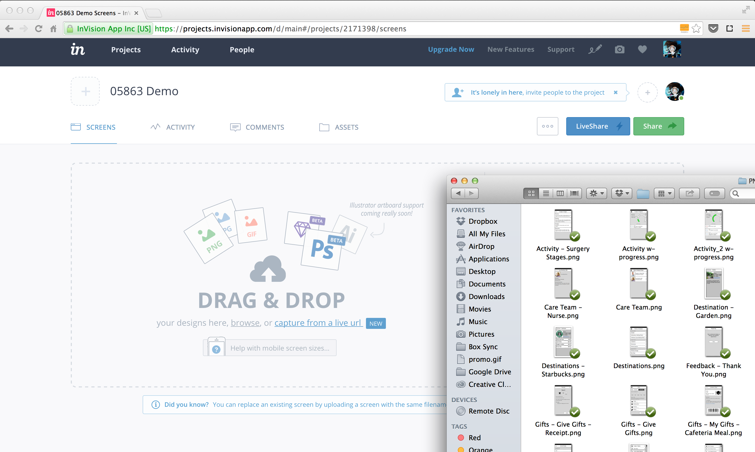
Drag and drop interface for uploading screens

Slide 38
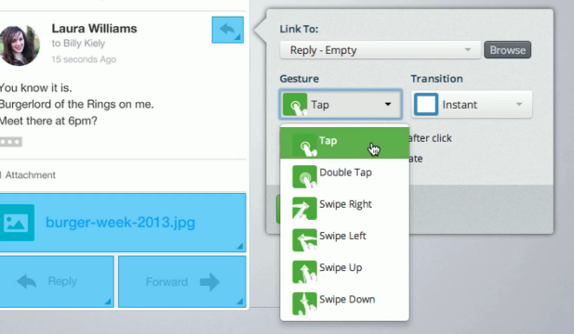
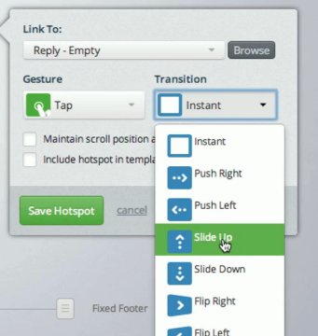
Add transitions and gesture effects to link screens

Slide 39
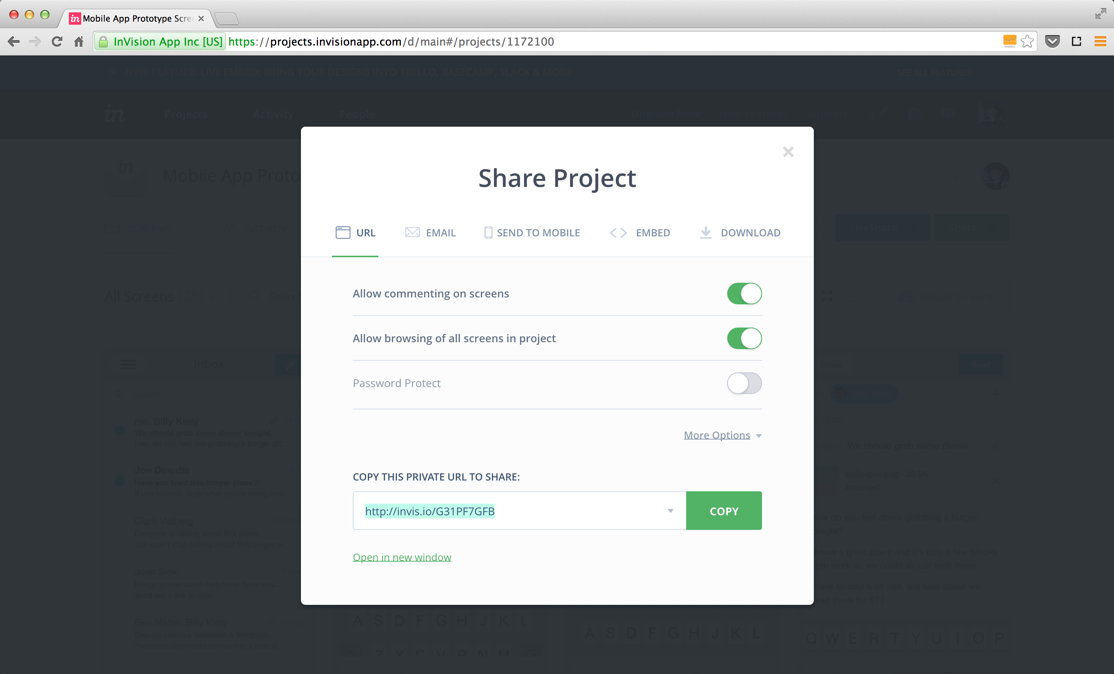
URL to display prototype online

Slide 40
Advantages
Quick
Hotspot Templates
Gestures and Transitions
Sharable

Slide 41
Drawbacks
Cannot create or modify designs
Mockups and screens must be imported
Supports limited file types (JPG, PNG, GIF)
Not as robust or powerful as other tools

Slide 42
http://www.invisionapp.com/

