Slide 1
Lecture 9:
Usability Process
Brad Myers
05-863 / 08-763 / 46-863: Introduction to
Human Computer Interaction for
Technology Executives
Fall, 2013, Mini 2

Slide 2

Happy
Thanksgiving!
No class Wednesday

Slide 3
How to organize development process
"Usability is not a quality that can be spread out to cover a poor design like a thick layer of peanut butter." [Nielsen]
Like Software Engineering, is a process for developing software to help insure high quality
  Need process so have structure, planning, management
Must plan for and support usability considerations throughout design
  Including right at the beginning
  Not enough to discover usability problems at the end

Slide 4

“Usability Engineering”
Parallel with “software engineering”
Make use of usability more like engineering:
“Engineering”
  Measurable, process-oriented
  Not just “art”
Term coined by John Bennett in the 1980’s
  Nielsen book: 1993
ISO 13407 & 13529 standards discuss UE process

Slide 5
Steps
Study the users and their tasks
Study the competition
Set usability goals
Participatory Design
Coordinating the Total Interface for Consistency
  Include documentation, help, etc.
Guidelines and Heuristic Evaluation
  Evaluate your interface according to the guidelines.
Make prototypes of the system early and quickly
Empirical testing
Iterative design with usability analysis
Collect feedback from field use

Slide 6
1. Know the User
Study the intended users and the use of the product
  Best if developers go and interview them personally
Difficult because
  May want to hide the developers
  Reluctance of sales people
  Reluctance of users
User Characteristics
  Work experience, education level, age, previous computer experience
  Time for learning, training
  Available hardware (monitor size, acceptance of plugins, cell-phones vs. desktop)
  Social context of use

Slide 7
“Early Focus on Users and Tasks”
(From Gould & Lewis article)
Not just “identifying,” “describing,” “stereotyping” users
  Direct contact through interviews, discussions
  HCI programs teach Contextual Inquiry method for this

Slide 8
Task analysis
What tasks the users will do?
Involve users in this
Important to include exceptions and error conditions
Many different kinds and variations on Task Analyses
  Nielsen’s
  “Hierarchical Task Analysis”
  (Better to use CI)
Need tasks to design CIs, usability analysis, scenarios

Slide 9
User-Centered Task Analysis
Based on what user will do
  Not what system will do
Not a list of system features
High-level
Nothing about how to accomplish at user level
  No discussion of web pages, buttons, filling in fields, etc.
Example, company YYY menu structure based on functions rather than tasks => Inefficient for every task!

Slide 10
Components of Task Analysis
Goals:
  What are the actions this task is supposed to accomplish?
  Remember: not how it will be done, just what
  Think alouds reveal why
Information needs
  What does the user need to know or view to do this task?
  Includes what needs to be on the screen.
  Both:
    What does the system need to show?
    What does the user need to know?

Slide 11
Task Analysis: Scenarios
Scenarios (stories) of typical uses:
  Related to software engineering "use cases"
  Specific example of how a user might use the system.
  One scenario for each major class of users doing each kind of important task
  Will want to make those tasks efficient and easy
  What is important to optimize?
  Will significantly affect the design
  Try to include lots of exceptional cases
  Shows how the interface will be used

Slide 12
“Personas”
Popularized by Alan Cooper
User archetype you can use to help guide decisions about design decisions
Created after contextual inquiry or equivalent
Summarizes properties of a group of users
Use: helps keep designers & implementers focused on user needs.
See, e.g.: http://www.cooper.com/newsletters/2001_07/perfecting_your_personas.htm
Include: behavior patterns, goals, skills, attitudes, and environment, with a few fictional personal details to bring the persona to life
Have a small number for each product
  One for each important group of users

Slide 13

Persona Example
From: http://www.steptwo.com.au/papers/kmc_personas/
Bob is 52 years old and works as a mechanic with an organisation offering road service to customers when their car breaks down. He has worked in the job for the past 12 years and knows it well. Many of the younger mechanics ask Bob for advice when they meet up in the depot as he always knows the answer to tricky mechanical problems. Bob likes sharing his knowledge with the younger guys, as it makes him feel a valued part of the team.
Bob works rolling day and night shifts and spends his shifts attending breakdowns and lockouts (when customers lock their keys in the car). About 20% of the jobs he attends are complex and he occasionally needs to refer to his standard issue manuals. Bob tries to avoid using the manuals in front of customers as he thinks it gives the impression he doesn't know what he's doing.
Bob has seen many changes over the years with the company and has tried his best to move with the times. However he found it a bit daunting when a new computer was installed in his van several years ago, and now he has heard rumours that the computer is going to be upgraded to one with a bigger screen that's meant to be faster and better.
Bob's been told that he will be able to access the intranet on the new computer. He has heard about the intranet and saw once in an early version on his manager's computer. He wonders if he will be able to find out want's going on in the company more easily, especially as customers' seem to know more about the latest company news than he does when he turns up at a job. This can be embarrassing and has been a source of frustration for Bob throughout his time with the company.
Bob wonders if he will be able to cope with the new computer system. He doesn't mind asking his grandchildren for help when he wants to send an email to his brother overseas, but asking the guys at work for help is another story.

Slide 14
Functional analysis
What really needs to be done
Not just the way users are doing it now
  May be a more efficient or more appropriate way to achieve same task
Usually, companies are good at this
  However, may include extra functions that are not useful

Slide 15
2. Competitive Analysis
“Know the competition”
For usability and function
Read trade-press reviews of products or web sites
Visit competitor’s web sites
  Also, web sites for related products
Importance of various features, issues
  Pictures, navigation, search, prices, shipping, metaphors

Slide 16
3. Goal Setting
What does it mean to be “easy to use”?
Some proposed definitions:
  “I like it”
  “I always do it that way”
  “That is the way the xxx system does it”
  “It is easy to implement”

Slide 17
Much better Goals:

Slide 18
Much better Goals:
  Can be learned in less than 2 minutes
  User will perform 2 error-free purchases per session
  The error rate will be lower than 2 per 10 operations
  Tasks will be performed in 30% of the time it takes using the competitor’s system
  Users will have a high satisfaction with the system as measured by a survey.
Explicit, specific, measurable metrics.
Allows objective decision making.

Slide 19
Goals, cont.
Tradeoffs, so have to pick relevant metrics
Some measures:

Slide 20
Goals, cont.
Tradeoffs, so have to pick relevant metrics
Some measures:
  Learnability: Time to learn how to do specific tasks (at a specific proficiency)
  Efficiency: (Expert) Time to execute benchmark (typical) tasks. Throughput.
  Errors: Error rate per task. Time spent on errors. Error severity.
  Lots of measures from web analytics:
    Abandonment rates, Completion rates, Clickthroughs,
    % completions, etc.
  Subjective satisfaction: Questionnaire.

Slide 21
Goal Levels
Pick Levels for your system:
  Minimum acceptable level
  Desired (planned) level
  Theoretical best level
  Current level or competitor's level
Minimum
Acceptable
Current
Best
Desired
0
1
2
5
Errors

Slide 22
Financial impact analysis
Prove It!
Demonstrates the importance of usability
# users * their salary per hour * # hours on system = cost of system per hour
Estimate savings of reduced training, error time, need for support staff, etc.
Tells how much time to spend on usability
Whole books on this topic:
  Randolph G. Bias and Deborah J. Mayhew, Eds.
  Cost-Justifying Usability: An Update for the Internet Age, Second Edition. Morgan Kaufmann, 2005
  Randolph G. Bias and Deborah J. Mayhew,
  Cost-Justifying Usability, Boston: Academic Press, 1994.

Slide 23
4. Participatory Design
Users involved during the design process through regular meetings
  Not just at the beginning during Contextual Inquiry
Users are good at reacting to concrete designs and prototypes
But users are not necessarily good designers

Slide 24
5. Coordinating for Consistency
Most important characteristic of UI
Requires oversight
  Not each department creating own section
May require overall design document, vocabulary guide, style guide, templates, etc.

Slide 25
6. Use Guidelines and Heuristic Analysis
Designers evaluating the Interface
Based on their experience
Already had lecture on this topic
  Current homework!

Slide 26
7. Prototypes
Simulation of interface
Quick and cheap to create (no “back end”)
Start with “low fidelity”
Progress to higher-fidelity

Slide 27
8. Empirical Testing
Critical to usable products
Designers must watch users
Web logs are not sufficient
Not necessarily difficult or expensive
Test low-fidelity prototypes, high-fidelity prototypes, final system
Notes:
**** STOPPED HERE *****

Slide 28
9. Iterative design
Redesign interface based on evaluation
New design may be worse or may break something
Keep track of reasons for design decisions
  Called "Design Rationale"
  So don't need to keep revisiting the same decisions
  When future conditions suggest changing a decision will remember why made that way and what implications for change are.
Instead of arguing about a design feature, figure out what information would tell you which way to go
  Experiment, marketing data, etc.

Slide 29
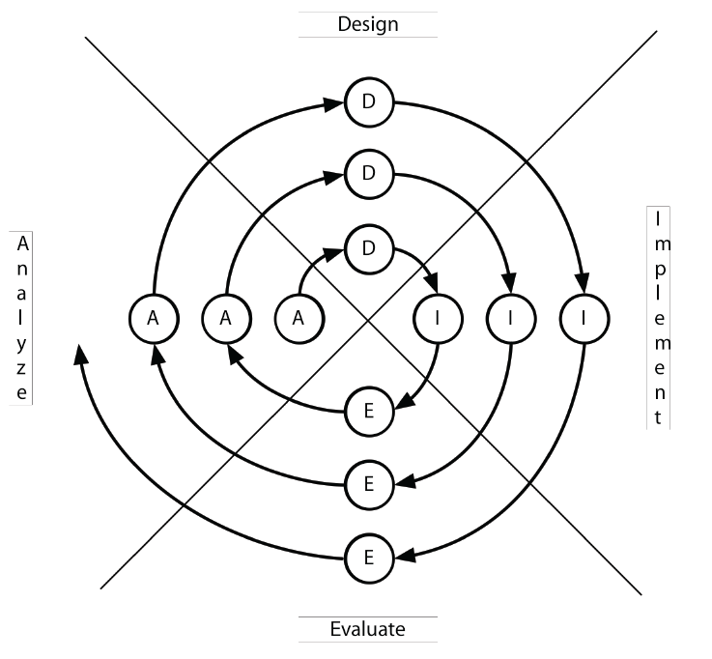
Iterative Design
Empirical testing with intention to fix the problems
Not just goals (“be easy
to use”), but a process to
achieve the goals
Successively
higher-fidelity designs
Spiral model from
(Boehm, 1988)

Slide 30
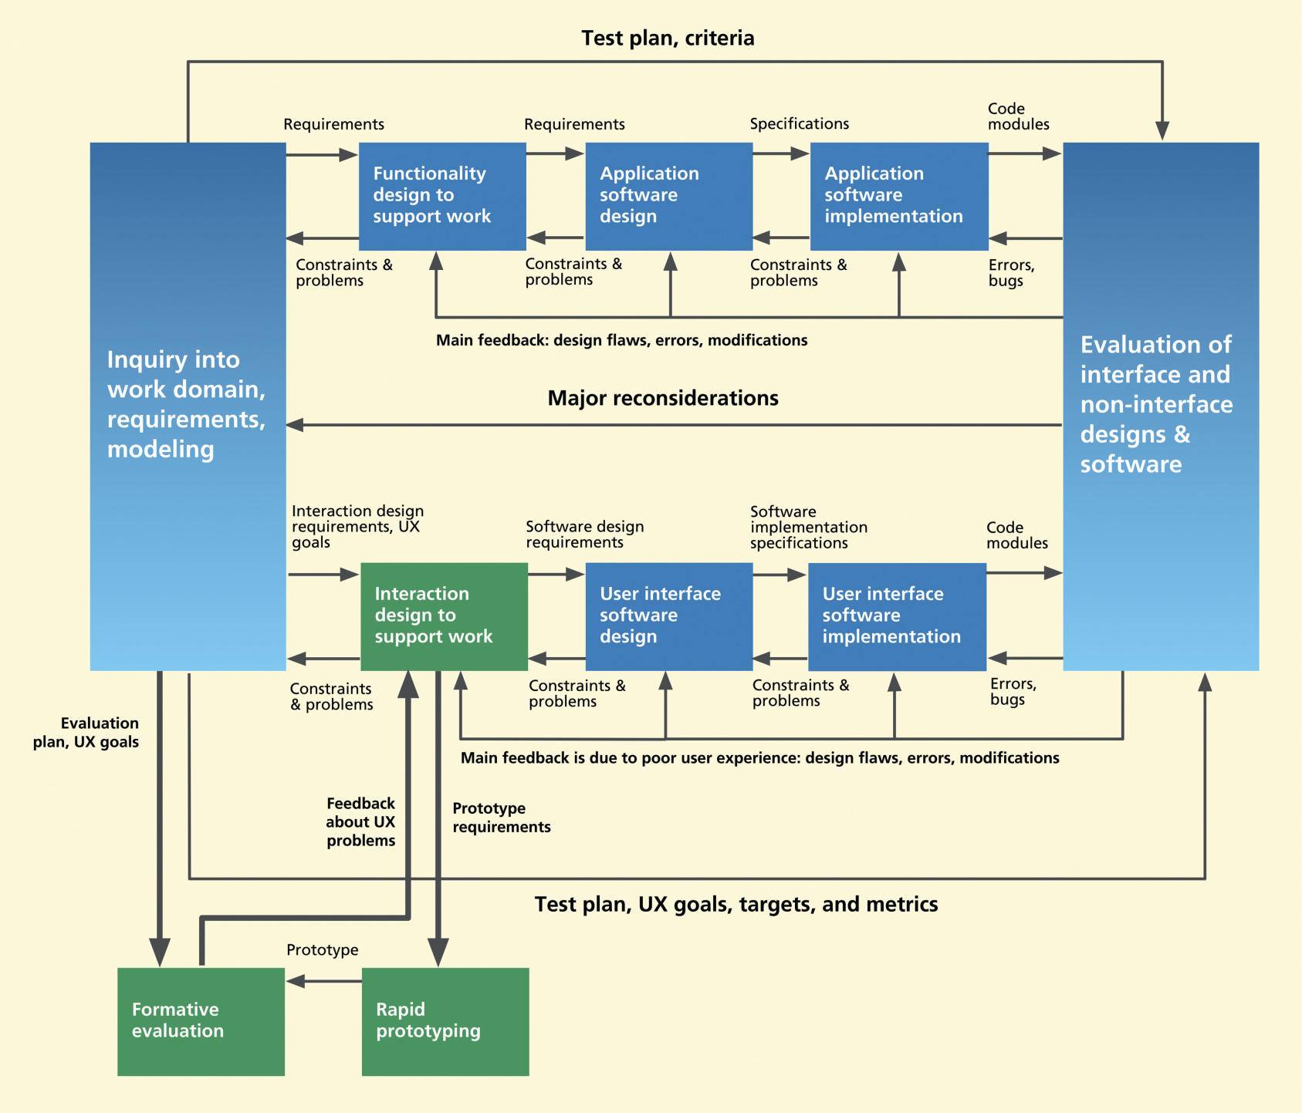
Hartson-Pyla steps: parallel track iterations
Fig 2-11
Software engineers and UX team both iterate
Focus on iterating early when cheaper and easier

Slide 31
10. Measure Real Use
Follow-up after release
For the next version
From bug reports, trainers, initial experiences (for conventional applications)
From web logs, reports, customer support

Slide 32
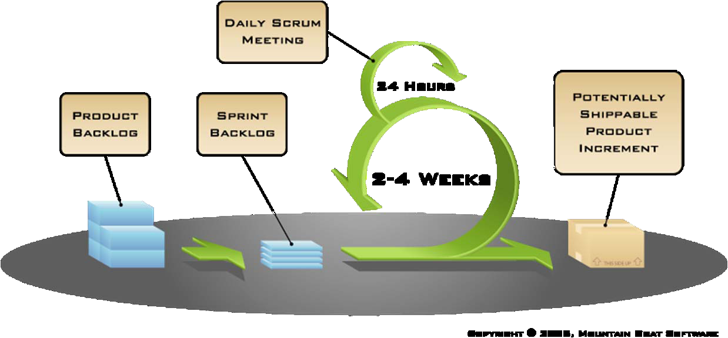
Agile Development
Increasingly software groups using “Agile” methods
  “eXtreme Programming” (XP)
  How does that interact with usability methods?
  Agile = “development iterations, teamwork, collaboration, and process adaptability throughout the life-cycle of the project.” – Wikipedia
  See “agile manifesto”: http://agilemanifesto.org/
  “Scrum” is one of many
  agile methods.
    Work is broken
    into 2 to 4
    week “sprints”
  Avoid “big design
  up front”

Slide 33
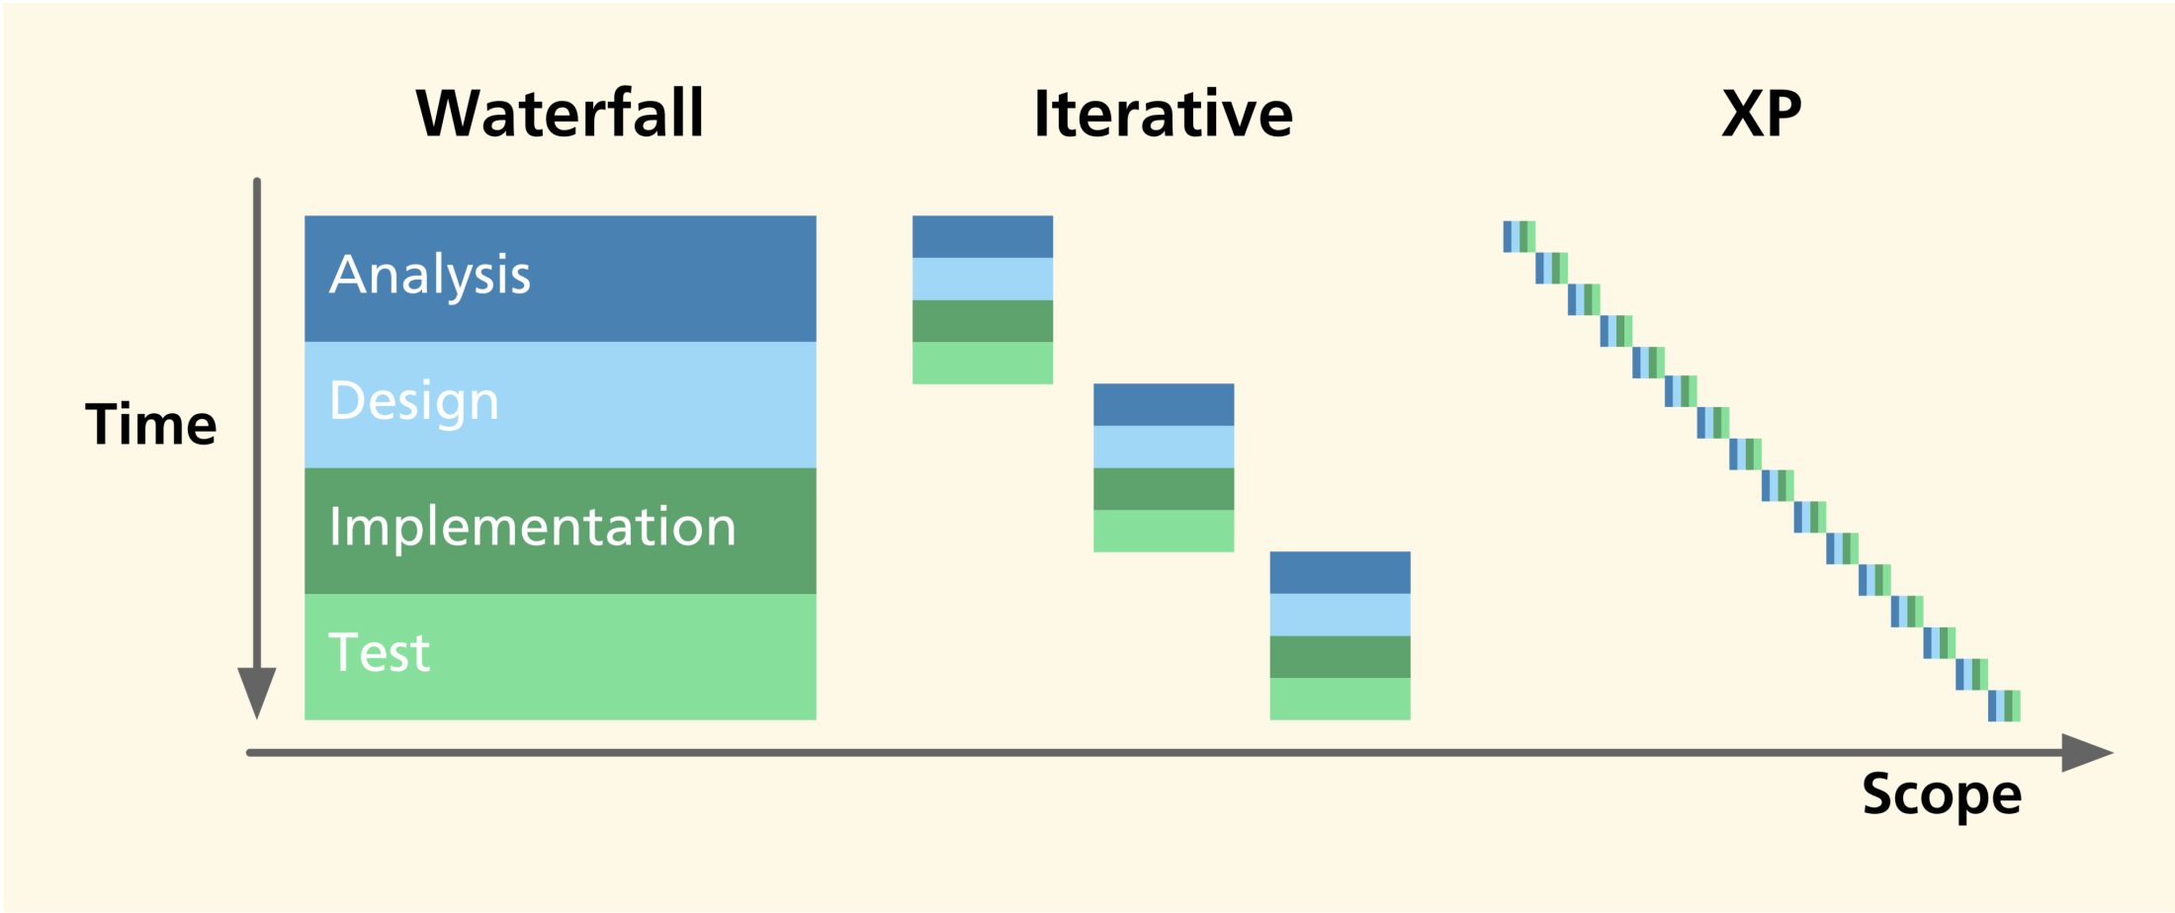
Waterfall, Iterative, XP
Fig. 19-1

Slide 34
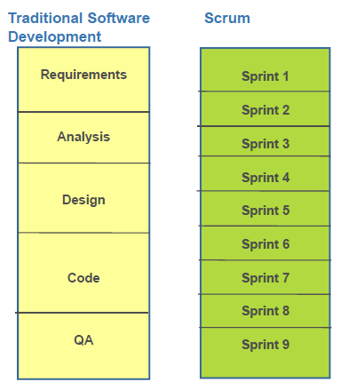
Scrum vs. traditional software development
Michael Budwig, http://doi.acm.org/10.1145/1520340.1520434

Slide 35
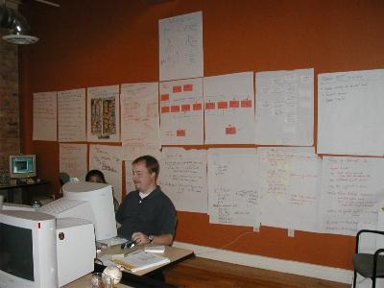
Shared Design and Implementation Space
“Radical co-location”
http://agileproductdesign.com/blog/emerging_best_agile_ux_practice.html

Slide 36
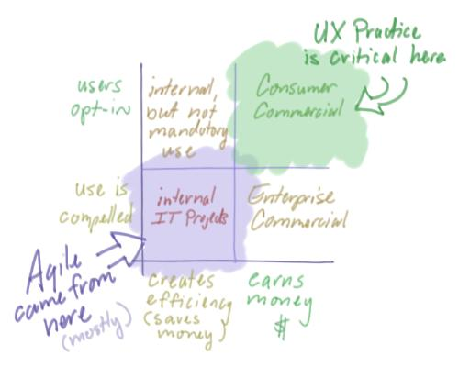
Issues with Agile UX
Created by programmers, not designers
UI might be patchwork of
non-integrated pieces
Reducing
documentation
→ not capturing
design rationale
No mention of
iteration on
design
http://agileproductdesign.com/blog/emerging_best_agile_ux_practice.html

Slide 37
Debate: UX Team
Centralized or Distributed?
(Applies to all development processes)
Centralized UX team services all projects
  Leverages resources, expertise
    Can have UI people with various skills: design, testing, etc.
  UI team has close colleagues
  Manager of UI people better able to judge quality UI work
  But doesn’t get to know products well
Distributed puts UX people into each project
  More influence with project since always there
  May not have appropriate skills
  Team may not need UI person full-time
  May work better for Agile – Nielsen http://www.useit.com/alertbox/agile-user-experience.html

Slide 38
Report from PayPal
Courtesy: Michael Budwig, User Experience Manager, Customer Experience and Merchant Solutions, PayPal, “When user experience met agile: a case study”, SIGCHI’2009, pp. 3075-3084. http://doi.acm.org/10.1145/1520340.1520434
Separate UX team, worked 1 or 2 sprints ahead of developer teams
Design vision sprint every 3-6 months
Worked well
See also Fig. 19-7
in textbook
UX team
Sprint 0
Sprint 1
Sprint 2
Sprint 3
Sprint 4
Sprint 5
Sprint 6
Vision
Sprint
Vision
Sprint
Sprint 0
Sprint 1
Sprint 2
Sprint 3
Sprint 4
Sprint 5
Sprint 6
Dev Scrum team

Slide 39
More Resources for
“Agile User-Centered Design
Agile-Usability Yahoo Group: http://tech.groups.yahoo.com/group/agile-usability/
Patton, J. (2008) Twelve emerging best practices for adding UX work to Agile development. http://agileproductdesign.com/blog/emerging_best_agile_ux_practice.html
UX Agile blog: http://uxagile.com/
Nielsen’s Alertbox: “Agile User Experience Projects”, Nov. 4, 2009: http://www.useit.com/alertbox/agile-user-experience.html & older one: http://www.useit.com/alertbox/agile-methods.html and expensive 119-page report: http://www.nngroup.com/reports/agile/

