Slide 1
Lecture 11:
International and Handheld
User Interfaces
Brad Myers
05-863 / 08-763 / 46-863: Introduction to
Human Computer Interaction for
Technology Executives
Fall, 2012, Mini 2

Slide 2

Logistics
Exam information:
  Fri, Dec. 14, 1 - 4pm in room 7500 Wean Hall
  Mon. Dec. 17, 2 – 5pm in Posner Hall 152 & 153
  Anyone can go to either
  See: http://www.cs.cmu.edu/~bam/uicourse/08763fall12/finalexam.html
Guest lecture next Wednesday
  David Bishop, Maya Design
  Please attend!
Final date for late homeworks:
Wednesday, December 12, 2012
Today is evaluation day – please fill out questionnaires

Slide 3
International User Interfaces

Slide 4
International User Interfaces
Note: These are in addition to all the previous recommendations / guidelines
Used in more than one country
Not just language translation
English versions of products may be used all over the world
Reviews of products may mention international usability issues

Slide 5
Web Sites Accessed World-Wide
Internationalization
  All web sites are globally accessible
  Providing multiple language versions
  Making the English version more accessible
Less than 10% of Internet users in US (cite, slide 5)
Internationalization
  One design that can be used world-wide
Localization
  Different designs customized to different languages

Slide 6




Icon International Design Issues
Mailbox icons?
No icons with fingers or feet or other gestures
Light switches on or off?
No visual puns
  Table of numbers as:
  (In Danish, use bord and tabel)
No baseball metaphors
Arbitrary icons are even harder
  Red cross for help

Slide 7
Translation Issues
Standard terms for “File”, “Edit”, etc. in each language
  There are probably hundreds of computer words
What about “Viewport”, “Canvas”, “Front”
  Across the industry, and in a company’s other products
  Keep glossaries of words to be used
Often need to know the rationale behind why names were chosen
  E.g. “Find” vs. “Find File” both translated to “Rechercher” in French
Notes:
Scroll bar, clipboard, View, Window, pane
Nudge,

Slide 8
Wording issues
Character Sets
  Supporting extra characters, like ¿ Á ñ æ ç ß Å, and many accents: ć ĉ ċ č ö
  Asian alphabets
  Sort order?
Avoid abbreviations and slang
  “MI” for middle initial
  “N/A” for not available or not applicable
  “Under the hood” for how something works
  “No cows on the ice”
Ask for child’s age not school grade
Holidays can be different
  Mother’s day, Thanksgiving, Independence Day can be at different times
People’s names: “First” name, “Last” name
  Which is which?
  Also, sometimes, First+Last not very unique (12 “Kim”s, 2 “Min Kim”s)
    Email address usually globally unique
Paper size issues for printing
  A4 vs. 8.5”x11” vs. ???
Notes:
“No cows on the ice” = no serious difficulties to be overcome (from Nielsen’s text, p. 245

Slide 9
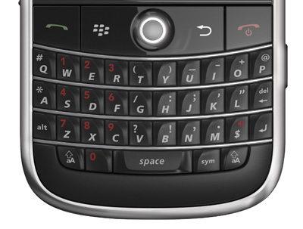
Number issues
Paying in international currency
  Currency symbols: $1000 (US, Canada), vs. ¥1000
Weights and sizes and clothing sizes in metric and U.S. units
Billion: thousand million or million million?
Number formats: 4.567 vs. 4,567
  Ask if ambiguous (not “illegal number”)
Time formats: 2:30 pm vs. 14:30; time zones: EDT
Date formats: 10/11/12? use October 11, 2012 instead
  Europeans say “Week 25”
Telephone number formats
  +45 47 17 17 17 vs. (412) 268-5150 vs. 1-412-268-5150
  Allow +, (), -, . etc.
  Don’t use letters only: 1-800-ASK-TOWER
Locations: England is on both sides
of 0° Longitude
  US software couldn’t deal with
  negative positions

Slide 10
Localization
Not just translating the interface
  Web sites may have different content
    e.g. German yahoo has “Lifestyle” on front tab, compared to US Yahoo “Jobs”
    And different icons for sports:
  Different sizes of language may require redesign
    But automatic layout can help
Indicate content that is not translated
  Bad example: “Radio KIT” on http://www.kit.edu/study/
When there is a choice of language
  Don’t use flags to indicate language: http://www.russell-newton.it/
    US vs. Canada vs. England
  Use language’s own name for itself (ENGLISH, ESPAÑOL, )
  Good place for pictures of text (if fonts aren’t loaded)
First page in default language first so many won’t need extra click
  Make links for other languages easy to find (e.g., www.knto.or.kr/)
  Not: http://thai.tourismthailand.org/home

Slide 11
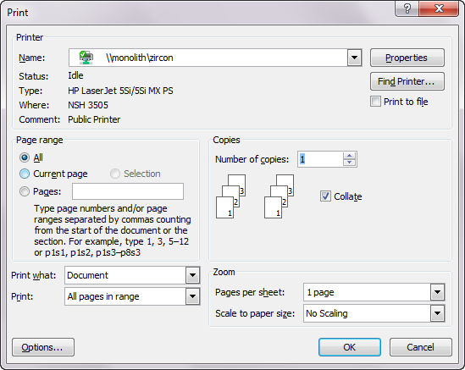
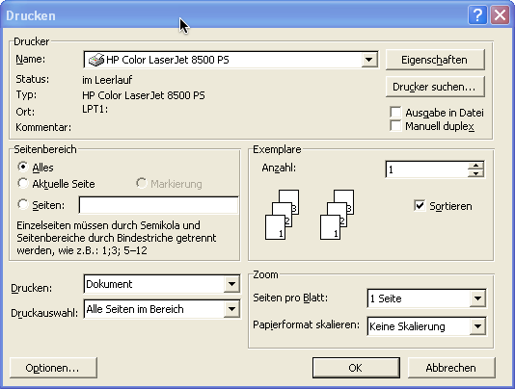
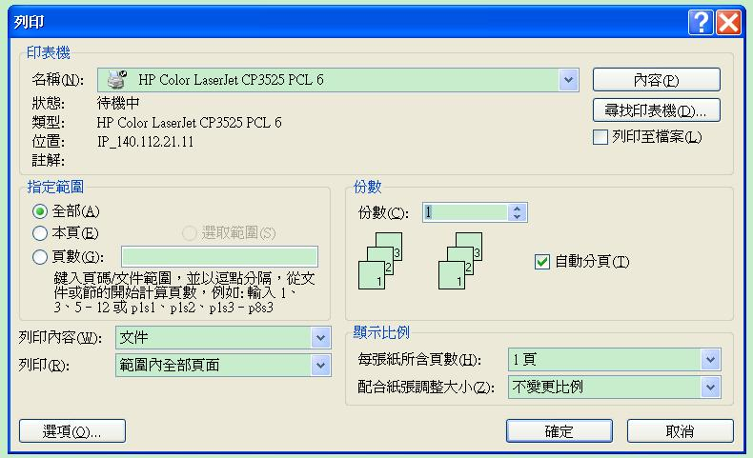
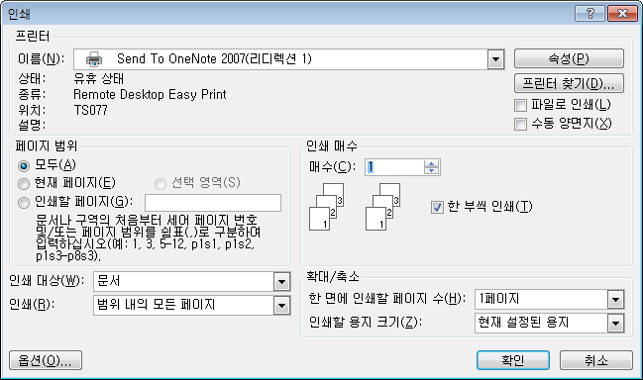
Dialog Box Layouts: Print

Slide 12
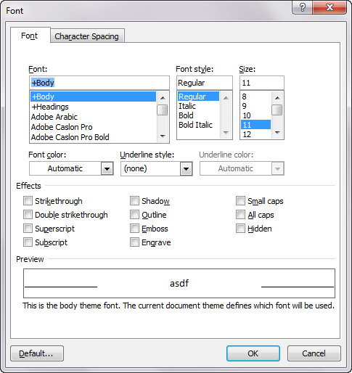
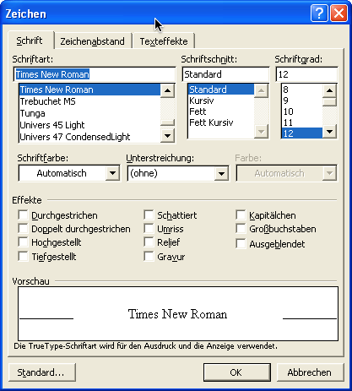
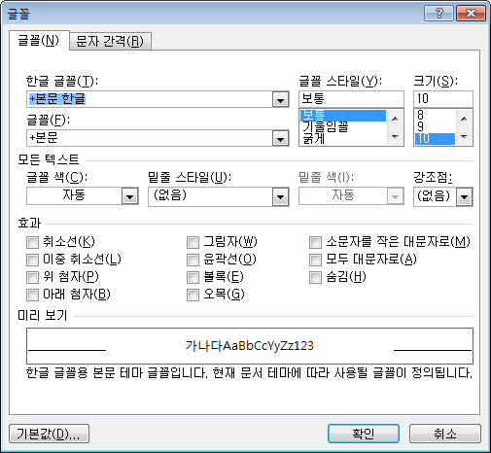
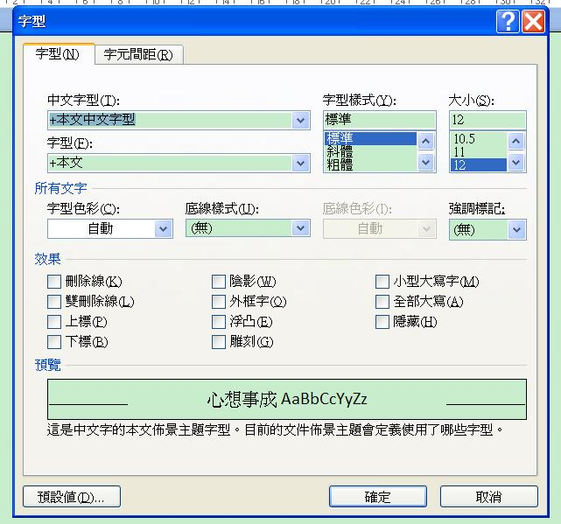
Dialog Box Layouts: Fonts

Slide 13
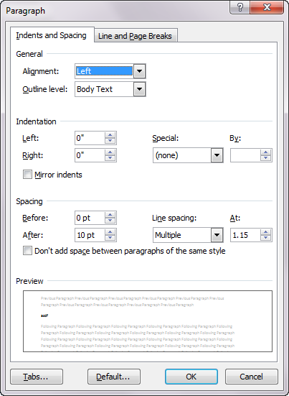
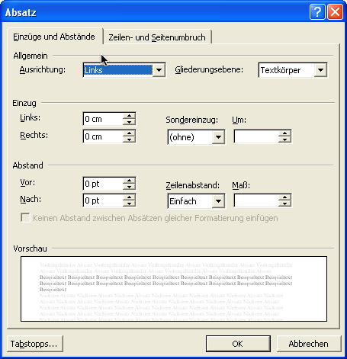
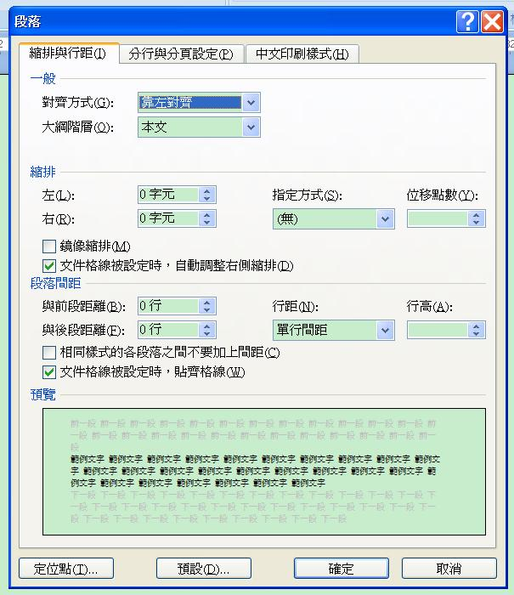
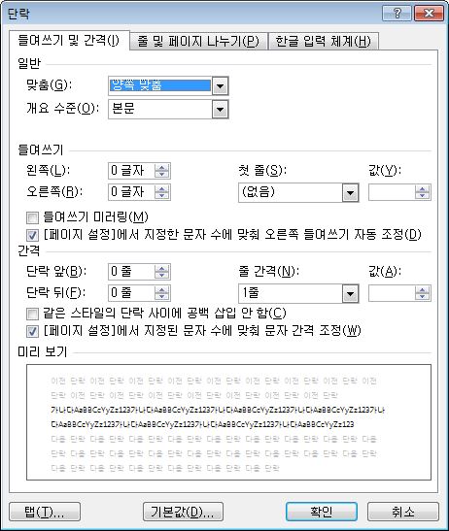
Dialog Box Layouts: Paragraph

Slide 14
Shipping Issues
Shipping charges and options for overseas
  Sales taxes?
Accept entry of non-US characters in fields
  May be an issue for sorting, etc.
Consider have separate US and overseas shipping pages
Otherwise:
  Use “zip / postal code” as prompt
  Different organization of postal address (postal code after city or after state?)
  In “state/province” field,
    Full-length state names
    Option for “other countries” in state field

Slide 15
URL issues
Use www.company.com for English language version
Use www.company.co.XX (.uk, .de, .kr) for foreign site
Use local (country specific) URL also for sites of only local interest

Slide 16
Implementation Issues
Separate “resource files”
  Put strings, etc. in separate file so can be easily changed without recompiling
  Not as part of the code
    Including error messages, etc
    Difficult due to constructed messages
      “Cannot copy file <#1> to directory <#2> due to <#err>”
      Even the order of the words may need to be different
  Also put in locations and sizes, since may change with the language
OS features help
  Automatic formatting and input for dates, etc.
  Toolkit support for layout, conversions, Unicode, etc.
  “Locale”
  But does changing it convert values or just show them differently?
    OK for date, not for currency!

Slide 17
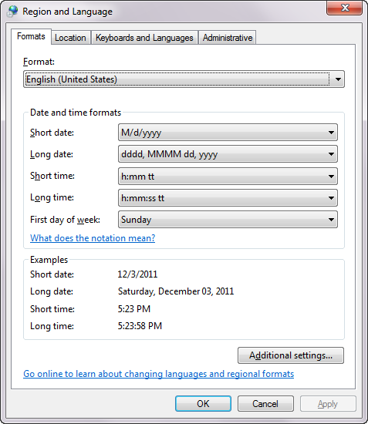
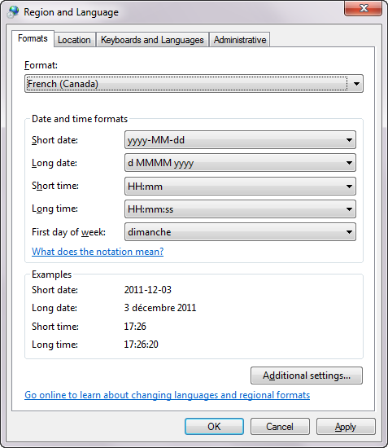
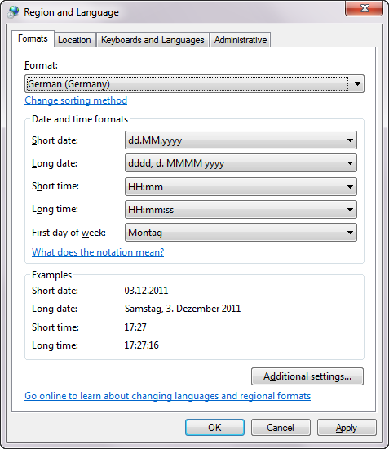
Windows 7 “Region and Language”
Formerly called “Locale”

Slide 18
International User testing
Localized interface can have new and different usability problems
  Not sufficient to test one version and then translate
Should perform heuristic analysis by usability specialists familiar with target culture and language
Should test with native speakers in different countries
Use international or national usability consultants
Use “remote testing” with instrumented web sites

Slide 19
Handheld User Interfaces

Slide 20
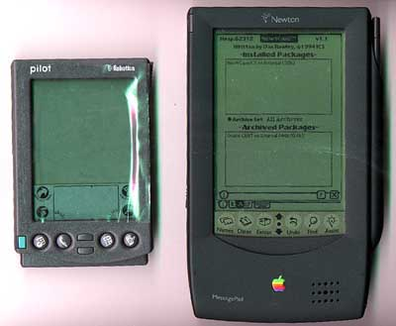
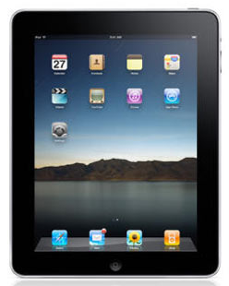
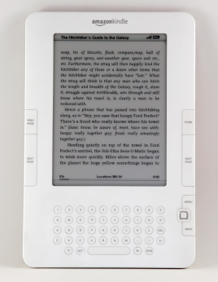
Why Important?
Now: Handheld = Mobile = Cell Phone
  Old: PDA = Personal Digital Assistant
Tablets: iPads, readers, Android’s
Big numbers of mobile phones
  Over 6 billion mobile phones in use (Wikipedia)
  About 50.4% of phones in use in US are Smartphones (Nielsen)
    1.1B global Smartphone users; only 17% of subscribers (cite, slide 7)
  “Mobile phones are rapidly becoming the preferred means of personal communication, creating the world's largest consumer electronics industry.”
  More mobile devices purchased last year than PCs and cars combined!

Slide 21
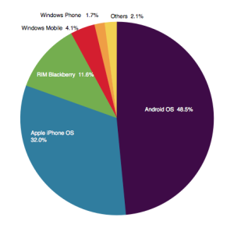
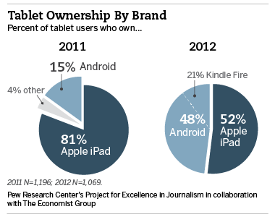
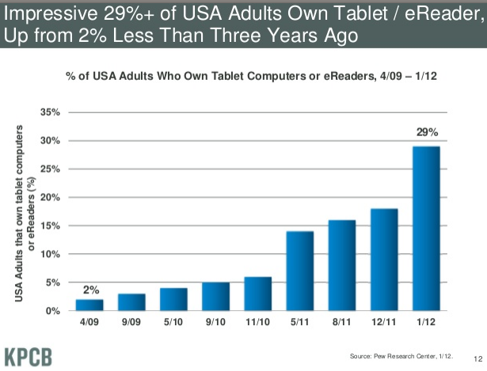
More Statistics
10% of all phones in US were iPhones in 2011
Android continues to take larger share of SmartPhones, currently
48.5% (iPhone 32%)
About 150 million tablets in US (cite) – 29% of adults
Smartphone market share in US as of May, 2012 (Nielsen)
(cite,
slide 12)
Tablet market share in US (Pew research)

Slide 22
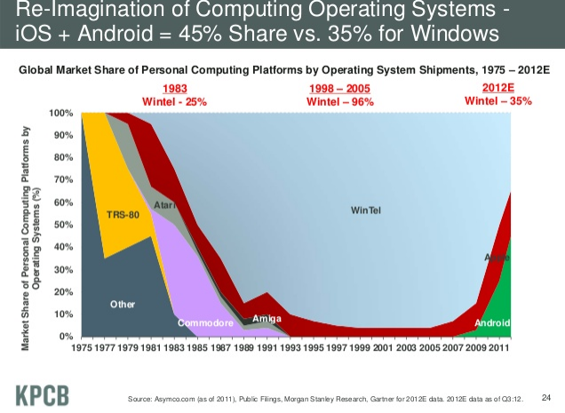
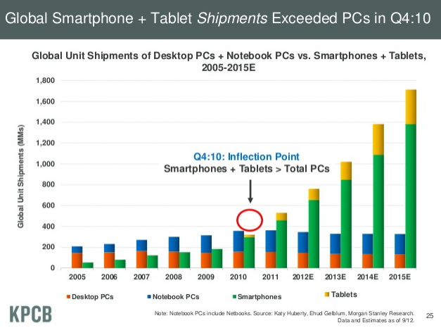
“Computers”
(cite,
slide 24, 25)

Slide 23
mCommerce Importance
Nielsen: “Mobile access will be the third ‘killer app’ for the Internet, after email and web browsing”
  “Anyone, anytime, anywhere, connected”
Mobile Devices are “Life Accessories”
  --Panu Korhonen, Usability Group Lead, Nokia
  Interact with mobile devices in a more “intimate” way than regular PCs

Slide 24
Usage Model Different for
Handhelds than PCs or Web
Immediate requests
Short interactions, frequently interrupted
Public use
Fashion statement
  Less business-oriented
  More value to design
Little engagement
Must always be able to answer the phone

Slide 25
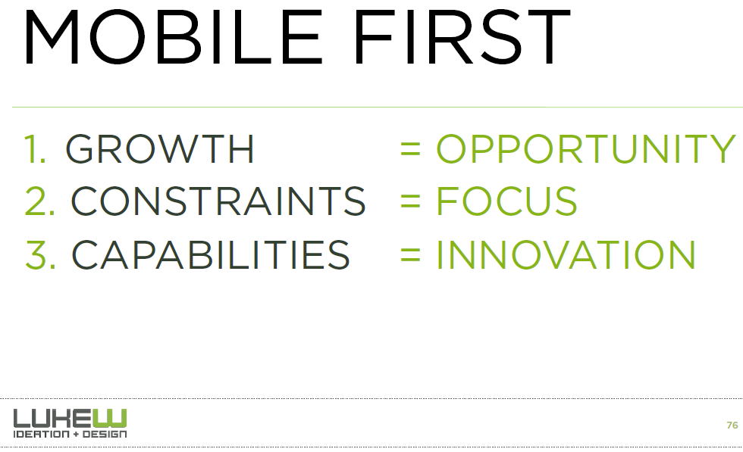
Design for Mobile First
Consultants recommend web sites designed for mobile first:
http://static.lukew.com/mmdd_workshop_11142012.pdf, slide 76

Slide 26
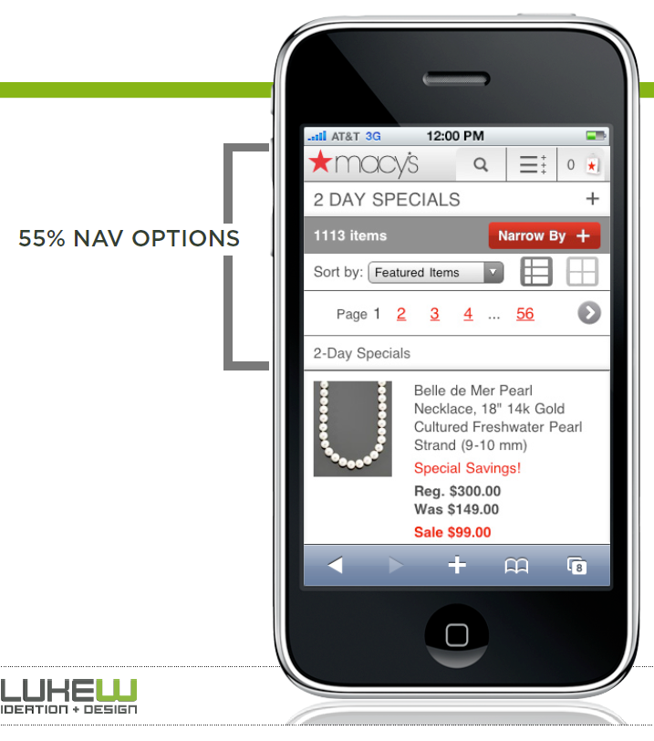
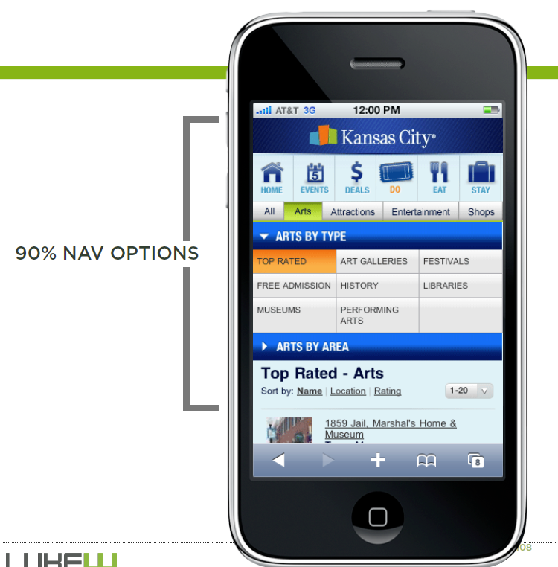
Focus on Navigation or Content?
http://static.lukew.com/mmdd_workshop_11142012.pdf, slides 107-8

Slide 27
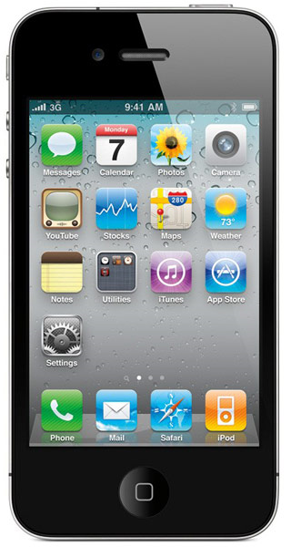
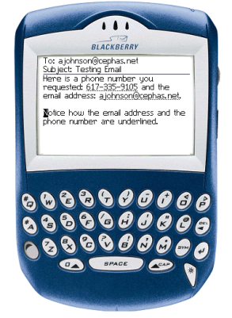
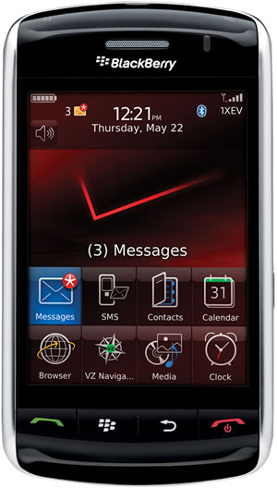
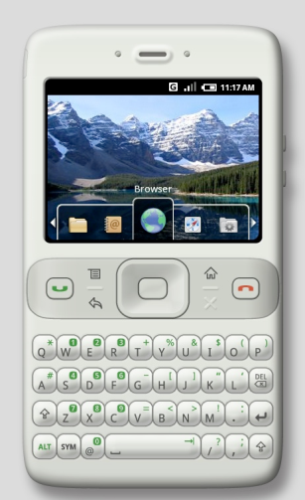
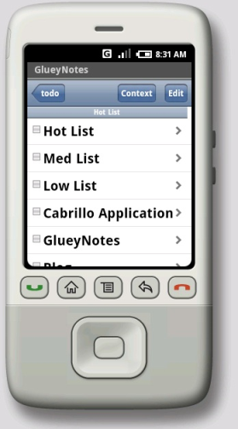
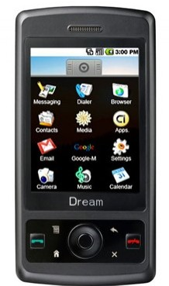
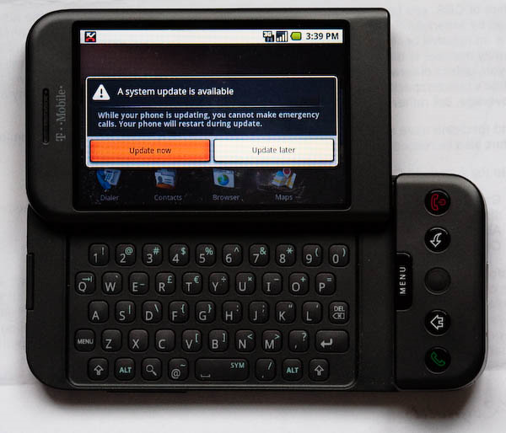
Issues with Handheld Designs
Must follow the device’s style guidelines
  May depend on OS, Hardware and carrier
    Verizon, AT&T, Sprint ….
  May be different hardware configurations
    Not with Apple iPhone – closed platform
    RIM’s Storm
    How many buttons?
    Windows Mobile has minimum requirements
    Android?

Slide 28
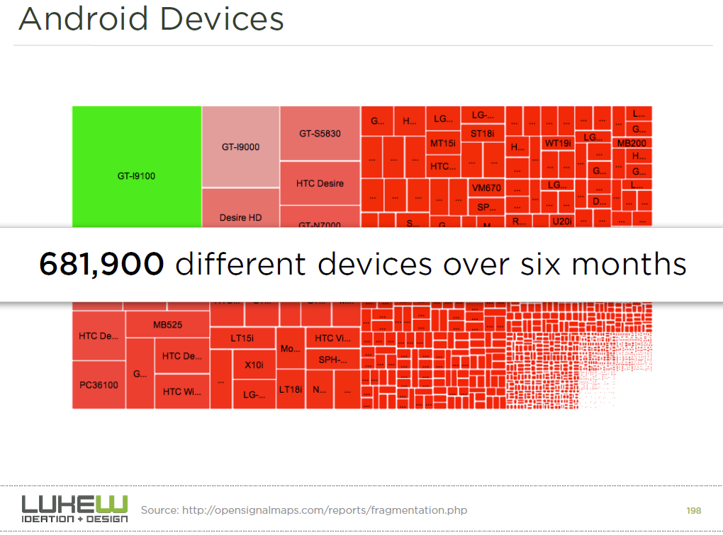
http://static.lukew.com/mmdd_workshop_11142012.pdf, slide 198

Slide 29
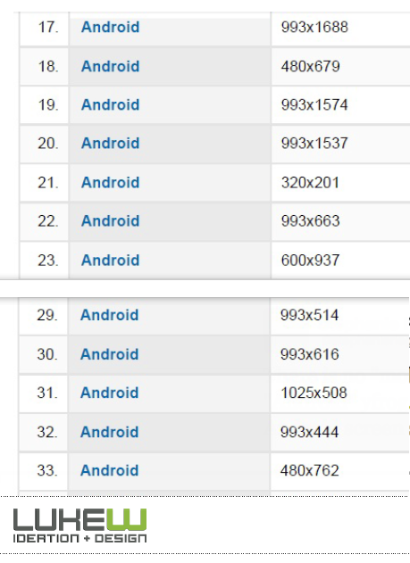
Many screen sizes
http://static.lukew.com/mmdd_workshop_11142012.pdf, slide 197

Slide 30
Design for Small Devices
Principles from the Palm’s designers
“Designing the Palm Pilot: A conversation with Rob Haitani”, by Eric Bergman and Rob Haitani, chapter 4 in Information Appliances and Beyond, Eric Bergman, ed. (2000)
  Fast access to key features on small screens ->
    Only a few commands used a lot
    Leave commands off main screen, even if not symmetric
      new vs. delete
      (think stapler and stapler remover)
    Note that violates consistency
    Tap and then type in schedule and to-do
    Only four buttons – which ones?
    Vs. Windows CE -> if know PC, this is familiar
      But usage models are different
        PC: infrequent long usage
        Palm: frequent short bursts of usage

Slide 31
Design for Small Devices, 2
  Analogy: people like to eat in a car
    Palm design is like adding the cup holder
    Have a house with the other appliances (like the PC)
  They did lots of user testing with prototypes created using HyperCard
  Usage scenarios

Slide 32
Studies for Original Windows CE
“The Interaction Design of Microsoft Windows CE”, by Sarah Zuberec, chapter 5 in Information Appliances and Beyond, Eric Bergman, ed. (2000)
Studies: minimum target: stylus = 5.04mm², finger = 9.04mm²
Drag between down and up for “tap” = 2mm
Many usage scenarios
User tests identified Tahoma 10 bold as best system font, but couldn’t be used because not enough content fit in the dialogs
  So used Tahoma 9
Novice users did better with keyboard, but experts preferred character recognizer
Problem with initial designs: too many taps
  Achieved “walk up and use” but too slow for experts
Double tap with stylus difficult and unnatural
  “Consistency worked against learning and use.”

