Slide 1
Lecture 14:
Novel interaction techniques and interfaces for new devices
Brad Myers
05-863 / 08-763 / 46-863: Introduction to
Human Computer Interaction for
Technology Executives
Fall, 2011, Mini 2

Slide 2
Can Still Fill Out Class Surveys
3 surveys (everyone do all 3):
  The official CMU course evaluation: http://cmu.onlinecourseevaluations.com or Tepper evaluation (if you are in 46-863)
  The questionnaire about the textbook -- remember, you agreed to fill this out when we gave you the free textbook
  The class questionnaire: http://www.surveymonkey.com/s/6MNQ96R
Only about 70% of class has done it so far

Slide 3
Final Exam Information
Exam Schedule:
  Thursday Dec. 15, 8:30am-11:30am in Scaife Hall (SH) 125
  Monday, Dec. 19, 1:30pm, Tepper Rm: 146
  Anyone can go to either
  (also Monday morning, 9:30-12:30 – already full)
  See full information: http://www.cs.cmu.edu/~bam/uicourse/08763fall11/finalexam.html
(Today’s lecture not on exam)

Slide 4


Interaction Techniques
An interaction technique is a graphical object which can be manipulated using a physical input device to input a certain type of value.
  Also called “widget” or “control”
Researchers invent new ones all
the time
  Reported at conferences like
  ACM SIGCHI or ACM UIST (User Interface
  Software & Technology)
  Or specialized conferences, e.g., for 3-D or for “Ubiquitous Computing” (ACM Ubicomp)
Measure with user studies compared to control / “conventional” way to do things

Slide 5
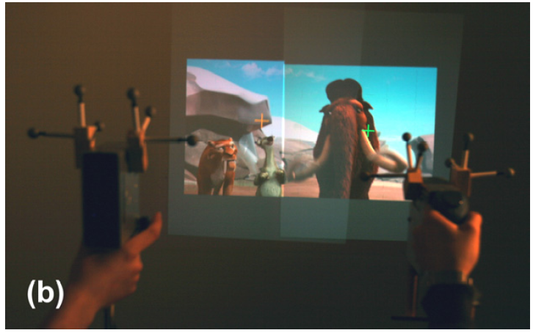
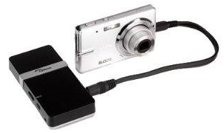
Multi-User Interaction using Handheld Projectors
UIST’07
  Xiang Cao, Clifton Forlines, Ravin Balakrishnan
Suppose each person has their own, very light data projector?
  How interact with things?
  Can move the projector itself, instead of moving things on the screen
  Currently big, but can be tiny
Local video (6:08), ACM video

Slide 6

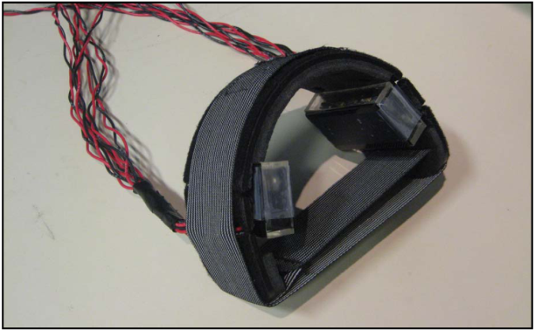
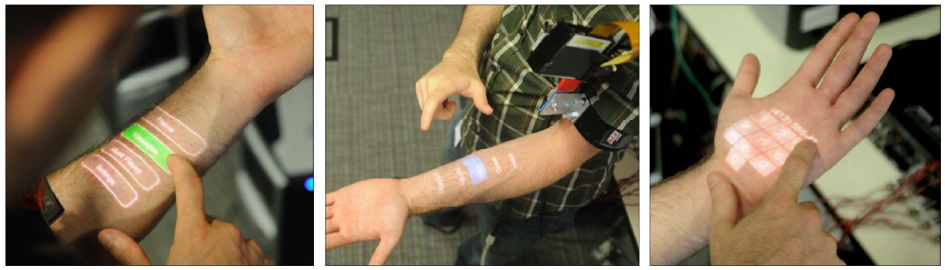
Skinput: Appropriating the Body as an Input Surface
CHI’2010
  Chris Harrison, HCII, Carnegie Mellon University, USA
  Desney Tan (formerly CMU), Dan Morris, Microsoft Research, USA
Use a tiny projector on body to show menus
Microphones to listen to taps on hand/arm
  Signal processing and machine learning to
  differentiate positions
Youtube video (3:04)

Slide 7
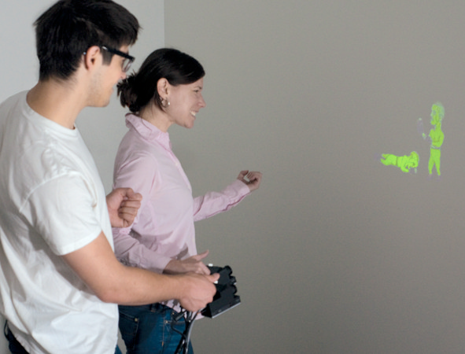
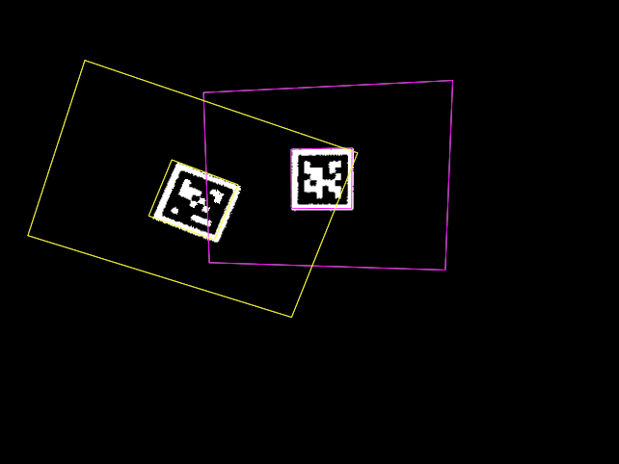
Two Projectors
Willis, K. D.D., Poupyrev, I., Hudson, S. E., Mahler, M. SideBySide: Ad-hoc Multi-user Interaction with Handheld Projectors. In Proceedings of UIST 2011: ACM: pp. 431-440.
Disney Research & CMU HCII
Project both the picture and an invisible marker which a camera sees
Video (3:30)

Slide 8

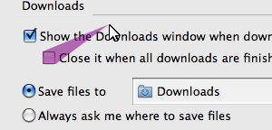
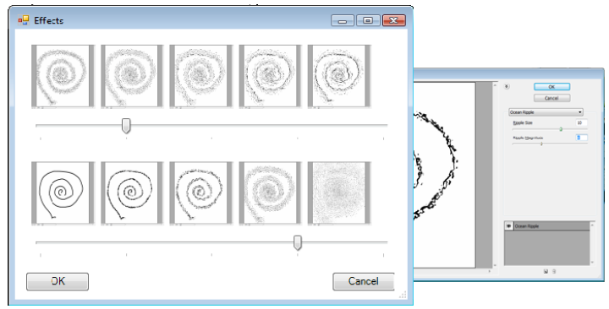
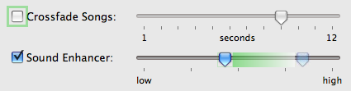
Prefab: Implementing Advanced Behaviors Using
Pixel-Based Reverse Engineering of Interface Structure
CHI’2010
  Morgan Dixon, James Fogarty (formerly CMU)
Reproduces interaction techniques of others
Bubble cursor
Sticky icons
Phosphor glow (to show what happened)
Parameter spectrums with sideviews
ACM Video (5:00) youtube

Slide 9
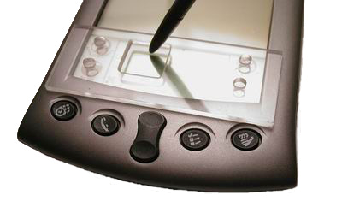
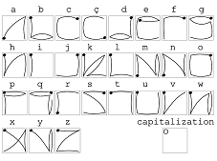
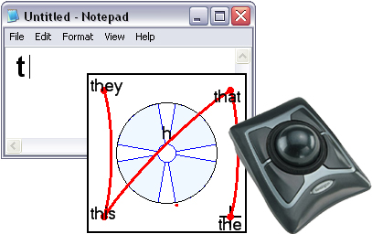
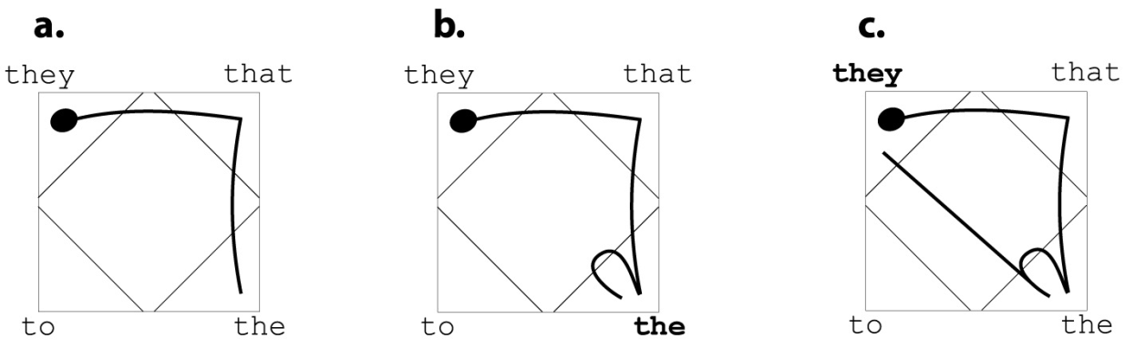
EdgeWrite
Jacob Wobbrock and Brad Myers
www.edgewrite.com
Text entry technique designed
to be more reliable
  Works for people with severe disabilities
  Also for mobile devices on the go
Move from corner to corner
End in top-left corner for capital
Word completions
As fast as other mobile techniques

Slide 10
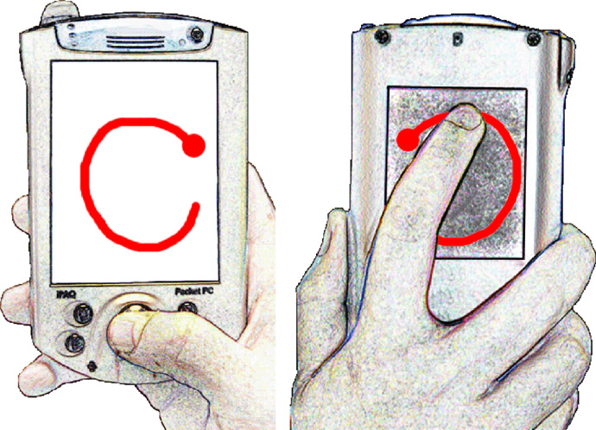
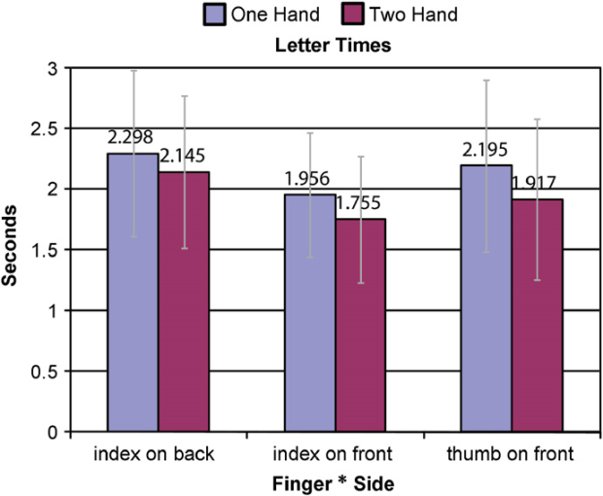
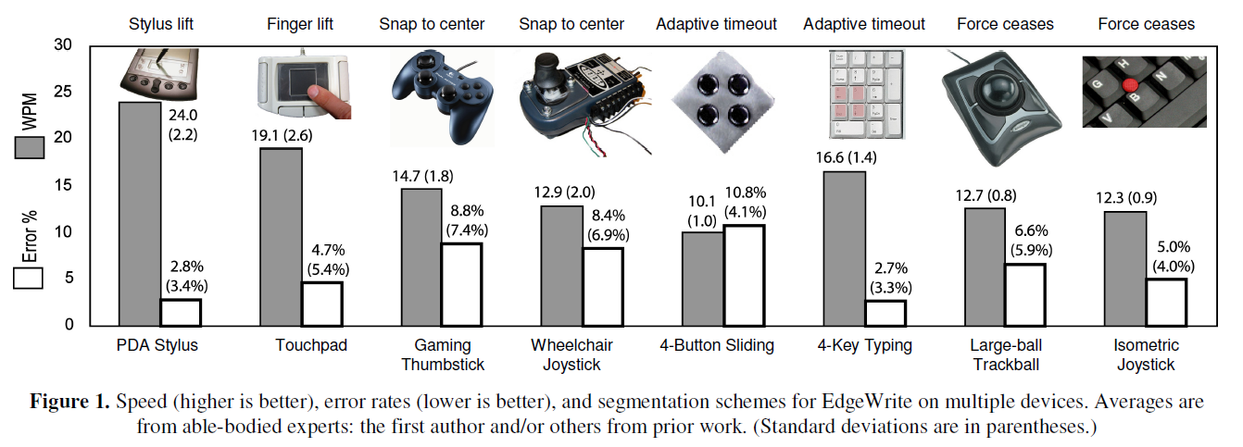
EdgeWrite, cont.
Many devices
Even on back
of device
iPhone app

Slide 11
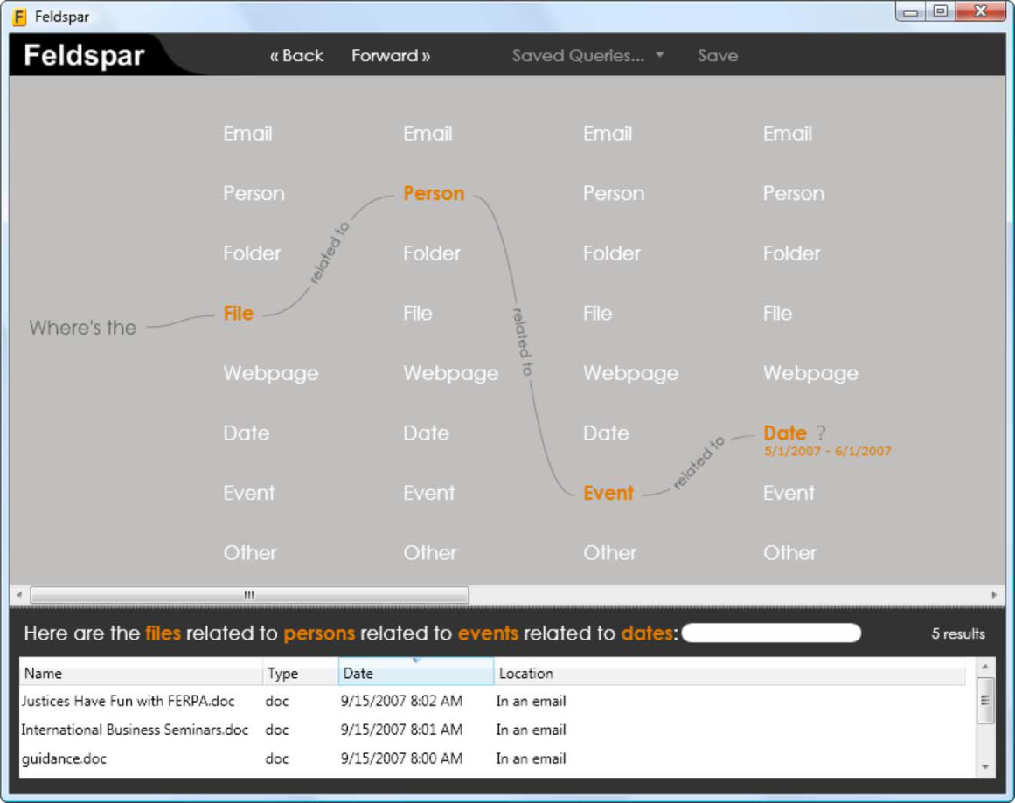
Feldspar: A System for Finding Information by Association
Finding Elements by Leveraging Diverse Sources of Pertinent Associative Recollection
CHI 2008
  Duen Horng (“Polo”) Chau, Brad Myers, Andrew Faulring
Find content by association
  Other items that go with this item
  Multiple levels
Implemented using
Google desktop data
E.g., “find the file from the
person who I met at an
event in May”
Video, youtube (2:29)

Slide 12
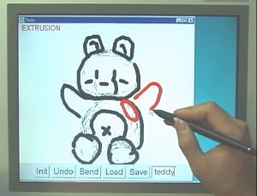
Teddy: A Sketching Interface for 3D Freeform Design
ACM SIGGRAPH'99
  Takeo Igarashi, Satoshi Matsuoka, Hidehiko Tanaka.
3-D sketching using a 2-D tool
His original PhD work; much interesting follow-on developments
Local copy; video, 5:01

Slide 13
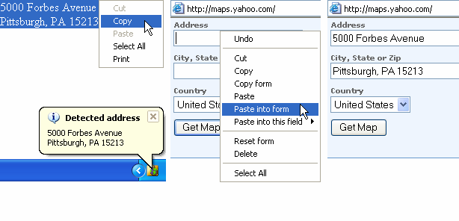
Citrine
UIST'04
  Jeffrey Stylos, Brad A. Myers, Andrew Faulring
Detects addresses, bibliographic references, and other structured data on clipboard
  Converts into various formats, e.g., vCard, Outlook
  Can paste in one operation
  Can paste into multiple form fields
http://www.cs.cmu.edu/~citrine/
Video
Clipboard Interaction Techniques that Recognize Information such as Names and
Events.

Slide 14
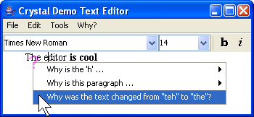
Crystal: Answering Why and Why Not Questions in User Interfaces
CHI’2006
  Brad Myers, David A. Weitzman,
  Andrew J. Ko, and Duen Horng Chau
Ask why applications like Microsoft Word do mysterious things
  Answers in terms of UI elements that control the behavior
video
Clarifications Regarding
Your
Software using a Toolkit, Architecture and Language.

Slide 15
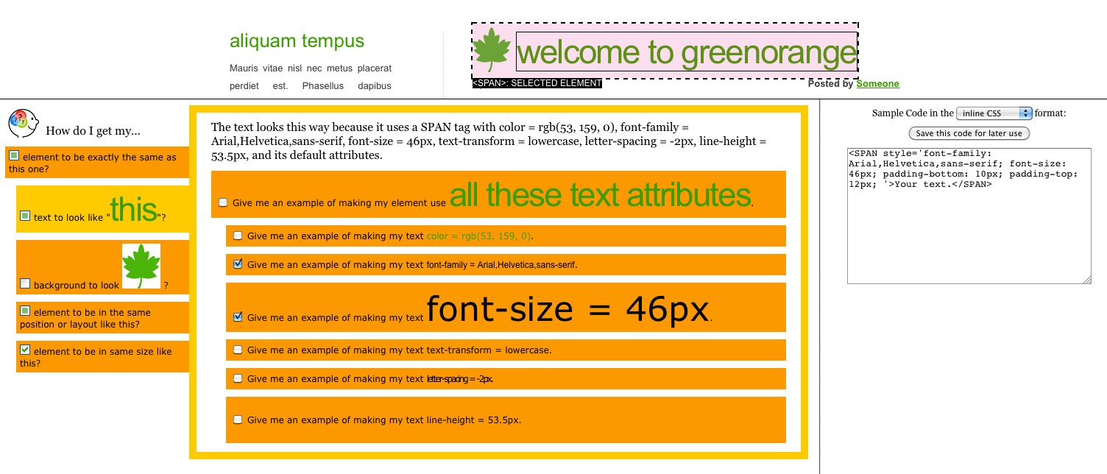
WebCrystal
CHI’2012!
  Kerry Chang and Brad Myers, "WebCrystal: Understanding and Reusing Examples in Web Design", Proceedings CHI'2012: Human Factors in Computing Systems. Austin, TX, May 5-10, 2012. To appear.
How are web pages implemented?
Ask questions about individual elements and get answers as explanations and html or css code
video (4:50)

Slide 16
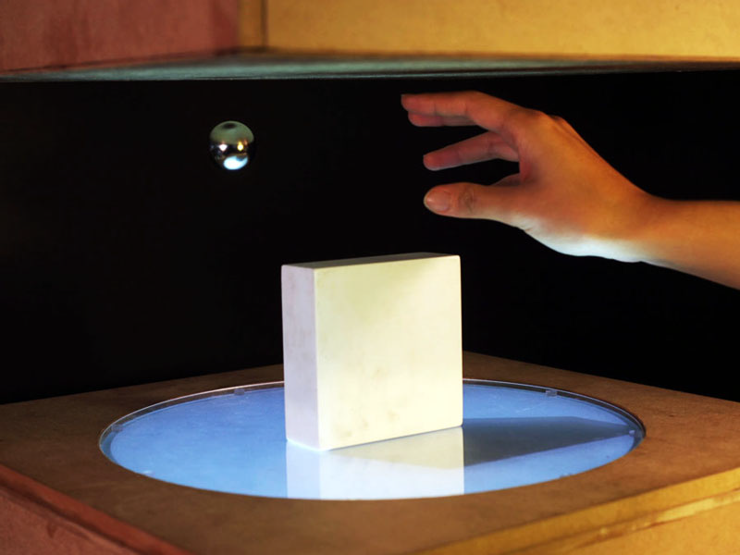
Magnetic Levitation
Jinha Lee, Rehmi Post, and Hiroshi Ishii. 2011. ZeroN: mid-air tangible interaction enabled by computer controlled magnetic levitation. In UIST '11. ACM, pp. 327-336.
MIT Media Laboratory
Metal objects dynamically levitated under computer control
  Moved by servo motors
Tracked by cameras and
sensors
Projected onto ball
video (3:06)

Slide 17
Apatite: A New Interface for Exploring APIs
CHI’2010
  Daniel S. Eisenberg, Jeffrey Stylos, and Brad A. Myers
Use Feldspar ideas for navigating APIs by association
  Other methods used with this method
Available: http://www.cs.cmu.edu/~apatite/
Local video (2:45)
Associative Perusal of APIs
That Identifies Targets
Easily

