Slide 1
Lecture 11:
International and Handheld
User Interfaces
Brad Myers
05-863 / 08-763 / 46-863: Introduction to
Human Computer Interaction for
Technology Executives
Fall, 2011, Mini 2

Slide 2

Logistics
Exam information:
  Thursday Dec. 15, 8:30am-11:30am in Scaife Hall (SH) 125
  Monday, Dec. 19, 1:30pm, Tepper Rm: 146
  Anyone can go to either
  (also Monday morning, 9:30-12:30)
  See: http://www.cs.cmu.edu/~bam/uicourse/08763fall11/finalexam.html
Guest lecture next Monday
  Paul Gould, Maya Design
  Please attend!
Final date for late homeworks:
Wednesday, December 14, 2011

Slide 3
Logistics, cont.
Wednesday, December 7, 2011 is evaluation day
  Please attend, and bring your laptop
Pick last lecture topic now (not on exam):
  Novel interaction techniques and interfaces for new devices
    Random collection of novel, researchy ways to use computers and computerized devices
  Examples of Good and Bad User Interfaces
    Fun examples from the me, the TAs, and you of good and bad user interfaces

Slide 4
International User Interfaces

Slide 5
International User Interfaces
Note: These are in addition to all the previous recommendations / guidelines
Used in more than one country
Not just language translation
English versions of products may be used all over the world
Reviews of products may mention international usability issues

Slide 6
Web Sites Accessed World-Wide
Internationalization
  All web sites are globally accessible
  Providing multiple language versions
  Making the English version more accessible
Less than 50% of WWW users in US
Internationalization
  One design that can be used world-wide
Localization
  Different designs customized to different languages

Slide 7





Icon International Design Issues
Mailbox icons?
No icons with fingers or feet or other gestures
Light switches on or off?
No visual puns
  Table of numbers as:
  (In Danish, use bord and tabel)
No baseball metaphors
No “trash can” icon
Arbitrary icons are even harder
  Red cross for help

Slide 8
Translation Issues
Standard terms for “File”, “Edit”, etc. in each language
  There are probably hundreds of computer words
What about “Viewport”, “Canvas”, “Front”
  Across the industry, and in a company’s other products
  Keep glossaries of words to be used
Often need to know the rationale behind why names were chosen
  E.g. “Find” vs. “Find File” both translated to “Rechercher” in French
Notes:
Scroll bar, clipboard, View, Window, pane
Nudge,

Slide 9
Wording issues
Character Sets
  Supporting extra characters, like ¿ Á ñ æ ç ß Å, and many accents: ć ĉ ċ č ö
  Asian alphabets
  Sort order?
Avoid abbreviations and slang
  “MI” for middle initial
  “N/A” for not available or not applicable
  “Under the hood” for how something works
  “No cows on the ice”
Ask for child’s age not school grade
Holidays can be different
  Mother’s day, Thanksgiving, Independence Day can be at different times
People’s names: “First” name, “Last” name
  Which is which?
  Also, sometimes, First+Last not very unique (12 “Kim”s, 2 “Min Kim”s)
    Email address usually globally unique
Paper size issues for printing
  A4 vs. 8.5”x11” vs. ???
Notes:
“No cows on the ice” = no serious difficulties to be overcome (from Nielsen’s text, p. 245

Slide 10
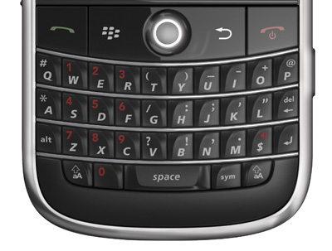
Number issues
Currency symbols: $1000 (US, Canada), vs. ¥1000
Billion: thousand million or million million?
Number formats: 4.567 vs. 4,567
  Ask if ambiguous (not “illegal number”)
Time formats: 2:30 pm vs. 14:30; time zones: EDT
Date formats: 08/09/10? use August 9, 2010 instead
  Europeans say “Week 25”
Telephone number formats
  +45 47 17 17 17 vs. (412) 268-5150 vs. 1-412-268-5150
  Allow +, (), -, . etc.
  Don’t use letters only:
  1-800-ASK-TOWER
Locations: England is on both sides
of 0° Longitude
  US software couldn’t deal with
  negative positions

Slide 11
Localization
Not just translating the interface
  Web sites may have different content
    e.g. German yahoo has “Lifestyle” on front tab, compared to US Yahoo “Jobs”
    And different icons for sports:
  Different sizes of language may require redesign
    But automatic layout can help
  Make sure translation of terms is consistent with industry standards
Indicate content that is not translated
  Bad example: “Long Evening…” on http://www.uni-karlsruhe.de/students/
When there is a choice of language
  Don’t use flags to indicate language: http://www.russell-newton.it/
    US vs. Canada vs. England
  Use language’s own name for itself (ENGLISH, ESPAÑOL, )
  Good place for pictures of text
    In case fonts aren’t loaded
First page in default language first so many won’t need extra click
  Make links for other languages easy to find (e.g., www.knto.or.kr/)
  Not: http://thai.tourismthailand.org/about-tat/

Slide 12
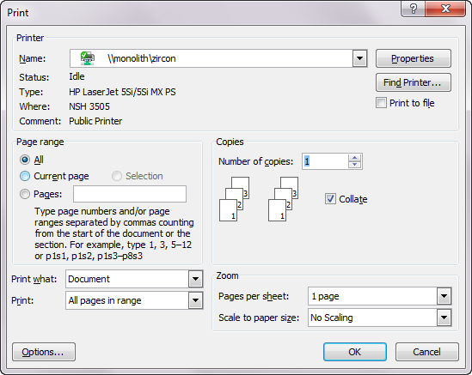
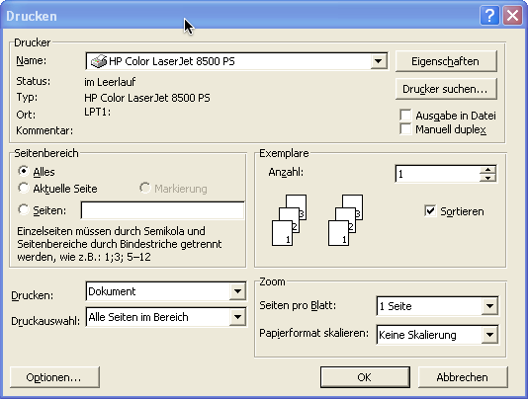
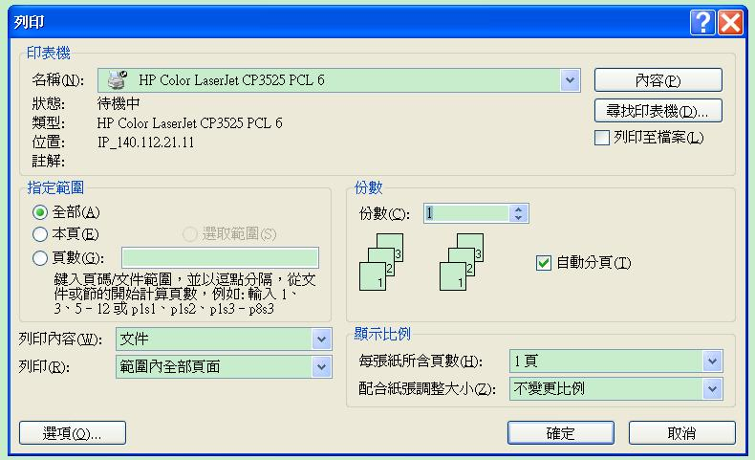
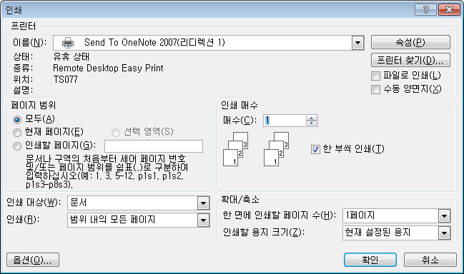
Dialog Box Layouts: Print

Slide 13
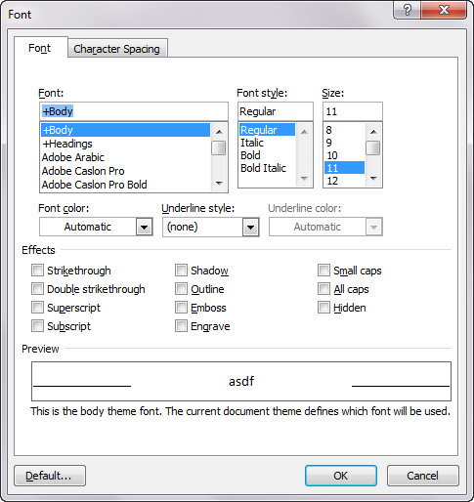
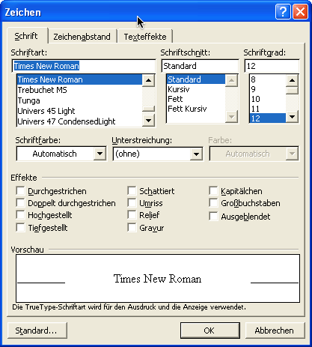
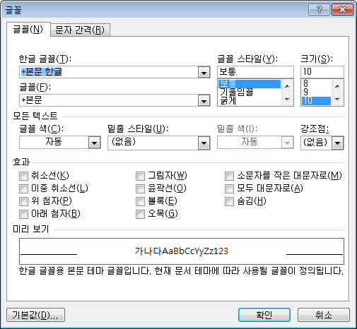
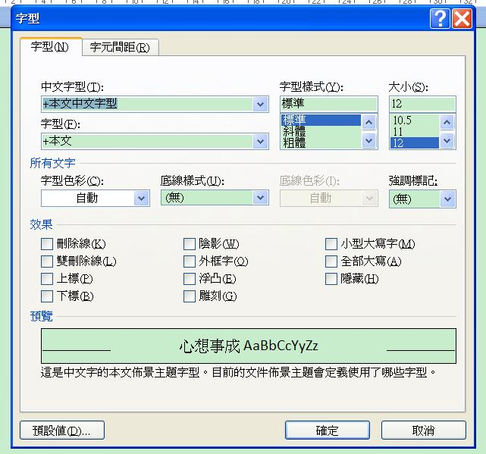
Dialog Box Layouts: Fonts

Slide 14
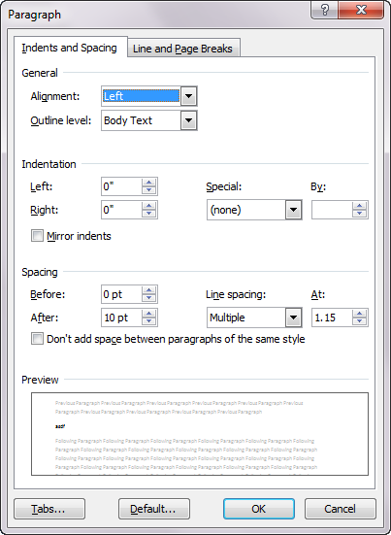
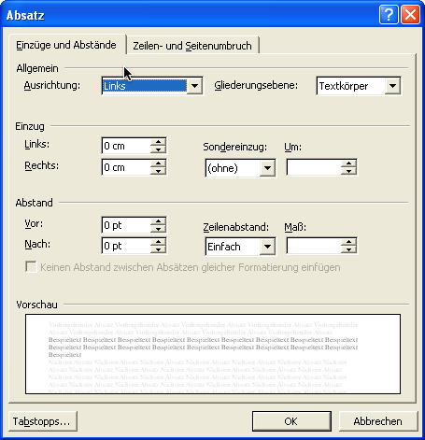
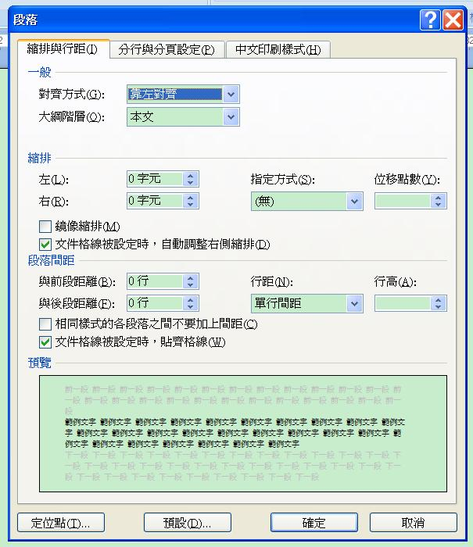
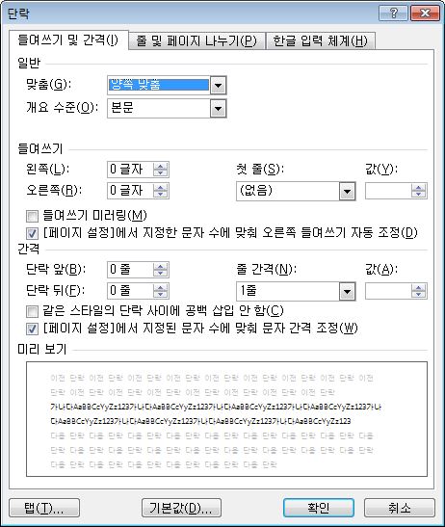
Dialog Box Layouts: Paragraph

Slide 15
E-commerce issues
Make sure that it is clear what areas are served
  E.g., cars not available in US, different formats, electrical (110v 220v)
  E.g., Service available?
  E.g, justflowers.com has international section
  Put on home page, shipping page, “about” page, and help
  Use keywords: “Shipping” and/or “International”
Paying in international currency
Weights and sizes and clothing sizes in metric and U.S. units

Slide 16
Shipping Issues
Shipping charges and options for overseas
  Sales taxes?
Accept entry of non-US characters in fields
  May be an issue for sorting, etc.
Consider have separate US and overseas shipping pages
Otherwise:
  Use “zip / postal code” as prompt
  Different organization of postal address (postal code after city or after state?)
  In “state/province” field,
    Full-length state names
    Option for “other countries” in state field

Slide 17
URL issues
Use www.company.com for English language version
Use www.company.co.XX (.uk, .de, .kr) for foreign site
Use local (country specific) URL also for sites of only local interest

Slide 18
Implementation Issues
Separate “resource files”
  Put strings, etc. in separate file so can be easily changed without recompiling
  Not as part of the code
    Including error messages, etc
    Difficult due to constructed messages
      “Cannot copy file <#1> to directory <#2> due to <#err>”
      Even the order of the words may need to be different
  Also put in locations and sizes, since may change with the language
OS features help
  Automatic formatting and input for dates, etc.
  Toolkit support for layout, conversions, Unicode, etc.
  “Locale”
  But does changing it convert values or just show them differently?
    OK for date, not for currency!

Slide 19
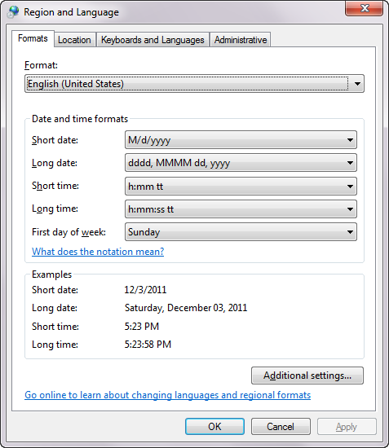
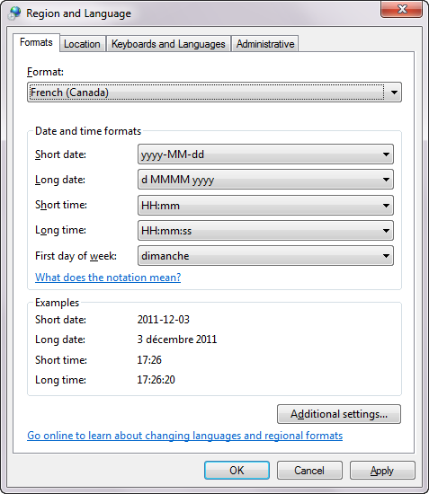
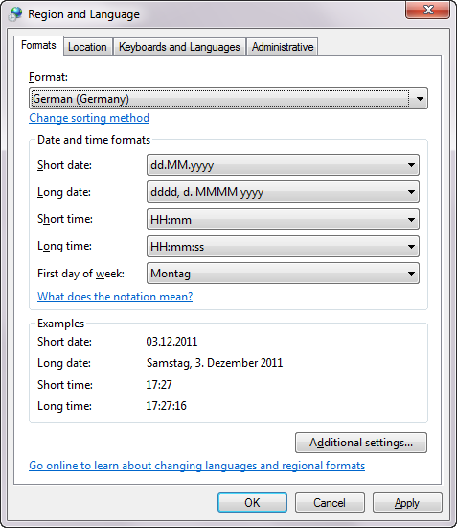
Windows 7 “Region and Language”
Formerly called “Locale”

Slide 20
International User testing
Localized interface can have new and different usability problems
  Not sufficient to test one version and then translate
Should perform heuristic analysis by usability specialists familiar with target culture and language
Should test with native speakers in different countries
Use international or national usability consultants
Use “remote testing” with instrumented web sites

Slide 21
Handheld User Interfaces

Slide 22
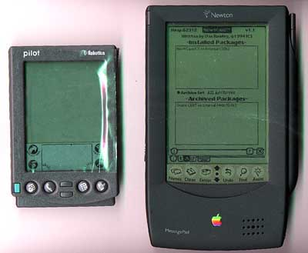
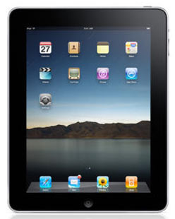
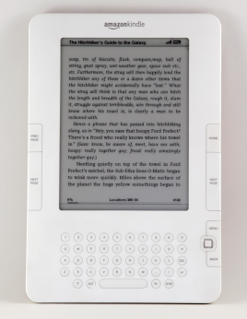
Why Important?
Now: Handheld = Mobile = Cell Phone
  Old: PDA = Personal Digital Assistant
  New: iPADs & readers
Big numbers of mobile phones
  Over 5 billion mobile phones in use this year (CBS News)
  About 38% of phones in use in US are Smartphones (comshare)
  “Mobile phones are rapidly becoming the preferred means of personal communication, creating the world's largest consumer electronics industry.”
  More mobile devices purchased last year than PCs and cars combined!

Slide 23
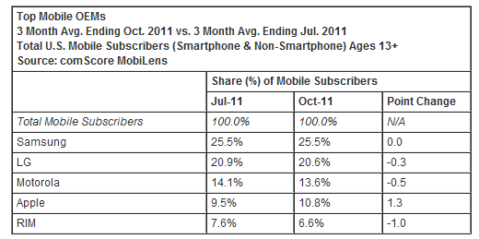
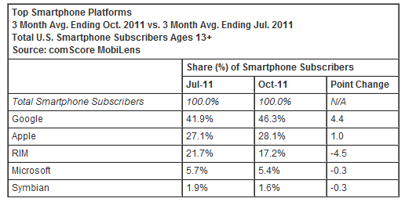
More Statistics
10% of all phones
in US are iPhones
Android continues
to take larger
share of Smart-
Phones, currently
46% (iPhone 28%)
(comshare)
60 million tablets
in 2011, ~65%
iPads (cite)

Slide 24
mCommerce Importance
Nielsen: “Mobile access will be the third ‘killer app’ for the Internet, after email and web browsing”
  “Anyone, anytime, anywhere, connected”
Mobile Devices are “Life Accessories”
  --Panu Korhonen, Usability Group Lead, Nokia
  Interact with mobile devices in a more “intimate” way than regular PCs

Slide 25
Usage Model Different for
Handhelds than PCs or Web
Immediate requests
Short interactions, frequently interrupted
Public use
Fashion statement
  Less business-oriented
  More value to design
Little engagement
Must always be able to answer the phone

Slide 26
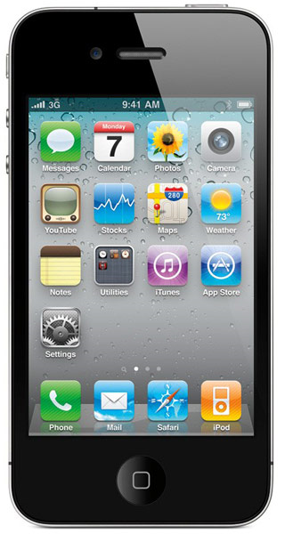
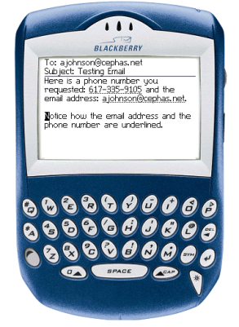
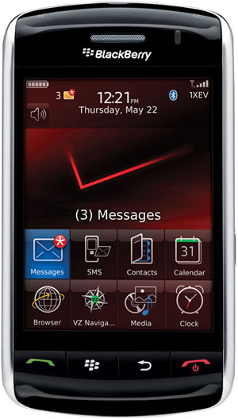
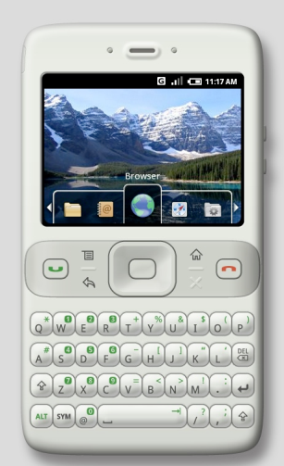
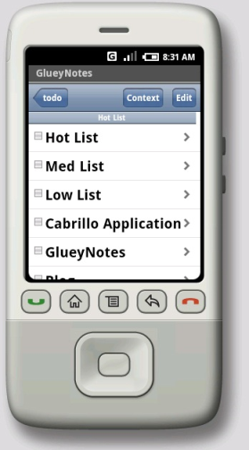
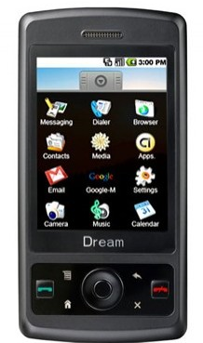
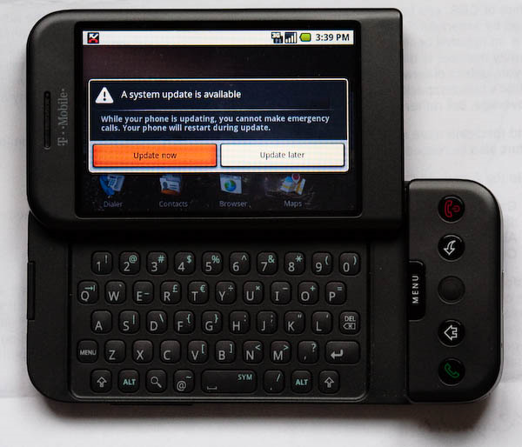
Issues with Handheld Designs
Must follow the device’s style guidelines
  May depend on OS, Hardware and carrier
    Symbian, Nokia, Verizon
  May be different hardware configurations
    Not with Apple iPhone – closed platform
    RIM’s Storm
    How many buttons?
    Windows Mobile has minimum requirements
    Android?

Slide 27
Design for Small Devices
Principles from the Palm’s designers
“Designing the Palm Pilot: A conversation with Rob Haitani”, by Eric Bergman and Rob Haitani, chapter 4 in Information Appliances and Beyond, Eric Bergman, ed. (2000)
  Fast access to key features on small screens ->
    Only a few commands used a lot
    Leave commands off main screen, even if not symmetric
      new vs. delete
      (think stapler and stapler remover)
    Note that violates consistency
    Tap and then type in schedule and to-do
    Only four buttons – which ones?
    Vs. Windows CE -> if know PC, this is familiar
      But usage models are different
        PC: infrequent long usage
        Palm: frequent short bursts of usage

Slide 28
Design for Small Devices, 2
  Analogy: people like to eat in a car
    Palm design is like adding the cup holder
    Have a house with the other appliances (like the PC)
  They did lots of user testing with prototypes created using HyperCard
  Usage scenarios

Slide 29
Studies for Original Windows CE
“The Interaction Design of Microsoft Windows CE”, by Sarah Zuberec, chapter 5 in Information Appliances and Beyond, Eric Bergman, ed. (2000)
Studies: minimum target: stylus = 5.04mm², finger = 9.04mm²
Drag between down and up for “tap” = 2mm
Many usage scenarios
User tests identified Tahoma 10 bold as best system font, but couldn’t be used because not enough content fit in the dialogs
  So used Tahoma 9
Novice users did better with keyboard, but experts preferred character recognizer
Problem with initial designs: too many taps
  Achieved “walk up and use” but too slow for experts
Double tap with stylus difficult and unnatural
  “Consistency worked against learning and use.”

