Slide 1
Lecture 7:
Implementing a Prototype:
Overview of Using PowerPoint, Adobe Illustrator, Adobe Fireworks, Balsamiq, OmniGraffle, html, etc.
Brad Myers
05-863 / 08-763 / 46-863: Introduction to
Human Computer Interaction for
Technology Executives
Fall, 2011, Mini 2

Slide 2

Housekeeping
Propose change to TA office hour:
  No one shows up for Anthony’s on Wed 1:30-2:30
  Lots of people at Preethi’s on Sunday 3:00pm-4:00pm
    Move both to Sunday?
    Have one on Saturday?
Third TA
  Brian Yee byee@cmu.edu
  Office hours on Friday 3-4 in
  NSH 2507?

Slide 3
From my Email
Homeworks on the wall outside my office, NSH 3517, in the black folders.
The average of the grades on HW #1 was 86%. The main reason people lost points was because of not following the directions.
Reminder of late policy: 10 points per class period.
Option for revised HW #2.
Note updated HW #3 description.

Slide 4
Implementing your Prototype
How “complete” an implementation for HW4?
  Screen transitions must work
  All buttons should do something, even if go to a “not implemented yet” page
  Search, other computation does not have to work
  “Click-through” level of behaviors
Level of complexity required:
  (Same as listed on homework0 page)
  At least 30 “controls” (widgets: buttons, text fields)
  About 10 different screens/pages/windows/modes
  Must be done in one (1) week – no extensions!

Slide 5
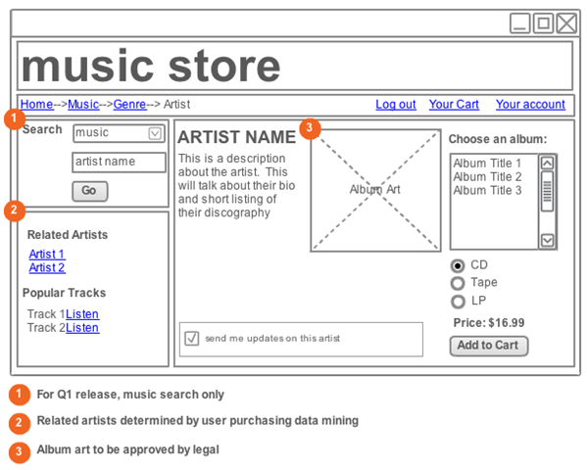
“Wireframe” Level Prototype
Outlines of the buttons and controls
No need for final graphics
Our requirement:
sufficient
functionality to
support your tasks
Labels should be
the real ones
  So can test that
  users understand
  what they do

Slide 6
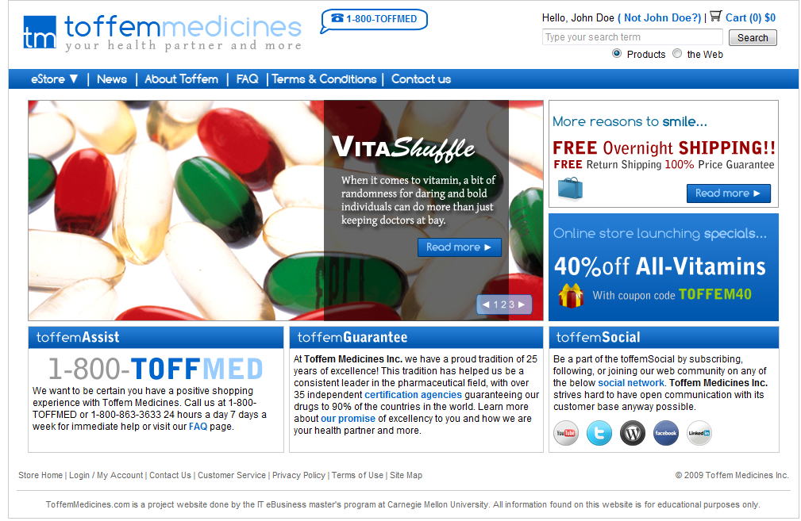
Or, Produce Final-Looking Graphics
Alternatively, could use Photoshop, Illustrator, etc. and produce final graphics
  Designers want to show what real UI will look like
  Details of the “look”
Web pages often use final graphics
  E.g., Toffem Medicines
Add “click-through”
behaviors
  Usually limited mostly
  to screen transitions

Slide 7
Implementation Options for HW4
Pretty much any way you want
  Must “work” – not just paintings
  “Click-through prototypes ”
  Note: TAs and prof. will probably not be able to help you with your code
We recommend you do not use Java, C++, Objective C (iPhone) or other “professional” language
Note: you must be able to create software that is easy for others to run
  Output a set of web pages, or a Windows .exe file

Slide 8
Recommended Options
These are easiest to use:
  PowerPoint – Brad demo
  Mockingbird web app (gomockingbird.com) – Brad demo
  Adobe Illustrator / Adobe Fireworks – Preethi demo
    Free 30 day trials
  Balsamiq – Anthony demo
  OmniGraffle (Macintosh only) – Anthony demo
  Html + Imagemaps
    Using editor like Dreamweaver – Brad demo
    Dreamweaver has a free 30-day trial
  Html + Javascript (more programming)
  Adobe Flash – free trial

Slide 9
Many other choices
  Axure is a popular commercial tool
    www.axure.com
  Visio for wireframes
  Microsoft Expression Blend / Sketchflow
    Free for students from www.dreamspark.com
  Microsoft Visual Basic
  Processing (www.processing.org)
  Python, tcl/tk, … or other desktop programming tool
  Ruby on Rails, or any other web scripting system
  http://mockupscreens.com/

Slide 10
Lots of Lists of Tools
Search for “Prototyping tools” or “Wireframing Tools”
  http://mashable.com/2010/07/15/wireframing-tools/ - “10 free wireframing tools”
  http://www.uxbooth.com/blog/15-desktop-online-wireframing-tools/
  http://www.tripwiremagazine.com/2010/04/15-best-wireframing-tools-for-designers.html
  http://www.uie.com/articles/prototyping_tools/?link=tips100318_6
  http://c2.com/cgi/wiki?GuiPrototypingTools

Slide 11
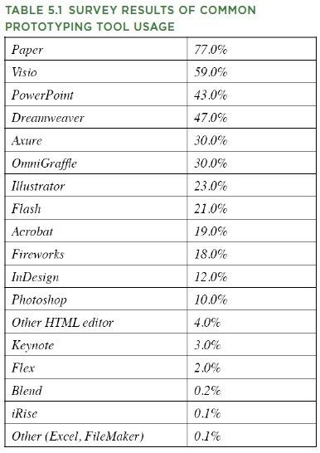
What Are People
Using?
  http://www.uie.com/articles/prototyping_tools/?link=tips100318_6
    Mar 18, 2010
  My survey results are similar (2007)

Slide 12
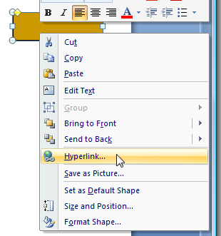
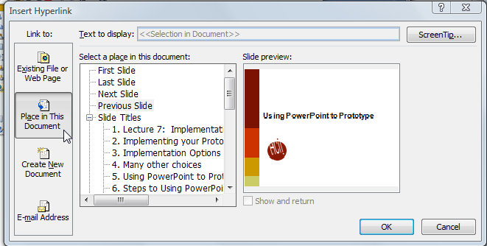
Using PowerPoint to Prototype
Add a shape, with a label
Add a hyperlink:
Select “Place in this document”
Create a slide for each mode of the
application
Can add nice animations
Go back
Go first

Slide 13

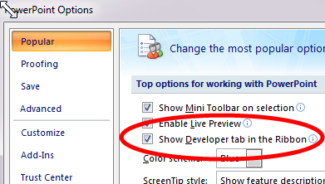
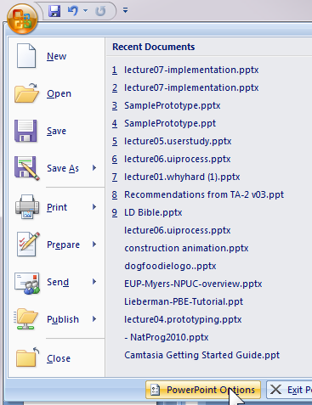

Adding Controls in PowerPoint
Turn on “Developer Toolbar”
  Can add buttons, text entry, etc.
  Script with VB

Slide 14
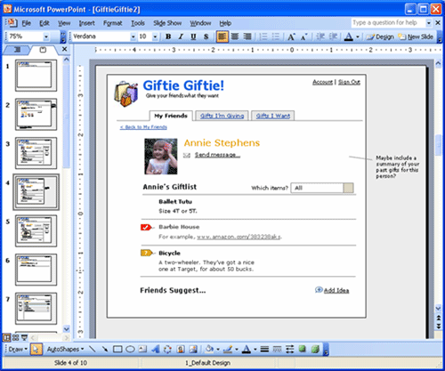
PowerPoint examples
Great training in using PowerPoint:
  http://www.boxesandarrows.com/view/interactive
    by Maureen Kelly on 2007/08/06

Slide 15
Html editing
Can use web editors to prototype any kind of interface
  Tricky for detailed layout
Can edit html using
  Microsoft Word (not recommended)
  Microsoft Expression Web (Blend)
    free for students: www.dreamspark.com
  Adobe Dreamweaver
    free trial: https://www.adobe.com/cfusion/tdrc/index.cfm?product=dreamweaver
    Dreamweaver CS5 (Adobe) in Clusters
  Many others

Slide 16
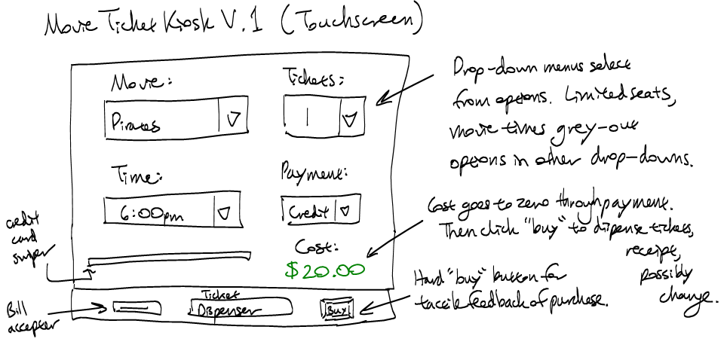
Example: Movie Kiosk
Dreamweaver works a lot like Word
Hint: use tables a lot for layout
Hint: Controls are in “forms”
Make use of the web for “how-to’s”
  E.g., “html button link”

Slide 17
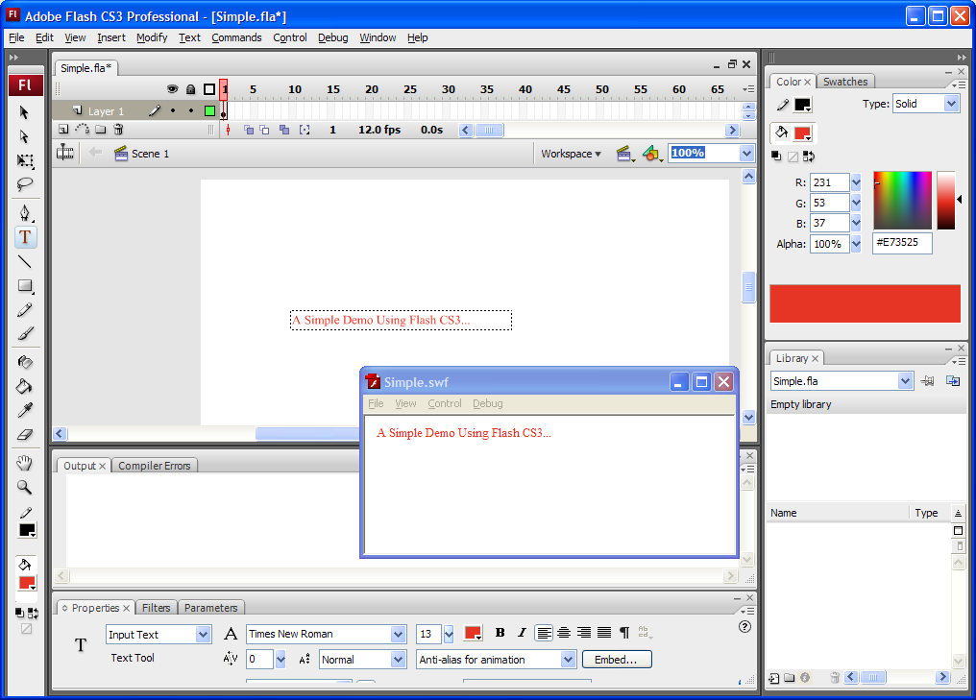
Adobe Flash
Free trial: http://www.adobe.com/products/flash/
Originally an animation tool
  Interactive editor with timeline
Also scripting in
“ActionScript”
(= JavaScript)
  Hint: ActionScript
  v.2 much easier to
  use than v.3
De-emphasized in
future

Slide 18
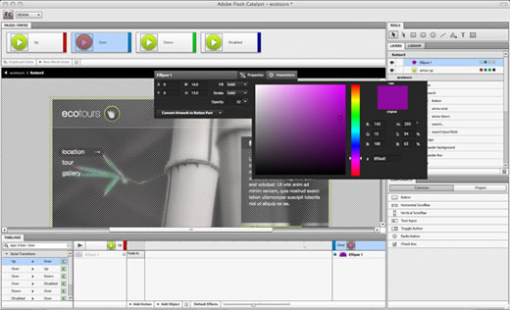
Adobe Flash Catalyst
Brand new tool in CS5
  (I consulted a little during its early design)
  De-emphasized ☹
Allows some of the behavior to be specified without scripting
  States &
  animations
Currently, no
“round tripping”

Slide 19
TA-Run Demos
  Adobe Illustrator / Adobe Fireworks – Preethi demo
    Free 30 day trials
  Balsamiq – Anthony demo
  OmniGraffle (Macintosh only) – Anthony demo

Slide 20
OmniGraffle
Generally used for diagramming and modeling
Allows clickable prototypes by linking canvases and export each page to HTML
Download:
  http://www.omnigroup.com/products/omnigraffle
Konigi Stencils:
  http://konigi.com/tools/omnigraffle-wireframe-stencils
Yahoo Design Stencil Kit:
  http://developer.yahoo.com/ypatterns/about/stencils/

Slide 21
Adobe Fireworks
Preferred by HCI professionals
Allows clickable and interactive prototypes
  Create pages and link pages via hot spots assigned to sections of the page.
  Export each page to HTML for an interactive prototype.
Download:
  http://www.adobe.com/cfusion/tdrc/index.cfm?product=fireworks
Download Stencils to Commons Library:
  http://developer.yahoo.com/ypatterns/about/stencils/fireworks.html

Slide 22
PROTOTYPING TOOLS
Balsamiq & Adobe Illustrator

Slide 23
Balsamiq : Basics
Balsamiq is a quick drag & drop prototyping tool.
  Many common UI components (input components, links, breadcrumbs, tables, grids, tabs, iOS, the list goes on!)
Paid Version ($79)
  Importing images, work with multiple mockups simultaneously, linking mockups together, master pages / reusable components

Slide 24
Balsamiq : Pros / Cons
Pros:
  Really fast, intuitive to use
  Great for low fidelity prototypes that look better than paper sketches / if you’re really bad at drawing
  Variety of helpful functions: aligning, grouping, locking
Cons:
  Very limited control over style (black & white)
  If it doesn’t have the widget you want, or the aesthetic you need, you’re out of luck
  Limitations of the free software

Slide 25
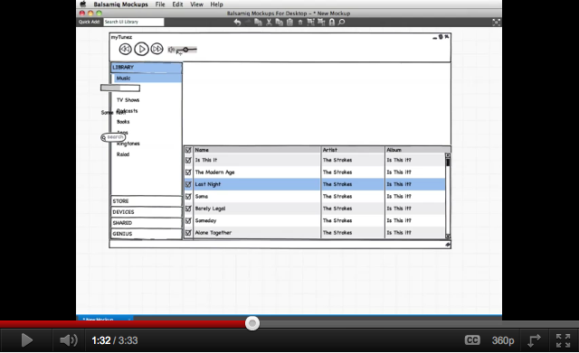
Balsamiq : Demo
Youtube: http://www.youtube.com/watch?feature=player_embedded&v=70hfU7_95Gw
Real Deal: http://www.balsamiq.com/

Slide 26
Illustrator : Basics
Adobe Illustrator is a vector-based drawing software part of the Adobe Creative Suite.
  Huge flexibility in the work you can do. Fantastic tool for creating things from scratch, but our focus will be on the publicly available UI templates online.

Slide 27
Illustrator : Pros / Cons
Pros:
  Infinite amount of resources, how-tos and many public libraries of UI components available online.
  It’s vector drawing! So everything stretches and even public libraries can be edited.
  Great for all levels of fidelities, particularly useful for making high fidelity mockups.
Cons:
  Significant learning curve for some things.
  Takes a bit longer to get stuff done.
  Costs $200 to buy / install.

Slide 28
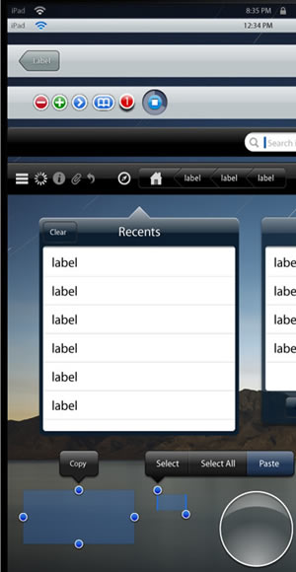
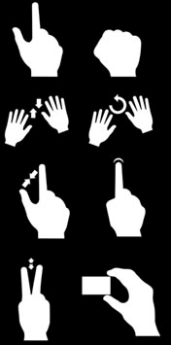
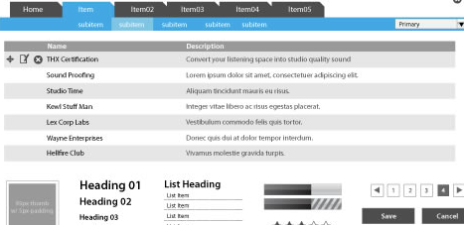
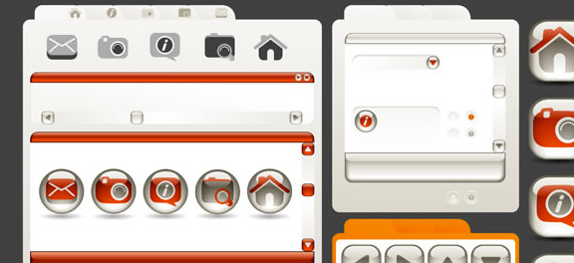
Illustrator : Demo
http://speckyboy.com/2010/09/01/illustrator-template-toolbox-for-web-mobile-and-app-developers/

