Slide 1
05-863 / 08-763 / 46-863: Introduction to Human Computer Interaction for Technology Executives
Brad Myers
Human Computer Interaction Institute
Fall, 2011, Mini 2

Slide 2
Course:
Time: Mondays & Wednesdays
10:30pm – 11:50pm
Room: NSH 1305
All lectures videotaped & available from schedule page

Slide 3

Instructor
Brad Myers
Human Computer Interaction Institute
Office: Newell-Simon Hall (NSH) 3517
Phone: x8-5150
E-mail: bam@cs.cmu.edu
http://www.cs.cmu.edu/~bam
Office hours: By appointment.
Secretary: Indra Szegedy,
NSH 3526
x8-4431

Slide 4
Administrators
For course add/drop problems
HCII – 05-863 | ISR – 08-763 | Tepper – 46-863
Nicole Willis nicolewi@cs.cmu.edu | Linda Francona laf20@cs.cmu.edu | Vickie Motz vmotz@andrew.cmu.edu

Slide 5


Teaching Assistants
Preethi Raju
http://www.contrib.andrew.cmu.edu/~preethir/
preethir @ andrew.cmu.edu
Office hours:
Sundays, 3:00pm-4:00pm, NSH 3001
Anthony Zhang
http://www.andrew.cmu.edu/user/aczhang/
aczhang @ andrew.cmu.edu
Office hours:
Wednesdays, 1:30pm-2:30pm, NSH 2507

Slide 6
Course Web page:
Course Web page:
http://www.cs.cmu.edu/~bam/uicourse/08763fall11
Course schedule is tentative
Note required readings
Note homework and final exam schedule
Some readings are CMU-only, use CMU network or VPN

Slide 7


Textbook (NEW!)
Free Draft Textbook!
H. Rex Hartson and Pardha S. Pyla, The UX Book: Ensuring a Quality User Experience, to be published by Morgan Kaufmann / Elsevier in 2011 or 2012. http://www.theuxbook.net/
Only have 50 copies (so far), so only people taking the course “for real” please!
Will be distributed at next lecture (Monday)
You get the whole book, but you don’t have to read it all!

Slide 8
Textbook agreement
Each person will be required to sign this agreement before getting their copy:
In exchange for getting this free copy of the book:
I agree to return the book to Professor Myers if I drop the course (but I get to keep the copy if I continue in the course to the end).
I will not scan or copy this book or otherwise reproduce it or put it onto the web.
I will not sell this book after the course is over. If I do not want it anymore, I will destroy it.
I will provide feedback about the book as requested during and at the end of the course.

Slide 9
Other useful books
Beyer, H. and Holtzblatt, K., “Contextual Design: Defining Custom-Centered Systems”. 1998, San Francisco, CA: Morgan Kaufmann Publishers, Inc. ISBN: 1-55860-411-1 (paperback)
Jakob Nielsen. "Usability Engineering". Boston: Academic Press, Inc. 1993.
Donald A. Norman, "The Design of Everyday Things". New edition: Basic Books, 2002, ISDN 0-465-06710-7. Or original edition (paperback): New York: Doubleday, 1988. ISBN 0-385-26774-6
Readings from these are “optional”
All readings listed on schedule

Slide 10
What is this class about?
Brief overview of Human Computer Interaction techniques
Understanding of what usability is and means
Awareness of Good and Bad design
HCI ≅ “Human Factors”, “Ergonomics”, Man-Machine Interfaces (MMI), etc.
Teach the 4 most important, proven methods for achieving better usability, and why they are important
Contextual Inquiry
Rapid Prototyping
User studies
Heuristic Analysis
You will be able to create better user interfaces, web sites, consumer products, etc.
You will be better able to lead design teams

Slide 11
Homeworks & Grading
6 individual homeworks
Overview of homework grading & policies
Note schedule of when due
Due before class
Turn-in by hardcopy (except for distance ed)
Final Exam
Note last day of class
Exam date during last week also
Pass/fail OK with me
Check with your program
Audit – not OK – just show up
(Don’t take a text book, except by special arrangement)

Slide 12
Assignment 0
Picking an appliance
Will do in-class next lecture
Everyone must have a different appliance
Everyone should attend class for next lecture or you get last choice
Mon, Oct 31, 2011

Slide 13
Requirements
Removed requirement to be able to program
One homework (#4) will have you create a medium-size prototype, but it can be in any language, including html or even PowerPoint
You are expected to chose an implementation you can do mostly on your own
Make this course more accessible to a wider range of students

Slide 14
Lecture 1: Introduction and Why are UIs Important and Difficult to Design and Implement
Brad Myers

Slide 15
Who are “Users”?
People who will use a product or web site.
As opposed to the “Designers”
People who create the system or web site
Designers ≠ Users
You are the designer
Have to make an effort to Know The User

Slide 16
What is the “User Interface”?
Everything the user encounters
Functionality & Usefulness
Content
Labels
Presentation
Layout
Navigation
Speed of response
Emotional Impact
Documentation & Help
Book calls it “User Experience”

Slide 17
What is Your Definition of “Quality” for a System?

Slide 18
What is “Usability”?
= Quality!
Learnability
Efficiency
Productivity
Memorability
Little “re-learning” required
Errors
Satisfaction
Pleasurable

Slide 19
User “Experience”
Even more than “usability”
Usability focuses on performance
User Experience
Emotion, Heritage
Fun, Style, Art
Branding, Reputation
Political, social personal connections
Beyond just the device itself – “Service Design”
Blends: usability engineering, software engineering, ergonomics, hardware engineering, marketing, graphic design

Slide 20
Why are Interfaces Important?
Sit-down-and-use computers and software
Don't read the manuals
Usability is critical to software sales:
In magazine ratings
"User friendly"
There are well-defined methods and techniques
Not just opinions, luck, domain-experience
HCI-trained people build better interfaces
Programmers don't think like end-users
Exposure to different kinds of interfaces, problems
User model, not system model
Guidelines

Slide 21
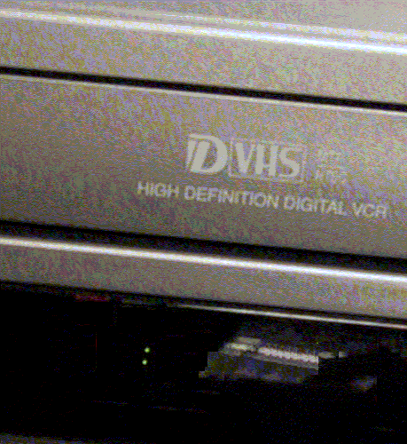
Problem
Appliances are too complex

Slide 22
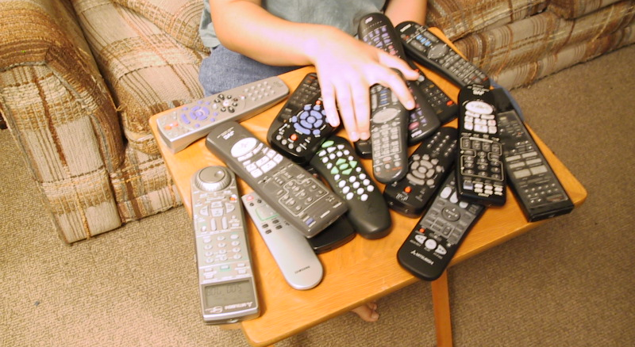
Problem
Too many remotes

Slide 23
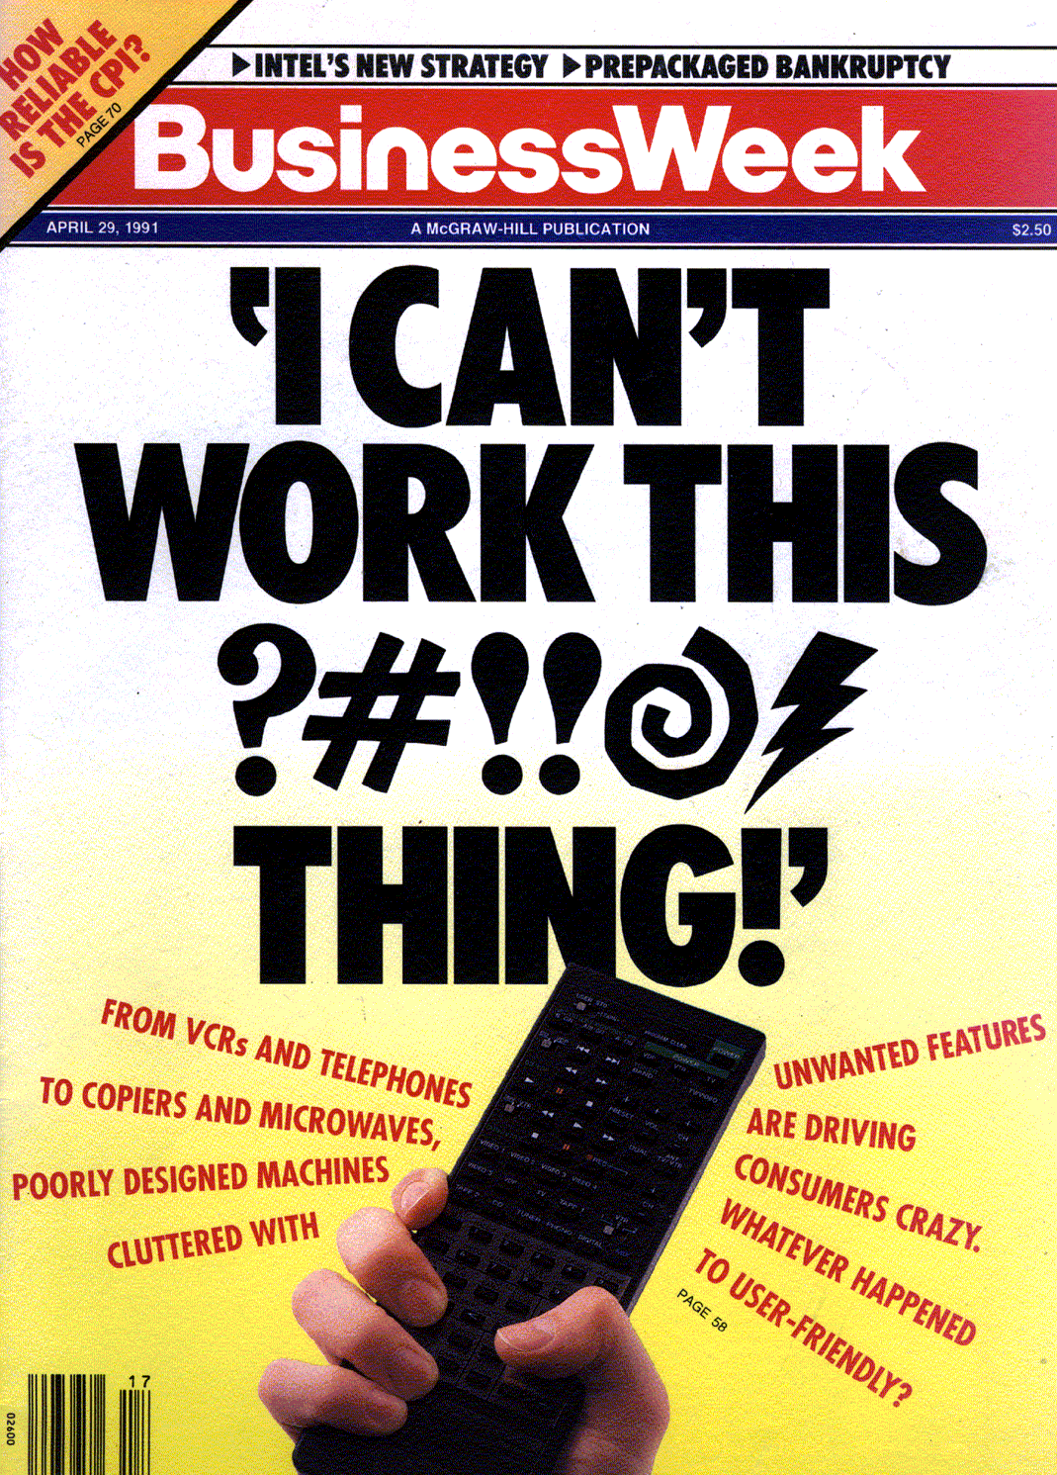
Problem
April 29, 1991

Slide 24
Why Important? cont.
Customer benefits:
Novices will be more effective quicker
Make experts more efficient
Efficiency is important to customers, especially with shrinking workforces & outsourcing
Reduce errors
Increased pride of ownership
Productivity and satisfaction

Slide 25
Why Important? cont.
Company Benefits
Usability engineering saves money (ROI)
$39,000, $613,000, $8,200,000
Up to 5000 times the cost
Reduce calls to the support center & support costs in general
Can cost $30 - $100 per call
Reduced complaints from customers
Can help identify what is really needed
What will be useful and what is not needed

Slide 26
Company Benefits, cont.
Reduce redesign costs
“lack of attention to user inputs is one of the most important reasons why many software projects were unsuccessful. This translated to costing corporations $80 billion dollars a year.” – [Hartson-Pyla, ch. 1, p. 33]
Easier to demonstrate and sell
Greater usage of features = realized value
Competitive Differentiation → Revenue and Profit

Slide 27
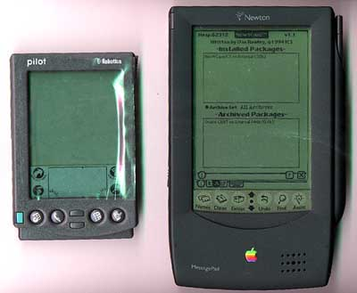
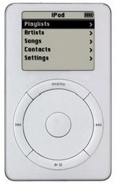
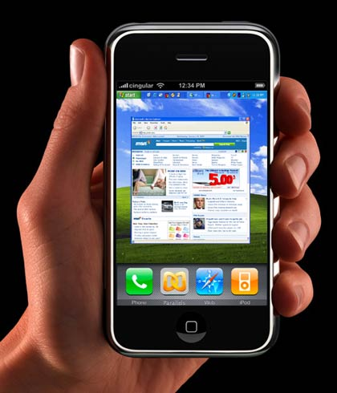
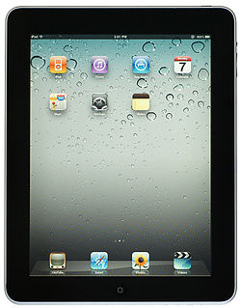
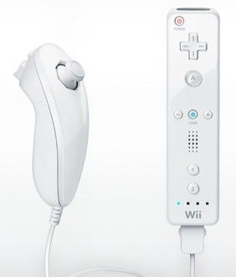
Good UIs on Successful Products
Palm succeeded where other handhelds had failed due to a focus on usability:
Fit into pocket
Reliable gestural text input
Commands immediately available
Apple iPod lauded for design and user interface
iTunes → entire service design
Apple iPhone – unique UI
Apple iPad – desireable
Wii controller, vs. XBox, PS3 graphics & power

Slide 28

Why Important? cont.
Recognized by industry, government, etc.
Plenty of jobs
Money for research
Significant time and code devoted to HCI now!
-- www.dray.com
Corollary: If the user can’t find or use a feature, it doesn’t exist!

Slide 29
Especially for the Web
“Usability rules the web”
If the customer cannot find your product, then it won’t be bought
Your competitors are only one click away
All web sites are compared to the best
Normal Products
Web Products

Slide 30
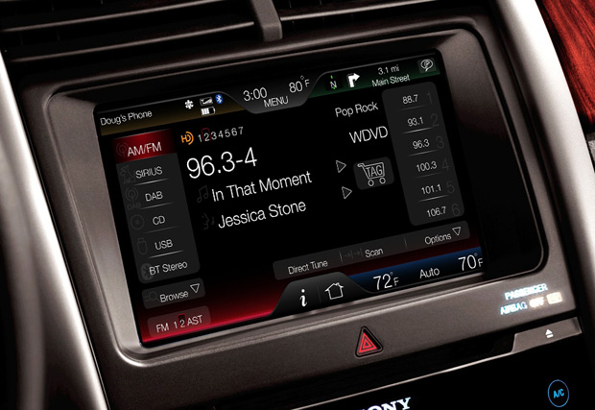
Bad UIs can Sink Products & Companies
Damage reputations
Ford dropped in ratings due to touch screen interface
“Despite Ford’s improvements in manufacturing quality, their overall ratings fell precipitously this year due solely to the poor software interaction on their dashboards.” – NYT, Cooper Report
“’annoying’ behavior of their driver-facing interactive systems that caused their ratings to plummet.”

Slide 31
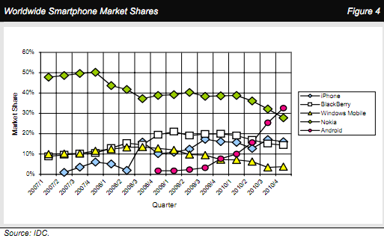
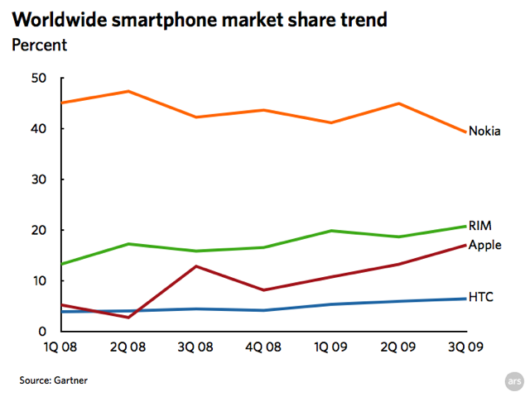
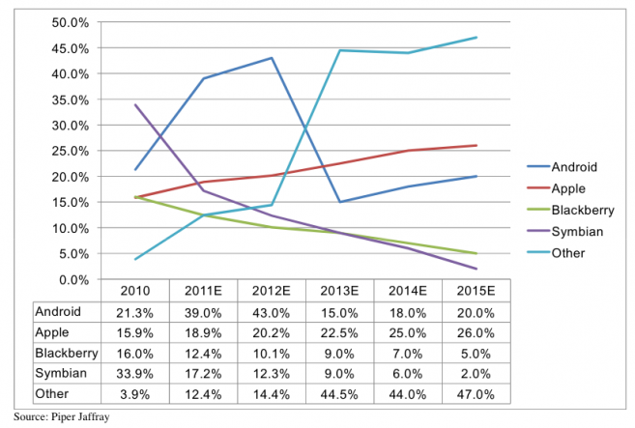
Nokia & RIM

Slide 32
Bad UIs Can Cause Disasters
Aegis
July 4, 1988; Iranian Airbus shootdown by the Vincennes
http://www.washingtonpost.com/wp-srv/inatl/longterm/flight801/stories/july88crash.htm http://en.wikipedia.org/wiki/USS_Vincennes_%28CG-49%29
Deaths in kids: http://pediatrics.aappublications.org/cgi/content/abstract/116/6/1506
“Unexpected Increased Mortality After Implementation of a Commercially Sold Computerized Physician Order Entry (CPOE) System”
Because it took so much longer, did not reduce errors overall
Florida ballots (2000)
http://www.asktog.com/columns/042ButterflyBallot.html

Slide 33
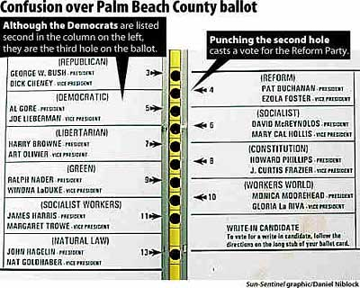
Florida Ballots in 2000

Slide 34
Why are User Interfaces Difficult to Design?

Slide 35
Why Hard to Design UIs?
“It is easy to make things hard. It is hard to make things easy.”
No silver bullet
Seems easy, common sense, but seldom done right
Once done right, however, seems “obvious”
User Interface design is a creative process
Designers have difficulty thinking like users
Often need to understand task domain
Can’t “unlearn” something

Slide 36
Can’t Unlearn Something

Slide 37
Why Difficult, 2
Specifications are always wrong:
"Only slightly more than 30% of the code developed in application software development ever gets used as intended by end-users. The reason for this statistic may be a result of developers not understanding what their users need."
-- Hugh Beyer and Karen Holtzblatt, "Contextual Design: A Customer-Centric Approach to Systems Design,“ ACM Interactions, Sep+Oct, 1997, iv.5, p. 62.
Need for prototyping and iteration

Slide 38
Why Difficult, 3
Tasks and domains are complex
Word 1 (100 commands) vs. Word 2010 (>2000)
MacDraw 1 vs. Illustrator
BMW iDrive adjusts over 700 functions
Existing theories and guidelines are not sufficient
Too specific and/or too general
Standard does not address all issues.
Adding graphics can make worse
Pretty ≠ Easy to use
Can’t just copy other designs
Legal issues

Slide 39
Why Difficult, 4
All UI design involves tradeoffs:
Standards (style guides, related products)
Graphic design (artistic)
Technical writing (Documentation)
Internationalization
Performance
Multiple platforms (hardware, browsers, etc.)
High-level and low-level details
External factors (social issues)
Legal issues
Time to develop and test (“time to market”)

Slide 40
Why are User Interfaces Difficult to Implement?

Slide 41
Why Are User Interfaces Hard to Implement?
They are hard to design, requiring iterative implementation
Not the waterfall model: specify, design, implement, test, deliver
They are reactive and are programmed from the "inside-out"
Event based programming
More difficult to modularize

Slide 42
Why Hard to Implement? cont.
They generally require multi-processing
To deal with user typing; aborts
Window refresh
Window system as a different process
Multiple input devices
There are real-time requirements for handling input events
Output 60 times a second
Keep up with mouse tracking
Video, sound, multi-media

Slide 43
Why Hard to Implement? cont.
Need for robustness
No crashing, on any input
Helpful error messages and recover gracefully
Aborts
Undo
Lower testability
Few tools for regression testing

Slide 44
Why Hard to Implement? cont.
Little language support
Primitives in computer languages make bad user interfaces
Enormous, complex libraries
Features like object-oriented, constraints, multi-processing
Complexity of the tools
Full bookshelf for documentation of user interface frameworks
MFC, Java Swing, VB .Net, etc.
Difficulty of Modularization

Slide 45
Examples
Difference between displaying “hello” and displaying a blue rectangle
Difficulty to read a file name
Reading a text string
Configuring and handling built-in file dialog
Creating a new file dialog

