Slide 1
Lecture 12: Other HCI Methods
Brad Myers
05-863 / 08-763 / 46-863: Introduction to Human Computer Interaction for Technology Executives
Fall, 2010, Mini 2

Slide 2
Fill Out Class Surveys Now
3 surveys (everyone do all 3):
The official CMU course evaluation: http://cmu.onlinecourseevaluations.com or Tepper evaluation (if you are in 46-863)
The questionnaire about the textbook -- remember, you agreed to fill this out when we gave you the free textbook
The class questionnaire: http://www.surveymonkey.com/s/3N279K5
10 minutes (right now!)

Slide 3
Final Exam Information
Exam Schedule:
Thursday, Dec 9, 2010, 1:30pm-4:30pm in Scaife Hall 125
Monday, Dec 13, 2010, 1:30pm-4:30pm in Tepper, Room 146
See full information: http://www.cs.cmu.edu/~bam/uicourse/08763fall10/finalexam.html

Slide 4
Some Usability Methods
Contextual Inquiry
Contextual Analysis (Design)
Paper Prototypes
Low-Fidelity Prototypes
Think-aloud protocols
Heuristic Evaluation
Affinity diagrams (WAAD)
Personas
Wizard of Oz
Task analysis
Questionnaires
Cultural Probes
Diary studies
Card sorting
Body storming
KLM and GOMS (CogTool)
“Speed Dating”
Cognitive Walkthrough
Cognitive Dimensions
Video prototyping
Expert interviews
Surveys
Interaction Relabeling
Log analysis
Focus groups
Improvisation
Use cases
Scenarios
…
(6)
(5)
(8)

Slide 5
Other Methods
Taught to the HCI Masters students:
Cultural Probes & Diary Studies, Card Sorting, "Bodystorming", Keystroke Model & GOMS, "Speed Dating”
Others I have used:
Cognitive Walkthroughs, Cognitive Dimensions
Design methods vs. evaluation methods
When are they useful?
What kind of information is produced?

Slide 6
Design Methods
Use along side of CIs to find out more about your users, domains, etc.
Also called generative methods – generate data & designs; also “formative” methods – help form the system
Many focused more on “feelings” and less on tasks and work
Culture, aesthetics, etc.
Others get at rare and intermittent occurrences
Design methods:
Cultural Probes & Diary Studies
Card Sorting
Bodystorming

Slide 7
“Cultural Probes”
Bill Gaver, Tony Dunne, & E Pacenti, Design: Cultural Probes, ACM Interactions. vol. 6, no. 1, 1999, pp. 21-29
Goal – learn more about the users’ culture and feelings
Give users a variety of recording devices (paper, maps, postcards, disposable cameras, audio-recorders) that they keep for a while
Users are asked to record various aspects of their lives
Examples:
On postcards: “Please tell us a piece of advice or insight that has been important to you.”; “Tell us about your favorite device.”
On a map: “Where would you like to go, but can’t”
On a camera: “Please take pictures of: Your home; Something desirable; Something boring; whatever you want to show us”
Looking for “Inspiration, not Information”
Beliefs and desires, aesthetic preferences, and cultural concerns
Game-like & fun, but also respectful & interactive

Slide 8
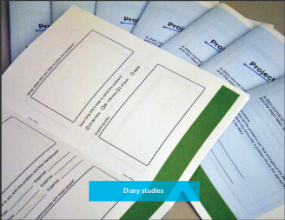
Diary Studies
A variation on Cultural Probes
Give users a diary and ask them to write about relevant events
E.g., each time they have a problem with the system
E.g., whenever a rare event happens, write about aspects of it
Good for rare events that users might not remembers the details of afterwards
Must happen when users can take the time to write down

Slide 9
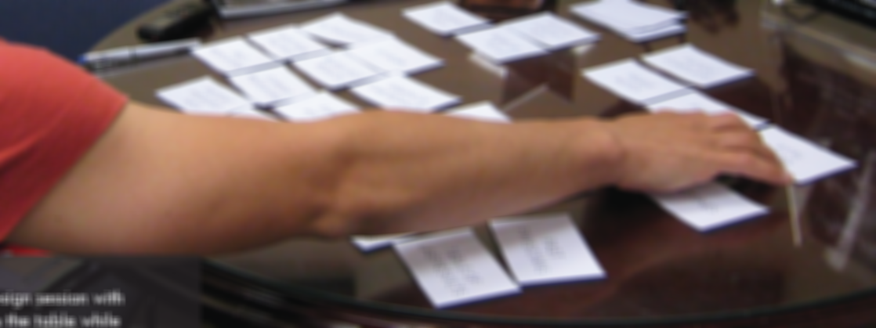
Card Sorting
Write important concepts on cards
Get users to help organize them
Hartson-Pyla text says same as Affinity Diagrams, but not necessarily
Can find out:
What concepts go together? Groupings?
What is a reasonable hierarchy?
What would be better names for items? For groups?

Slide 10
“Bodystorming”
Marion Buchenau and Jane Fulton Suri. 2000. "Experience prototyping." In Proceedings of the 3rd conference on Designing interactive systems: processes, practices, methods, and techniques (DIS '00), pp. 424-433. ACM DL PDF
Term coined by Interval Research ~ for physically-situated brainstorming
Designers pretend to be users, and act out the usage experience
In context, with as much fidelity as possible
Discover constraints of the context
Play different roles in a collaborative situation
Example: buying a ticket at a kiosk
Now with gloves on, collaborating with another, etc.
Example: radio for use in shower, close eyes

Slide 11
Evaluation Methods
Use along side or instead of user testing & heuristic analyses
Also called “summative” methods
To assess or compare the level of usability that has been achieved by the design
Get at different kinds of information
Maximum expert performance
How much learning is required?
What concepts are needed?
Evaluation Methods:
Human Performance Modeling: KLM & GOMS
“Speed Dating”
Cognitive Walkthroughs
Cognitive Dimensions

Slide 12
Human Performance Modeling
John, B. E. (2003) "Information processing and skilled behavior." Chapter 4 In J. M. Carroll, (Ed.), Toward a multidisciplinary science of human computer interaction. Morgan Kaufman. pp. 55-101. Local CMU-only copy
Goal: Compute measures of human performance without needing to do user tests
Use a “model” of how people work, that has been validated to be reasonably accurate, given certain assumptions
Works well for low-level, expert tasks
“How long will it take to enter this sequence of commands?”
Errors (both novice and skilled)
Research on higher-level, problem solving tasks
Visual search, figure out how to do things, etc.

Slide 13
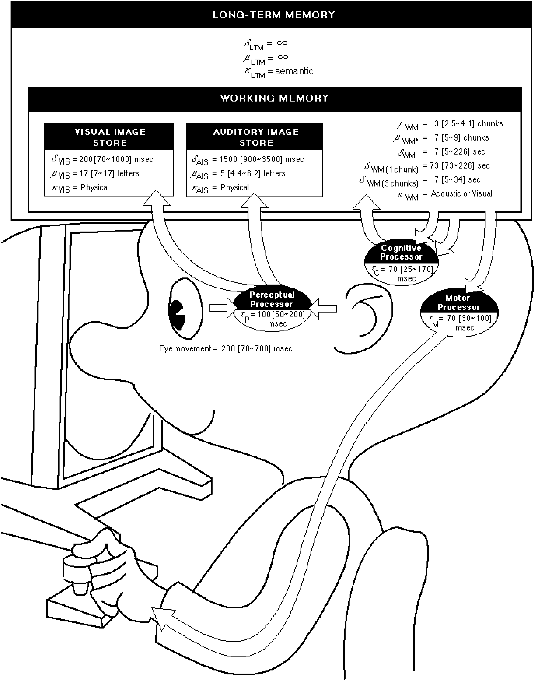
Wouldn’t it be great…
Just point Mr. Bubblehead (the Model Human Processor) at a system, automatically generate performance measures, in context, AND see what’s inside its “mind” and “heart”?
Better yet, point Mr. Bubblehead at design ideas (systems that haven’t been built yet)
Fast, cheap, easy to interpret
Quantitative measures to help persuade

Slide 14
Time Constants

Slide 15
The simplest model: the Keystroke-Level Model (KLM)
Card. Moran & Newell, 1980, 1983 (CMN)
Pre-defined level of detail: K (keystroke), P (point with mouse), H (home between devices), M (mental operator), R (system response time)
Procedure for constructing a sequence of operators that perform a task
Heuristics for placing mental operators
Input:
A suite of benchmark tasks that are important to your design or evaluation
A specification of the proposed system
Output:
A prediction of the time it would take a skilled user to perform the benchmark tasks on the proposed system
Accurate to within about 20% of observed performance
Appropriate for skilled performance, without problem solving

Slide 16
GOMS models
Goals, Operators, Methods, and Selection rules (GOMS)
Also originally from Card, Moran, and Newell
Significant advances by Bonnie John in HCII and others
Multiple strategies (“methods”) possible to do an operation (to reach a “goal”) (e.g., delete a character)
Each strategy uses a variety of “operators”
“Selection rules” to pick which method
E.g., use backspace when previous character, use arrow keys when a few characters away, but use mouse when far away
Write these in a special language (e.g., ACT-R, SOAR) and system predicts how long tasks will take.

Slide 17
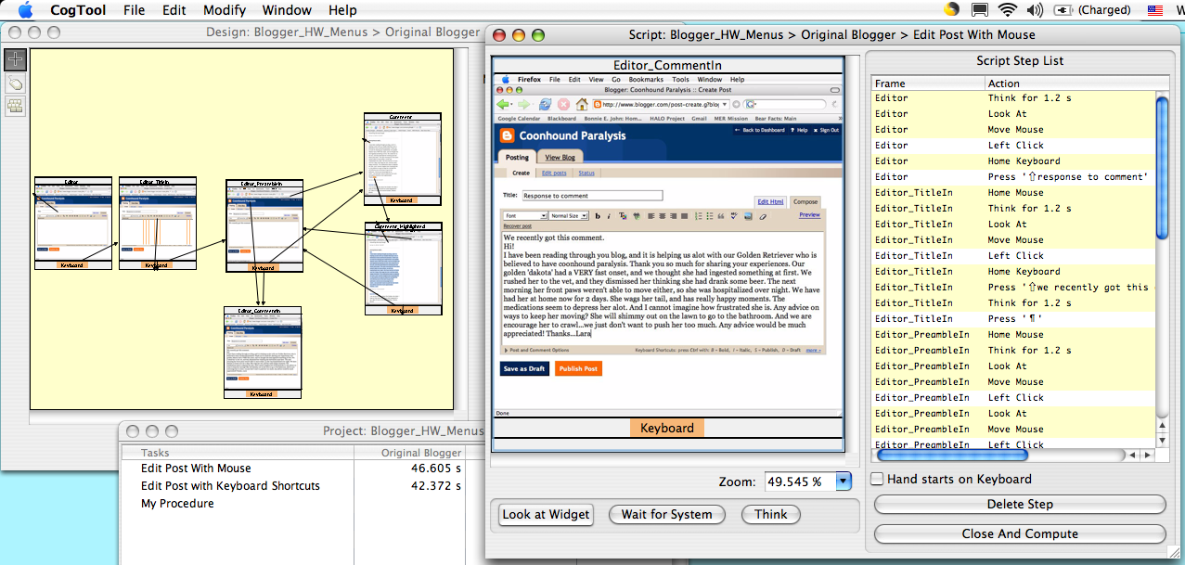
CogTool produces predictions

Slide 18
CogTool
Bonnie John’s tool to help with Cognitive Modeling
http://cogtool.hcii.cs.cmu.edu/
Mock-up an interface in a storyboard
States & transitions between those states
Use interactive widgets on a blank canvas
Useful as a prototyping tool
Outputs performance predictions

Slide 19
CogTool produces predictions through demonstrating tasks on a storyboard
1. Mock-up design in a storyboard
3. Predictions appear in a spreadsheet
2. Demonstrate the tasks

Slide 20
Speed Dating
Invented by CMU PhD students & faculty (including Prof. Zimmerman), and now widely used
Scott Davidoff, Min Kyung Lee, Anind K. Dey, and John Zimmerman. 2007. Rapidly exploring application design through speed dating. In Proceedings of the 9th international conference on Ubiquitous computing (UbiComp '07), Springer-Verlag, Berlin, Heidelberg, 429-446. pdf
(Thanks to Prof. Zimmerman for some of these slides)
“Low-cost, rapid comparison of design opportunities and situated applications by creating structured, bounded, serial engagements.”
Usually used with sketches & storyboards of various designs that users can react to
“Highly-disposable creations to support user enactments”
Users discuss advantages and disadvantages of different designs/approaches
Especially for when no existing product to evaluate
“Field work in the future”

Slide 21
Designer’s hunches
Leverage people’s familiarity with their current experiences in order to:
infer how they might react to new products
uncover desires they cannot expressed because they cannot imagine the future
understand social boundaries
the challenge is to connect them with their past experience

Slide 22
Really Two Methods
needs validation
user enactments
(like bodystorming for users)
Notes:
changed concept validation to needs validation…because it really is about the need, not the concept

Slide 23
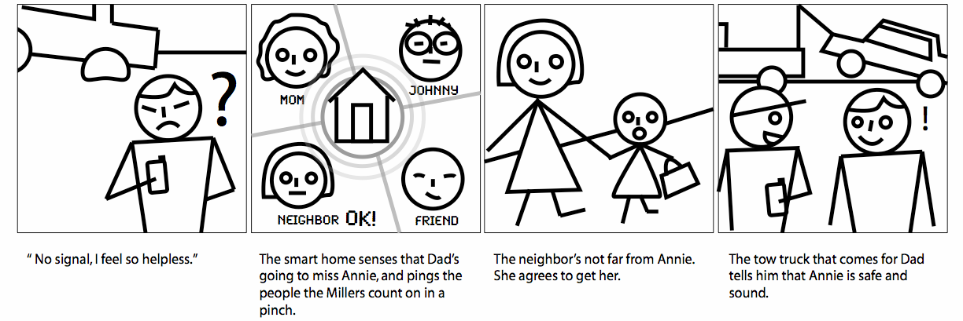
Example: 22 “Smart Home” scenarios

Slide 24
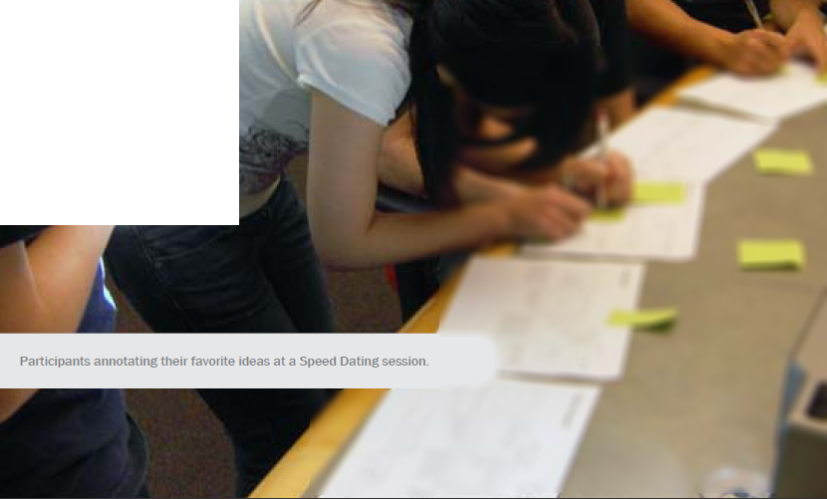
Example: Speed Dating
From an M-HCI 2010 report
Each sheet has one scenario

Slide 25
Cognitive Walkthroughs
Clayton Lewis and John Rieman, "4.1. Cognitive Walkthroughs", in Task-Centered User Interface Design; A Practical Introduction (on-line book), 1994. html
Cognitive Walkthroughs: Simulates user problem solving process
For addressing ease of exploration
Requires specific tasks
Expert analysis
Determine what knowledge the user would have to have to take each step of the task
Ask questions at each step
Will users be trying to produce whatever effect the action has?
Will users see the control (button, menu, switch, etc.) for the action?
Once users find the control, will they recognize that it produces the effect they want?
After the action is taken, will users understand the feedback they get, so they can go on to the next action with confidence?

Slide 26
Cognitive Dimensions
T. R. G. Green and M. Petre. Usability analysis of visual programming environments: A ‘cognitive dimensions’ framework. Journal of Visual Languages and Computing, 7:131—174, 1996. pdf
See also: http://www.cl.cam.ac.uk/~afb21/CognitiveDimensions/
14 heuristics for evaluating usability of programming systems
Abstraction gradient
Closeness of mapping
Consistency
Diffuseness / terseness
Error-proneness
Hard mental operations
Hidden dependencies
Juxtaposability
Premature commitment
Progressive evaluation
Role-expressiveness
Secondary notation and escape from formalism
Viscosity
Visibility

