Slide 1
Lecture 7: Implementing a Prototype: Overview of Using PowerPoint, Flash Catalyst, html, Microsoft Sketchflow/Expression Blend, etc.
Brad Myers
05-863 / 08-763 / 46-863: Introduction to Human Computer Interaction for Technology Executives
Fall, 2010, Mini 2

Slide 2
Implementing your Prototype
How “complete” an implementation for HW4?
Screen transitions must work
All buttons should do something, even if go to a “not implemented yet” page
Search, other computation does not have to work
“Click-through” level of behaviors
Level of complexity required:
At least 30 “controls” (widgets: buttons, text fields)
About 10 different screens/pages/windows/modes
Must be done in one (1) week – no extensions!

Slide 3
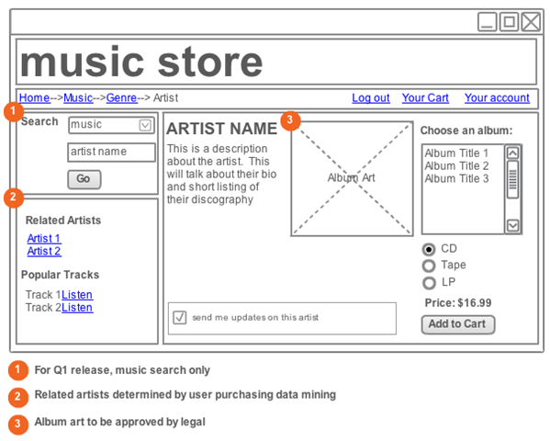
“Wireframe” Level Prototype
Outlines of the buttons and controls
No need for final graphics
Our requirement: sufficient functionality to support your tasks
Labels should be the real ones
So can test that users understand what they do

Slide 4
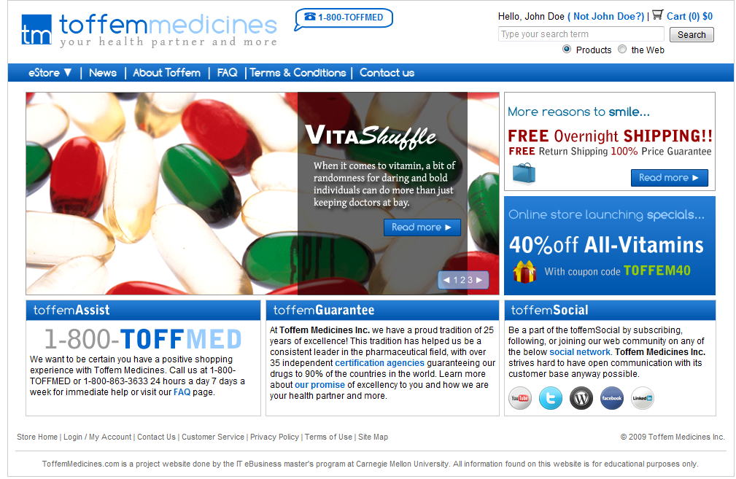
Or, Produce Final-Looking Graphics
Alternatively, could use Photoshop, Illustrator, etc. and produce final graphics
Designers want to show what real UI will look like
Details of the “look”
Web pages often use final graphics
E.g., Toffem Medicines
Add “click-through” behaviors
Usually limited mostly to screen transitions

Slide 5
Implementation Options for HW4
Pretty much any way you want
Must “work” – not just paintings
Note: TAs and prof. will probably not be able to help you with your code
We recommend you do not use Java, C++, Objective C (iPhone) or other “professional” language
Note: you must be able to create software that is easy for others to run
Output a set of web pages, or a Windows .exe file

Slide 6
Recommended Options
These are easiest to use:
PowerPoint – Brad demo
Mockingbird web app (gomockingbird.com) – Noah demo
Html + Imagemaps
Using editor like Dreamweaver – Jane demo
Dreamweaver has a free 30-day trial
Html + Javascript (more programming)
Balsamiq Mockups – Kevin demo
Adobe Flash – free trial

Slide 7
Many other choices
Axure is a popular commercial tool
www.axure.com
OmniGraffle (Macintosh only)
Visio for wireframes
Adobe Fireworks
Microsoft Expression Blend / Sketchflow
Free for students from www.dreamspark.com
Microsoft Visual Basic
Processing (www.processing.org)
Python, tcl/tk, … or other desktop programming tool
Ruby on Rails, or any other web scripting system
http://mockupscreens.com/

Slide 8
Lots of Lists of Tools
Search for “Prototyping tools” or “Wireframing Tools”
http://mashable.com/2010/07/15/wireframing-tools/
http://www.uxbooth.com/blog/15-desktop-online-wireframing-tools/
http://www.tripwiremagazine.com/2010/04/15-best-wireframing-tools-for-designers.html
http://www.uie.com/articles/prototyping_tools/?link=tips100318_6
http://c2.com/cgi/wiki?GuiPrototypingTools

Slide 9
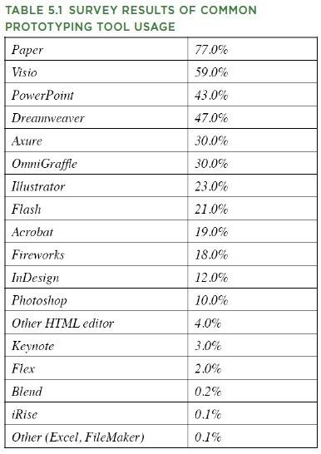
What Are People Using?
http://www.uie.com/articles/prototyping_tools/?link=tips100318_6
Mar 18, 2010
My survey results are similar (2007)

Slide 10
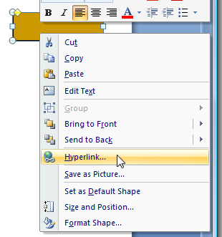
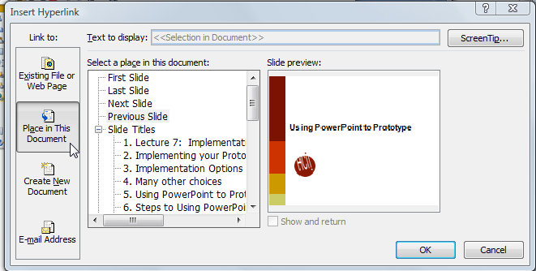
Using PowerPoint to Prototype
Add a shape, with a label
Add a hyperlink:
Select “Place in this document”
Create a slide for each mode of the application
Can add nice animations
Limitations: no text entry, no scripting, no data validation
Go back
Go first

Slide 11
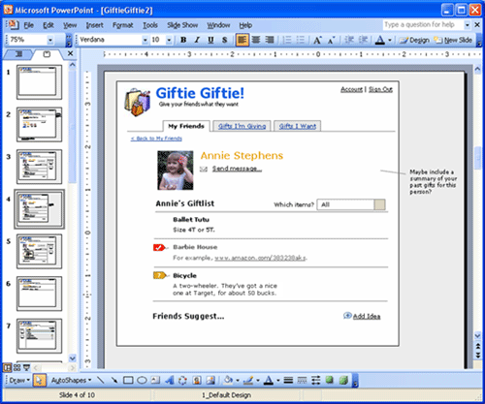
PowerPoint examples
Great training in using PowerPoint:
http://www.boxesandarrows.com/view/interactive
by Maureen Kelly on 2007/08/06

Slide 12
Html editing
Can use web editors to prototype any kind of interface
Tricky for detailed layout
Can edit html using
Microsoft Word (not recommended)
Microsoft Expression Web (Blend)
free for students: www.dreamspark.com
Adobe Dreamweaver
free trial: https://www.adobe.com/cfusion/tdrc/index.cfm?product=dreamweaver
Dreamweaver CS5 (Adobe) in Clusters
Many others

Slide 13
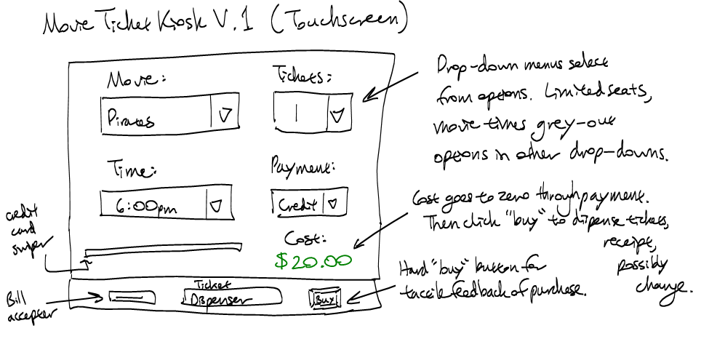
Example: Movie Kiosk
Dreamweaver works a lot like Word
Hint: use tables a lot for layout
Hint: Controls are in “forms”
Make use of the web for “how-to’s”
E.g., “html button link”

Slide 14
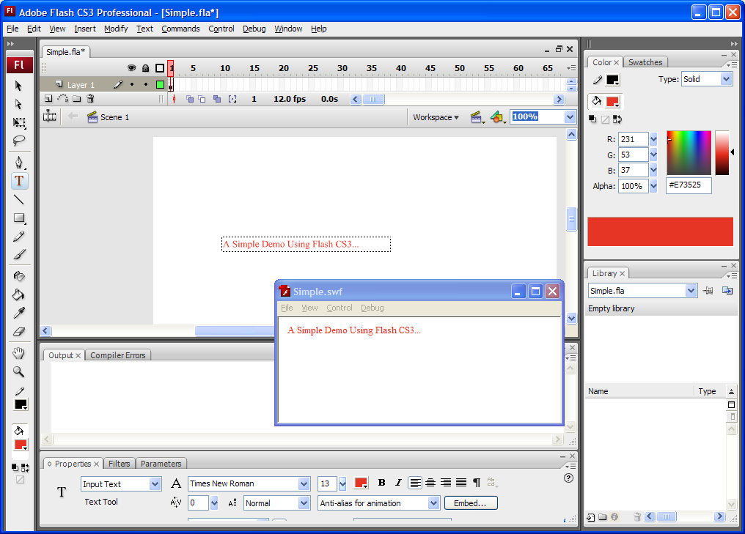
Adobe Flash
In Clusters for Mac or PC
Free trial: http://www.adobe.com/products/flash/
Originally an animation tool
Interactive editor with timeline
Also scripting in “ActionScript” (= JavaScript)
Hint: ActionScript v.2 much easier to use than v.3

Slide 15
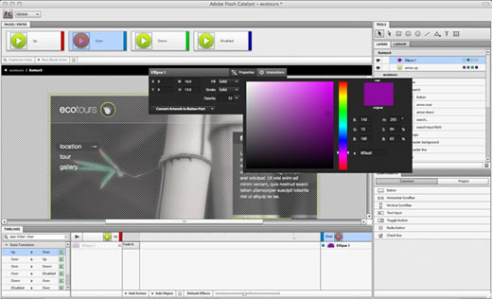
Adobe Flash Catalyst
Brand new tool in CS5
(I consulted a little during its early design)
Allows some of the behavior to be specified without scripting
States & animations
Currently, no “round tripping”

