Slide 1
Lecture 4:
From Analysis to Design:
Sketching and Prototyping
Brad Myers
05-863 / 08-763 / 46-863: Introduction to
Human Computer Interaction for
Technology Executives
Fall, 2010, Mini 2

Slide 2
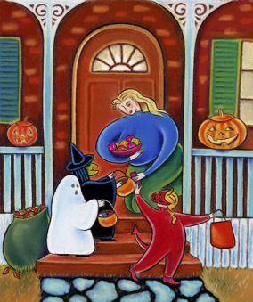
Happy Halloween!

Slide 3

New Third TA
Kevin Yeh
kyeh@andrew.cmu.edu
Office hour:
  Every Friday, 3-4pm
  NSH 3001

Slide 4
Homeworks
Homework 1 due before class today in hardcopy
Start on Homework 2

Slide 5
Going From Analysis To Design
Analysis produces lists of issues/problems = requirements
Requirements also from elsewhere – e.g., marketing
Text (ch. 5) discusses requirements specifications
  How deduce the requirements themselves
  Vague vs. specific requirements
    “User Friendly” vs. “ENTER key should work in all text fields”
  How to write up the specifications
    Not further covered in this course – ref. software engineering
But not necessarily how to address those requirements
  Tradeoffs between conflicting goals
  Gap between Analysis and Design
Note: design of UI, not design of the software

Slide 6
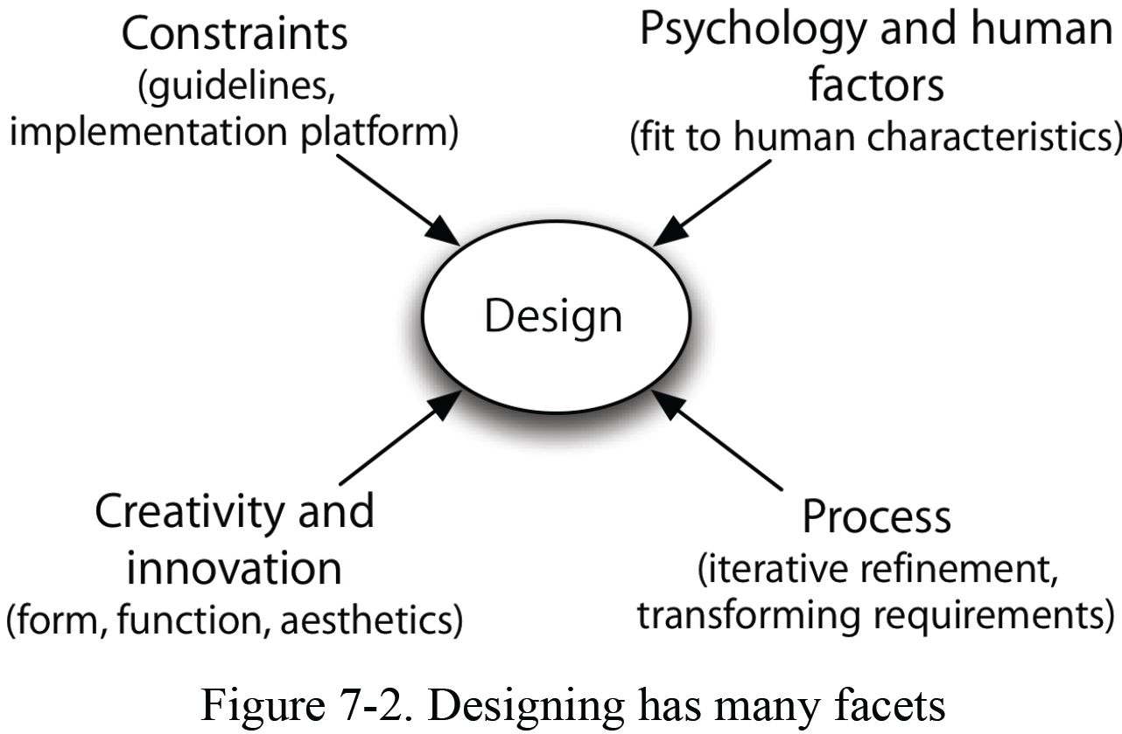
Facets of Design

Slide 7
Design
Design is
  Creative
  Informed
  Respectful
  Responsible

Slide 8
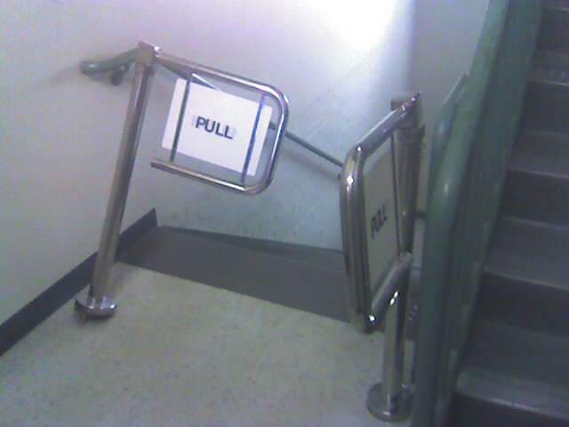
Tradeoffs
Time-to-market vs. good design
Cost
“Curse of individuality”
  Has to be different
Legal considerations
When usability is not desired
  Uncomfortable chairs, exit here
Client isn’t the user
Market Forces:
  Creeping Featurism / “Bloat”
Notes:
Games

Slide 9
How Design?
Don’t know up front exactly what to design
  Don’t know real requirements
  Don’t know appropriate designs
  Can’t get perfect information from users
Very little of the software is independent of the user interface
  Database design, data structures, architecture
    http://www.cs.cmu.edu/~bej/usa/
So need to build and test = Iterative Design
But too expensive to build the real system and test it
  Too hard to redesign
  Too much is already unchangeable

Slide 10
Low Level vs. High Level
Need to design at multiple levels
  High level: Overall metaphors, styles, approaches
  Low level: Detailed interactions and content
High level:
  Conceptual Models, Mental Models, Mappings
  Designer’s vision of the system
  Overall metaphors and organization
  Often inspired by other designs, e.g.
    “Folders like Outlook” (vs. Gmail’s search, later tags)
    “Scrolling like iPhone”

Slide 11
Encourage Accurate User Model
Design model
User’s model
Designer
User
System

Slide 12
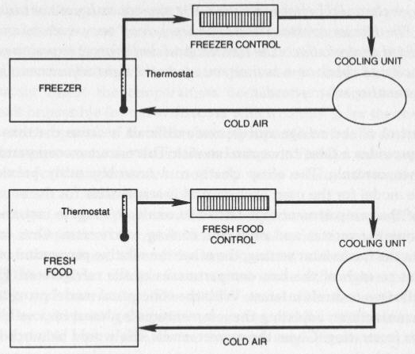
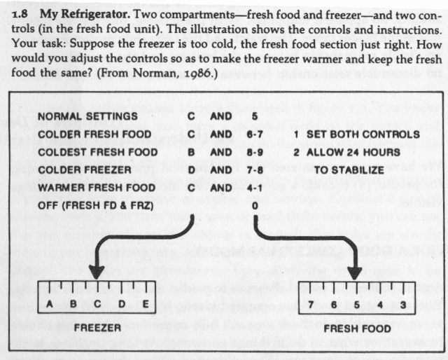
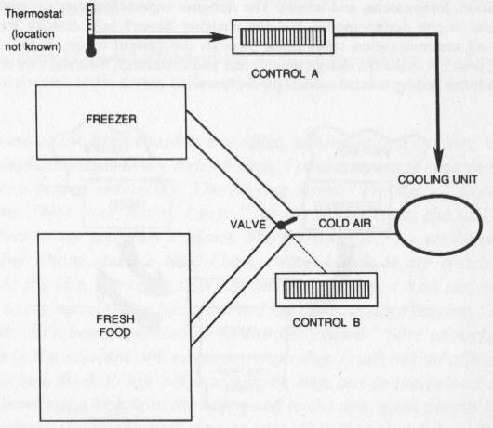
Norman’s Refrigerator
pp. 14-15

Slide 13
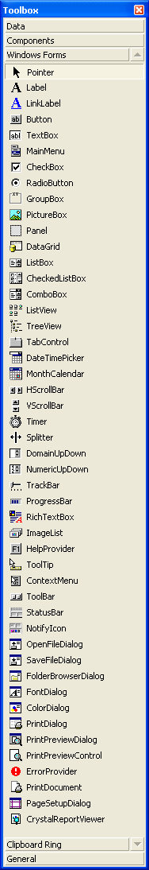
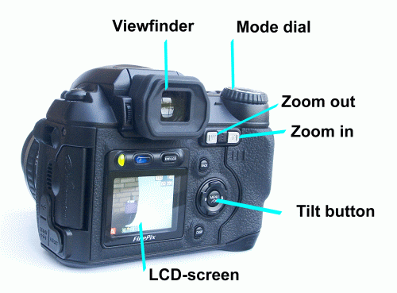
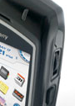
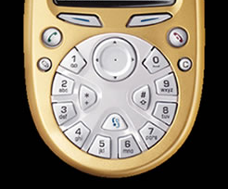
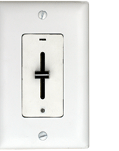
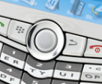
Low Level Design
How the specific Interactions work
Widget Choice
  E.g., many types of menus
    Pull-down
    Cascading
    Tear off
    Pop-up menus
    Context menus
  Physical buttons

Slide 14
“Affordances”
“Perceived and actual properties of the thing, primarily those fundamental properties that determine how the thing could possibly be used.” (Norman book, p. 9)
  “When affordances are taken advantage of, the user knows what to do just by looking”

Slide 15
Incorrect assessments
Three Mile Island
  Incorrect meaning of indicator light that a valve was closed, when it really meant that the valve was told to close
    There was no actual indicator of the status of the valve
Aegis: Ascent vs. Descent
☞ Provide accurate and appropriate feedback

Slide 16
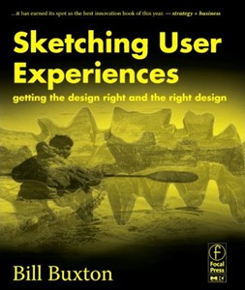
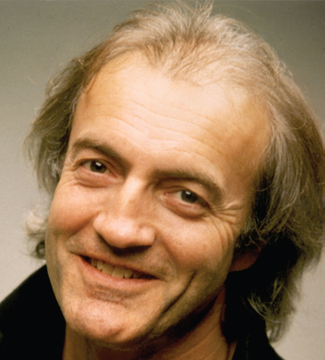
Answer: Sketching and
Early Prototypes
Sketch – used to decide what to design
“Prototype” – Simulation of interface
Buxton differentiates:
  Getting the right design, vs.
  Getting the design right
Quick and cheap to create

Slide 17
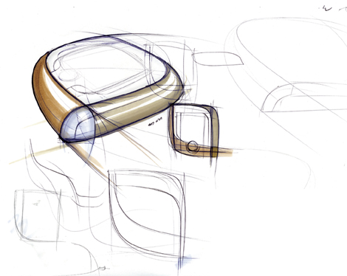
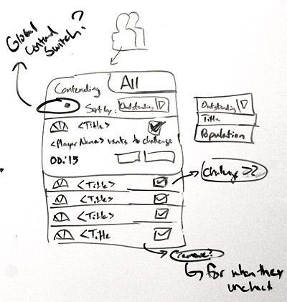
Sketches & Ideation
Designers invent while sketching
  Don’t have design in their head
  first and then transfer it to paper
  Aristotle: “The things we have to learn
  before we do them, we learn by doing them”
Sketching aids the process of invention
Ideation --
  Coming up with ideas to help solve the design problems
Everyone sketches
  Whiteboards, paper
  For collaboration and private investigations
Don’t have to be “artistic”
Be creative!

Slide 18
Properties of Sketches
From Buxton’s article and book
Quick: to produce, so can do many
Timely: provided when needed, done “in the moment”
Inexpensive: so doesn’t inhibit exploration early in the design process.
Disposable: no investment in the sketch itself
Plentiful: both multiple sketches per idea, and multiple ideas
Clear vocabulary: informal, common elements
Distinct Gesture: open, free, “sketchy”
Constrained Resolution: no higher than required to capture the concept
Appropriate Degree of Refinement: don’t imply more finished
Ambiguity: can be interpreted in different ways, and new relationships seen within them, even by the person who drew them.
Suggest & explore rather than confirm: foster collaborative exploration

Slide 19
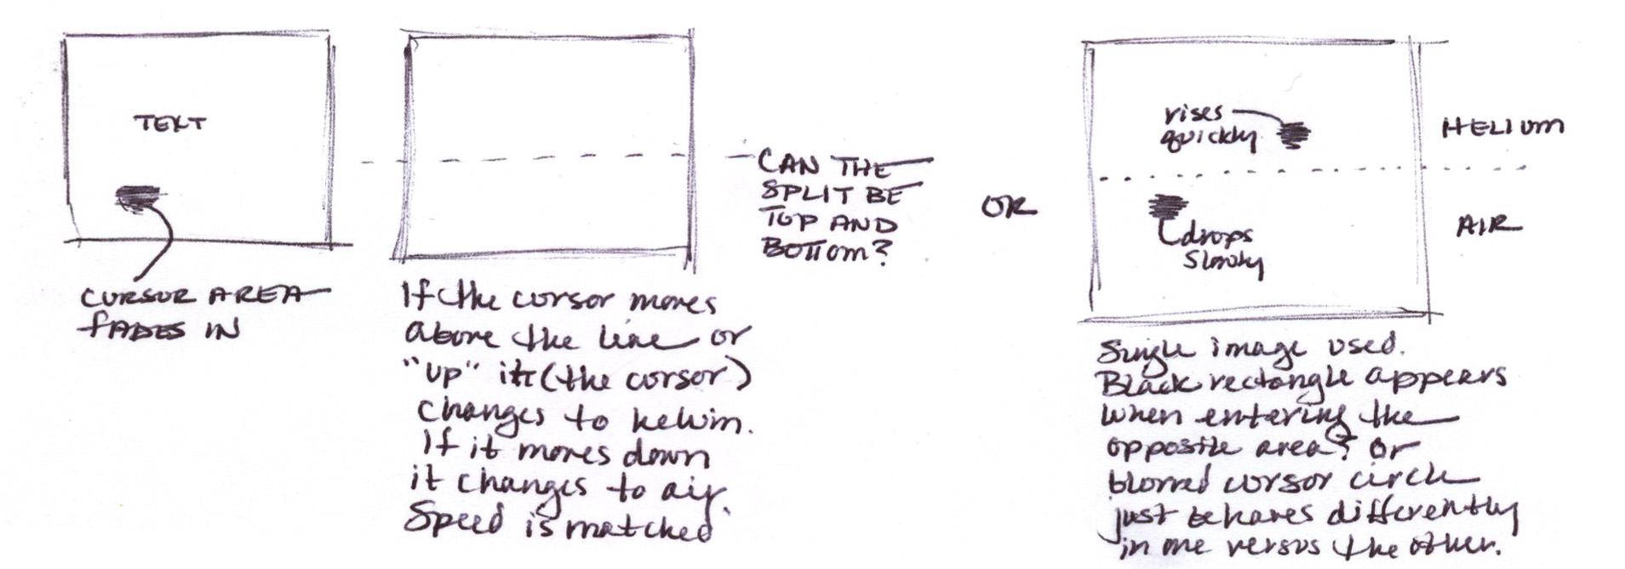
Multiple Sketches, Annotations
Linus Pauling: “The best way to a good idea is to have lots of ideas”
In our new survey, over 90% of designers explore multiple designs
Annotations are important for understanding intent, differences

Slide 20
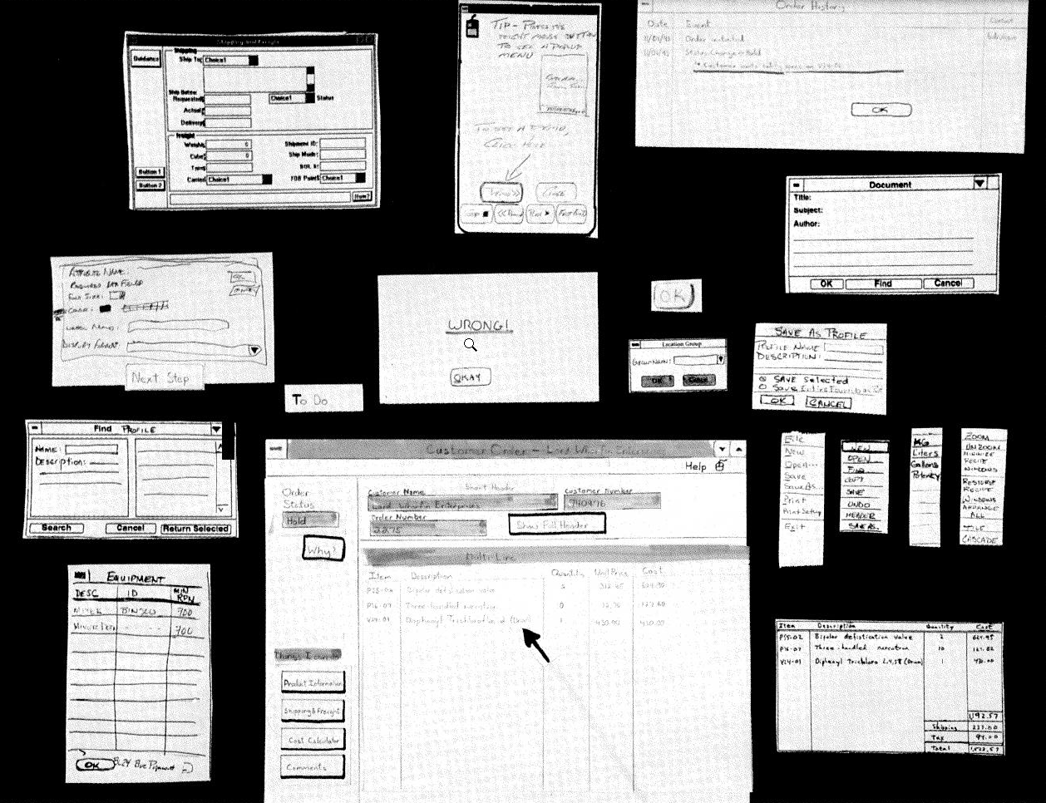
Examples of Sketches

Slide 21
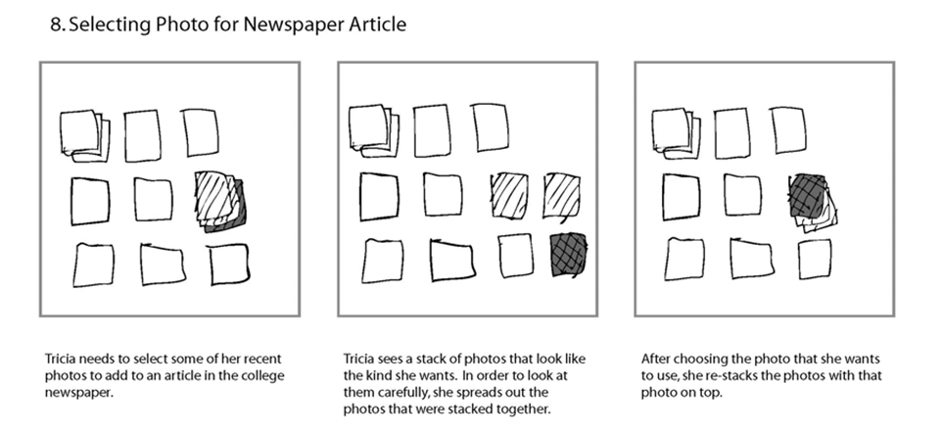
“Storyboards”
Multiple sketches of a behavior = “storyboards”
  Comic strip of what happens
Example: from M-HCI project on a photo browser

Slide 22
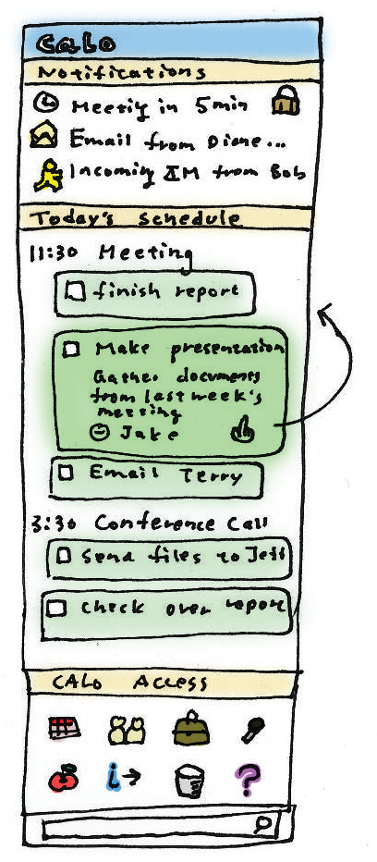
More Examples
From SRI M-HCI project

Slide 23
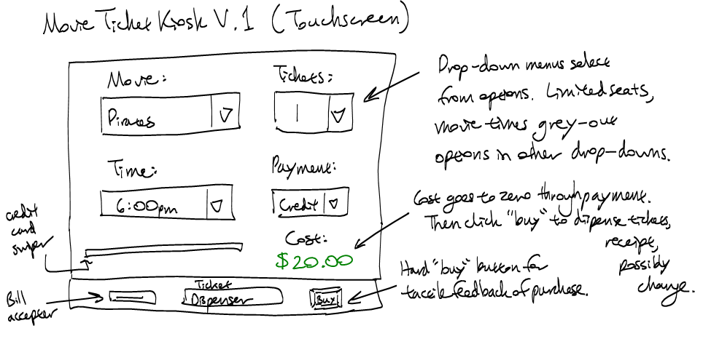
Movie Ticket Kiosk, 1
3 different example designs

Slide 24
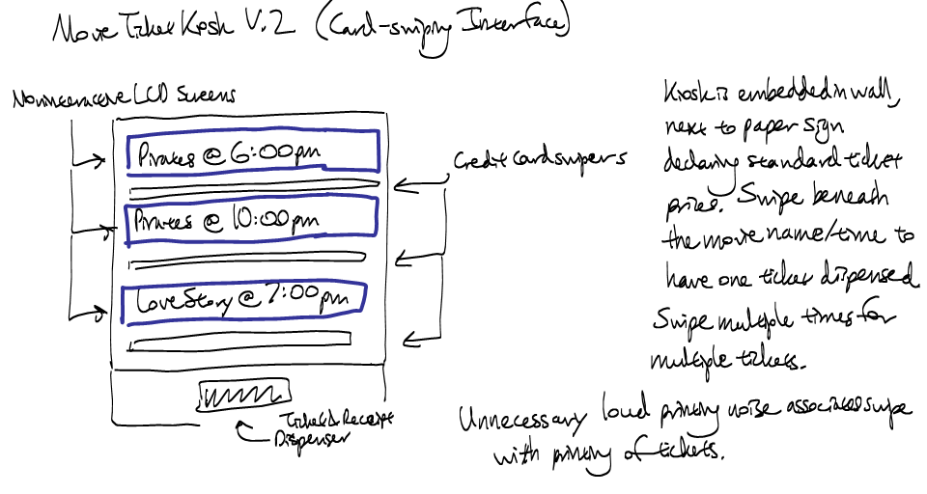
Movie Ticket Kiosk, 2

Slide 25
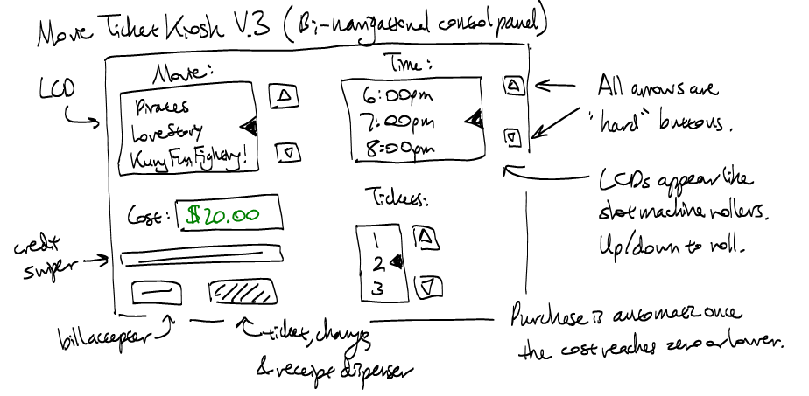
Movie Ticket Kiosk, 3

Slide 26
Sketches vs. Prototypes
Different purposes:
  Sketch for ideation, refinement
  Prototypes for evaluation, usability
Prototypes: more investment, more “weight”
  More difficult to change, but still much easier than real system

Slide 27
Sketches vs. Prototypes
Differences in intent and purpose
Sketch | Prototype
Evocative | Didactic
Suggest | Describe
Explore | Refine
Question | Answer
Propose | Test
Provoke | Resolve
Tentative | Specific
Noncommittal | Depiction

Slide 28
Prototypes
Don't worry about efficiency, robustness
Fake data
Might not need to implement anything – fake the system (no “back end”)
May not use "real" widgets
Just show what looks like
  Storyboard of screens
Some support for behavior: typically changing screens
  Like a movie of the interaction
Goal: see some of interface very quickly (hours)

Slide 29
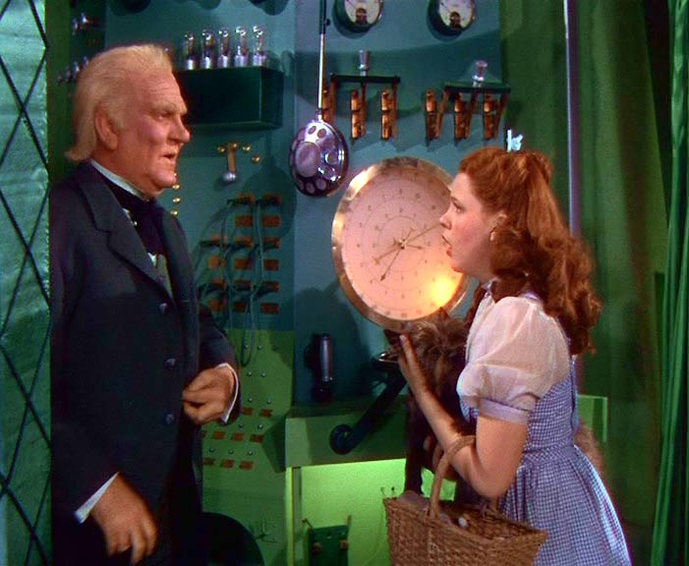
Types of Prototypes
Increasing fidelity
Paper
  “Low fidelity prototyping”
  Often surprisingly effective
  Experimenter plays the computer
  Drawn on paper → drawn on computer
“Wizard of Oz”
  User’s computer is “slave” to experimenter’s computer
    Experimenter provides the computer’s output
  “Pay no attention to that man behind the curtain”
  Especially for AI and other hard-to-implement systems
Implemented Prototype
  Visual Basic
  Adobe (MacroMind) Flash and Director
  Visio
  PowerPoint
  Web tools (even for non-web UIs)
    Html
    Scripting
  (no database)
Real system
Better if sketchier for early design
  Use paper or “sketchy” tools, not real widgets
  People focus on wrong issues: colors, alignment, names
  Rather than overall structure and fundamental design

Slide 30
Types of Prototypes
Horizontal Prototype
Vertical
Prototype
Real
System
Fewer features = Vertical
  Realistic on part
Less Level of functionality = Horizontal
  Overview of all

Slide 31
Uses of Prototypes
What questions will the prototype help you answer?
Is this approach a good idea?
  Usually only need to test a few people for test:
  Most results with first 3 people
  Can refine interface after each test
Look what a cool design we have!
Transfer design from UI specialists to programmers
  Often better than written specifications
Design A versus Design B
  Rare, except in academic environments
What are the real requirements and specifications?
As a basis for “Participatory Design”
  Involve users in the design process, not just the evaluation

Slide 32
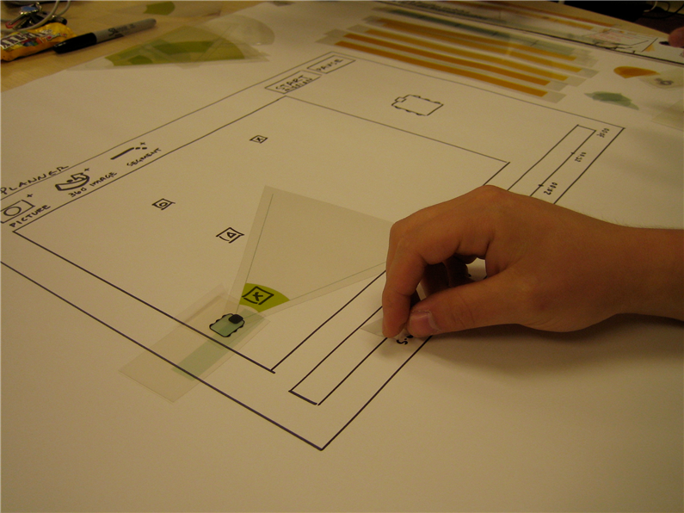
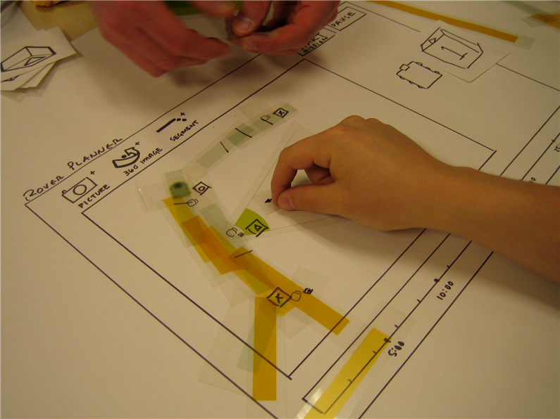
Example of Full Prototype
Prototype of interface for controlling the paths of a robot

Slide 33
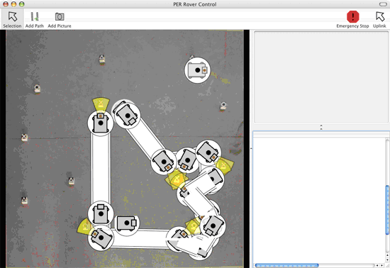
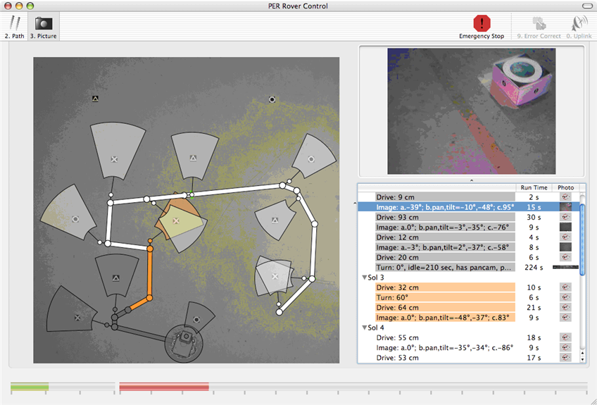
Resulting Prototype and
Final Design

Slide 34

Another Example
From Jingjing Xia in a previous year’s class: washing machine done in PowerPoint (one of 7 screens)
Default->Temperature->Level->Mode
Do you want to use the default settings?
  Water Temperature: Cold 10 ̊C
  Water Level: Low 1/3
  Wash Mode: Delicate
  Make sure you loaded clothes and added detergent.
BACK
Tech Support
Change Settings
Yes
START
Please contact 1-800-JNJ-WASH for any questions or feedbacks.

Slide 35
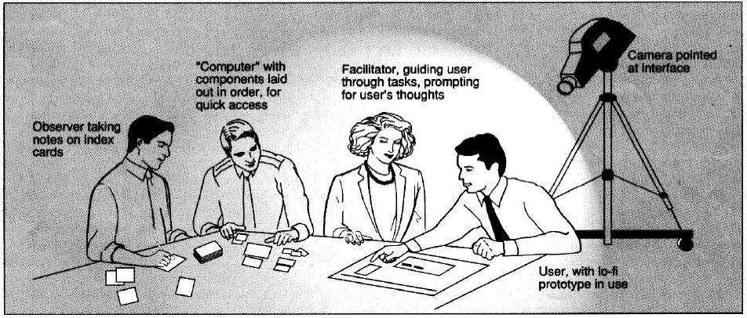
Another example
Video of the process (audio in Dutch)

Slide 36
Evolve Sketches into
Working Prototypes
Make the controls actually work
“Wireframe” prototype
  Just the outlines of the controls, not the “real look”
But not the “back end”
Use prototyping tools
  HTML
  Visual Basic
  PowerPoint
  Special-purpose tools: Axure, etc.
Also, prototype final looks, graphics, design elements
  Often using Photoshop, etc.
Handoff prototypes as part of the specification to implementation team

Slide 37
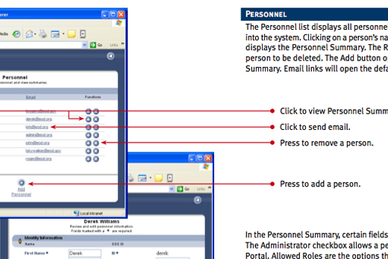
Hand-off to Implementers
Annotated screenshots from prototype as specification

