Slide 1
Lecture 13: What is Design?
Brad Myers
05-863 / 08-763 / 46-863: Introduction to Human Computer Interaction for Technology Executives
Fall, 2009, Mini 2

Slide 2
Next lecture: Examples
Reminder: Send me examples of good and bad User Interfaces
Up to 2 points extra on exam
Only have 3 so far ☹

Slide 3
What is Design?

Slide 4
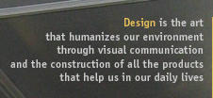
What is Design?
From dictionary.com:
http://dictionary.reference.com/search?q=design
“To conceive or fashion in the mind; invent”
…
“The purposeful or inventive arrangement of parts or details”
Formerly on: http://www.cmu.edu/cfa/design/:

Slide 5
Design vs. Art
What is the difference between Design and Art?
Missions of CMU’s school of design vs. art
http://www.design.cmu.edu/show_program.php?s=1&t=1
http://www.art.cfa.cmu.edu/philosophy
Notes:
Intention of

Slide 6
Definitions, cont.
From Norman text (p. 158)
“Design is the successive application of constraints until only a unique product is left”
Key: constraints = trade offs

Slide 7
Design
Design is
Creative
Informed
Respectful
Responsible

Slide 8
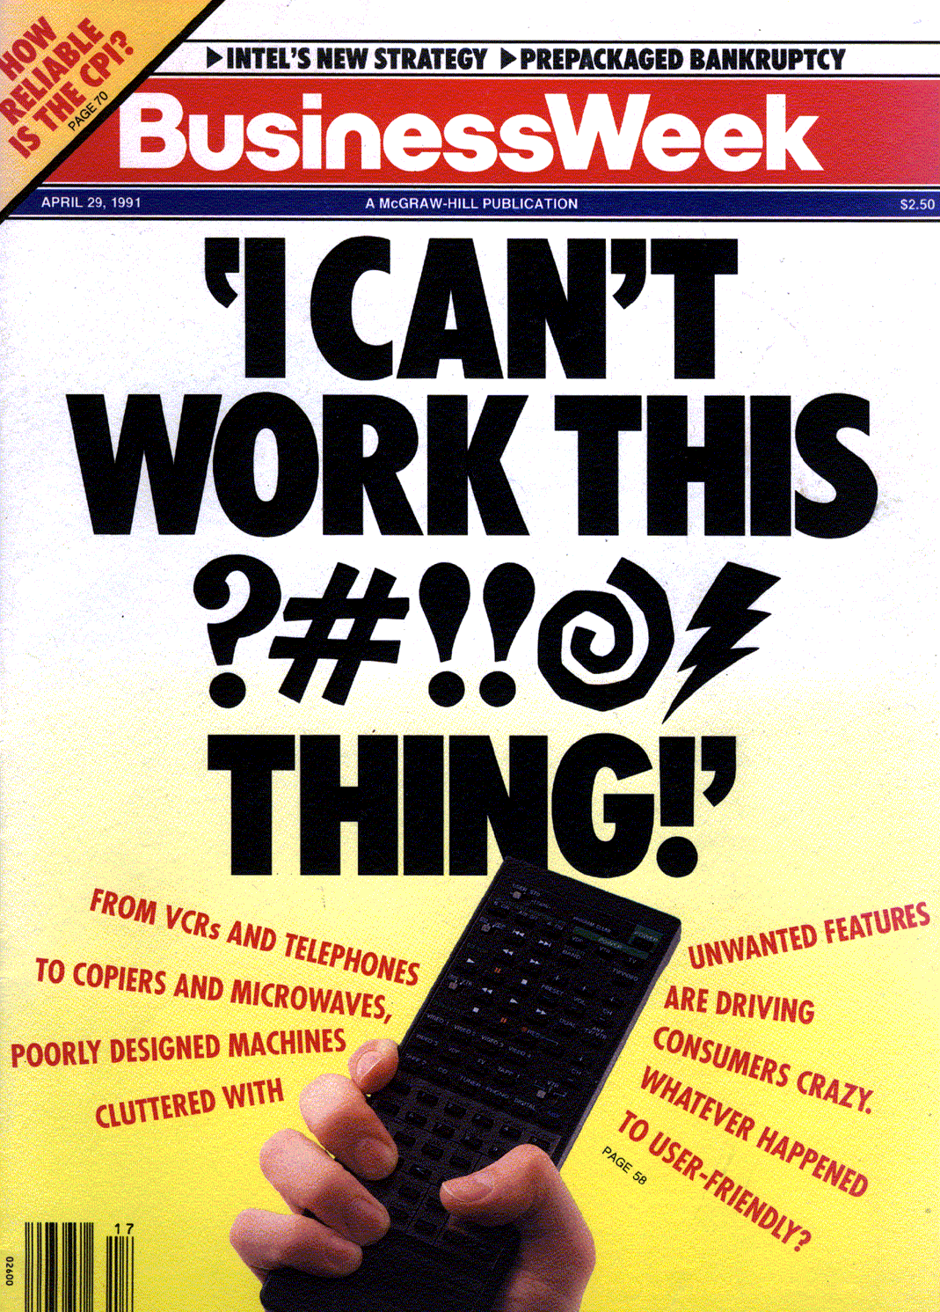
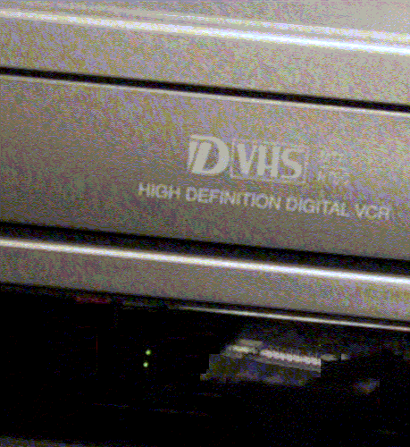
Complexities
April 8, 1991

Slide 9
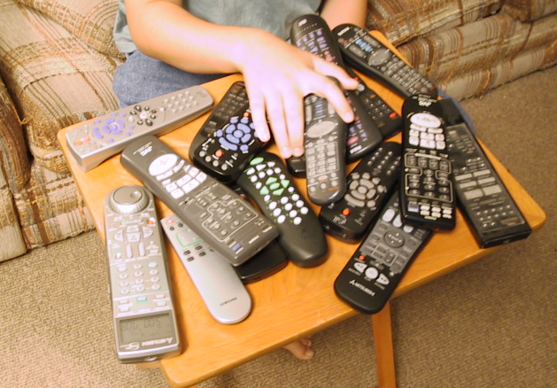
Complexities

Slide 10
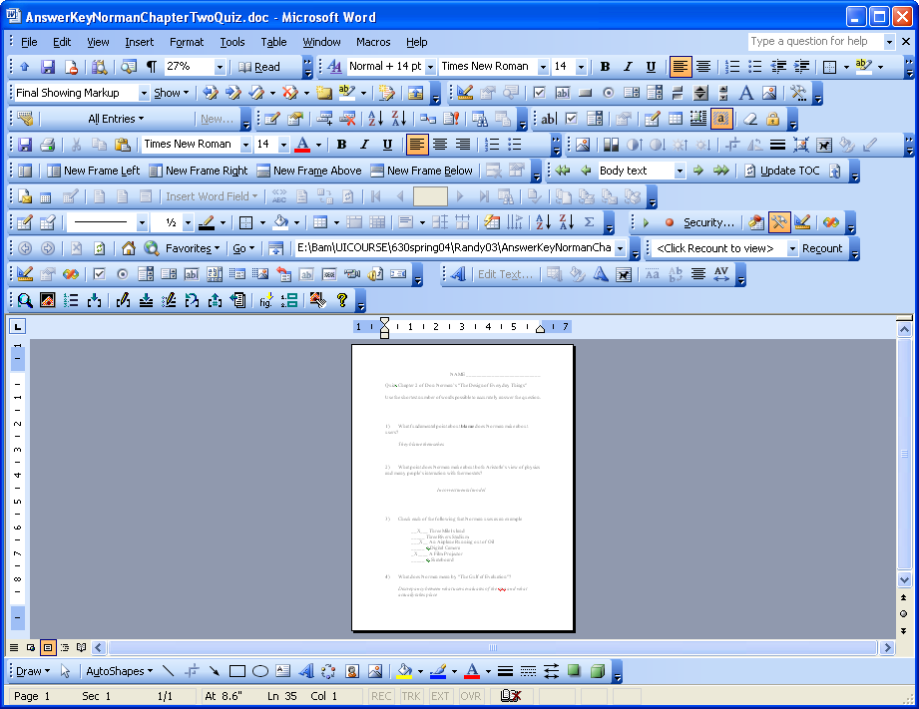
Complexities
Notes:
Over 20 toolbars, hundreds of little icons

Slide 11
Bad Design vs. Good Design
What is the difference?
Properties of good design?

Slide 12
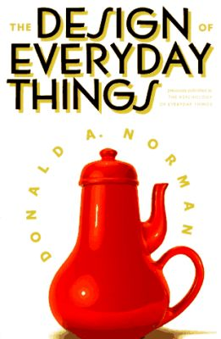
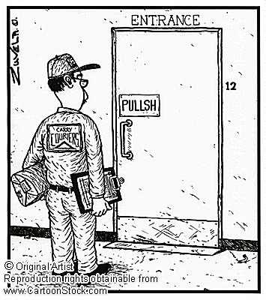
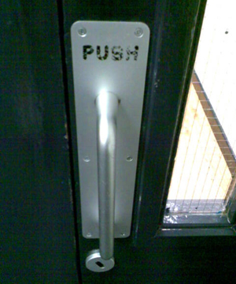
Examples of Good and Bad Design
Lots in Norman book
Physical or computer products
(Not so much web pages)
3½ in floppy
Door handles

Slide 13
Topics of Design
Good Conceptual Model
Visibility
Natural Mapping
Affordances
Constraints
Taking into account errors
Aesthetics and other considerations
Design in the real world

Slide 14
Encourage Accurate User Model
Design model
User’s model
Designer
User
System
p. 16: Conceptual Model

Slide 15
User Model
Overcome by providing a good understanding
Revealing the status and operations
Visibility of system status
Natural mappings for actions
Easier if can be a simpler model
Norman’s refrigerator and freezer example

Slide 16
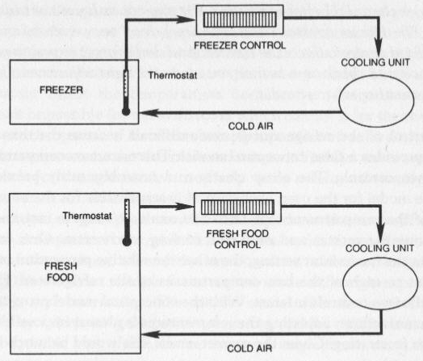
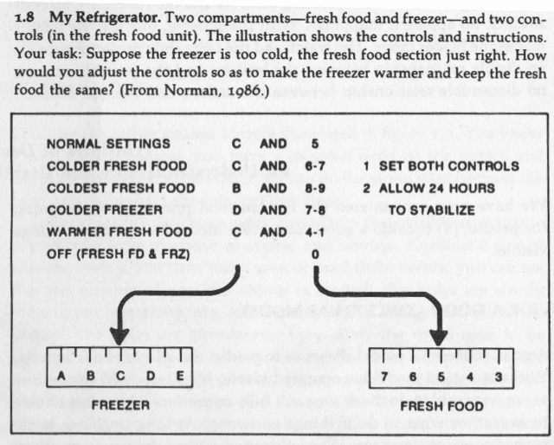
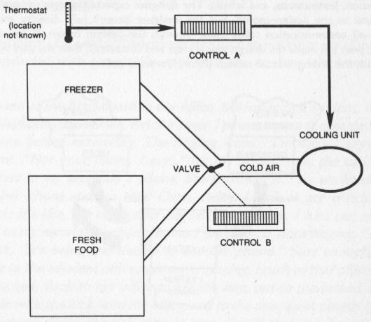
Norman’s Refrigerator
pp. 14-15

Slide 17
Explanations
People will invent explanations for all occurrences
Even if unintentional
Coincidences
“It crashed the last time I did this”
Observed differences
-> Consistency
Too complex to understand how it really works
Superstitions
Notes:
Ask for examples

Slide 18
Incorrect assessments
Three Mile Island
Incorrect meaning of indicator light that a valve was closed, when it really meant that the valve was told to close
There was no actual indicator of the status of the valve
Aegis: Ascent vs. Descent
☞ Provide accurate and appropriate feedback

Slide 19
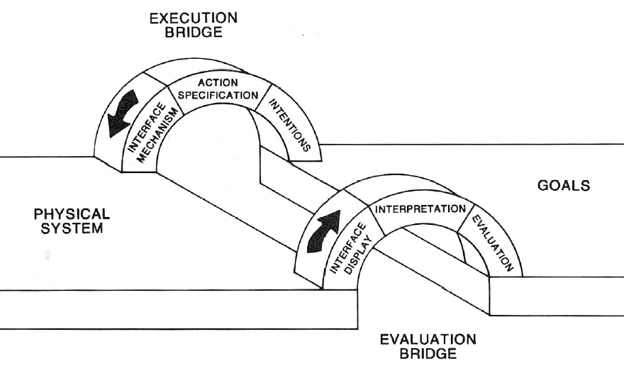
“Gulfs”
“Gulf of Evaluation”
“Gulf of Execution”
7 stages:
Form goal
Form intention
Specify action
Execute action
Perceive state
Interpret state
Evaluate outcome

Slide 20
Memory
Short Term Memory (STM), 7 ± 2
Long Term Memory (LTM)
People’s names, Phone numbers, birthdays, email accounts, IM names, zip codes, social security numbers, addresses, etc.
Also: special codes (*70, *69, CMU’s 152), flight numbers
Passwords
I have > 160 passwords for web sites

Slide 21
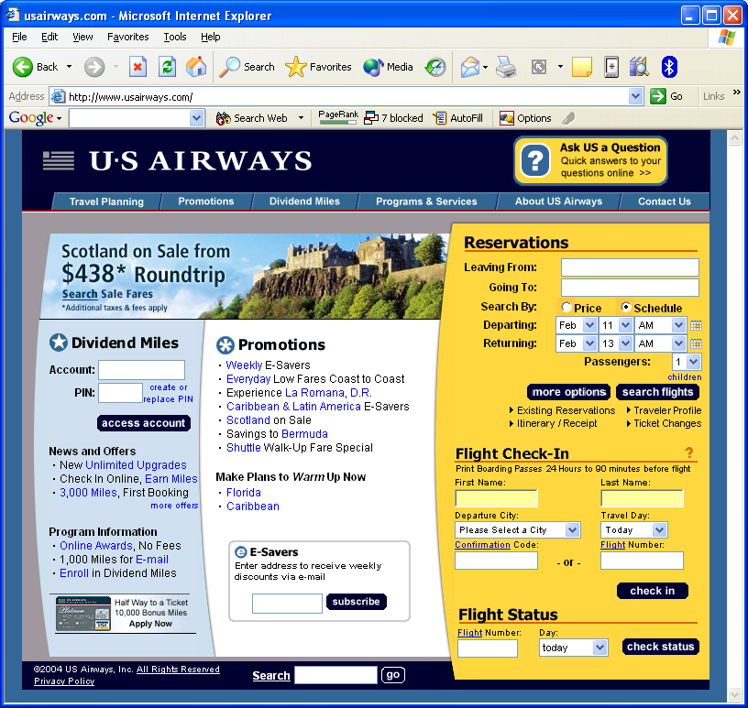
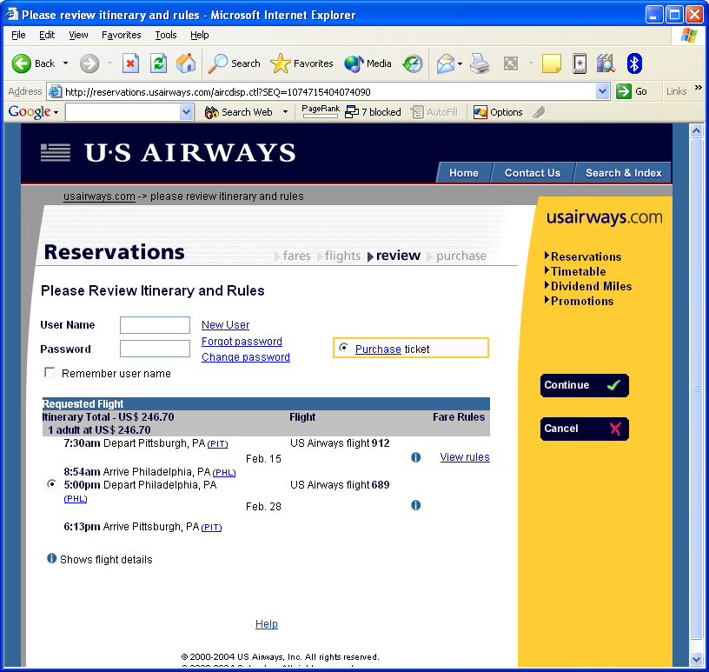
Many Passwords
TODAY:

Slide 22
Remembering
Also, the meaning of symbolic items
And, how to operate things
Control-C = copy
Control-V = paste?
Control-Shift-< = ?
Make easier through: rules, explanations, consistency

Slide 23
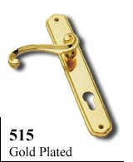
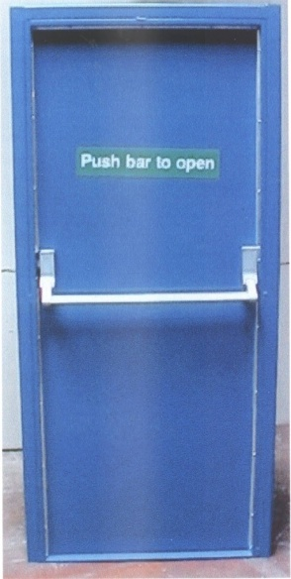
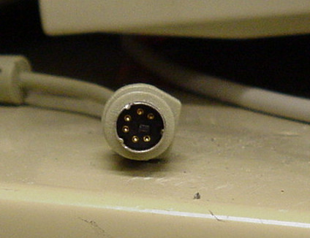
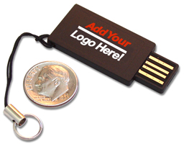
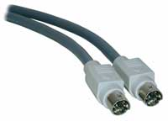
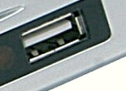
Constraints
Physical Constraints
Door handles
Mac vs. PC plugs; USB

Slide 24
“Affordances”
“Perceived and actual properties of the thing, primarily those fundamental properties that determine how the thing could possibly be used.” (p. 9)
“When affordances are taken advantage of, the user knows what to do just by looking”

Slide 25
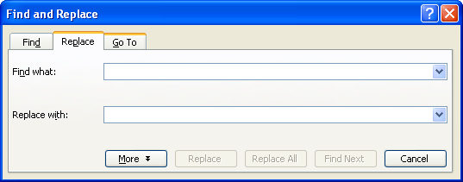
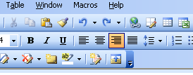
Widget Design
Analog of “physical constraints” and “affordances”
Try to make it obvious what to do with the widget
3-D Buttons “afford” “pushing”
Where are the buttons?
Scroll wheel affords turning, not pushing

Slide 26
Constraints, 2
Semantic Constraints
Meaning of operation
Cultural Constraints
(Consistency)
Which way to turn a knob
Logical Constraints
Switches to lights, knobs to burners
☞ Natural Mappings

Slide 27
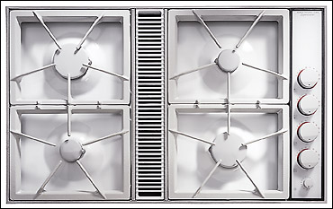
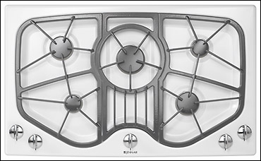
Natural Mappings
Or, avoid needing to remember
“Natural mappings”
Evident from observation

Slide 28
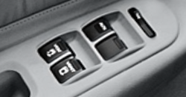
Natural Mappings
“Taking advantage of physical analogies and cultural standards”
Leads to immediate understanding
Which way to turn a knob, which light switch to use, automobile window adjustments

Slide 29
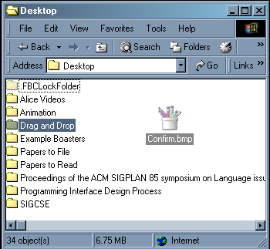
Taking Errors Into Account
People make mistake
Slips
Typos
Hitting wrong menu item
Drag and drop to wrong place
Mode Errors
Digital watch
“Daytime” in ed
Confirmations don’t help (much)
Confirms operation more than parameters
Blame design (designer), not user!

Slide 30
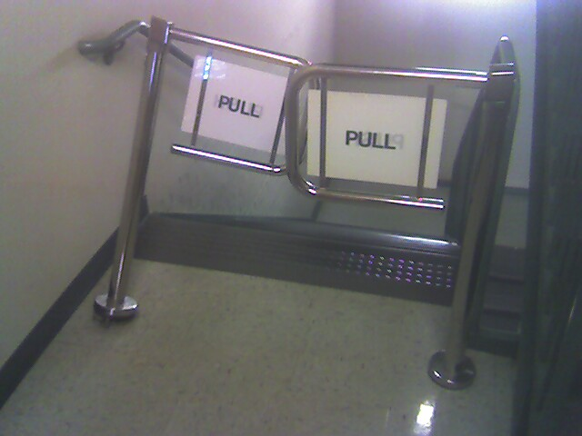
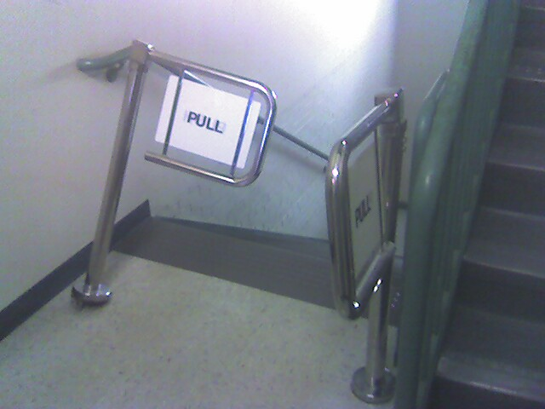
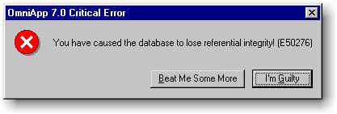
Design to Minimize Errors
Reduce opportunities for errors
Selection rather than fill-in
“Forcing Functions”
Physical constraints
Lockouts → NSH 3rd floor stairway gates
Now gone!
But often annoying
Reduce severity of errors
Cancel, undo
Make errors more obvious
Good Feedback

Slide 31
Aesthetics
Design for desirability not just usability
Attractive design
“Graphic Design”?
Color choice, layout, icon design, fonts, illustrations, etc.
Physical objects: shape, texture, weight
Design Awards as disparagement

Slide 32
Tradeoffs
Time-to-market vs. good design
Cost
“Curse of individuality”
Has to be different
Legal considerations
When usability is not desired
Uncomfortable chairs
Client isn’t the user
Market Forces:
Creeping Featurism / “Bloat”
Notes:
Games

