Slide 1
Lecture 10:
Designing for the Web
Brad Myers
05-863 / 08-763 / 46-863: Introduction to
Human Computer Interaction for
Technology Executives
Fall, 2009, Mini 2

Slide 2
Design for multiple browsers
Cross platform design
You don’t control the layout or navigation
  People use various browsers, window sizes, etc.
  Various languages and fonts installed
  Even cell phones, PDAs, pagers, etc.
  Users can jump in middle, go back and forward
Test your pages in Firefox, Safari, Internet Explorer, and now Chrome
Test in all (recent) versions

Slide 3
Design for multiple browsers, 2
Resolution-independent design
  Don’t use fixed column widths
    MSN.com has fixed column sizes
      Note effect when change font size
    UIST’02 changes with window width
  Icons that work at different resolutions
Don’t use overly specific fonts
  <font face="Arial Black">Windows font</font>
Don’t put text in pictures (http://www.chi2009.org/)
  Also can’t be selected for copy/paste

Slide 4
Design for multiple browsers, 3
Don’t use “advanced” features
  People don’t upgrade browsers
  Nielsen: wait at least 1 year from introduction
  Keep old versions of browsers around for testing
  IE version 6
  Also, iPhone (no Flash), other Smartphones, etc.

Slide 5
Design for multiple browsers, 4
Use “semantic” tags instead of markup tags
  <H3> instead of <B>
  Enables translation by “special” browsers
  Speech interfaces, screen readers

Slide 6
Design for quick downloading
Users #1 complaint is slow downloading
Users want response times of less than 1 second
  Longer than 10 seconds, users cannot stay focused on the task
  Forwards and backwards
Predictable is important
  Always mark pages that may be slow due to multimedia content
  www.pepsi.com

Slide 7
Design for quick downloading, 2
Nielsen’s pages are mostly text
  Pictures only when useful
  Can get fancy designs without lots of pictures
Arrange for first screen full to display immediately
  Requires pictures to have sizes, layout to be computable without full page, tables that have specified sizing

Slide 8
Rules for links
Provide links to related items of interest
Begin Link Names with the Most Important Keyword
  (scanning in CI video)
Link text should be descriptive
  Not: “For the schedule, click here”
  Better: “See the schedule and homeworks”
    Easier to tell what link will get to
    Underlined words are visually highlighted
    Handicapped, etc. users won’t “click”

Slide 9
Rules for links, 2
Use default link colors
If re-coloring:
  Unvisited links should be blue
  Visited links should be reddish or purple
Using pop-ups, roll-overs and JavaScript means links are not colored differently when visited

Slide 10
Rules for links, 3
Don’t open up new browser windows
  Can’t go back
  Lose track of all the windows
  Even more confusing with Tabs
  Example: ACM dl search: pdf vs. link for results
OK to have outbound links (to other sites)
  Maybe mark them
Make site friendly for incoming links
  Every page has a permanent URL: ACM Technews not obvious
  Every page has links to the home page, and other parts of the structure
Advertising links go to “payoff” pages rather than to general pages
  Users don’t explore to find the advertised item
  Users want information now not 5 clicks from now

Slide 11
Don’t use frames
Why
  Title gives wrong URL. Example: UIST’01
  Can mess up “back” and “forward” buttons
  Can make it hard to print
  Sometimes can’t tell what is being scrolled
  Hard to link to the page
Usually OK if left column scrolls with the content (so no need for frames)

Slide 12
Design for credibility
Don’t look amateurish
  Nice, clean designs
    Bad example: http://miauk.com/
  Good graphic design and color choices
  Links and code that work
Ability to find out privacy policy
Obvious way to provide feedback to the company

Slide 13
Design for printing
Many people print web pages
Provide 2 formats:
  printable versions or PDF versions
  PDF links should be clearly marked
Provide simple way to print multiple related parts
  E.g., all papers from a workshop

Slide 14
Why Focus on Content?
“Publishing is about getting the right content to the right person at the right time at the right cost. It's about selecting the best content and editing it really well, so that it makes compelling reading…. My approach doesn't ignore the software or the visuals, but focuses fundamentally on the words on the page. That's because, it is *words* that drive *actions* on a web page.”
-- Gerry McGovern, Content Critical

Slide 15
Web is an Attention Economy
Ultimate currency is the user’s time
There is too much content on the WWW
In traditional media, inertia helps keep people reading
On the web, it is almost as easy to go to the competitor as to go to your next page
Web content must give immediate benefits to the users or they will allocate their time to other sites

Slide 16
Content Study
In a study of 24 web sites, content-related issues caused 40.2% of the usability obstacles.
  Inaccuracies or missing information in the sites' text
  Text that didn't do its job
  -- Jared Spool, www.uie.com

Slide 17
Writing for the Web
Different than manuals, papers, reports
  Keep text short, succinct
  Copyedit and proofread (spell-check)
    Typos: “Garantee”
  Write for scannability
    People don’t read word-for-word
    Multiple heading levels
    Bulleted lists
    Hypertext links and other highlighting for important words
    Provide sufficient information on source page to avoid needing to follow links

Slide 18
Writing for the Web, 2
Plain language
  Limit use of metaphors
  Caution on use of humor, sarcasm, puns
  International audience
Relatively short pages
  But logical breaks, not “continued”

Slide 19
Page Titles
Remember to title your pages
Don’t use URL, codes in title
Make different pages have different titles
  Page history, bookmarks
Make first word most important
  Shows up in icon, abbreviations, etc.
  “MyCompany” instead of “Welcome to MyCompany”

Slide 20
Headlines
Different from headlines in paper, reports
Often used out of context as links, search engine results, etc.
  People scan using headlines
  Must be readable on its own
Don’t start with “a”, “an”, “the”
Good Example: Slashdot

Slide 21
Legibility
Good color choice
  Optimal: black text on white background
  Need good contrast
  Color blind people
  Background: plain-color or extremely subtle pattern
    Busy background
    Bad color choice
  NOT IN ALL CAPS. READ 10% SLOWER
    Seems like shouting

Slide 22

Form Fields
Provide formats and prompts that help
  Even better: be flexible: ignore spaces, ,-(), etc.
    4122685150 vs. (412) 268-5150
  Phone numbers, social security numbers, etc.
Tradeoff: plain text type-in vs. fields
  E.g., for dates:

Slide 23
Multimedia
Often are slow to load
  Make sure are optional and well labeled
Fewer images
  “An image is worth 1000 words” but
  “An image takes 2000 words worth of download time”
Animation
  Distracting, seems like ads
  Good for smooth transitions, attracting attention

Slide 24
Multimedia, 2
Flash
  Interactive animation facilities from Adobe (formerly from Macromedia)
  The most installed plug-in
    98.7% of all browsers
  "Flash is not bad. Flash makes bad design EASY.”
  -- David Collins
    Flash allows for incredible creativity
    Good if design needs to manipulate something that is time-based or spatial, or fun
    But can distract from making site useful

Slide 25
Navigating sites is often difficult
Studies find 58% or 74% failure at achieving a task at a site!
  Lower rate when need a sequence of steps
Never say “under construction”
  The web is always changing

Slide 26
Helpful Error Messages
Don’t expose scripting errors
Help users understand and recover

Slide 27
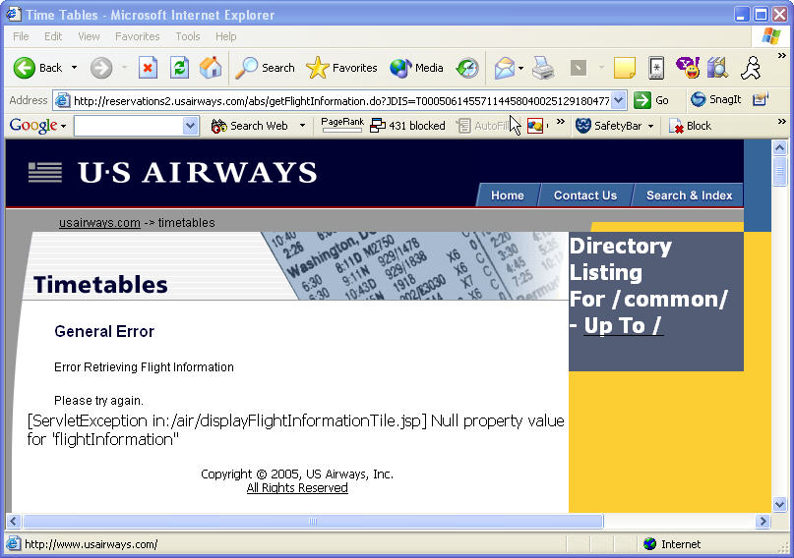
Bad Example

Slide 28
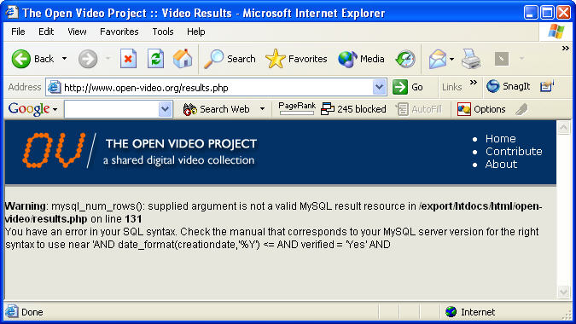
Another Bad Example

Slide 29
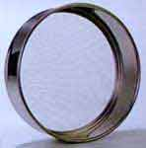
The Customer Sieve
Article by UIE
  Out of original 100 purchase-ready shoppers, only 34 people actually got what they wanted.
1) The Home Page Stage
2) The Location Stage
  Loose 9%
3) The Product List Stage
  Loose 8%
4) The Product Evaluation Stage
  Loose 25%
5) The Checkout Stage
  Loose 13%
6) The Receipt and Acceptance Stage
  Loose 11%

Slide 30
Why Follow Conventions?
“Now, if you're designing a website, wouldn't you want to put the 'Home' link in the position where people are used to finding it? Implementing web convention means that the person who visits your website has less to learn in order to successfully navigate around your website.”
-- Gerry McGovern, Content Critical

Slide 31
Why Home Page Design is Important
From: Jakob Nielsen's Alertbox, May 12, 2002: “Top Ten Guidelines for Homepage Usability”: http://www.useit.com/alertbox/20020512.html
“Homepages are the most valuable real estate in the world”
“A homepage's impact on a company’s bottom line is far greater than simple measures of e-commerce revenues: The homepage is your company's face to the world. Increasingly, potential customers will look at your company's online presence before doing business with you - regardless of whether they plan to close the actual sale online.”

Slide 32
Home Page
Design differently than inside pages
Larger logo and company name (upper left corner)
  Non-conventional logo placement: Excell
Should be obvious what company does
  Serco knows jargon and TLAs*!
  Good example: allrecipes
Provide good entry into site’s navigation
  Also news that of general interest
    Secondary
    Reason to return to site
*Three Letter Acronyms

Slide 33
Home Page, 2
Provide direct access to most important functions (USAirways example)
No “splash screens” – waste time
  (Except for porn sites!)
Don’t require pop-ups for site to work
One click access to home from all interior pages
Good title for home page (used by search engines)
Nielsen’s “Top Ten Guidelines for Homepage Usability”
  Or his book with 113 usability guidelines

Slide 34
Site Design
Make Search Easy
  Many users are “search oriented”
    Search in upper right, especially on home page
    Search box on front page
      Other examples: CDW, etc.
Metaphors
  Minimize use of metaphors
    Not pretend web page is like things in the real world
    But with “Ajax”, can make it work (somewhat) like desktop application
      Still no “undo”, etc.
      Examples Google maps, gmail, GoogleDocs
  Shopping cart metaphor is useful
    Make it easy to add, remove items

Slide 35
Navigation
Where am I?
  Make sure each page identifies site
    Logo, standard structure and consistent design
Where have I been?
  Trails (also called “breadcrumbs”) now common
    Yahoo, Useit, PNC Bank
  Link coloring
Where can I go?
  Visible links on page
  Standard navigation-bar is good
    Show where you are
Don’t use pop-ups for links
Links should have meaningful labels

Slide 36
Navigation, 2
Site Structure
  Have one!
    Hierarchy
    Table
    List
    Multiple ways to get to same information
  Easy to tell from web site
  Maps into user’s ideas and tasks
    Nielsen reports 80% vs. 9% success rates depending on structure
Product lists
  Make it easy to compare
Careful with forwarding
  Breaks the “back” button

Slide 37
Search
Nielsen: ½ users go straight for the search option
CDW focused on improved search results:
  “The results are in: CDW has realized a 4.5% increase in sales driven through site search and a 16% increase in shoppers clicking through from results pages to product pages.” -- http://www.internetretailer.com/article.asp?id=28897
Jumps right to pages, so need to be clear where ended up
Show what searched for
Offer scoped search if large space
Larger search box -> type more terms -> better results
Don’t use Boolean queries
  Men and Women
Search results
  As a useful list
    Allow user to change sort order
  Sorted by quality and relevance
  New: clustering

Slide 38
Search, 2
UIE: searching again doesn’t help
  First time: 23% of the users got a "no results" message.
  Of those users who kept going, 44% got a "no results" on the second attempt.
  If they still persisted, 50% got a "no results" on the third attempt.
  And if they were really persistent, it didn't help because 100% got a "no results" on the fourth attempt.
  Encouraging users to continue with helpful hints doesn't actually seem to help.
  So: get users relevant results on the first try!
  Reference

Slide 39
Search, 3
Another UIE Search study showed:
1) The more users used Search, the less they purchased.
2) Users waited, on average, three clicks into the site before
attempting to use Search.
3) The more users used Search, the worse they rated the site.
4) The more users used Search, the less less likely they'd
return to shop on the site again.
5) The more previous experience a user had with a site, the less they used Search on that site.
6) Two of the study's best performing sites, the Gap and Old Navy, have no Search feature. (And the users didn't notice.)

Slide 40
Picking your URLs
Company.com and www.company.com
  Pick a new company name that can be the URL
  Easy to remember and spell
Multiple words: run together
  Not hyphenate : zero-sixty vs. zerosixty (ok for 555-1212)
Put “index.html” file in every directory
  Use directory name as main URL
People will guess URLs of interior sites
  http://www.microsoft.com/pocketpc -> goes to right place
  Will try to navigate by removing words
Allow URLs to be archived and emailed
  Current vs. permanent reference (ACM Technews)
  Even for products and steps of a purchasing process
  Add links or “redirects” so old URLs still work

Slide 41
Fun!
http://www.webpagesthatsuck.com/

Slide 42
Happy Thanksgiving!
(No class Wednesday!)

