Slide 1
Lecture 9: Designing for the Web
Brad Myers
05-863 / 45-888: Introduction to Human Computer Interaction for Technology Executives
Fall, 2017, Mini 2

Slide 2
Homework 5
You should have received an email from your TA with two systems
Full list is on Canvas
Including email addresses, if you want to contact the author
Evaluate and fill in the on-line template
Due Monday
No late turn-ins for HW #5!

Slide 3

Web and Mobile Topics
Norman-Nielsen Group (NN/g) Alertbox E-Mail Newsletter
Excellent source for data-backed recommendations for web and mobile usability and design
Once a week, 1 or 2 articles
Always concise and interesting and relevant
Subscribe here: http://www.nngroup.com/articles/subscribe/

Slide 4
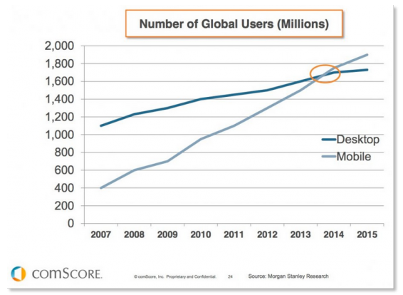
Note: Focus on Desktop Web
Mobile web will be covered in future lecture
Source: http://www.smartinsights.com/mobile-marketing/mobile-marketing-analytics/mobile-marketing-statistics/

Slide 5
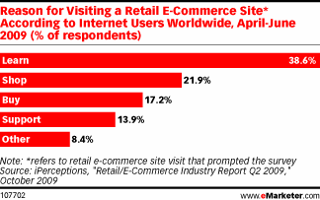
E-Commerce Usability
Web sites are a requirement for all companies
Usability of web sites improving, but still bad
Failure rate: in 2000: 39%; vs. in 2010: 22%. (78% success)
http://www.useit.com/alertbox/usability-progress-rate.html
38.6% of e-commerce visitors were there for information-gathering
Source: Keys to E-Commerce Success, Nov. 2, 2009 http://www.emarketer.com/Article.aspx?R=1007358

Slide 6
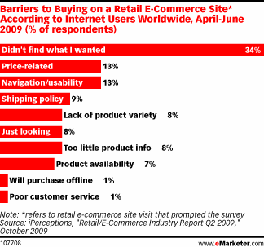
Navigating sites is often difficult
Studies find 58% or 74% failure at achieving a task at a site!
Lower rate when need a sequence of steps
eMarketer study: 61.5% success rate
Source: Keys to E-Commerce Success, Nov. 2, 2009 http://www.emarketer.com/Article.aspx?R=1007358

Slide 7
Importance of Web Usability
“Nearly 9 of 10 of Americans Have Negative Feelings About Brands with Poorly Performing Websites and Mobile Apps, New SOASTA Study Reveals” – June 20, 2013
https://www.bulldogreporter.com/dailydog/article/user-unfriendly-pr-nearly-9-of-10-of-americans-have-negative-feelings-about-brands-
“For those Americans who said they have a negative reaction when a website takes too long, 28% would visit a competitor’s website, 27% would not trust the website, 18% would not visit that page again, and 13% would think the site may have been hacked.”

Slide 8
Report on Intranet Web Usability
Cite: http://www.useit.com/alertbox/intranet-usability.html (12/2012)
“Employees' average success rate when attempting basic intranet tasks:
2002: 75%
2012: 74%
By comparison, 2012’s average success rate on public websites is around 80%. Website usability has improved dramatically over the past decade…”
“Based on time-on-task metrics from our recent study, a company with 10,000 employees can save $4 million per year by going from bad intranet usability (defined as being among the worst 25% we tested) to average intranet usability.”
(cite: http://www.useit.com/alertbox/usability-progress-rate.html)
New article: The Top Enduring Intranet-Design Mistakes: 7 Deadly Sins, https://www.nngroup.com/articles/top-intranet-design-mistakes/

Slide 9
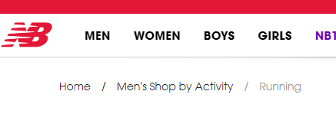
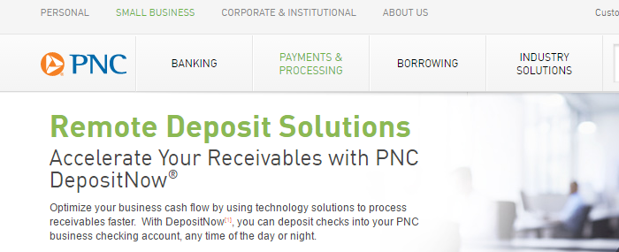
Navigation
Where am I?
Make sure each page identifies site
Logo, standard structure and consistent design
Where have I been?
Trails (also called “breadcrumbs”) (cite: http://www.nngroup.com/articles/breadcrumb-navigation-useful/)
Should start with the “home” link
Or shown by highlighting the menu structure
Link coloring:

Slide 10
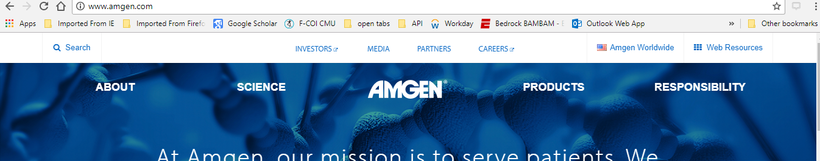
Navigation 2
Where can I go?
Visible links on page
This has gotten dramatically worse with “flat design” (cite: http://www.nngroup.com/articles/flat-design-long-exposure)
Standard navigation-bar is good
Show where you are
Links should have meaningful labels
All pages should have one-click link to the homepage – cite
Non-standard location: http://www.amgen.com/

Slide 11
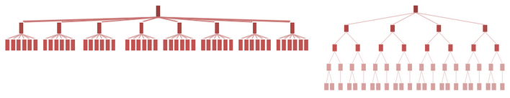
Navigation, 3
Site Structure that maps into user’s ideas and tasks
Nielsen reports 80% vs. 9% success rates depending on structure
Product lists
Make it easy to compare - cite
Shallow vs. Deep Website Hierarchies
Tradeoffs – depends on “natural” structure of infomation
Cite: http://www.nngroup.com/articles/flat-vs-deep-hierarchy
Never say “under construction”
The web is always changing
Except for prototypes (obviously)

Slide 12
Design for multiple browsers
Cross platform design
You don’t control the layout or navigation
People use various browsers, window sizes, etc.
Various languages and fonts installed
Cell phones, tablets, etc.
Users can jump in middle, go back and forward
Test your pages in Chrome, Safari, Microsoft Edge, Internet Explorer, and Firefox
Test in all (recent) versions
People don’t update

Slide 13
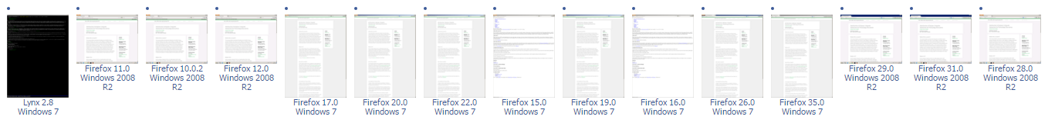
Design for multiple browsers, 2
Tools for checking:
“BrowserLab” built into Dreamweaver
http://browsershots.org/ (Thanks to Kevin McEachern for finding this link)

Slide 14

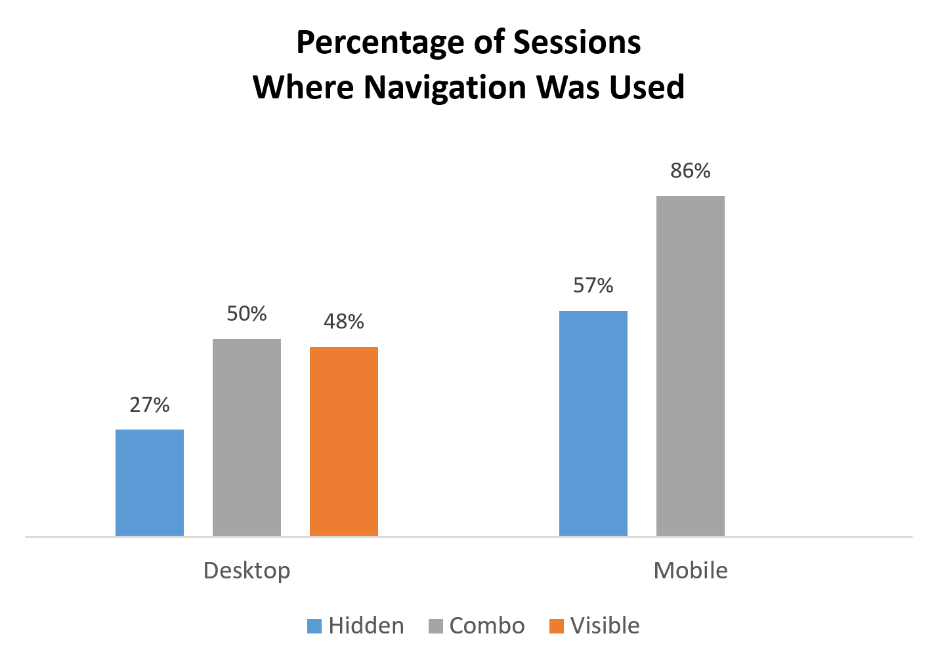
Responsive Design
“Responsive Design” - definition
One design fits all, or
Compute design based on window width - example
Change size, position, and even which elements are present
But don’t just use menu icon on desktop
“Discoverability is cut almost in half by hiding a website’s main navigation.” -- cite
Example: http://www.gm.com/

Slide 15
Design for quick downloading
Users #1 complaint is slow downloading
HCII’s slow website: http://www.hcii.cmu.edu/ ☹
Users want response times of less than 1 second
Longer than 10 seconds, users cannot stay focused on the task
Forwards and backwards
Predictable is important
Always mark pages that may be slow due to multimedia content

Slide 16
Rules for links
Provide links to related items of interest
Misleading link names are a “broken promise” – erodes trust and credibility (cite: http://www.nngroup.com/articles/link-promise/)
Link text should be descriptive
Not: “For the schedule, click here”
Better: “See the schedule and homeworks”
Easier to tell what link will get to
Underlined words are visually highlighted
Handicapped, etc. users won’t “click”

Slide 17
Rules for links, 2
Be cautious about opening up new browser windows or tabs
Can’t go back
Lose track of all the windows
Example: Stuttering Foundation shop
Example: ACM dl search: pdf vs. link for results
Advertising links go to “payoff” pages rather than to general pages
Users don’t explore to find the advertised item
Users want information now not 5 clicks from now
Make sure the links stay valid

Slide 18
Why Focus on Content?
“Publishing is about getting the right content to the right person at the right time at the right cost. It's about selecting the best content and editing it really well, so that it makes compelling reading…. My approach doesn't ignore the software or the visuals, but focuses fundamentally on the words on the page. That's because, it is *words* that drive *actions* on a web page.”
-- Gerry McGovern, Content Critical

Slide 19
Design for credibility
Don’t look amateurish
Nice, clean designs
Good graphic design and color choices
Links and code that work
Copyedit and proofread (spell-check)
Typo “Policys”
Typo in title: “Warantee”
Ability to find out privacy policy
Obvious way to provide feedback to the company

Slide 20
Web is an Attention Economy
Ultimate currency is the user’s time
There is too much content on the WWW
In traditional media, inertia helps keep people reading
On the web, it is almost as easy to go to the competitor as to go to your next page
Web content must give immediate benefits to the users or they will allocate their time to other sites

Slide 21
Content Study
In a study of 24 web sites, content-related issues caused 40.2% of the usability obstacles.
Inaccuracies or missing information in the sites' text
Text that didn't do its job
-- Jared Spool, www.uie.com
Even for domain experts:
https://www.nngroup.com/articles/writing-domain-experts/

Slide 22
Text in Pictures
Don’t put important text in pictures
https://chi2018.acm.org/
Also can’t be selected for copy/paste
Exceptions

Slide 23
Writing for the Web
Different than manuals, papers, reports
Keep text short, succinct
“Plain Language Is for Everyone, Even Experts” - cite
Better SEO ranking; has strong business value
Write for scannability
Nielsen study: “Users scarcely read anything during an average website visit.”
Eye tracking studies
Cite: http://www.nngroup.com/articles/website-reading/
Begin Link Names with the Most Important Keyword
(scanning in CI video of Stuttering Foundation)
Multiple heading levels
Bulleted lists
Hypertext links and other highlighting for important words
Provide sufficient information on source page to avoid needing to follow links

Slide 24
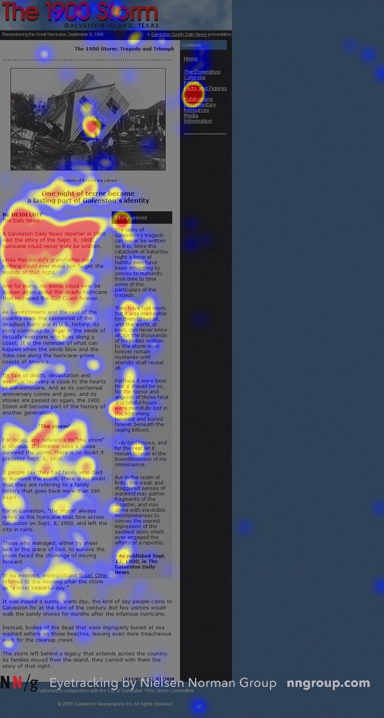
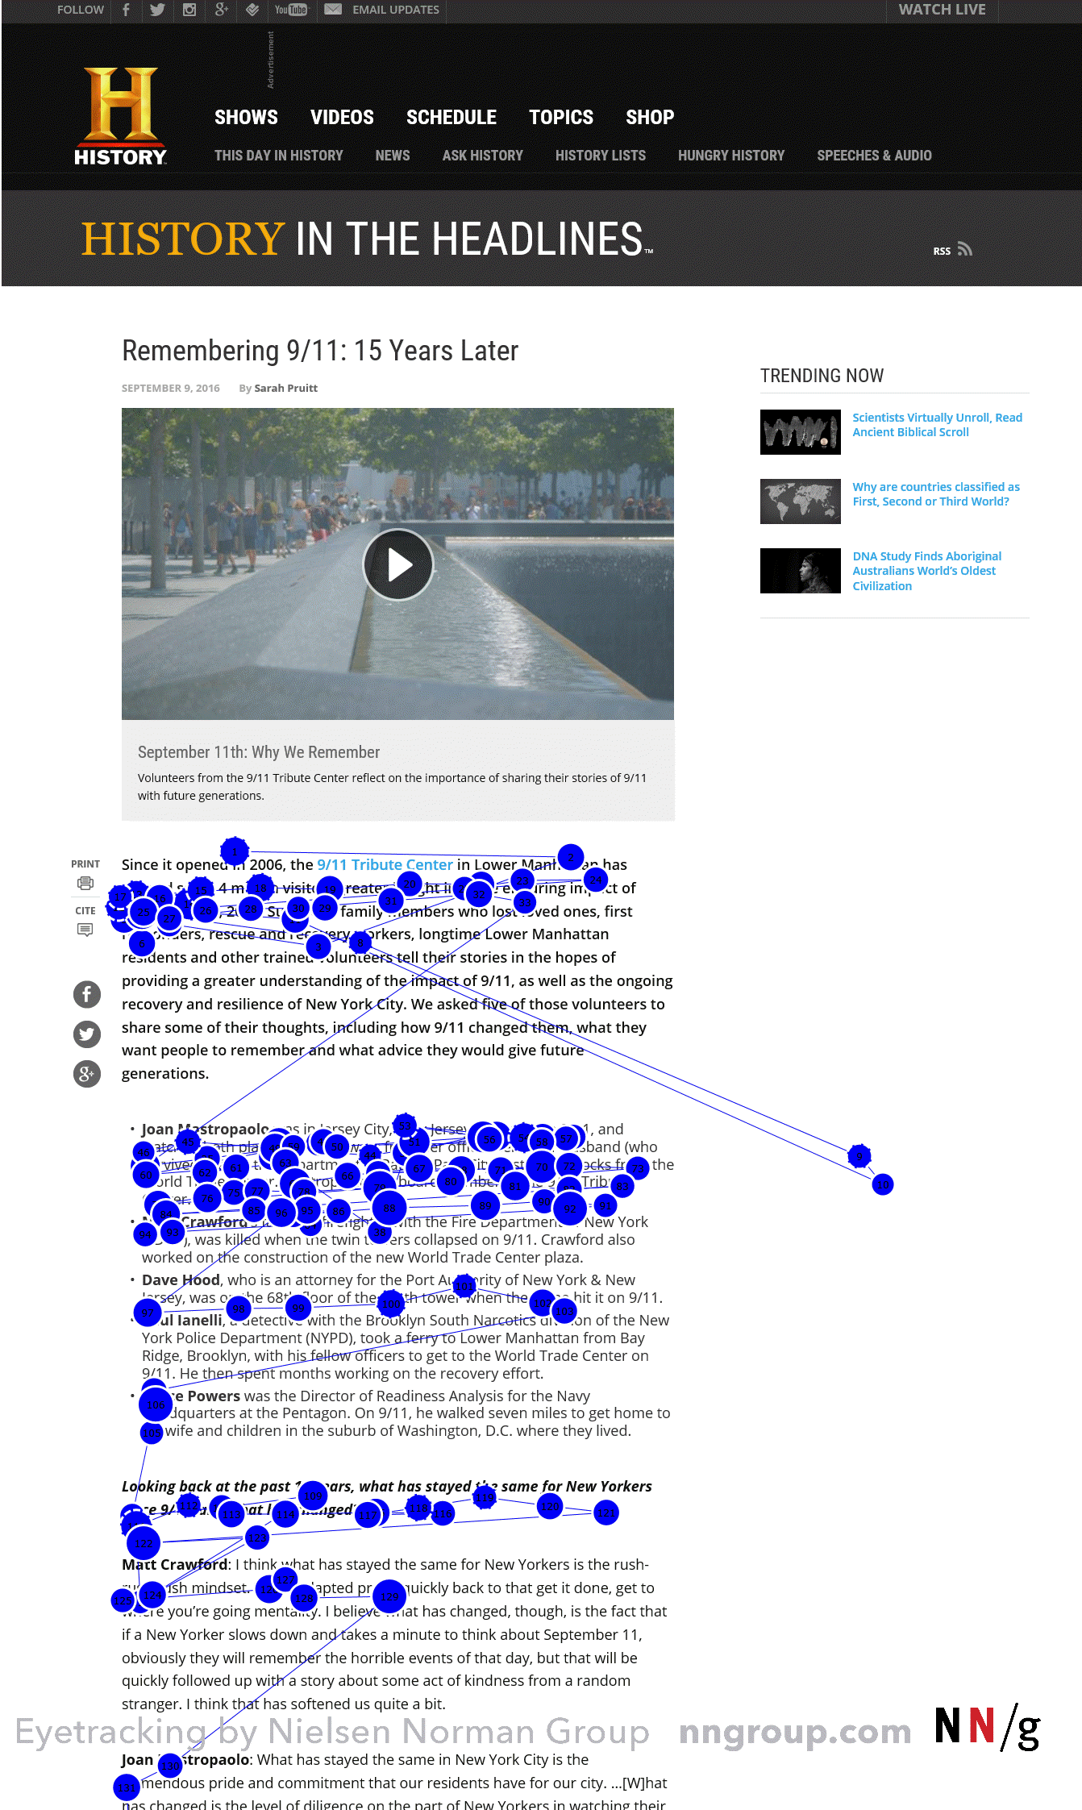
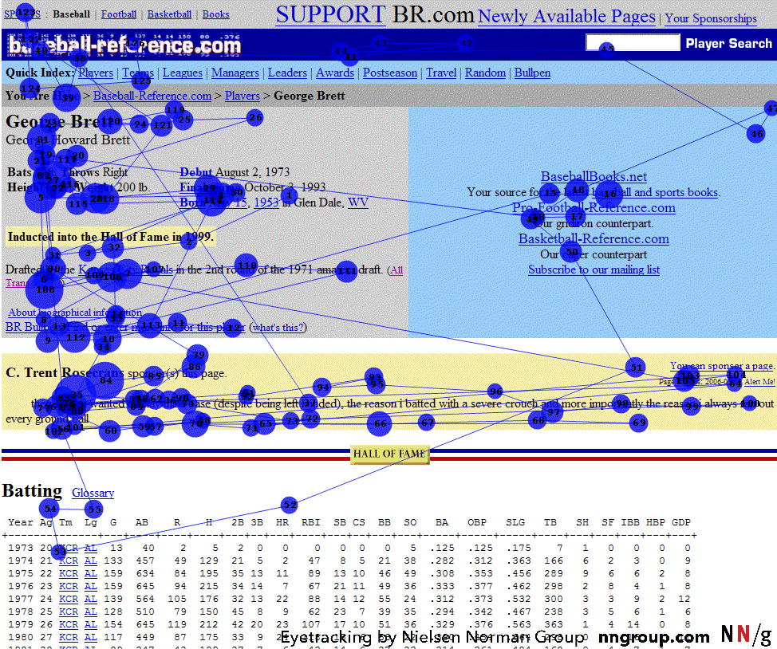
Design for Quick Scanning
Neilsen reports “F” shape scanning
https://www.nngroup.com/articles/f-shaped-pattern-reading-web-content/
When little structure to content
Across top two content rows
Then, down content
“I can’t believe it’s not there” - cite

Slide 25
Legibility
Design for legibility & “Readability”
Can be measured cite: http://www.nngroup.com/articles/legibility-readability-comprehension/
Good color choice
Optimal: black text on white background
Need good contrast
Color blind people
Background: plain-color or extremely subtle pattern
Busy background
Too much animation
NOT IN ALL CAPS. READ 10% SLOWER
Seems like shouting

Slide 26
Page Titles
Remember to title your pages
Don’t use URL, codes in title
Make different pages have different titles
Page history, bookmarks
Make first word most important
Shows up in icon, abbreviations, etc.
“MyCompany” instead of “Welcome to MyCompany”

Slide 27
Form Fields
Provide formats and prompts that help
Even better: be flexible: ignore spaces, ,-(), etc.
4122685150 vs. (412) 268-5150 vs 1-412-268-5150
Phone numbers, social security numbers, etc.

Slide 28
Why Follow Conventions?
“Now, if you're designing a website, wouldn't you want to put the 'Home' link in the position where people are used to finding it? Implementing web convention means that the person who visits your website has less to learn in order to successfully navigate around your website.”
-- Gerry McGovern, Content Critical

Slide 29
Why Home Page Design is Important
“Homepages are the most valuable real estate in the world”
“Space on a big company's homepage is worth 1,300 times as much as land in the center of Tokyo.“
Cite: http://www.nngroup.com/articles/homepage-real-estate-allocation/
“A homepage's impact on a company’s bottom line is far greater than simple measures of e-commerce revenues: The homepage is your company's face to the world. Increasingly, potential customers will look at your company's online presence before doing business with you.”

Slide 30
Home Page
Design differently than inside pages
Larger logo and company name (upper left corner)
Also on all other page (cite: https://www.nngroup.com/articles/logo-placement-brand-recall/)
Should be obvious what company does
www.Oath.com
Good example: https://www.expedia.com/
Provide good entry into site’s navigation
Good example: https://sites.google.com/site/vlhcc2017/
Bad example: http://mojoyogurt.com/#/home
Also news that of general interest
Secondary
Reason to return to site

Slide 31
Home Page, 2
Provide direct access to most important functions (Delta example)
Vs. www.AA.com – picture is probably too tall
No “splash screens” – waste time
Don’t require pop-ups for site to work
One click access to home from all interior pages
Good title for home page (used by search engines)
Cite: Nielsen’s “Top Ten Guidelines for Homepage Usability”

Slide 32
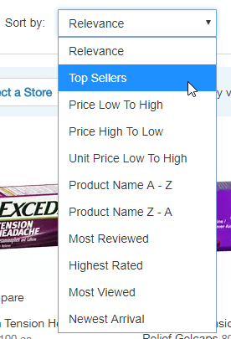
Search
Nielsen: ½ users go straight for the search option
Search in upper right, especially on home page
CDW focused on improved search results (2008):
“The results are in: CDW has realized a 4.5% increase in sales driven through site search and a 16% increase in shoppers clicking through from results pages to product pages.” – cite: http://www.internetretailer.com/article.asp?id=28897
Jumps right to pages, so need to be clear where ended up
Show what searched for
Offer scoped search if large space, e.g.: Amazon
Larger search box -> type more terms -> better results
Don’t use Boolean queries
Men and Women
Replace with ability to filter results
Search results
Allow user to change sort order
Sorted by quality and relevance
Only give what asked for
Cite: http://www.uie.com/articles/three_perils_search

Slide 33
Search, 2
UIE: searching again doesn’t help
First time: 23% of the users got a "no results" message.
Of those users who kept going, 44% got a "no results" on the second attempt.
If they still persisted, 50% got a "no results" on the third attempt.
And if they were really persistent, it didn't help because 100% got a "no results" on the fourth attempt.
Encouraging users to continue with helpful hints doesn't actually seem to help.
So: get users relevant results on the first try!
Reference

Slide 34
Picking your URLs
Company.com and www.company.com
Pick a new company name that can be the URL
Easy to remember and spell
Put “index.html” file in every directory
Use directory name as main URL
Allow URLs to be archived and emailed
Make site friendly for incoming links
Current vs. permanent reference (ACM Technews)
Even for products and steps of a purchasing process
Add links or “redirects” so old URLs still work
www.Microsoft.com/pocketpc -> https://www.microsoft.com/en-us/windows/windows-10-mobile-upgrade

Slide 35
Fun!
My list of Good and Bad UIs
“Bad Web Design” (2015)
Most are still unchanged
http://www.webpagesthatsuck.com/
(not updated since 2014)

